Slide 1
English Essentials
Geoff Barton
General Secretary, Association of School & College Leaders
… and former English teacher
… who trained at Leicester Uni 1984-5
Twitter: @RealGeoffBarton
Download this presentation at www.geoffbarton.co.uk
(Presentation number 158)

Slide 2
As a school subject, English first existed as instruction in the basic skills of reading and writing …
The ancient universities, public schools and grammar schools ignored English throughout the nineteenth century …
Yet it was from the high status establishments with their ideal of a liberal education that the notion of English as a character-building subject drew much of its strength”

Slide 3
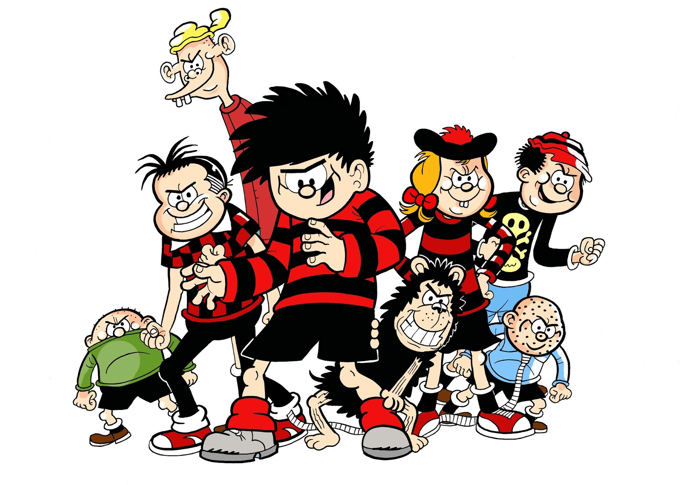

Slide 4
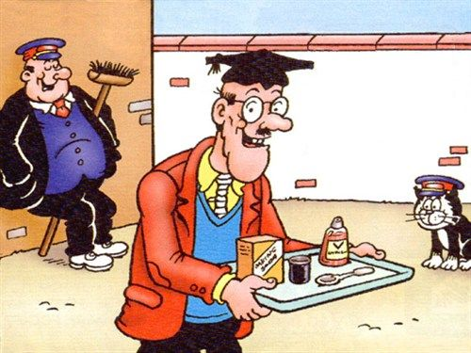

Slide 5
The Matthew Effect
(Robert K Merton)

Slide 6
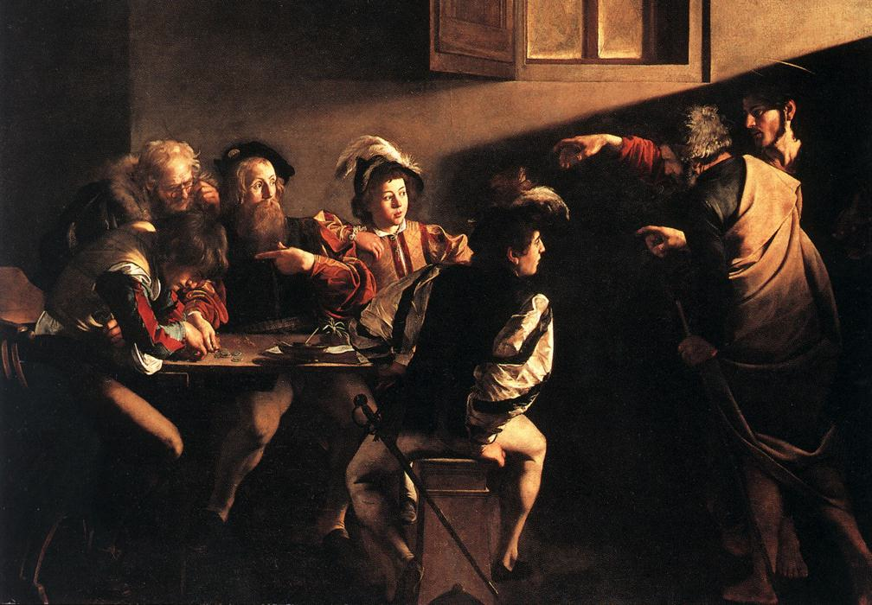

Slide 7
The Matthew Effect:
The rich will get richer &
the poor will get poorer

Slide 8
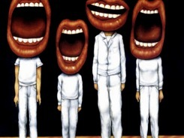
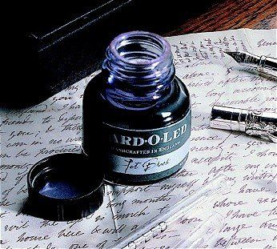

Slide 9
Understand the significance of exploratory talk
Model good talk – eg connectives & whole-sentence responses
Re-think questioning – ‘why & how’, thinking time, and less commentary
Consciously vary groupings
Focus on your own teacher talk

Slide 10
Teach reading – scanning, skimming, reading for pleasure, occasional analysis
Read aloud and display
Teach key vocabulary
Demystify spelling
Teach research, not FOFO

Slide 11
DEMO

Slide 12
SKIMMING

Slide 13
The climate of the Earth is always changing. In the past it has altered as a result of natural causes. Nowadays, however, the term climate change is generally used when referring to changes in our climate which have been identified since the early part of the 1900's . The changes we've seen over recent years and those which are predicted over the next 80 years are thought to be mainly as a result of human behaviour rather than due to natural changes in the atmosphere.

Slide 15
The best treatment for mouth ulcers. Gargle with salt water. You should find that it works a treat. Salt is cheap and easy to get hold of and we all have it at home, so no need to splash out and spend lots of money on expensive mouth ulcer creams.

Slide 17
Lexical v Grammatical Words

Slide 18
Urquhart castle is probably one of the most picturesquely situated castles in the Scottish Highlands. Located 16 miles south-west of Inverness, the castle, one of the largest in Scotland, overlooks much of Loch Ness. Visitors come to stroll through the ruins of the 13th-century castle because Urquhart has earned the reputation of being one of the best spots for sighting Loch Ness’s most famous inhabitant.

Slide 19
Urquhart castle is probably one of the most picturesquely situated castles in the Scottish Highlands. Located 16 miles south-west of Inverness, the castle, one of the largest in Scotland, overlooks much of Loch Ness. Visitors come to stroll through the ruins of the 13th-century castle because Urquhart has earned the reputation of being one of the best spots for sighting Loch Ness’s most famous inhabitant.

Slide 20
Urquhart castle is probably one of the most picturesquely situated castles in the Scottish Highlands. Located 16 miles south-west of Inverness, the castle, one of the largest in Scotland, overlooks much of Loch Ness. Visitors come to stroll through the ruins of the 13th-century castle because Urquhart has earned the reputation of being one of the best spots for sighting Loch Ness’s most famous inhabitant.

Slide 21
Urquhart castle is probably one of the most picturesquely situated castles in the Scottish Highlands. Located 16 miles south-west of Inverness, the castle, one of the largest in Scotland, overlooks much of Loch Ness. Visitors come to stroll through the ruins of the 13th-century castle because Urquhart has earned the reputation of being one of the best spots for sighting Loch Ness’s most famous inhabitant.

Slide 22
Urquhart castle is probably one of the most picturesquely situated castles in the Scottish Highlands. Located 16 miles south-west of Inverness, the castle, one of the largest in Scotland, overlooks much of Loch Ness. Visitors come to stroll through the ruins of the 13th-century castle because Urquhart has earned the reputation of being one of the best spots for sighting Loch Ness’s most famous inhabitant.

Slide 23
SCANNING

Slide 24
Where did the first cell phones begin?
Name 2 other features that started to be included in phones
Why are cell phones especially useful in some countries?

Slide 25
Where begin?
Two features?
Some countries?
Cellular telephones
The first cellular telephone system began operation in Tokyo in 1979, and the first U.S. system began operation in 1983 in Chicago. A camera phone is a cellular phone that also has picture taking capabilities. Some camera phones have the capability to send these photos to another cellular phone or computer. Advances in digital technology and microelectronics has led to the inclusion of unrelated applications in cellular telephones, such as alarm clocks, calculators, Internet browsers, and voice memos for recording short verbal reminders, while at the same time making such telephones vulnerable to certain software viruses. In many countries with inadequate wire-based telephone networks, cellular telephone systems have provided a means of more quickly establishing a national telecommunications network.

Slide 27
Reading for pleasure

Slide 29
RESEARCH SKILLS

Slide 30
Research the life of
Martin Luther King

Slide 31
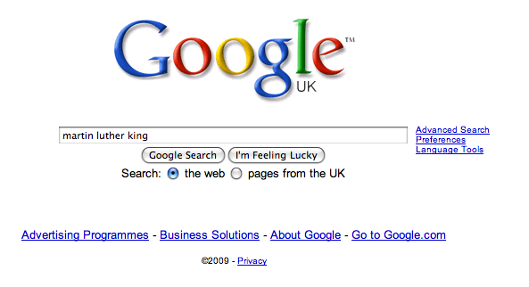

Slide 38
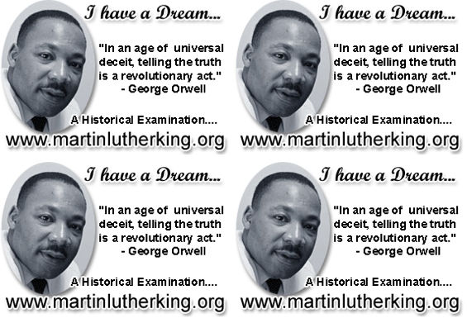

Slide 39
DEMYSTIFYING
SPELLING
3
Notes:
7 spellings: Government – February – parliament – separate – believe – necessary - accommodation

Slide 40
1 - SOUNDS

Slide 41
Government

Slide 42
February

Slide 43
Parliament

Slide 44
2 -VISUALS

Slide 45
Se-para-te
Be-lie-ve

Slide 46
3 - MNEMONICS

Slide 47
necessary

Slide 48
accommodation

Slide 49
Teach reading – scanning, skimming, enjoyment, occasional analysis
Read aloud and display
Teach key vocabulary
Demystify spelling
Teach research, not FOFO

Slide 50
Demonstrate writing
Teach composition & planning
Allow oral rehearsal
Short & long sentences
Connectives

Slide 51
Know your connectives
Adding: and, also, as well as, moreover, too
Cause & effect: because, so, therefore, thus, consequently
Sequencing: next, then, first, finally, meanwhile, before, after
Qualifying: however, although, unless, except, if, as long as, apart from, yet
Emphasising: above all, in particular, especially, significantly, indeed, notably
Illustrating: for example, such as, for instance, as revealed by, in the case of
Comparing: equally, in the same way, similarly, likewise, as with, like
Contrasting: whereas, instead of, alternatively, otherwise, unlike, on the other hand

Slide 53
English Essentials
Geoff Barton
General Secretary, Association of School & College Leaders
… and former English teacher
… who trained at Leicester Uni 1984-5
Twitter: @RealGeoffBarton
Download this presentation at www.geoffbarton.co.uk
(Presentation number 158)

Slide 54
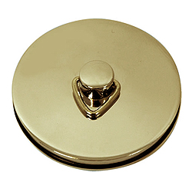
This is an expensive plug ➔

Slide 55
This is a
cheap plug ➔

Slide 56
English Essentials
Geoff Barton
General Secretary, Association of School & College Leaders
… and former English teacher
… who trained at Leicester Uni 1984-5
Twitter: @RealGeoffBarton
Download this presentation at www.geoffbarton.co.uk
(Presentation number 158)

