Slide 1
Leading Whole-School iteracy: From Ambition to Impact
Geoff Barton & Julie McCulloch
General Secretary & Director of Policy
Association of School and College Leaders
@RealGeoffBarton @JulieMcCulloch
Download this presentation free at www.geoffbarton.co.uk (number 153)

Slide 2
10.00 Changing things in schools:
What works and what doesn’t
11.30 Break
11.45 Literacy basics:
the essential ingredients in speaking, listening, reading and writing
12.30 Transition:
how to maintain momentum from KS2 to KS3
1.15 Lunch
2.15 Reading: developing and maintaining a culture
3.00 Making it happen:
ensuring consistency across every team,
every teacher and every teaching assistant
3.30 Evaluation
Today: the content …

Slide 3
“Not all readers are leaders, but all leaders are readers”
Harry Truman
Harry Truman

Slide 4
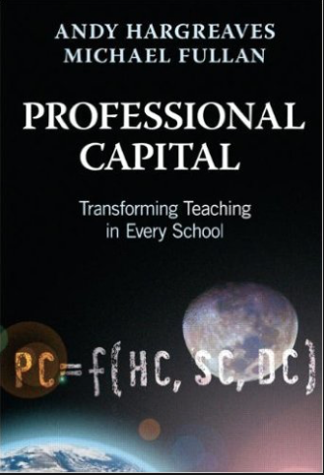
8
‘Better leaders produce better teachers’

Slide 5
2
‘Standards are raised ONLY by changes which are put into direct effect by teachers and pupils in classrooms’
Dylan Wiliam and Paul Black

Slide 6
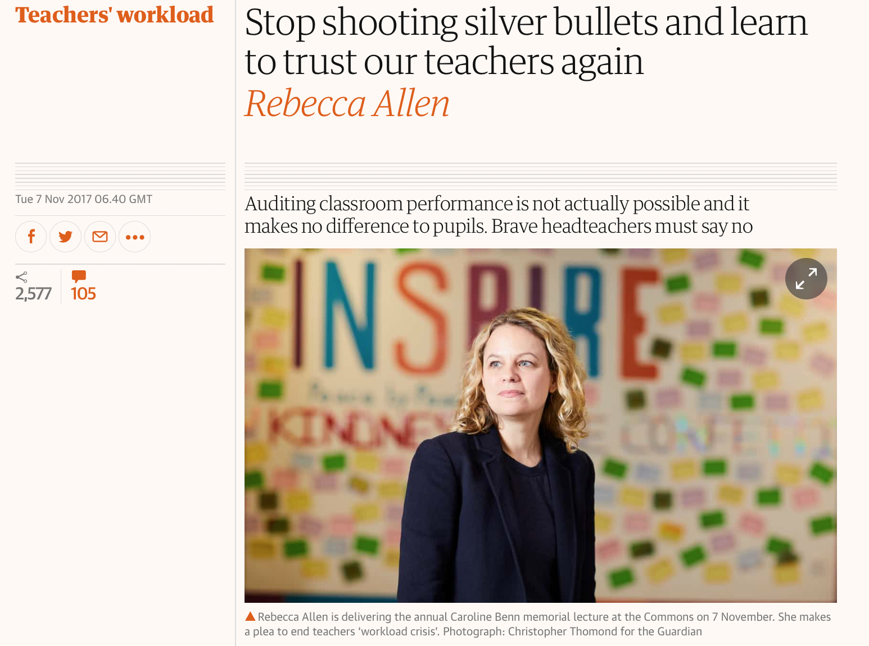

Slide 7
‘Teaching has always been a demanding job. But over the past 15 years, there has been one significant change.
Today, teaching is no longer a private endeavour that takes place in a classroom. Now teachers are required to create a paper trail that proves learning has happened, for people who were not present in the room at the time.
This audit culture means that, in many schools, the teacher no longer is able to decide how to prepare and deliver lessons, mark pupils’ work, and assess and record learning.’

Slide 8
1

Slide 9
1

Slide 10
7
All change is making people behave differently
What looks like resistance can be lack of clarity
Importance of “bright spots” - showcasing positive examples

Slide 11
9
In my experience, teaching is about sensitivity and adaptation. Things that work one day may not work the next day.
In order to navigate the complexity of the circumstances in which a teacher works, it is not possible just to follow a recipe. As a teacher, you make adaptations. You must.

Slide 12
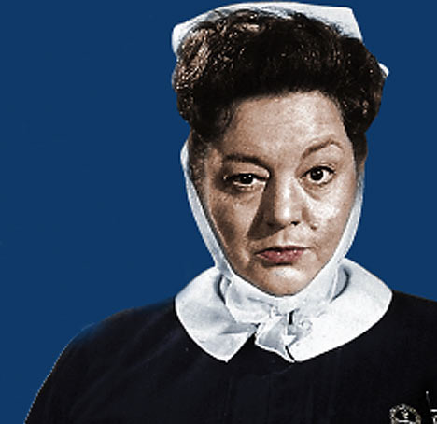
Learning & Teaching Diagnosis:
What did you do?
How did you do it?
What could I have done more/less of?
What could I do next?

Slide 13
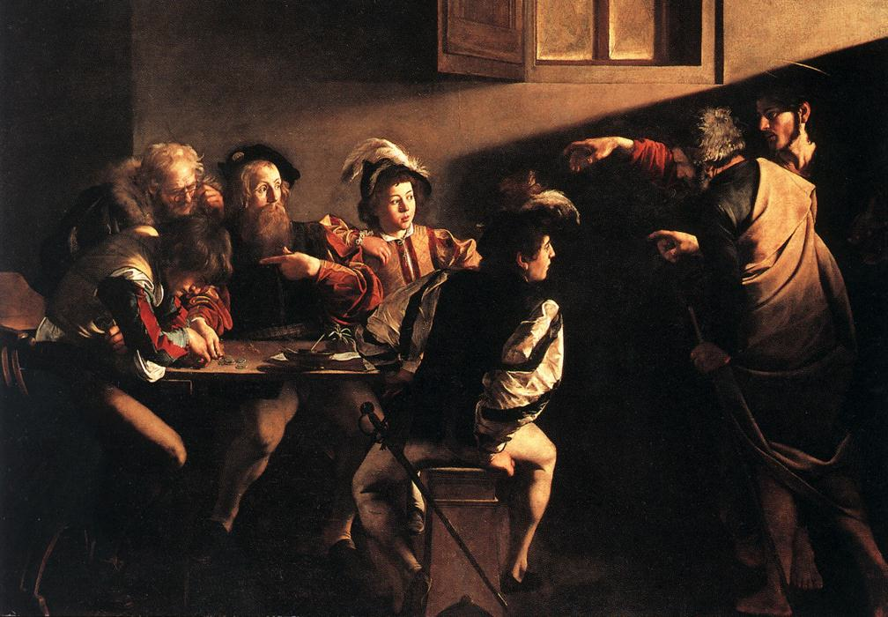

Slide 15
The Literacy Club

Slide 16
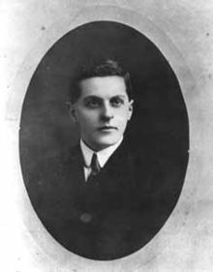
“The limits of my language mean the limits of my world”
Ludwig Wittgenstein

Slide 17
“The word-rich get richer while the word-poor get poorer” in their reading skills
(CASL)

Slide 18
“While good readers gain new skills very rapidly, and quickly move from learning to read to reading to learn, poor readers become increasingly frustrated with the act of reading, and try to avoid reading where possible”
The Matthew Effect
Daniel Rigney

Slide 19
“Students who begin with high verbal aptitudes find themselves in verbally enriched social environments and have a double advantage.”
The Matthew Effect
Daniel Rigney

Slide 20
“Good readers may choose friends who also read avidly while poor readers seek friends with whom they share other enjoyments”
The Matthew Effect
Daniel Rigney

Slide 21
Sticht’s Law: “reading ability in children cannot exceed their listening ability …”
E.D. Hirsch
The Schools We Need

Slide 22
“Spoken language forms a constraint, a ceiling not only on the ability to comprehend but also on the ability to write, beyond which literacy cannot progress”
Myhill and Fisher

Slide 23
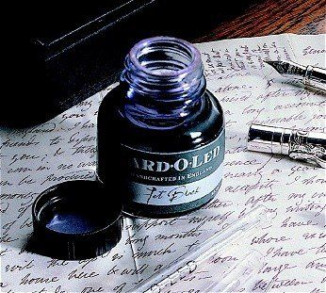

Slide 24
Understand the significance of exploratory talk
Model good talk – eg connectives & whole-sentence responses
Re-think questioning – ‘why & how’, thinking time, and less commentary
Consciously vary groupings
Get conversation into the school culture

Slide 25
Coaching
Training days
Meetings
Subject reviews
Learning walks
Appraisal
Research groups
Sharing good practice

Slide 26
Teach reading – scanning, skimming, analysis
Read aloud and display
Teach key vocabulary
Demystify spelling
Teach research

Slide 27
SKIMMING

Slide 28
The climate of the Earth is always changing. In the past it has altered as a result of natural causes. Nowadays, however, the term climate change is generally used when referring to changes in our climate which have been identified since the early part of the 1900's . The changes we've seen over recent years and those which are predicted over the next 80 years are thought to be mainly as a result of human behaviour rather than due to natural changes in the atmosphere.

Slide 29
The best treatment for mouth ulcers. Gargle with salt water. You should find that it works a treat. Salt is cheap and easy to get hold of and we all have it at home, so no need to splash out and spend lots of money on expensive mouth ulcer creams.

Slide 30
Lexical v Grammatical Words

Slide 31
Urquhart castle is probably one of the most picturesquely situated castles in the Scottish Highlands. Located 16 miles south-west of Inverness, the castle, one of the largest in Scotland, overlooks much of Loch Ness. Visitors come to stroll through the ruins of the 13th-century castle because Urquhart has earned the reputation of being one of the best spots for sighting Loch Ness’s most famous inhabitant.

Slide 32
Urquhart castle is probably one of the most picturesquely situated castles in the Scottish Highlands. Located 16 miles south-west of Inverness, the castle, one of the largest in Scotland, overlooks much of Loch Ness. Visitors come to stroll through the ruins of the 13th-century castle because Urquhart has earned the reputation of being one of the best spots for sighting Loch Ness’s most famous inhabitant.

Slide 33
Urquhart castle is probably one of the most picturesquely situated castles in the Scottish Highlands. Located 16 miles south-west of Inverness, the castle, one of the largest in Scotland, overlooks much of Loch Ness. Visitors come to stroll through the ruins of the 13th-century castle because Urquhart has earned the reputation of being one of the best spots for sighting Loch Ness’s most famous inhabitant.

Slide 34
Urquhart castle is probably one of the most picturesquely situated castles in the Scottish Highlands. Located 16 miles south-west of Inverness, the castle, one of the largest in Scotland, overlooks much of Loch Ness. Visitors come to stroll through the ruins of the 13th-century castle because Urquhart has earned the reputation of being one of the best spots for sighting Loch Ness’s most famous inhabitant.

Slide 35
Urquhart castle is probably one of the most picturesquely situated castles in the Scottish Highlands. Located 16 miles south-west of Inverness, the castle, one of the largest in Scotland, overlooks much of Loch Ness. Visitors come to stroll through the ruins of the 13th-century castle because Urquhart has earned the reputation of being one of the best spots for sighting Loch Ness’s most famous inhabitant.

Slide 36
Urquhart castle is probably one of the most picturesquely situated castles in the Scottish Highlands. Located 16 miles south-west of Inverness, the castle, one of the largest in Scotland, overlooks much of Loch Ness. Visitors come to stroll through the ruins of the 13th-century castle because Urquhart has earned the reputation of being one of the best spots for sighting Loch Ness’s most famous inhabitant.

Slide 37
SCANNING

Slide 38
Where did the first cell phones begin?
Name 2 other features that started to be included in phones
Why are cell phones especially useful in some countries?

Slide 39
Where begin?
Two features?
Some countries?
Cellular telephones
The first cellular telephone system began operation in Tokyo in 1979, and the first U.S. system began operation in 1983 in Chicago. A camera phone is a cellular phone that also has picture taking capabilities. Some camera phones have the capability to send these photos to another cellular phone or computer. Advances in digital technology and microelectronics has led to the inclusion of unrelated applications in cellular telephones, such as alarm clocks, calculators, Internet browsers, and voice memos for recording short verbal reminders, while at the same time making such telephones vulnerable to certain software viruses. In many countries with inadequate wire-based telephone networks, cellular telephone systems have provided a means of more quickly establishing a national telecommunications network.

Slide 40
RESEARCH SKILLS

Slide 41
Research the life of
Martin Luther King

Slide 42
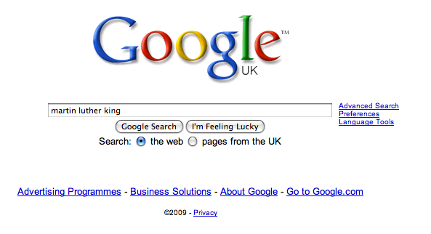

Slide 50
DEMYSTIFYING
SPELLING
3
Notes:
7 spellings: Government – February – parliament – separate – believe – necessary - accommodation

Slide 51
1 - SOUNDS

Slide 52
Government

Slide 53
February

Slide 54
Parliament

Slide 55
2 -VISUALS

Slide 56
Se-para-te
Be-lie-ve

Slide 57
3 - MNEMONICS

Slide 58
necessary

Slide 59
accommodation

Slide 60
Teach reading – scanning, skimming, analysis
Read aloud and display
Teach key vocabulary
Demystify spelling
Teach research

Slide 61
Coaching
Training days
Meetings
Subject reviews
Learning walks
Appraisal
Research groups
Sharing good practice

Slide 62
Demonstrate writing
Teach composition & planning
Allow oral rehearsal
Short & long sentences
Connectives

Slide 63
Know your connectives
Adding: and, also, as well as, moreover, too
Cause & effect: because, so, therefore, thus, consequently
Sequencing: next, then, first, finally, meanwhile, before, after
Qualifying: however, although, unless, except, if, as long as, apart from, yet
Emphasising: above all, in particular, especially, significantly, indeed, notably
Illustrating: for example, such as, for instance, as revealed by, in the case of
Comparing: equally, in the same way, similarly, likewise, as with, like
Contrasting: whereas, instead of, alternatively, otherwise, unlike, on the other hand

Slide 64
Demonstrate writing
Teach composition & planning
Allow oral rehearsal
Short & long sentences
Connectives

Slide 65
Coaching
Training days
Meetings
Subject reviews
Learning walks
Appraisal
Research groups
Sharing good practice

Slide 66
From WHAT to HOW

Slide 67
Revitalising Reading for Pleasure

Slide 68
‘Too often the argument for reading is made by those who have spent their lives as insiders; the pleasures of solitary reading are so obvious, the value of reading so self-evident, that we fail to appreciate how utterly strange reading is to the outsider’

Slide 69
She requires students to read 40 books a year
‘I have transformed my classroom into a workshop, a place where apprentices hone a craft under the tutelage of a master’
Year starts with ‘book frenzy’: ‘I never preach to my students about their need to read … Choosing not to read is never discussed. It is simply not an option. Readers without power to make their own choices are unmotivated’
Richard Allington: ‘students in remedial settings read roughly 75% less than their peers in regular reading classes …. Students who do not read regularly become weaker readers with each subsequent year’
Yet ‘these students have the ability to become strong readers … They need to read and read. Time and again, I have seen a heavy dose of independent reading, paired with explicit instruction in reading strategies, transform nonreaders into readers’

Slide 70
More attention needed to scaffold reading
‘More and more, my students are coming to me less and less prepared to tackle challenging text’. Importance of first chapters – we need to teach that ‘confusion is natural’
David Sousa: ‘past experiences always influence new learning. What we know acts as a filter, helping us attend to those things that have meaning (ie relevancy) and discard those that don’t’.
Teachers: ‘we are the headsets – the guides who provide the context necessary for students to appreciate the greatness of literature’
Collaboration is the key to reading. Barnes & Todd: ‘Small groups of students, working together, can advance learning in ways not available when a teacher talks to the entire class’.

Slide 71
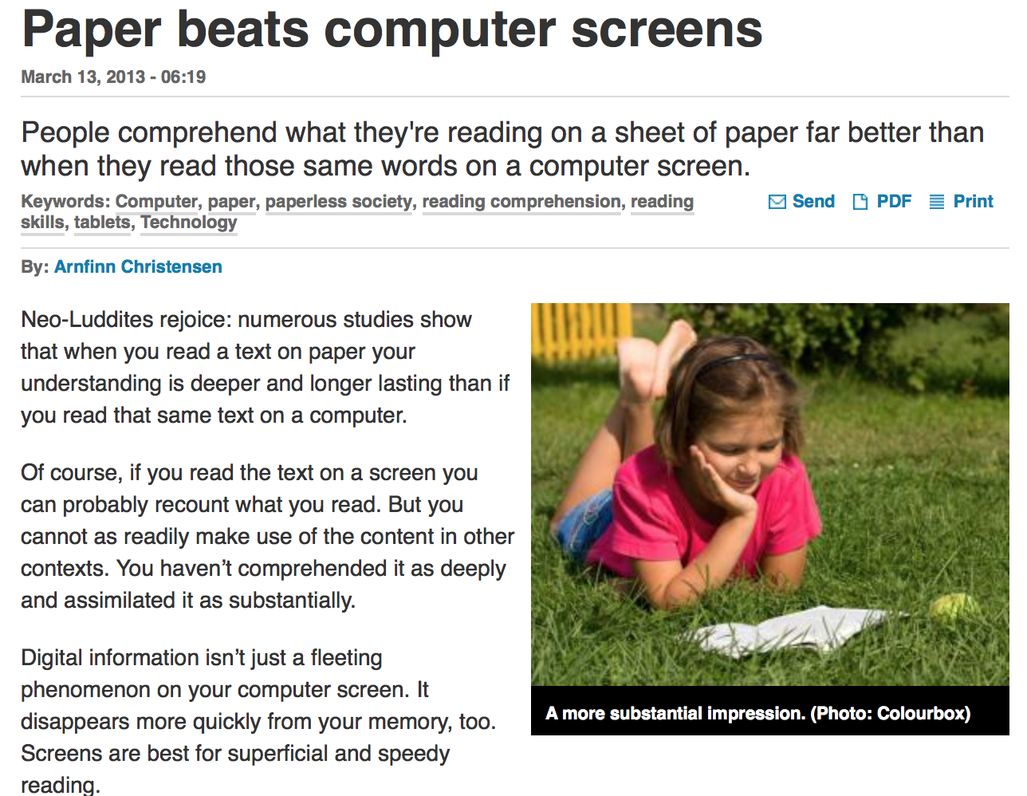

Slide 72
Ten things we know:
Reading matters
It is a habit
Choice beats coercion
Sustained silent reading alone isn’t enough
Make reading sociable
Personalise reading
Value paper
KS2 to KS3 is vital
Read more (inc aloud); analyse less
It’s about teaching not just doing reading
Harry Truman

Slide 73
Reflection
Questions
Challenges

Slide 74
Making it Happen

Slide 75
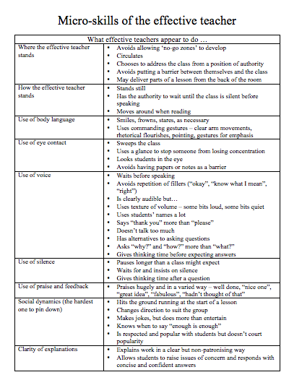

Slide 76
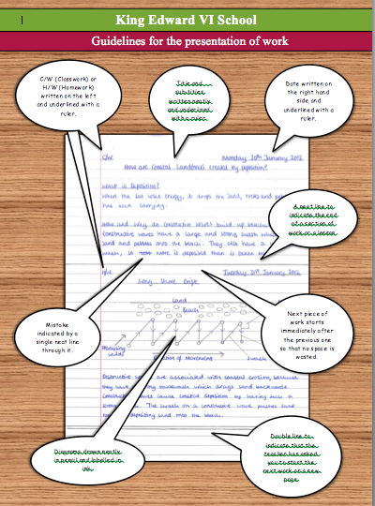

Slide 78
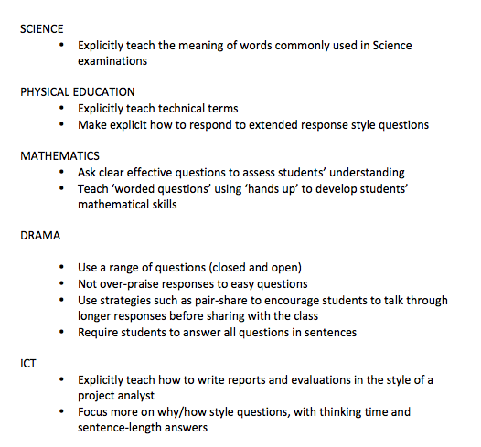
One Literacy Promise

Slide 80
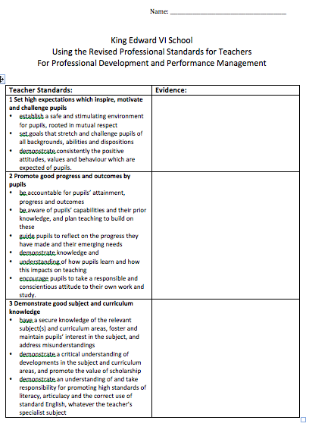

Slide 81
The City Academy, Hackney:
The school has established a literacy policy with five strands that guide the work of all teachers.
Pupils in lessons should always speak in sentences.
There should be a consistent policy on marking and feedback (a ‘green pen’ approach).
Improving literacy in secondary schools: a shared responsibility April 2013, No. 120363
■ Pupils should always have a ‘book on every table’.
■ Teachers in all subjects should model writing for their pupils.
■ Pupils should be taught to organise their extended writing into well- structured paragraphs.

Slide 82
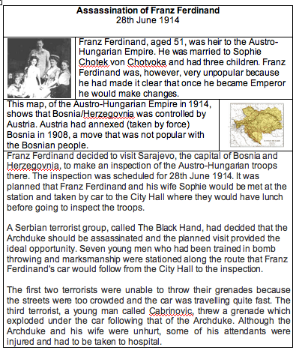
3 Highlight key words
1 Mention big picture / purpose
2 Flag first task in advance
4 Add more visuals

Slide 83
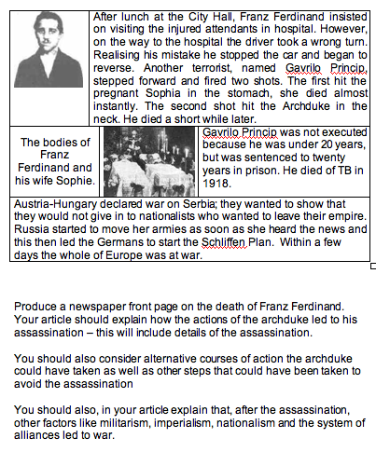
LITERACY IMPACT!
5 Use small-scale questions to build comprehension
7 Provide sentence starters / connectives
6 Give guidance on the style and conventions of the writing task
8 Give some indication of how the task will be assessed

Slide 84
LITERACY IMPACT!
For teachers of humanities subjects …
Readability through questions, subheadings, layout
Use of connectives like later, despite this, although
Formality (eg essay style that avoids “I” and emotion)

Slide 85
LITERACY IMPACT!
For teachers of Science subjects …
Demystifying complex vocabulary (making connections between words)
Modelling an impersonal style (including passive v active)
Teaching causal connectives

Slide 86
Reflection
Questions
Challenges

Slide 87
Literacy strategy: The next phase
KEY PLAYER | NEXT STEPS
Head
You
SENCO
Teachers
Teaching assistants
Governors
Librarian
Tutors

Slide 88
Key Messages:
1
This is about teacher expertise

Slide 89
Key Messages:
2
‘Every teacher in English is a teacher of English’ is now placed centre-stage – with carrot and stick to help make it happen

Slide 90
Key Messages:
Rethink systems:
Performance management
Training
Use of TAs
Role of the Librarian
3

Slide 91
Key Messages:
Teachers need to see how good and outstanding teachers make implicit skills explicit, so …
4
develop a team of classroom coaches

Slide 92
Key Messages:
5
Every school needs an astringent culture of evaluation that leads to action

Slide 93
Key Messages:
6
Involve pupils more in feedback: what helps them to learn?

Slide 94
Key Messages:
7
Turn fewer blind eyes … but pick your battles

Slide 95
Key Messages:
8
Celebrate bright-spots

Slide 96
Key Messages:
9
Teach rather than do reading

Slide 97
Key Messages:
10
There are no simple solutions

Slide 99
English Teacher
Petite, white-haired Miss Cartwright
Knew Shakespeare off by heart,
Or so we pupils thought.
Once in the stalls at the Old Vic
She prompted Lear when he forgot his part.
Ignorant of Scrutiny and Leavis,
She taught Romantic poetry,
Dreamt of gossip with dead poets.
To an amazed sixth form once said: ‘How good to spend a night with Shelley.’
In long war years she fed us plays,
Sophocles to Shaw’s St Joan.
Her reading nights we named our Courting Club,
Yet always through the blacked-out streets
One boy left the girls and saw her home.
When she closed her eyes and chanted
‘Ode to a Nightingale’
We laughed yet honoured her devotion.
We knew the man she should have married
Was killed at Passchendaele.
Brian Cox
From Collected Poems, Carcanet Press 1993.

Slide 100
Leading Whole-School iteracy: From Ambition to Impact
Geoff Barton & Julie McCulloch
General Secretary & Director of Policy
Association of School and College Leaders
@RealGeoffBarton @JulieMcCulloch
Download this presentation free at www.geoffbarton.co.uk (number 153)

Slide 101
This is an expensive plug ➔

Slide 102
This is a
cheap plug ➔

Slide 103
Leading Whole-School iteracy: From Ambition to Impact
Geoff Barton & Julie McCulloch
General Secretary & Director of Policy
Association of School and College Leaders
@RealGeoffBarton @JulieMcCulloch
Download this presentation free at www.geoffbarton.co.uk (number 153)

