Slide 1
Don’t Call it iteracy
Geoff Barton
General Secretary
Association of School & College Leaders
6 September 2017
@RealGeoffBarton
Download this presentation at www.geoffbarton.co.uk
(Presentation number 153)

Slide 2
The Matthew Effect
(Robert K Merton)

Slide 3
The rich shall get richer and the poor shall get poorer
Matthew 13:12

Slide 4
“The word-rich get richer while the word-poor get poorer” in their reading skills
(Canadian Association of School Librarians)

Slide 5
“While good readers gain new skills very rapidly, and quickly move from learning to read to reading to learn, poor readers become increasingly frustrated with the act of reading, and try to avoid reading where possible”
The Matthew Effect
Daniel Rigney

Slide 6
“Students who begin with high verbal aptitudes find themselves in verbally enriched social environments and have a double advantage.”
The Matthew Effect
Daniel Rigney

Slide 7
Stricht’s Law: “reading ability in children cannot exceed their listening ability …”
E.D. Hirsch
The Schools We Need

Slide 8
“Spoken language forms a constraint, a ceiling not only on the ability to comprehend but also on the ability to write, beyond which literacy cannot progress”
Myhill and Fisher

Slide 9
Aged 7:
Children in the top quartile have 7100 words; children in the lowest have around 3000.
The main influence is parents.
DfE Research Unit

Slide 10
The Matthew Effect:
The rich will get richer &
the poor will get poorer

Slide 11
The Literacy Club

Slide 12
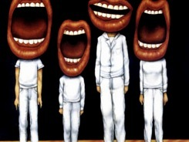
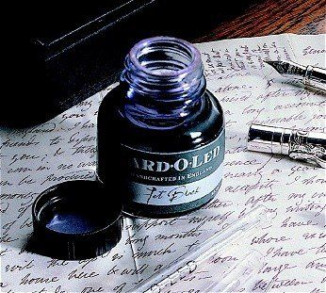
5 key ingredients
Then teach you something
Then reflection

Slide 13
Understand the significance of exploratory talk
Model good talk – eg connectives & whole-sentence responses
Re-think questioning – ‘why & how’, thinking time, and less commentary
Consciously vary groupings
Get conversation into the school culture

Slide 14
Teach reading – scanning, skimming, analysis
Read aloud and display
Teach key vocabulary
Demystify spelling
Teach research, not FOFO

Slide 15
DEMO

Slide 16
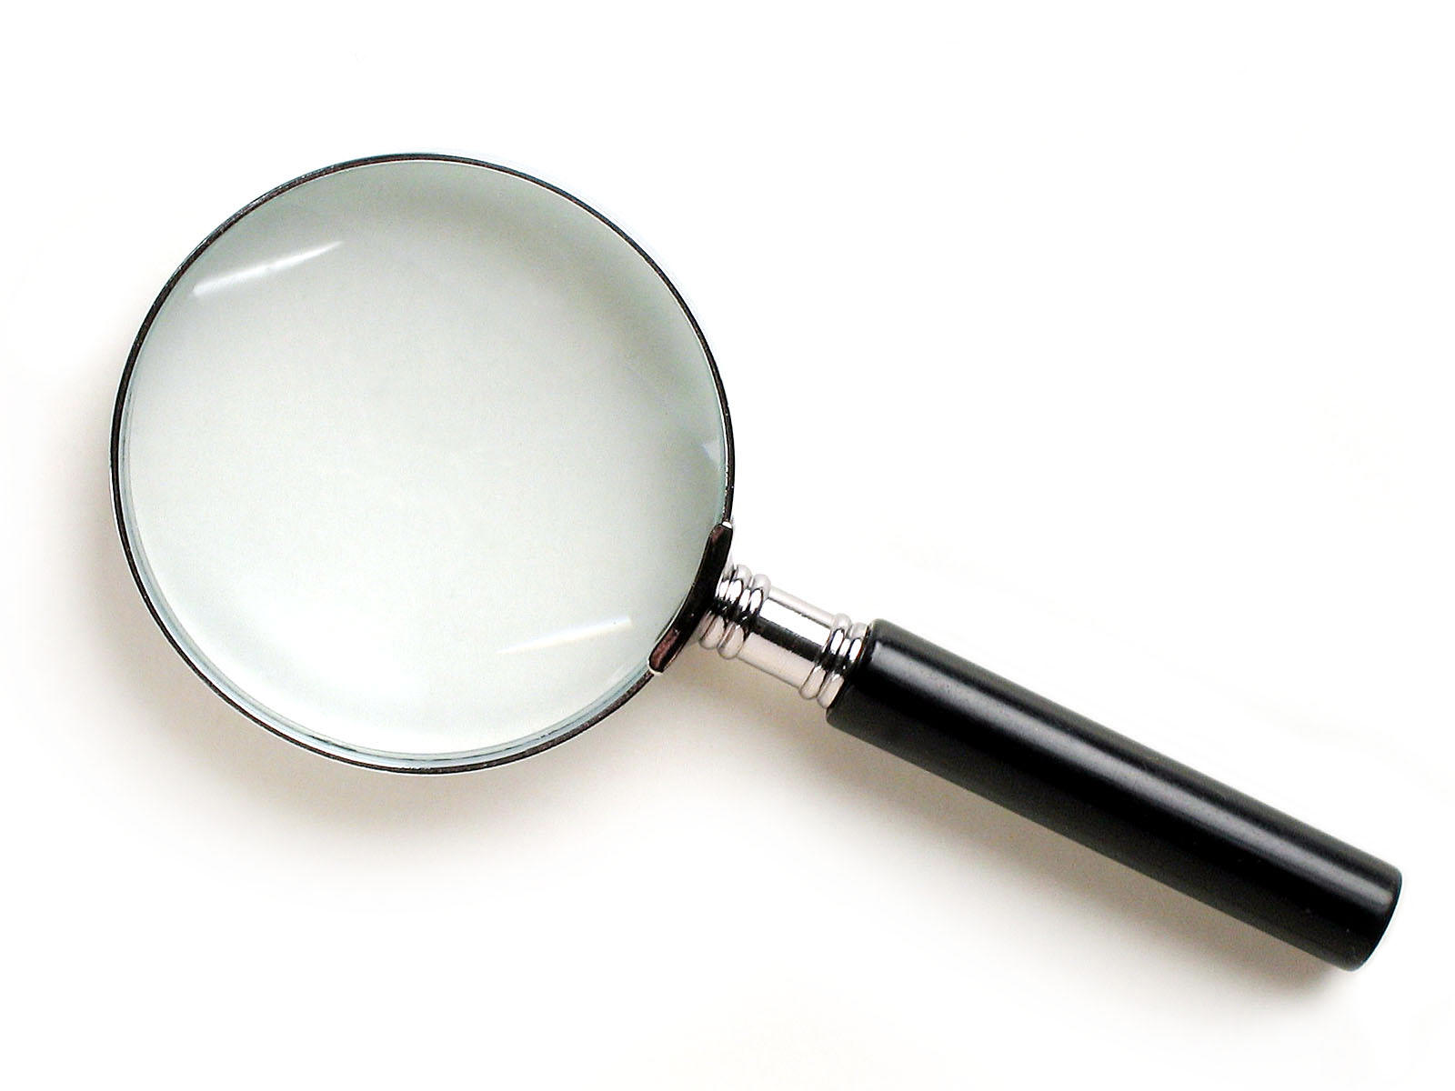
SKIMMING

Slide 17
The climate of the Earth is always changing. In the past it has altered as a result of natural causes. Nowadays, however, the term climate change is generally used when referring to changes in our climate which have been identified since the early part of the 1900's . The changes we've seen over recent years and those which are predicted over the next 80 years are thought to be mainly as a result of human behaviour rather than due to natural changes in the atmosphere.

Slide 18
The best treatment for mouth ulcers. Gargle with salt water. You should find that it works a treat. Salt is cheap and easy to get hold of and we all have it at home, so no need to splash out and spend lots of money on expensive mouth ulcer creams.

Slide 19
Lexical v Grammatical Words

Slide 20
Urquhart castle is probably one of the most picturesquely situated castles in the Scottish Highlands. Located 16 miles south-west of Inverness, the castle, one of the largest in Scotland, overlooks much of Loch Ness. Visitors come to stroll through the ruins of the 13th-century castle because Urquhart has earned the reputation of being one of the best spots for sighting Loch Ness’s most famous inhabitant.

Slide 21
Urquhart castle is probably one of the most picturesquely situated castles in the Scottish Highlands. Located 16 miles south-west of Inverness, the castle, one of the largest in Scotland, overlooks much of Loch Ness. Visitors come to stroll through the ruins of the 13th-century castle because Urquhart has earned the reputation of being one of the best spots for sighting Loch Ness’s most famous inhabitant.

Slide 22
Urquhart castle is probably one of the most picturesquely situated castles in the Scottish Highlands. Located 16 miles south-west of Inverness, the castle, one of the largest in Scotland, overlooks much of Loch Ness. Visitors come to stroll through the ruins of the 13th-century castle because Urquhart has earned the reputation of being one of the best spots for sighting Loch Ness’s most famous inhabitant.

Slide 23
Urquhart castle is probably one of the most picturesquely situated castles in the Scottish Highlands. Located 16 miles south-west of Inverness, the castle, one of the largest in Scotland, overlooks much of Loch Ness. Visitors come to stroll through the ruins of the 13th-century castle because Urquhart has earned the reputation of being one of the best spots for sighting Loch Ness’s most famous inhabitant.

Slide 24
Urquhart castle is probably one of the most picturesquely situated castles in the Scottish Highlands. Located 16 miles south-west of Inverness, the castle, one of the largest in Scotland, overlooks much of Loch Ness. Visitors come to stroll through the ruins of the 13th-century castle because Urquhart has earned the reputation of being one of the best spots for sighting Loch Ness’s most famous inhabitant.

Slide 25
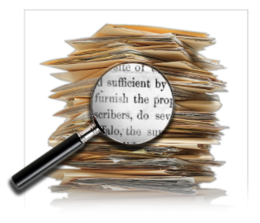
SCANNING

Slide 26
Where did the first cell phones begin?
Name 2 other features that started to be included in phones
Why are cell phones especially useful in some countries?

Slide 27
Where begin?
Two features?
Some countries?
Cellular telephones
The first cellular telephone system began operation in Tokyo in 1979, and the first U.S. system began operation in 1983 in Chicago. A camera phone is a cellular phone that also has picture taking capabilities. Some camera phones have the capability to send these photos to another cellular phone or computer. Advances in digital technology and microelectronics has led to the inclusion of unrelated applications in cellular telephones, such as alarm clocks, calculators, Internet browsers, and voice memos for recording short verbal reminders, while at the same time making such telephones vulnerable to certain software viruses. In many countries with inadequate wire-based telephone networks, cellular telephone systems have provided a means of more quickly establishing a national telecommunications network.

Slide 28
CLOSE READING

Slide 29
RESEARCH SKILLS

Slide 30
Research the life of
Martin Luther King

Slide 31
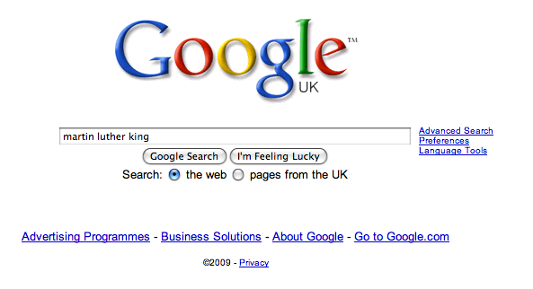

Slide 38
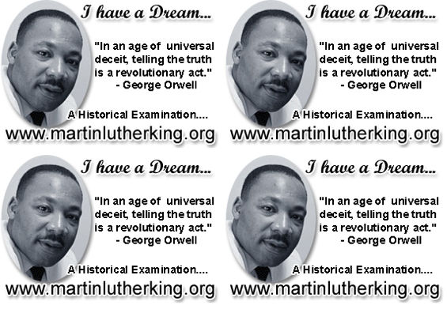

Slide 39
DEMYSTIFYING
SPELLING
3
Notes:
7 spellings: Government – February – parliament – separate – believe – necessary - accommodation

Slide 40
1 - SOUNDS

Slide 41
Government

Slide 42
February

Slide 43
Parliament

Slide 44
2 -VISUALS

Slide 45
Se-para-te
Be-lie-ve

Slide 46
3 - MNEMONICS

Slide 47
necessary

Slide 48
accommodation

Slide 49
Teach reading – scanning, skimming, analysis
Read aloud and display
Teach key vocabulary
Demystify spelling
Teach research, not FOFO

Slide 50
Demonstrate writing
Teach composition & planning
Allow oral rehearsal
Short & long sentences
Connectives

Slide 51
Know your connectives
Adding: and, also, as well as, moreover, too
Cause & effect: because, so, therefore, thus, consequently
Sequencing: next, then, first, finally, meanwhile, before, after
Qualifying: however, although, unless, except, if, as long as, apart from, yet
Emphasising: above all, in particular, especially, significantly, indeed, notably
Illustrating: for example, such as, for instance, as revealed by, in the case of
Comparing: equally, in the same way, similarly, likewise, as with, like
Contrasting: whereas, instead of, alternatively, otherwise, unlike, on the other hand

Slide 53
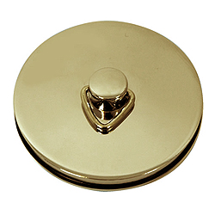
This is an expensive plug ➔

Slide 54
This is a
cheap plug ➔

Slide 55
Don’t Call it iteracy
Geoff Barton
General Secretary
Association of School & College Leaders
6 September 2017
@RealGeoffBarton
Download this presentation at www.geoffbarton.co.uk
(Presentation number 153)

