Slide 1
‘O Brave New World’:
NATE Conference 2015
Geoff Barton
Head, King Edward VI School, Suffolk
Download this presentation at www.geoffbarton.co.uk (138) Twitter: @RealGeoffBarton

Slide 2
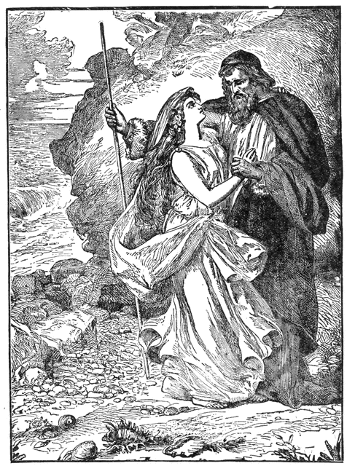
Miranda:
“O, wonder! How many goodly creatures are there here!How beauteous mankind is! O brave new world, That has such people in't!”
Prospero:
“’Tis new to thee”

Slide 3
Provocations
Questions
Principles

Slide 4
1: What is English for at your school?

Slide 5
2: What kind of learners are we creating?

Slide 6
3: What kind of readers?

Slide 7
4: What kind of writers?

Slide 8
5: What kind of teachers are we developing?

Slide 9
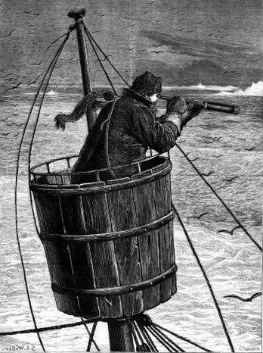
The view from here
Master:
“We run ourselves aground”

Slide 11
Testing times

Slide 12
“Those who stand for nothing fall for anything”
Alexander Hamilton
Founding Father, 1755-1803

Slide 13
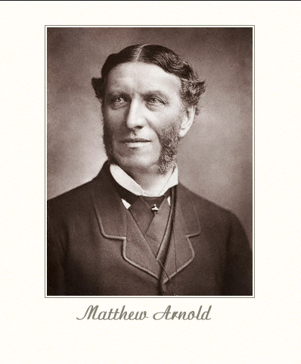
‘The Preachers of Culture’

Slide 14
You taught me language, and my profit on ’t
Is I know how to curse.

Slide 15
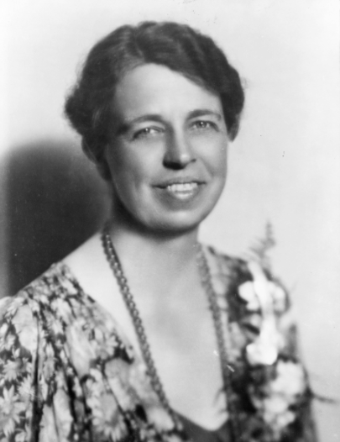
‘No one can make you feel inferior without your consent’
Eleanor Roosevelt

Slide 16
1: What is English for at your school?

Slide 17
2: What kind of learners are we creating?

Slide 18
3: What kind of readers?

Slide 19
4: What kind of writers?

Slide 20
5: What kind of teachers are we developing?

Slide 21
1: What is English at your school for?
What does English distinctively add to the culture of your school?
What are the non-negotiable activities and texts of your curriculum?
Does it combine depth with breadth?
Does it relate to your distinctive context?
Does it challenge students linguistically and conceptually more than they might expect?
Does it raise aspirations for the ‘word poor’?

Slide 22
2: What kind of learners are we creating?
Does English pass the Google test?
The past illuminating the present?
‘Soft’ skills: teamwork, problem-solving, resilience, debating, journalism?
Equip them with the language of power?
Relish for & curiosity about the endless playfulness of language
Assisting the ‘word poor’ alongside the ‘word rich’?

Slide 23
The past illuminating the present

Slide 26
3: What kind of readers?
At the heart of English: a reading curriculum
Inquisitive readers taught by inquisitive readers, high culture rubbing shoulders with low
Understand how reading works: skimming, scanning, analysis, lexical v grammatical words, conventions of texts, point-of-view, unreliable narrators, endings, speech verbs, drop paragraphs …
Built on prior knowledge
Research, not FOFO.

Slide 27
Prior Knowledge

Slide 28
What if JD Salinger rewrote ‘The Book of Genesis’?

Slide 29
Boy, when I saw old Eve I thought I was going to flip. I mean it isn’t that Eve is good-looking or anything like that, it’s just that she’s different. I don’t know what the hell it is exactly – but you always know when she’s around.
She looked nervous as hell. I kinda felt sorry for her – even though she’s got one of my goddam ribs, so I went over to talk to old Eve.
“You look very, very nice, Adam” she said to me in a funny way, like she was ashamed of something. “Why don’t you join me in some apple?”
Goddam, is that all these sophisticated babes think about all the time? It’s enough to drive a guy crazy, if you know what I mean.
From Simon Brett, The Faber Book of Parodies

Slide 30
What if Dylan Thomas rewrote ‘Pride & Prejudice’?

Slide 31
Adventures In The Marriage Trade
FIRST VOICE: It is night in the smug-as-a-bug-in-a-rug household of Mr and Mrs Dai Bennet and their simpering daughters – five breast-bobbing man-hungry titivators, innocent as ice-cream, panting for balls and matrimony.
MRS BENNET: Our new neighbour, Mr Darcy, quite tickles my fancy.
MR BENNET: Don’t let him turn Lizzy’s head, Darcy-versy.
ELIZABETH: I shall wed whom I please.
FIRST VOICE: And busy Lizzie retires to her room with visions of bridling up the aisle to ‘I will’ with half-a-dozen demon lovers. She dreams of coaches and pairs and being a fine lady; dressing for dinner in silken gown and undressing afterwards for heaven knows what in the saucy haven of a double bed.
From EO Parrott, How to be Well Versed in Poetry

Slide 32
Skimming

Slide 33
You will need:
a basic patch repair kit, including:
tyre levers
fine sandpaper or emery board
rubber solution
patch
bike pump
1. Take the wheel off the bike, and using the tyre levers take the tyre off one side of the rim so you can pull the inner tube out. You might be able to save time by leaving the valve of the tube in the wheel as shown below, but only if the hole is elsewhere on the tube. Blow the tube up. You can find a puncture by listening for the hiss of escaping air. The smallest, slowest punctures are hardest to find – you may have to immerse the tube in water and look for bubbles. In an emergency, a puddle will do.
2. Once you find a puncture it will lead you to the right section of tyre to look for a hole or a sharp object. Check the tyre for grit, glass, thorns or nails. Check for holes where they may have been. The flint, thorn or glass that caused the puncture may have been blown out by the escaping air, or dislodged in the last few metres when you were running on a flat tyre. Pick out whatever caused the puncture. Tweezers or a pin may be useful.

Slide 34
You will need:
a basic patch repair kit, including:
tyre levers
fine sandpaper or emery board
rubber solution
patch
bike pump
1. Take the wheel off the bike, and using the tyre levers take the tyre off one side of the rim so you can pull the inner tube out. You might be able to save time by leaving the valve of the tube in the wheel as shown below, but only if the hole is elsewhere on the tube. Blow the tube up. You can find a puncture by listening for the hiss of escaping air. The smallest, slowest punctures are hardest to find – you may have to immerse the tube in water and look for bubbles. In an emergency, a puddle will do.
2. Once you find a puncture it will lead you to the right section of tyre to look for a hole or a sharp object. Check the tyre for grit, glass, thorns or nails. Check for holes where they may have been. The flint, thorn or glass that caused the puncture may have been blown out by the escaping air, or dislodged in the last few metres when you were running on a flat tyre. Pick out whatever caused the puncture. Tweezers or a pin may be useful.

Slide 35
You will need:
a basic patch repair kit, including:
tyre levers
fine sandpaper or emery board
rubber solution
patch
bike pump
1. Take the wheel off the bike, and using the tyre levers take the tyre off one side of the rim so you can pull the inner tube out. You might be able to save time by leaving the valve of the tube in the wheel as shown below, but only if the hole is elsewhere on the tube. Blow the tube up. You can find a puncture by listening for the hiss of escaping air. The smallest, slowest punctures are hardest to find – you may have to immerse the tube in water and look for bubbles. In an emergency, a puddle will do.
2. Once you find a puncture it will lead you to the right section of tyre to look for a hole or a sharp object. Check the tyre for grit, glass, thorns or nails. Check for holes where they may have been. The flint, thorn or glass that caused the puncture may have been blown out by the escaping air, or dislodged in the last few metres when you were running on a flat tyre. Pick out whatever caused the puncture. Tweezers or a pin may be useful.

Slide 36
You will need:
a basic patch repair kit, including:
tyre levers
fine sandpaper or emery board
rubber solution
patch
bike pump
1. Take the wheel off the bike, and using the tyre levers take the tyre off one side of the rim so you can pull the inner tube out. You might be able to save time by leaving the valve of the tube in the wheel as shown below, but only if the hole is elsewhere on the tube. Blow the tube up. You can find a puncture by listening for the hiss of escaping air. The smallest, slowest punctures are hardest to find – you may have to immerse the tube in water and look for bubbles. In an emergency, a puddle will do.
2. Once you find a puncture it will lead you to the right section of tyre to look for a hole or a sharp object. Check the tyre for grit, glass, thorns or nails. Check for holes where they may have been. The flint, thorn or glass that caused the puncture may have been blown out by the escaping air, or dislodged in the last few metres when you were running on a flat tyre. Pick out whatever caused the puncture. Tweezers or a pin may be useful.

Slide 37
You will need:
a basic patch repair kit, including:
tyre levers
fine sandpaper or emery board
rubber solution
patch
bike pump
1. Take the wheel off the bike, and using the tyre levers take the tyre off one side of the rim so you can pull the inner tube out. You might be able to save time by leaving the valve of the tube in the wheel as shown below, but only if the hole is elsewhere on the tube. Blow the tube up. You can find a puncture by listening for the hiss of escaping air. The smallest, slowest punctures are hardest to find – you may have to immerse the tube in water and look for bubbles. In an emergency, a puddle will do.
2. Once you find a puncture it will lead you to the right section of tyre to look for a hole or a sharp object. Check the tyre for grit, glass, thorns or nails. Check for holes where they may have been. The flint, thorn or glass that caused the puncture may have been blown out by the escaping air, or dislodged in the last few metres when you were running on a flat tyre. Pick out whatever caused the puncture. Tweezers or a pin may be useful.

Slide 38
You will need:
a basic patch repair kit, including:
tyre levers
fine sandpaper or emery board
rubber solution
patch
bike pump
1. Take the wheel off the bike, and using the tyre levers take the tyre off one side of the rim so you can pull the inner tube out. You might be able to save time by leaving the valve of the tube in the wheel as shown below, but only if the hole is elsewhere on the tube. Blow the tube up. You can find a puncture by listening for the hiss of escaping air. The smallest, slowest punctures are hardest to find – you may have to immerse the tube in water and look for bubbles. In an emergency, a puddle will do.
2. Once you find a puncture it will lead you to the right section of tyre to look for a hole or a sharp object. Check the tyre for grit, glass, thorns or nails. Check for holes where they may have been. The flint, thorn or glass that caused the puncture may have been blown out by the escaping air, or dislodged in the last few metres when you were running on a flat tyre. Pick out whatever caused the puncture. Tweezers or a pin may be useful.

Slide 39
You will need:
a basic patch repair kit, including:
tyre levers
fine sandpaper or emery board
rubber solution
patch
bike pump
1. Take the wheel off the bike, and using the tyre levers take the tyre off one side of the rim so you can pull the inner tube out. You might be able to save time by leaving the valve of the tube in the wheel as shown below, but only if the hole is elsewhere on the tube. Blow the tube up. You can find a puncture by listening for the hiss of escaping air. The smallest, slowest punctures are hardest to find – you may have to immerse the tube in water and look for bubbles. In an emergency, a puddle will do.
2. Once you find a puncture it will lead you to the right section of tyre to look for a hole or a sharp object. Check the tyre for grit, glass, thorns or nails. Check for holes where they may have been. The flint, thorn or glass that caused the puncture may have been blown out by the escaping air, or dislodged in the last few metres when you were running on a flat tyre. Pick out whatever caused the puncture. Tweezers or a pin may be useful.

Slide 40
You will need:
a basic patch repair kit, including:
tyre levers
fine sandpaper or emery board
rubber solution
patch
bike pump
1. Take the wheel off the bike, and using the tyre levers take the tyre off one side of the rim so you can pull the inner tube out. You might be able to save time by leaving the valve of the tube in the wheel as shown below, but only if the hole is elsewhere on the tube. Blow the tube up. You can find a puncture by listening for the hiss of escaping air. The smallest, slowest punctures are hardest to find – you may have to immerse the tube in water and look for bubbles. In an emergency, a puddle will do.
2. Once you find a puncture it will lead you to the right section of tyre to look for a hole or a sharp object. Check the tyre for grit, glass, thorns or nails. Check for holes where they may have been. The flint, thorn or glass that caused the puncture may have been blown out by the escaping air, or dislodged in the last few metres when you were running on a flat tyre. Pick out whatever caused the puncture. Tweezers or a pin may be useful.

Slide 41
You will need:
a basic patch repair kit, including:
tyre levers
fine sandpaper or emery board
rubber solution
patch
bike pump
1. Take the wheel off the bike, and using the tyre levers take the tyre off one side of the rim so you can pull the inner tube out. You might be able to save time by leaving the valve of the tube in the wheel as shown below, but only if the hole is elsewhere on the tube. Blow the tube up. You can find a puncture by listening for the hiss of escaping air. The smallest, slowest punctures are hardest to find – you may have to immerse the tube in water and look for bubbles. In an emergency, a puddle will do.
2. Once you find a puncture it will lead you to the right section of tyre to look for a hole or a sharp object. Check the tyre for grit, glass, thorns or nails. Check for holes where they may have been. The flint, thorn or glass that caused the puncture may have been blown out by the escaping air, or dislodged in the last few metres when you were running on a flat tyre. Pick out whatever caused the puncture. Tweezers or a pin may be useful.

Slide 42
You will need:
a basic patch repair kit, including:
tyre levers
fine sandpaper or emery board
rubber solution
patch
bike pump
1. Take the wheel off the bike, and using the tyre levers take the tyre off one side of the rim so you can pull the inner tube out. You might be able to save time by leaving the valve of the tube in the wheel as shown below, but only if the hole is elsewhere on the tube. Blow the tube up. You can find a puncture by listening for the hiss of escaping air. The smallest, slowest punctures are hardest to find – you may have to immerse the tube in water and look for bubbles. In an emergency, a puddle will do.
2. Once you find a puncture it will lead you to the right section of tyre to look for a hole or a sharp object. Check the tyre for grit, glass, thorns or nails. Check for holes where they may have been. The flint, thorn or glass that caused the puncture may have been blown out by the escaping air, or dislodged in the last few metres when you were running on a flat tyre. Pick out whatever caused the puncture. Tweezers or a pin may be useful.

Slide 43
Walnuts are rounded, single-seeded stone fruits of the walnut tree commonly used for the meat after fully ripening. Following full ripening, the removal of the husk reveals the wrinkly walnut shell, which is usually commercially found in two segments (three-segment shells can also form). During the ripening process, the husk will become brittle and the shell hard. The shell encloses the kernel or meat, which is usually made up of two halves separated by a partition. The seed kernels – commonly available as shelled walnuts – are enclosed in a brown seed coat which contains antioxidants. The antioxidants protect the oil-rich seed from atmospheric oxygen, thereby preventing rancidity.
Walnuts are late to grow leaves, typically not until more than halfway through the spring. They secrete chemicals into the soil to prevent competing vegetation from growing. Because of this, flowers or vegetable gardens should not be planted close to them.
The two most common major species of walnuts are grown for their seeds – the Persian or English walnut and the black walnut. The English walnut (J. regia) originated in Persia, and the black walnut (J. nigra) is native to eastern North America. The black walnut is of high flavor, but due to its hard shell and poor hulling characteristics it is not grown commercially for nut production. Numerous walnut cultivars have been developed commercially, which are nearly all hybrids of the English walnut.

Slide 44
Walnuts are rounded, single-seeded stone fruits of the walnut tree commonly used for the meat after fully ripening. Following full ripening, the removal of the husk reveals the wrinkly walnut shell, which is usually commercially found in two segments (three-segment shells can also form). During the ripening process, the husk will become brittle and the shell hard. The shell encloses the kernel or meat, which is usually made up of two halves separated by a partition. The seed kernels – commonly available as shelled walnuts – are enclosed in a brown seed coat which contains antioxidants. The antioxidants protect the oil-rich seed from atmospheric oxygen, thereby preventing rancidity.
Walnuts are late to grow leaves, typically not until more than halfway through the spring. They secrete chemicals into the soil to prevent competing vegetation from growing. Because of this, flowers or vegetable gardens should not be planted close to them.
The two most common major species of walnuts are grown for their seeds – the Persian or English walnut and the black walnut. The English walnut (J. regia) originated in Persia, and the black walnut (J. nigra) is native to eastern North America. The black walnut is of high flavor, but due to its hard shell and poor hulling characteristics it is not grown commercially for nut production. Numerous walnut cultivars have been developed commercially, which are nearly all hybrids of the English walnut.

Slide 45
Walnuts are rounded, single-seeded stone fruits of the walnut tree commonly used for the meat after fully ripening. Following full ripening, the removal of the husk reveals the wrinkly walnut shell, which is usually commercially found in two segments (three-segment shells can also form). During the ripening process, the husk will become brittle and the shell hard. The shell encloses the kernel or meat, which is usually made up of two halves separated by a partition. The seed kernels – commonly available as shelled walnuts – are enclosed in a brown seed coat which contains antioxidants. The antioxidants protect the oil-rich seed from atmospheric oxygen, thereby preventing rancidity.
Walnuts are late to grow leaves, typically not until more than halfway through the spring. They secrete chemicals into the soil to prevent competing vegetation from growing. Because of this, flowers or vegetable gardens should not be planted close to them.
The two most common major species of walnuts are grown for their seeds – the Persian or English walnut and the black walnut. The English walnut (J. regia) originated in Persia, and the black walnut (J. nigra) is native to eastern North America. The black walnut is of high flavor, but due to its hard shell and poor hulling characteristics it is not grown commercially for nut production. Numerous walnut cultivars have been developed commercially, which are nearly all hybrids of the English walnut.

Slide 46
Walnuts are rounded, single-seeded stone fruits of the walnut tree commonly used for the meat after fully ripening. Following full ripening, the removal of the husk reveals the wrinkly walnut shell, which is usually commercially found in two segments (three-segment shells can also form). During the ripening process, the husk will become brittle and the shell hard. The shell encloses the kernel or meat, which is usually made up of two halves separated by a partition. The seed kernels – commonly available as shelled walnuts – are enclosed in a brown seed coat which contains antioxidants. The antioxidants protect the oil-rich seed from atmospheric oxygen, thereby preventing rancidity.
Walnuts are late to grow leaves, typically not until more than halfway through the spring. They secrete chemicals into the soil to prevent competing vegetation from growing. Because of this, flowers or vegetable gardens should not be planted close to them.
The two most common major species of walnuts are grown for their seeds – the Persian or English walnut and the black walnut. The English walnut (J. regia) originated in Persia, and the black walnut (J. nigra) is native to eastern North America. The black walnut is of high flavor, but due to its hard shell and poor hulling characteristics it is not grown commercially for nut production. Numerous walnut cultivars have been developed commercially, which are nearly all hybrids of the English walnut.

Slide 47
Scanning

Slide 48
‘Dementor’ Wasps and Worse
How long is the stick-insect?
How many species of insects have been found?
Who is the conservation director for WWF-Greater Mekong?
Which was the 10,000th creature to be discovered?
What are the main features of the long-toothed pipistrelle bat?

Slide 49
‘Dementor’ Wasps and Worse
How long is the stick-insect?
How many species of insects have been found?
Who is the conservation director for WWF-Greater Mekong?
Which was the 10,000th creature to be discovered?
What are the main features of the long-toothed pipistrelle bat?

Slide 50
A “dementor” wasp named after the Harry Potter creatures, a stick insect more than half a metre long, and a colour-changing thorny frog are among new species discovered in South East Asia’s Greater Mekong region. The discoveries also include a bent-toed gecko which is the 10,000th reptile to be recorded on Earth, a feathered coral whose nearest relatives are found in Africa and four moths named after Thai princesses.
A total of 139 new species were identified in the region in 2014, including a new mammal - a long-toothed pipistrelle bat - as well as 90 plants, 23 reptiles, 16 amphibians and nine fish found by scientists. It brings the total number of species found in the Greater Mekong, which covers Cambodia, Laos, Burma, and Vietnam, between 1997 and 2014 to 2,216 or an average of three new plants or creatures a week. But many of the newly-discovered species are already at risk from threats such as destruction of their habitat, poaching or the illegal wildlife trade, a Magical Mekong report by wildlife charity WWF warned.
Teak Seng, conservation director for WWF-Greater Mekong, said: “The Greater Mekong’s unique ecosystems are truly the gift that keeps on giving, providing sanctuary for a treasure trove of species and critical benefits for millions of people across the region. “As Magical Mekong reveals, the scientists behind these discoveries feel they are racing against the clock to document them and strongly advocate for their protection before they disappear.”
The Ampulex dementor wasp from Thailand, which was named by popular vote after the soul-sucking creatures in the Harry Potter books, paralyses its prey with venom before eating them alive.
A stick insect measuring 54cm (21 inches), making it - for now - the world’s second largest insect, was found in Vietnam, while a stealthy wolf snake with a “flying bat” pattern on its skin which helps it blend into trees and mosses was discovered in Cambodia.

Slide 52
A “dementor” wasp named after the Harry Potter creatures, a stick insect more than half a metre long, and a colour-changing thorny frog are among new species discovered in South East Asia’s Greater Mekong region. The discoveries also include a bent-toed gecko which is the 10,000th reptile to be recorded on Earth, a feathered coral whose nearest relatives are found in Africa and four moths named after Thai princesses.
A total of 139 new species were identified in the region in 2014, including a new mammal - a long-toothed pipistrelle bat - as well as 90 plants, 23 reptiles, 16 amphibians and nine fish found by scientists. It brings the total number of species found in the Greater Mekong, which covers Cambodia, Laos, Burma, and Vietnam, between 1997 and 2014 to 2,216 or an average of three new plants or creatures a week. But many of the newly-discovered species are already at risk from threats such as destruction of their habitat, poaching or the illegal wildlife trade, a Magical Mekong report by wildlife charity WWF warned.
Teak Seng, conservation director for WWF-Greater Mekong, said: “The Greater Mekong’s unique ecosystems are truly the gift that keeps on giving, providing sanctuary for a treasure trove of species and critical benefits for millions of people across the region. “As Magical Mekong reveals, the scientists behind these discoveries feel they are racing against the clock to document them and strongly advocate for their protection before they disappear.”
The Ampulex dementor wasp from Thailand, which was named by popular vote after the soul-sucking creatures in the Harry Potter books, paralyses its prey with venom before eating them alive.
A stick insect measuring 54cm (21 inches), making it - for now - the world’s second largest insect, was found in Vietnam, while a stealthy wolf snake with a “flying bat” pattern on its skin which helps it blend into trees and mosses was discovered in Cambodia.

Slide 53
A “dementor” wasp named after the Harry Potter creatures, a stick insect more than half a metre long, and a colour-changing thorny frog are among new species discovered in South East Asia’s Greater Mekong region. The discoveries also include a bent-toed gecko which is the 10,000th reptile to be recorded on Earth, a feathered coral whose nearest relatives are found in Africa and four moths named after Thai princesses.
A total of 139 new species were identified in the region in 2014, including a new mammal - a long-toothed pipistrelle bat - as well as 90 plants, 23 reptiles, 16 amphibians and nine fish found by scientists. It brings the total number of species found in the Greater Mekong, which covers Cambodia, Laos, Burma, and Vietnam, between 1997 and 2014 to 2,216 or an average of three new plants or creatures a week. But many of the newly-discovered species are already at risk from threats such as destruction of their habitat, poaching or the illegal wildlife trade, a Magical Mekong report by wildlife charity WWF warned.
Teak Seng, conservation director for WWF-Greater Mekong, said: “The Greater Mekong’s unique ecosystems are truly the gift that keeps on giving, providing sanctuary for a treasure trove of species and critical benefits for millions of people across the region. “As Magical Mekong reveals, the scientists behind these discoveries feel they are racing against the clock to document them and strongly advocate for their protection before they disappear.”
The Ampulex dementor wasp from Thailand, which was named by popular vote after the soul-sucking creatures in the Harry Potter books, paralyses its prey with venom before eating them alive.
A stick insect measuring 54cm (21 inches), making it - for now - the world’s second largest insect, was found in Vietnam, while a stealthy wolf snake with a “flying bat” pattern on its skin which helps it blend into trees and mosses was discovered in Cambodia.

Slide 54
A “dementor” wasp named after the Harry Potter creatures, a stick insect more than half a metre long, and a colour-changing thorny frog are among new species discovered in South East Asia’s Greater Mekong region. The discoveries also include a bent-toed gecko which is the 10,000th reptile to be recorded on Earth, a feathered coral whose nearest relatives are found in Africa and four moths named after Thai princesses.
A total of 139 new species were identified in the region in 2014, including a new mammal - a long-toothed pipistrelle bat - as well as 90 plants, 23 reptiles, 16 amphibians and nine fish found by scientists. It brings the total number of species found in the Greater Mekong, which covers Cambodia, Laos, Burma, and Vietnam, between 1997 and 2014 to 2,216 or an average of three new plants or creatures a week. But many of the newly-discovered species are already at risk from threats such as destruction of their habitat, poaching or the illegal wildlife trade, a Magical Mekong report by wildlife charity WWF warned.
Teak Seng, conservation director for WWF-Greater Mekong, said: “The Greater Mekong’s unique ecosystems are truly the gift that keeps on giving, providing sanctuary for a treasure trove of species and critical benefits for millions of people across the region. “As Magical Mekong reveals, the scientists behind these discoveries feel they are racing against the clock to document them and strongly advocate for their protection before they disappear.”
The Ampulex dementor wasp from Thailand, which was named by popular vote after the soul-sucking creatures in the Harry Potter books, paralyses its prey with venom before eating them alive.
A stick insect measuring 54cm (21 inches), making it - for now - the world’s second largest insect, was found in Vietnam, while a stealthy wolf snake with a “flying bat” pattern on its skin which helps it blend into trees and mosses was discovered in Cambodia.

Slide 55
Reseaching

Slide 56
Research the life of
Martin Luther King

Slide 65
4: What kind of writers?
Know that writing is about choices
Accuracy isn’t optional. We are judged by it. Teach self-regulation
Vocabulary is a proxy for intelligence
Writing is nourished by rich talk and rich reading
Skills: short/long sentences; avoidance of repetition; lexical continuum; chronological v non-chronological structures; alternatives to declarative sentences; alternatives to ‘and’ and ‘but’
Understand ‘interestingness’

Slide 66
5: What kind of teachers?
Principled, passionate, optimistic
Self-critical
Evangelical on behalf of the ‘word poor’
Known as a stickler
Connected
An obsessive, open-minded reader
Knows that rigour underpins creativity
Has a legacy of students who read (English)
Part of a great tradition of English teachers.

Slide 67
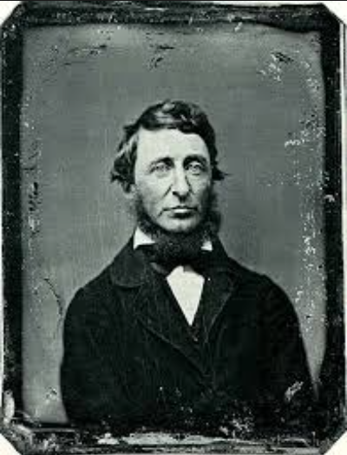
‘Most people lead lives of quiet desperation and go to their grave with the song still in them’
Henry David Thoreau

Slide 68
English Teacher
Petite, white-haired Miss Cartwright
Knew Shakespeare off by heart,
Or so we pupils thought.
Once in the stalls at the Old Vic
She prompted Lear when he forgot his part.
Ignorant of Scrutiny and Leavis,
She taught Romantic poetry,
Dreamt of gossip with dead poets.
To an amazed sixth form once said: ‘How good to spend a night with Shelley.’
In long war years she fed us plays,
Sophocles to Shaw’s St Joan.
Her reading nights we named our Courting Club,
Yet always through the blacked-out streets
One boy left the girls and saw her home.
When she closed her eyes and chanted
‘Ode to a Nightingale’
We laughed yet honoured her devotion.
We knew the man she should have married
Was killed at Passchendaele.
Brian Cox
From Collected Poems, Carcanet Press 1993.

Slide 69
‘O Brave New World’:
NATE Conference 2015
Geoff Barton
Head, King Edward VI School, Suffolk
Download this presentation at www.geoffbarton.co.uk (138) Twitter: @RealGeoffBarton

