Slide 1
Don’t Call it iteracy
Geoff Barton
Hind Leys College
April 13, 2010
www.geoffbarton.co.uk

Slide 2
Today:
Why literacy matters
How we’re all members of the Literacy Club
What makes an impact across subjects

Slide 3
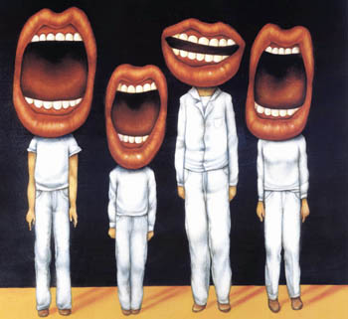
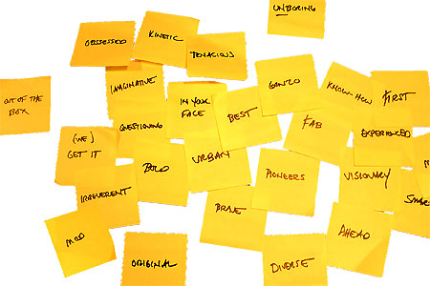
Approach:

Slide 4
Health Check

Slide 6
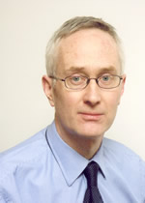
Michael Barber

Slide 7
Literacy standards in England
1945
1997

Slide 8
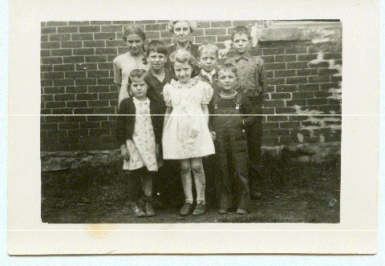

Slide 9
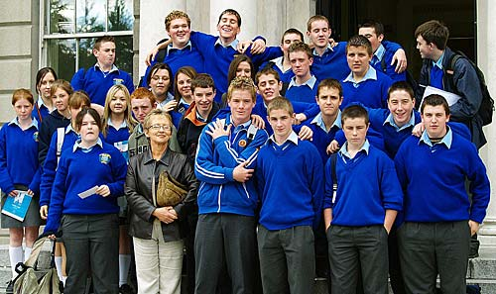

Slide 11
Beacon Schools
Training Schools
Coasting Schools
Super Heads
Consultant Heads
Executive Heads
Schools are becoming immune to school improvement
London Challenge
National Challenge
National Strategies
Leading Edge
Consultants
School improvement partners
Gaining Ground
Leading Light Schools
Trust Schools

Slide 12
3 Provocations:
1
We haven’t ‘done’ literacy

Slide 13
3 Provocations:
2
Every teacher in English is a teacher of English
George Sampson, 1922

Slide 14
3 Provocations:
3
It’s not about grammar:
it’s about teaching & learning

Slide 15
Language oddities

Slide 16
DOGS MUST BE CARRIED ON THE ESCALATOR

Slide 17
Please don't smoke and live a more healthy life
PSHE Poster

Slide 18
Sign at Suffolk hospital:
Criminals operate in this area

Slide 19
ICI FIBRES

Slide 20
Churchdown parish magazine:
‘Would the congregation please note that the bowl at the back of the church labelled “for the sick” is for monetary donations only’

Slide 21
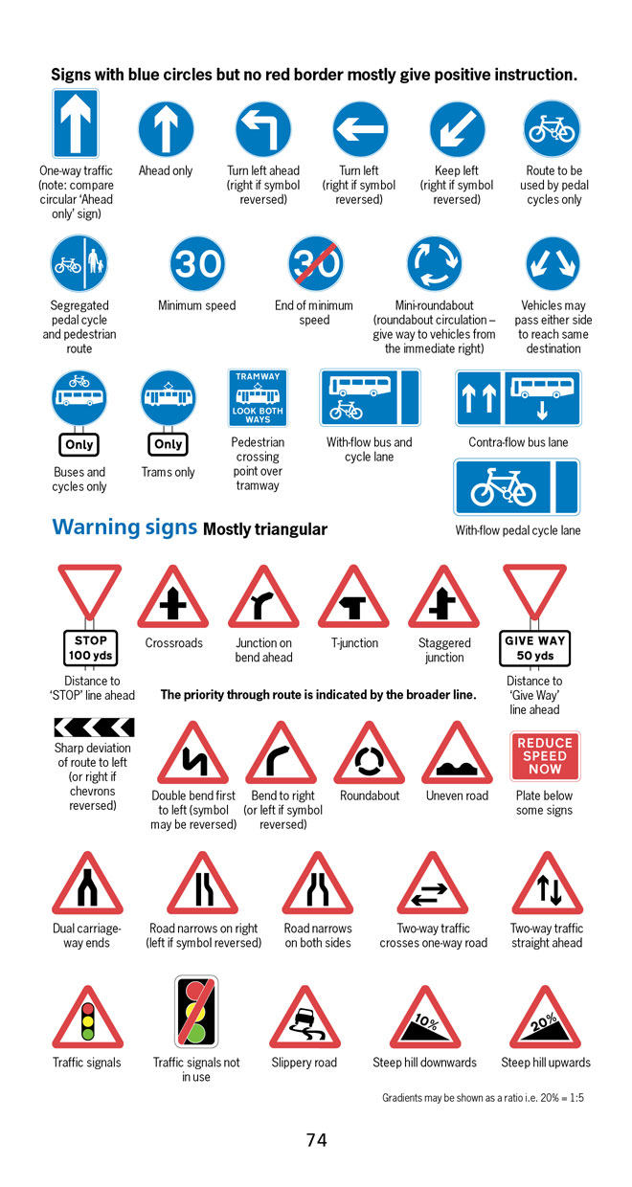
BBC NEWS ONLINE:
More than half of British motorists cannot interpret road signs properly, according to a survey by the Royal Automobile Club.
The survey of 500 motorists highlighted just how many people are still grappling with it.

Slide 22
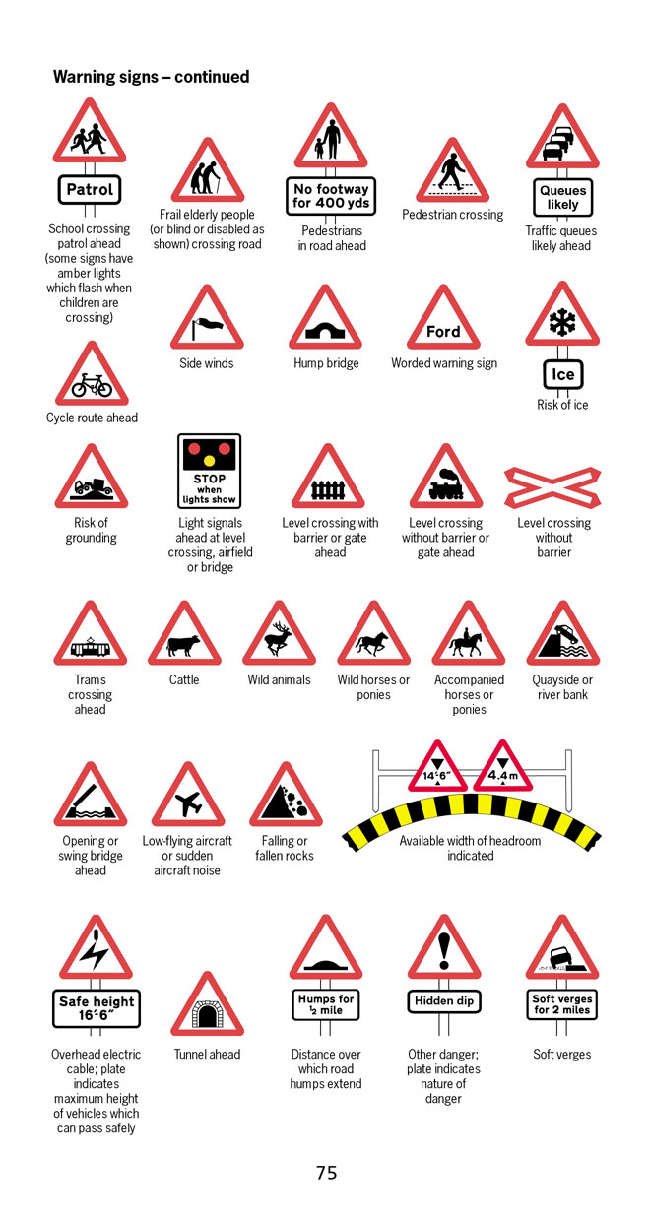
According to the survey, three in five motorists thought a "be aware of cattle" warning sign indicated …
an area infected with foot-and-mouth disease.

Slide 23
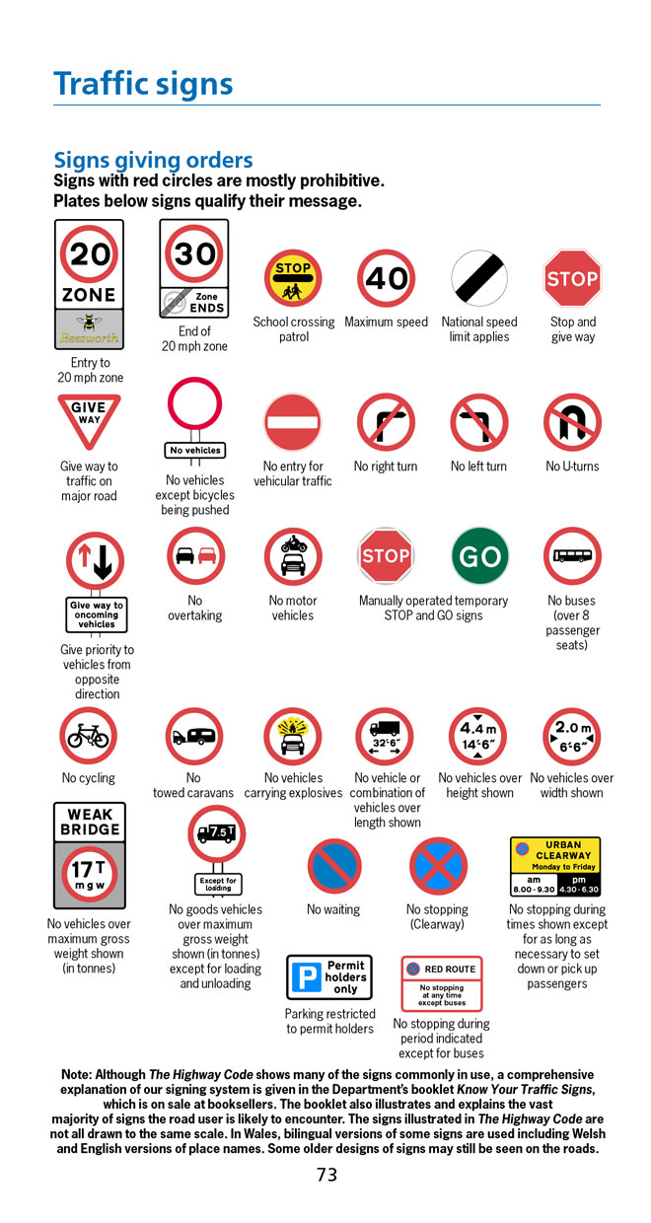
Common mistakes:
No motor vehicles - Beware of fast motorbikes
Wild fowl - Puddles in the road
Riding school close by - "Marlborough country" advert

Slide 24
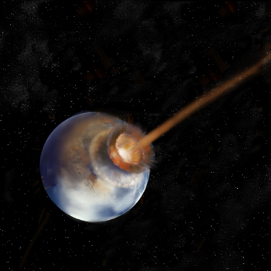
LITERACY
IMPACT
IMPACT

Slide 25
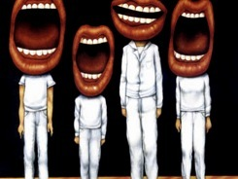
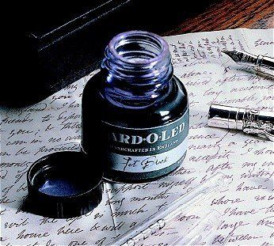

Slide 26
So …?
Understand the significance of exploratory talk
Model good talk – eg connectives
Re-think questioning: why & how?
Re-think hands-up
Get conversations into the school culture

Slide 27
Teach reading – scanning, skimming, analysis
Read aloud and display
Teach key vocabulary
Demystify spelling
Teach research, not FOFO

Slide 28
SKIMMING

Slide 29
The climate of the Earth is always changing. In the past it has altered as a result of natural causes. Nowadays, however, the term climate change is generally used when referring to changes in our climate which have been identified since the early part of the 1900’s. The changes we've seen over recent years and those which are predicted over the next 80 years are thought to be mainly as a result of human behaviour rather than due to natural changes in the atmosphere.

Slide 30
The best treatment for mouth ulcers. Gargle with salt water. You should find that it works a treat. Salt is cheap and easy to get hold of and we all have it at home, so no need to splash out and spend lots of money on expensive mouth ulcer creams.

Slide 31
Urquhart castle is probably one of the most picturesquely situated castles in the Scottish Highlands. Located 16 miles south-west of Inverness, the castle, one of the largest in Scotland, overlooks much of Loch Ness. Visitors come to stroll through the ruins of the 13th-century castle because Urquhart has earned the reputation of being one of the best spots for sighting Loch Ness’s most famous inhabitant.

Slide 32
SCANNING

Slide 33
Where did the first cell phones begin?
Name 2 other features that started to be included in phones
Why are cell phones especially useful in some countries?

Slide 34
Where begin?
Two features?
Some countries?
Cellular telephones
The first cellular telephone system began operation in Tokyo in 1979, and the first U.S. system began operation in 1983 in Chicago. A camera phone is a cellular phone that also has picture taking capabilities. Some camera phones have the capability to send these photos to another cellular phone or computer. Advances in digital technology and microelectronics has led to the inclusion of unrelated applications in cellular telephones, such as alarm clocks, calculators, Internet browsers, and voice memos for recording short verbal reminders, while at the same time making such telephones vulnerable to certain software viruses. In many countries with inadequate wire-based telephone networks, cellular telephone systems have provided a means of more quickly establishing a national telecommunications network.

Slide 35
CLOSE READING

Slide 36
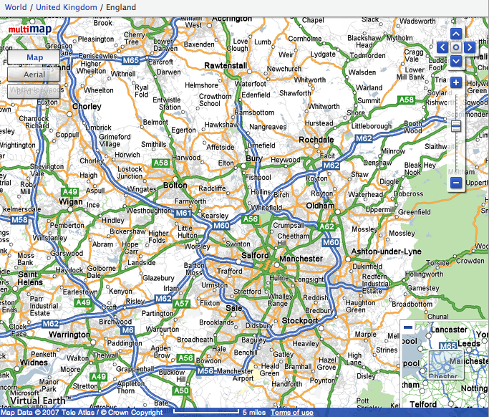

Slide 37
Research skills, not FOFO

Slide 38
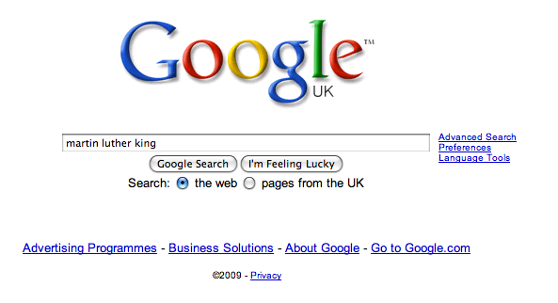

Slide 46
DEMYSTIFYING
SPELLING

Slide 47
MNEMONICS

Slide 48
necessary

Slide 49
Words within words

Slide 50
Se-para-te
Be-lie-ve

Slide 51
SOUNDS

Slide 52
Govern+ment

Slide 53
SPELLING STARTERS

Slide 54
-ible -able

Slide 55
Homophones
Sound of Music Kylie Beethoven
their there they’re
too two to
pray prey

Slide 56
Hard
Homophones
Freeze Stand
advice advise
practice practise
effect affect
It’s its

Slide 57
So …?
Teach reading – scanning, skimming, analysis
Read aloud and display
Teach key vocabulary
Demystify spelling
Teach research, not FOFO

Slide 58
Demonstrate writing
Teach composition & conventions
Allow oral rehearsal
Short & long sentences
Connectives

Slide 59
Know your connectives
Adding: and, also, as well as, moreover, too
Cause & effect: because, so, therefore, thus, consequently
Sequencing: next, then, first, finally, meanwhile, before, after
Qualifying: however, although, unless, except, if, as long as, apart from, yet
Emphasising: above all, in particular, especially, significantly, indeed, notably
Illustrating: for example, such as, for instance, as revealed by, in the case of
Comparing: equally, in the same way, similarly, likewise, as with, like
Contrasting: whereas, instead of, alternatively, otherwise, unlike, on the other hand

Slide 60
So …?
Demonstrate writing
Teach composition & conventions
Allow oral rehearsal
Short & long sentences
Connectives

Slide 61
LITERACY
IMPACT
Over to you …

Slide 62
Don’t Call it iteracy
Geoff Barton
Hind Leys College
April 13, 2010
www.geoffbarton.co.uk

