Slide 1
LITERACY FOR LEARNING
Geoff Barton
Head, King Edward VI School, Bury St Edmunds
Thursday, July 1, 2010
Download this presentation at www.geoffbarton.uk
Teacher Resources page: download number 76

Slide 2
LITERACY FOR LEARNING
WHAT
HOW

Slide 3
LITERACY FOR LEARNING
THEORY
PRACTICE

Slide 4
LITERACY FOR LEARNING
Handouts
In class
A Literacy Culture
Reading for Pleasure
Around the classroom

Slide 5
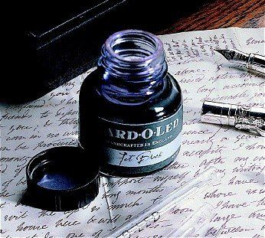
LITERACY FOR LEARNING

Slide 6
LITERACY FOR LEARNING
APPROACH

Slide 7
LITERACY FOR LEARNING
STARTING-POINTS

Slide 8
LITERACY FOR LEARNING

Slide 9
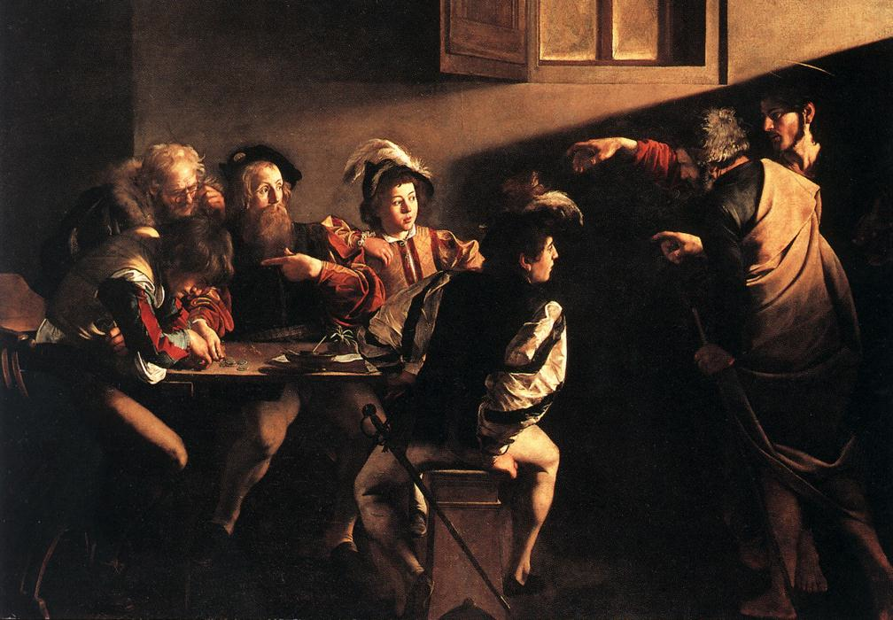

Slide 10
LITERACY FOR LEARNING
“For whosoever hath, to him shall be given and he shall have more abundance: but whosoever hath not, from him shall be taken away even that he hath”.

Slide 11
LITERACY FOR LEARNING
The rich shall get richer and the poor shall get poorer

Slide 12
LITERACY FOR LEARNING
“the word-rich get richer while the word-poor get poorer” in their reading skills

Slide 13
LITERACY FOR LEARNING
“Students who begin with high verbal aptitudes and find themselves in verbally enriched social environments are at a double advantage.”

Slide 14
LITERACY FOR LEARNING
Poor readers more likely to drop out of school and less likely to find rewarding employment … “good readers may choose friends who also read avidly while poor readers seek friends with whom they share other enjoyments”

Slide 15
LITERACY FOR LEARNING
“While good readers gain new skills very rapidly, and quickly move from learning to read to reading to learn, poor readers become increasingly frustrated with the act of reading, and try to avoid reading where possible”

Slide 16
LITERACY FOR LEARNING
“While good readers gain new skills very rapidly, and quickly move from learning to read to reading to learn, poor readers become increasingly frustrated with the act of reading, and try to avoid reading where possible”

Slide 17
LITERACY FOR LEARNING
Antonio Gramsci, Italian Marxist thinker:
“Each generation educates the new generation”

Slide 18
LITERACY FOR LEARNING
GK Chesterton:
“Education is simply the soul of society as it passes from one generation to another”

Slide 19
LITERACY FOR LEARNING
“Pedagogy is fixated on learning styles but is devoid of interest in the knowledge to be learned”

Slide 20
LITERACY FOR LEARNING
The knowledge that children gain through traditional subjects “is no more outdated today than it was 100 or 200 years ago”

Slide 21
LITERACY FOR LEARNING
Bactock: academic subjects have “evolved as they have simply because they have proved to be the most economical and lucid ways of handling the undifferentiated mass of phenomena we experience in the natural and social worlds around us …”

Slide 22
LITERACY FOR LEARNING
“Children are much more likely to grasp the insights of different subjects if they have a firm grounding in core academic disciplines”

Slide 23
LITERACY FOR LEARNING
Gramsci:
“Education is the struggle against folklore”
Furedi:
“Bestowing an educational value on people’s street knowledge does not help them to deal with social and economic disadvantage”

Slide 24
LITERACY FOR LEARNING
Stricht’s Law: “reading ability in children cannot exceed their listening ability …”

Slide 25
LITERACY FOR LEARNING
“The children who possess intellectual capital when they first arrive at school have the mental scaffolding and Velcro to catch hold of what is going on, and they can turn the new knowledge into still more Velcro to gain still more knowledge”.

Slide 26
LITERACY FOR LEARNING
LITERACY

Slide 27
LITERACY FOR LEARNING
Whole-school literacy has an impact when …
Senior managers are actively involved in the planning and monitoring
Audits and action planning are rigorous
Monitoring focuses on a range of approaches, e.g. classroom observation, work scrutiny as well as formal tests
Time is given to training, its dissemination and embedding
Schools work to identified priorities.

Slide 28
LITERACY FOR LEARNING
Whole-school literacy has an impact when …
Literacy skills are taught consistently and systematically across the curriculum
Expectation of standards of accuracy and presentation are similar in all classrooms
Teachers are equipped to deal with literacy issues in their subject both generically and specifically
The same strategies are used across the school: the teaching sequence for writing; active reading strategies; planning speaking and listening for learning
Teachers use the same terminology to describe language.
National Strategies

Slide 29
LITERACY FOR LEARNING
What we know about … vocabulary
Aged 7: children in the top quartile have 7100 words; children in the lowest have around 3000. The main influence in parents.
Using and explaining high-level words is a key to expanding vocabulary. A low vocabulary has a negative effect throughout schooling.
Declining reading comprehension from 8 onwards is largely a result of low vocabulary. Vocabulary aged 6 accounts for 30% of reading variance aged 16.
Vocabulary is built via reading to children, getting children to read themselves, engaging in rich oral language, encouraging reading and talking at home
In the classroom: defining and explaining word meanings, arranging frequent encounters with new words in different contexts, creating a word-rich environment, addressing vocabulary learning explicitly, selecting appropriate words for systematic instruction/reinforcement, teaching word-learning strategies
DfE

Slide 30
LITERACY FOR LEARNING
What we know about … the importance of talk
“Spoken language forms a constraint, a ceiling not only on the ability to comprehend but also on the ability to write, beyond which literacy cannot progress”
Myhill & Fisher
Cited in Ofsted English Report 2005

Slide 31
LITERACY FOR LEARNING
What we know about … talk in the classroom
Teachers are very aware that some children lack experience and skills in using talk for thinking.
However, most teachers do not expressly teach children to become better at using talk for reasoning, discussing and solving problems.
If they ‘teach talk’, teachers tend to focus on developing good ‘presentational talk’, not good ‘exploratory talk’.
It is still largely dominated by teachers’ closed questions and students’ brief attempts at ‘right answers’.
Neil Mercer, University of Cambridge

Slide 32
LITERACY FOR LEARNING

Slide 33
LITERACY FOR LEARNING
What we know about … students who make slow progress …
Characteristics: 2/3 boys. Generally well-behaved. Positive in outlook. “Invisible” to teachers. Keen to respond but unlikely to think first. Persevere with tasks, especially with tasks that are routine. Lack self-help strategies. Stoical, patient, resigned.
Reading: they over-rely on a limited range of strategies and lack higher order reading skills
Writing: struggle to combine different skills simultaneously. Don’t get much chance for oral rehearsal, guided writing, precise feedback
S&L: don’t see it as a key tool in thinking and writing
Targets: set low-level targets; overstate functional skills; infrequently review progress
DfE

Slide 35
Understand the significance of exploratory talk
Model good talk – eg connectives
Re-think questioning: why & how?
Re-think hands-up
Get conversations into the school culture

Slide 36
Teach reading – scanning, skimming, analysis
Read aloud and display
Teach key vocabulary
Demystify spelling
Teach research, not FOFO

Slide 37
SKIMMING

Slide 38
The climate of the Earth is always changing. In the past it has altered as a result of natural causes. Nowadays, however, the term climate change is generally used when referring to changes in our climate which have been identified since the early part of the 1900's . The changes we've seen over recent years and those which are predicted over the next 80 years are thought to be mainly as a result of human behaviour rather than due to natural changes in the atmosphere.

Slide 39
The best treatment for mouth ulcers. Gargle with salt water. You should find that it works a treat. Salt is cheap and easy to get hold of and we all have it at home, so no need to splash out and spend lots of money on expensive mouth ulcer creams.

Slide 40
Urquhart castle is probably one of the most picturesquely situated castles in the Scottish Highlands. Located 16 miles south-west of Inverness, the castle, one of the largest in Scotland, overlooks much of Loch Ness. Visitors come to stroll through the ruins of the 13th-century castle because Urquhart has earned the reputation of being one of the best spots for sighting Loch Ness’s most famous inhabitant.

Slide 41
SCANNING

Slide 42
Where did the first cell phones begin?
Name 2 other features that started to be included in phones
Why are cell phones especially useful in some countries?

Slide 43
Where begin?
Two features?
Some countries?
Cellular telephones
The first cellular telephone system began operation in Tokyo in 1979, and the first U.S. system began operation in 1983 in Chicago. A camera phone is a cellular phone that also has picture taking capabilities. Some camera phones have the capability to send these photos to another cellular phone or computer. Advances in digital technology and microelectronics has led to the inclusion of unrelated applications in cellular telephones, such as alarm clocks, calculators, Internet browsers, and voice memos for recording short verbal reminders, while at the same time making such telephones vulnerable to certain software viruses. In many countries with inadequate wire-based telephone networks, cellular telephone systems have provided a means of more quickly establishing a national telecommunications network.

Slide 44
CLOSE READING

Slide 45
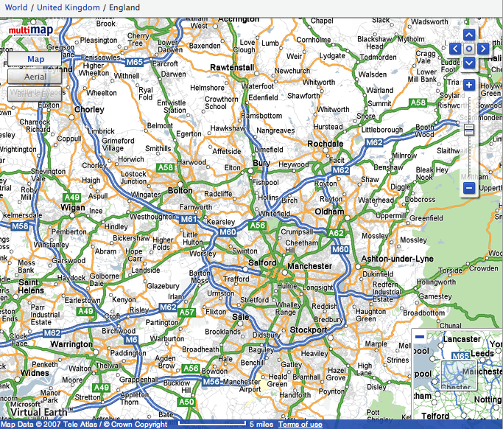

Slide 46
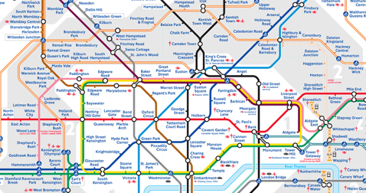
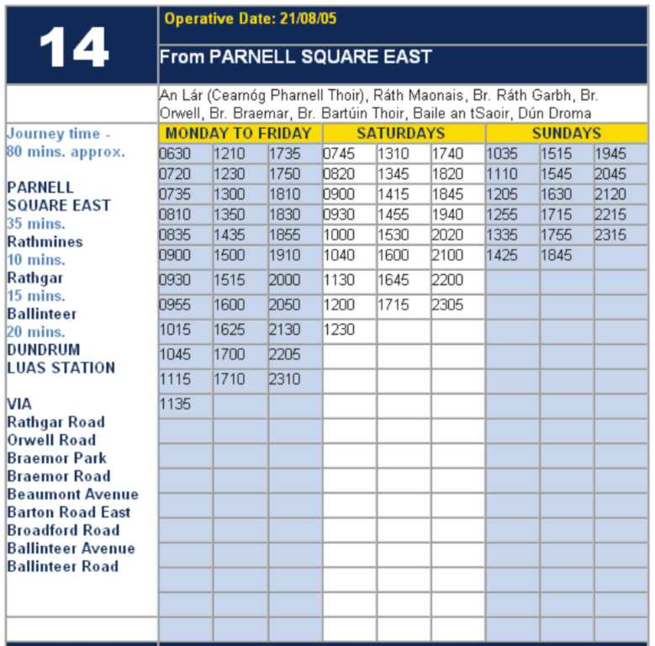
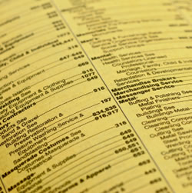

Slide 47
Research skills, not FOFO

Slide 48
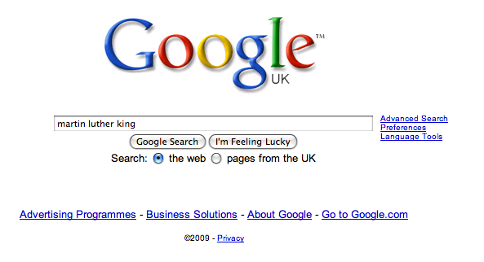

Slide 55
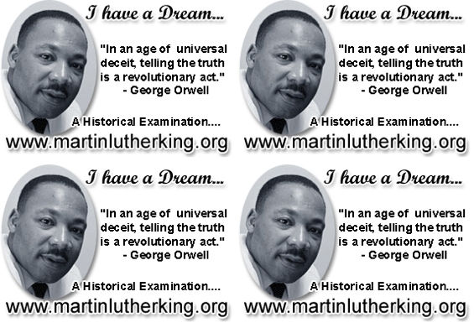

Slide 56
Demonstrate writing
Teach composition & conventions
Allow oral rehearsal
Short & long sentences
Connectives

Slide 57
Know your connectives
Adding: and, also, as well as, moreover, too
Cause & effect: because, so, therefore, thus, consequently
Sequencing: next, then, first, finally, meanwhile, before, after
Qualifying: however, although, unless, except, if, as long as, apart from, yet
Emphasising: above all, in particular, especially, significantly, indeed, notably
Illustrating: for example, such as, for instance, as revealed by, in the case of
Comparing: equally, in the same way, similarly, likewise, as with, like
Contrasting: whereas, instead of, alternatively, otherwise, unlike, on the other hand

Slide 58
LITERACY FOR LEARNING
CREATING A LITERACY CULTURE

Slide 59
Have core skills for all staff and build into school systems
Demystify spelling and build word power
Get consistency in handouts and displays
Focus on library and tutor time to build reading communities
Celebrate curiosity and expertise

Slide 60
LITERACY FOR LEARNING
Demystify Spelling

Slide 61
1 - SOUNDS

Slide 62
Govern+ment

Slide 63
2 -VISUALS

Slide 64
Se-para-te
Be-lie-ve

Slide 65
3 - MNEMONICS

Slide 66
necessary

Slide 67
LITERACY FOR LEARNING
BUILD WORD POWER

Slide 68
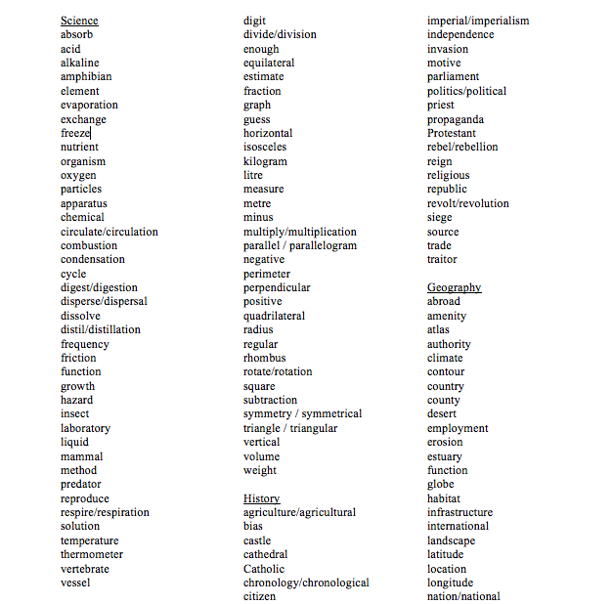

Slide 69
LITERACY FOR LEARNING
IMPROVE HANDOUTS

Slide 70
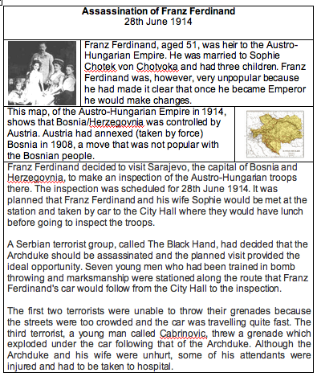

Slide 71
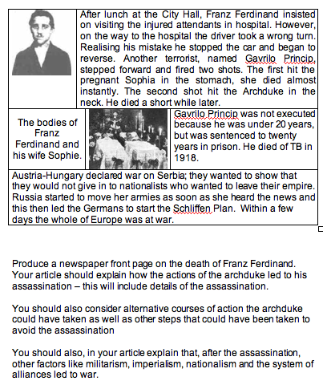

Slide 72
3 Highlight key words
1 Mention big picture / purpose
2 Flag first task in advance
4 Add more visuals

Slide 73
5 Use small-scale questions to build comprehension
7 Provide sentence starters / connectives
6 Give guidance on the style and conventions of the writing task
8 Give some indication of how the task will be assessed

Slide 74
LITERACY FOR LEARNING
Build literacy into school systems

Slide 76
LITERACY FOR LEARNING
SUMMARY

Slide 77
LITERACY FOR LEARNING
Handouts
In class
A Literacy Culture
Reading for Pleasure
Around the classroom

Slide 78
LITERACY FOR LEARNING
Geoff Barton
Head, King Edward VI School, Bury St Edmunds
Thursday, July 1, 2010
Download this presentation at www.geoffbarton.uk
Teacher Resources page: download number 77

