Slide 1
English GCSE: C or higher – guaranteed!

Slide 2
Hello.

Slide 3
Getting a C in English is easier than you think

Slide 4
Today

Slide 5
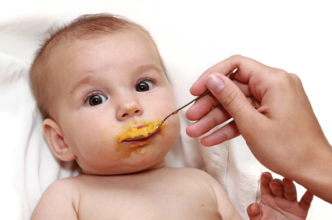
x

Slide 6
What

Slide 7
How

Slide 8
2

Slide 9
1 – Listen
2 - Practise

Slide 10
Visualise what success will feel like

Slide 12
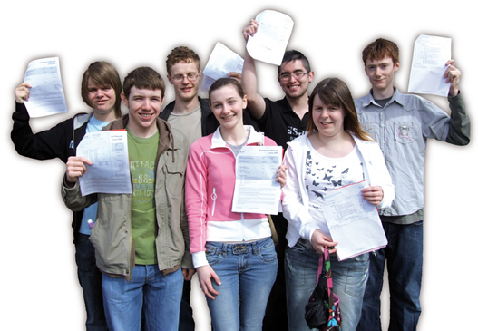

Slide 14
What

Slide 15
How

Slide 16
What

Slide 17
English -v-
English Literature

Slide 18
PAPER 1

Slide 19
1:
Reading non-fiction:
understand / presentation / language
Writing to argue / persuade / advise

Slide 21
Read

Slide 22
Write

Slide 23
Foundation

Slide 24
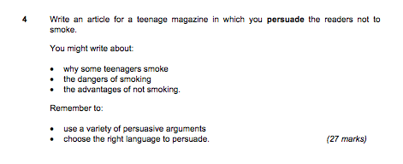

Slide 25
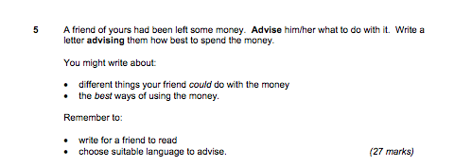

Slide 26
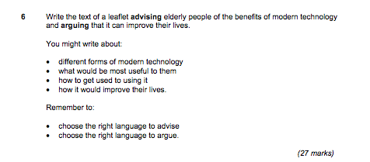

Slide 27
Higher

Slide 31
PAPER 2

Slide 32
2:
Reading poetry
Writing to inform / explain / describe

Slide 33
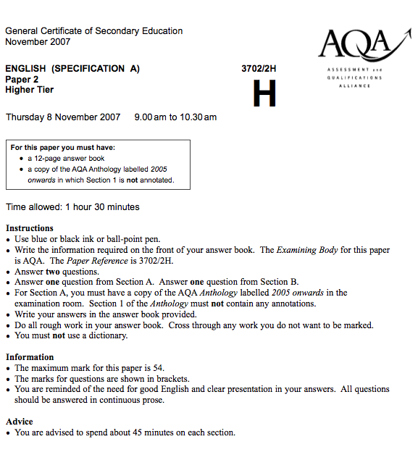

Slide 34
Foundation

Slide 35
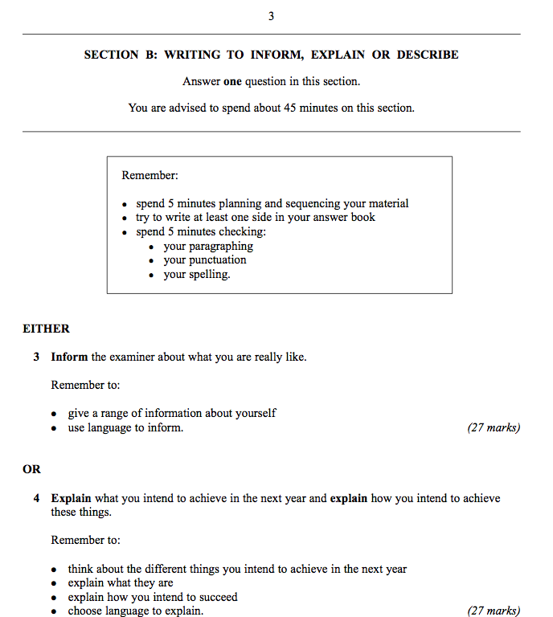

Slide 36
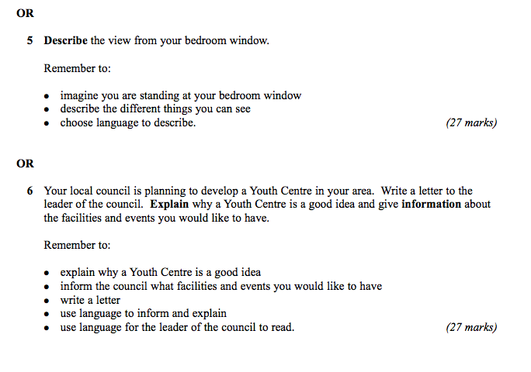

Slide 37
Higher

Slide 38
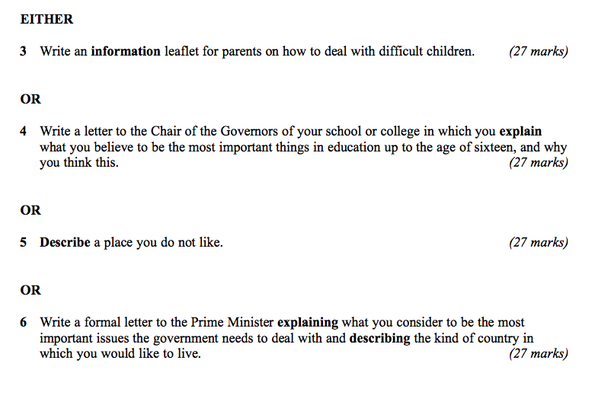

Slide 39
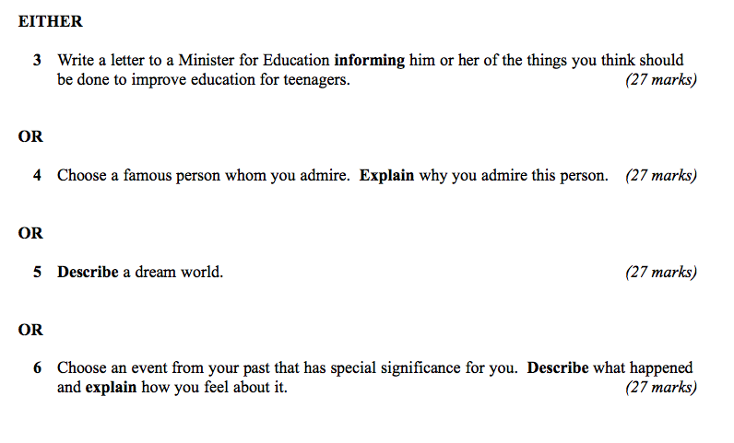

Slide 40
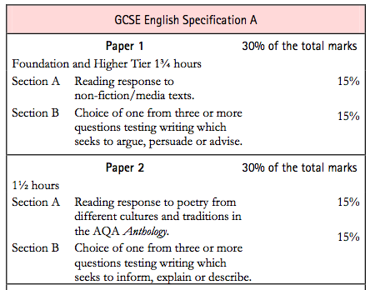

Slide 41
Today:
Write better
Plan better
Spell better

Slide 42
What

Slide 43
How

Slide 45
Describe the room you are in

Slide 47
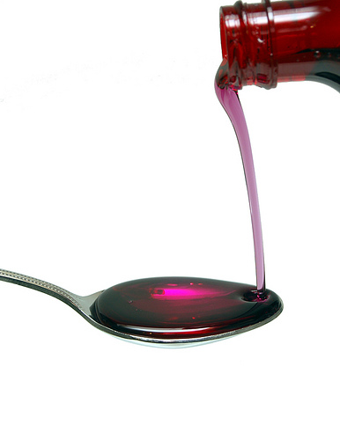

Slide 48
3

Slide 49
1: You find it hard to come up with ideas / to get started / to keep going …
2: You’re not very confident about writing accurately / being interesting
3: You’re not sure how to revise for English /you lack concentration …

Slide 50
1: How to write better

Slide 51
Make your sentences shorter: 12 words.
Make some much shorter: 3 – 5 words.
Use “and” less
Join some sentences with “that”, “who”, “which”
Write some 2 part sentences starting with “As …, …”, “Although …, …”, “When …, …”

Slide 52
2: How to plan better

Slide 53
Choose the right question: description and letters are most straightforward
Do a spider diagram of ideas, then number them 5-7 for paragraphing
Use:
Vivid description
Dialogue
Questions
Then & now
For & against

Slide 54
3: How to prepare

Slide 55
Read and write stuff
Hide your spelling weaknesses
Learn vocabulary (eg “suggest”)
Trick the examiner
Trick your brain

Slide 56
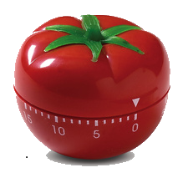
25 mins
+5 mins
Pomodoro Technique

Slide 57
Practise …

Slide 58
Describe a person you admire

Slide 59
Write a letter to your headteacher asking for more PE and sport

Slide 60
Spelling is not about intelligence

Slide 61
Spelling is not about intelligence

Slide 62
1: You’re better at spelling than you think

Slide 63
2: People judge us by appearances

Slide 64
3: A small number of words make a big difference

Slide 65
4: There are 3 easy ways to improve your spelling

Slide 66
5: Stop thinking that spelling is linked to intelligence

Slide 67
Spelling is not about intelligence
Test

Slide 68
Spelling is not about intelligence
3

Slide 69
See

Slide 70
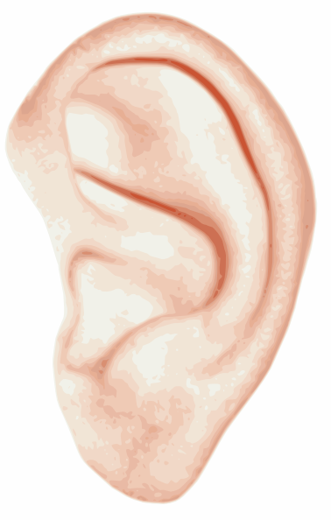
Hear

Slide 71
Memorise

Slide 72
See

Slide 73
1: Be-lie-ve

Slide 74
2: Bu-sin-ess

Slide 75
3: Se-para-te

Slide 76
4: Envi-ron-ment

Slide 77
Hear

Slide 78
5: Govern+ment

Slide 79
6: Feb-RU-ary

Slide 80
7: Happen+ed

Slide 81
8: Sur+prise

Slide 82
9: Interesting

Slide 83
Memorise

Slide 84
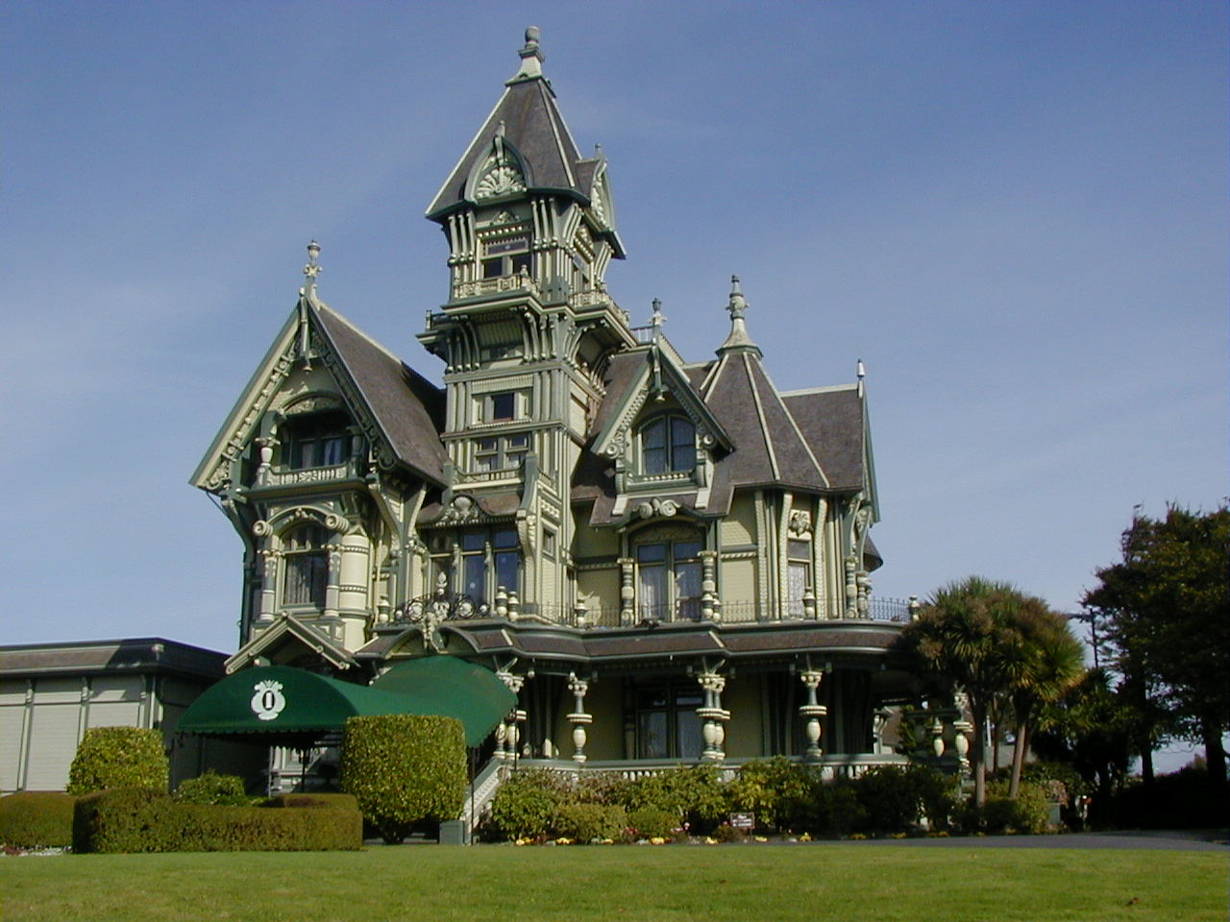
10: Accommodation

Slide 85
11: Skilful

Slide 86
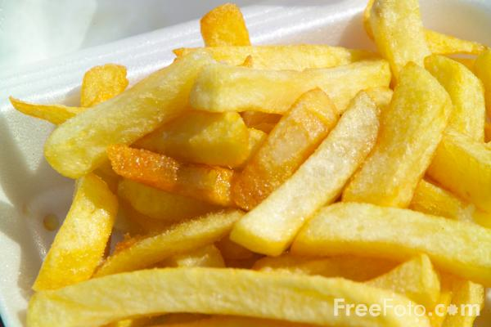
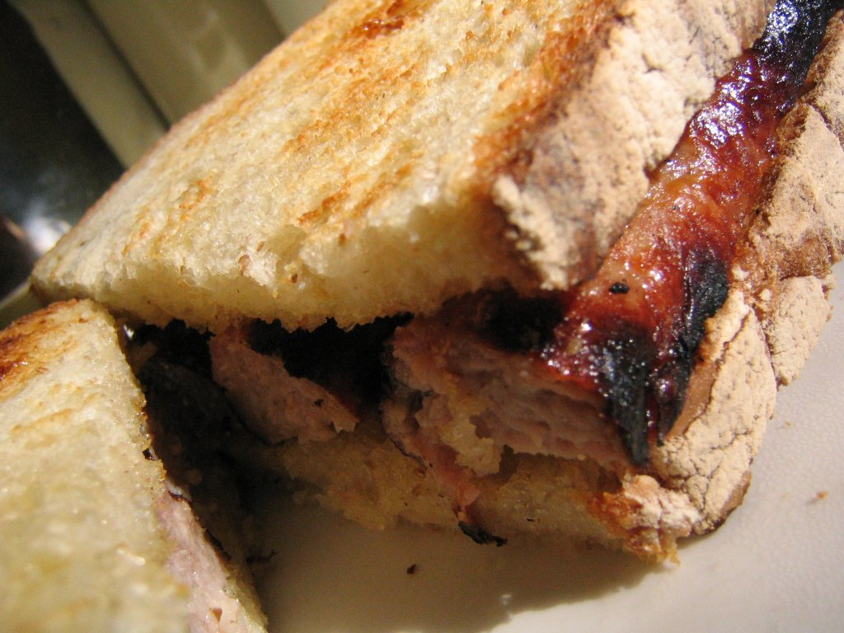
12: Necessary

Slide 87
Spelling is not about intelligence
Test

Slide 88
English GCSE: Grade C – guaranteed!
www.geoffbarton.co.uk

Slide 89
So what have we learned …?

Slide 90
www.geoffbarton.co.uk

Slide 91
English GCSE: Grade C – guaranteed!
www.geoffbarton.co.uk

Slide 92
GOOD LUCK!
www.geoffbarton.co.uk

