Slide 1
Leading Whole-School iteracy: The Essentials
Geoff Barton
General Secretary
Association of School and College Leaders
Twitter @RealGeoffBarton
Download this presentation free at www.geoffbarton.co.uk (number 155)

Slide 2
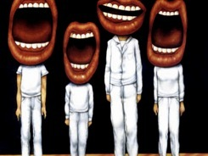
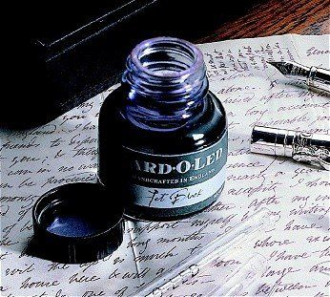

Slide 3
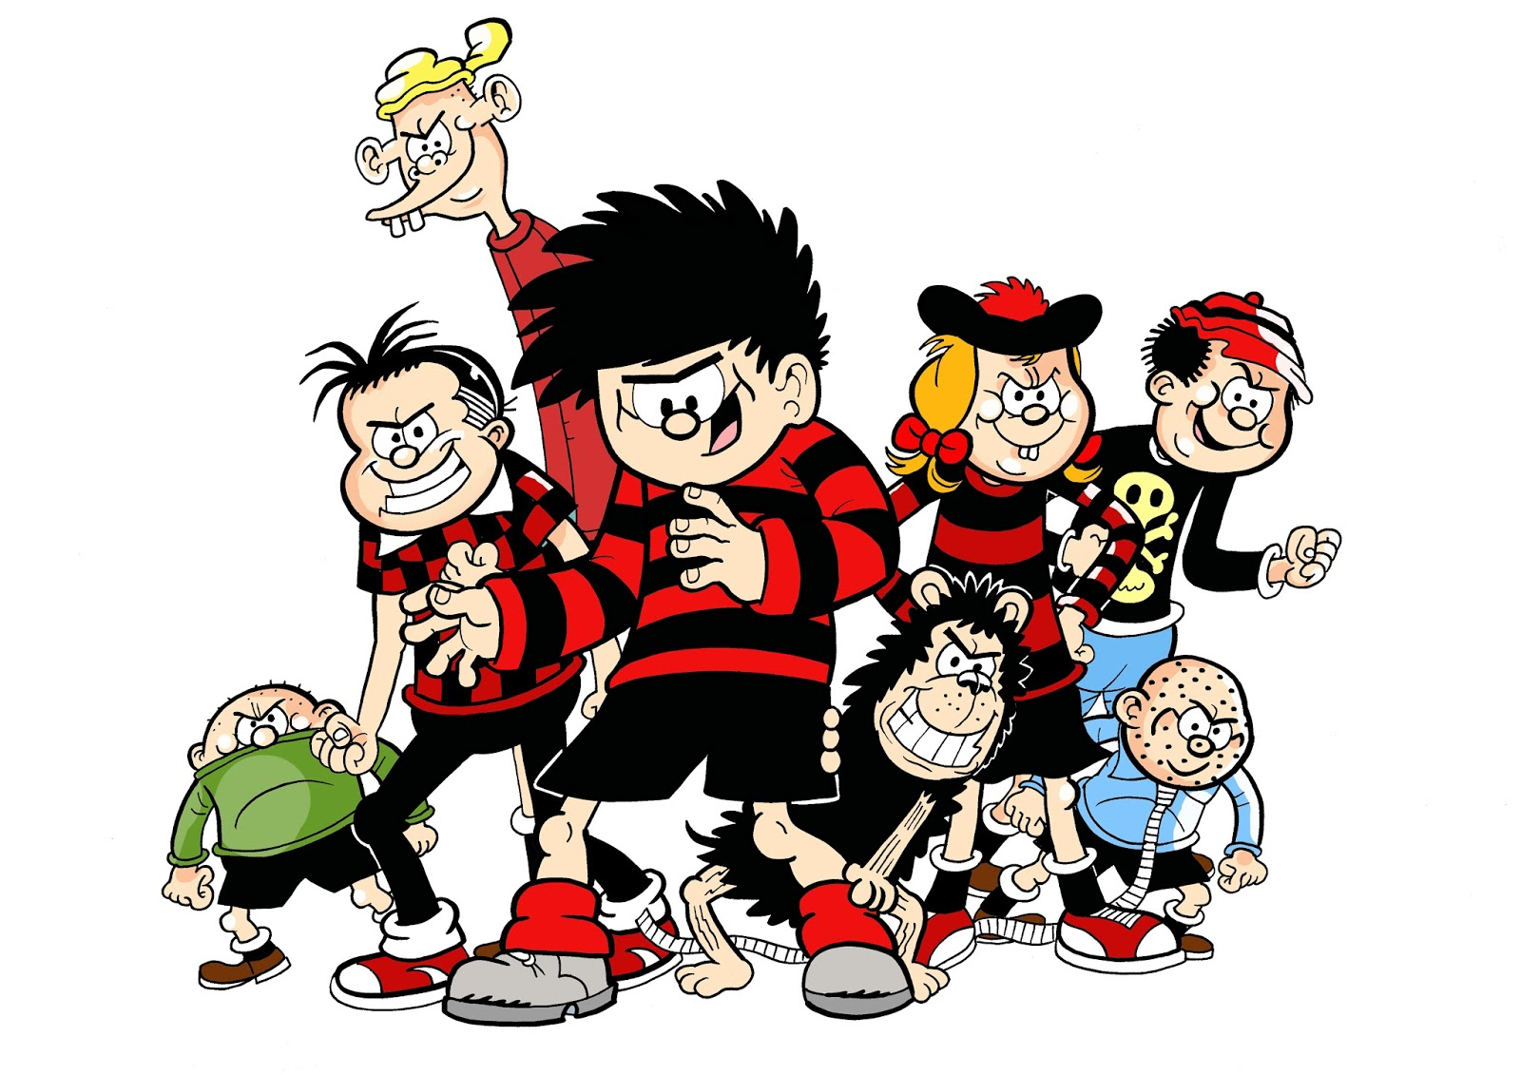

Slide 4
“Not all readers are leaders, but all leaders are readers”
Harry Truman
Harry Truman

Slide 5
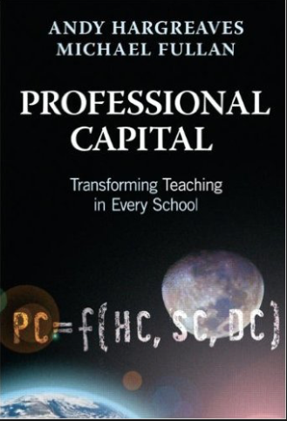
8
‘Better leaders produce better teachers’

Slide 6
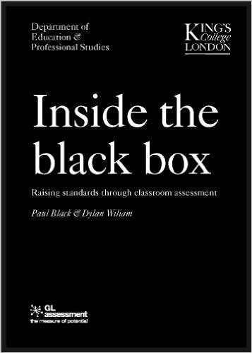
2
‘Standards are raised ONLY by changes which are put into direct effect by teachers and pupils in classrooms’
Dylan Wiliam and Paul Black

Slide 7
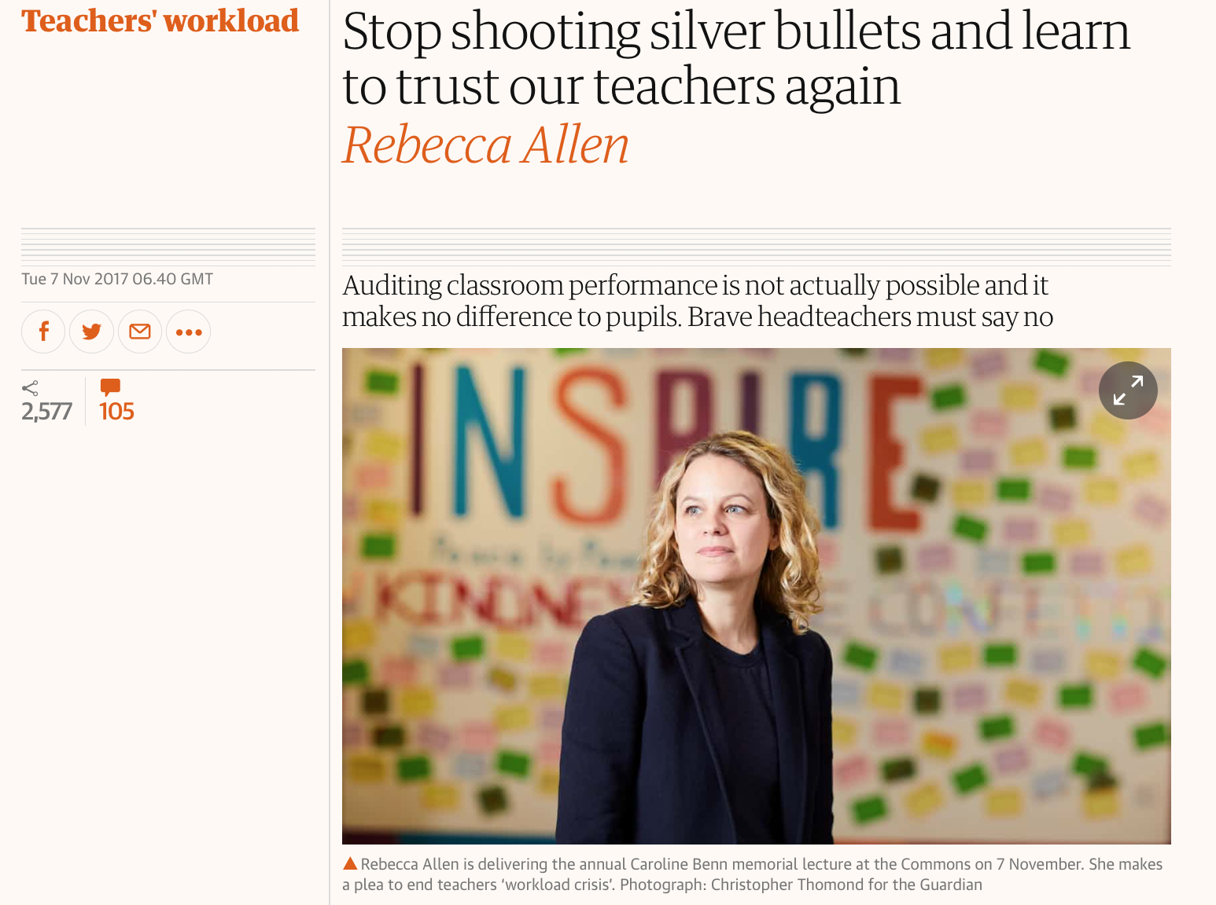

Slide 8
‘Teaching has always been a demanding job. But over the past 15 years, there has been one significant change.
Today, teaching is no longer a private endeavour that takes place in a classroom. Now teachers are required to create a paper trail that proves learning has happened, for people who were not present in the room at the time.
This audit culture means that, in many schools, the teacher no longer is able to decide how to prepare and deliver lessons, mark pupils’ work, and assess and record learning.’

Slide 9
1

Slide 10
1

Slide 11
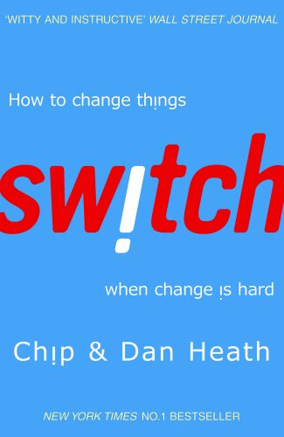
7
All change is making people behave differently
What looks like resistance can be lack of clarity
Importance of “bright spots” - showcasing positive examples

Slide 12
9
In my experience, teaching is about sensitivity and adaptation. Things that work one day may not work the next day.
In order to navigate the complexity of the circumstances in which a teacher works, it is not possible just to follow a recipe. As a teacher, you make adaptations. You must.

Slide 13
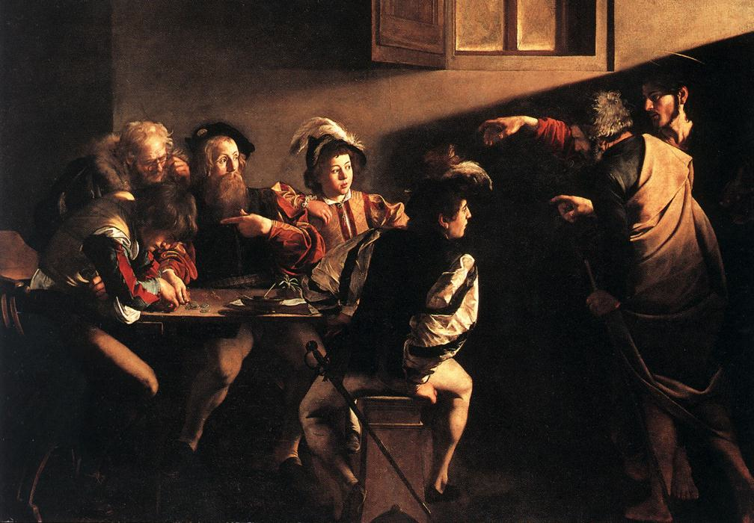

Slide 15
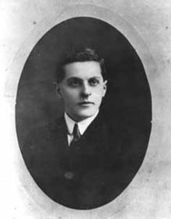
“The limits of my language mean the limits of my world”
Ludwig Wittgenstein

Slide 16
“The word-rich get richer while the word-poor get poorer” in their reading skills
(CASL)

Slide 17
“While good readers gain new skills very rapidly, and quickly move from learning to read to reading to learn, poor readers become increasingly frustrated with the act of reading, and try to avoid reading where possible”
The Matthew Effect
Daniel Rigney

Slide 18
“Students who begin with high verbal aptitudes find themselves in verbally enriched social environments and have a double advantage.”
The Matthew Effect
Daniel Rigney

Slide 19
“Good readers may choose friends who also read avidly while poor readers seek friends with whom they share other enjoyments”
The Matthew Effect
Daniel Rigney

Slide 20
Sticht’s Law: “reading ability in children cannot exceed their listening ability …”
E.D. Hirsch
The Schools We Need

Slide 21
“Spoken language forms a constraint, a ceiling not only on the ability to comprehend but also on the ability to write, beyond which literacy cannot progress”
Myhill and Fisher

Slide 23
Understand the significance of exploratory talk
Model good talk – eg connectives & whole-sentence responses
Re-think questioning – ‘why & how’, thinking time, and less commentary
Consciously vary groupings
Get conversation into the school culture

Slide 24
Teach reading – scanning, skimming, analysis
Read aloud and display
Teach key vocabulary
Demystify spelling
Teach research

Slide 25
SKIMMING

Slide 26
The climate of the Earth is always changing. In the past it has altered as a result of natural causes. Nowadays, however, the term climate change is generally used when referring to changes in our climate which have been identified since the early part of the 1900's . The changes we've seen over recent years and those which are predicted over the next 80 years are thought to be mainly as a result of human behaviour rather than due to natural changes in the atmosphere.

Slide 27
The best treatment for mouth ulcers. Gargle with salt water. You should find that it works a treat. Salt is cheap and easy to get hold of and we all have it at home, so no need to splash out and spend lots of money on expensive mouth ulcer creams.

Slide 28
Lexical v Grammatical Words

Slide 29
Urquhart castle is probably one of the most picturesquely situated castles in the Scottish Highlands. Located 16 miles south-west of Inverness, the castle, one of the largest in Scotland, overlooks much of Loch Ness. Visitors come to stroll through the ruins of the 13th-century castle because Urquhart has earned the reputation of being one of the best spots for sighting Loch Ness’s most famous inhabitant.

Slide 30
Urquhart castle is probably one of the most picturesquely situated castles in the Scottish Highlands. Located 16 miles south-west of Inverness, the castle, one of the largest in Scotland, overlooks much of Loch Ness. Visitors come to stroll through the ruins of the 13th-century castle because Urquhart has earned the reputation of being one of the best spots for sighting Loch Ness’s most famous inhabitant.

Slide 31
Urquhart castle is probably one of the most picturesquely situated castles in the Scottish Highlands. Located 16 miles south-west of Inverness, the castle, one of the largest in Scotland, overlooks much of Loch Ness. Visitors come to stroll through the ruins of the 13th-century castle because Urquhart has earned the reputation of being one of the best spots for sighting Loch Ness’s most famous inhabitant.

Slide 32
Urquhart castle is probably one of the most picturesquely situated castles in the Scottish Highlands. Located 16 miles south-west of Inverness, the castle, one of the largest in Scotland, overlooks much of Loch Ness. Visitors come to stroll through the ruins of the 13th-century castle because Urquhart has earned the reputation of being one of the best spots for sighting Loch Ness’s most famous inhabitant.

Slide 33
Urquhart castle is probably one of the most picturesquely situated castles in the Scottish Highlands. Located 16 miles south-west of Inverness, the castle, one of the largest in Scotland, overlooks much of Loch Ness. Visitors come to stroll through the ruins of the 13th-century castle because Urquhart has earned the reputation of being one of the best spots for sighting Loch Ness’s most famous inhabitant.

Slide 34
Urquhart castle is probably one of the most picturesquely situated castles in the Scottish Highlands. Located 16 miles south-west of Inverness, the castle, one of the largest in Scotland, overlooks much of Loch Ness. Visitors come to stroll through the ruins of the 13th-century castle because Urquhart has earned the reputation of being one of the best spots for sighting Loch Ness’s most famous inhabitant.

Slide 35
SCANNING

Slide 36
Where did the first cell phones begin?
Name 2 other features that started to be included in phones
Why are cell phones especially useful in some countries?

Slide 37
Where begin?
Two features?
Some countries?
Cellular telephones
The first cellular telephone system began operation in Tokyo in 1979, and the first U.S. system began operation in 1983 in Chicago. A camera phone is a cellular phone that also has picture taking capabilities. Some camera phones have the capability to send these photos to another cellular phone or computer. Advances in digital technology and microelectronics has led to the inclusion of unrelated applications in cellular telephones, such as alarm clocks, calculators, Internet browsers, and voice memos for recording short verbal reminders, while at the same time making such telephones vulnerable to certain software viruses. In many countries with inadequate wire-based telephone networks, cellular telephone systems have provided a means of more quickly establishing a national telecommunications network.

Slide 38
RESEARCH SKILLS

Slide 39
Research the life of
Martin Luther King

Slide 40
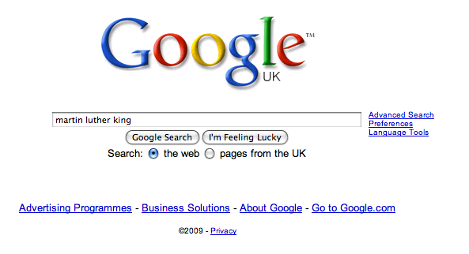

Slide 47
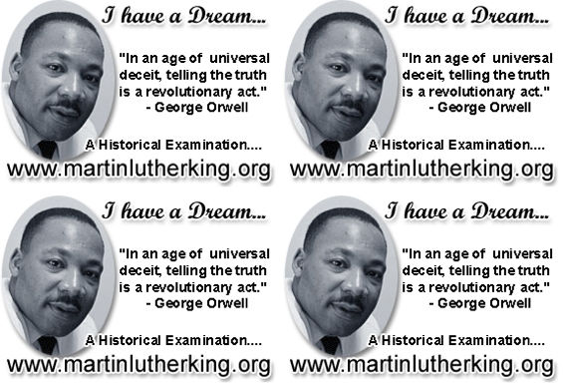

Slide 48
DEMYSTIFYING
SPELLING
3
Notes:
7 spellings: Government – February – parliament – separate – believe – necessary - accommodation

Slide 49
1 - SOUNDS

Slide 50
Government

Slide 51
February

Slide 52
Parliament

Slide 53
2 -VISUALS

Slide 54
Se-para-te
Be-lie-ve

Slide 55
3 - MNEMONICS

Slide 56
necessary

Slide 57
accommodation

Slide 58
Teach reading – scanning, skimming, analysis
Read aloud and display
Teach key vocabulary
Demystify spelling
Teach research

Slide 59
Demonstrate writing
Teach composition & planning
Allow oral rehearsal
Short & long sentences
Connectives

Slide 60
Know your connectives
Adding: and, also, as well as, moreover, too
Cause & effect: because, so, therefore, thus, consequently
Sequencing: next, then, first, finally, meanwhile, before, after
Qualifying: however, although, unless, except, if, as long as, apart from, yet
Emphasising: above all, in particular, especially, significantly, indeed, notably
Illustrating: for example, such as, for instance, as revealed by, in the case of
Comparing: equally, in the same way, similarly, likewise, as with, like
Contrasting: whereas, instead of, alternatively, otherwise, unlike, on the other hand

Slide 61
Demonstrate writing
Teach composition & planning
Allow oral rehearsal
Short & long sentences
Connectives

Slide 62
Leading Whole-School iteracy: The Essentials
Geoff Barton
General Secretary
Association of School and College Leaders
Twitter @RealGeoffBarton
Download this presentation free at www.geoffbarton.co.uk (number 155)

