Slide 1
Literacy Impact:
Maximising KS2 to KS3 Transitions
Geoff Barton,
General Secretary,
Association of School & College Leaders
Download this presentation free at geoffbarton.co.uk/teacher-resources (156)

Slide 2
Literacy

Slide 3
Leadership

Slide 4
The Final Frontier

Slide 5
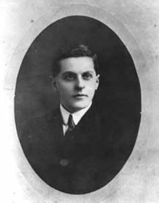
“The limits of my language mean the limits of my world”
Ludwig Wittgenstein

Slide 6
“Not all readers are leaders, but all leaders are readers”
Harry Truman

Slide 7
Five texts

Slide 8
‘As the word-rich get richer, the word-poor get poorer’

Slide 9
‘Better leaders produce better teachers’

Slide 10
Teaching is about sensitivity and adaptation. Things that work one day may not work the next day.
In order to navigate the complexity of the circumstances in which a teacher works, it is not possible just to follow a recipe. As a teacher, you make adaptations. You must.

Slide 11
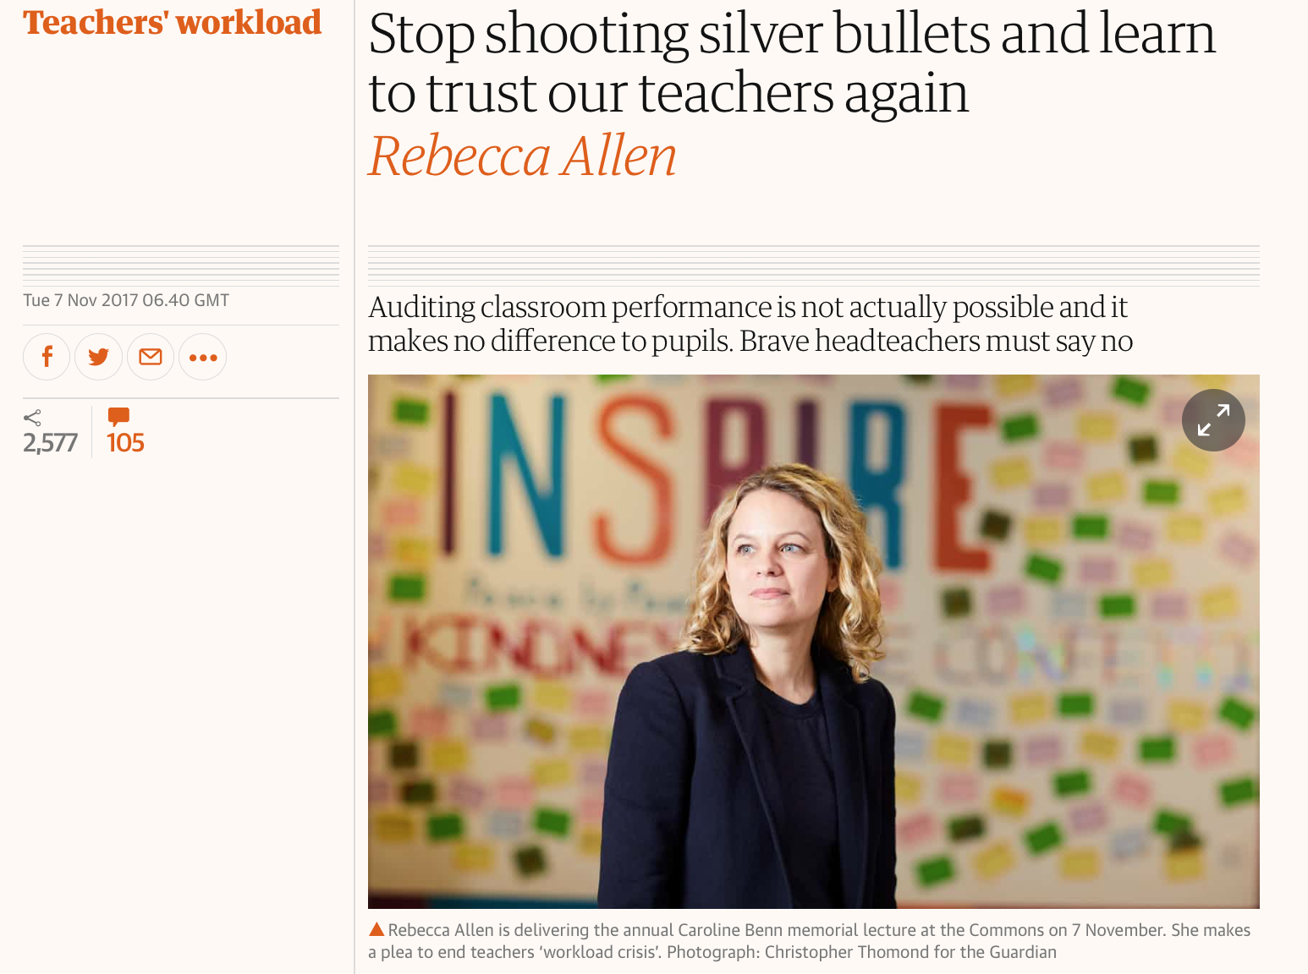

Slide 12
‘Teaching has always been a demanding job. But over the past 15 years, there has been one significant change.
Today, teaching is no longer a private endeavour that takes place in a classroom. Now teachers are required to create a paper trail that proves learning has happened, for people who were not present in the room at the time.
This audit culture means that, in many schools, the teacher no longer is able to decide how to prepare and deliver lessons, mark pupils’ work, and assess and record learning.’

Slide 13
A: ‘Too often the argument for reading is made by those who have spent their lives as insiders; the pleasures of solitary reading are so obvious, the value of reading so self-evident, that we fail to appreciate how utterly strange reading is to the outsider’
B: “I guess people who read all the time must get something out of it that I haven’t experienced”

Slide 14
The Trouble with Transitions

Slide 15
KS2 → KS3
Pupil Teacher

Slide 16
KS4 → Post-16
Pupil Teacher

Slide 17
Post-16 → HE

Slide 18
Common features:
Anxiety
Superiority risk
Accountability silos

Slide 19
The Trouble with Transitions

Slide 20
The Secret of Transitions

Slide 21
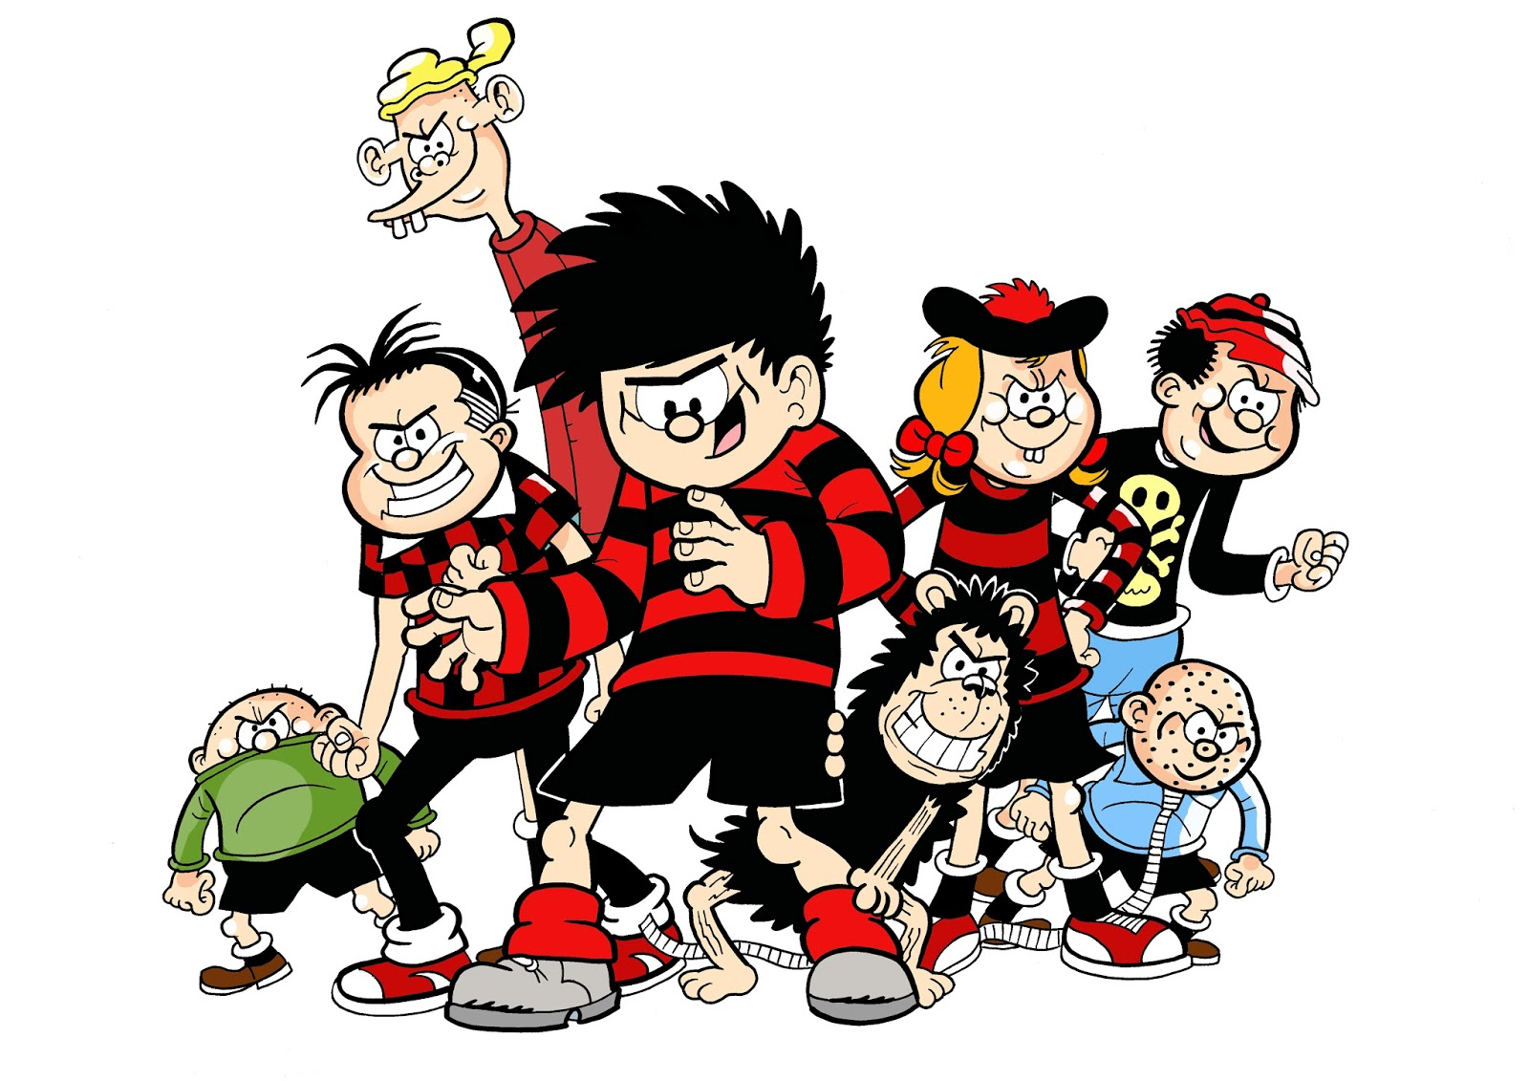

Slide 23
Suggestion:
Around pupils

Slide 24
Tell your story via three pupils

Slide 25
Suggestion:
Around teachers

Slide 26
Choose a key barrier for shared CPD

Slide 27
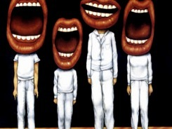

Slide 33
Literacy Impact:
Maximising KS2 to KS3 Transitions
Geoff Barton,
General Secretary,
Association of School & College Leaders
Download this presentation free at geoffbarton.co.uk/teacher-resources (156)

