Slide 1
The Leadership of Learning: Challenges and opportunities
Geoff Barton
General Secretary
Association of School and College Leaders
@RealGeoffBarton
www.geoffbarton.co.uk/teacher-resources (157)

Slide 2
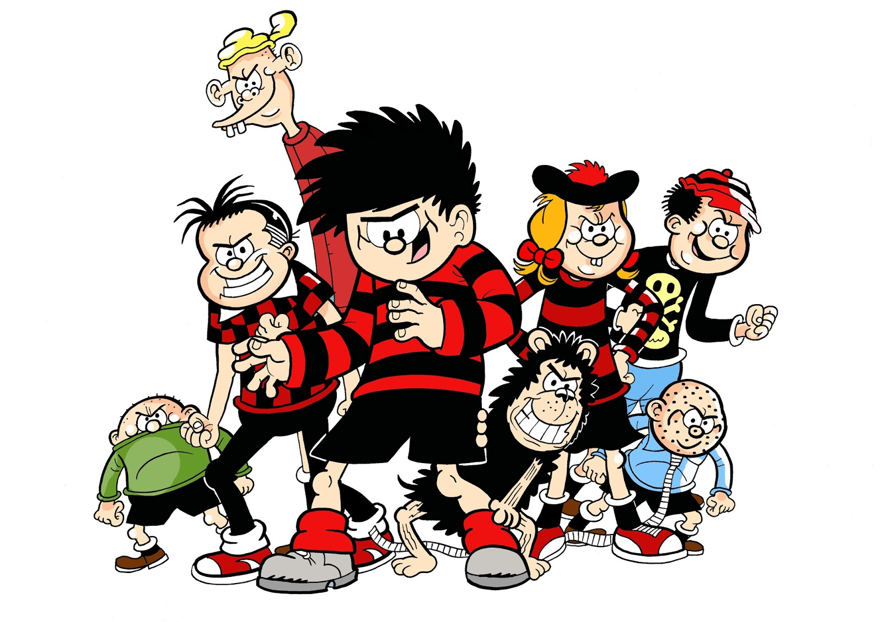

Slide 3
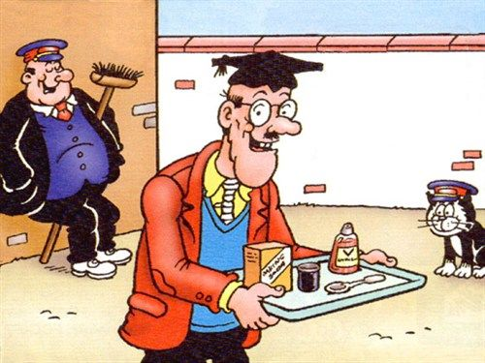

Slide 4
“Not all readers are leaders, but all leaders are readers”
Harry Truman

Slide 5
7 Books

Slide 6
There are a few people who choose to inspire rather than manipulate people. Whether individuals or organisations, every single one of these inspiring leaders thinks, acts and communicates exactly the same way.
Consciously or not, how they do it is by following a naturally occurring patterns that I call The Golden Circle.
1

Slide 7
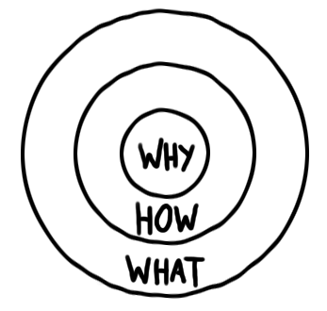
Every single company and organisation on the planet knows WHAT they do. Some companies and people know HOW they do what they do. Very few can clearly articulate WHY they do what they do.

Slide 8
2
‘Standards are raised ONLY by changes which are put into direct effect by teachers and pupils in classrooms’
Dylan Wiliam and Paul Black

Slide 9
3
‘Better leaders produce better teachers’

Slide 10
4
In my experience, teaching is about sensitivity and adaptation. Things that work one day may not work the next day.
In order to navigate the complexity of the circumstances in which a teacher works, it is not possible just to follow a recipe. As a teacher, you make adaptations. You must.

Slide 11
Skill is developed not by practising performances or final tasks, but by practising much narrower and more specific skills …
Chess players don’t practise by playing entire games but by studying decomposed problems and textbook openings and endings. …
Narrow and focused practice is more effective at developing these mental models than broader and more complex practice
5

Slide 12
Teachers face a very steep learning curve after graduation – unlike junior doctors.
90% of school leaders reported that their beginning teachers were given constructive, non-evaluative feedback while only 34% of teachers agreed. Similarly, 82% of school leaders reported providing tailored professional development for beginning teachers, while only 58% of beginning teachers reported receiving this.
6

Slide 13
7
All change is making people behave differently
What looks like resistance can be lack of clarity
Remember the importance of “bright spots” - showcasing positive examples

Slide 14
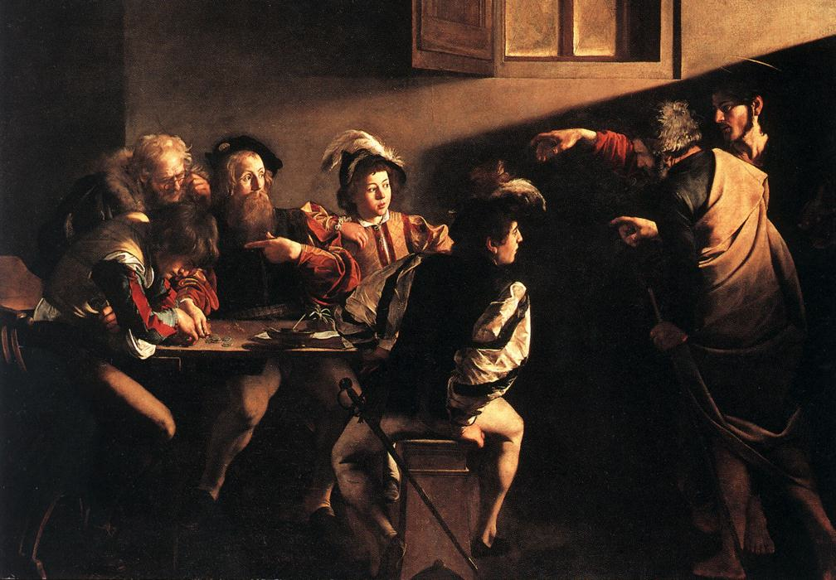

Slide 16
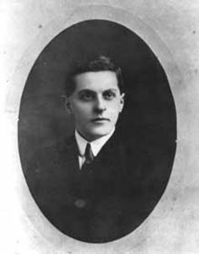
“The limits of my language mean the limits of my world”
Ludwig Wittgenstein

Slide 17
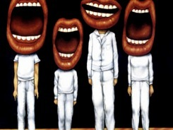
WHAT?
HOW?

Slide 18
Understand the significance of exploratory talk

Slide 19
Teach vocabulary

Slide 20
Demonstrate writing

Slide 21
WHAT?
HOW?

Slide 22
The Leadership of Learning: Challenges and opportunities
Geoff Barton
General Secretary
Association of School and College Leaders
@RealGeoffBarton
www.geoffbarton.co.uk/teacher-resources (157)

