Slide 1
Leadership in English, Maths & Science: Why, How, Who?
Geoff Barton, General Secretary
Association of School & College Leaders
Wednesday, 5 July 2017
Download this presentation at www.geoffbarton.co.uk (Teacher Resources, number 152)

Slide 2
?

Slide 3
“Not all readers are leaders, but all leaders are readers.”
Harry Truman
US President 1945-53

Slide 4
Why & How
... in 10 Texts

Slide 5
1
Your subject
You

Slide 6
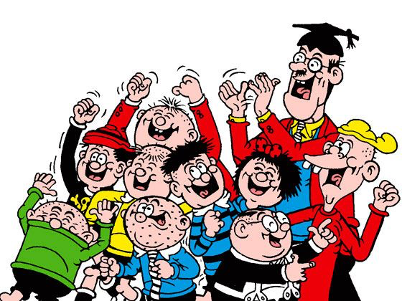

Slide 7
How

Slide 8
2
‘Standards are raised ONLY by changes which are put into direct effect by teachers and pupils in classrooms’

Slide 9
'A bad curriculum well taught is invariably a better experience than a good curriculum badly taught’
Dylan William

Slide 10
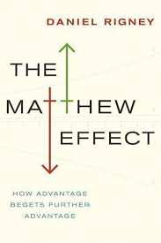
3
Whilst the word rich get richer, the word poor get poorer

Slide 11
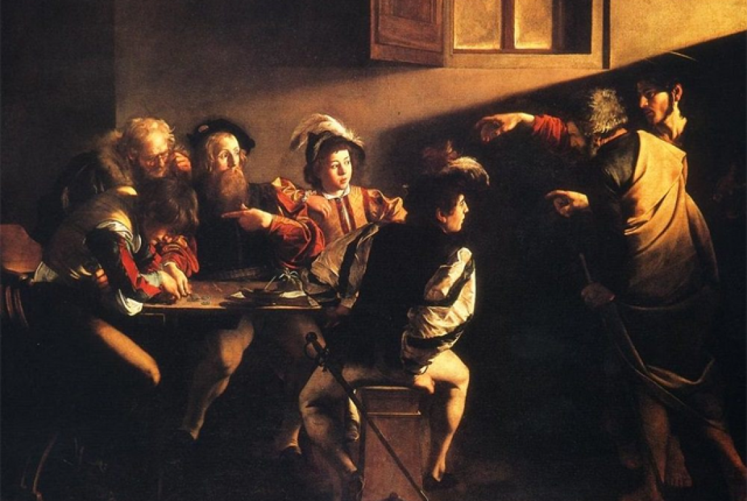

Slide 12
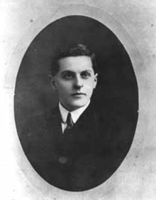
“The limits of my language mean the limits of my world”
Ludwig Wittgenstein

Slide 13
4
“The children who possess intellectual capital when they first arrive at school have the mental scaffolding and Velcro to catch hold of what is going on, and they can turn the new knowledge into still more Velcro to gain still more knowledge”.

Slide 14
5
There can be as much value in the blink of an eye as in months of rational analysis.

Slide 15
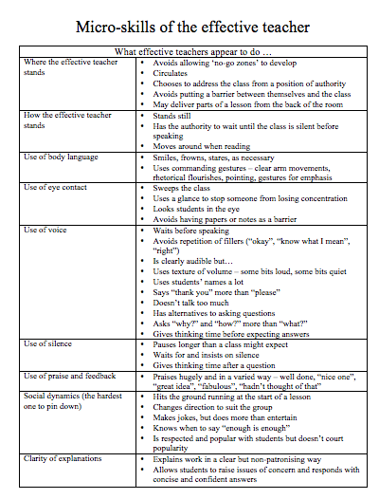

Slide 16
6
Content knowledge (Strong evidence of impact on student outcomes)
Quality of instruction (Strong evidence of impact on student outcomes)
Classroom climate (Moderate evidence of impact on student outcomes)
Classroom management (Moderate evidence of impact on student outcomes)

Slide 17
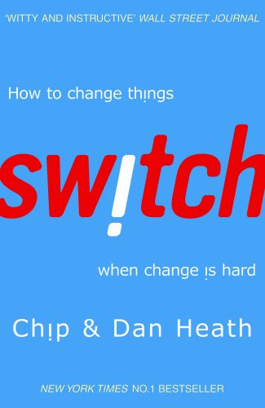
7
All change is making people behave differently
What looks like resistance can be lack of clarity
Importance of “bright spots” - showcasing positive examples
Big problems are often solved with a sequence of small solutions
Intrinsic motivation: make first graders aspire to be third graders

Slide 18
8
‘Better leaders produce better teachers’

Slide 19
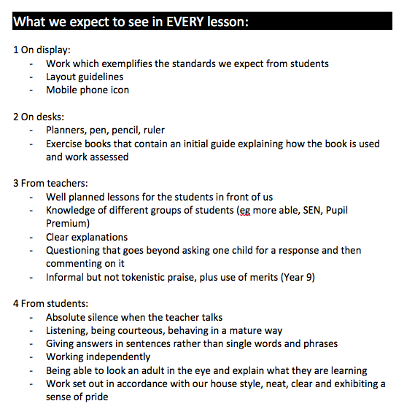

Slide 20
9
In my experience, teaching is about sensitivity and adaptation. Things that work one day may not work the next day.
In order to navigate the complexity of the circumstances in which a teacher works, it is not possible just to follow a recipe. As a teacher, you make adaptations. You must.

Slide 22
Keith Grainger: Spot Coaching
I am left in no doubt that immediate feedback, in the same way that a tennis coach or dance instructor provides, has powerful potential as a professional development tool in teaching. Our recent work has been exhilarating. I hope never to grade a single lesson again.

Slide 23
WHO

Slide 25
Leadership in English, Maths & Science: Why, How, Who?
Geoff Barton, General Secretary
Association of School & College Leaders
Wednesday, 5 July 2017
Download this presentation at www.geoffbarton.co.uk (Teacher Resources, number 152)

Slide 26
10
Brilliant gift idea for family and friends ➔

Slide 27
Leadership in English, Maths & Science: Why, How, Who?
Geoff Barton, General Secretary
Association of School & College Leaders
Wednesday, 5 July 2017
Download this presentation at www.geoffbarton.co.uk (Teacher Resources, number 152)

