Slide 1
Optimistic Leadership in Times of Uncertainty
Geoff Barton & Russell Hobby
#ILConf2017

Slide 2
1 Sticking to your principles and values 2 Telling the story of your school 3 Playing a community leadership role 4 Managing your own wellbeing Q&A
#ILConf2017

Slide 3
Sticking to your principles and values
Spoiler alert:
Questions, not commands
#ILConf2017

Slide 4
Sticking to your principles and values
What do you stand for?
How do you test those values?
Do you read? (the Harry S Truman Test)
What’s distinctive? x 3
How do you see ethical leadership?
So …
#ILConf2017

Slide 5
Sticking to your principles and values
How do people know what you stand for?
#ILConf2017

Slide 6
Sticking to your principles and values
#ILConf2017

Slide 7
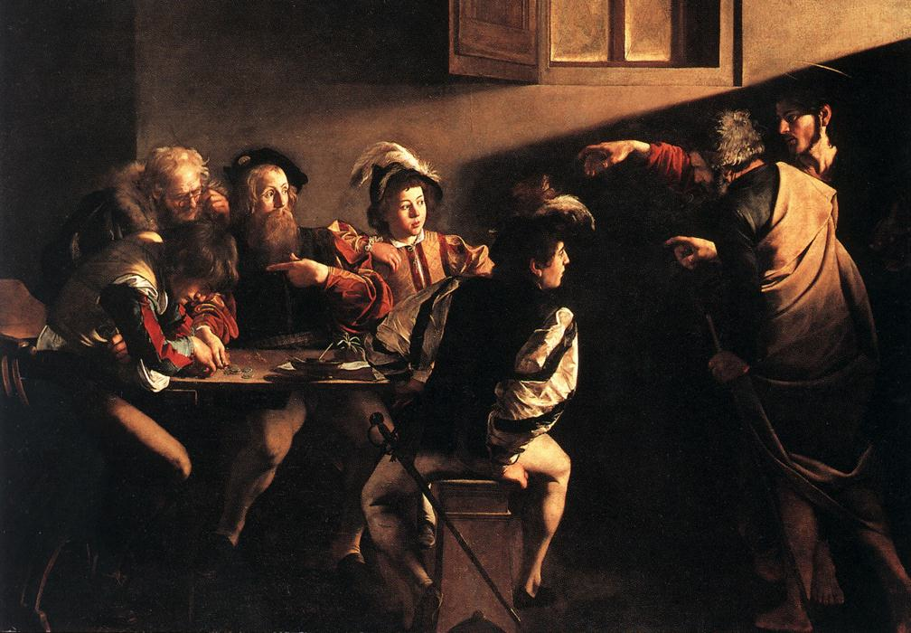

Slide 8
Telling the story of your school
1 The Dunford Principle 2 Blink!: first impressions matter
3 Know your audiences 4 Websites & newsletters & social
media & the press
5 Think distinctiveness. Think stories.
Think pictures
#ILConf2017

Slide 9
1 Sticking to your principles and values 2 Telling the story of your school 3 Playing a community leadership role 4 Managing your own wellbeing Q&A
#ILConf2017

Slide 10
Optimistic Leadership in Times of Uncertainty
Geoff Barton & Russell Hobby
#ILConf2017

