Slide 1

The Habits of Literacy
Geoff Barton,
Head, King Edward VI School
Suffolk
Teachology National Conference
8 November 2016
Twitter: @RealGeoffBarton
Download slides: geoffbarton.co.uk/teacher-resources (number 147)

Slide 2

2

Slide 3

1:

Slide 4
2:
Literacy

Slide 5
WHY
WHAT
HOW

Slide 6
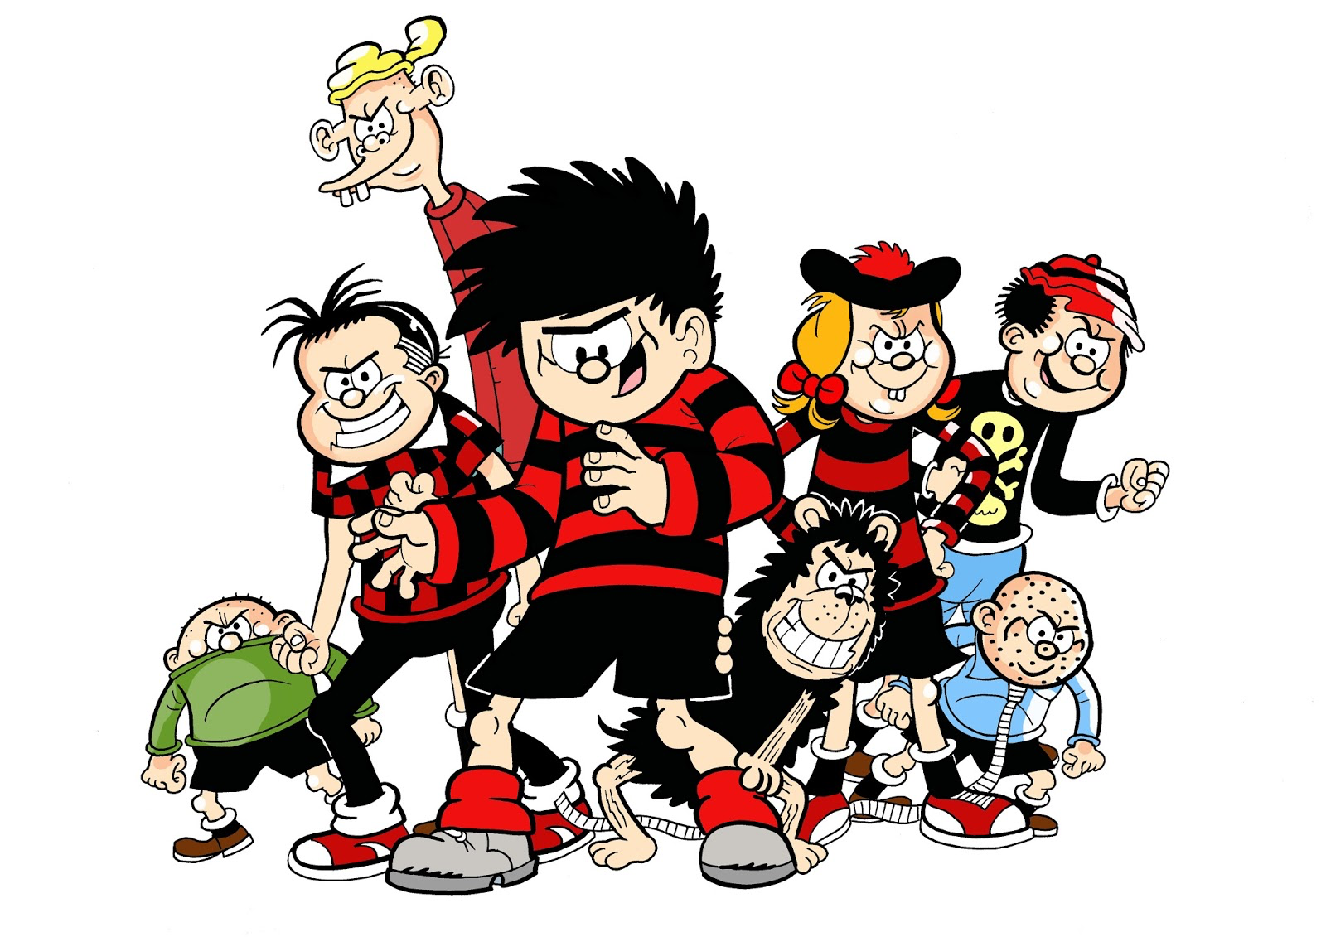

Slide 7
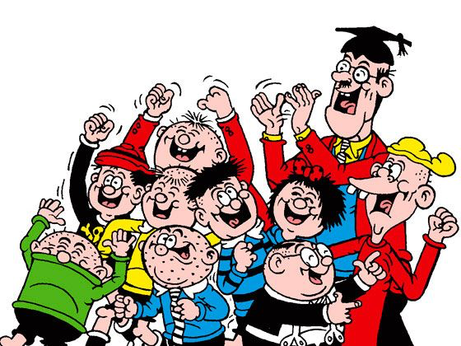

Slide 8
Teaching
Leadership

Slide 9

‘Standards are raised ONLY by changes which are put into direct effect by teachers and pupils in classrooms’

Slide 10
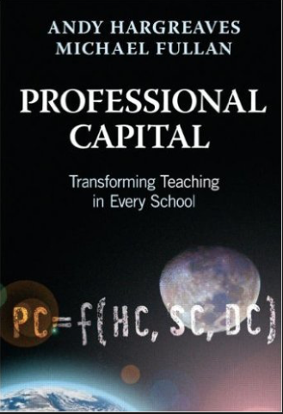
Three-quarters of teachers who demonstrated sustained commitment said that good leadership helped them sustain their commitment over time.
Better leaders produce better teachers.

Slide 11


Slide 12
Arthur L. Costa and Bena Kallick, Habits of Mind

Slide 13
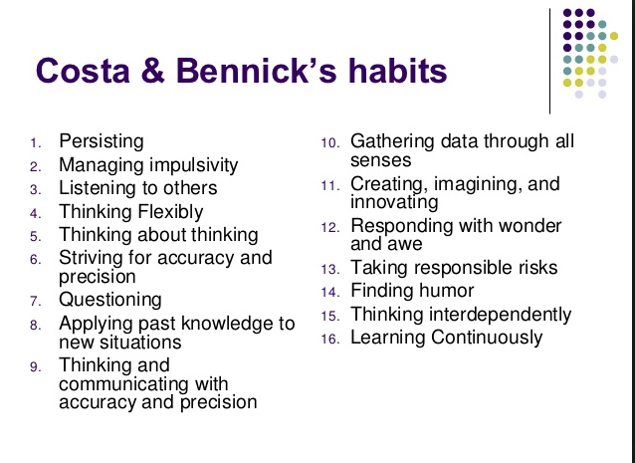

Slide 14
WHY

Slide 15
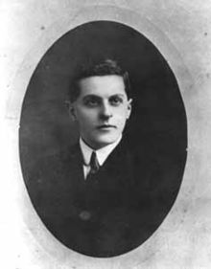
“The limits of my language mean the limits of my world”
Ludwig Wittgenstein

Slide 16

5 texts

Slide 17

‘Habits, scientists say, emerge because the brain is constantly looking for ways to save effort’

Slide 18

In my experience, teaching is about sensitivity and adaptation. Things that work one day may not work the next day.
In order to navigate the complexity of the circumstances in which a teacher works, it is not possible just to follow a recipe. As a teacher, you make adaptations. You must.

Slide 19

‘Too often the argument for reading is made by those who have spent their lives as insiders; the pleasures of solitary reading are so obvious, the value of reading so self-evident, that we fail to appreciate how utterly strange reading is to the outsider’

Slide 20

People who have large vocabularies tend to be intrigued with words.
As such, a major impetus for writing this book is our concern that school vocabulary instruction tends to be dull, rather than of the sort that might instigate student’s interest and awareness of words.
Indeed, asking students to look up words in a dictionary and use them in a sentence is a stereotypical example of what students find uninteresting in school.

Slide 21

Content knowledge (Strong evidence of impact on student outcomes)
Quality of instruction (Strong evidence of impact on student outcomes)
Classroom climate (Moderate evidence of impact on student outcomes)
Classroom management (Moderate evidence of impact on student outcomes)

Slide 23

The Changing Face of Literacy

Slide 24

“The children who possess intellectual capital when they first arrive at school have the mental scaffolding and Velcro to catch hold of what is going on, and they can turn the new knowledge into still more Velcro to gain still more knowledge”.

Slide 25
On Reading:
Teenagers who read books are significantly more likely to end up in a professional job than those who don’t (survey of 17,000 people born in 1970).
Three in 10 young people aged 8 to 17 love in households without any books (Indy, in the Week, 11/6/11)
Studies also show that reading a variety of literature independently by the age of 15 is the single biggest indicator of future success, outweighing negative factors such as socioeconomic background or family situation. NLT April 2011
One in three children in UK does not own a book. NLT April 2011

Slide 26


Slide 27
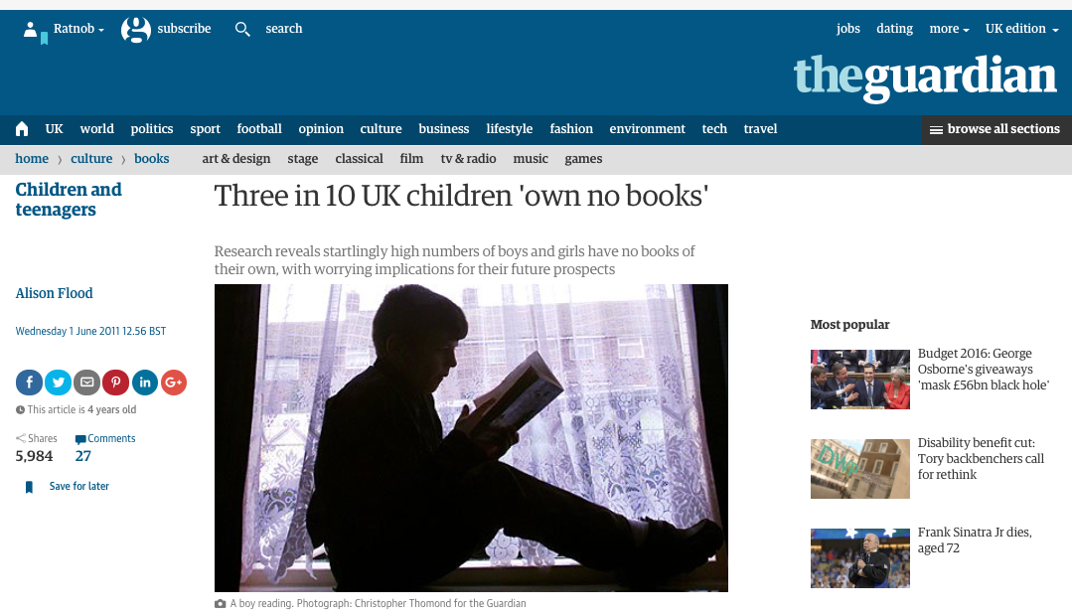

Slide 28
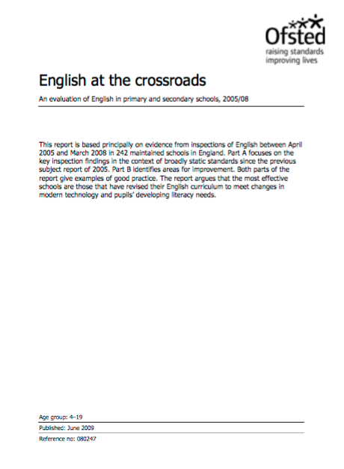

Slide 29
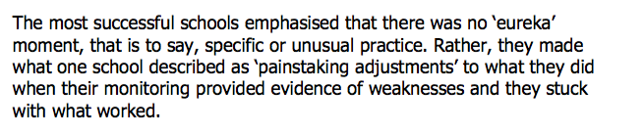

Slide 30
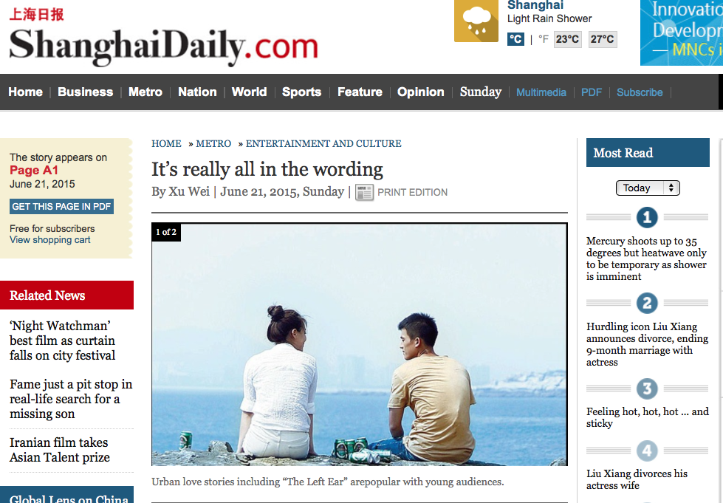

Slide 31
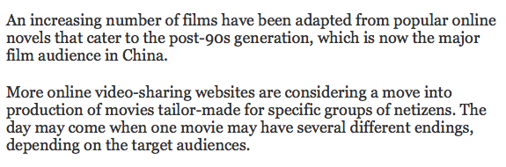

Slide 32

Books are no more threatened by Kindle than stairs by elevators.
STEPHEN FRY

Slide 33
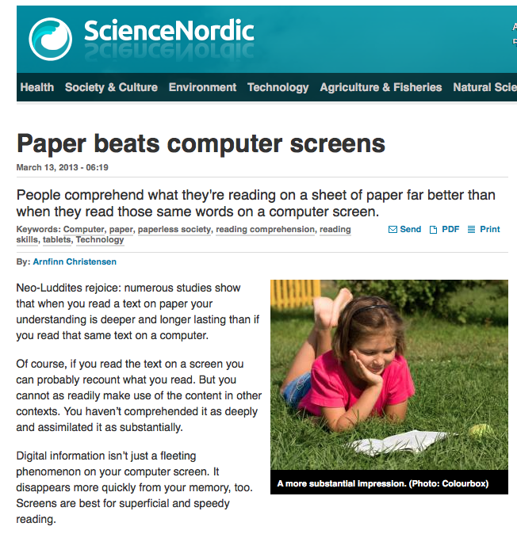

Slide 34
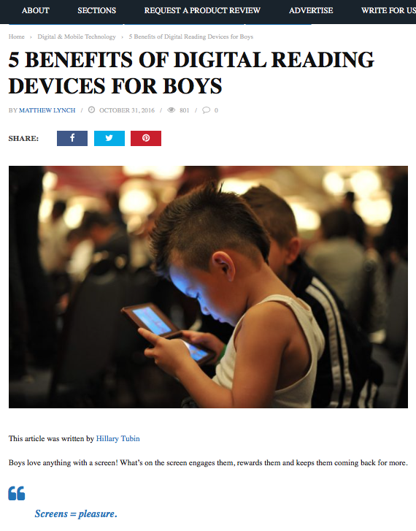

Slide 35
WHAT

Slide 36

Understand the significance of exploratory talk
Build extended responses & public speaking
Model good talk – eg connectives
Consciously vary groupings
Re-think questioning – ‘why & how’, thinking time, and kill fatuous praise

Slide 37
in August 1990 two hikers were walking in the Scottish Highlands, close to Calvine, north of Pitlochry when suddenly they saw something incredible.
A diamond shaped aircraft was hovering over the landscape before speeding off into the distance. The two hikers took pictures of the craft and immediately contacted journalists from the Scottish Daily Record Newspaper. After viewing their photos, the journalists chose to share both pictures and negatives with the Ministry of Defence.
Teacher: What tense is the first paragraph in?

Slide 38
Teacher: OK. Looking at the text now I want you please to tell me what tense the first paragraph is, in what tense the first paragraph is in.
Girl: The past tense.
Teacher: Yes it’s in the past tense.
Teacher: How do you know it’s in the past tense?
Girl: Because it says August 1990.
Teacher: You know by the date it’s in the past tense, but you know by something else you know, you know by the doing words in the text that change. What’s a doing word? What do we call a doing word, David?
David: A verb.
Teacher: A verb. Good. Will you give me one verb please out of this first paragraph. Find one verb in this paragraph. Stephen?
Stephen: Rescued.
Teacher: Rescued, excellent, excellent and that’s in the past tense.
(Neil Mercer, from Hardman, 2007)

Slide 39
Understand the significance of exploratory talk
Build extended responses & public speaking
Model good talk – eg connectives
Consciously vary groupings
Re-think questioning – ‘why & how’, thinking time, and kill fatuous praise

Slide 40
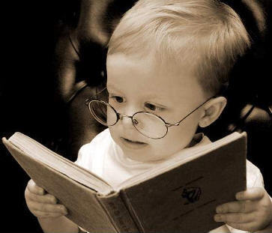
Teach and model reading
Personalise reading
Teach key vocabulary
Demystify spelling
Teach research, not FOFO

Slide 41
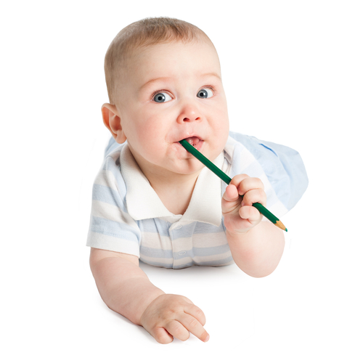
Demonstrate writing as a process – including planning
Teach depersonalisation & self-regulation
Allow oral rehearsal
Short & long sentences
Connectives

Slide 42
Know your connectives
Adding: and, also, as well as, moreover, too
Cause & effect: because, so, therefore, thus, consequently
Sequencing: next, then, first, finally, meanwhile, before, after
Qualifying: however, although, unless, except, if, as long as, apart from, yet
Emphasising: above all, in particular, especially, significantly, indeed, notably
Illustrating: for example, such as, for instance, as revealed by, in the case of
Comparing: equally, in the same way, similarly, likewise, as with, like
Contrasting: whereas, instead of, alternatively, otherwise, unlike, on the other hand

Slide 43
Demonstrate writing as a process – including planning
Teach depersonalisation & self-regulation
Allow oral rehearsal
Short & long sentences
Connectives

Slide 44
HOW

Slide 45
INPUT
PROCESS
OUTPUT

Slide 46
The City Academy, Hackney:
The school has established a literacy policy with five strands that guide the work of all teachers.
Pupils in lessons should always speak in sentences.
There should be a consistent policy on marking and feedback (a ‘green pen’ approach).
Improving literacy in secondary schools: a shared responsibility April 2013, No. 120363
■ Pupils should always have a ‘book on every table’.
■ Teachers in all subjects should model writing for their pupils.
■ Pupils should be taught to organise their extended writing into well- structured paragraphs.

Slide 47
In mathematics and science lessons observed by inspectors, there was considerable emphasis on pupils explaining their answers in detail. Teachers modelled the appropriate language, for example:
In full sentences, please. ‘In the first place, we should get rid of fractions and then...’
Can you explain that in a full sentence? ‘I know that magnesium is more reactive than copper because...’
Marking in all subjects has a literacy focus, as do success criteria and learning objectives. For example, in a very effective history lesson observed by inspectors, there was an explicit expectation that pupils would answer using full sentences. There was an equally explicit and shared expectation that pupils’ writing would be carefully structured, using paragraphs, capital letters and full stops.

Slide 48
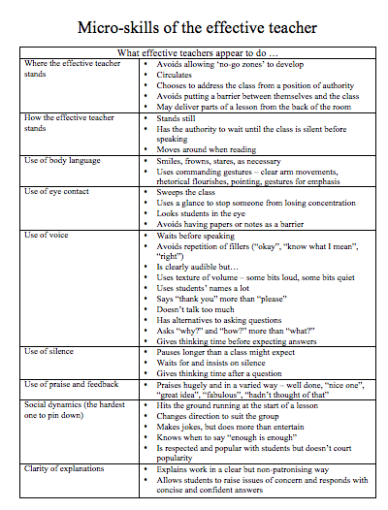

Slide 49
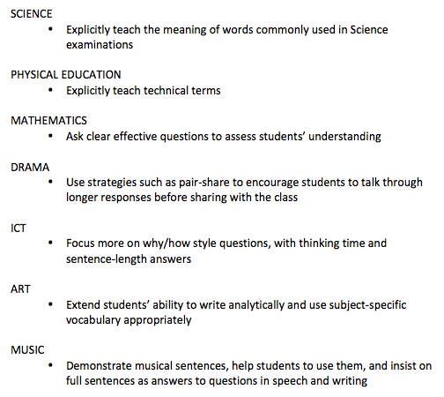
Literacy Promises

Slide 50
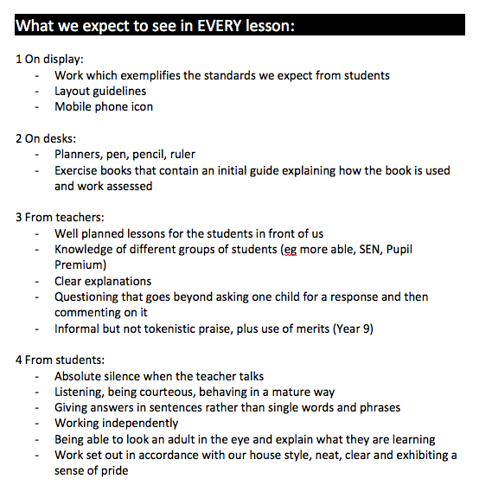

Slide 51


Slide 52
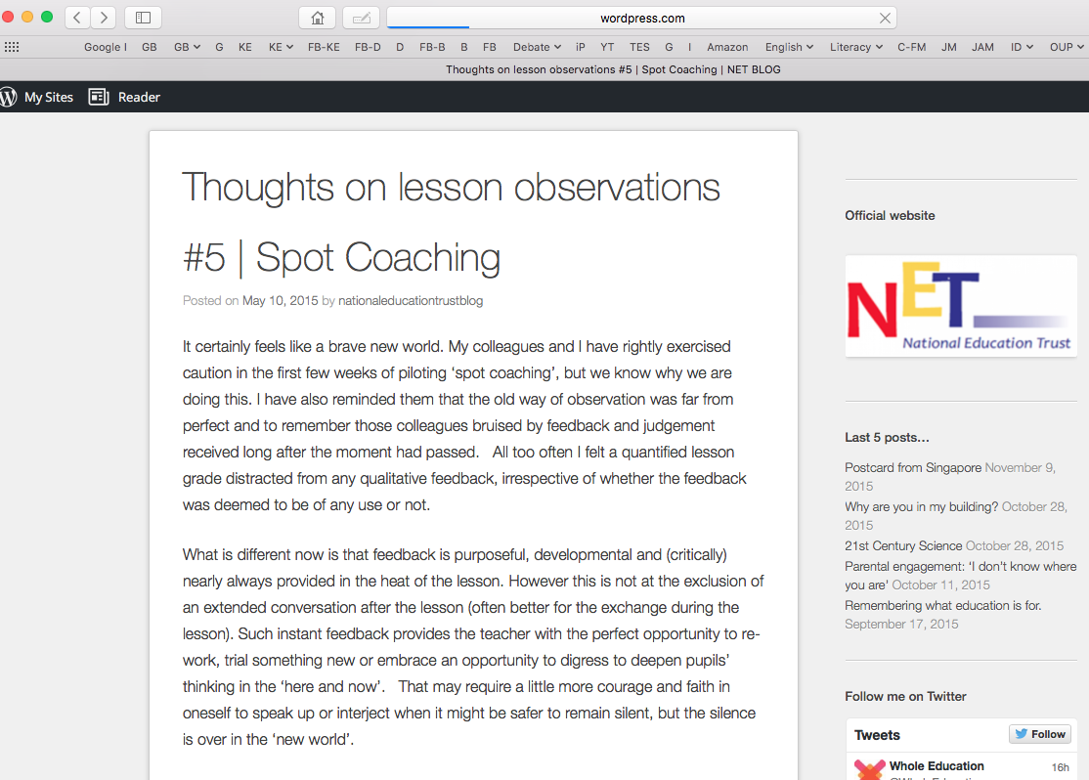

Slide 53
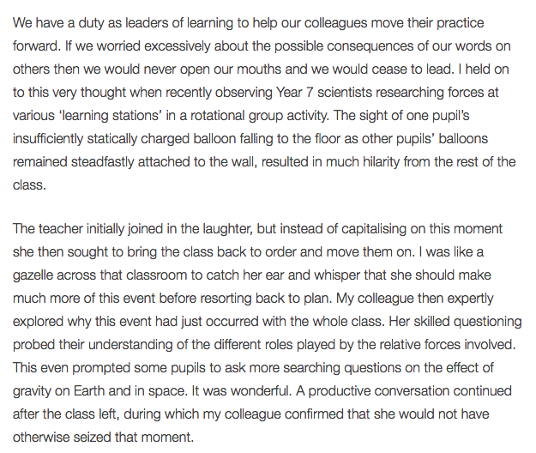

Slide 54
Keith Grainger: Spot Coaching
I am left in no doubt that immediate feedback, in the same way that a tennis coach or dance instructor provides, has powerful potential as a professional development tool in teaching. Our recent work has been exhilarating. I hope never to grade a single lesson again.

Slide 55
The Habits of Literacy
Geoff Barton,
Head, King Edward VI School
Suffolk
Teachology National Conference
8 November 2016
Twitter: @RealGeoffBarton
Download slides: geoffbarton.co.uk/teacher-resources (number 147)

Slide 56

Christmas stocking-filler idea ➔

Slide 57
The Habits of Literacy
Geoff Barton,
Head, King Edward VI School
Suffolk
Teachology National Conference
8 November 2016
Twitter: @RealGeoffBarton
Download slides: geoffbarton.co.uk/teacher-resources (number 147)

