Slide 1
Don’t Call it iteracy
Teaching Leaders Residential
September 2016
@RealGeoffBarton #tlfp2016
Download this presentation at www.geoffbarton.co.uk
(Presentation number 139)

Slide 2
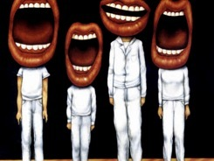
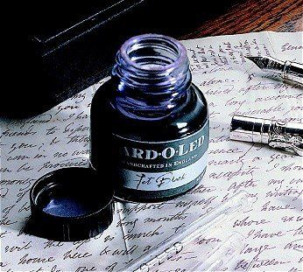

Slide 3
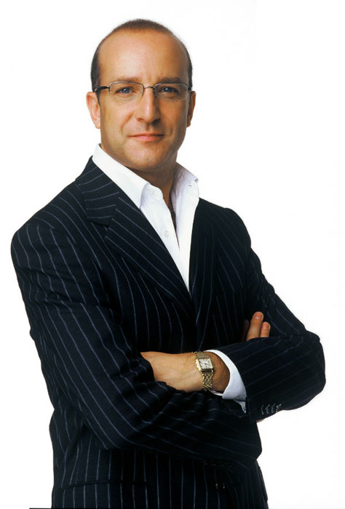
Aims:
I will make you better at SPEAKING& READING
& WRITING

Slide 4
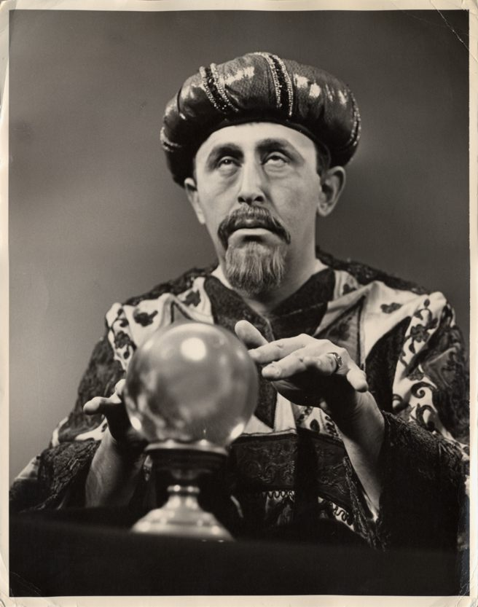
Fellows’ bonus:
Today I will reveal the secret of literacy

Slide 5
WHAT

Slide 6
HOW

Slide 7
Structure:
Rant 1: The Habits of Literacy
Rant 2: Essentials for Impact:
- Speaking & Listening
- Reading
- Writing
And how to make them happen …

Slide 8
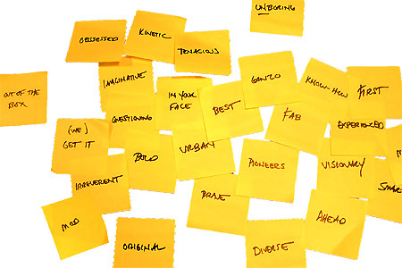
Approach:

Slide 9
Hypothesis:
Become a Year 11 writer again
… for ‘four’ minutes

Slide 10
Hypothesis:
Task:
Describe the room we are in

Slide 11
Q:
?
Unconfident
Confident
Irrespective of background

Slide 12
A:
Teach them

Slide 13
Provocations:
We haven’t done literacy
It’s all about the classroom
Knowledge and instruction may be more important than we realised
Remember the “Matthew Effect”

Slide 14
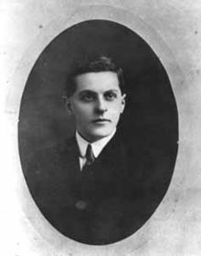
“The limits of my language mean the limits of my world”
Ludwig Wittgenstein

Slide 15
The Matthew Effect
(Robert K Merton)

Slide 16
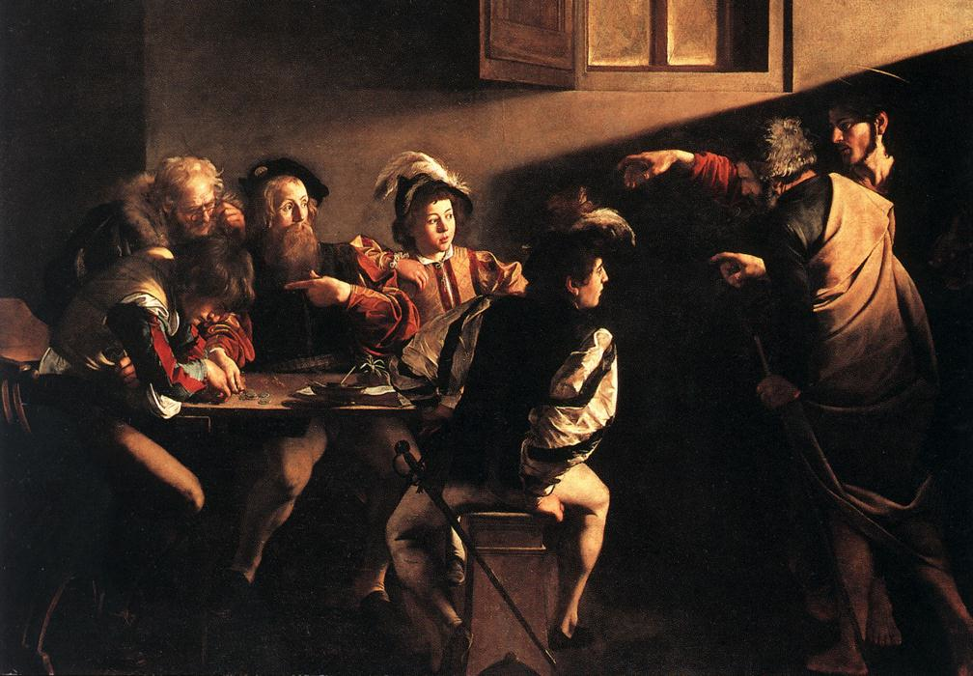

Slide 17
The rich shall get richer and the poor shall get poorer
Matthew 13:12

Slide 18
“The word-rich get richer while the word-poor get poorer” in their reading skills
(Canadian Association of School Librarians)

Slide 19
“While good readers gain new skills very rapidly, and quickly move from learning to read to reading to learn, poor readers become increasingly frustrated with the act of reading, and try to avoid reading where possible”
The Matthew Effect
Daniel Rigney

Slide 20
“Students who begin with high verbal aptitudes find themselves in verbally enriched social environments and have a double advantage.”
The Matthew Effect
Daniel Rigney

Slide 21
Stricht’s Law: “reading ability in children cannot exceed their listening ability …”
E.D. Hirsch
The Schools We Need

Slide 22
“Spoken language forms a constraint, a ceiling not only on the ability to comprehend but also on the ability to write, beyond which literacy cannot progress”
Myhill and Fisher

Slide 23
Aged 7:
Children in the top quartile have 7100 words; children in the lowest have around 3000.
The main influence is parents.
DfE Research Unit

Slide 24
The Matthew Effect:
The rich will get richer &
the poor will get poorer

Slide 25
5 key ingredients
Then teach you something
Then reflection

Slide 26
Understand the significance of exploratory talk
Model good talk – eg connectives & whole-sentence responses
Re-think questioning – ‘why & how’, thinking time, and less commentary
Consciously vary groupings
Get conversation into the school culture

Slide 27
DEMO

Slide 28
Focus: speaking in public

Slide 29
Task: why school uniform crushes our individuality

Slide 30
Understand the significance of exploratory talk
Model good talk – eg connectives
Re-think questioning – ‘why & how’, thinking time, and less commentary
Consciously vary groupings
Get conversation into the school culture

Slide 32
Teach reading – scanning, skimming, analysis
Read aloud and display
Teach key vocabulary
Demystify spelling
Teach research, not FOFO

Slide 33
DEMO

Slide 34
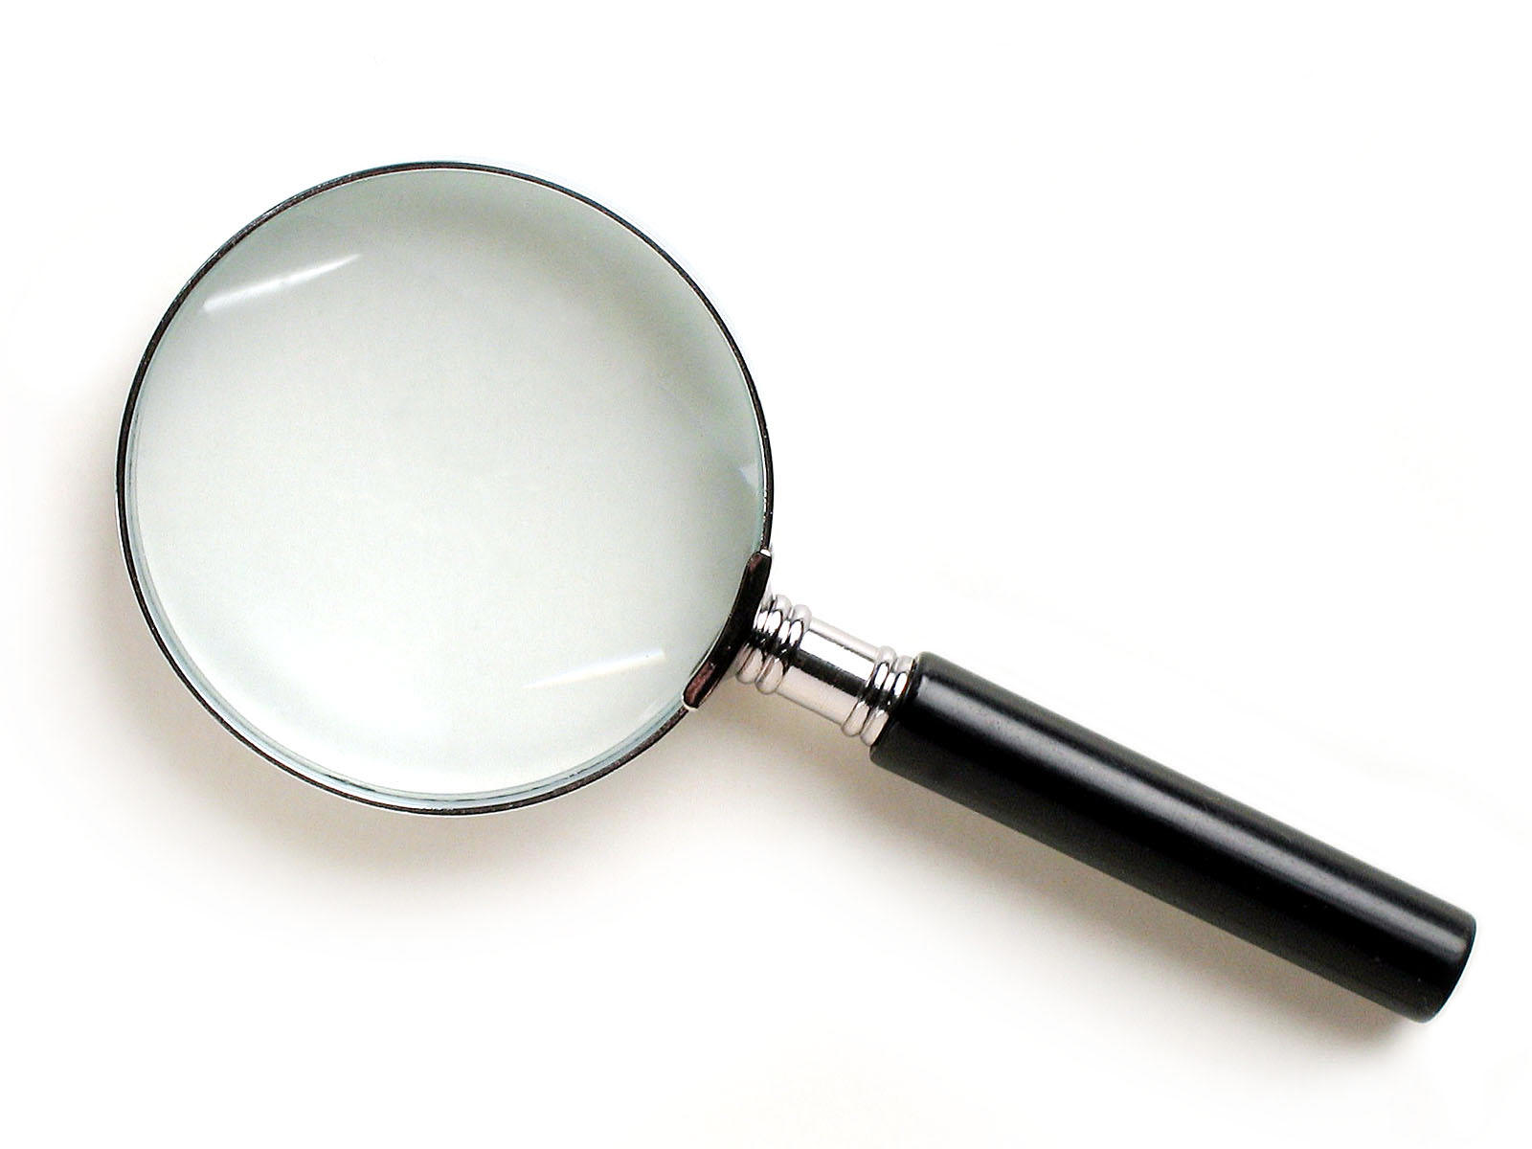
SKIMMING

Slide 35
The climate of the Earth is always changing. In the past it has altered as a result of natural causes. Nowadays, however, the term climate change is generally used when referring to changes in our climate which have been identified since the early part of the 1900's . The changes we've seen over recent years and those which are predicted over the next 80 years are thought to be mainly as a result of human behaviour rather than due to natural changes in the atmosphere.

Slide 36
The best treatment for mouth ulcers. Gargle with salt water. You should find that it works a treat. Salt is cheap and easy to get hold of and we all have it at home, so no need to splash out and spend lots of money on expensive mouth ulcer creams.

Slide 37
Lexical v Grammatical Words

Slide 38
Urquhart castle is probably one of the most picturesquely situated castles in the Scottish Highlands. Located 16 miles south-west of Inverness, the castle, one of the largest in Scotland, overlooks much of Loch Ness. Visitors come to stroll through the ruins of the 13th-century castle because Urquhart has earned the reputation of being one of the best spots for sighting Loch Ness’s most famous inhabitant.

Slide 39
Urquhart castle is probably one of the most picturesquely situated castles in the Scottish Highlands. Located 16 miles south-west of Inverness, the castle, one of the largest in Scotland, overlooks much of Loch Ness. Visitors come to stroll through the ruins of the 13th-century castle because Urquhart has earned the reputation of being one of the best spots for sighting Loch Ness’s most famous inhabitant.

Slide 40
Urquhart castle is probably one of the most picturesquely situated castles in the Scottish Highlands. Located 16 miles south-west of Inverness, the castle, one of the largest in Scotland, overlooks much of Loch Ness. Visitors come to stroll through the ruins of the 13th-century castle because Urquhart has earned the reputation of being one of the best spots for sighting Loch Ness’s most famous inhabitant.

Slide 41
Urquhart castle is probably one of the most picturesquely situated castles in the Scottish Highlands. Located 16 miles south-west of Inverness, the castle, one of the largest in Scotland, overlooks much of Loch Ness. Visitors come to stroll through the ruins of the 13th-century castle because Urquhart has earned the reputation of being one of the best spots for sighting Loch Ness’s most famous inhabitant.

Slide 42
Urquhart castle is probably one of the most picturesquely situated castles in the Scottish Highlands. Located 16 miles south-west of Inverness, the castle, one of the largest in Scotland, overlooks much of Loch Ness. Visitors come to stroll through the ruins of the 13th-century castle because Urquhart has earned the reputation of being one of the best spots for sighting Loch Ness’s most famous inhabitant.

Slide 43
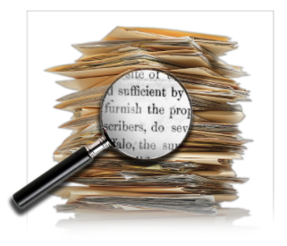
SCANNING

Slide 44
Where did the first cell phones begin?
Name 2 other features that started to be included in phones
Why are cell phones especially useful in some countries?

Slide 45
Where begin?
Two features?
Some countries?
Cellular telephones
The first cellular telephone system began operation in Tokyo in 1979, and the first U.S. system began operation in 1983 in Chicago. A camera phone is a cellular phone that also has picture taking capabilities. Some camera phones have the capability to send these photos to another cellular phone or computer. Advances in digital technology and microelectronics has led to the inclusion of unrelated applications in cellular telephones, such as alarm clocks, calculators, Internet browsers, and voice memos for recording short verbal reminders, while at the same time making such telephones vulnerable to certain software viruses. In many countries with inadequate wire-based telephone networks, cellular telephone systems have provided a means of more quickly establishing a national telecommunications network.

Slide 46
CLOSE READING

Slide 47
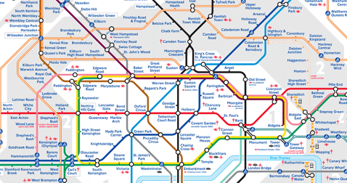
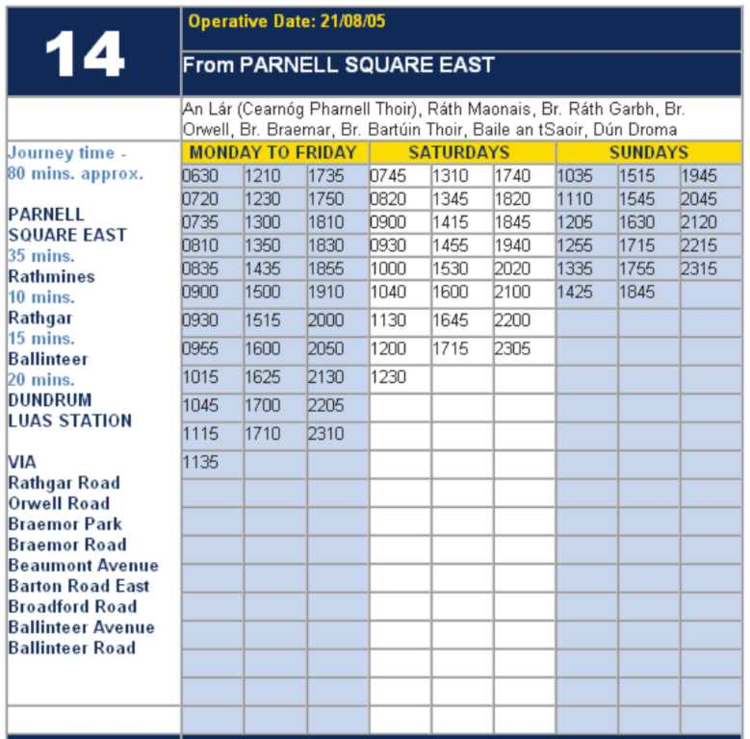
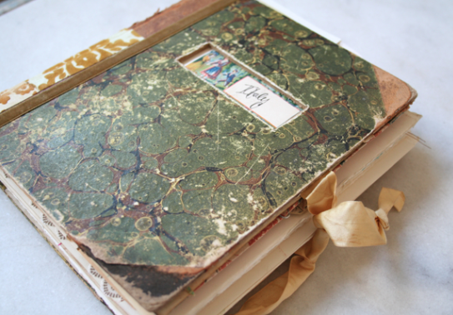
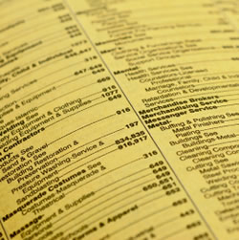

Slide 48
RESEARCH SKILLS

Slide 49
Research the life of
Martin Luther King

Slide 50
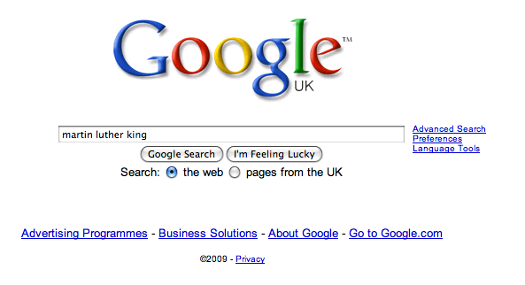

Slide 57
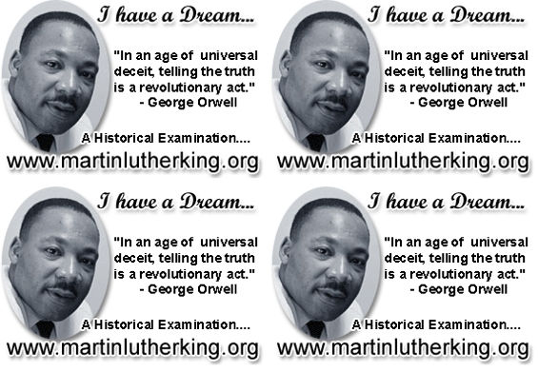

Slide 58
DEMYSTIFYING
SPELLING
3
Notes:
7 spellings: Government – February – parliament – separate – believe – necessary - accommodation

Slide 59
1 - SOUNDS

Slide 60
Government

Slide 61
February

Slide 62
Parliament

Slide 63
2 -VISUALS

Slide 64
Se-para-te
Be-lie-ve

Slide 65
3 - MNEMONICS

Slide 66
necessary

Slide 67
accommodation

Slide 69
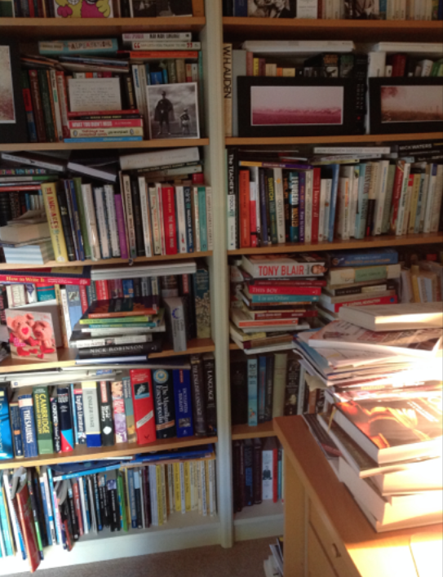

Slide 70
Teach reading – scanning, skimming, analysis
Read aloud and display
Teach key vocabulary
Demystify spelling
Teach research, not FOFO

Slide 71
Demonstrate writing
Teach composition & planning
Allow oral rehearsal
Short & long sentences
Connectives

Slide 72
Know your connectives
Adding: and, also, as well as, moreover, too
Cause & effect: because, so, therefore, thus, consequently
Sequencing: next, then, first, finally, meanwhile, before, after
Qualifying: however, although, unless, except, if, as long as, apart from, yet
Emphasising: above all, in particular, especially, significantly, indeed, notably
Illustrating: for example, such as, for instance, as revealed by, in the case of
Comparing: equally, in the same way, similarly, likewise, as with, like
Contrasting: whereas, instead of, alternatively, otherwise, unlike, on the other hand

Slide 73
DEMO

Slide 74
Demonstrate writing
Teach composition & planning
Allow oral rehearsal
Short & long sentences
Connectives

Slide 76
SUMMARY:
The Secret of Literacy

Slide 77
Stand by …

Slide 78
Ready …?

Slide 79
Tension now intolerable … ?

Slide 80
Well, it’s not literacy …

Slide 81
… it’s making the implicit explicit – and modelling it …

Slide 82
… without which, the rich will get richer & the poor will get poorer

Slide 84
… so we could just call it ‘what great teachers do’

Slide 85
Don’t Call it iteracy
Teaching Leaders Residential
September 2016
@RealGeoffBarton #tlfp2016
Download this presentation at www.geoffbarton.co.uk
(Presentation number 139)

Slide 86
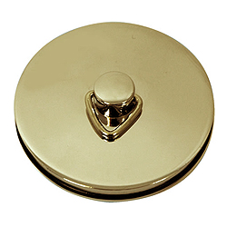
This is an expensive plug ➔

Slide 87
This is a
cheap plug ➔

Slide 88
Don’t Call it iteracy
Teaching Leaders Residential
September 2016
@RealGeoffBarton #tlfp2016
Download this presentation at www.geoffbarton.co.uk
(Presentation number 139)

