Slide 1
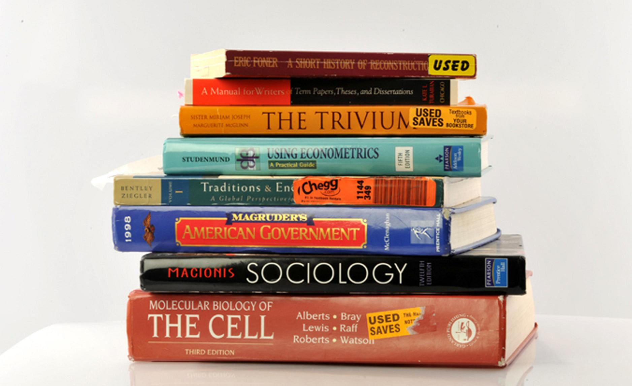
Why do I need a textbook now I’ve got _ _ _ _ _ _?
Geoff Barton ⎜ Society of Authors ⎜ 7 May 2016
www.geoffbarton.co.uk (presentation 144) ⎜ Twitter: @RealGeoffBarton

Slide 2
Why do I need a textbook now I’ve got _ _ _ _ _ _?

Slide 3
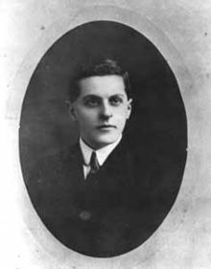
“The limits of my language mean the limits of my world”
Ludwig Wittgenstein

Slide 4
“The children who possess intellectual capital when they first arrive at school have the mental scaffolding and Velcro to catch hold of what is going on, and they can turn the new knowledge into still more Velcro to gain still more knowledge”.

Slide 5
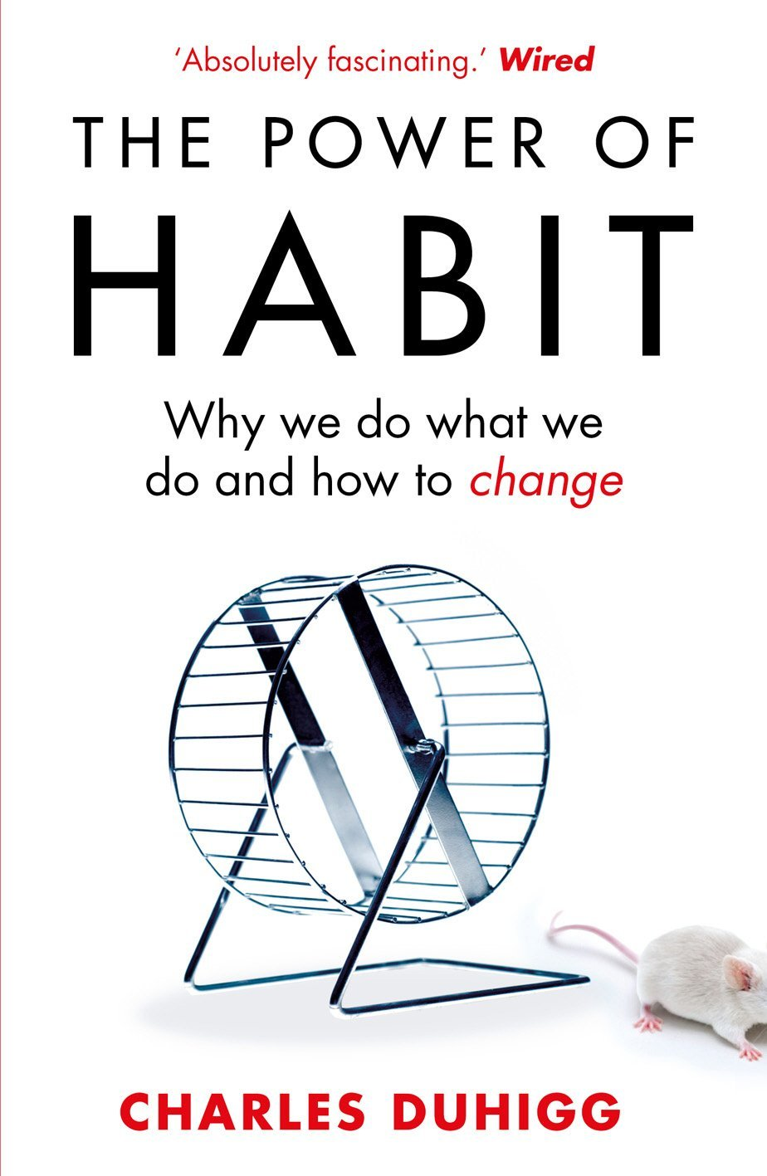
‘Habits, scientists say, emerge because the brain is constantly looking for ways to save effort’

Slide 6
‘That’s why signing kids up for piano lessons or sports is so important. It has nothing to do with creating a good musician or a five year-old soccer star’

Slide 7
‘Too often the argument for reading is made by those who have spent their lives as insiders; the pleasures of solitary reading are so obvious, the value of reading so self-evident, that we fail to appreciate how utterly strange reading is to the outsider’

Slide 8
The Matthew Effect
(Robert K Merton)

Slide 9
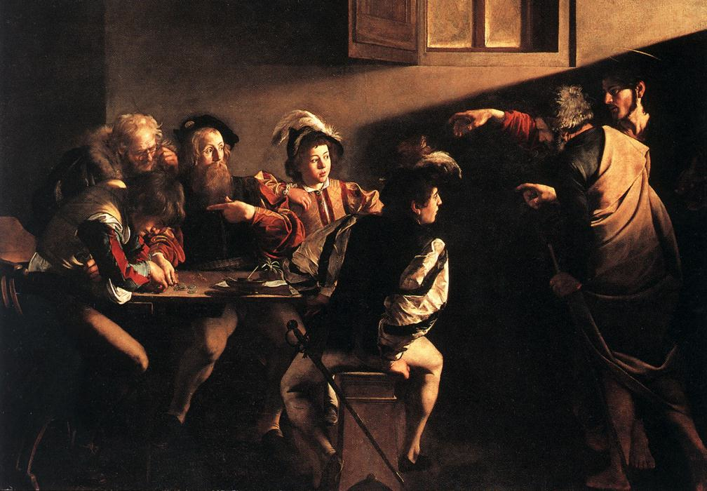

Slide 10
The rich shall get richer and the poor shall get poorer
Matthew 13:12

Slide 11
“The word-rich get richer while the word-poor get poorer” in their reading skills
(CASL)

Slide 12
“While good readers gain new skills very rapidly, and quickly move from learning to read to reading to learn, poor readers become increasingly frustrated with the act of reading, and try to avoid reading where possible”
The Matthew Effect
Daniel Rigney

Slide 13
“Students who begin with high verbal aptitudes find themselves in verbally enriched social environments and have a double advantage.”
The Matthew Effect
Daniel Rigney

Slide 14
“Good readers may choose friends who also read avidly while poor readers seek friends with whom they share other enjoyments”
The Matthew Effect
Daniel Rigney

Slide 15
The Matthew Effect:
The rich will get richer &
the poor will get poorer

Slide 16
The world of our students is different from the world when we were students:
Some implications

Slide 17
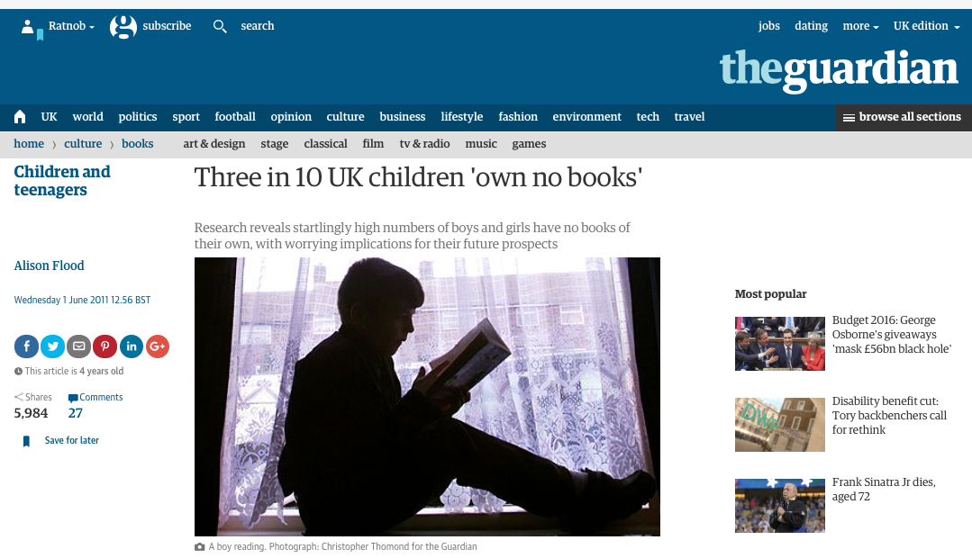

Slide 18
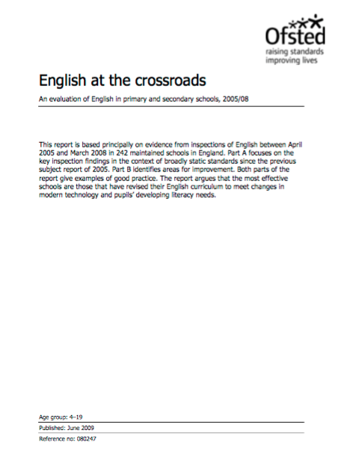

Slide 20
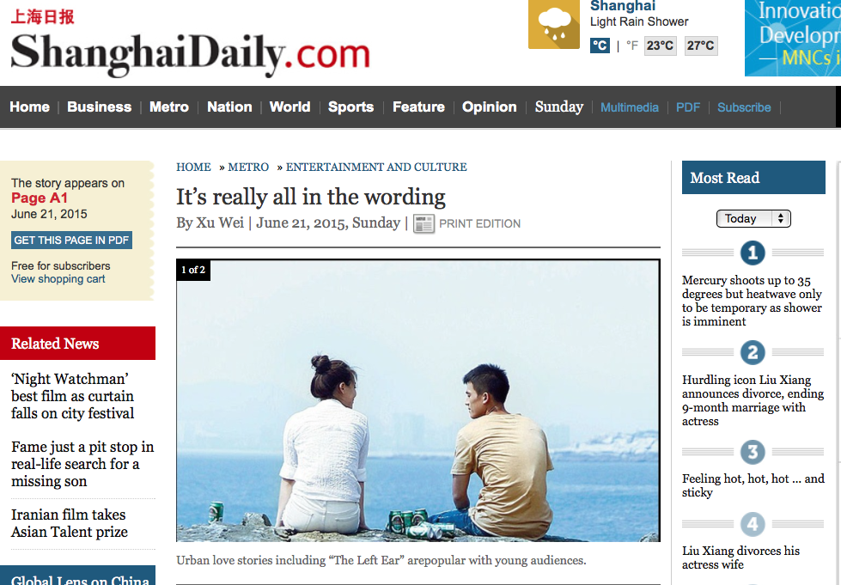

Slide 22
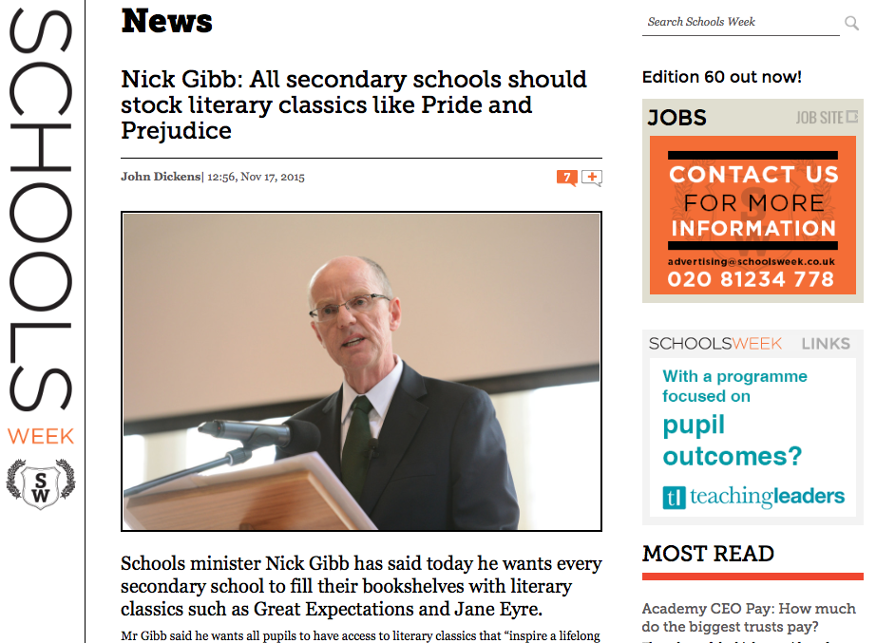

Slide 23
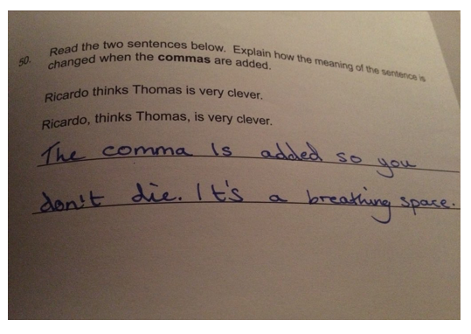
Notes:
Driven by testing - 1

Slide 24
Literary birthright

Slide 27
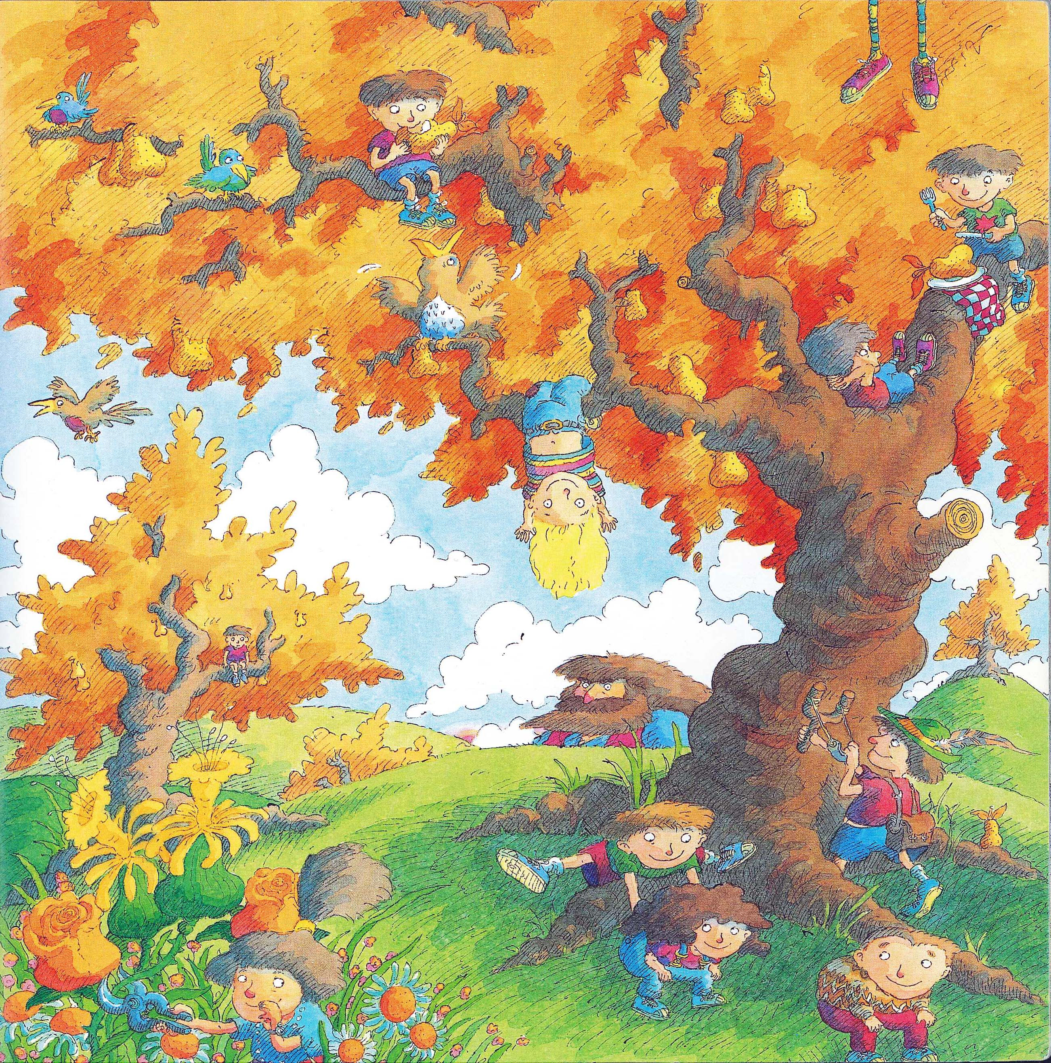

Slide 28
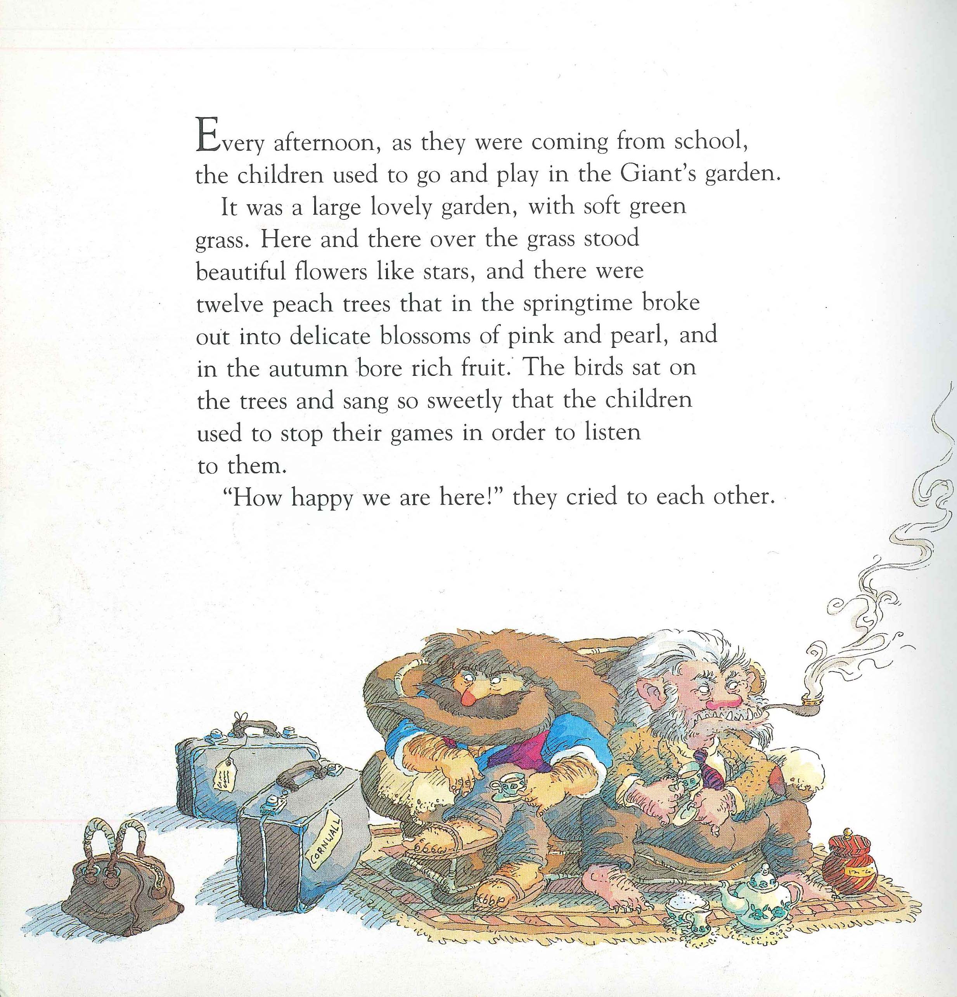

Slide 29
Conventions

Slide 30
A:
The Life of Charles Dickens
Chapter 1
CHARLES DICKENS, the most popular novelist of the century, and one of the greatest humorists that England has produced, was born at Lanport, in Portsea, on Friday, the seventh of February, 1812.
His father, John Dickens, a clerk in the navy pay-office, was at this time stationed in the Portsmouth Dockyard. He had made acquaintance with the lady, Elizabeth Barrow, who became afterwards his wife, through her elder brother, Thomas Barrow, also engaged on the establishment at Somerset House, and she bore him in all a family of eight children, of whom two died in infancy. The eldest, Fanny (born 1810), was followed by Charles (entered in the baptismal register of Portsea as Charles John Huffham, though on the very rare occasions when he subscribed that name he wrote Huffam); by another son, named Alfred, who died in childhood; by Letitia (born 1816); by another daughter, Harriet, who died also in childhood; by Frederick (born 1820); by Alfred Lamert (born 1822); and by Augustus (born 1827).
John Forster

Slide 31
B:
DICKENS by Peter Ackroyd
CHARLES DICKENS was dead. He lay on a narrow green sofa – but there was room enough for him, so spare had he become – in the dining room of Gad’s Hill Place. He had died in the house which he had first seen as a small boy and which his father had pointed out to him as a suitable object of his ambitions; so great was his father’s hold upon his life that, forty years later, he had bought it. Now he had gone. It was customary to close the blinds and curtains, thus enshrouding the corpse in darkness before its last journey to the tomb; but in the dining room of Gad’s Hill the curtains were pulled apart and on this June day the bright sunshine streamed in, glittering on the large mirrors around the room.
All the lines and wrinkles which marked the passage of his life were new erased in the stillness of death. He was not old – he died in his fifty-eighth year – but there had been signs of premature ageing on a visage so marked and worn; he had acquired, it was said, a “sarcastic look”. But now all that was gone and his daughter, Katey, who watched him as he lay dead, noticed how there once more emerged upon his face “beauty and pathos”.
Peter Ackroyd

Slide 32
‘Too many people waste money on expensive holidays’
Notes:
It’s really beautiful out there; in here, however, it’s quite claustrophobic

Slide 33
For your next holiday, why don’t you take all your money and put it on the fire? Then stand in a fridge for a week, beating your children with a baseball bat until their arms and legs break. And then, after you’ve eaten some melted cheese, dislocate your shoulder. If all of this appeals then you are probably one of the 1.3 million British people …
… who go on a skiing holiday at this time of year.
Notes:
It’s really beautiful out there; in here, however, it’s quite claustrophobic

Slide 34
Wide reading

Slide 35
A Short History of England – Simon Jenkins
King John:
Turning to the barons for support he found them reluctant to advance him funds, though this did nothing to relieve his extravagance. He welcomed at court yet more of his wife’s relatives, and even gave London its first zoo, kept at the Tower.
It included a polar bear that swam in the Thames, lions, snakes, rhinoceros and an elephant. The ostrich died after being fed a diet of silverware.
Later, visitors had to pay to enter, or bring a cat or dog as food for the lions.

Slide 36
The Great Silence – Juliet Nicolson
And when Mr Lloyd came through the door the pyjama-wearing sisters had to unscrew their expressions of revulsion and force themselves to kiss his cheek as far away as possible from his mouth before running upstairs and making audible noises as soon as they reached their bedroom door.
Before going to bed, the children were asked to include Mr Lloyd in their prayers, ‘Please God make Mr Lloyd quite quite well’, they would dutifully ask, running the sentence on without a break as they asked God for forgiveness ‘for anything I have done wrong today’. But there was little hope of God intervening.
When Mr Lloyd stayed for supper the children would turn their faces away, dreading the reappearance of food from his nose. Half of Stuart Lloyd’s face was gone, his palate missing, blown off at the Somme.

Slide 37
Jonathan Swift, Eating people is right
A child will make two dishes at an entertainment for friends: and when the family dines alone, the fore or hind quarter will make a reasonable dish, and, seasoned with a little pepper or salt, be very good boiled on the fourth day, especially in winter.
I have reckoned, upon a medium, that a child just born will weigh twelve pounds, and in a solar year, if tolerably nursed, increaseth to twenty-eight pounds.
I grant this food will be somewhat dear, and therefore very proper for landlords, who, as they have already devoured most of the parents, seem to have the best title to the children.
Infant’s flesh will be in season throughout the year, but more plentiful in March, and a little before and after.

Slide 38
Resilience

Slide 39
one
t
hi
s
snowflake
(a
li
ght
in
g)
is upon a gra
v
es
t
one
ee cummings

Slide 40
SKIMMING

Slide 41
The climate of the Earth is always changing. In the past it has altered as a result of natural causes. Nowadays, however, the term climate change is generally used when referring to changes in our climate which have been identified since the early part of the 1900s . The changes we've seen over recent years and those which are predicted over the next 80 years are thought to be mainly as a result of human behaviour rather than due to natural changes in the atmosphere.

Slide 42
The best treatment for mouth ulcers. Gargle with salt water. You should find that it works a treat. Salt is cheap and easy to get hold of and we all have it at home, so no need to splash out and spend lots of money on expensive mouth ulcer creams.

Slide 43
Urquhart castle is probably one of the most picturesquely situated castles in the Scottish Highlands. Located 16 miles south-west of Inverness, the castle, one of the largest in Scotland, overlooks much of Loch Ness. Visitors come to stroll through the ruins of the 13th-century castle because Urquhart has earned the reputation of being one of the best spots for sighting Loch Ness’s most famous inhabitant.

Slide 44
Lexical v Grammatical Words

Slide 45
Urquhart castle is probably one of the most picturesquely situated castles in the Scottish Highlands. Located 16 miles south-west of Inverness, the castle, one of the largest in Scotland, overlooks much of Loch Ness. Visitors come to stroll through the ruins of the 13th-century castle because Urquhart has earned the reputation of being one of the best spots for sighting Loch Ness’s most famous inhabitant.

Slide 46
Urquhart castle is probably one of the most picturesquely situated castles in the Scottish Highlands. Located 16 miles south-west of Inverness, the castle, one of the largest in Scotland, overlooks much of Loch Ness. Visitors come to stroll through the ruins of the 13th-century castle because Urquhart has earned the reputation of being one of the best spots for sighting Loch Ness’s most famous inhabitant.

Slide 47
Urquhart castle is probably one of the most picturesquely situated castles in the Scottish Highlands. Located 16 miles south-west of Inverness, the castle, one of the largest in Scotland, overlooks much of Loch Ness. Visitors come to stroll through the ruins of the 13th-century castle because Urquhart has earned the reputation of being one of the best spots for sighting Loch Ness’s most famous inhabitant.

Slide 48
Urquhart castle is probably one of the most picturesquely situated castles in the Scottish Highlands. Located 16 miles south-west of Inverness, the castle, one of the largest in Scotland, overlooks much of Loch Ness. Visitors come to stroll through the ruins of the 13th-century castle because Urquhart has earned the reputation of being one of the best spots for sighting Loch Ness’s most famous inhabitant.

Slide 49
Urquhart castle is probably one of the most picturesquely situated castles in the Scottish Highlands. Located 16 miles south-west of Inverness, the castle, one of the largest in Scotland, overlooks much of Loch Ness. Visitors come to stroll through the ruins of the 13th-century castle because Urquhart has earned the reputation of being one of the best spots for sighting Loch Ness’s most famous inhabitant.

Slide 50
SCANNING

Slide 51
Where did the first cell phones begin?
Name 2 other features that started to be included in phones
Why are cell phones especially useful in some countries?

Slide 52
Where begin?
Two features?
Some countries?
Cellular telephones
The first cellular telephone system began operation in Tokyo in 1979, and the first U.S. system began operation in 1983 in Chicago. A camera phone is a cellular phone that also has picture taking capabilities. Some camera phones have the capability to send these photos to another cellular phone or computer. Advances in digital technology and microelectronics has led to the inclusion of unrelated applications in cellular telephones, such as alarm clocks, calculators, Internet browsers, and voice memos for recording short verbal reminders, while at the same time making such telephones vulnerable to certain software viruses. In many countries with inadequate wire-based telephone networks, cellular telephone systems have provided a means of more quickly establishing a national telecommunications network.

Slide 53
RESEARCH SKILLS (not FOFO)

Slide 54
Research the life of
Martin Luther King

Slide 55
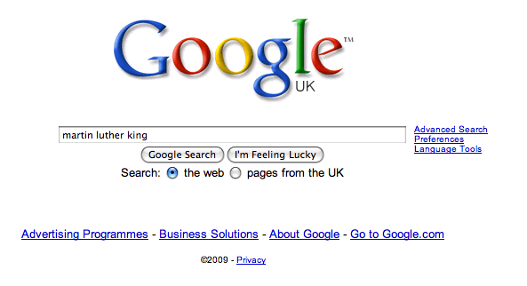

Slide 62
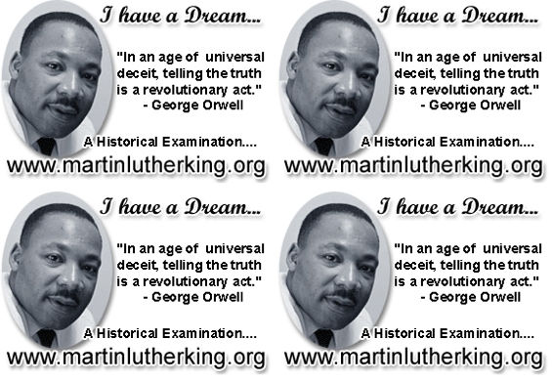

Slide 63
Intertextuality

Slide 64
What if JD Salinger rewrote the Bible?

Slide 65
Boy, when I saw old Eve I thought I was going to flip. I mean it isn’t that Eve is good-looking or anything like that, it’s just that she’s different. I don’t know what the hell it is exactly – but you always know when she’s around.
She looked nervous as hell. I kinda felt sorry for her – even though she’s got one of my goddam ribs, so I went over to talk to old Eve.
“You look very, very nice, Adam” she said to me in a funny way, like she was ashamed of something. “Why don’t you join me in some apple?”
Goddam, is that all these sophisticated babes think about all the time? It’s enough to drive a guy crazy, if you know what I mean.
From Simon Brett, The Faber Book of Parodies

Slide 66
What if Dylan Thomas rewrote ‘Pride & Prejudice’?

Slide 67
Adventures In The Marriage Trade
FIRST VOICE: It is night in the smug-as-a-bug-in-a-rug household of Mr and Mrs Dai Bennet and their simpering daughters – five breast-bobbing man-hungry titivators, innocent as ice-cream, panting for balls and matrimony.
MRS BENNET: Our new neighbour, Mr Darcy, quite tickles my fancy.
MR BENNET: Don’t let him turn Lizzy’s head, Darcy-versy.
ELIZABETH: I shall wed whom I please.
FIRST VOICE: And busy Lizzie retires to her room with visions of bridling up the aisle to ‘I will’ with half-a-dozen demon lovers. She dreams of coaches and pairs and being a fine lady; dressing for dinner in silken gown and undressing afterwards for heaven knows what in the saucy haven of a double bed.
From EO Parrott, How to be Well Versed in Poetry

Slide 68
English Teacher
Petite, white-haired Miss Cartwright
Knew Shakespeare off by heart,
Or so we pupils thought.
Once in the stalls at the Old Vic
She prompted Lear when he forgot his part.
Ignorant of Scrutiny and Leavis,
She taught Romantic poetry,
Dreamt of gossip with dead poets.
To an amazed sixth form once said: ‘How good to spend a night with Shelley.’
In long war years she fed us plays,
Sophocles to Shaw’s St Joan.
Her reading nights we named our Courting Club,
Yet always through the blacked-out streets
One boy left the girls and saw her home.
When she closed her eyes and chanted
‘Ode to a Nightingale’
We laughed yet honoured her devotion.
We knew the man she should have married
Was killed at Passchendaele.
Brian Cox
From Collected Poems, Carcanet Press 1993.

Slide 69
Why do I need a textbook now I’ve got GOOGLE?
Geoff Barton ⎜ Society of Authors ⎜ 7 May 2016
www.geoffbarton.co.uk (presentation 144) ⎜ Twitter: @RealGeoffBarton

