Slide 1
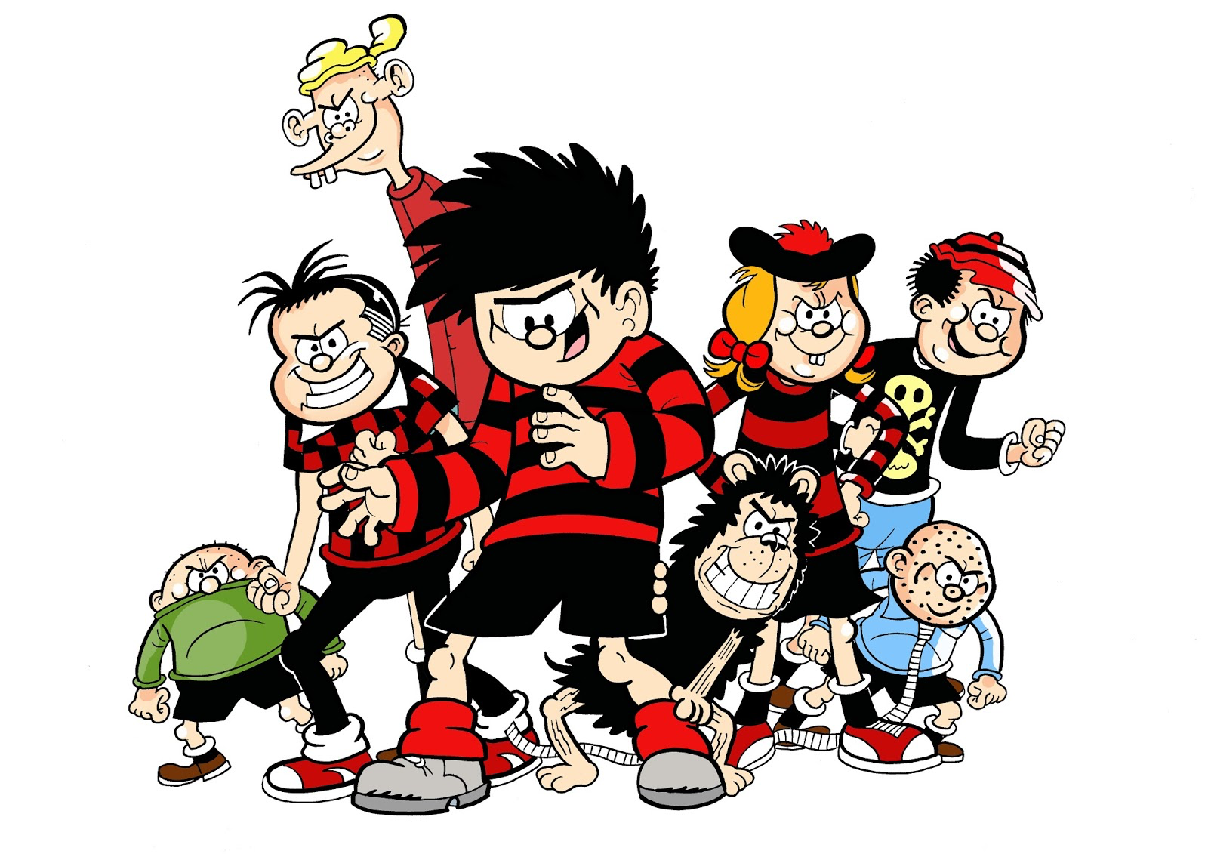
Putting Reading at the Heart of School
Geoff Barton
Head, King Edward VI School
Suffolk
OUP Professional Development
29 November 2016
Twitter: @RealGeoffBarton
Presentation free at: geoffbarton.co.uk/teacher-resources (number 150)

Slide 2

2

Slide 3

1:

Slide 4
2:
Literacy

Slide 5

The HABITS of READING

Slide 6

1 Spelling Test
Notes:
1 accommodation; 2 necessary; 3 separate; 4 fulfil; 5 they’re

Slide 7
Discuss:
How did you approach that task? How did you feel?
Notes:
1 accommodation; 2 necessary; 3 separate; 4 fulfil; 5 they’re

Slide 8
2 Read
Notes:
1 accommodation; 2 necessary; 3 separate; 4 fulfil; 5 they’re

Slide 9
Compare and contrast:
A
The Global Positioning System (GPS) is a network of about 30 satellites orbiting the Earth at an altitude of 20,000 km. The system was originally developed by the US government for military navigation but now anyone with a GPS device, be it a SatNav, mobile phone or handheld GPS unit, can receive the radio signals that the satellites broadcast.
Wherever you are on the planet, at least four GPS satellites are ‘visible’ at any time. Each one transmits information about its position and the current time at regular intervals. These signals, travelling at the speed of light, are intercepted by your GPS receiver, which calculates how far away each satellite is based on how long it took for the messages to arrive.
B
GPS (global positioning system) can be defined as a collection of satellites and ground stations that allow users with specifically designed radio equipment to obtain position, distance and velocity data. Mariners at one time used constellations and the stars (such as Polaris in the Little Dipper or Alpha Ursae Minoris) as landmarks at night to determine their position and direction at sea. The distance from a satellite is calculated by the “time of flight” of a radio signal from the satellite. Suppose it takes 0.06 seconds for a radio signal traveling at 186000 miles per second to reach the receiver from the satellite. Knowing this, the distance from the satellite can be calculated as follows:
Velocity (186000 mi/s) x Time (.06 s) = Distance (11160 miles)
Notes:
http://www.physics.org/article-questions.asp?id=55

Slide 10
Discuss:
How did you approach that task? How did you feel?
Notes:
1 accommodation; 2 necessary; 3 separate; 4 fulfil; 5 they’re

Slide 11


Slide 12
Discuss:
How did you approach that task? How did you feel?
Notes:
1 accommodation; 2 necessary; 3 separate; 4 fulfil; 5 they’re

Slide 13
Arthur L. Costa and Bena Kallick, Habits of Mind

Slide 14
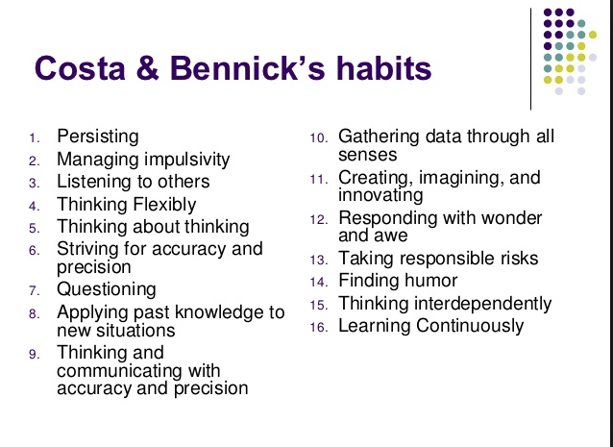

Slide 15
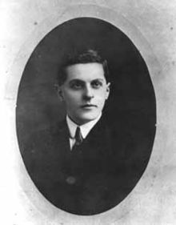
“The limits of my language mean the limits of my world”
Ludwig Wittgenstein

Slide 16
On Reading:
Teenagers who read books are significantly more likely to end up in a professional job than those who don’t (survey of 17,000 people born in 1970).
Three in 10 young people aged 8 to 17 love in households without any books (Indy, in the Week, 11/6/11)
Studies also show that reading a variety of literature independently by the age of 15 is the single biggest indicator of future success, outweighing negative factors such as socioeconomic background or family situation. NLT April 2011
One in three children in UK does not own a book. NLT April 2011

Slide 17

7 Texts

Slide 18

‘Standards are raised ONLY by changes which are put into direct effect by teachers and pupils in classrooms’

Slide 19
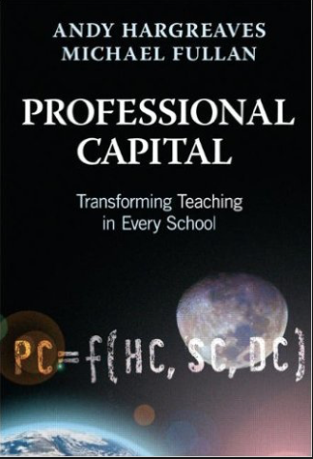
Better leaders produce better teachers.

Slide 20

“The children who possess intellectual capital when they first arrive at school have the mental scaffolding and Velcro to catch hold of what is going on, and they can turn the new knowledge into still more Velcro to gain still more knowledge”.

Slide 21

Whilst the word rich get richer, the word poor get poorer

Slide 22

People who have large vocabularies tend to be intrigued with words.
As such, a major impetus for writing this book is our concern that school vocabulary instruction tends to be dull, rather than of the sort that might instigate students’ interest and awareness of words.
Indeed, asking students to look up words in a dictionary and use them in a sentence is a stereotypical example of what students find uninteresting in school.

Slide 23

Students in remedial settings read roughly 75% less than their peers in regular reading classes … Readers who do not read regularly become weaker readers with each subsequent year.
(Yet) these students have the ability to become strong readers … They need to read and read.
Time and again, I have seen a heavy dose of independent reading, paired with explicit instruction in reading strategies, transform nonreaders into readers.’

Slide 24
‘I transformed my classroom into a workshop, a place where apprentices hone a craft under the tutelage of a master.
I learned that being the best reader and writer in the room is not about power and control. Instead, I must be a source of knowledge that my students access while learning how to read and write …
I must lead students away from me and toward their own autonomy as literate people’

Slide 25

‘Too often the argument for reading is made by those who have spent their lives as insiders. The pleasures of solitary reading are so obvious, the value of reading so self-evident, that we fail to appreciate how utterly strange reading is to the outsider’

Slide 26
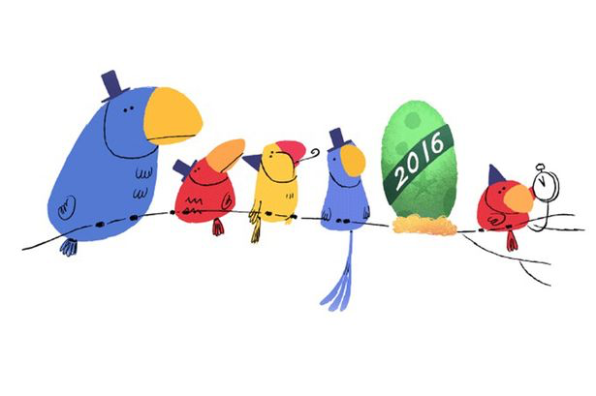
The Changing Face of Literacy

Slide 27
How do you react to these rooms?

Slide 28
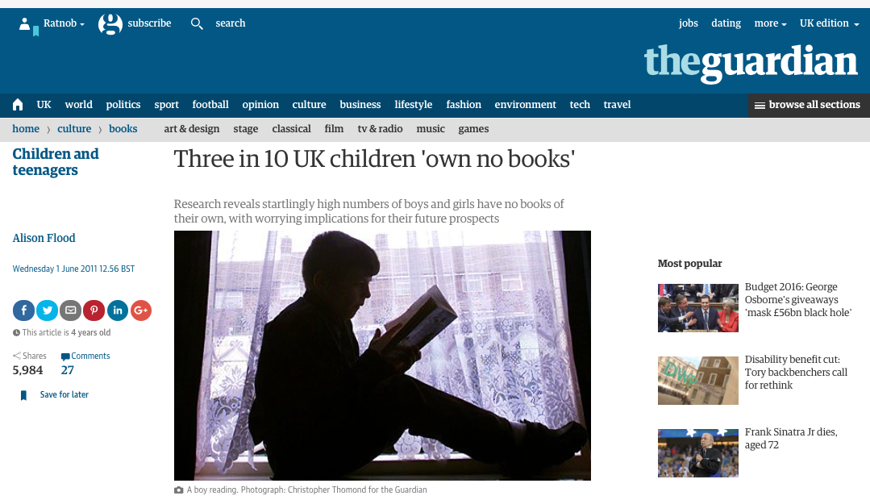

Slide 29
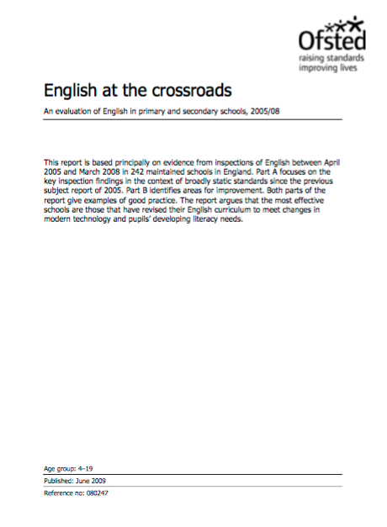

Slide 30
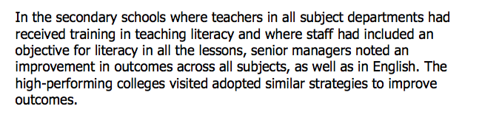

Slide 31
FUTURE

Slide 32
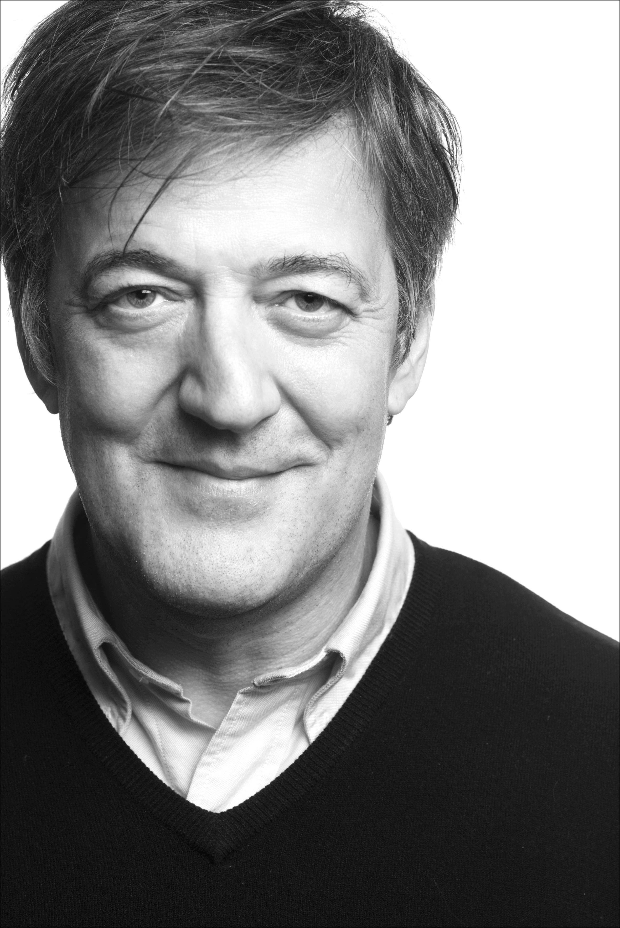
Books are no more threatened by Kindle than stairs by elevators.
STEPHEN FRY

Slide 33
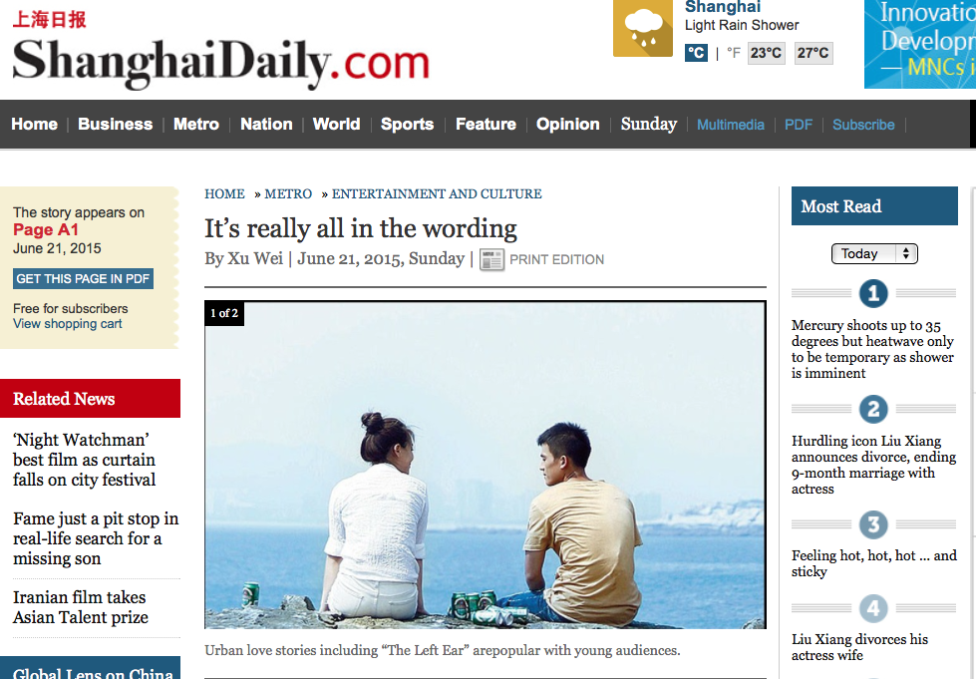

Slide 34
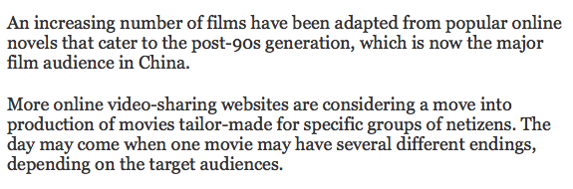

Slide 35
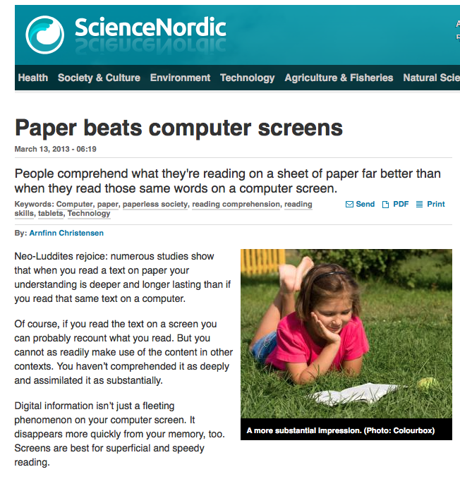

Slide 36
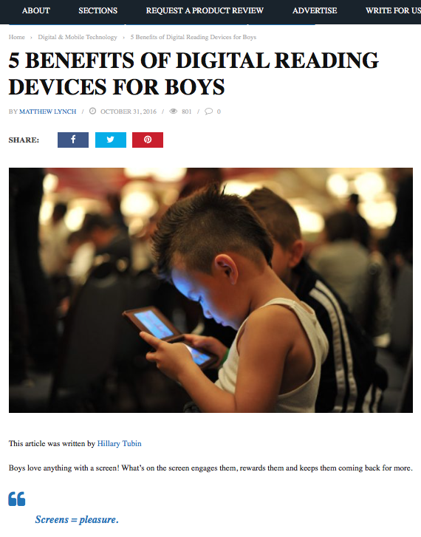

Slide 37

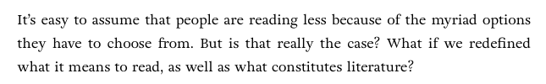

Slide 38
PAST

Slide 39
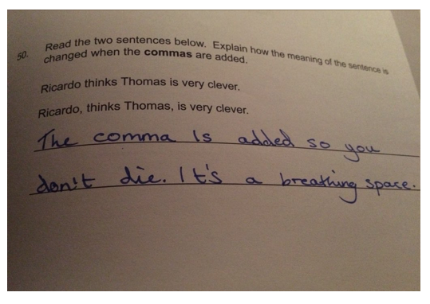
Notes:
Driven by testing - 1

Slide 40
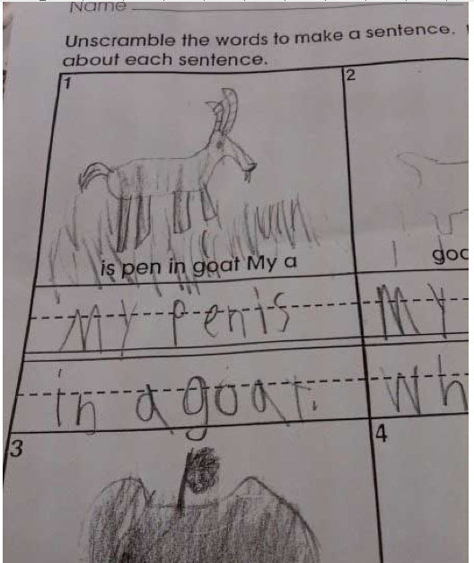
Notes:
Driven by testing - 1

Slide 41
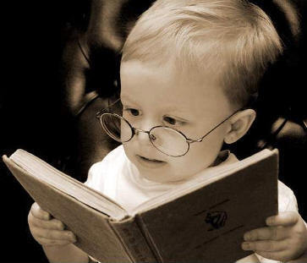
Teach and model reading
Personalise reading
Teach key vocabulary
Demystify spelling
Teach research, not FOFO

Slide 42
Reading Aloud

Slide 43


Slide 44
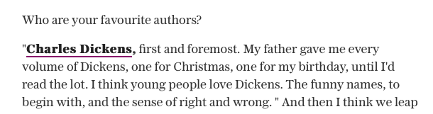

Slide 45


Slide 46


Slide 47
Teaching Conventions & Genres

Slide 48
Write a biography of a famous writer. How will it begin?
Notes:
It’s really beautiful out there; in here, however, it’s quite claustrophobic

Slide 49
A:
The Life of Charles Dickens
Chapter 1
CHARLES DICKENS, the most popular novelist of the century, and one of the greatest humorists that England has produced, was born at Lanport, in Portsea, on Friday, the seventh of February, 1812.
His father, John Dickens, a clerk in the navy pay-office, was at this time stationed in the Portsmouth Dockyard. He had made acquaintance with the lady, Elizabeth Barrow, who became afterwards his wife, through her elder brother, Thomas Barrow, also engaged on the establishment at Somerset House, and she bore him in all a family of eight children, of whom two died in infancy. The eldest, Fanny (born 1810), was followed by Charles (entered in the baptismal register of Portsea as Charles John Huffham, though on the very rare occasions when he subscribed that name he wrote Huffam); by another son, named Alfred, who died in childhood; by Letitia (born 1816); by another daughter, Harriet, who died also in childhood; by Frederick (born 1820); by Alfred Lamert (born 1822); and by Augustus (born 1827).
John Forster

Slide 50
B:
DICKENS by Peter Ackroyd
CHARLES DICKENS was dead. He lay on a narrow green sofa – but there was room enough for him, so spare had he become – in the dining room of Gad’s Hill Place. He had died in the house which he had first seen as a small boy and which his father had pointed out to him as a suitable object of his ambitions; so great was his father’s hold upon his life that, forty years later, he had bought it. Now he had gone. It was customary to close the blinds and curtains, thus enshrouding the corpse in darkness before its last journey to the tomb; but in the dining room of Gad’s Hill the curtains were pulled apart and on this June day the bright sunshine streamed in, glittering on the large mirrors around the room.
All the lines and wrinkles which marked the passage of his life were new erased in the stillness of death. He was not old – he died in his fifty-eighth year – but there had been signs of premature ageing on a visage so marked and worn; he had acquired, it was said, a “sarcastic look”. But now all that was gone and his daughter, Katey, who watched him as he lay dead, noticed how there once more emerged upon his face “beauty and pathos”.
Peter Ackroyd

Slide 51
Describe your holiday
Notes:
It’s really beautiful out there; in here, however, it’s quite claustrophobic

Slide 52
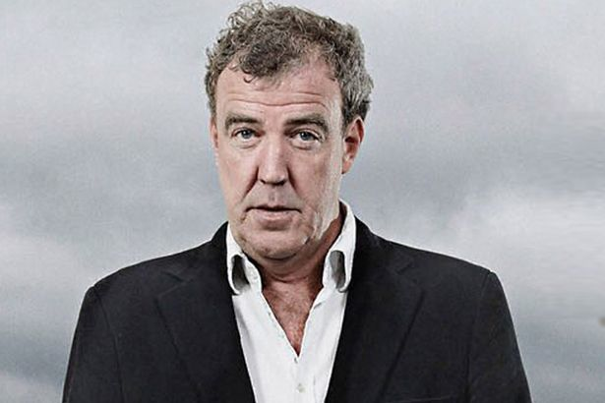
Notes:
It’s really beautiful out there; in here, however, it’s quite claustrophobic

Slide 53
For your next holiday, why don’t you take all your money and put it on the fire? Then stand in a fridge for a week, beating your children with a baseball bat until their arms and legs break. And then, after you’ve eaten some melted cheese, dislocate your shoulder.
If all of this appeals then you are probably one of the 1.3 million British people …
… who go on a skiing holiday at this time of year.
Notes:
It’s really beautiful out there; in here, however, it’s quite claustrophobic

Slide 54

SKIMMING

Slide 55
The climate of the Earth is always changing. In the past it has altered as a result of natural causes. Nowadays, however, the term climate change is generally used when referring to changes in our climate which have been identified since the early part of the 1900's . The changes we've seen over recent years and those which are predicted over the next 80 years are thought to be mainly as a result of human behaviour rather than due to natural changes in the atmosphere.

Slide 56
The best treatment for mouth ulcers. Gargle with salt water. You should find that it works a treat. Salt is cheap and easy to get hold of and we all have it at home, so no need to splash out and spend lots of money on expensive mouth ulcer creams.

Slide 57
Lexical v Grammatical Words

Slide 58
Urquhart castle is probably one of the most picturesquely situated castles in the Scottish Highlands. Located 16 miles south-west of Inverness, the castle, one of the largest in Scotland, overlooks much of Loch Ness. Visitors come to stroll through the ruins of the 13th-century castle because Urquhart has earned the reputation of being one of the best spots for sighting Loch Ness’s most famous inhabitant.

Slide 59
Urquhart castle is probably one of the most picturesquely situated castles in the Scottish Highlands. Located 16 miles south-west of Inverness, the castle, one of the largest in Scotland, overlooks much of Loch Ness. Visitors come to stroll through the ruins of the 13th-century castle because Urquhart has earned the reputation of being one of the best spots for sighting Loch Ness’s most famous inhabitant.

Slide 60
Urquhart castle is probably one of the most picturesquely situated castles in the Scottish Highlands. Located 16 miles south-west of Inverness, the castle, one of the largest in Scotland, overlooks much of Loch Ness. Visitors come to stroll through the ruins of the 13th-century castle because Urquhart has earned the reputation of being one of the best spots for sighting Loch Ness’s most famous inhabitant.

Slide 61
Urquhart castle is probably one of the most picturesquely situated castles in the Scottish Highlands. Located 16 miles south-west of Inverness, the castle, one of the largest in Scotland, overlooks much of Loch Ness. Visitors come to stroll through the ruins of the 13th-century castle because Urquhart has earned the reputation of being one of the best spots for sighting Loch Ness’s most famous inhabitant.

Slide 62
Urquhart castle is probably one of the most picturesquely situated castles in the Scottish Highlands. Located 16 miles south-west of Inverness, the castle, one of the largest in Scotland, overlooks much of Loch Ness. Visitors come to stroll through the ruins of the 13th-century castle because Urquhart has earned the reputation of being one of the best spots for sighting Loch Ness’s most famous inhabitant.

Slide 63

SCANNING

Slide 64
Where did the first cell phones begin?
Name 2 other features that started to be included in phones
Why are cell phones especially useful in some countries?

Slide 65
Where begin?
Two features?
Some countries?
Cellular telephones
The first cellular telephone system began operation in Tokyo in 1979, and the first U.S. system began operation in 1983 in Chicago. A camera phone is a cellular phone that also has picture taking capabilities. Some camera phones have the capability to send these photos to another cellular phone or computer. Advances in digital technology and microelectronics has led to the inclusion of unrelated applications in cellular telephones, such as alarm clocks, calculators, Internet browsers, and voice memos for recording short verbal reminders, while at the same time making such telephones vulnerable to certain software viruses. In many countries with inadequate wire-based telephone networks, cellular telephone systems have provided a means of more quickly establishing a national telecommunications network.

Slide 66
CLOSE READING

Slide 67
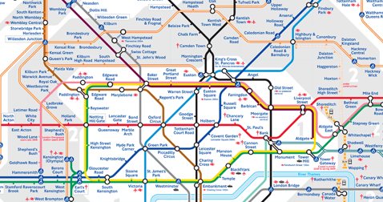
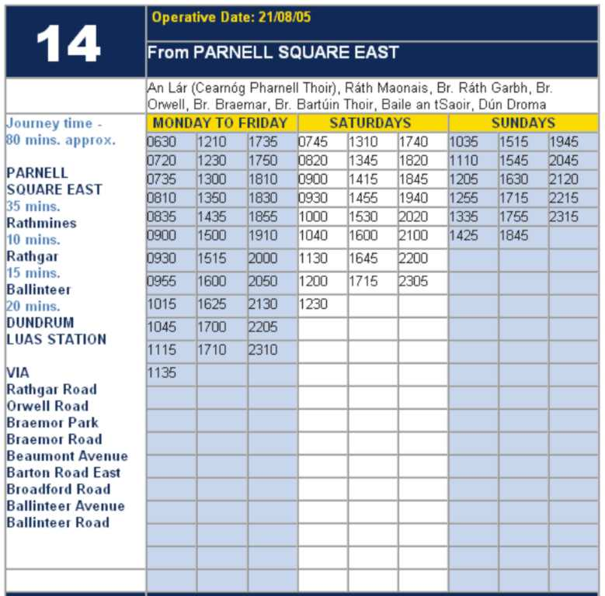
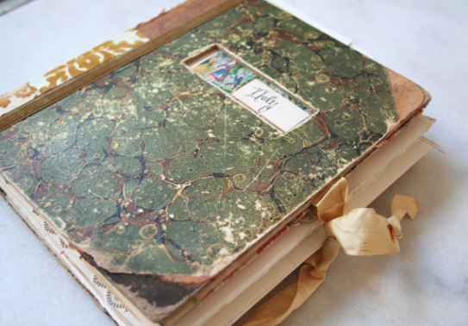




Slide 68

RESEARCH SKILLS

Slide 69
Research the life of
Martin Luther King

Slide 70
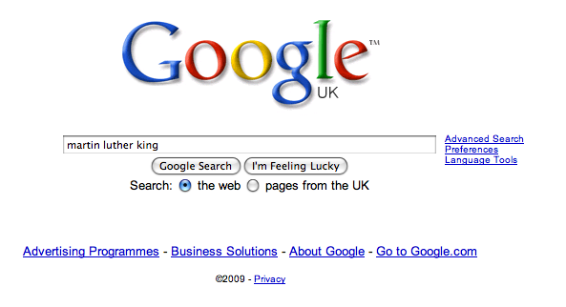

Slide 71


Slide 72
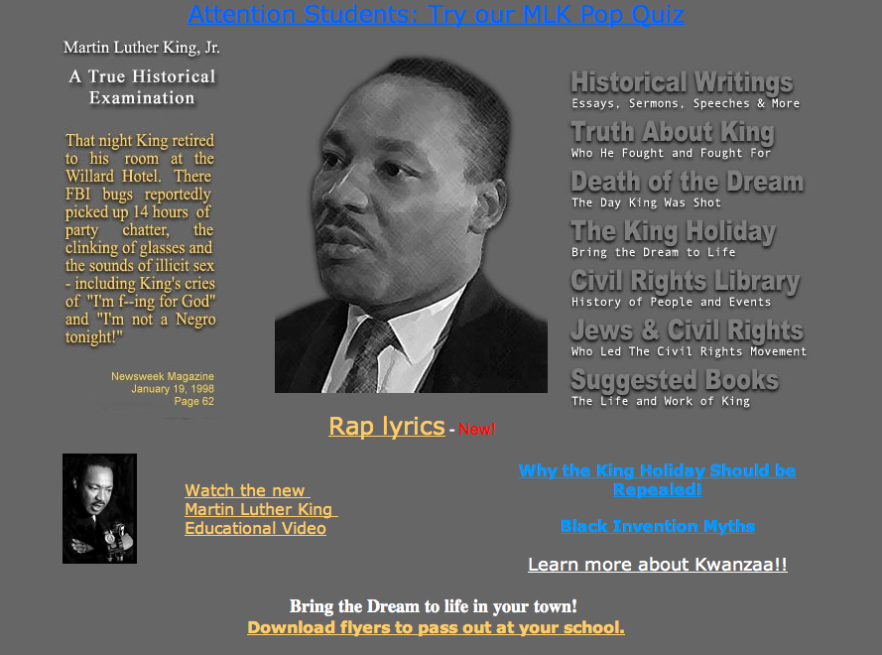


Slide 73
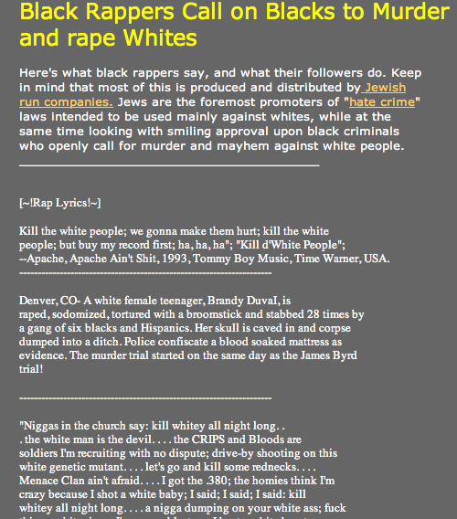

Slide 74
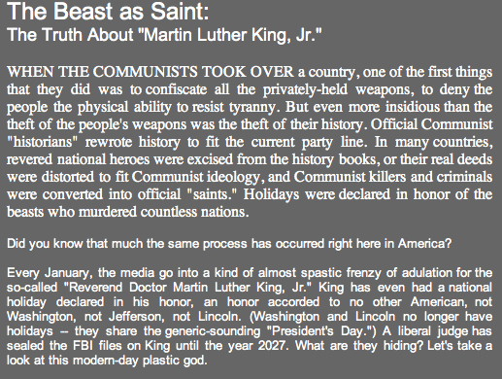

Slide 75


Slide 76


Slide 77
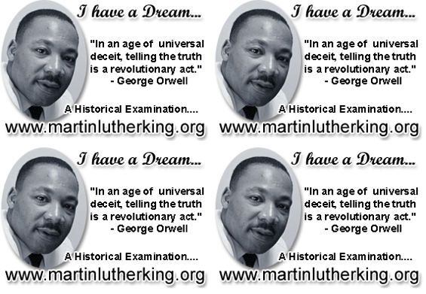

Slide 78
PRIOR KNOWLEDGE

Slide 79
What if Jane Austen was rewritten by Dylan Thomas?
Notes:
Necessary; accommodation; February;

Slide 80
Adventures In The Marriage Trade
FIRST VOICE: It is night in the smug-as-a-bug-in-a-rug household of Mr and Mrs Dai Bennet and their simpering daughters – five breast-bobbing man-hungry titivators, innocent as ice-cream, panting for balls and matrimony.
MRS BENNET: Our new neighbour, Mr Darcy, quite tickles my fancy.
MR BENNET: Don’t let him turn Lizzy’s head, Darcy-versy.
ELIZABETH: I shall wed whom I please.
FIRST VOICE: And busy Lizzie retires to her room with visions of bridling up the aisle to ‘I will’ with half-a-dozen demon lovers. She dreams of coaches and pairs and being a fine lady; dressing for dinner in silken gown and undressing afterwards for heaven knows what in the saucy haven of a double bed.
From EO Parrott, How to be Well Versed in Poetry

Slide 81
Normalising Reading

Slide 82
PREDICTION FUN
Brian Moore, Cold Heaven

Slide 83
1
The wooden seats of the little pedal boat were angled so that Marie looked up at the sky. There were no clouds. In the vastness above her a gull calligraphed its flight. Marie and Alex pedalled in unison, the revolving paddles making a slapping sound against the waves as the pedal boat treadmilled away from the beach, passing through ranks of bathers to move into the deeper, more solitary waters of the Baie des Anges. Marie slackened her efforts but Alex continued determinedly, steering the pedalo straight out into the Mediterranean.

Slide 84
2
‘Let’s not go too far,’ she said.
‘I want to get away from the crowd. I’m going to swim.’
It was like him to have some plan of his own, to translate idleness into activity even in these few days of vacation. She now noted his every fault. It was as though, having decided to leave him, she had withdrawn his credit. She looked back at the sweep of hotels along the Promenade des Anglais. Today was the day she had hoped to tell him. She had planned to announce it at breakfast and leave, first for New York, then on to Los Angeles to join Daniel. But at breakfast she lacked all courage. Now, with half the day gone, she decided to postpone it until tomorrow.

Slide 85
3
Far out from shore, the paddles stopped. The pedalo rocked on its twin pontoons as Alex eased himself up from his seat. He handed her his sunglasses. ‘This should do,’ he said and, rocking the boat even more, dived into the ultramarine waters. She watched him surface. He called out: ‘Just follow along, okay?’ He was not a good swimmer, but thrashed about in an energetic, erratic freestyle. Marie began to pedal again, her hand on the tiller, steering the little boat so that she followed close. Watching him, she knew he could not keep up this pace for long. She saw his flailing arms and for a moment thought of those arms hitting her. He had never hit her. He was not the sort of man who would hit you. He would be hurt, and cold, and possibly vindictive. But he was not violent.

Slide 86
4
She heard a motorboat, the sound becoming louder. She looked back but did not see a boat behind her. Then she looked to the right where Alex was swimming and saw a big boat with an outboard motor coming right at them, coming very fast.

Slide 87
5
Of course they see us, she thought, alarmed, and then as though she were watching a film, as though this were happening to someone else, she saw there was a man in the motorboat, a young man wearing a green shirt; he was not at the tiller, he was standing in the middle of the boat with his back to her and as she watched he bent down and picked up a child who had fallen on the floorboards. ‘Hey?’ she called. ‘Hey?’ for he must turn around, the motorboat was coming right at Alex, right at her. But the man in the boat did not hear. He carried the child across to the far side of the boat; the boat was only yards away now.

Slide 88
6
‘Alex,’ she called. ‘Alex, look out.’ But Alex flailed on and then the prow of the motorboat, slicing up water like a knife, hit Alex with a sickening thump, went over him and smashed into the pontoons of the little pedal boat, upending it, and she found herself in the water, going under, coming up. She looked and saw the motorboat churning off, the pedal boat hanging from its prow like a tangle of branches. She heard the motorboat engine cut to silence, then start up again as the boat veered around in a semicircle and came back to her. Alex?

Slide 89
7
She looked: saw his body near her just under the water. She swam toward him, breastroke, it was all she knew. He was floating face down, spread-eagle. She caught hold of his wrist and pulled him towards her. The motorboat came alongside, the man in the green shirt reaching down for her, but, ‘No, no,’ she called and tried to push Alex toward him. The man caught Alex by the hair of his head and pulled him up, she pushing, Alex falling back twice into the water, before the man, with a great effort, lifted him like a sack across the side of the boat, tugging and heaving until Alex disappeared into the boat. The man shouted, ‘Un instant, madame, un instant’ and reappeared, putting a little steel ladder over the side. She climbed up onto the motorboat as the man went out onto the prow to disentangle the wreckage of the pedalo.

Slide 90
8
A small child was sitting at the back of the boat, staring at Alex’s body, which lay face-down on the floorboards. She went to Alex and saw blood from a wound, a gash in the side of his head, blood matting his hair. He was breathing but unconscious. She lifted him and cradled him in her arms, his blood trickling onto her breasts. She saw the boat owner’s bare legs go past her as he went to the rear of the boat to restart the engine. The child began to bawl but the man leaned over, silenced it with an angry slap, the man turned to her, his face sick with fear. ‘Nous y serons dans un instant,’ he shouted, opening the motor to full throttle. She hugged Alex to her, a rivulet of blood dripping off her forearm onto the floorboards as the boat raced to the beach.

Slide 91
PREDICTION FUN
Brian Moore, Cold Heaven

Slide 92
A Reading Culture
Demystify and personalise reading
Whole texts, real books, extracts and displays
Celebrate intertextuality, low/high culture, imaginative/non-fiction, conventions
Relish difficultness; introduce it early; model our response
Read stuff aloud, including classics
Demystify the past – including language choices
Teach knowledge

Slide 93
Putting Reading at the Heart of School
Geoff Barton
Head, King Edward VI School
Suffolk
OUP Professional Development
29 November 2016
Twitter: @RealGeoffBarton
Presentation free at: geoffbarton.co.uk/teacher-resources (number 150)

