Slide 1
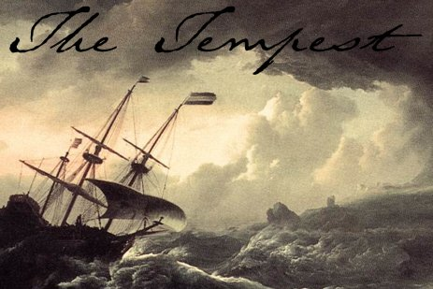
‘The past is another country:
they do things differently there’:
OCR Annual English Conference 2016
Geoff Barton
Head, King Edward VI School, Suffolk
Download this presentation at www.geoffbarton.co.uk (143) Twitter: @RealGeoffBarton

Slide 2
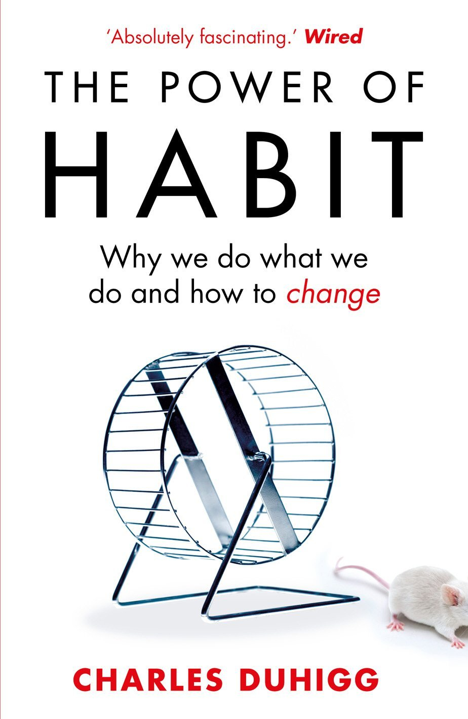

Slide 3
Context

Slide 4
The world of our students is different from the world when we were students

Slide 5
How do you react to these rooms?

Slide 6
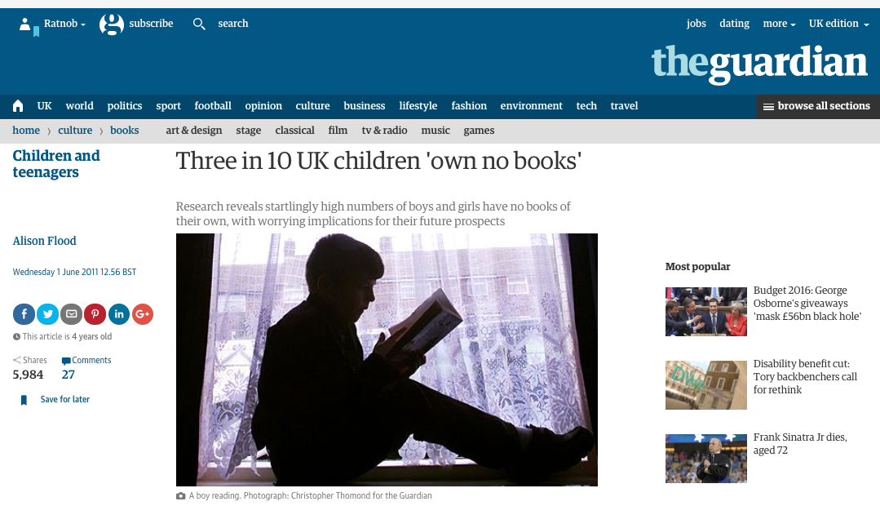

Slide 7
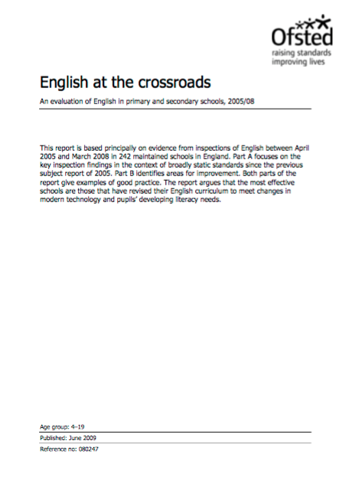

Slide 8
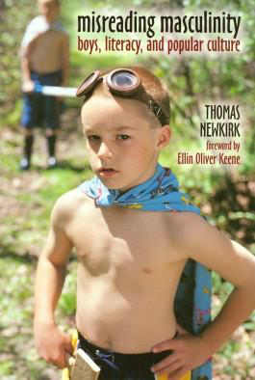
‘Too often the argument for reading is made by those who have spent their lives as insiders; the pleasures of solitary reading are so obvious, the value of reading so self-evident, that we fail to appreciate how utterly strange reading is to the outsider’

Slide 10
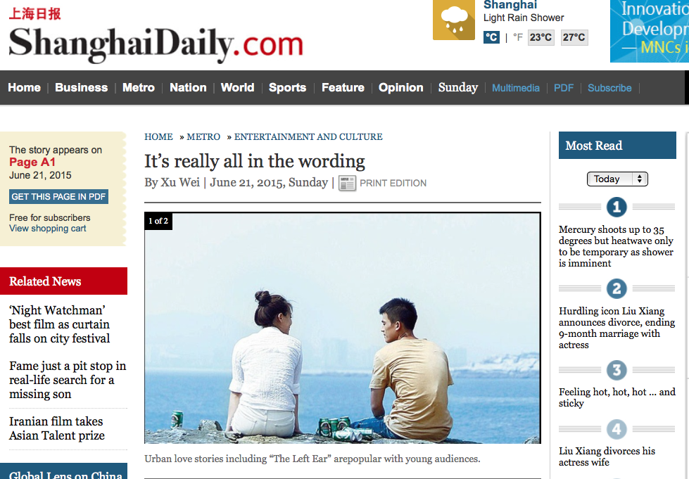

Slide 12
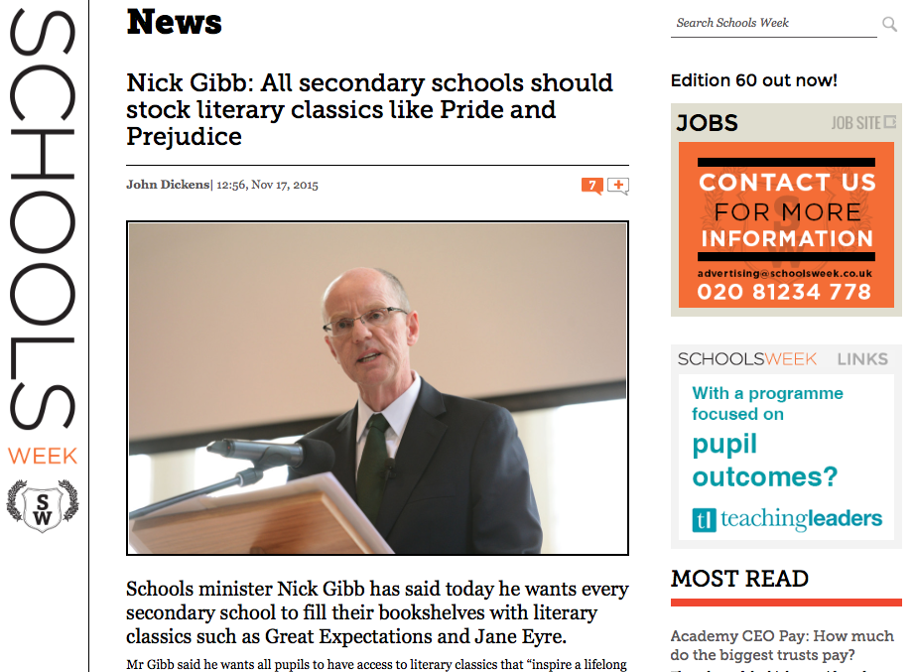

Slide 13
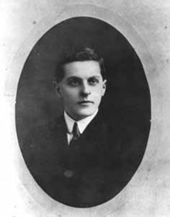
“The limits of my language mean the limits of my world”
Ludwig Wittgenstein

Slide 14
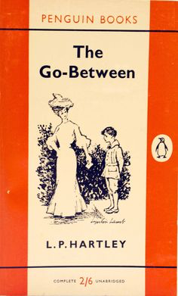
‘The past is another country:
they do things differently there’:

Slide 15
What is English for at your school and how are you building the habits of reading?

Slide 16
What is English at your school for?
What does English distinctively add to the experience of your students?
What are the non-negotiable activities and texts in your English curriculum?
How does it instil essential knowledge?
Does it combine depth with breadth?
Does it challenge students linguistically and conceptually more than they might expect – especially the ‘word poor’?

Slide 17
How are we building reading habits?
At the heart of English: a reading curriculum within a reading culture
Inquisitive readers are taught by inquisitive readers, high culture rubbing shoulders with low
We teach how reading works: skimming, scanning, analysis, register, conventions of texts, point-of-view, unreliable narrators, endings, speech verbs, drop paragraphs …
Build knowledge

Slide 18
“The children who possess intellectual capital when they first arrive at school have the mental scaffolding and Velcro to catch hold of what is going on, and they can turn the new knowledge into still more Velcro to gain still more knowledge”.

Slide 19
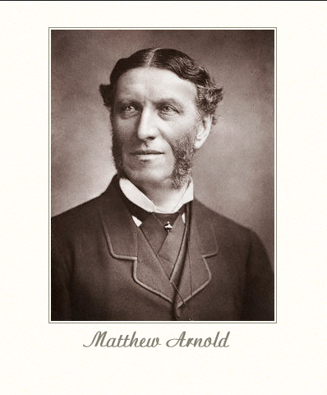
‘The Preachers of Culture’

Slide 20
Reading:
Culture & Pedagogy

Slide 21
A Reading Culture
Demystify and personalise reading
Whole texts, real books, extracts and displays
Celebrate intertextuality, low/high culture, imaginative/non-fiction, conventions
Relish difficultness; introduce it early; model our response
Read stuff aloud, including classics
Demystify the past – including language choices
Teach knowledge

Slide 22
Let’s teach stuff

Slide 23
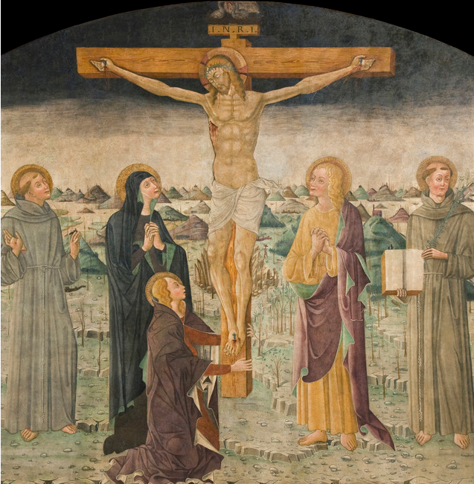
Notes:
the rightly obscure Polidoro di Bartolomeo 1480

Slide 24
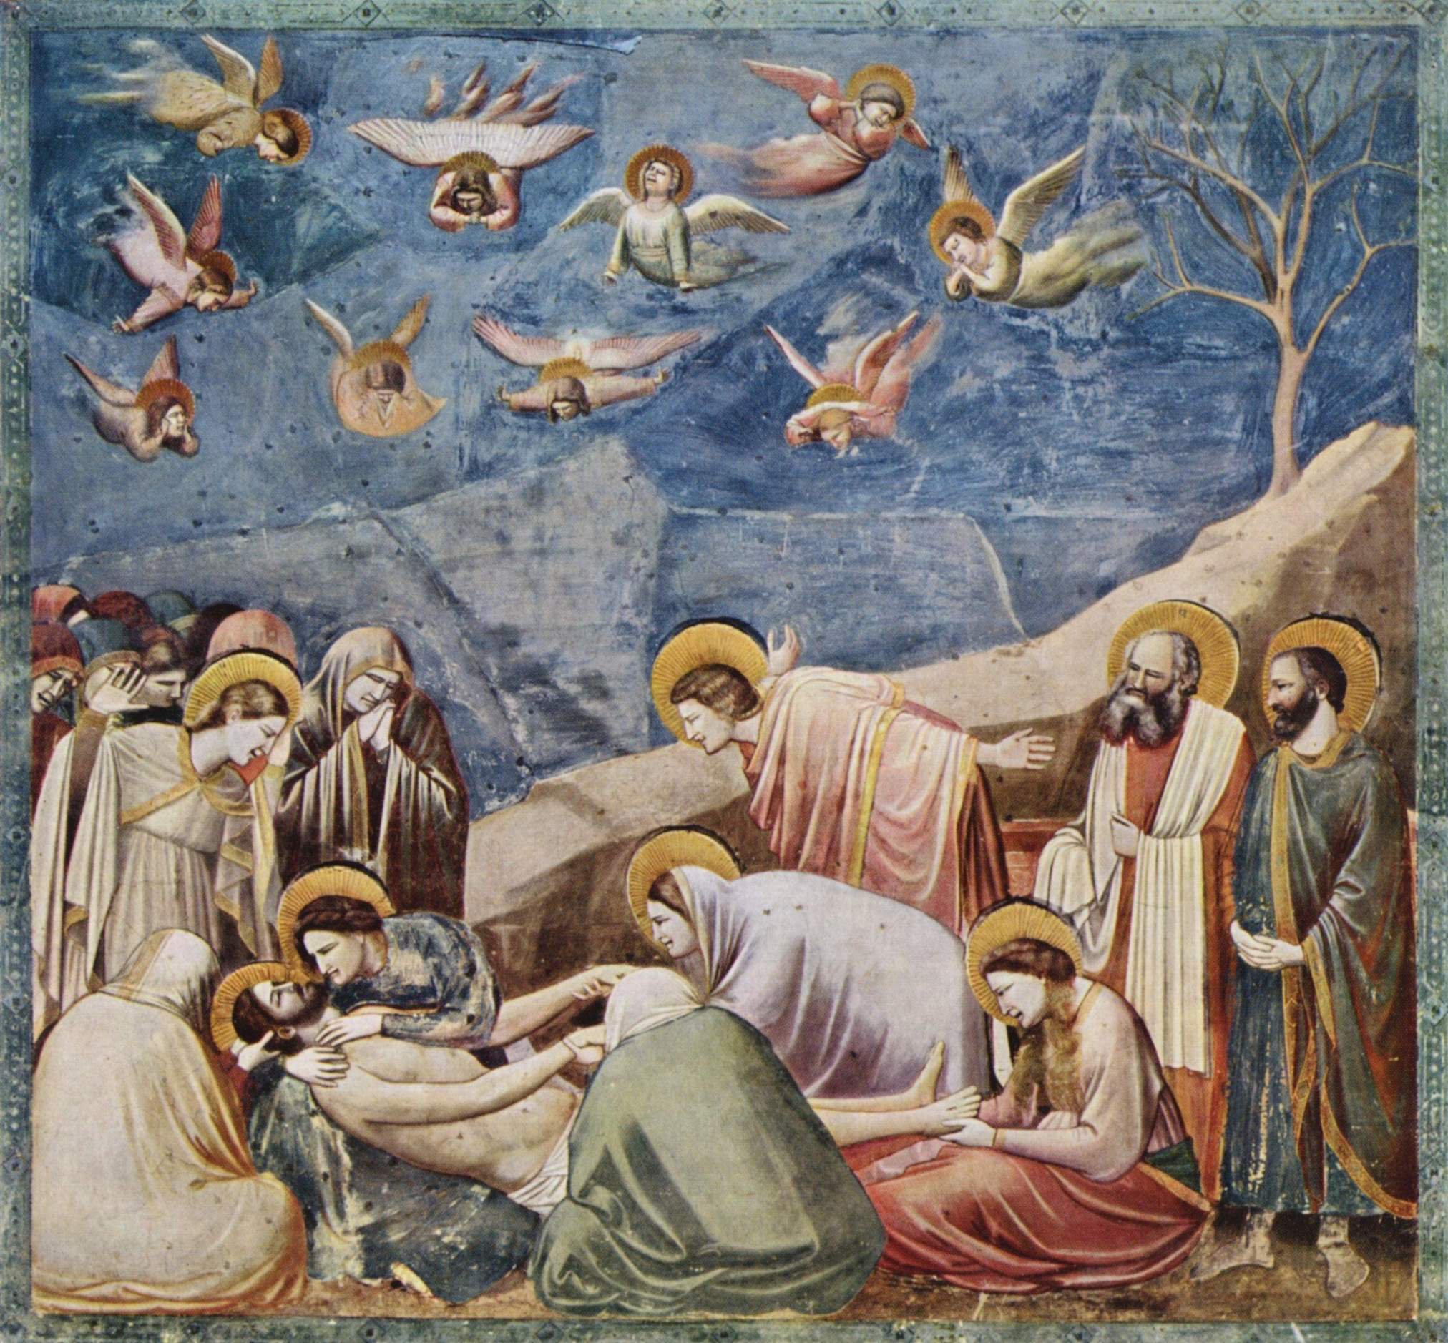
Notes:
Giotto 1330

Slide 25
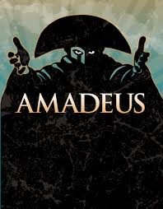
Serenade in B Flat

Slide 26
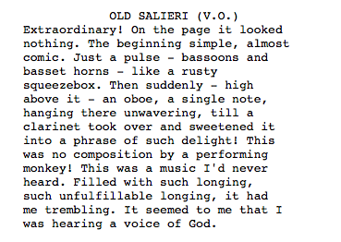

Slide 27
Literary birthright

Slide 28
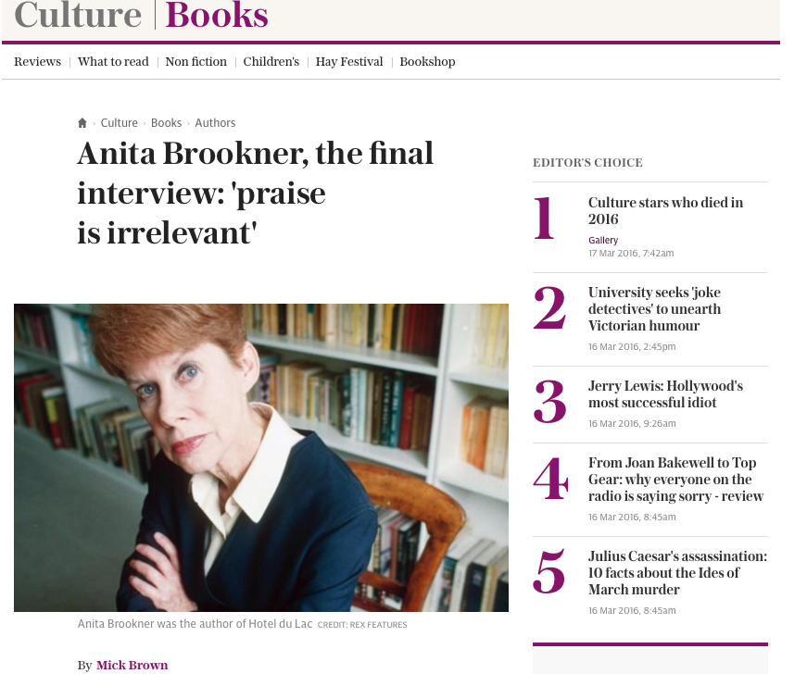

Slide 30
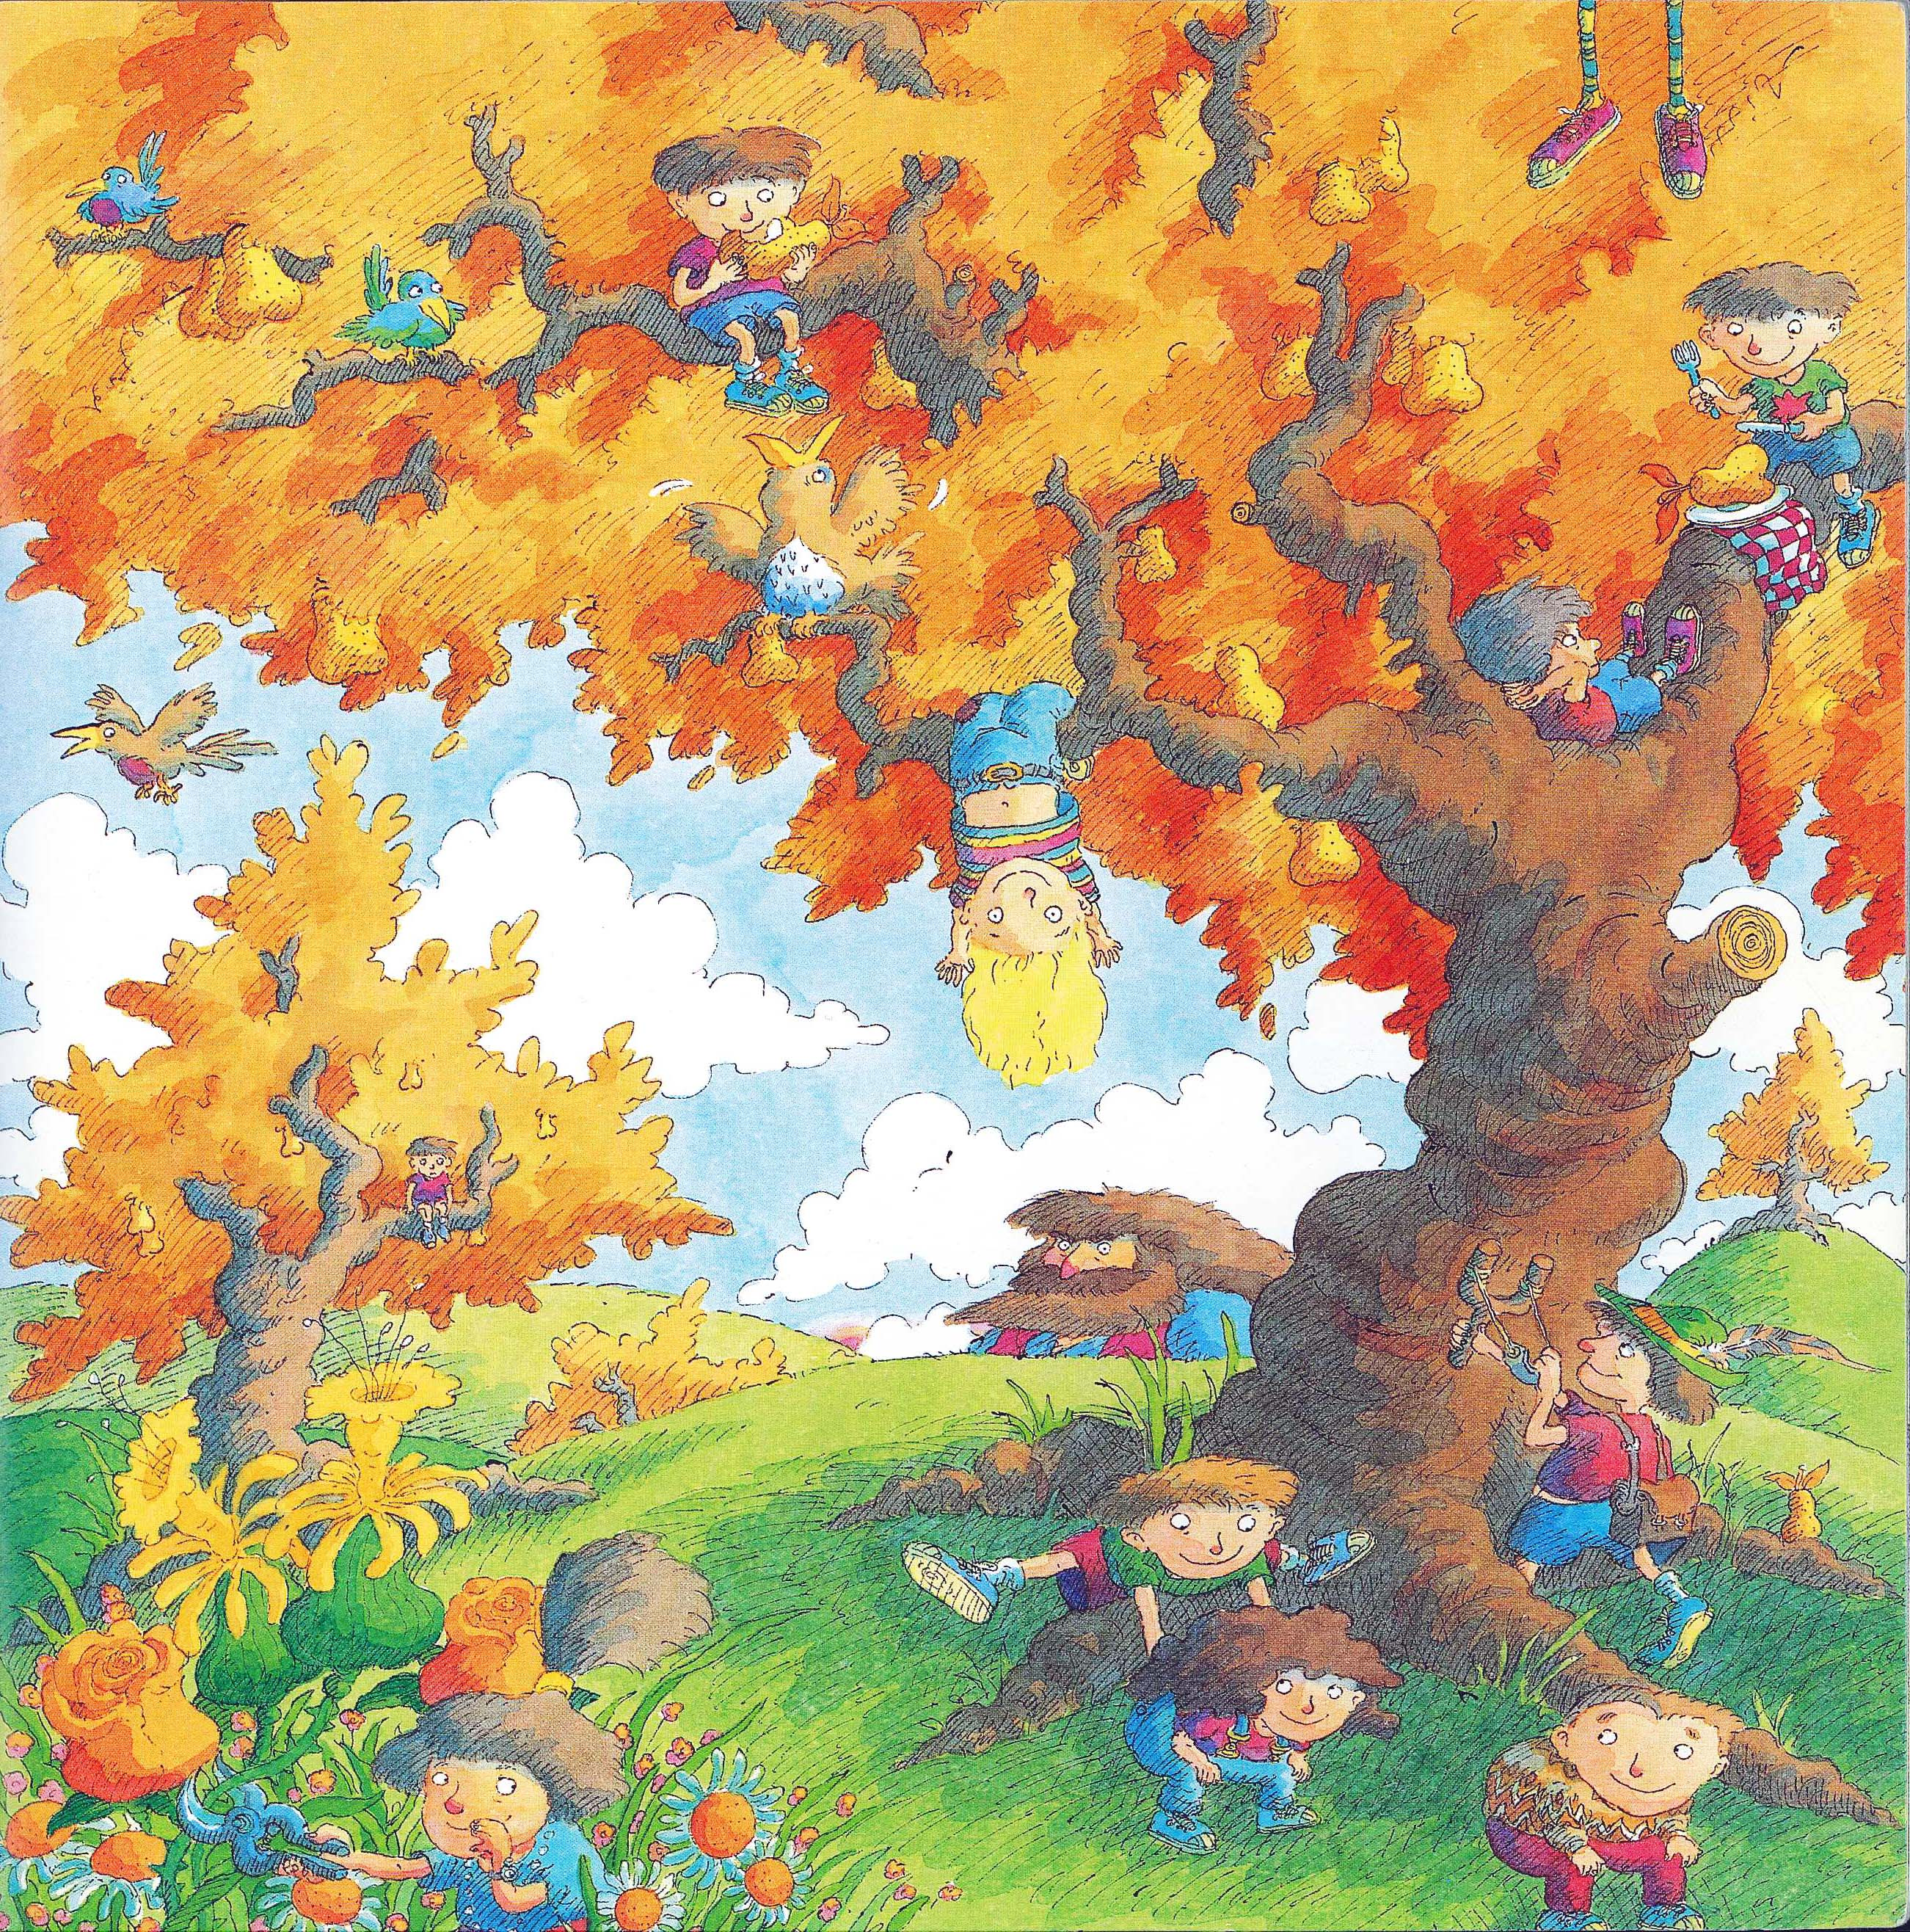

Slide 31
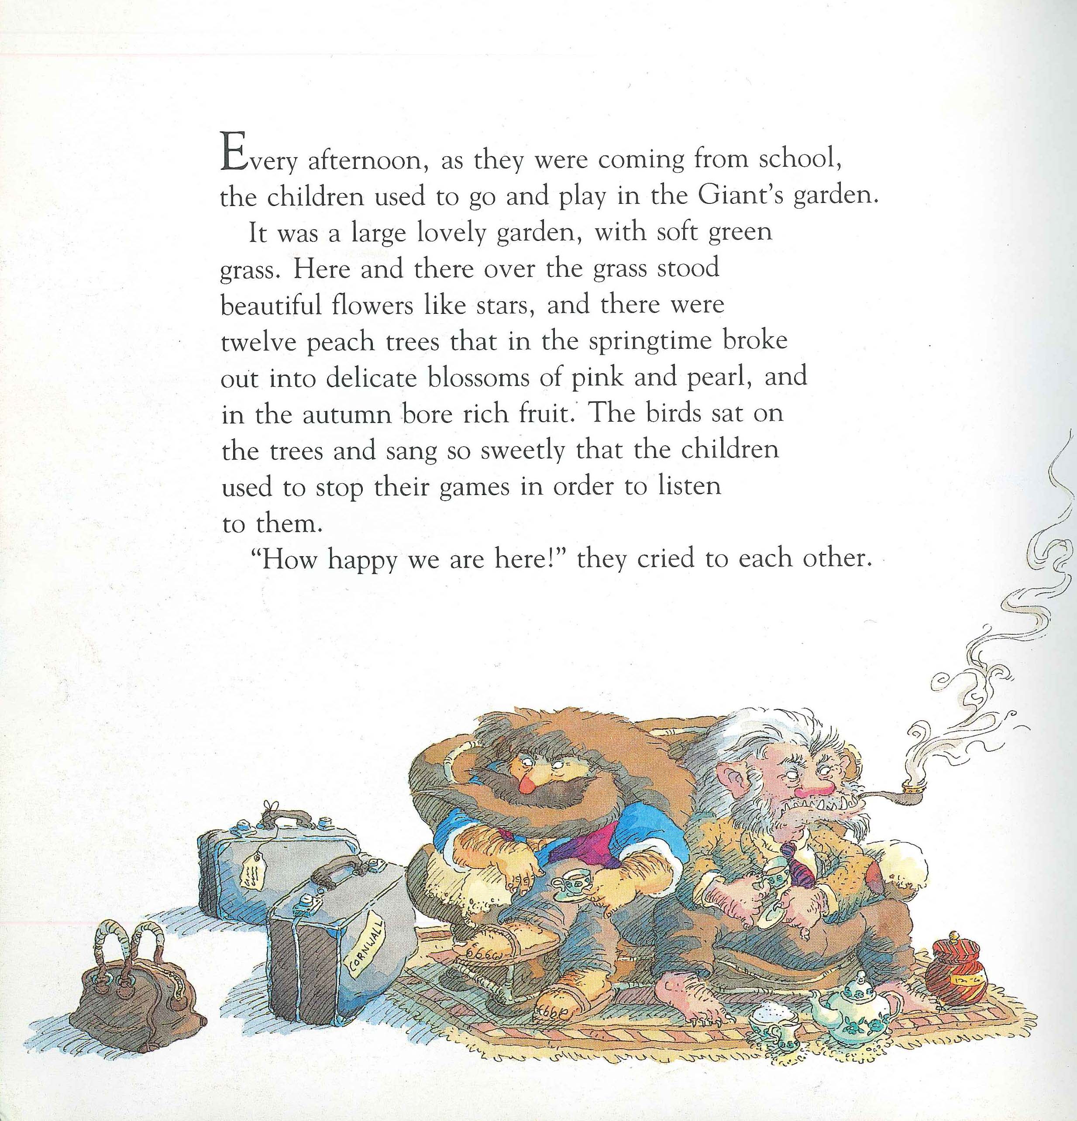

Slide 32
Conventions:
How would you begin a biography of a famous writer?

Slide 33
A:
The Life of Charles Dickens
Chapter 1
CHARLES DICKENS, the most popular novelist of the century, and one of the greatest humorists that England has produced, was born at Lanport, in Portsea, on Friday, the seventh of February, 1812.
His father, John Dickens, a clerk in the navy pay-office, was at this time stationed in the Portsmouth Dockyard. He had made acquaintance with the lady, Elizabeth Barrow, who became afterwards his wife, through her elder brother, Thomas Barrow, also engaged on the establishment at Somerset House, and she bore him in all a family of eight children, of whom two died in infancy. The eldest, Fanny (born 1810), was followed by Charles (entered in the baptismal register of Portsea as Charles John Huffham, though on the very rare occasions when he subscribed that name he wrote Huffam); by another son, named Alfred, who died in childhood; by Letitia (born 1816); by another daughter, Harriet, who died also in childhood; by Frederick (born 1820); by Alfred Lamert (born 1822); and by Augustus (born 1827).
John Forster

Slide 34
B:
DICKENS by Peter Ackroyd
CHARLES DICKENS was dead. He lay on a narrow green sofa – but there was room enough for him, so spare had he become – in the dining room of Gad’s Hill Place. He had died in the house which he had first seen as a small boy and which his father had pointed out to him as a suitable object of his ambitions; so great was his father’s hold upon his life that, forty years later, he had bought it. Now he had gone. It was customary to close the blinds and curtains, thus enshrouding the corpse in darkness before its last journey to the tomb; but in the dining room of Gad’s Hill the curtains were pulled apart and on this June day the bright sunshine streamed in, glittering on the large mirrors around the room.
All the lines and wrinkles which marked the passage of his life were new erased in the stillness of death. He was not old – he died in his fifty-eighth year – but there had been signs of premature ageing on a visage so marked and worn; he had acquired, it was said, a “sarcastic look”. But now all that was gone and his daughter, Katey, who watched him as he lay dead, noticed how there once more emerged upon his face “beauty and pathos”.
Peter Ackroyd

Slide 35
The creative power of non-fiction

Slide 36
A Short History of England – Simon Jenkins
King John:
Turning to the barons for support he found them reluctant to advance him funds, though this did nothing to relieve his extravagance. He welcomed at court yet more of his wife’s relatives, and even gave London its first zoo, kept at the Tower.
It included a polar bear that swam in the Thames, lions, snakes, rhinoceros and an elephant. The ostrich died after being fed a diet of silverware.
Later, visitors had to pay to enter, or bring a cat or dog as food for the lions.

Slide 37
The Great Silence – Juliet Nicolson
And when Mr Lloyd came through the door the pyjama-wearing sisters had to unscrew their expressions of revulsion and force themselves to kiss his cheek as far away as possible from his mouth before running upstairs and making audible noises as soon as they reached their bedroom door.
Before going to bed, the children were asked to include Mr Lloyd in their prayers, ‘Please God make Mr Lloyd quite quite well’, they would dutifully ask, running the sentence on without a break as they asked God for forgiveness ‘for anything I have done wrong today’. But there was little hope of God intervening.
When Mr Lloyd stayed for supper the children would turn their faces away, dreading the reappearance of food from his nose. Half of Stuart Lloyd’s face was gone, his palate missing, blown off at the Somme.

Slide 38
Jonathan Swift, Eating people is right
A child will make two dishes at an entertainment for friends: and when the family dines alone, the fore or hind quarter will make a reasonable dish, and, seasoned with a little pepper or salt, be very good boiled on the fourth day, especially in winter.
I have reckoned, upon a medium, that a child just born will weigh twelve pounds, and in a solar year, if tolerably nursed, increaseth to twenty-eight pounds.
I grant this food will be somewhat dear, and therefore very proper for landlords, who, as they have already devoured most of the parents, seem to have the best title to the children.
Infant’s flesh will be in season throughout the year, but more plentiful in March, and a little before and after.

Slide 39
Reading:
Culture & Pedagogy

Slide 40
A Pedagogy for Reading
Build inquisitiveness through questioning
Relish difficultness; model resilience
Demonstrate tentativeness
Focus on words
Celebrate playfulness
Comprehension ➔ comparison ➔ genres ➔ discrimination
Write from a reader’s perspective; read from a writer’s
Talk about and show your reading

Slide 41
Modelling resilience:
What do you notice?
How do you read this?

Slide 42
What / How?
one
t
hi
s
snowflake
(a
li
ght
in
g)
is upon a gra
v
es
t
one
ee cummings

Slide 43
Parody:
What if JD Salinger rewrote the Bible?

Slide 44
Boy, when I saw old Eve I thought I was going to flip. I mean it isn’t that Eve is good-looking or anything like that, it’s just that she’s different. I don’t know what the hell it is exactly – but you always know when she’s around.
She looked nervous as hell. I kinda felt sorry for her – even though she’s got one of my goddam ribs, so I went over to talk to old Eve.
“You look very, very nice, Adam” she said to me in a funny way, like she was ashamed of something. “Why don’t you join me in some apple?”
Goddam, is that all these sophisticated babes think about all the time? It’s enough to drive a guy crazy, if you know what I mean.
From Simon Brett, The Faber Book of Parodies

Slide 45
Parody:
What if Dylan Thomas rewrote ‘Pride & Prejudice’?

Slide 46
Adventures In The Marriage Trade
FIRST VOICE: It is night in the smug-as-a-bug-in-a-rug household of Mr and Mrs Dai Bennet and their simpering daughters – five breast-bobbing man-hungry titivators, innocent as ice-cream, panting for balls and matrimony.
MRS BENNET: Our new neighbour, Mr Darcy, quite tickles my fancy.
MR BENNET: Don’t let him turn Lizzy’s head, Darcy-versy.
ELIZABETH: I shall wed whom I please.
FIRST VOICE: And busy Lizzie retires to her room with visions of bridling up the aisle to ‘I will’ with half-a-dozen demon lovers. She dreams of coaches and pairs and being a fine lady; dressing for dinner in silken gown and undressing afterwards for heaven knows what in the saucy haven of a double bed.
From EO Parrott, How to be Well Versed in Poetry

Slide 47
‘The past is another country’:
Simple summary:
It’s about great teaching
Reading is about habits
The ‘word poor’ need us more than ever

Slide 48
English Teacher
Petite, white-haired Miss Cartwright
Knew Shakespeare off by heart,
Or so we pupils thought.
Once in the stalls at the Old Vic
She prompted Lear when he forgot his part.
Ignorant of Scrutiny and Leavis,
She taught Romantic poetry,
Dreamt of gossip with dead poets.
To an amazed sixth form once said: ‘How good to spend a night with Shelley.’
In long war years she fed us plays,
Sophocles to Shaw’s St Joan.
Her reading nights we named our Courting Club,
Yet always through the blacked-out streets
One boy left the girls and saw her home.
When she closed her eyes and chanted
‘Ode to a Nightingale’
We laughed yet honoured her devotion.
We knew the man she should have married
Was killed at Passchendaele.
Brian Cox
From Collected Poems, Carcanet Press 1993.

Slide 49
‘The past is another country:
They do things differently there’:
OCR Annual English Conference 2016
Geoff Barton
Head, King Edward VI School, Suffolk
Download this presentation at www.geoffbarton.co.uk (143) Twitter: @RealGeoffBarton

