Slide 1
Don’t Call it iteracy
Warwickshire Literacy
Training
12 October 2015
Twitter: @RealGeoffBarton
Download this presentation at www.geoffbarton.co.uk
(Presentation number 141)

Slide 2
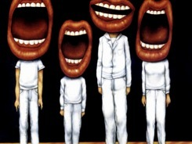
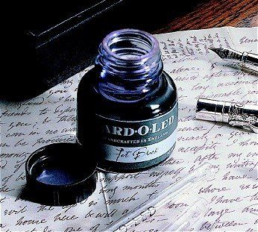

Slide 3
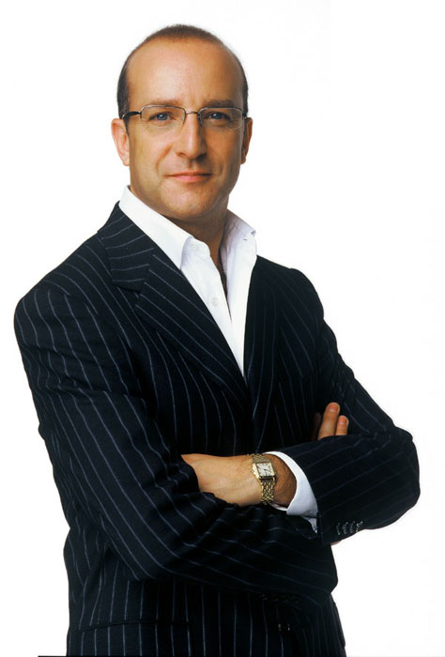
Aims:
I will make you better at SPEAKING& READING
& WRITING

Slide 4
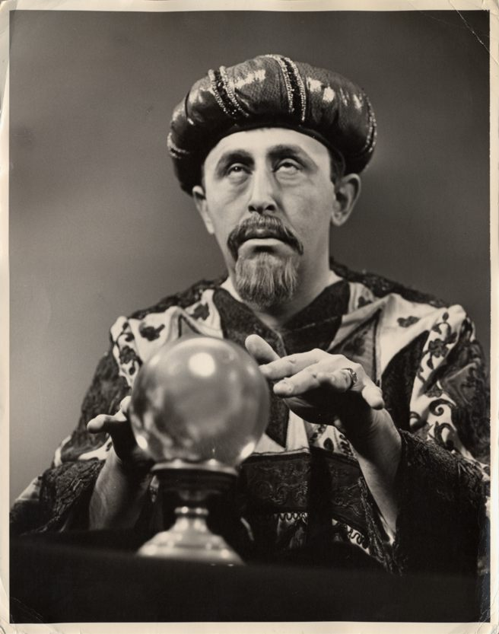
Warwickshire bonus:
Today I will reveal the secret of literacy

Slide 5
WHAT

Slide 6
HOW

Slide 7
Structure:
Part 1: The Habits of Literacy
Part 2: Essentials for Impact:
- Speaking & Listening
- Reading
- Writing
And how to make them happen …

Slide 8
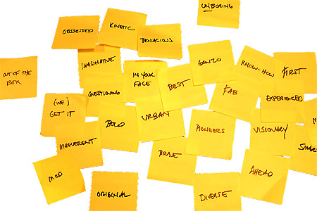
Approach:

Slide 9
Hypothesis:
Become a Year 11 writer again
… for ‘four’ minutes

Slide 10
Hypothesis:
Task:
Describe the room we are in

Slide 11
Q:
?
Unconfident
Confident
Irrespective of background

Slide 12
A:
Teach them

Slide 13
Provocations:
We haven’t done literacy
It’s all about the classroom
Knowledge and instruction may be more important than we realised
Remember the “Matthew Effect”

Slide 14
The Matthew Effect
(Robert K Merton)

Slide 15
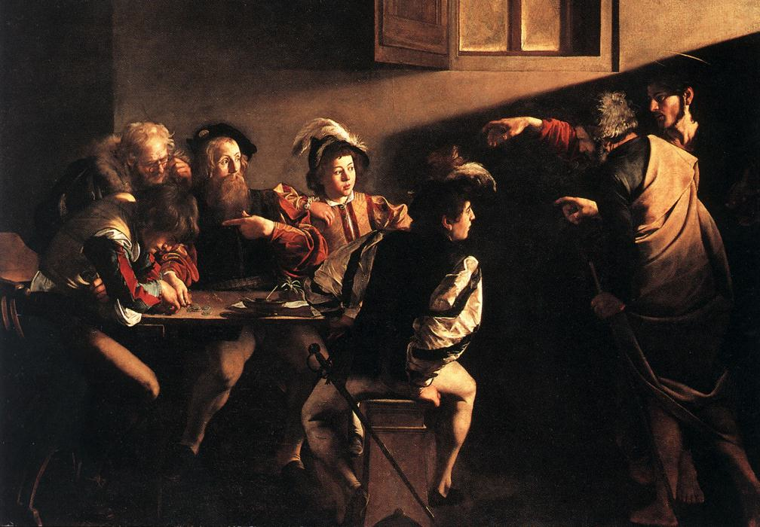

Slide 16
The rich shall get richer and the poor shall get poorer
Matthew 13:12

Slide 17
“The word-rich get richer while the word-poor get poorer” in their reading skills
(Canadian Association of School Librarians)

Slide 18
“While good readers gain new skills very rapidly, and quickly move from learning to read to reading to learn, poor readers become increasingly frustrated with the act of reading, and try to avoid reading where possible”
The Matthew Effect
Daniel Rigney

Slide 19
“Students who begin with high verbal aptitudes find themselves in verbally enriched social environments and have a double advantage.”
The Matthew Effect
Daniel Rigney

Slide 20
Stricht’s Law: “reading ability in children cannot exceed their listening ability …”
E.D. Hirsch
The Schools We Need

Slide 21
“Spoken language forms a constraint, a ceiling not only on the ability to comprehend but also on the ability to write, beyond which literacy cannot progress”
Myhill and Fisher

Slide 22
Aged 7:
Children in the top quartile have 7100 words; children in the lowest have around 3000.
The main influence is parents.
DfE Research Unit

Slide 23
The Matthew Effect:
The rich will get richer &
the poor will get poorer

Slide 24
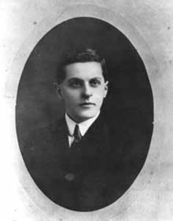
“The limits of my language mean the limits of my world”
Ludwig Wittgenstein

Slide 25
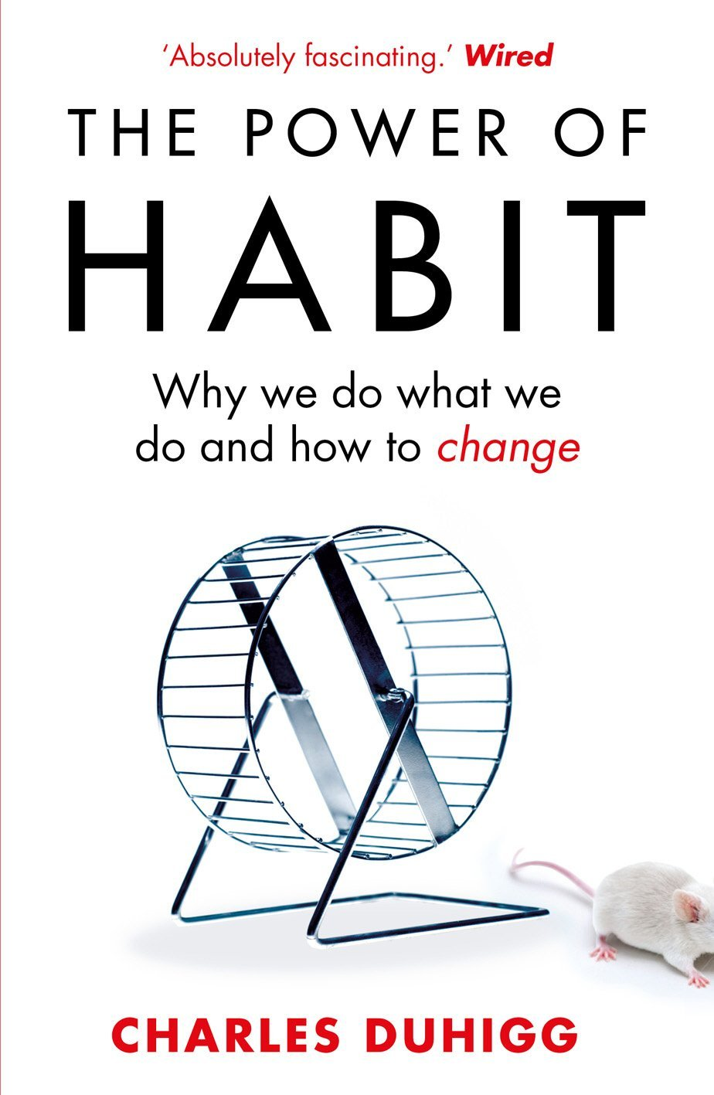
‘More than 40% of the actions people perform each day aren’t decisions but habits …’

Slide 26
The Literacy Club

Slide 27
5 key ingredients
Then teach you something
Then reflection

Slide 28
Understand the significance of exploratory talk
Model good talk – eg connectives
Re-think questioning – ‘why & how’, thinking time, and full-sentence responses
Consciously vary groupings
Get conversation into the school culture

Slide 29
DEMO

Slide 30
Focus: speaking in public

Slide 31
Barriers:
Lack of confidence
Lack of structure
Lack of depersonalised tone

Slide 32
Task: why school uniform crushes our individuality

Slide 33
Stance, notes, pen
Number points
Be repetitive
Sentence functions
Confidence
Structure
Depersonalised tone
Avoid I / me
Use ‘so’ / ‘because’ / ‘however’ / ‘therefore’

Slide 34
Understand the significance of exploratory talk
Model good talk – eg connectives
Re-think questioning – ‘why & how’, thinking time, and full-sentence responses
Consciously vary groupings
Get conversation into the school culture

Slide 36
Teach reading – scanning, skimming, analysis
Read aloud and display
Teach key vocabulary
Demystify spelling
Teach research, not FOFO

Slide 37
DEMO

Slide 38
SKIMMING

Slide 39
The climate of the Earth is always changing. In the past it has altered as a result of natural causes. Nowadays, however, the term climate change is generally used when referring to changes in our climate which have been identified since the early part of the 1900's . The changes we've seen over recent years and those which are predicted over the next 80 years are thought to be mainly as a result of human behaviour rather than due to natural changes in the atmosphere.

Slide 40
The best treatment for mouth ulcers. Gargle with salt water. You should find that it works a treat. Salt is cheap and easy to get hold of and we all have it at home, so no need to splash out and spend lots of money on expensive mouth ulcer creams.

Slide 41
Lexical v Grammatical Words

Slide 42
Urquhart castle is probably one of the most picturesquely situated castles in the Scottish Highlands. Located 16 miles south-west of Inverness, the castle, one of the largest in Scotland, overlooks much of Loch Ness. Visitors come to stroll through the ruins of the 13th-century castle because Urquhart has earned the reputation of being one of the best spots for sighting Loch Ness’s most famous inhabitant.

Slide 43
Urquhart castle is probably one of the most picturesquely situated castles in the Scottish Highlands. Located 16 miles south-west of Inverness, the castle, one of the largest in Scotland, overlooks much of Loch Ness. Visitors come to stroll through the ruins of the 13th-century castle because Urquhart has earned the reputation of being one of the best spots for sighting Loch Ness’s most famous inhabitant.

Slide 44
Urquhart castle is probably one of the most picturesquely situated castles in the Scottish Highlands. Located 16 miles south-west of Inverness, the castle, one of the largest in Scotland, overlooks much of Loch Ness. Visitors come to stroll through the ruins of the 13th-century castle because Urquhart has earned the reputation of being one of the best spots for sighting Loch Ness’s most famous inhabitant.

Slide 45
Urquhart castle is probably one of the most picturesquely situated castles in the Scottish Highlands. Located 16 miles south-west of Inverness, the castle, one of the largest in Scotland, overlooks much of Loch Ness. Visitors come to stroll through the ruins of the 13th-century castle because Urquhart has earned the reputation of being one of the best spots for sighting Loch Ness’s most famous inhabitant.

Slide 46
Urquhart castle is probably one of the most picturesquely situated castles in the Scottish Highlands. Located 16 miles south-west of Inverness, the castle, one of the largest in Scotland, overlooks much of Loch Ness. Visitors come to stroll through the ruins of the 13th-century castle because Urquhart has earned the reputation of being one of the best spots for sighting Loch Ness’s most famous inhabitant.

Slide 47
SCANNING

Slide 48
Where did the first cell phones begin?
Name 2 other features that started to be included in phones
Why are cell phones especially useful in some countries?

Slide 49
Where begin?
Two features?
Some countries?
Cellular telephones
The first cellular telephone system began operation in Tokyo in 1979, and the first U.S. system began operation in 1983 in Chicago. A camera phone is a cellular phone that also has picture taking capabilities. Some camera phones have the capability to send these photos to another cellular phone or computer. Advances in digital technology and microelectronics has led to the inclusion of unrelated applications in cellular telephones, such as alarm clocks, calculators, Internet browsers, and voice memos for recording short verbal reminders, while at the same time making such telephones vulnerable to certain software viruses. In many countries with inadequate wire-based telephone networks, cellular telephone systems have provided a means of more quickly establishing a national telecommunications network.

Slide 50
CLOSE READING

Slide 51
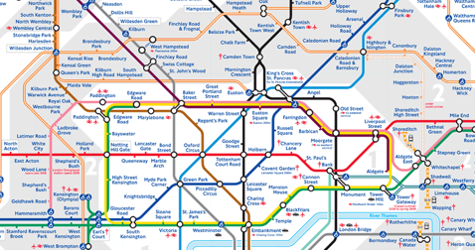
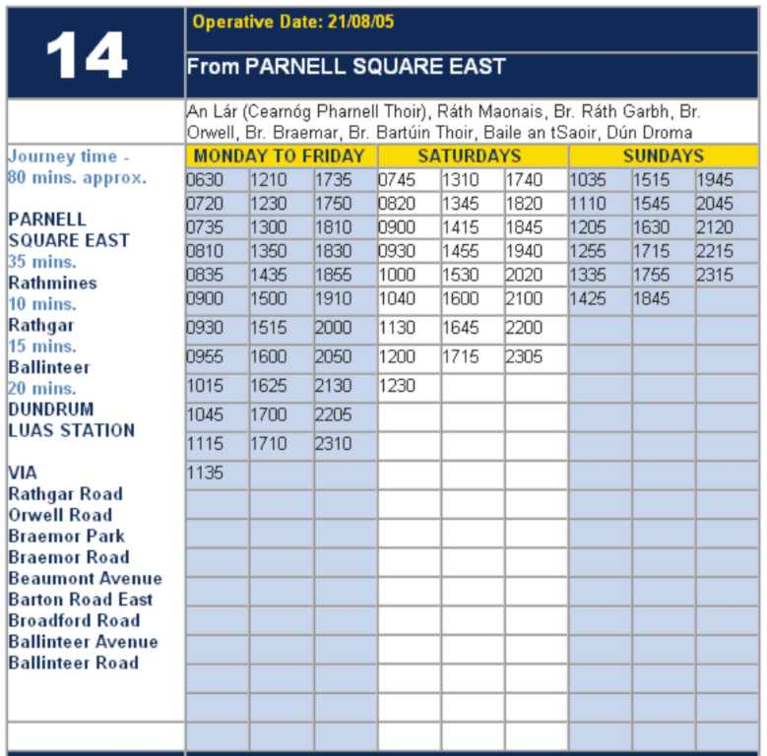
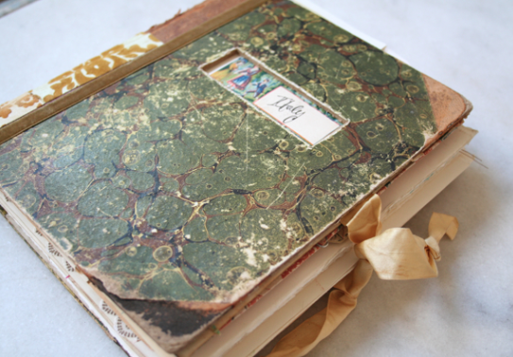
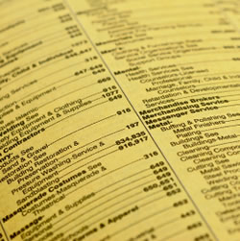

Slide 52
RESEARCH SKILLS

Slide 53
Research the life of
Martin Luther King

Slide 54
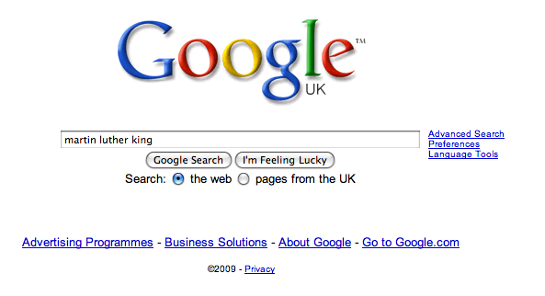

Slide 61
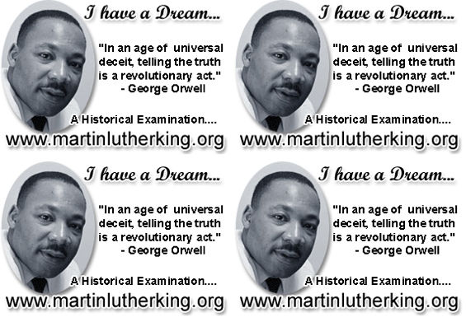

Slide 62
DEMYSTIFYING
SPELLING
3
Notes:
7 spellings: Government – February – parliament – separate – believe – necessary - accommodation

Slide 63
1 - SOUNDS

Slide 64
Government

Slide 65
February

Slide 66
Parliament

Slide 67
2 -VISUALS

Slide 68
Se-para-te
Be-lie-ve

Slide 69
3 - MNEMONICS

Slide 70
necessary

Slide 71
accommodation

Slide 72
Teach reading – scanning, skimming, analysis
Read aloud and display
Teach key vocabulary
Demystify spelling
Teach research, not FOFO

Slide 73
Demonstrate writing
Teach composition & planning
Allow oral rehearsal
Short & long sentences
Connectives

Slide 74
Know your connectives
Adding: and, also, as well as, moreover, too
Cause & effect: because, so, therefore, thus, consequently
Sequencing: next, then, first, finally, meanwhile, before, after
Qualifying: however, although, unless, except, if, as long as, apart from, yet
Emphasising: above all, in particular, especially, significantly, indeed, notably
Illustrating: for example, such as, for instance, as revealed by, in the case of
Comparing: equally, in the same way, similarly, likewise, as with, like
Contrasting: whereas, instead of, alternatively, otherwise, unlike, on the other hand

Slide 75
DEMO

Slide 76
Demonstrate writing
Teach composition & planning
Allow oral rehearsal
Short & long sentences
Connectives

Slide 78
So what will change in our lessons tomorrow?

Slide 79
A LITERACY PROMISE

Slide 80
SUMMARY:
The Secret of Literacy

Slide 81
Stand by …

Slide 82
Ready …?

Slide 83
Tension now intolerable … ?

Slide 84
Well, it’s not literacy …

Slide 85
… it’s making the implicit explicit – and modelling it …

Slide 86
… without which, the rich will get richer & the poor will get poorer

Slide 87
… so we could just call it ‘what great teachers do’

Slide 88
Don’t Call it iteracy
Warwickshire Literacy
Training
12 October 2015
Twitter: @RealGeoffBarton
Download this presentation at www.geoffbarton.co.uk
(Presentation number 141)

Slide 89
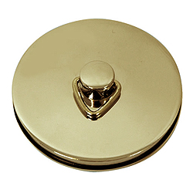
This is an expensive plug ➔

Slide 90
This is a
cheap plug ➔

Slide 91
Don’t Call it iteracy
Warwickshire Literacy
Training
12 October 2015
Twitter: @RealGeoffBarton
Download this presentation at www.geoffbarton.co.uk
(Presentation number 141)

