Slide 1

The Habits of Literacy
Geoff Barton,
Head, King Edward VI School
Suffolk
Teachology National Conference
13 November 2015
Twitter: @RealGeoffBarton
Download slides: geoffbarton.co.uk/teacher-resources (number 142)

Slide 2

2

Slide 3

1:

Slide 4
2:
Literacy

Slide 5
This session …
How are we doing? Assessing literacy standards in 2015
Where do we need to be?
What actually makes a difference in schools?

Slide 6
This session …
How are we doing? Assessing literacy standards in 2015
England – schools - classrooms

Slide 7
WHY
WHAT
HOW

Slide 8
Teaching & Learning

Slide 9
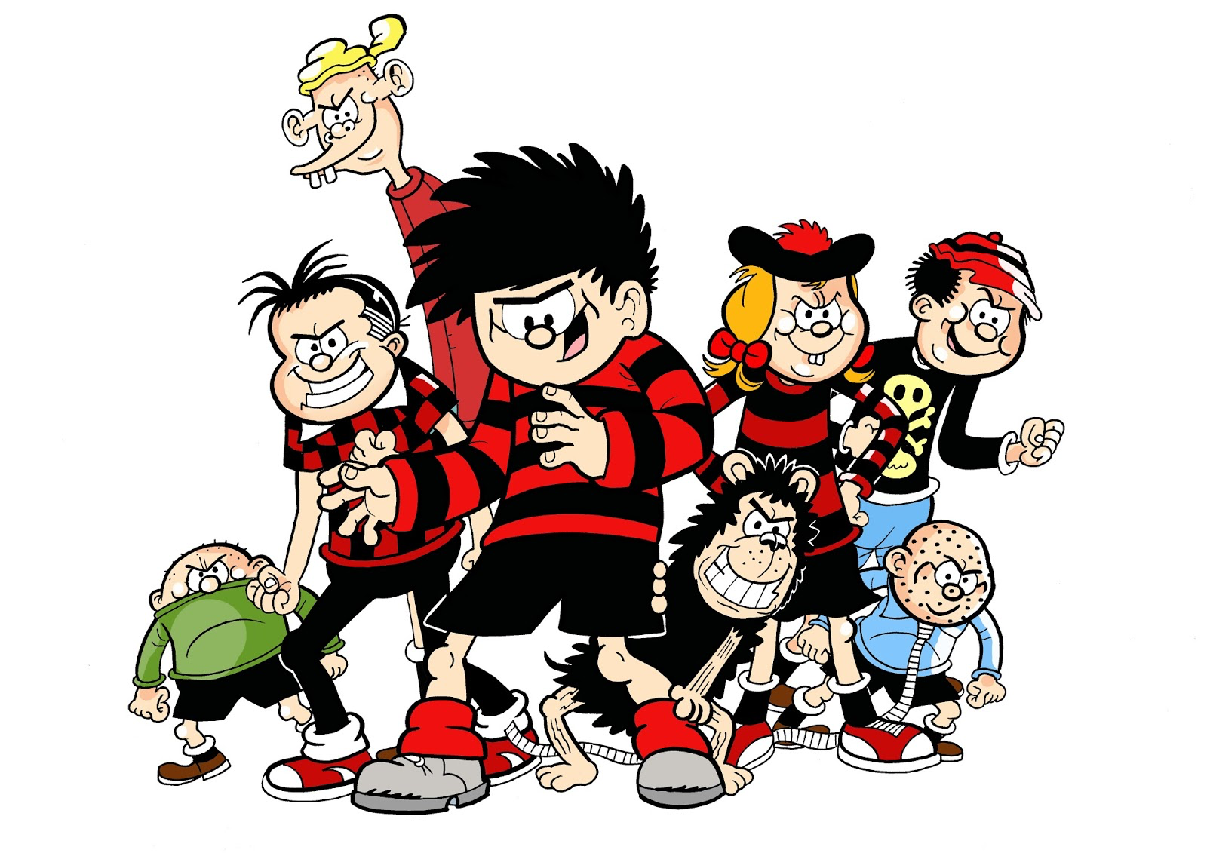
Ice-Breaker A:
Think of the most effective student you teach.
What does she do?
skills – attitude - qualities

Slide 10
Ice-Breaker B:
Think of your most effective teacher.
What does he do?
skills – attitude - qualities

Slide 11


Slide 12
Arthur L. Costa and Bena Kallick, Habits of Mind

Slide 13
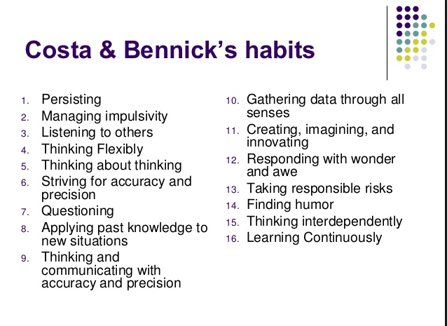

Slide 14
WHY

Slide 15

8 texts

Slide 16

‘Habits, scientists say, emerge because the brain is constantly looking for ways to save effort’

Slide 17

In my experience, teaching is about sensitivity and adaptation. Things that work one day may not work the next day.
In order to navigate the complexity of the circumstances in which a teacher works, it is not possible just to follow a recipe. As a teacher, you make adaptations. You must.

Slide 18

Participants viewed 6-second silent video clips before evaluating the teachers.
95% correlation

Slide 19

‘Too often the argument for reading is made by those who have spent their lives as insiders; the pleasures of solitary reading are so obvious, the value of reading so self-evident, that we fail to appreciate how utterly strange reading is to the outsider’

Slide 20

People who have large vocabularies tend to be intrigued with words.
As such, a major impetus for writing this book is our concern that school vocabulary instruction tends to be dull, rather than of the sort that might instigate student’s interest and awareness of words.
Indeed, asking students to look up words in a dictionary and use them in a sentence is a stereotypical example of what students find uninteresting in school.

Slide 21

Content knowledge (Strong evidence of impact on student outcomes)
Quality of instruction (Strong evidence of impact on student outcomes)
Classroom climate (Moderate evidence of impact on student outcomes)
Classroom management (Moderate evidence of impact on student outcomes)

Slide 22
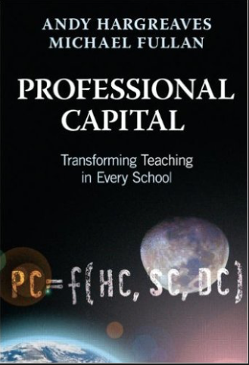
Three-quarters of teachers who demonstrated sustained commitment said that good leadership helped them sustain their commitment over time.
Better leaders produce better teachers.

Slide 23

Whilst the word rich get richer, the word poor get poorer

Slide 24
WHAT

Slide 25

Understand the significance of exploratory talk
Build extended responses & public speaking
Model good talk – eg connectives
Consciously vary groupings
Re-think questioning – ‘why & how’, thinking time, and kill fatuous praise

Slide 26
Teacher: OK. Looking at the text now I want you please to tell me what tense the first paragraph is, in what tense the first paragraph is in.
Girl: The past tense.
Teacher: Yes it’s in the past tense.
Teacher: How do you know it’s in the past tense?
Girl: Because it says August 1990.
Teacher: You know by the date it’s in the past tense, but you know by something else you know, you know by the doing words in the text that change. What’s a doing word? What do we call a doing word, David?
David: A verb.
Teacher: A verb. Good. Will you give me one verb please out of this first paragraph. Find one verb in this paragraph. Stephen?
Stephen: Rescued.
Teacher: Rescued, excellent, excellent and that’s in the past tense.
(Neil Mercer, from Hardman, 2007)

Slide 27

Teach and model reading
Personalise reading
Teach key vocabulary
Demystify spelling
Teach research, not FOFO

Slide 28

Demonstrate writing as a process – including planning
Teach depersonalisation & self-regulation
Allow oral rehearsal
Short & long sentences
Connectives

Slide 29
Know your connectives
Adding: and, also, as well as, moreover, too
Cause & effect: because, so, therefore, thus, consequently
Sequencing: next, then, first, finally, meanwhile, before, after
Qualifying: however, although, unless, except, if, as long as, apart from, yet
Emphasising: above all, in particular, especially, significantly, indeed, notably
Illustrating: for example, such as, for instance, as revealed by, in the case of
Comparing: equally, in the same way, similarly, likewise, as with, like
Contrasting: whereas, instead of, alternatively, otherwise, unlike, on the other hand

Slide 30
HOW

Slide 31
INPUT
PROCESS
OUTPUT

Slide 32
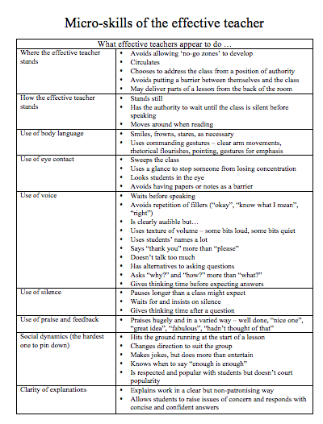

Slide 33
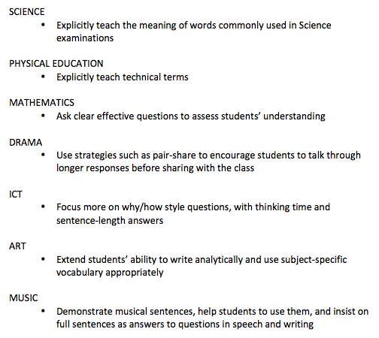
Literacy Promises

Slide 34
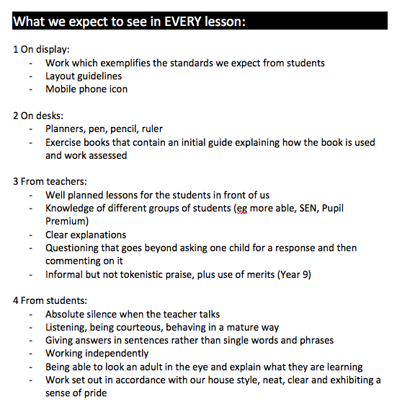

Slide 35


Slide 36
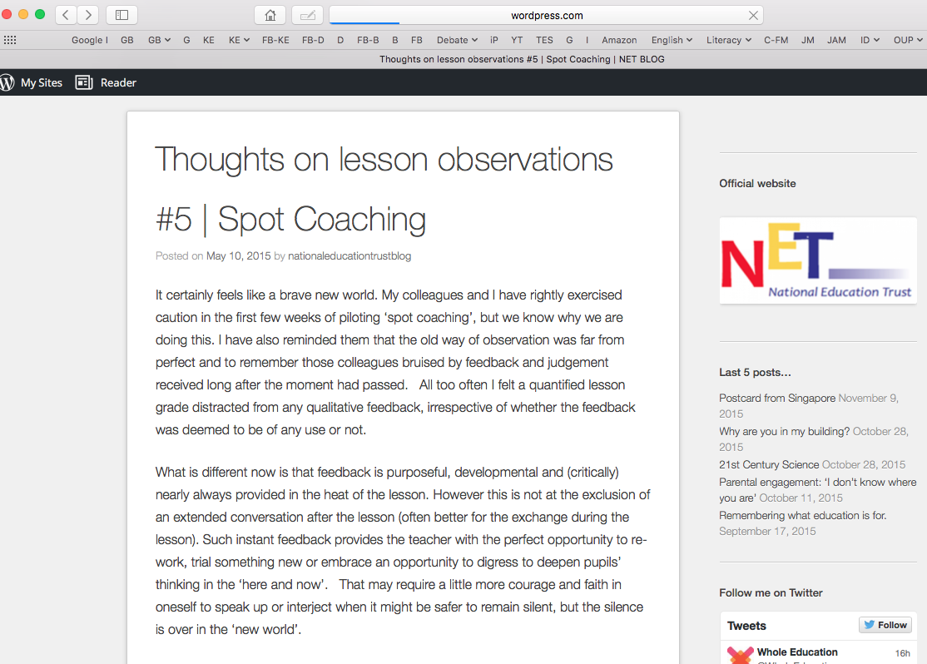

Slide 37
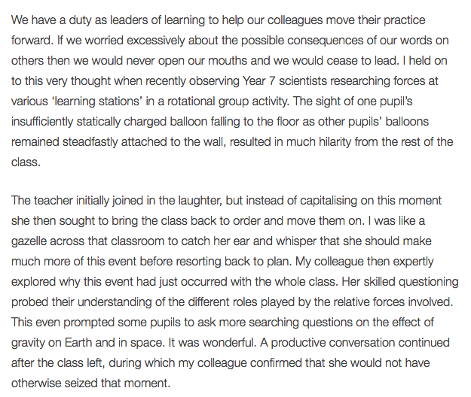

Slide 38
Keith Grainger: Spot Coaching
I am left in no doubt that immediate feedback, in the same way that a tennis coach or dance instructor provides, has powerful potential as a professional development tool in teaching. Our recent work has been exhilarating. I hope never to grade a single lesson again.

Slide 39
The Habits of Literacy
Geoff Barton,
Head, King Edward VI School
Suffolk
Teachology National Conference
13 November 2015
Twitter: @RealGeoffBarton
Download slides: geoffbarton.co.uk/teacher-resources (number 142)

Slide 40

Christmas stocking-filler idea ➔

