Slide 2
Don’t Call it iteracy
Teaching Leaders Residential
August 2015
Twitter: @RealGeoffBarton
Download this presentation at www.geoffbarton.co.uk
(Presentation number 139)

Slide 3
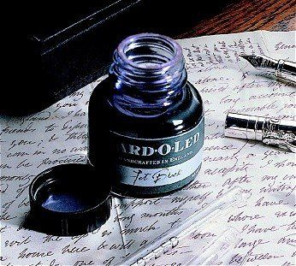

Slide 4
Aims:
I will make you better at SPEAKING& READING
& WRITING

Slide 5
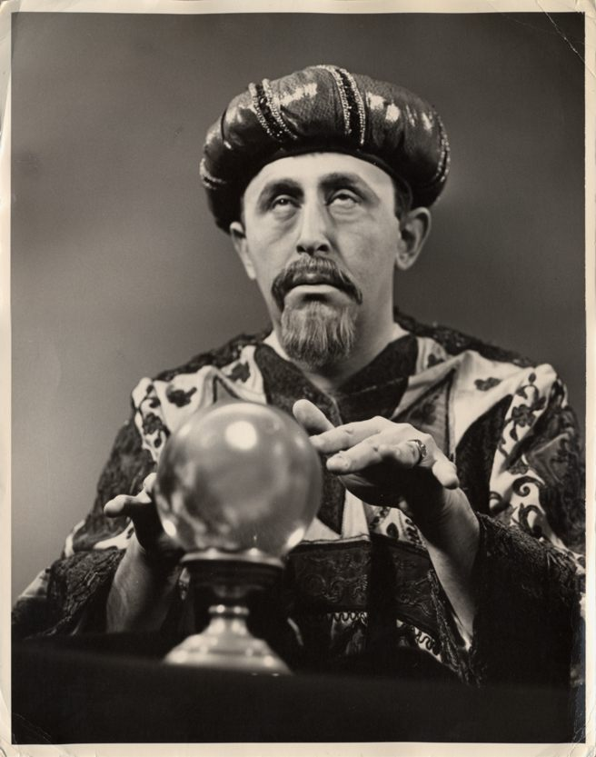
Fellows’ bonus:
Today I will reveal the secret of literacy

Slide 6
WHAT

Slide 7
HOW

Slide 8
Structure:
Rant 1: The Habits of Literacy
Rant 2: Essentials for Impact:
- Speaking & Listening
- Reading
- Writing
And how to make them happen …

Slide 9
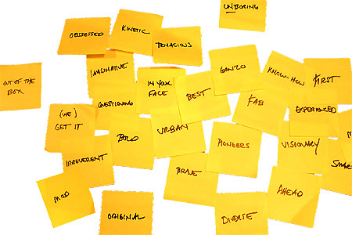
Approach:

Slide 10
Hypothesis:
Become a Year 11 writer again
… for four minutes

Slide 11
Hypothesis:
Task:
Describe the room we are in

Slide 12
Q:
?
Unconfident
Confident
Irrespective of background

Slide 13
A:
Teach them

Slide 14
Provocations:
We haven’t done literacy
It’s all about the classroom
Knowledge and instruction may be more important than we realised
Remember the “Matthew Effect”

Slide 15
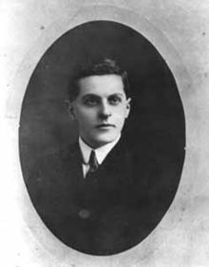
“The limits of my language mean the limits of my world”
Ludwig Wittgenstein

Slide 16
The Matthew Effect
(Robert K Merton)

Slide 17
The rich shall get richer and the poor shall get poorer
Matthew 13:12

Slide 18
“The word-rich get richer while the word-poor get poorer” in their reading skills
(Canadian Association of School Librarians)

Slide 19
“While good readers gain new skills very rapidly, and quickly move from learning to read to reading to learn, poor readers become increasingly frustrated with the act of reading, and try to avoid reading where possible”
The Matthew Effect
Daniel Rigney

Slide 20
“Students who begin with high verbal aptitudes find themselves in verbally enriched social environments and have a double advantage.”
The Matthew Effect
Daniel Rigney

Slide 21
“Good readers may choose friends who also read avidly while poor readers seek friends with whom they share other enjoyments”
The Matthew Effect
Daniel Rigney

Slide 22
Stricht’s Law: “reading ability in children cannot exceed their listening ability …”
E.D. Hirsch
The Schools We Need

Slide 23
“Spoken language forms a constraint, a ceiling not only on the ability to comprehend but also on the ability to write, beyond which literacy cannot progress”
Myhill and Fisher

Slide 24
Aged 7:
Children in the top quartile have 7100 words; children in the lowest have around 3000.
The main influence is parents.
DfE Research Unit

Slide 25
The Matthew Effect:
The rich will get richer &
the poor will get poorer

Slide 26
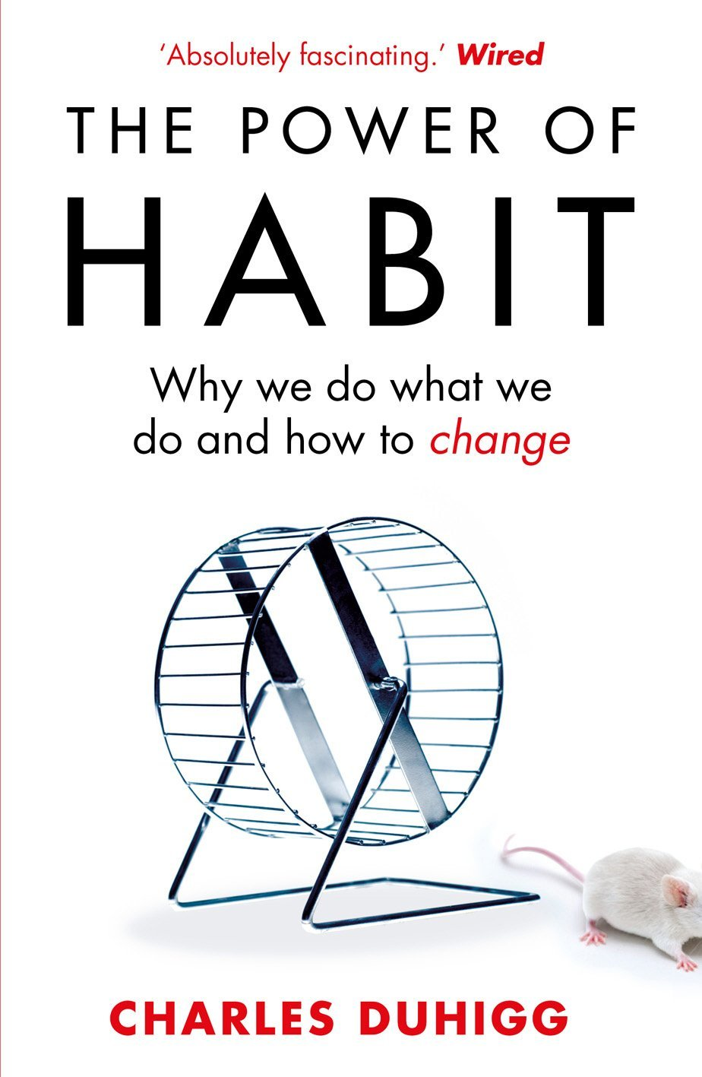
‘More than 40% of the actions people perform each day aren’t decisions but habits …’

Slide 27
‘Habits, scientists say, emerge because the brain is constantly looking for ways to save effort’

Slide 28
‘That’s why signing kids up for piano lessons or sports is so important. It has nothing to do with creating a good musician or a five year-old soccer star’

Slide 29
The Literacy Club

Slide 30
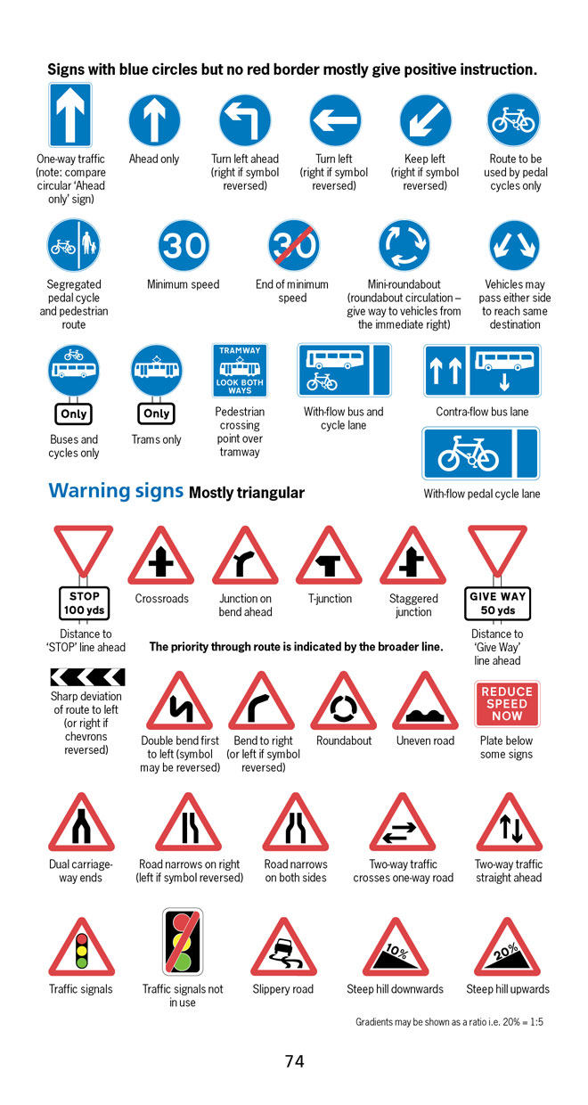
BBC NEWS ONLINE:
More than half of British motorists cannot interpret road signs properly, according to a survey by the Royal Automobile Club.
The survey of 500 motorists highlighted just how many people are still grappling with it.

Slide 31
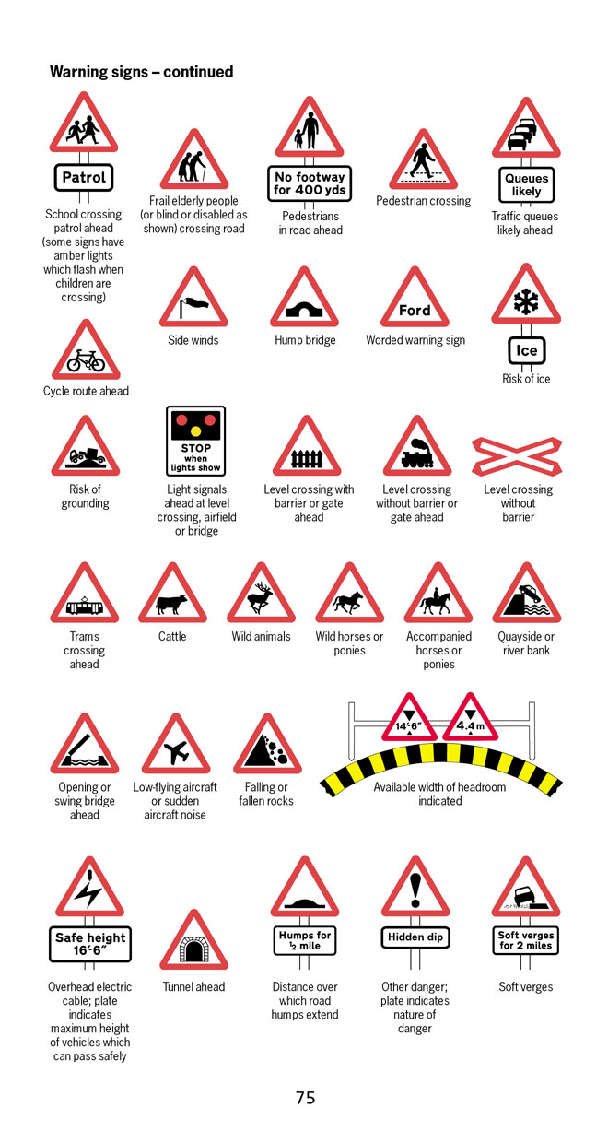
According to the survey, three in five motorists thought a "be aware of cattle" warning sign indicated …
an area infected with foot-and-mouth disease.

Slide 32
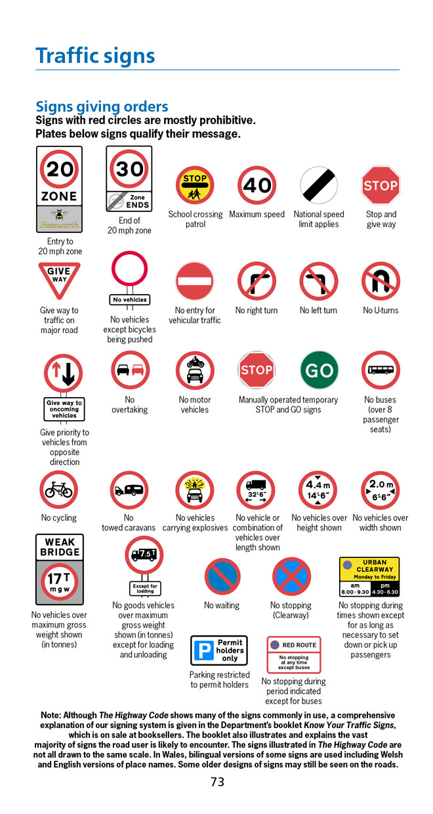
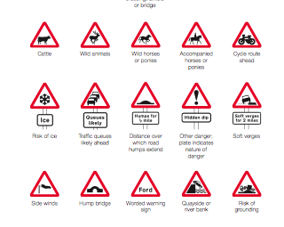
Common mistakes:
No motor vehicles: Beware of fast motorbikes
Wild horses:
‘Marlborough country’ advert

Slide 33
5 key ingredients
Then teach you something
Then reflection

Slide 34
Understand the significance of exploratory talk
Model good talk – eg connectives
Re-think questioning – ‘why & how’, thinking time, and no-hands-up
Consciously vary groupings
Get conversation into the school culture

Slide 35
DEMO

Slide 36
Focus: speaking in public

Slide 37
Barriers:
Lack of confidence
Lack of structure
Lack of depersonalised tone

Slide 38
Task: why school uniform crushes our individuality

Slide 39
Stance, notes, pen
Number points
Be repetitive
Sentence functions
Confidence
Structure
Depersonalised tone
Avoid I / me
Use ‘so’ / ‘because’ / ‘however’ / ‘therefore’

Slide 40
Understand the significance of exploratory talk
Model good talk – eg connectives
Re-think questioning – ‘why & how’, thinking time, and no-hands-up
Consciously vary groupings
Get conversation into the school culture

Slide 42
Teach reading – scanning, skimming, analysis
Read aloud and display
Teach key vocabulary
Demystify spelling
Teach research, not FOFO

Slide 43
DEMO

Slide 44
SKIMMING

Slide 45
The climate of the Earth is always changing. In the past it has altered as a result of natural causes. Nowadays, however, the term climate change is generally used when referring to changes in our climate which have been identified since the early part of the 1900's . The changes we've seen over recent years and those which are predicted over the next 80 years are thought to be mainly as a result of human behaviour rather than due to natural changes in the atmosphere.

Slide 46
The best treatment for mouth ulcers. Gargle with salt water. You should find that it works a treat. Salt is cheap and easy to get hold of and we all have it at home, so no need to splash out and spend lots of money on expensive mouth ulcer creams.

Slide 47
Lexical v Grammatical Words

Slide 48
Urquhart castle is probably one of the most picturesquely situated castles in the Scottish Highlands. Located 16 miles south-west of Inverness, the castle, one of the largest in Scotland, overlooks much of Loch Ness. Visitors come to stroll through the ruins of the 13th-century castle because Urquhart has earned the reputation of being one of the best spots for sighting Loch Ness’s most famous inhabitant.

Slide 49
Urquhart castle is probably one of the most picturesquely situated castles in the Scottish Highlands. Located 16 miles south-west of Inverness, the castle, one of the largest in Scotland, overlooks much of Loch Ness. Visitors come to stroll through the ruins of the 13th-century castle because Urquhart has earned the reputation of being one of the best spots for sighting Loch Ness’s most famous inhabitant.

Slide 50
Urquhart castle is probably one of the most picturesquely situated castles in the Scottish Highlands. Located 16 miles south-west of Inverness, the castle, one of the largest in Scotland, overlooks much of Loch Ness. Visitors come to stroll through the ruins of the 13th-century castle because Urquhart has earned the reputation of being one of the best spots for sighting Loch Ness’s most famous inhabitant.

Slide 51
Urquhart castle is probably one of the most picturesquely situated castles in the Scottish Highlands. Located 16 miles south-west of Inverness, the castle, one of the largest in Scotland, overlooks much of Loch Ness. Visitors come to stroll through the ruins of the 13th-century castle because Urquhart has earned the reputation of being one of the best spots for sighting Loch Ness’s most famous inhabitant.

Slide 52
Urquhart castle is probably one of the most picturesquely situated castles in the Scottish Highlands. Located 16 miles south-west of Inverness, the castle, one of the largest in Scotland, overlooks much of Loch Ness. Visitors come to stroll through the ruins of the 13th-century castle because Urquhart has earned the reputation of being one of the best spots for sighting Loch Ness’s most famous inhabitant.

Slide 53
SCANNING

Slide 54
Where did the first cell phones begin?
Name 2 other features that started to be included in phones
Why are cell phones especially useful in some countries?

Slide 55
Where begin?
Two features?
Some countries?
Cellular telephones
The first cellular telephone system began operation in Tokyo in 1979, and the first U.S. system began operation in 1983 in Chicago. A camera phone is a cellular phone that also has picture taking capabilities. Some camera phones have the capability to send these photos to another cellular phone or computer. Advances in digital technology and microelectronics has led to the inclusion of unrelated applications in cellular telephones, such as alarm clocks, calculators, Internet browsers, and voice memos for recording short verbal reminders, while at the same time making such telephones vulnerable to certain software viruses. In many countries with inadequate wire-based telephone networks, cellular telephone systems have provided a means of more quickly establishing a national telecommunications network.

Slide 56
CLOSE READING

Slide 57
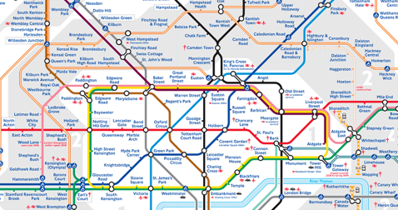
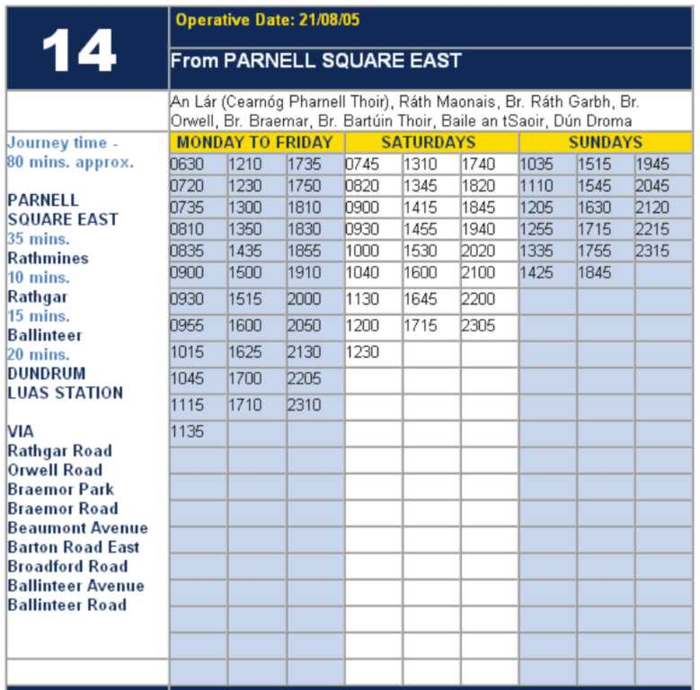
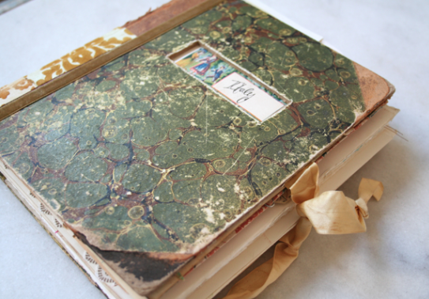
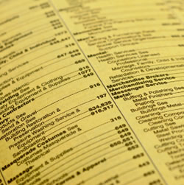

Slide 58
RESEARCH SKILLS

Slide 59
Research the life of
Martin Luther King

Slide 60
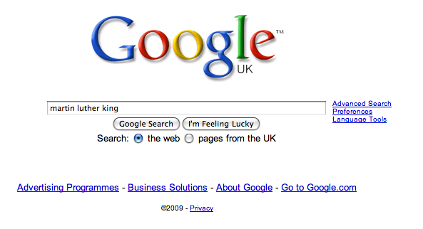

Slide 68
DEMYSTIFYING
SPELLING
3
Notes:
7 spellings: Government – February – parliament – separate – believe – necessary - accommodation

Slide 69
1 - SOUNDS

Slide 70
Government

Slide 71
February

Slide 72
Parliament

Slide 73
2 -VISUALS

Slide 74
Se-para-te
Be-lie-ve

Slide 75
3 - MNEMONICS

Slide 76
necessary

Slide 77
accommodation

Slide 80
Teach reading – scanning, skimming, analysis
Read aloud and display
Teach key vocabulary
Demystify spelling
Teach research, not FOFO

Slide 81
Demonstrate writing
Teach composition & planning
Allow oral rehearsal
Short & long sentences
Connectives

Slide 82
Know your connectives
Adding: and, also, as well as, moreover, too
Cause & effect: because, so, therefore, thus, consequently
Sequencing: next, then, first, finally, meanwhile, before, after
Qualifying: however, although, unless, except, if, as long as, apart from, yet
Emphasising: above all, in particular, especially, significantly, indeed, notably
Illustrating: for example, such as, for instance, as revealed by, in the case of
Comparing: equally, in the same way, similarly, likewise, as with, like
Contrasting: whereas, instead of, alternatively, otherwise, unlike, on the other hand

Slide 83
DEMO

Slide 84
Demonstrate writing
Teach composition & planning
Allow oral rehearsal
Short & long sentences
Connectives

Slide 86
Don’t Call it iteracy
Teaching Leaders Residential
August 2015
Twitter: @RealGeoffBarton
Download this presentation at www.geoffbarton.co.uk
(Presentation number 139)

Slide 87
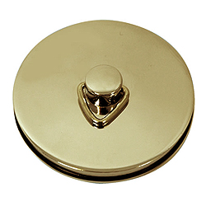
This is an expensive plug ➔

Slide 88
This is a
cheap plug ➔

Slide 89
Don’t Call it iteracy
Teaching Leaders Residential
August 2015
Twitter: @RealGeoffBarton
Download this presentation at www.geoffbarton.co.uk
(Presentation number 139)

