Slide 1
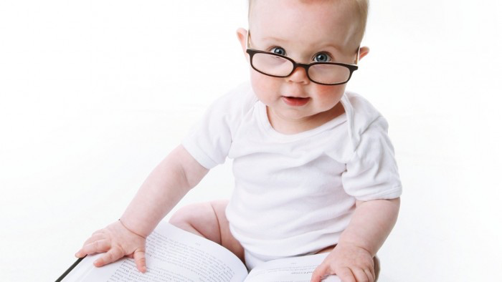
Making Reading Matter
⎜@RealGeoffBarton ⎜Downloaded at www.geoffbarton.co.uk ⎜ www.blog.geoffbarton.co.uk ⎜
⎜Festival of Education ⎜ 18 June 2015 ⎜ NB: Don’t Call it Literacy is one of my favourite books ⎜

Slide 2
☑WHY READING MATTERS

Slide 3
☒THINGS THAT DON’T MATTER

Slide 4
3
Let’s understand the importance of reading
Let’s teach it
Let’s guarantee it

Slide 5
3
WHY?
WHAT?
HOW?

Slide 6
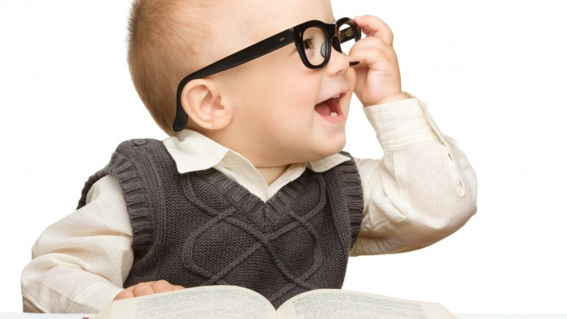
1: WHY READING MATTERS

Slide 7
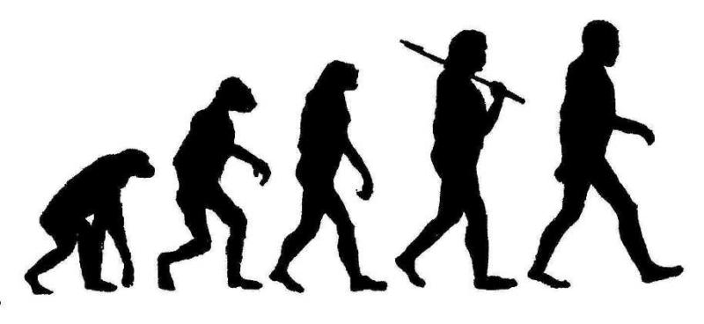
A History of Technology

Slide 8
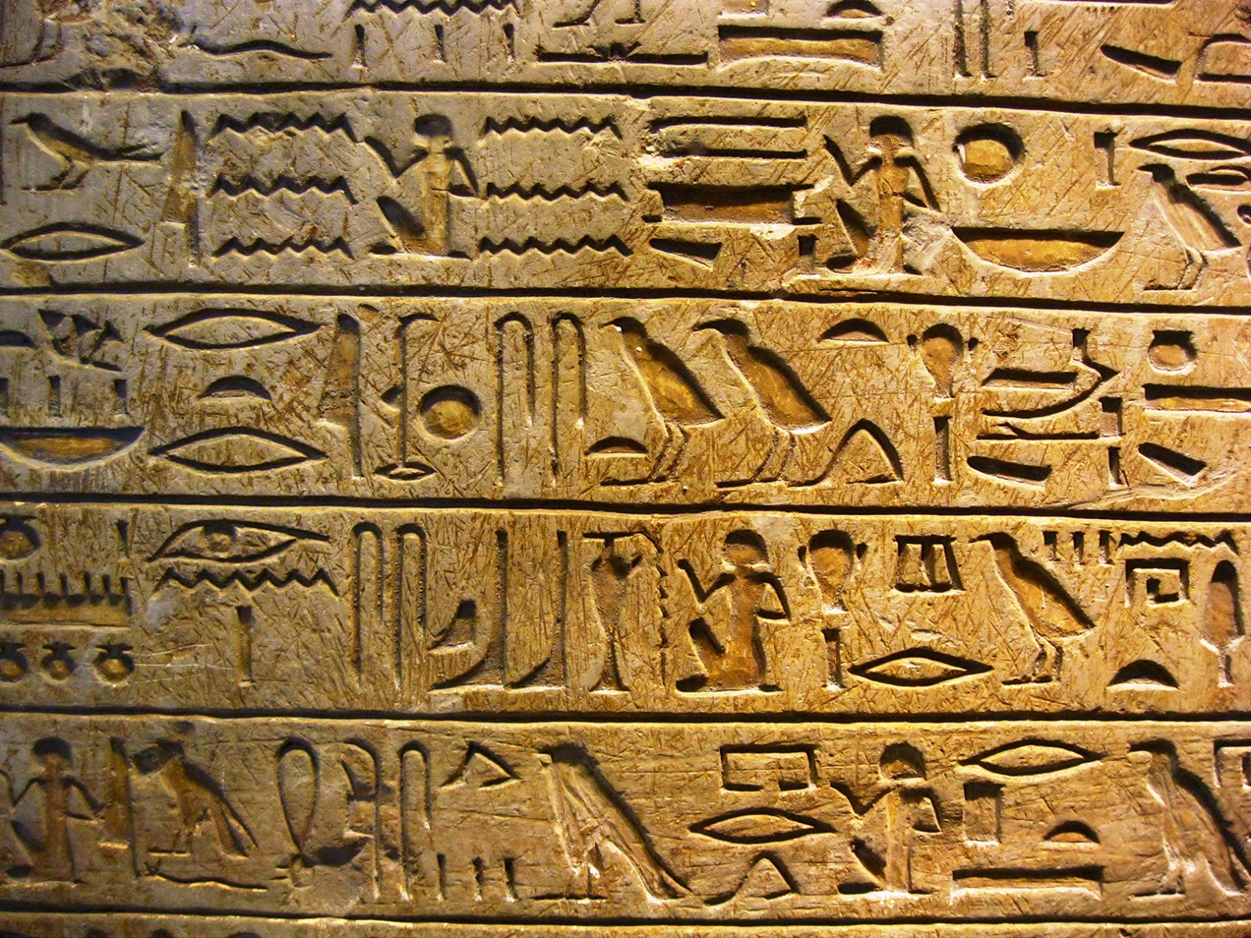

Slide 9
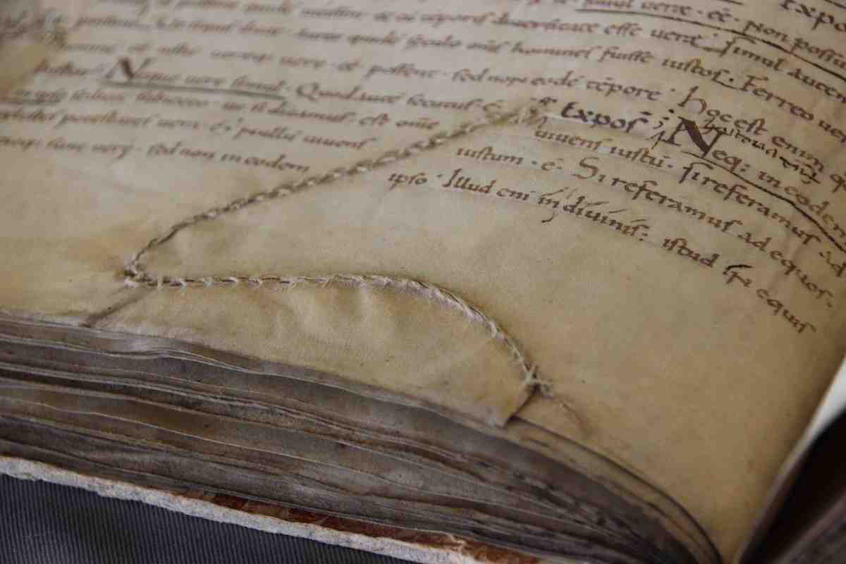

Slide 10
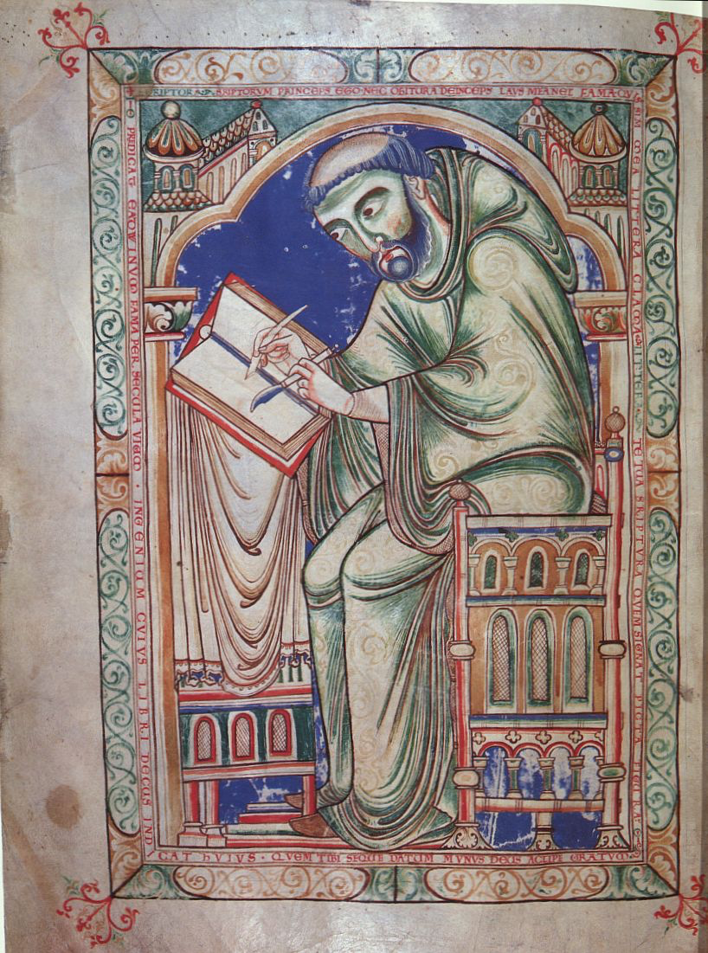

Slide 11
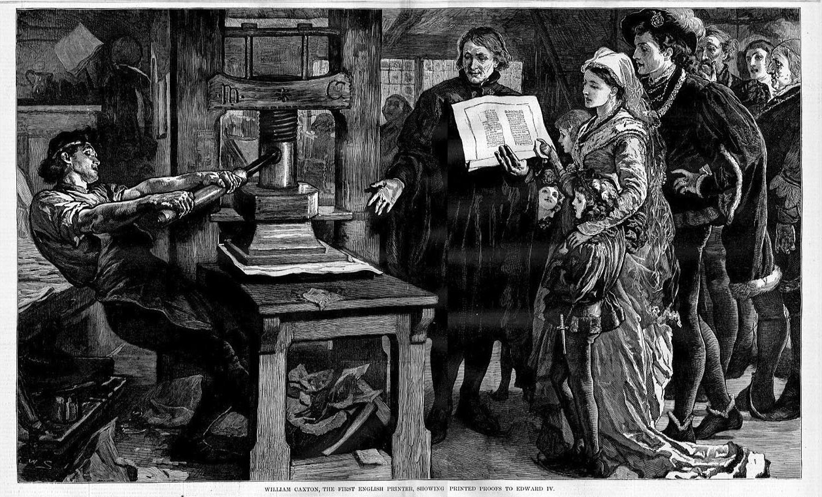

Slide 12
Craig Raine, ‘A Martian Sends a Postcard Home’
Caxtons are mechanical birds with many wings
and some are treasured for their markings –
they cause the eyes to melt
or the body to shriek without pain.
I have never seen one fly, but
sometimes they perch on the hand.

Slide 13
How many books do you think the UK’s biggest library had in 1602?

Slide 16
We go to university in order to read
a subject
‘read’

Slide 17
The importance of reading ...

Slide 18
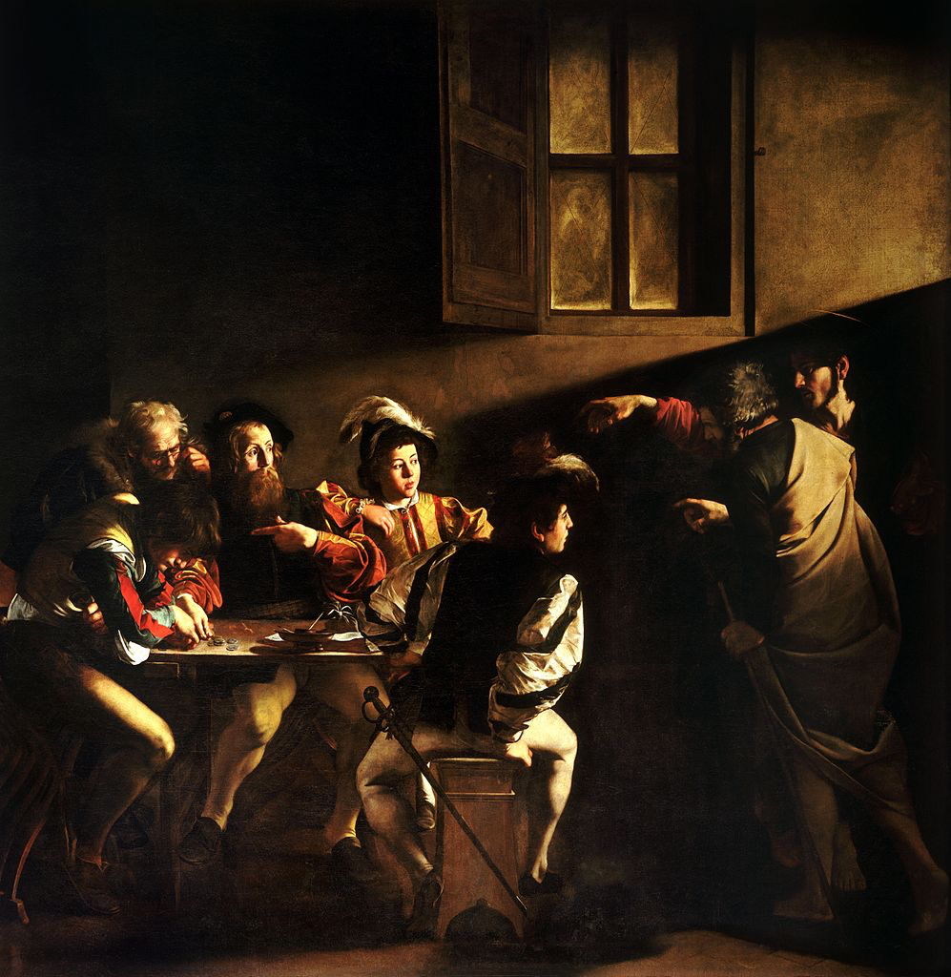

Slide 19
“While good readers gain new skills very rapidly, and quickly move from learning to read to reading to learn, poor readers become increasingly frustrated with the act of reading, and try to avoid reading where possible”
Daniel Rigney
The Matthew Effect

Slide 20
“Good readers may choose friends who also read avidly while poor readers seek friends with whom they share other enjoyments”
Daniel Rigney
The Matthew Effect

Slide 21
“Students who begin with high verbal aptitudes find themselves in verbally enriched social environments and have a double advantage.”
Daniel Rigney
The Matthew Effect

Slide 22
National Literacy Trust

Slide 23
National Literacy Trust

Slide 24
National Literacy Trust

Slide 25
National Literacy Trust

Slide 26
National Literacy Trust

Slide 27
National Literacy Trust

Slide 28
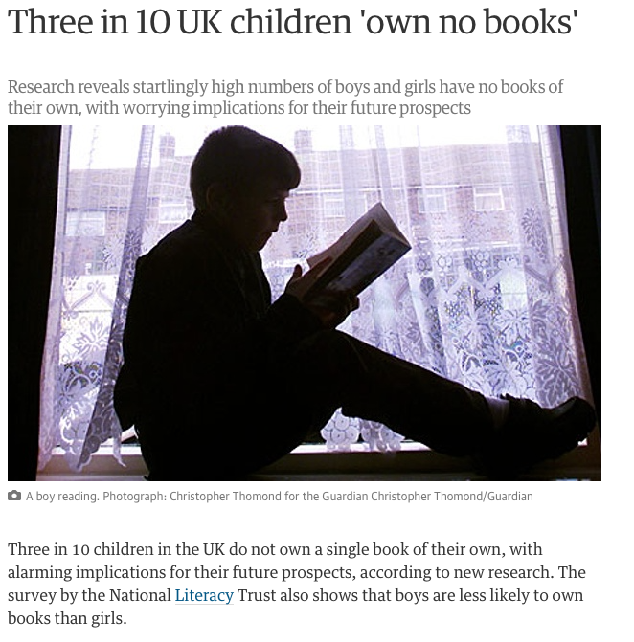

Slide 29
2: WHAT MATTERS

Slide 30
Personalise reading: having a school library isn’t enough
Vocabulary is a proxy for intelligence
Teach prior knowledge & conventions
Make word-rich habits explicit
Have a staff reading culture

Slide 31
PRIOR KNOWLEDGE

Slide 32
What if JD Salingar rewrote the Book of Genesis?
The Matthew Effect
Daniel Rigney

Slide 33
What if JD Salingar rewrote the Book of Genesis?
The Matthew Effect
Daniel Rigney

Slide 34
Boy, when I saw old Eve I thought I was going to flip. I mean it isn’t that Eve is good-looking or anything like that, it’s just that she’s different. I don’t know what the hell it is exactly – but you always know when she’s around.
All of a sudden I knew there was something wrong with old Eve the minute I saw her. She looked nervous as hell. I kinda felt sorry for her – even though she’s got one of my goddam ribs, so I went over to talk to old Eve.
“You look very, very nice, Adam” she said to me in a funny way, like she was ashamed of something. “Why don’t you join me in some apple?”
Goddam, is that all these sophisticated babes think about all the time? It’s enough to drive a guy crazy, if you know what I mean.

Slide 35
SKIMMING

Slide 36
The climate of the Earth is always changing. In the past it has altered as a result of natural causes. Nowadays, however, the term climate change is generally used when referring to changes in our climate which have been identified since the early part of the 1900's . The changes we've seen over recent years and those which are predicted over the next 80 years are thought to be mainly as a result of human behaviour rather than due to natural changes in the atmosphere.

Slide 37
The best treatment for mouth ulcers. Gargle with salt water. You should find that it works a treat. Salt is cheap and easy to get hold of and we all have it at home, so no need to splash out and spend lots of money on expensive mouth ulcer creams.

Slide 38
Lexical v Grammatical Words

Slide 39
Urquhart castle is probably one of the most picturesquely situated castles in the Scottish Highlands. Located 16 miles south-west of Inverness, the castle, one of the largest in Scotland, overlooks much of Loch Ness. Visitors come to stroll through the ruins of the 13th-century castle because Urquhart has earned the reputation of being one of the best spots for sighting Loch Ness’s most famous inhabitant.

Slide 40
Urquhart castle is probably one of the most picturesquely situated castles in the Scottish Highlands. Located 16 miles south-west of Inverness, the castle, one of the largest in Scotland, overlooks much of Loch Ness. Visitors come to stroll through the ruins of the 13th-century castle because Urquhart has earned the reputation of being one of the best spots for sighting Loch Ness’s most famous inhabitant.

Slide 41
Urquhart castle is probably one of the most picturesquely situated castles in the Scottish Highlands. Located 16 miles south-west of Inverness, the castle, one of the largest in Scotland, overlooks much of Loch Ness. Visitors come to stroll through the ruins of the 13th-century castle because Urquhart has earned the reputation of being one of the best spots for sighting Loch Ness’s most famous inhabitant.

Slide 42
Urquhart castle is probably one of the most picturesquely situated castles in the Scottish Highlands. Located 16 miles south-west of Inverness, the castle, one of the largest in Scotland, overlooks much of Loch Ness. Visitors come to stroll through the ruins of the 13th-century castle because Urquhart has earned the reputation of being one of the best spots for sighting Loch Ness’s most famous inhabitant.

Slide 43
Urquhart castle is probably one of the most picturesquely situated castles in the Scottish Highlands. Located 16 miles south-west of Inverness, the castle, one of the largest in Scotland, overlooks much of Loch Ness. Visitors come to stroll through the ruins of the 13th-century castle because Urquhart has earned the reputation of being one of the best spots for sighting Loch Ness’s most famous inhabitant.

Slide 44
SCANNING

Slide 45
Where did the first cell phones begin?
Name 2 other features that started to be included in phones
Why are cell phones especially useful in some countries?

Slide 46
Where begin?
Two features?
Some countries?
Cellular telephones
The first cellular telephone system began operation in Tokyo in 1979, and the first U.S. system began operation in 1983 in Chicago. A camera phone is a cellular phone that also has picture taking capabilities. Some camera phones have the capability to send these photos to another cellular phone or computer. Advances in digital technology and microelectronics has led to the inclusion of unrelated applications in cellular telephones, such as alarm clocks, calculators, Internet browsers, and voice memos for recording short verbal reminders, while at the same time making such telephones vulnerable to certain software viruses. In many countries with inadequate wire-based telephone networks, cellular telephone systems have provided a means of more quickly establishing a national telecommunications network.

Slide 47
RESEARCH SKILLS

Slide 48
Research the life of
Martin Luther King

Slide 49
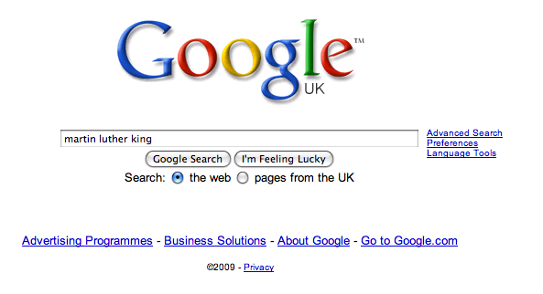

Slide 56
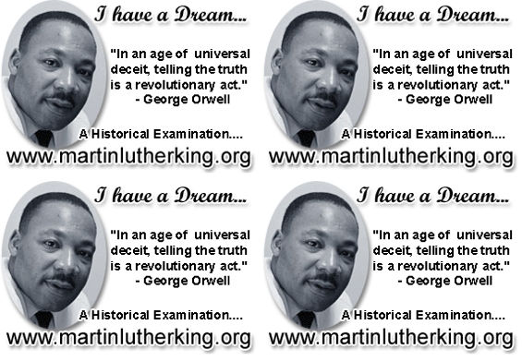

Slide 57
PREDICTION

Slide 58
Brian Moore, Cold Heaven
How tense is it, 1 (low) to 10 (high)?
What do you think will happen next?
What do you notice?

Slide 59
1 of 8
The wooden seats of the little pedal boat were angled so that Marie looked up at the sky. There were no clouds. In the vastness above her a gull calligraphed its flight. Marie and Alex pedalled in unison, the revolving paddles making a slapping sound against the waves as the pedal boat treadmilled away from the beach, passing through ranks of bathers to move into the deeper, more solitary waters of the Baie des Anges. Marie slackened her efforts but Alex continued determinedly, steering the pedalo straight out into the Mediterranean.
(1) Tension 1 to 10? (2) What next? (3) What do you notice?

Slide 60
2 of 8
‘Let’s not go too far,’ she said.
‘I want to get away from the crowd. I’m going to swim.’
It was like him to have some plan of his own, to translate idleness into activity even in these few days of vacation. She now noted his every fault. It was as though, having decided to leave him, she had withdrawn his credit. She looked back at the sweep of hotels along the Promenade des Anglais. Today was the day she had hoped to tell him. She had planned to announce it at breakfast and leave, first for New York, then on to Los Angeles to join Daniel. But at breakfast she lacked all courage. Now, with half the day gone, she decided to postpone it until tomorrow.
(1) Tension 1 to 10? (2) What next? (3) What do you notice?

Slide 61
3 of 8
Far out from shore, the paddles stopped. The pedalo rocked on its twin pontoons as Alex eased himself up from his seat. He handed her his sunglasses. ‘This should do,’ he said and, rocking the boat even more, dived into the ultramarine waters. She watched him surface. He called out: ‘Just follow along, okay?’ He was not a good swimmer, but thrashed about in an energetic, erratic freestyle. Marie began to pedal again, her hand on the tiller, steering the little boat so that she followed close. Watching him, she knew he could not keep up this pace for long. She saw his flailing arms and for a moment thought of those arms hitting her. He had never hit her. He was not the sort of man who would hit you. He would be hurt, and cold, and possibly vindictive. But he was not violent.
(1) Tension 1 to 10? (2) What next? (3) What do you notice?

Slide 62
4 of 8
She heard a motorboat, the sound becoming louder. She looked back but did not see a boat behind her. Then she looked to the right where Alex was swimming and saw a big boat with an outboard motor coming right at them, coming very fast.
(1) Tension 1 to 10? (2) What next? (3) What do you notice?

Slide 63
5 of 8
Of course they see us, she thought, alarmed, and then as though she were watching a film, as though this were happening to someone else, she saw there was a man in the motorboat, a young man wearing a green shirt; he was not at the tiller, he was standing in the middle of the boat with his back to her and as she watched he bent down and picked up a child who had fallen on the floorboards. ‘Hey?’ she called. ‘Hey?’ for he must turn around, the motorboat was coming right at Alex, right at her. But the man in the boat did not hear. He carried the child across to the far side of the boat; the boat was only yards away now.
(1) Tension 1 to 10? (2) What next? (3) What do you notice?

Slide 64
6 of 8
‘Alex,’ she called. ‘Alex, look out.’ But Alex flailed on and then the prow of the motorboat, slicing up water like a knife, hit Alex with a sickening thump, went over him and smashed into the pontoons of the little pedal boat, upending it, and she found herself in the water, going under, coming up. She looked and saw the motorboat churning off, the pedal boat hanging from its prow like a tangle of branches. She heard the motorboat engine cut to silence, then start up again as the boat veered around in a semicircle and came back to her. Alex?
(1) Tension 1 to 10? (2) What next? (3) What do you notice?

Slide 65
7 of 8
She looked: saw his body near her just under the water. She swam toward him, breastroke, it was all she knew. He was floating face down, spread-eagle. She caught hold of his wrist and pulled him towards her. The motorboat came alongside, the man in the green shirt reaching down for her, but, ‘No, no,’ she called and tried to push Alex toward him. The man caught Alex by the hair of his head and pulled him up, she pushing, Alex falling back twice into the water, before the man, with a great effort, lifted him like a sack across the side of the boat, tugging and heaving until Alex disappeared into the boat. The man shouted, ‘Un instant, madame, un instant’ and reappeared, putting a little steel ladder over the side. She climbed up onto the motorboat as the man went out onto the prow to disentangle the wreckage of the pedalo.
(1) Tension 1 to 10? (2) What next? (3) What do you notice?

Slide 66
8 of 8
A small child was sitting at the back of the boat, staring at Alex’s body, which lay face-down on the floorboards. She went to Alex and saw blood from a wound, a gash in the side of his head, blood matting his hair. He was breathing but unconscious. She lifted him and cradled him in her arms, his blood trickling onto her breasts. She saw the boat owner’s bare legs go past her as he went to the rear of the boat to restart the engine. The child began to bawl but the man leaned over, silenced it with an angry slap, the man turned to her, his face sick with fear. ‘Nous y serons dans un instant,’ he shouted, opening the motor to full throttle. She hugged Alex to her, a rivulet of blood dripping off her forearm onto the floorboards as the boat raced to the beach.
(1) Tension 1 to 10? (2) What next? (3) What do you notice?

Slide 67
Brian Moore, Cold Heaven

Slide 68
3: HOW

Slide 69
Create a moral purpose through the ‘Matthew Effect’: word-rich & word-poor
Departmental focus: what type of reading matters most? Back it with a Departmental written promise
Build literacy into monitoring and appraisal systems
Have books in classrooms
Cling on to joy

Slide 71
English Teacher
Petite, white-haired Miss Cartwright
Knew Shakespeare off by heart,
Or so we pupils thought.
Once in the stalls at the Old Vic
She prompted Lear when he forgot his part.
Ignorant of Scrutiny and Leavis,
She taught Romantic poetry,
Dreamt of gossip with dead poets.
To an amazed sixth form once said: ‘How good to spend a night with Shelley.’
In long war years she fed us plays,
Sophocles to Shaw’s St Joan.
Her reading nights we named our Courting Club,
Yet always through the blacked-out streets
One boy left the girls and saw her home.
When she closed her eyes and chanted
‘Ode to a Nightingale’
We laughed yet honoured her devotion.
We knew the man she should have married
Was killed at Passchendaele.
Brian Cox
From Collected Poems, Carcanet Press 1993.

Slide 72
Making Reading Matter
⎜@RealGeoffBarton ⎜Downloaded at www.geoffbarton.co.uk ⎜ www.blog.geoffbarton.co.uk ⎜
⎜Festival of Education ⎜ 18 June 2015 ⎜ NB: Don’t Call it Literacy is one of my favourite books ⎜

