Slide 1
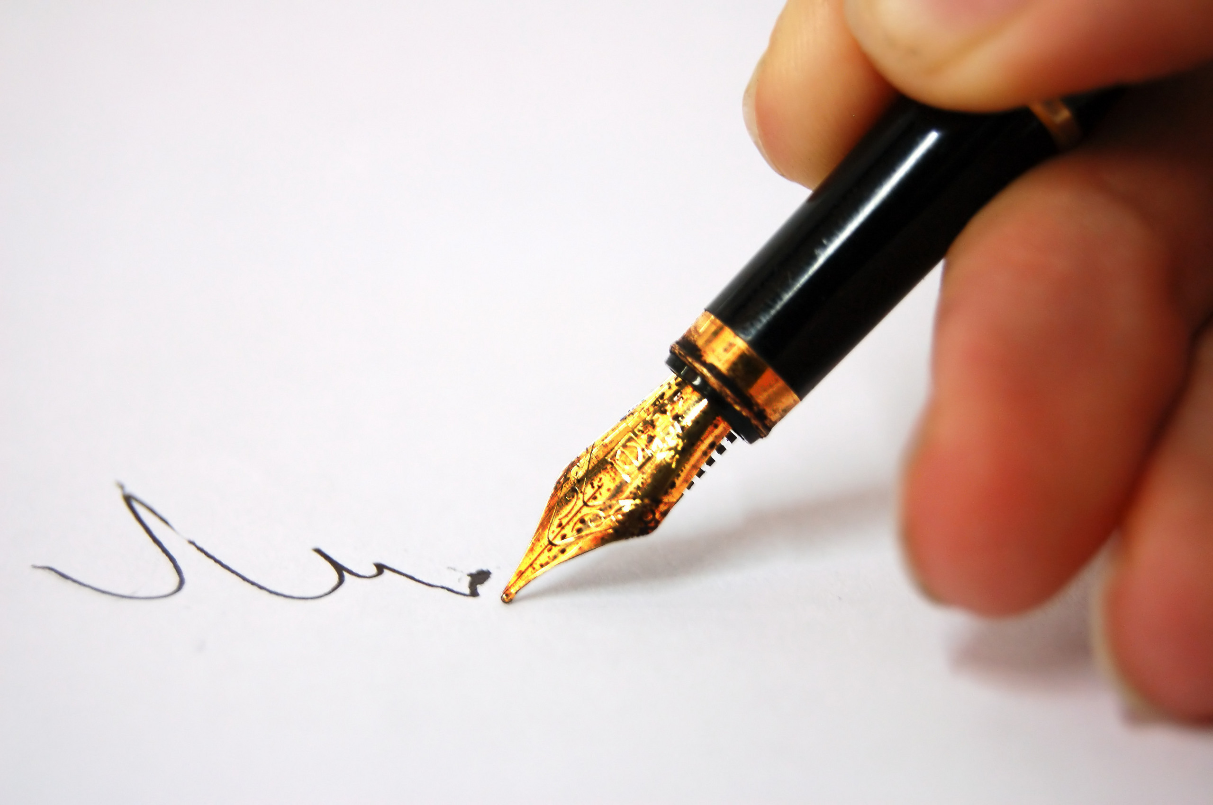
THE HABITS OF LITERACY
Geoff Barton
Festival of Education 2014
21 June 2014
geoffbarton.co.uk/teacher_resources
(Number 129)
Twitter: @RealGeoffBarton
Geoff Barton ⎜ ASCL Conference 2015 ⎜ 20 March 2015
Download this presentation free at: geoffbarton.co.uk/teacher_resources (Number 136)
Twitter: @RealGeoffBarton
Small-print:
There will be no use of Post-It notes or role-play.
However, you will need something to write with and on – preferably pen and paper

Slide 2
THE HABITS OF LITERACY

Slide 3
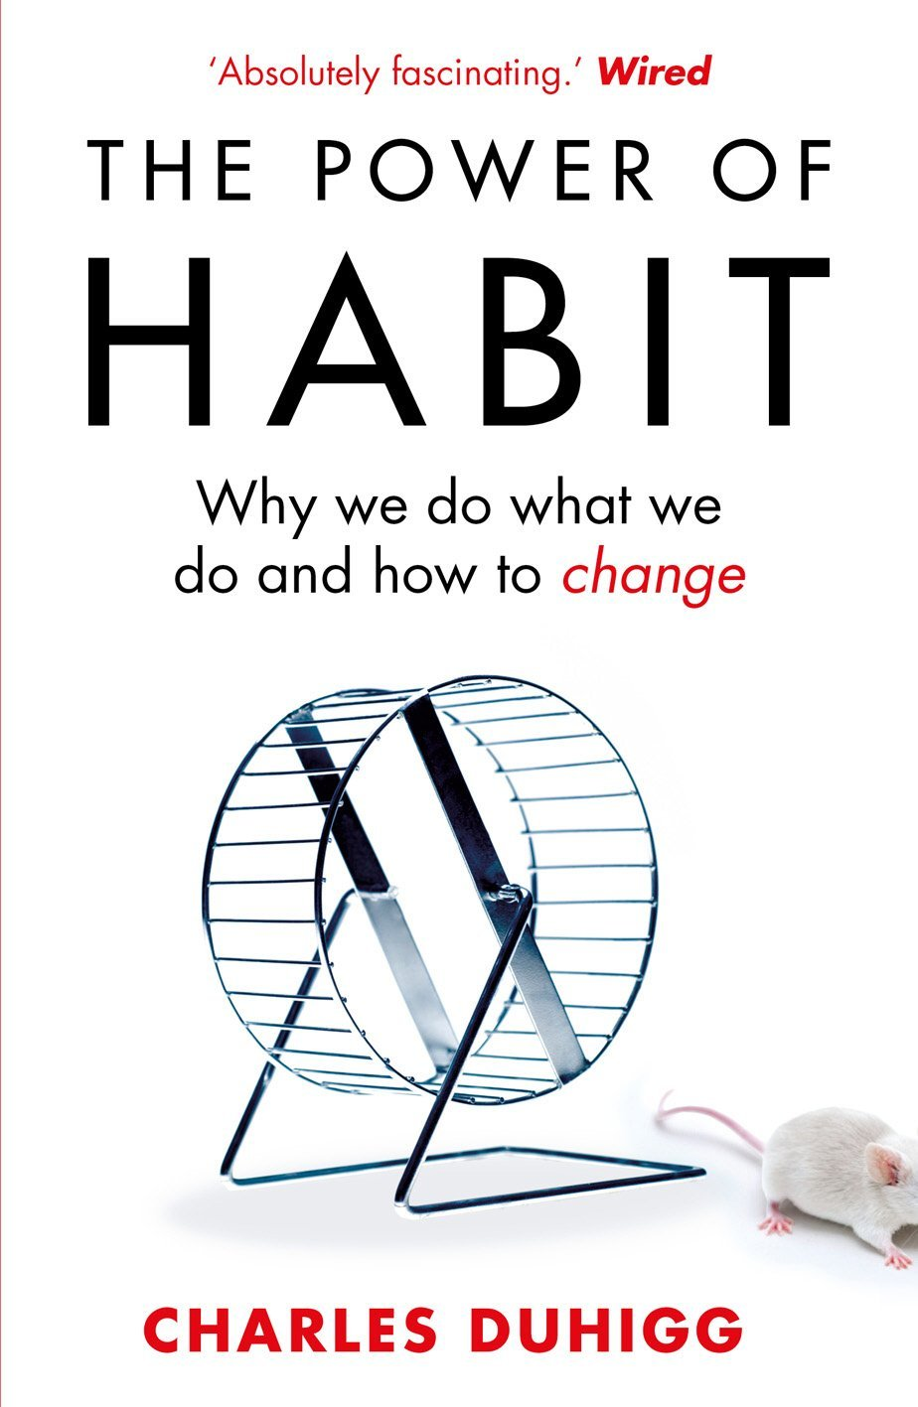
‘More than 40% of the actions people perform each day aren’t decisions but habits …’

Slide 4
‘Habits, scientists say, emerge because the brain is constantly looking for ways to save effort’

Slide 5
‘That’s why signing kids up for piano lessons or sports is so important. It has nothing to do with creating a good musician or a five year-old soccer star’

Slide 6
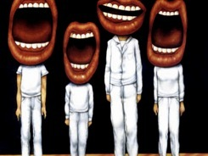
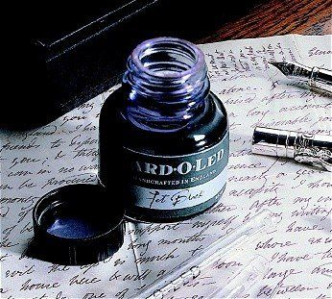

Slide 7
DEMO

Slide 8
The Matthew Effect
(Robert K Merton)

Slide 9
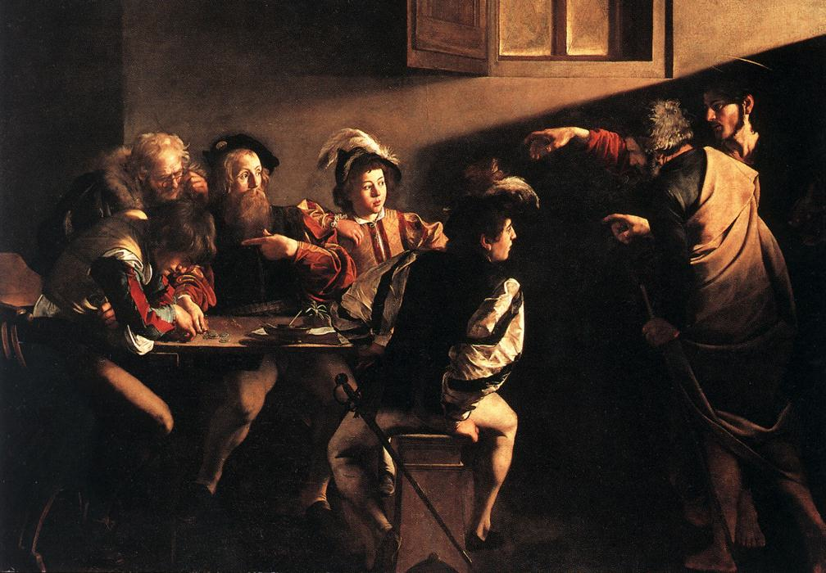

Slide 10
The rich shall get richer and the poor shall get poorer
Matthew 13:12

Slide 11
“The word-rich get richer while the word-poor get poorer” in their reading skills
(CASL)

Slide 12
“While good readers gain new skills very rapidly, and quickly move from learning to read to reading to learn, poor readers become increasingly frustrated with the act of reading, and try to avoid reading where possible”
The Matthew Effect
Daniel Rigney

Slide 13
“Students who begin with high verbal aptitudes find themselves in verbally enriched social environments and have a double advantage.”
The Matthew Effect
Daniel Rigney

Slide 14
“Spoken language forms a constraint, a ceiling not only on the ability to comprehend but also on the ability to write, beyond which literacy cannot progress”
Myhill and Fisher

Slide 15
The Matthew Effect:
The rich will get richer &
the poor will get poorer

Slide 16
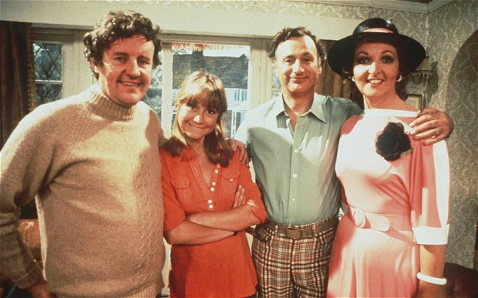
The Literacy Club

Slide 18
Understand the significance of exploratory talk
Model good talk – eg connectives
Re-think questioning – ‘why & how’, thinking time, and no-hands-up
Consciously vary groupings
Get conversation into the school culture

Slide 19
Teach reading – scanning, skimming, analysis
Teach conventions
Teach key vocabulary
Demystify spelling
Teach research, not FOFO

Slide 20
SKIMMING

Slide 21
The climate of the Earth is always changing. In the past it has altered as a result of natural causes. Nowadays, however, the term climate change is generally used when referring to changes in our climate which have been identified since the early part of the 1900's . The changes we've seen over recent years and those which are predicted over the next 80 years are thought to be mainly as a result of human behaviour rather than due to natural changes in the atmosphere.

Slide 22
The best treatment for mouth ulcers. Gargle with salt water. You should find that it works a treat. Salt is cheap and easy to get hold of and we all have it at home, so no need to splash out and spend lots of money on expensive mouth ulcer creams.

Slide 23
Lexical v Grammatical Words

Slide 24
Urquhart castle is probably one of the most picturesquely situated castles in the Scottish Highlands. Located 16 miles south-west of Inverness, the castle, one of the largest in Scotland, overlooks much of Loch Ness. Visitors come to stroll through the ruins of the 13th-century castle because Urquhart has earned the reputation of being one of the best spots for sighting Loch Ness’s most famous inhabitant.

Slide 25
Urquhart castle is probably one of the most picturesquely situated castles in the Scottish Highlands. Located 16 miles south-west of Inverness, the castle, one of the largest in Scotland, overlooks much of Loch Ness. Visitors come to stroll through the ruins of the 13th-century castle because Urquhart has earned the reputation of being one of the best spots for sighting Loch Ness’s most famous inhabitant.

Slide 26
Urquhart castle is probably one of the most picturesquely situated castles in the Scottish Highlands. Located 16 miles south-west of Inverness, the castle, one of the largest in Scotland, overlooks much of Loch Ness. Visitors come to stroll through the ruins of the 13th-century castle because Urquhart has earned the reputation of being one of the best spots for sighting Loch Ness’s most famous inhabitant.

Slide 27
Urquhart castle is probably one of the most picturesquely situated castles in the Scottish Highlands. Located 16 miles south-west of Inverness, the castle, one of the largest in Scotland, overlooks much of Loch Ness. Visitors come to stroll through the ruins of the 13th-century castle because Urquhart has earned the reputation of being one of the best spots for sighting Loch Ness’s most famous inhabitant.

Slide 28
Urquhart castle is probably one of the most picturesquely situated castles in the Scottish Highlands. Located 16 miles south-west of Inverness, the castle, one of the largest in Scotland, overlooks much of Loch Ness. Visitors come to stroll through the ruins of the 13th-century castle because Urquhart has earned the reputation of being one of the best spots for sighting Loch Ness’s most famous inhabitant.

Slide 29
SCANNING

Slide 30
Where did the first cell phones begin?
Name 2 other features that started to be included in phones
Why are cell phones especially useful in some countries?

Slide 31
Where begin?
Two features?
Some countries?
Cellular telephones
The first cellular telephone system began operation in Tokyo in 1979, and the first U.S. system began operation in 1983 in Chicago. A camera phone is a cellular phone that also has picture taking capabilities. Some camera phones have the capability to send these photos to another cellular phone or computer. Advances in digital technology and microelectronics has led to the inclusion of unrelated applications in cellular telephones, such as alarm clocks, calculators, Internet browsers, and voice memos for recording short verbal reminders, while at the same time making such telephones vulnerable to certain software viruses. In many countries with inadequate wire-based telephone networks, cellular telephone systems have provided a means of more quickly establishing a national telecommunications network.

Slide 32
What if Jane Austen was rewritten by Dylan Thomas?
Notes:
Necessary; accommodation; February;

Slide 33
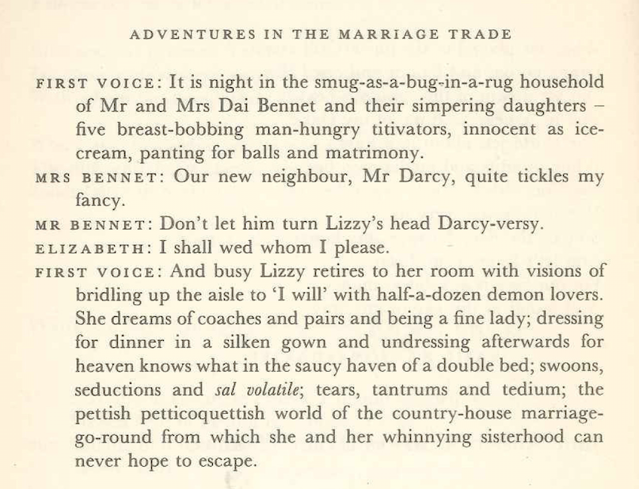

Slide 34
RESEARCH SKILLS

Slide 35
Research the life of
Martin Luther King

Slide 36
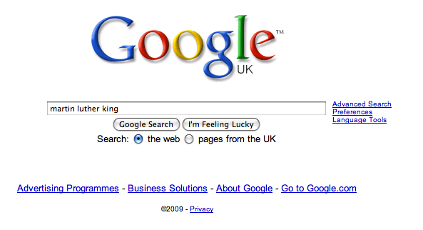

Slide 44
Teach reading – scanning, skimming, analysis
Teach conventions
Teach key vocabulary
Demystify spelling
Teach research, not FOFO

Slide 45
Demonstrate writing
Teach self-regulation
Allow oral rehearsal
Short & long sentences
Teach vocabulary: subject-specific & generic

Slide 46
Know your connectives
Adding: and, also, as well as, moreover, too
Cause & effect: because, so, therefore, thus, consequently
Sequencing: next, then, first, finally, meanwhile, before, after
Qualifying: however, although, unless, except, if, as long as, apart from, yet
Emphasising: above all, in particular, especially, significantly, indeed, notably
Illustrating: for example, such as, for instance, as revealed by, in the case of
Comparing: equally, in the same way, similarly, likewise, as with, like
Contrasting: whereas, instead of, alternatively, otherwise, unlike, on the other hand

Slide 47
Describe your holiday
Notes:
It’s really beautiful out there; in here, however, it’s quite claustrophobic

Slide 48
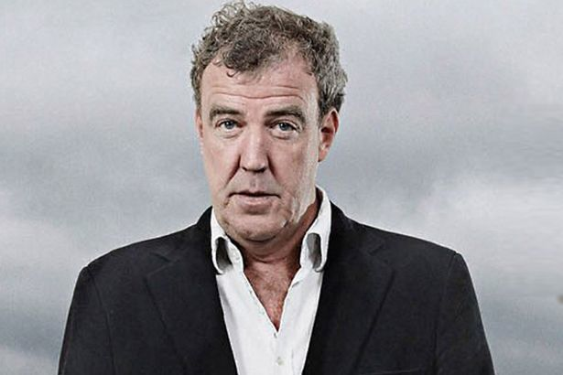
Notes:
It’s really beautiful out there; in here, however, it’s quite claustrophobic

Slide 49
For your next holiday, why don’t you take all your money and put it on the fire? Then stand in a fridge for a week, beating your children with a baseball bat until their arms and legs break. And then, after you’ve eaten some melted cheese, dislocate your shoulder. If all of this appeals then you are probably one of the 1.3 million British people …
… who go on a skiing holiday at this time of year.
Notes:
It’s really beautiful out there; in here, however, it’s quite claustrophobic

Slide 50
Demonstrate writing
Teach self-regulation
Allow oral rehearsal
Short & long sentences
Teach vocabulary: subject-specific & generic

Slide 51
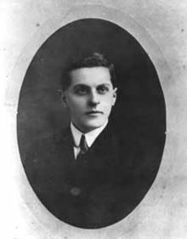
The limits of my language mean the limits of my world
Notes:
It’s really beautiful out there; in here, however, it’s quite claustrophobic

Slide 52
WHAT ➔ HOW
Notes:
It’s really beautiful out there; in here, however, it’s quite claustrophobic

Slide 53
Ask every teacher in every classroom to do one thing differently …
Notes:
It’s really beautiful out there; in here, however, it’s quite claustrophobic

Slide 54
SCIENCE
Explicitly teach the meaning of words commonly used in Science examinations
Notes:
It’s really beautiful out there; in here, however, it’s quite claustrophobic

Slide 55
MEDIA STUDIES
Develop teacher questioning, particularly in relation to the analysis of media texts.
Notes:
It’s really beautiful out there; in here, however, it’s quite claustrophobic

Slide 56
HOME ECONOMICS
Ask more how/why questions when observing a practical session so that students describe the processes they are using in a more precise way
Notes:
It’s really beautiful out there; in here, however, it’s quite claustrophobic

Slide 58
THE HABITS OF LITERACY
Geoff Barton
Festival of Education 2014
21 June 2014
geoffbarton.co.uk/teacher_resources
(Number 129)
Twitter: @RealGeoffBarton
Geoff Barton ⎜ ASCL Conference 2015 ⎜ 20 March 2015
Download this presentation free at: geoffbarton.co.uk/teacher_resources (Number 136)
Twitter: @RealGeoffBarton
Small-print:
There will be no use of Post-It notes or role-play.
However, you will need something to write with and on – preferably pen and paper

Slide 59
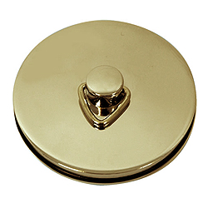
This is an expensive plug ➔

Slide 60
This is a
cheap plug ➔
Available here today!!!
Perfect gift for family & friends!!!

Slide 61
THE HABITS OF LITERACY
Geoff Barton
Festival of Education 2014
21 June 2014
geoffbarton.co.uk/teacher_resources
(Number 129)
Twitter: @RealGeoffBarton
Geoff Barton ⎜ ASCL Conference 2015 ⎜ 20 March 2015
Download this presentation free at: geoffbarton.co.uk/teacher_resources (Number 136)
Twitter: @RealGeoffBarton
Small-print:
There will be no use of Post-It notes or role-play.
However, you will need something to write with and on – preferably pen and paper

