Slide 1
Don’t Call it Literacy
Geoff Barton

Slide 2
Don’t Call it iteracy
Teaching Leaders Residential
August 2014
Twitter: @RealGeoffBarton
Download this presentation at www.geoffbarton.co.uk
(Presentation number 133)

Slide 3
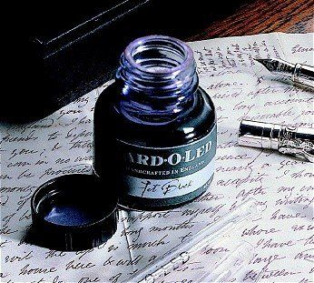

Slide 4
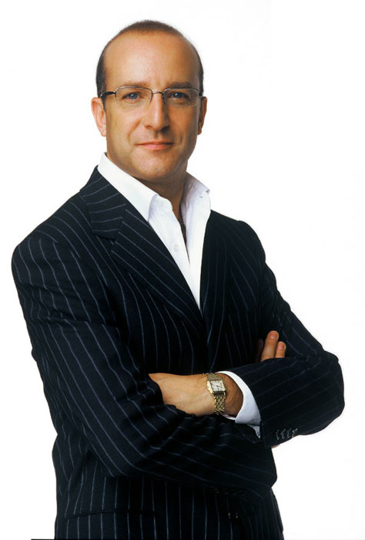
Aims:
I will make you better at SPEAKING& READING
& WRITING

Slide 5
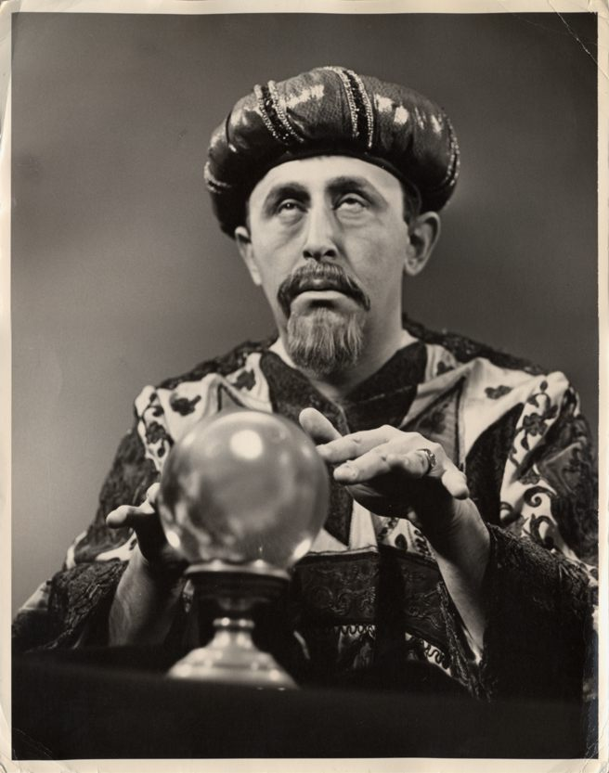
Fellows’ bonus:
Today I will reveal the secret of literacy

Slide 6
WHAT

Slide 7
HOW

Slide 8
1: The sacrifices
2: The language
3: The authenticity

Slide 9
1: Sacrifices

Slide 10
From Prince to King:
The courses of his youth promised it not. The breath no sooner left his father's body, But that his wildness, mortified in him, Seem'd to die too.

Slide 11
Mistress Quickly about Henry’s old friend:
‘The king has killed his heart’

Slide 12
2: Language

Slide 13
Henry to the enemy:
Your fathers taken by the silver beards,
And their most reverend heads dash'd to the walls,
Your naked infants spitted upon pikes,
While the mad mothers with their howls confused
Do break the clouds …
What say you? will you yield, and this avoid,
Or, guilty in defence, be thus destroy'd?

Slide 14
3: Authenticity

Slide 15
Henry to Catherine:
I speak to thee plain soldier:
Take me, take a soldier; take a soldier,
take a king.

Slide 16
Structure:
Session 1: Why literacy matters
Session 2: The Ofsted view
Session 3: Essentials for impact:
- Speaking & Listening
- Reading
- Writing

Slide 17
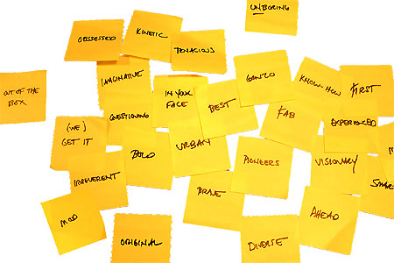
Approach:

Slide 18
Hypothesis:
Become a Year 11 writer again
… for four minutes

Slide 19
Hypothesis:
Task:
Describe the room we are in

Slide 20
Hypothesis:
Unconfident
Confident
What?
How?

Slide 21
Q:
?
Unconfident
Confident
Irrespective of background

Slide 22
A:
Teach them

Slide 23
Provocations:
We haven’t done literacy
It’s all about the classroom
Knowledge and instruction may be more important than we realised
Remember the “Matthew Effect”

Slide 24
The Matthew Effect
(Robert K Merton)

Slide 25
The rich shall get richer and the poor shall get poorer
Matthew 13:12

Slide 26
“The word-rich get richer while the word-poor get poorer” in their reading skills
(CASL)

Slide 27
“While good readers gain new skills very rapidly, and quickly move from learning to read to reading to learn, poor readers become increasingly frustrated with the act of reading, and try to avoid reading where possible”
The Matthew Effect
Daniel Rigney

Slide 28
“Students who begin with high verbal aptitudes find themselves in verbally enriched social environments and have a double advantage.”
The Matthew Effect
Daniel Rigney

Slide 29
“Good readers may choose friends who also read avidly while poor readers seek friends with whom they share other enjoyments”
The Matthew Effect
Daniel Rigney

Slide 30
Stricht’s Law: “reading ability in children cannot exceed their listening ability …”
E.D. Hirsch
The Schools We Need

Slide 31
“Spoken language forms a constraint, a ceiling not only on the ability to comprehend but also on the ability to write, beyond which literacy cannot progress”
Myhill and Fisher

Slide 32
“The children who possess intellectual capital when they first arrive at school have the mental scaffolding and Velcro to catch hold of what is going on, and they can turn the new knowledge into still more Velcro to gain still more knowledge”.
E.D. Hirsch
The Schools We Need

Slide 33
Aged 7:
Children in the top quartile have 7100 words; children in the lowest have around 3000.
The main influence is parents.
DfE Research Unit

Slide 34
The Matthew Effect:
The rich will get richer &
the poor will get poorer

Slide 35
The Literacy Club

Slide 36
The
view
of literacy

Slide 37
✗ May be mechanistic and superficial
✔ Yet may be very helpful

Slide 38
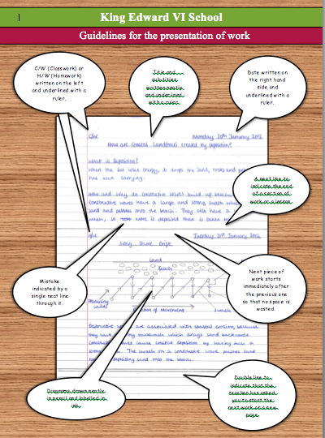

Slide 40
Are key terms and vocabulary clear and explored with pupils to ensure that they recognise and understand them? Are they related to similar words or the root from which they are derived?
Do teachers identify any particular features of key terms and help pupils with strategies for remembering how to spell them or why they might be capitalised (e.g. ‘Parliament’ in history or citizenship)?
Do teachers remind pupils of important core skills – for example how to skim a text to extract the main elements of its content quickly or to scan a text for information about a key word or topic?

Slide 41
Do teachers make expectations clear before pupils begin a task – for example on the conventions of layout in a formal letter or on the main features of writing persuasively?
Do teachers reinforce the importance of accuracy in spoken or written language – for example, emphasising the need for correct sentence punctuation in one-sentence answers or correcting ‘we was...’ in pupils’ speech?
Do teachers identify when it is important to use standard English and when other registers or dialects may be used – for example, in a formal examination answer and when recreating dialogue as part of narrative writing?

Slide 42
Do teachers help pupils with key elements of literacy as they support them in lessons? Do they point out spelling, grammar or punctuation issues as they look at work around the class?
Does teachers’ marking support key literacy points? For example, are key subject terms always checked for correct spelling? Is sentence punctuation always corrected?

Slide 43
Talking Point
Why literacy matters – ‘The Matthew Effect’ – the Literacy Club – the Ofsted view
What’s new? What’s familiar?
Implications for you and your subject?

Slide 44
5 key ingredients
Then teach you something
Then reflection

Slide 45
Understand the significance of exploratory talk
Model good talk – eg connectives
Re-think questioning – ‘why & how’, thinking time, and no-hands-up
Consciously vary groupings
Get conversation into the school culture

Slide 46
DEMO

Slide 47
Focus: speaking in public

Slide 48
Barriers:
Lack of confidence
Lack of structure
Lack of depersonalised tone

Slide 49
Task: why school uniform crushes our individuality

Slide 50
Stance, notes, pen
Number points
Be repetitive
Sentence functions
Confidence
Structure
Depersonalised tone
Avoid I / me
Use ‘so’ / ‘because’ / ‘however’ / ‘therefore’

Slide 51
Talking Point
Understand the significance of exploratory talk
Model good talk – eg connectives
Re-think questioning – ‘why & how’, thinking time, and no-hands-up
Consciously vary groupings
Get conversation into the school culture
What are the main types of talk needed in your subject?
Barriers?
So what could you do?

Slide 52
Teach reading – scanning, skimming, analysis
Read aloud and display
Teach key vocabulary
Demystify spelling
Teach research, not FOFO

Slide 53
DEMO

Slide 54
SKIMMING

Slide 55
The climate of the Earth is always changing. In the past it has altered as a result of natural causes. Nowadays, however, the term climate change is generally used when referring to changes in our climate which have been identified since the early part of the 1900's . The changes we've seen over recent years and those which are predicted over the next 80 years are thought to be mainly as a result of human behaviour rather than due to natural changes in the atmosphere.

Slide 56
The best treatment for mouth ulcers. Gargle with salt water. You should find that it works a treat. Salt is cheap and easy to get hold of and we all have it at home, so no need to splash out and spend lots of money on expensive mouth ulcer creams.

Slide 57
Lexical v Grammatical Words

Slide 58
Urquhart castle is probably one of the most picturesquely situated castles in the Scottish Highlands. Located 16 miles south-west of Inverness, the castle, one of the largest in Scotland, overlooks much of Loch Ness. Visitors come to stroll through the ruins of the 13th-century castle because Urquhart has earned the reputation of being one of the best spots for sighting Loch Ness’s most famous inhabitant.

Slide 59
Urquhart castle is probably one of the most picturesquely situated castles in the Scottish Highlands. Located 16 miles south-west of Inverness, the castle, one of the largest in Scotland, overlooks much of Loch Ness. Visitors come to stroll through the ruins of the 13th-century castle because Urquhart has earned the reputation of being one of the best spots for sighting Loch Ness’s most famous inhabitant.

Slide 60
Urquhart castle is probably one of the most picturesquely situated castles in the Scottish Highlands. Located 16 miles south-west of Inverness, the castle, one of the largest in Scotland, overlooks much of Loch Ness. Visitors come to stroll through the ruins of the 13th-century castle because Urquhart has earned the reputation of being one of the best spots for sighting Loch Ness’s most famous inhabitant.

Slide 61
Urquhart castle is probably one of the most picturesquely situated castles in the Scottish Highlands. Located 16 miles south-west of Inverness, the castle, one of the largest in Scotland, overlooks much of Loch Ness. Visitors come to stroll through the ruins of the 13th-century castle because Urquhart has earned the reputation of being one of the best spots for sighting Loch Ness’s most famous inhabitant.

Slide 62
Urquhart castle is probably one of the most picturesquely situated castles in the Scottish Highlands. Located 16 miles south-west of Inverness, the castle, one of the largest in Scotland, overlooks much of Loch Ness. Visitors come to stroll through the ruins of the 13th-century castle because Urquhart has earned the reputation of being one of the best spots for sighting Loch Ness’s most famous inhabitant.

Slide 63
SCANNING

Slide 64
Where did the first cell phones begin?
Name 2 other features that started to be included in phones
Why are cell phones especially useful in some countries?

Slide 65
Where begin?
Two features?
Some countries?
Cellular telephones
The first cellular telephone system began operation in Tokyo in 1979, and the first U.S. system began operation in 1983 in Chicago. A camera phone is a cellular phone that also has picture taking capabilities. Some camera phones have the capability to send these photos to another cellular phone or computer. Advances in digital technology and microelectronics has led to the inclusion of unrelated applications in cellular telephones, such as alarm clocks, calculators, Internet browsers, and voice memos for recording short verbal reminders, while at the same time making such telephones vulnerable to certain software viruses. In many countries with inadequate wire-based telephone networks, cellular telephone systems have provided a means of more quickly establishing a national telecommunications network.

Slide 66
CLOSE READING

Slide 67
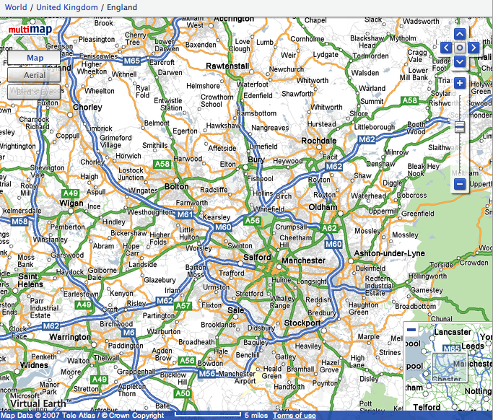

Slide 68
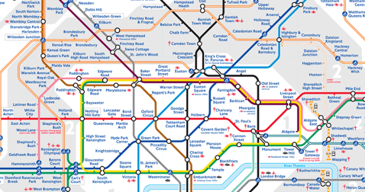
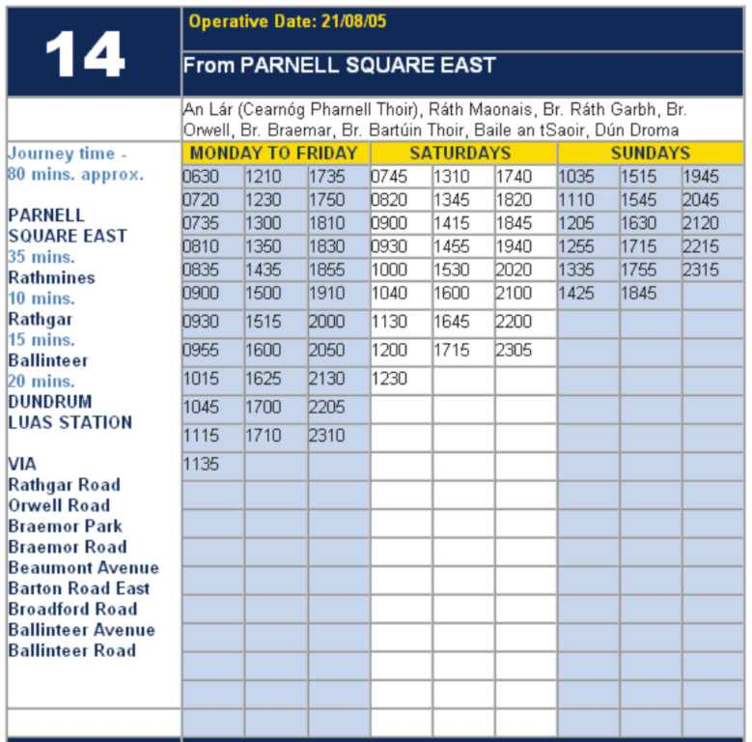

Slide 69
RESEARCH SKILLS

Slide 70
Research the life of
Martin Luther King

Slide 71
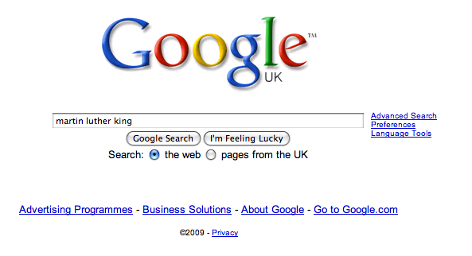

Slide 79
DEMYSTIFYING
SPELLING
3
Notes:
7 spellings: Government – February – parliament – separate – believe – necessary - accommodation

Slide 80
1 - SOUNDS

Slide 81
Government

Slide 82
February

Slide 83
Parliament

Slide 84
2 -VISUALS

Slide 85
Se-para-te
Be-lie-ve

Slide 86
3 - MNEMONICS

Slide 87
necessary

Slide 88
accommodation

Slide 89
Talking Point
Teach reading – scanning, skimming, analysis
Read aloud and display
Teach key vocabulary
Demystify spelling
Teach research, not FOFO
What are the main types of reading needed in your subject?
Barriers?
So what could you do?

Slide 90
Demonstrate writing
Teach composition & planning
Allow oral rehearsal
Short & long sentences
Connectives

Slide 91
Know your connectives
Adding: and, also, as well as, moreover, too
Cause & effect: because, so, therefore, thus, consequently
Sequencing: next, then, first, finally, meanwhile, before, after
Qualifying: however, although, unless, except, if, as long as, apart from, yet
Emphasising: above all, in particular, especially, significantly, indeed, notably
Illustrating: for example, such as, for instance, as revealed by, in the case of
Comparing: equally, in the same way, similarly, likewise, as with, like
Contrasting: whereas, instead of, alternatively, otherwise, unlike, on the other hand

Slide 92
Demonstrate writing
Teach composition & planning
Allow oral rehearsal
Short & long sentences
Connectives

Slide 93
DEMO

Slide 94
Task: write a horror story set in a mundane setting

Slide 95
Barriers:
Predictability
Telling, not showing
Lack of narrative ambition

Slide 96
Be sensuous; reject first word; use pronouns
Experiment with point-of-view
Predictability
Telling, not showing
Lack of narrative ambition
Use narrative disjuncture

Slide 97
Talking Point
Demonstrate writing
Teach composition & planning
Allow oral rehearsal
Short & long sentences
Connectives
What are the main types of writing needed in your subject?
Barriers?
So what could you do?

Slide 99
SUMMARY:
The Secret of Literacy

Slide 100
Stand by …

Slide 101
Ready …?

Slide 102
Tension now intolerable … ?

Slide 103
Well, it’s not literacy …

Slide 104
… it’s making the implicit explicit – and modelling it …

Slide 105
… without which, the rich will get richer & the poor will get poorer

Slide 106
… so we could just call it ‘what great teachers do’

Slide 107
Don’t Call it iteracy
Teaching Leaders Residential
August 2014
Twitter: @RealGeoffBarton
Download this presentation at www.geoffbarton.co.uk
(Presentation number 133)

Slide 108
This is an expensive plug ➔

Slide 109
This is a
cheap plug ➔

Slide 110
Don’t Call it iteracy
Teaching Leaders Residential
August 2014
Twitter: @RealGeoffBarton
Download this presentation at www.geoffbarton.co.uk
(Presentation number 133)

