Slide 1
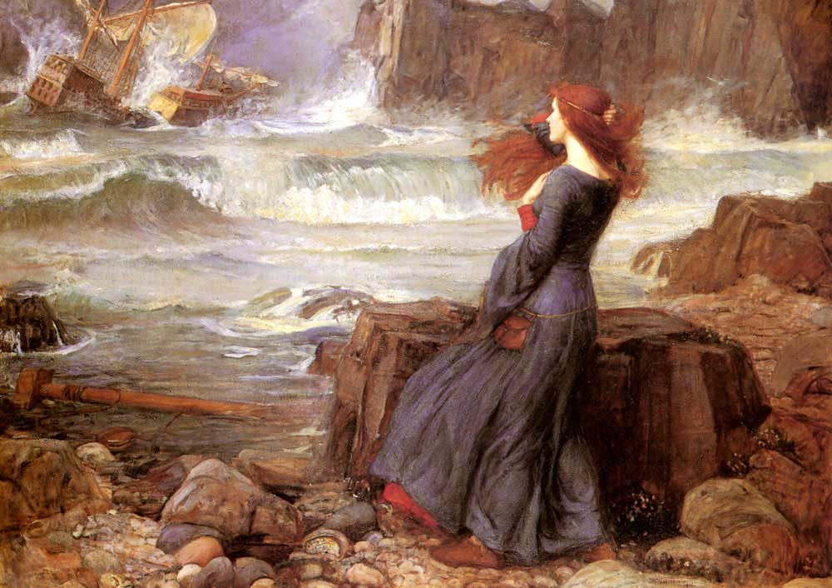
MIRANDA:
O brave new world, That has such people in't!
PROSPERO:
'Tis new to thee.

Slide 3
English & literacy in a brave new world: Beyond exam syllabuses and Ofsted
Geoff Barton
Head, King Edward VI School, Bury St Edmunds
18 June 2014
Download this presentation at www.geoffbarton.co.uk
(Presentation number 128)
Twitter: @RealGeoffBarton

Slide 4
Reclaiming English:
3
1 The state of English:
What matters?
2 You & your team:
How are you surviving?
How are you improving teaching?
How are you managing ‘the management’?
3 You & your students:
What elements lead to most progress?

Slide 6
The State of English

Slide 7
5 Questions;
5 Minutes

Slide 8
1 What is distinctive about English at your school?
2 What is English teaching students beyond what is in a prescribed syllabus?
3 What does it give students that is distinctive to your context?
4 How is English perceived by your students? By the management?
5 What will a teacher be doing in your school now that helps a child speak, read, write better - as a result of your leadership?

Slide 10
1 The report is based on evidence from inspections of English between April 2008 and March 2011 in 133 primary schools, 128 secondary schools and four special schools in England, supplemented by three additional good practice visits.

Slide 11
1 The report is based on evidence from inspections of English between April 2008 and March 2011 in 133 primary schools, 128 secondary schools and four special schools in England, supplemented by three additional good practice visits.

Slide 12
2 The quality of teaching was good or outstanding in seven in 10 of the lessons seen. In these lessons, teaching plans were clear about the key learning for pupils, teaching was flexible and responded to pupils’ needs as the lesson developed, and tasks were meaningful, giving pupils real audiences and contexts where possible.

Slide 13
3 The curriculum for English was judged to be good or outstanding in the large majority of schools inspected.
The most successful schools were those that had identified the particular needs of their pupils and then designed a distinctive curriculum to meet those needs

Slide 14
4 The quality of pupils’ learning was hampered in weaker lessons by a number of ‘myths’ about what makes a good lesson. The factors that most commonly limited learning included:
an excessive pace; an overloading of activities; inflexible planning; and limited time for pupils to work independently.
Learning was also constrained in schools where teachers concentrated too much or too early on a narrow range of test or examination skills.

Slide 15
5 However, few of the secondary schools visited had taken the opportunity, following the ending of the Year 9 statutory tests, to refresh their Key Stage 3 schemes of work.
The best schools provided students with tasks that had practical outcomes beyond the classroom, thus reinforcing the importance and relevance of the subject, but this was not common enough across the survey schools.

Slide 16
IMPLICATIONS:
What is English ‘for’ at your school? Specifically, what is KS3 for?
What skills and knowledge and experiences do you want learners to leave with – beyond what is statutory?
What does your school teach students about the ‘relevance’ of English?
Is there anything you need to do more of and less of?
How are you bringing the ‘word poor’ into the Literacy Club?

Slide 17
1 The state of English:
What matters?
2 You & your team:
How are you surviving?
How are you improving teaching?
How are you managing ‘the management’?
3 You & your students:
What elements lead to most progress?

Slide 18
Book frenzies
Library centrality
Idiolect
Global English
Self-regulation & resilience
Wow factor
The word-poor are stretched as the word-rich are indulged
Teachers who …
model exploratory talk, explaining and questioning
read obsessively
know what constitutes good writing

Slide 19
The Matthew Effect
(Robert K Merton)

Slide 20
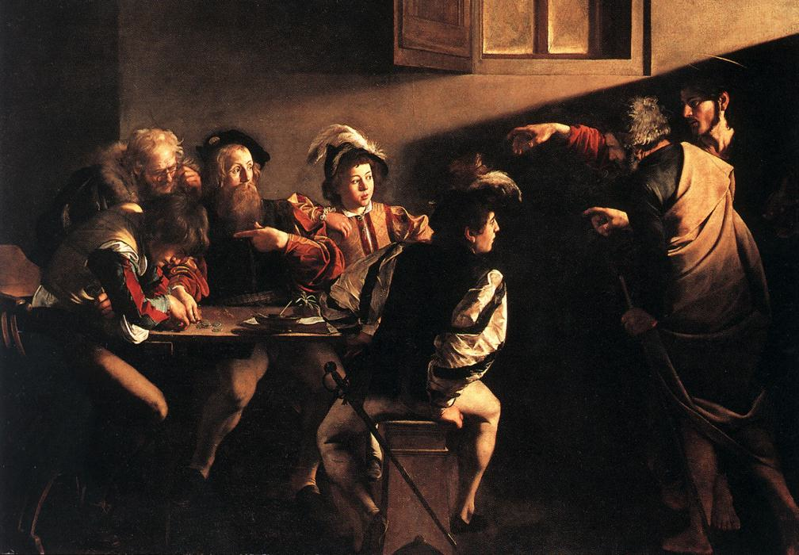

Slide 21
The rich shall get richer and the poor shall get poorer
Matthew 13:12

Slide 22
“The word-rich get richer while the word-poor get poorer” in their reading skills
(CASL)

Slide 23
“While good readers gain new skills very rapidly, and quickly move from learning to read to reading to learn, poor readers become increasingly frustrated with the act of reading, and try to avoid reading where possible”
The Matthew Effect
Daniel Rigney

Slide 24
“Students who begin with high verbal aptitudes find themselves in verbally enriched social environments and have a double advantage.”
The Matthew Effect
Daniel Rigney

Slide 25
“Good readers may choose friends who also read avidly while poor readers seek friends with whom they share other enjoyments”
The Matthew Effect
Daniel Rigney

Slide 26
Stricht’s Law: “reading ability in children cannot exceed their listening ability …”
E.D. Hirsch
The Schools We Need

Slide 27
“Spoken language forms a constraint, a ceiling not only on the ability to comprehend but also on the ability to write, beyond which literacy cannot progress”
Myhill and Fisher

Slide 28
“The children who possess intellectual capital when they first arrive at school have the mental scaffolding and Velcro to catch hold of what is going on, and they can turn the new knowledge into still more Velcro to gain still more knowledge”.
E.D. Hirsch
The Schools We Need

Slide 29
Aged 7:
Children in the top quartile have 7100 words; children in the lowest have around 3000.
The main influence is parents.
DfE Research Unit

Slide 30
The Matthew Effect:
The rich will get richer &
the poor will get poorer

Slide 31
The
view
of literacy

Slide 32
Key terms and vocabulary
Spelling
Core skills (skimming, scanning)
Conventions
Accuracy
Standard English
Spelling, grammar or punctuation
Marking to support literacy

Slide 33
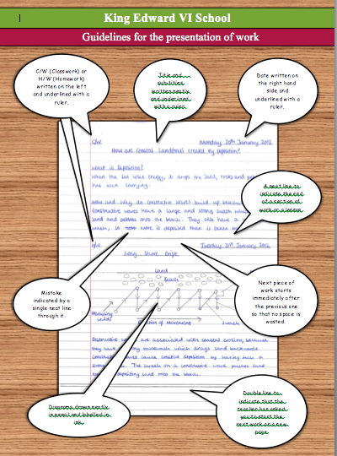

Slide 35
Talking Point
Your response?
How are you improving teaching?
How do you tackle teaching that’s not good enough?
How do teachers get to see and then practise what excellent teaching looks like?

Slide 36
5 key ingredients
Then teach you something
Then reflection

Slide 37
Understand the significance of exploratory talk
Model good talk – eg connectives
Re-think questioning – ‘why & how’, thinking time, and no-hands-up
Consciously vary groupings
Get conversation into the school culture

Slide 38
DEMO

Slide 39
Focus: speaking in public

Slide 40
Barriers:
Lack of confidence
Lack of structure
Lack of depersonalised tone

Slide 41
Task: why school uniform crushes our individuality

Slide 42
Stance, notes, pen
Number points
Be repetitive
Sentence functions
Confidence
Structure
Depersonalised tone
Avoid I / me
Use ‘so’, ‘because’, ‘however’ & ‘therefore’

Slide 43
Talking Point
Understand the significance of exploratory talk
Model good talk – eg connectives
Re-think questioning – ‘why & how’, thinking time, and no-hands-up
Consciously vary groupings
Get conversation into the school culture
What are the main types of talk needed in your subject?
Barriers?
So what could you do?

Slide 44
Teach reading – scanning, skimming, analysis
Read aloud and display
Teach key vocabulary
Build habits of reading
Teach research, not FOFO

Slide 45
DEMO

Slide 46
SKIMMING

Slide 47
The climate of the Earth is always changing. In the past it has altered as a result of natural causes. Nowadays, however, the term climate change is generally used when referring to changes in our climate which have been identified since the early part of the 1900's . The changes we've seen over recent years and those which are predicted over the next 80 years are thought to be mainly as a result of human behaviour rather than due to natural changes in the atmosphere.

Slide 48
The best treatment for mouth ulcers. Gargle with salt water. You should find that it works a treat. Salt is cheap and easy to get hold of and we all have it at home, so no need to splash out and spend lots of money on expensive mouth ulcer creams.

Slide 49
Lexical v Grammatical Words

Slide 50
Urquhart castle is probably one of the most picturesquely situated castles in the Scottish Highlands. Located 16 miles south-west of Inverness, the castle, one of the largest in Scotland, overlooks much of Loch Ness. Visitors come to stroll through the ruins of the 13th-century castle because Urquhart has earned the reputation of being one of the best spots for sighting Loch Ness’s most famous inhabitant.

Slide 51
Urquhart castle is probably one of the most picturesquely situated castles in the Scottish Highlands. Located 16 miles south-west of Inverness, the castle, one of the largest in Scotland, overlooks much of Loch Ness. Visitors come to stroll through the ruins of the 13th-century castle because Urquhart has earned the reputation of being one of the best spots for sighting Loch Ness’s most famous inhabitant.

Slide 52
Urquhart castle is probably one of the most picturesquely situated castles in the Scottish Highlands. Located 16 miles south-west of Inverness, the castle, one of the largest in Scotland, overlooks much of Loch Ness. Visitors come to stroll through the ruins of the 13th-century castle because Urquhart has earned the reputation of being one of the best spots for sighting Loch Ness’s most famous inhabitant.

Slide 53
Urquhart castle is probably one of the most picturesquely situated castles in the Scottish Highlands. Located 16 miles south-west of Inverness, the castle, one of the largest in Scotland, overlooks much of Loch Ness. Visitors come to stroll through the ruins of the 13th-century castle because Urquhart has earned the reputation of being one of the best spots for sighting Loch Ness’s most famous inhabitant.

Slide 54
Urquhart castle is probably one of the most picturesquely situated castles in the Scottish Highlands. Located 16 miles south-west of Inverness, the castle, one of the largest in Scotland, overlooks much of Loch Ness. Visitors come to stroll through the ruins of the 13th-century castle because Urquhart has earned the reputation of being one of the best spots for sighting Loch Ness’s most famous inhabitant.

Slide 55
SCANNING

Slide 56
Where did the first cell phones begin?
Name 2 other features that started to be included in phones
Why are cell phones especially useful in some countries?

Slide 57
Where begin?
Two features?
Some countries?
Cellular telephones
The first cellular telephone system began operation in Tokyo in 1979, and the first U.S. system began operation in 1983 in Chicago. A camera phone is a cellular phone that also has picture taking capabilities. Some camera phones have the capability to send these photos to another cellular phone or computer. Advances in digital technology and microelectronics has led to the inclusion of unrelated applications in cellular telephones, such as alarm clocks, calculators, Internet browsers, and voice memos for recording short verbal reminders, while at the same time making such telephones vulnerable to certain software viruses. In many countries with inadequate wire-based telephone networks, cellular telephone systems have provided a means of more quickly establishing a national telecommunications network.

Slide 58
CLOSE READING

Slide 59
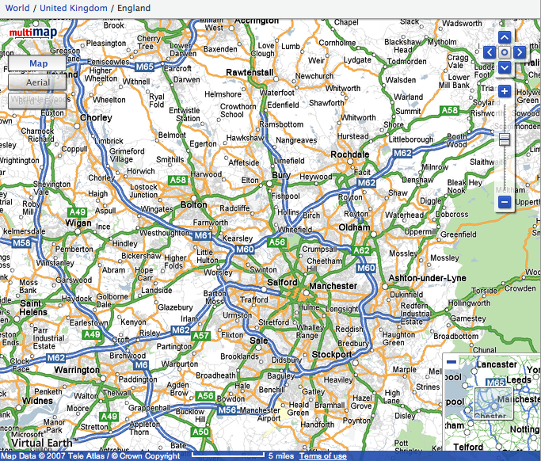

Slide 60
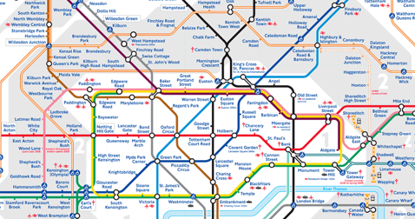
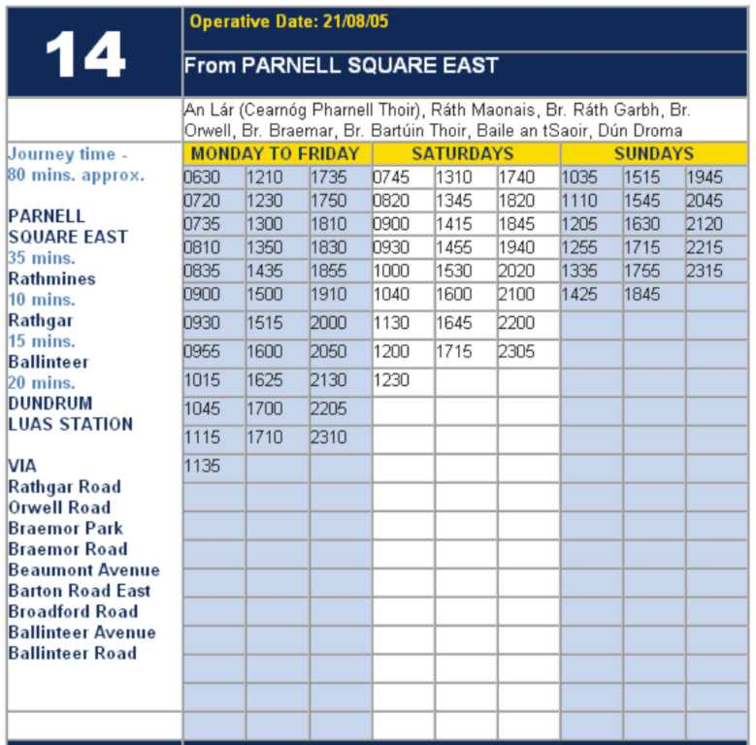
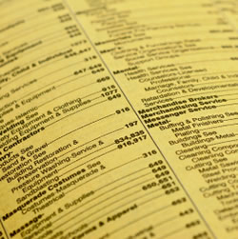

Slide 61
RESEARCH SKILLS

Slide 62
Research the life of
Martin Luther King

Slide 63
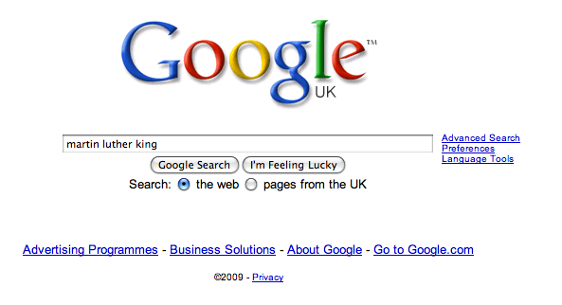

Slide 71
Talking Point
Teach reading – scanning, skimming, analysis
Read aloud and display
Teach key vocabulary
Build reading habits
Teach research, not FOFO
What are the main types of reading needed in your subject?
Barriers?
So what could you do?

Slide 72
Demonstrate writing
Teach composition & planning
Allow oral rehearsal
Short & long sentences
Connectives

Slide 73
Know your connectives
Adding: and, also, as well as, moreover, too
Cause & effect: because, so, therefore, thus, consequently
Sequencing: next, then, first, finally, meanwhile, before, after
Qualifying: however, although, unless, except, if, as long as, apart from, yet
Emphasising: above all, in particular, especially, significantly, indeed, notably
Illustrating: for example, such as, for instance, as revealed by, in the case of
Comparing: equally, in the same way, similarly, likewise, as with, like
Contrasting: whereas, instead of, alternatively, otherwise, unlike, on the other hand

Slide 74
Demonstrate writing
Teach self-regulation
Allow oral rehearsal
Teach sentence & lexical variety
Connectives

Slide 75
Demonstrate writing
Teach self-regulation
Allow oral rehearsal
Teach sentence & lexical variety
Connectives

Slide 76
DEMO

Slide 77
Task: write a horror story set in a mundane setting

Slide 78
Barriers:
Predictability
Telling, not showing
Lack of narrative ambition

Slide 79
Be sensuous; reject first word; use pronouns
Experiment with point-of-view
Predictability
Telling, not showing
Lack of narrative ambition
Use narrative disjuncture

Slide 80
Talking Point
Demonstrate writing
Teach self-regulation
Allow oral rehearsal
Teach sentence & lexical variety
Connectives
What are the main types of writing needed in your subject?
Barriers?
So what could you do?

Slide 82
English & literacy in a brave new world: Beyond exam syllabuses and Ofsted
Geoff Barton
Head, King Edward VI School, Bury St Edmunds
19 June 2014
Download this presentation at www.geoffbarton.co.uk
(Presentation number 128)
Twitter: @RealGeoffBarton

Slide 83
Reclaiming English:
3
1 The state of English:
What matters?
2 You & your team:
How are you surviving?
How are you improving teaching?
How are you managing ‘the management’?
3 You & your students:
What elements lead to most progress?

Slide 84
This is an expensive plug ➔

Slide 85
This is a
cheap plug ➔

Slide 86
English for a brave new world

