Slide 1
Reclaiming English
Birmingham (Take Two)
13 November 2013
Twitter: @RealGeoffBarton
Download this presentation at www.geoffbarton.co.uk
(Presentation number 123)

Slide 2
IGNITE ENGLISH
TODAY

Slide 3
IGNITE ENGLISH
What’s KS3 English for?: exploring ‘distinctiveness’
Improving writing: introducing ‘self-regulation’
Bonus: I’ll make you speak, read and write better
Go home

Slide 4
IGNITE ENGLISH
The State of English

Slide 6
IGNITE ENGLISH

Slide 7
IGNITE ENGLISH
1
The report is based on evidence from inspections of English between April 2008 and March 2011 in 133 primary schools, 128 secondary schools and four special schools in England, supplemented by three additional good practice visits.

Slide 8
IGNITE ENGLISH
2
The quality of teaching was good or outstanding in seven in 10 of the lessons seen. In these lessons, teaching plans were clear about the key learning for pupils, teaching was flexible and responded to pupils’ needs as the lesson developed, and tasks were meaningful, giving pupils real audiences and contexts where possible.

Slide 9
IGNITE ENGLISH
The quality of pupils’ learning was hampered in weaker lessons by a number of ‘myths’ about what makes a good lesson. The factors that most commonly limited learning included:
an excessive pace; an overloading of activities; inflexible planning; and limited time for pupils to work independently.
Learning was also constrained in schools where teachers concentrated too much or too early on a narrow range of test or examination skills.
3

Slide 10
IGNITE ENGLISH
4
The curriculum for English was judged to be good or outstanding in the large majority of schools inspected.
The most successful schools were those that had identified the particular needs of their pupils and then designed a distinctive curriculum to meet those needs

Slide 11
IGNITE ENGLISH
5
However, few of the secondary schools visited had taken the opportunity, following the ending of the Year 9 statutory tests, to refresh their Key Stage 3 schemes of work.
The best schools provided students with tasks that had practical outcomes beyond the classroom, thus reinforcing the importance and relevance of the subject, but this was not common enough across the survey schools.

Slide 12
IGNITE ENGLISH
So what’s distinctive about English at your school?

Slide 13
IGNITE ENGLISH
What is English ‘for’ at your school? Specifically, what is KS3 for?
What skills and knowledge and experiences do you want learners to leave with – beyond what is statutory?
What does your school teach students about the ‘relevance’ of English?

Slide 14
IGNITE ENGLISH
So what’s distinctive about English at your school:
Is this a chance to reclaim English?

Slide 15
IGNITE ENGLISH
Introducing ‘self-regulation’

Slide 16
IGNITE ENGLISH
Demo

Slide 17
IGNITE ENGLISH

Slide 18
IGNITE ENGLISH
What does this student need from me as a teacher?

Slide 19
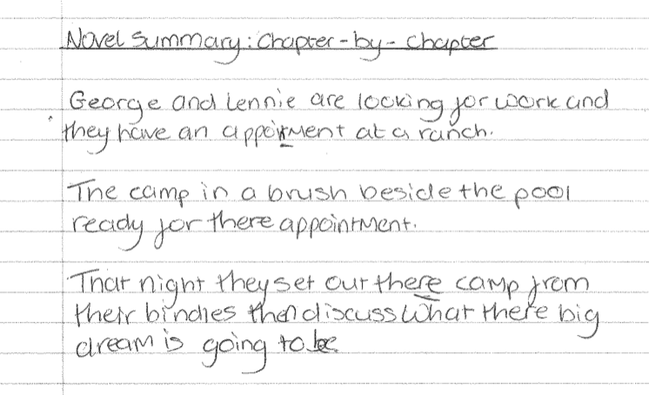
IGNITE ENGLISH

Slide 20
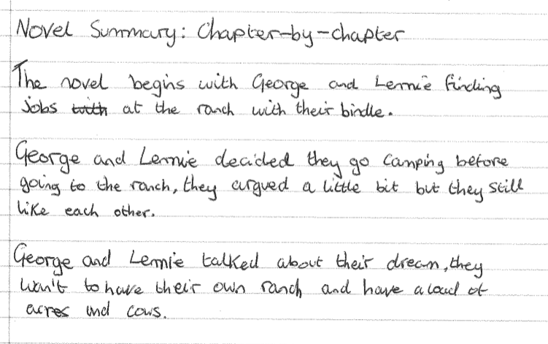
IGNITE ENGLISH

Slide 21
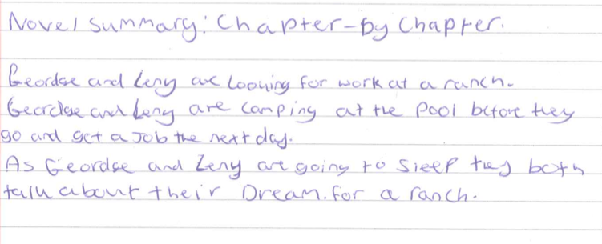
IGNITE ENGLISH

Slide 22
Aims:
I will make you better at SPEAKING& READING
& WRITING

Slide 24
5 key ingredients
Then teach you something
Then reflection

Slide 25
Understand the significance of exploratory talk
Model good talk – eg connectives
Re-think questioning – ‘why & how’, thinking time, and no-hands-up
Consciously vary groupings
Get conversation into the school culture

Slide 26
Focus: speaking in public

Slide 27
Barriers:
Lack of confidence
Lack of structure
Lack of depersonalised tone

Slide 28
Task: why school uniform crushes our individuality

Slide 29
Stance, notes, pen
Number points
Be repetitive
Sentence functions
Confidence
Structure
Depersonalised tone
Avoid I / me
Use ‘so’, ‘because’, ‘however’ & ‘therefore’

Slide 30
Talking Point
Understand the significance of exploratory talk
Model good talk – eg connectives
Re-think questioning – ‘why & how’, thinking time, and no-hands-up
Consciously vary groupings
Get conversation into the school culture
What are the main types of talk needed in your subject?
Barriers?
So what could you do?

Slide 31
Teach reading – scanning, skimming, analysis
Read aloud and display
Teach key vocabulary
Demystify spelling
Teach research, not FOFO

Slide 32
DEMO

Slide 33
SKIMMING

Slide 34
The climate of the Earth is always changing. In the past it has altered as a result of natural causes. Nowadays, however, the term climate change is generally used when referring to changes in our climate which have been identified since the early part of the 1900's . The changes we've seen over recent years and those which are predicted over the next 80 years are thought to be mainly as a result of human behaviour rather than due to natural changes in the atmosphere.

Slide 35
The best treatment for mouth ulcers. Gargle with salt water. You should find that it works a treat. Salt is cheap and easy to get hold of and we all have it at home, so no need to splash out and spend lots of money on expensive mouth ulcer creams.

Slide 36
Lexical v Grammatical Words

Slide 37
Urquhart castle is probably one of the most picturesquely situated castles in the Scottish Highlands. Located 16 miles south-west of Inverness, the castle, one of the largest in Scotland, overlooks much of Loch Ness. Visitors come to stroll through the ruins of the 13th-century castle because Urquhart has earned the reputation of being one of the best spots for sighting Loch Ness’s most famous inhabitant.

Slide 38
Urquhart castle is probably one of the most picturesquely situated castles in the Scottish Highlands. Located 16 miles south-west of Inverness, the castle, one of the largest in Scotland, overlooks much of Loch Ness. Visitors come to stroll through the ruins of the 13th-century castle because Urquhart has earned the reputation of being one of the best spots for sighting Loch Ness’s most famous inhabitant.

Slide 39
Urquhart castle is probably one of the most picturesquely situated castles in the Scottish Highlands. Located 16 miles south-west of Inverness, the castle, one of the largest in Scotland, overlooks much of Loch Ness. Visitors come to stroll through the ruins of the 13th-century castle because Urquhart has earned the reputation of being one of the best spots for sighting Loch Ness’s most famous inhabitant.

Slide 40
Urquhart castle is probably one of the most picturesquely situated castles in the Scottish Highlands. Located 16 miles south-west of Inverness, the castle, one of the largest in Scotland, overlooks much of Loch Ness. Visitors come to stroll through the ruins of the 13th-century castle because Urquhart has earned the reputation of being one of the best spots for sighting Loch Ness’s most famous inhabitant.

Slide 41
Urquhart castle is probably one of the most picturesquely situated castles in the Scottish Highlands. Located 16 miles south-west of Inverness, the castle, one of the largest in Scotland, overlooks much of Loch Ness. Visitors come to stroll through the ruins of the 13th-century castle because Urquhart has earned the reputation of being one of the best spots for sighting Loch Ness’s most famous inhabitant.

Slide 42
SCANNING

Slide 43
Where did the first cell phones begin?
Name 2 other features that started to be included in phones
Why are cell phones especially useful in some countries?

Slide 44
Where begin?
Two features?
Some countries?
Cellular telephones
The first cellular telephone system began operation in Tokyo in 1979, and the first U.S. system began operation in 1983 in Chicago. A camera phone is a cellular phone that also has picture taking capabilities. Some camera phones have the capability to send these photos to another cellular phone or computer. Advances in digital technology and microelectronics has led to the inclusion of unrelated applications in cellular telephones, such as alarm clocks, calculators, Internet browsers, and voice memos for recording short verbal reminders, while at the same time making such telephones vulnerable to certain software viruses. In many countries with inadequate wire-based telephone networks, cellular telephone systems have provided a means of more quickly establishing a national telecommunications network.

Slide 45
CLOSE READING

Slide 46
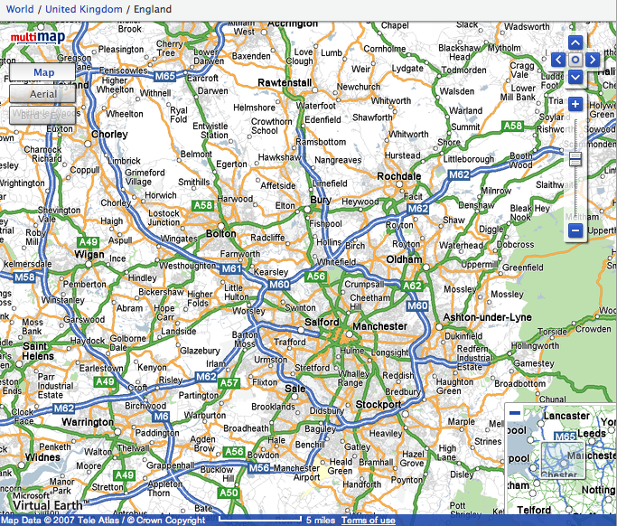

Slide 47
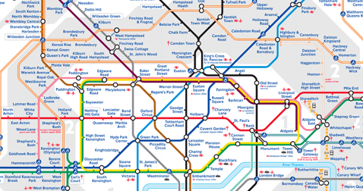
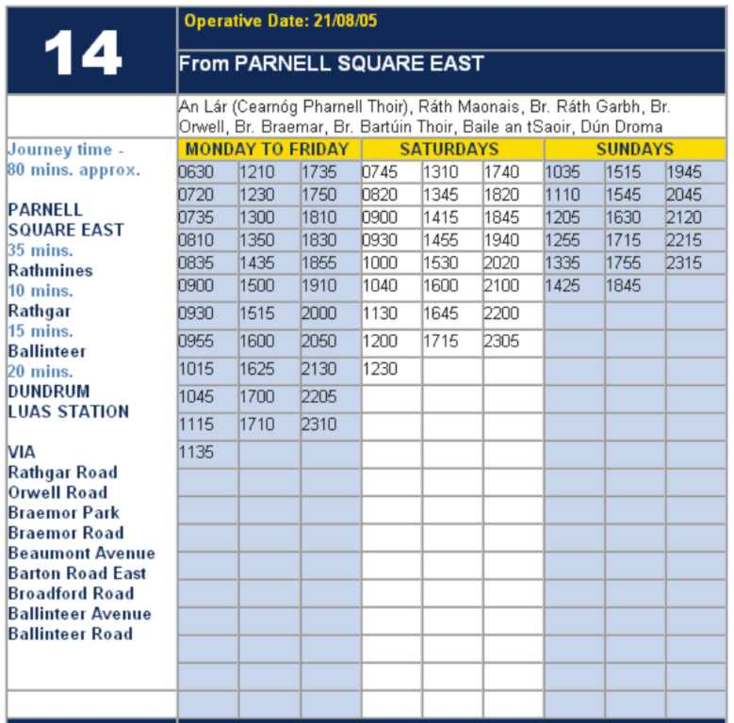

Slide 48
RESEARCH SKILLS

Slide 49
Research the life of
Martin Luther King

Slide 50
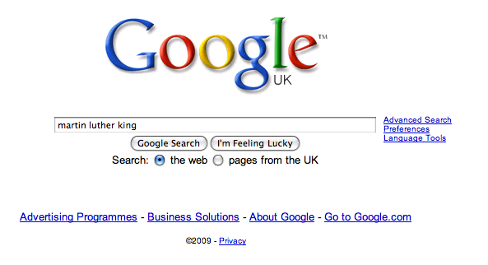

Slide 58
Talking Point
Teach reading – scanning, skimming, analysis
Read aloud and display
Teach key vocabulary
Demystify spelling
Teach research, not FOFO
What are the main types of reading needed in your subject?
Barriers?
So what could you do?

Slide 59
Demonstrate writing
Teach composition & planning
Allow oral rehearsal
Short & long sentences
Connectives

Slide 60
Know your connectives
Adding: and, also, as well as, moreover, too
Cause & effect: because, so, therefore, thus, consequently
Sequencing: next, then, first, finally, meanwhile, before, after
Qualifying: however, although, unless, except, if, as long as, apart from, yet
Emphasising: above all, in particular, especially, significantly, indeed, notably
Illustrating: for example, such as, for instance, as revealed by, in the case of
Comparing: equally, in the same way, similarly, likewise, as with, like
Contrasting: whereas, instead of, alternatively, otherwise, unlike, on the other hand

Slide 61
Demonstrate writing
Teach composition & planning
Allow oral rehearsal
Short & long sentences
Connectives

Slide 62
DEMO

Slide 63
Task: write a horror story set in a mundane setting

Slide 64
Barriers:
Predictability
Telling, not showing
Lack of narrative ambition

Slide 65
Be sensuous; reject first word; use pronouns
Experiment with point-of-view
Predictability
Telling, not showing
Lack of narrative ambition
Use narrative disjuncture

Slide 66
Talking Point
Demonstrate writing
Teach composition & planning
Allow oral rehearsal
Short & long sentences
Connectives
What are the main types of writing needed in your subject?
Barriers?
So what could you do?

Slide 68
IGNITE ENGLISH
This is an expensive plug ➔

Slide 69
IGNITE ENGLISH
This is a
cheap plug ➔

Slide 70
IGNITE ENGLISH

Slide 71
Reclaiming English
Birmingham (Take Two)
13 November 2013
Twitter: @RealGeoffBarton
Download this presentation at www.geoffbarton.co.uk
(Presentation number 123)

