Slide 1
NDTA Conference 2013: ‘Moving On’
Geoff Barton
Headteacher
King Edward VI School, Suffolk
Twitter: @RealGeoffBarton
www.geoffbarton.co.uk

Slide 2
‘When it is dark enough, you can see the stars’
Ralph Waldo Emerson
‘Those who can't dance say the music is no good.’ Jamaican Saying
Notes:
These are dark times in education

Slide 3
‘When it is dark enough, you can see the stars’
Ralph Waldo Emerson
‘Those who can't dance say the music is no good.’ Jamaican Saying
Notes:
These are dark times in education

Slide 4
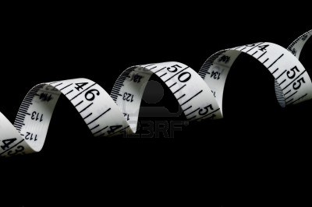
‘We should measure what we value, not just value what we can measure’
John MacBeath
University of Cambridge
Notes:
These are dark times in education

Slide 5
‘We should measure what we value, not value only what we can measure’
Notes:
These are dark times in education

Slide 6
Then
Notes:
These are dark times in education

Slide 7
Now
Notes:
These are dark times in education

Slide 8
Next
Notes:
These are dark times in education

Slide 9
1550
Notes:
These are dark times in education

Slide 10
Now
Notes:
These are dark times in education

Slide 11
Next
Notes:
These are dark times in education

Slide 12
Value-added
Notes:
These are dark times in education

Slide 13
Values-added
Notes:
These are dark times in education

Slide 14
3
Notes:
Physical, musical, cultural, social,

Slide 15
1: Dance challenges …
Notes:
Physical, musical, cultural, social,

Slide 16
2: Partnership matters
Notes:
These are dark times in education

Slide 17
3: Tell your story
Notes:
Creativity, discipline,

Slide 18
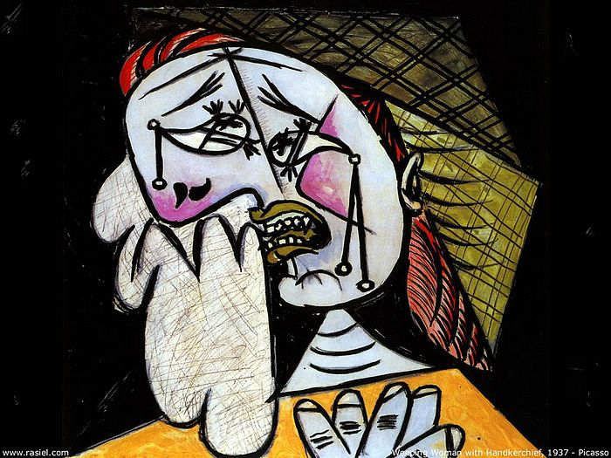
Notes:
These are dark times in education

Slide 19
‘I am always doing that which I cannot do, in order that I may learn how to do it’
Pablo Picasso
Notes:
Creativity, discipline, fundamentally about learning

Slide 20
‘Those who can't dance say the music is no good.’ Jamaican Saying
Notes:
These are dark times in education

Slide 21
‘Darkness is my closest friend’
Psalm 88
Notes:
These are dark times in education

Slide 22
NDTA Conference 2013: ‘Moving On’
Geoff Barton
Headteacher
King Edward VI School, Suffolk
Twitter: @RealGeoffBarton
www.geoffbarton.co.uk

