Slide 1
Hertfordshire Headteachers’ Conference:
‘Assembling the Jigsaw’
Geoff Barton
Headteacher, King Edward VI School, Suffolk
Twitter: @RealGeoffBarton
Download presentation at www.geoffbarton.co.uk/teacher-resources (114)

Slide 2
‘O Brave New World’:
What kind of leaders does our education system need?

Slide 3
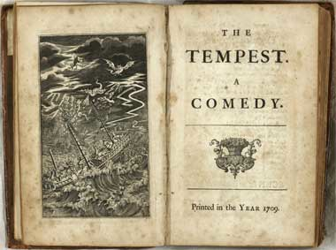

Slide 4
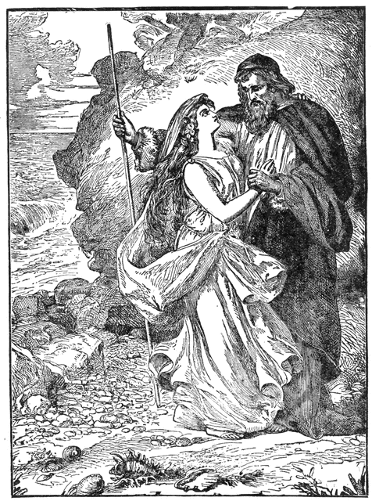
Miranda:
“O brave new world, That has such people in't!”
Prospero:
“Tis new to thee”

Slide 5
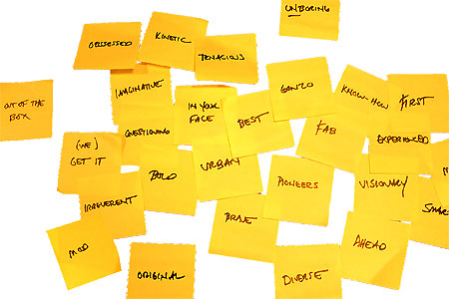

Slide 6
Missing pieces:
1 Real teaching & learning*
2 Character-building
*Literacy

Slide 7
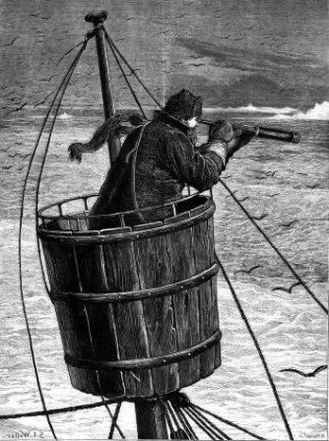
Part 1: Surveying the landscape
Master:
“We run ourselves aground”

Slide 8
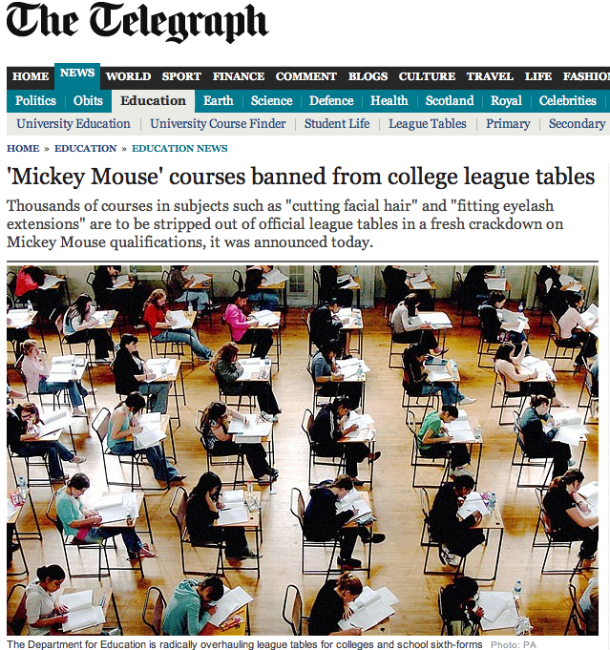

Slide 9
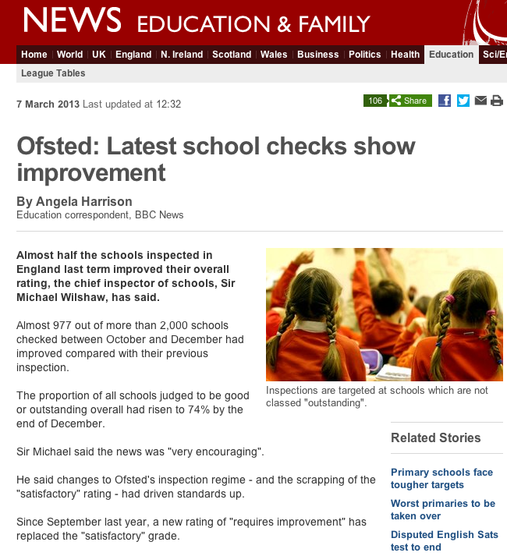

Slide 10
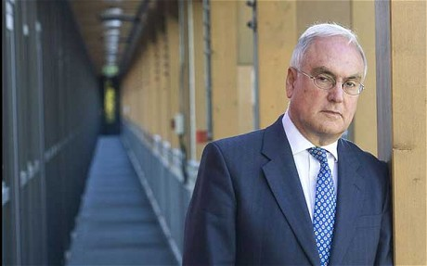
Sir Michael Wilshaw, 7 March 2013:
Changes to Ofsted's inspection regime - and the scrapping of the "satisfactory" rating - had driven standards up …
Ofsted's new framework is having a "galvanising effect" on the schools system.

Slide 11
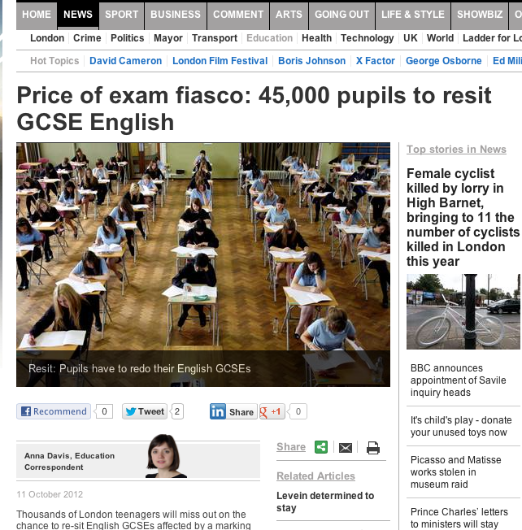
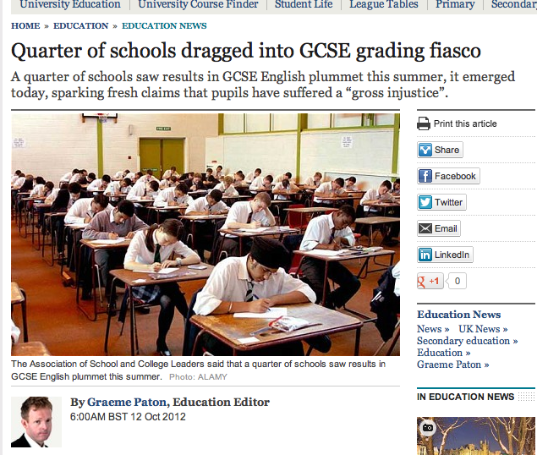
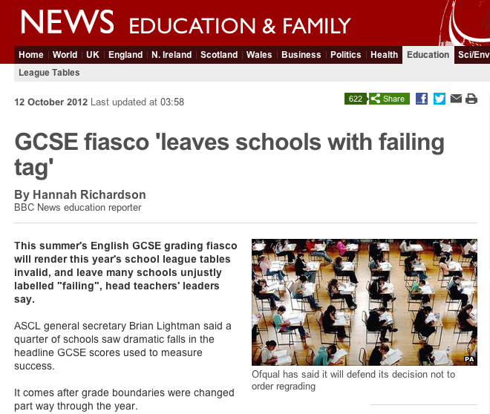

Slide 12
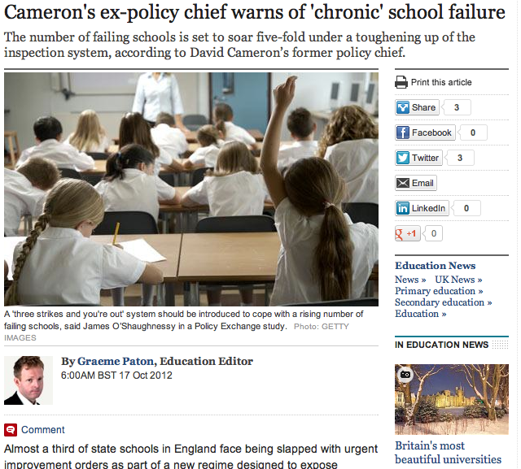

Slide 13
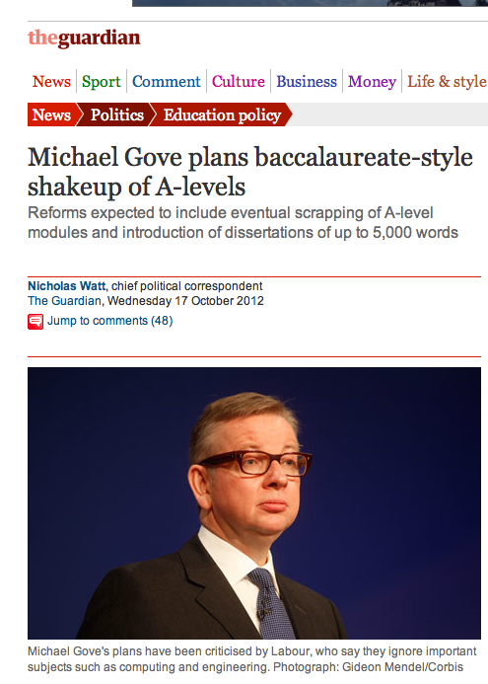

Slide 14
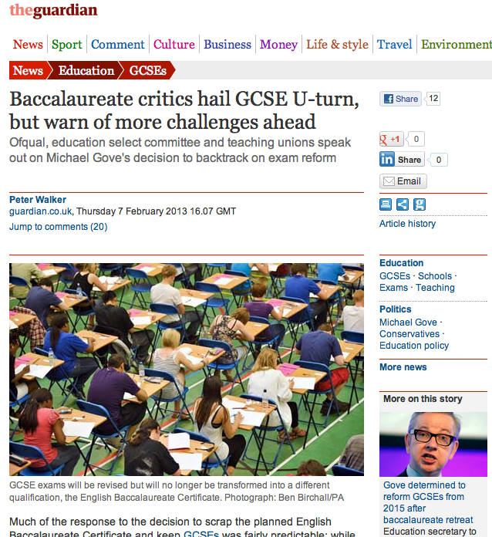

Slide 15
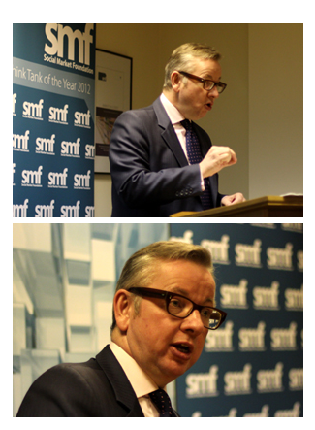
Speech to Social Market Foundation
5 February 2013

Slide 17
“Two particular individuals have influenced me more than any others …”

Slide 18
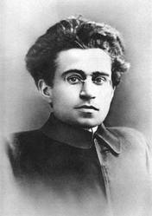

Slide 19
At a tragically early age Jade was diagnosed with cervical cancer. Terminally ill, she had to make plans for her two beloved boys …
She used her money to send them to the most traditional, academically demanding prep school she could find. So they could enjoy the best education reality TV could buy.

Slide 20
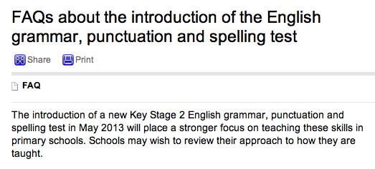

Slide 21
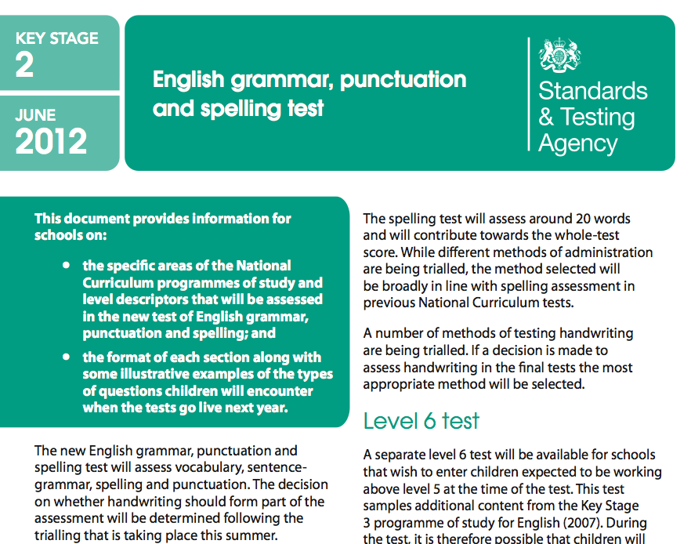

Slide 22
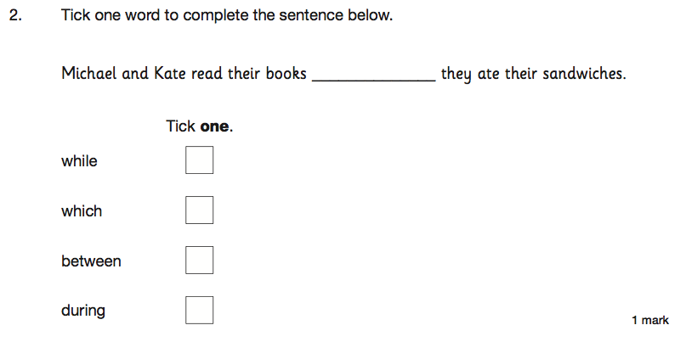

Slide 23
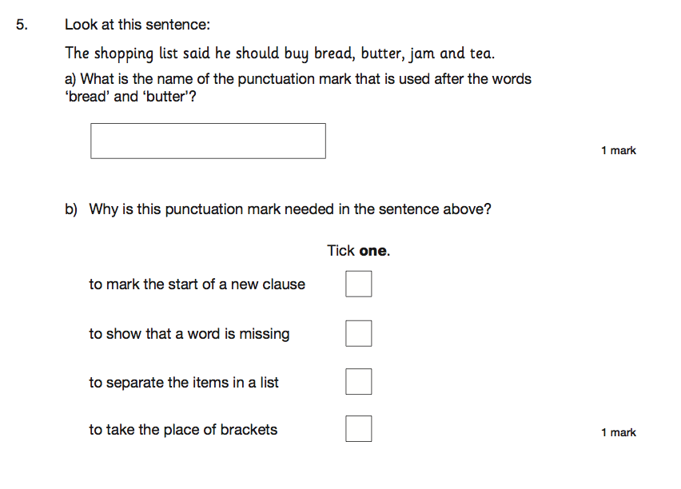

Slide 24
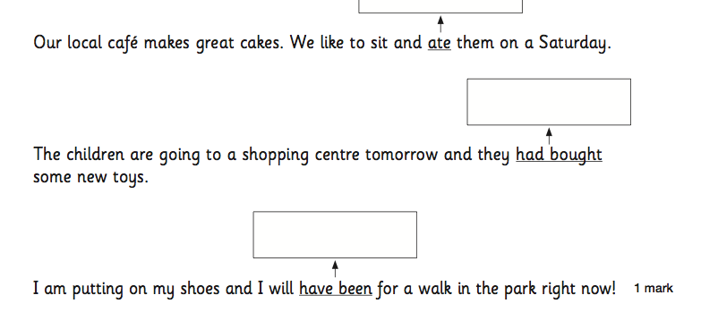

Slide 25
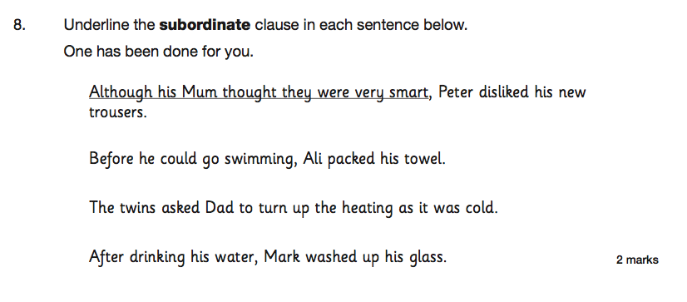

Slide 26
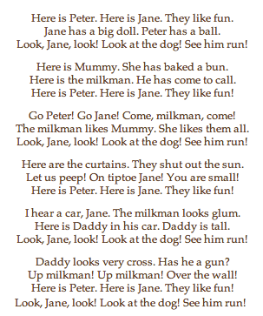
Wendy Cope
Reading Scheme

Slide 27
Unintended consequences

Slide 28
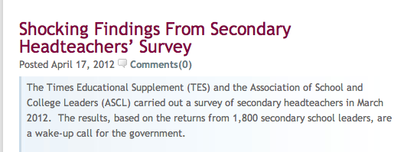

Slide 29
37% are actively planning to leave the profession.
92% don’t think the government is supportive of the teaching profession.
23% would recommend headship to their colleagues the corollary of which is that 77% wouldn’t recommend it.
61% said the government’s education reforms will have a detrimental impact on state education.
73% of deputies and assistant headteachers said they were less likely to want to take up a headship than they would have been 12 months ago.

Slide 30
37% are actively planning to leave the profession.
92% don’t think the government is supportive of the teaching profession.
23% would recommend headship to their colleagues the corollary of which is that 77% wouldn’t recommend it.
61% said the government’s education reforms will have a detrimental impact on state education.
73% of deputies and assistant headteachers said they were less likely to want to take up a headship than they would have been 12 months ago.

Slide 31
I am a head of a fantastic school. It was designated satisfactory by Ofsted following 16 months in special measures.
My job is currently secure in spite of flatlining this year due to the English issue at 54% 5 A*-C inc E and M. All other indicators soared. I have invited Ofsted in to redesignate and am awaiting the call.
We are resitting with our students - all who have come back from college on a Friday night to undertake intensive revision sessions with the Head of English. She is a teacher with real integrity and professionalism, who on results day spent the morning throwing up and apologising for the mess she had made when in reality it was none of her doing.
My frustration at this is immense. The young men who it has mostly affected deserve better. The teachers deserve better.
Head 1:

Slide 32
Friday morning. Sick in the stomach. Just picked up your blog via Twitter.
Yesterday I invited my Head of English to a meeting to further discuss English performance and his leadership.
HoD opens letter and after reading the contents (pretty ominous but genuinely praising his professionalism, and suggestions of how to improve things) promptly resigns.
Tears (sadness & relief) follow. Relief? That there wasn’t going to be a sacking. Relief from me that I took a step to deal with a matter which in truth I wanted to ignore - for my colleague is a very decent person.
I used to love my job as a Headteacher. Yesterday wasn’t an easy call. Since our 5+A*-C E/M dropped a long way I haven’t loved my job.
I feel impotent, a failure and, like now, I cry over work issues.
Head 2:

Slide 33
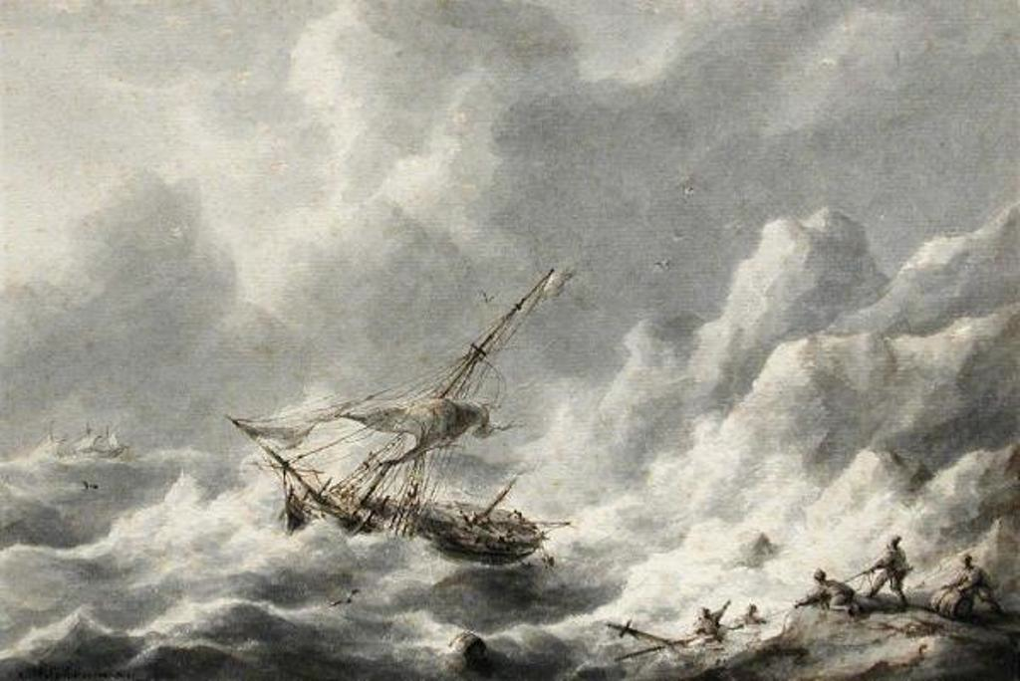
Issues:

Slide 34
Pace of reform
Nature of reform
Tone of reform
Disconnect
Feeling of being run by people who haven’t run things
Ironically mechanistic view of education
Swagger.
Issues:

Slide 35
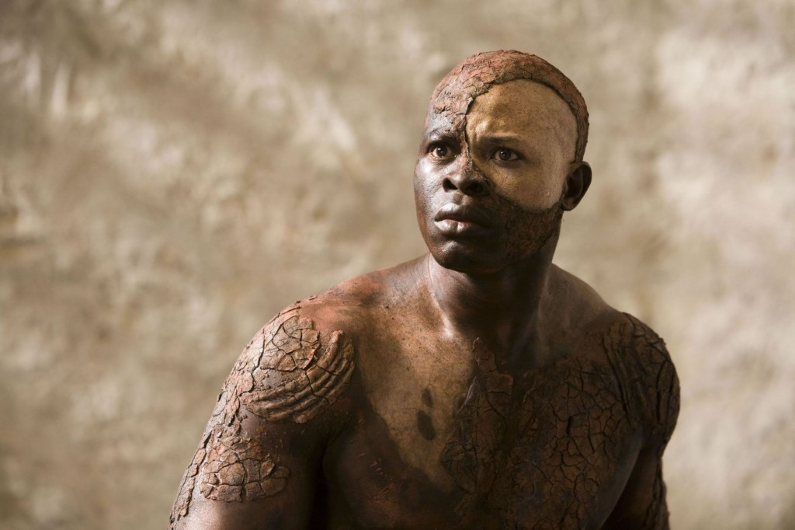
Part 2:
What’s missing for our students?

Slide 37
‘When the classroom door is closed, the teacher will always remain in charge. Where students are concerned, the teacher will always be more powerful than the principal, the president or the prime minister.
Successful and sustainable improvement can therefore never be done to
or even for teachers.
It can only ever be achieved
by and with them.’

Slide 38
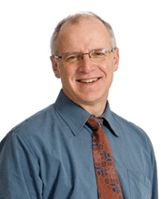

Slide 39
Much of the research on change in schools is pessimistic: Milbrey McLaughlin once wrote that ‘policy cannot mandate what matters’

Slide 40
‘We need to distinguish change from improvement’

Slide 41
‘I put teaching and learning practices far ahead of curriculum as a means of improving student outcomes and believe that the emphasis on curriculum in many places has not been the best priority for limited time, energy and resources.’

Slide 42
It is a myth that you have to address students’ personal problems before you get to their learning: ‘as more kids learned to read and were successful, behaviour problems declined precipitously: good teaching was the best strategy to improve student behaviour’

Slide 43
‘Curriculum matters less than quality of teaching, as shown by the very significant differences in achievement from one teacher to another in the same course or curriculum.’

Slide 44
Real teaching & learning
Character-building

Slide 45
The Matthew Effect
(Robert K Merton)

Slide 46
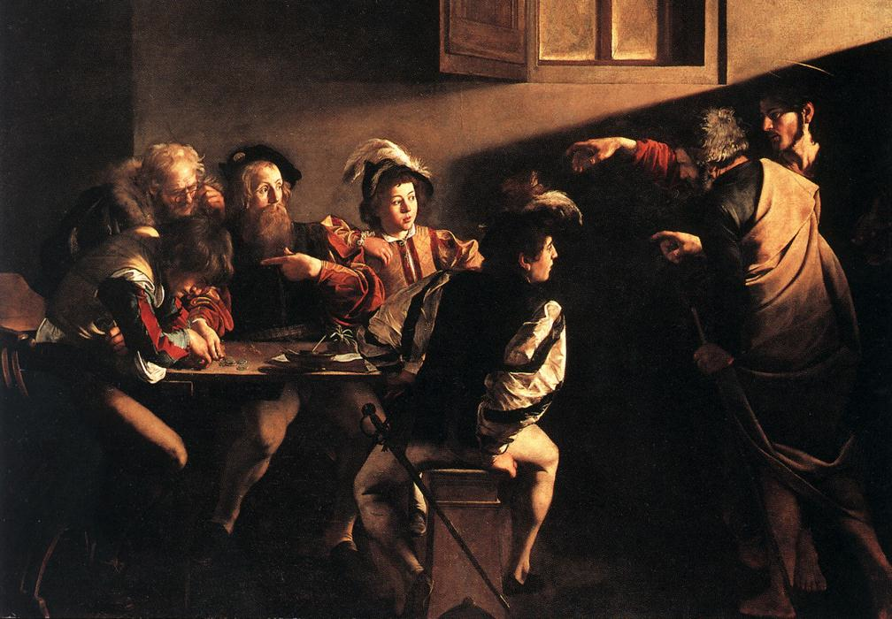

Slide 47
The rich shall get richer and the poor shall get poorer
Matthew 13:12

Slide 48
“The word-rich get richer while the word-poor get poorer” in their reading skills
(CASL)

Slide 49
“While good readers gain new skills very rapidly, and quickly move from learning to read to reading to learn, poor readers become increasingly frustrated with the act of reading, and try to avoid reading where possible”
The Matthew Effect
Daniel Rigney

Slide 50
“Students who begin with high verbal aptitudes find themselves in verbally enriched social environments and have a double advantage.”
The Matthew Effect
Daniel Rigney

Slide 51
“Good readers may choose friends who also read avidly while poor readers seek friends with whom they share other enjoyments”
The Matthew Effect
Daniel Rigney

Slide 52
Stricht’s Law: “reading ability in children cannot exceed their listening ability …”
E.D. Hirsch
The Schools We Need

Slide 53
“Spoken language forms a constraint, a ceiling not only on the ability to comprehend but also on the ability to write, beyond which literacy cannot progress”
Myhill and Fisher

Slide 54
“The children who possess intellectual capital when they first arrive at school have the mental scaffolding and Velcro to catch hold of what is going on, and they can turn the new knowledge into still more Velcro to gain still more knowledge”.
E.D. Hirsch
The Schools We Need

Slide 55
Aged 7:
Children in the top quartile have 7100 words; children in the lowest have around 3000.
The main influence is parents.
DfE Research Unit

Slide 56
Every teacher in English is a teacher of English
George Sampson, 1922

Slide 57
The Matthew Effect:
The rich will get richer &
the poor will get poorer

Slide 58
Teach reading – scanning, skimming, analysis
Teach research, not FOFO

Slide 59
DEMO

Slide 60
SKIMMING

Slide 61
The climate of the Earth is always changing. In the past it has altered as a result of natural causes. Nowadays, however, the term climate change is generally used when referring to changes in our climate which have been identified since the early part of the 1900's . The changes we've seen over recent years and those which are predicted over the next 80 years are thought to be mainly as a result of human behaviour rather than due to natural changes in the atmosphere.

Slide 62
The best treatment for mouth ulcers. Gargle with salt water. You should find that it works a treat. Salt is cheap and easy to get hold of and we all have it at home, so no need to splash out and spend lots of money on expensive mouth ulcer creams.

Slide 63
Lexical v Grammatical Words

Slide 64
Urquhart castle is probably one of the most picturesquely situated castles in the Scottish Highlands. Located 16 miles south-west of Inverness, the castle, one of the largest in Scotland, overlooks much of Loch Ness. Visitors come to stroll through the ruins of the 13th-century castle because Urquhart has earned the reputation of being one of the best spots for sighting Loch Ness’s most famous inhabitant.

Slide 65
Urquhart castle is probably one of the most picturesquely situated castles in the Scottish Highlands. Located 16 miles south-west of Inverness, the castle, one of the largest in Scotland, overlooks much of Loch Ness. Visitors come to stroll through the ruins of the 13th-century castle because Urquhart has earned the reputation of being one of the best spots for sighting Loch Ness’s most famous inhabitant.

Slide 66
Urquhart castle is probably one of the most picturesquely situated castles in the Scottish Highlands. Located 16 miles south-west of Inverness, the castle, one of the largest in Scotland, overlooks much of Loch Ness. Visitors come to stroll through the ruins of the 13th-century castle because Urquhart has earned the reputation of being one of the best spots for sighting Loch Ness’s most famous inhabitant.

Slide 67
Urquhart castle is probably one of the most picturesquely situated castles in the Scottish Highlands. Located 16 miles south-west of Inverness, the castle, one of the largest in Scotland, overlooks much of Loch Ness. Visitors come to stroll through the ruins of the 13th-century castle because Urquhart has earned the reputation of being one of the best spots for sighting Loch Ness’s most famous inhabitant.

Slide 68
Urquhart castle is probably one of the most picturesquely situated castles in the Scottish Highlands. Located 16 miles south-west of Inverness, the castle, one of the largest in Scotland, overlooks much of Loch Ness. Visitors come to stroll through the ruins of the 13th-century castle because Urquhart has earned the reputation of being one of the best spots for sighting Loch Ness’s most famous inhabitant.

Slide 69
The Matthew Effect:
The rich will get richer &
the poor will get poorer

Slide 70
SCANNING

Slide 71
Where did the first cell phones begin?
Name 2 other features that started to be included in phones
Why are cell phones especially useful in some countries?

Slide 72
Where begin?
Two features?
Some countries?
Cellular telephones
The first cellular telephone system began operation in Tokyo in 1979, and the first U.S. system began operation in 1983 in Chicago. A camera phone is a cellular phone that also has picture taking capabilities. Some camera phones have the capability to send these photos to another cellular phone or computer. Advances in digital technology and microelectronics has led to the inclusion of unrelated applications in cellular telephones, such as alarm clocks, calculators, Internet browsers, and voice memos for recording short verbal reminders, while at the same time making such telephones vulnerable to certain software viruses. In many countries with inadequate wire-based telephone networks, cellular telephone systems have provided a means of more quickly establishing a national telecommunications network.

Slide 73
RESEARCH SKILLS

Slide 74
Research the life of
Martin Luther King

Slide 75
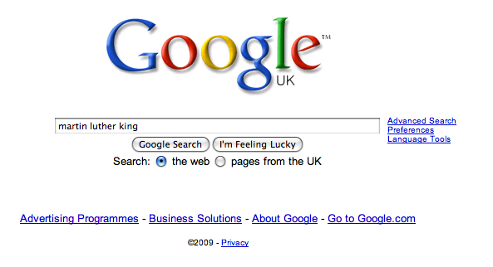

Slide 83
Real teaching & learning
Character-building

Slide 85
Five years with us is not long. Every experience needs to make a difference, and be part of a wider whole which serves as a framework to shape the lives of these young men and women. It needs to reinforce values and beliefs that will make them good people as well as preparing them for the competitive, dynamic and global workplace of the 21st century.
Yes, we are hugely ambitious academically for our pupils, ensuring that they secure the results to go on to the world’s best universities and on to careers of significance, influence and service.
But we also want them to live lives which are personally and socially fulfilling. In those five years, we can develop within them a love for art, music, dance, theatre and culture which will enrich the whole of their lives.

Slide 87
Grit
Curiosity
Self-control
Social intelligence
Zest
Optimism
Gratitude
Plus …
Bouncing back from failure

Slide 88
The missing pieces of the jigsaw aren’t with other people ….

Slide 89
They’re with us.

Slide 90
Real teaching & learning
Character

Slide 91
Leadership

Slide 92
‘O Brave New World’:
What kind of leaders does our education system need?
Twitter: @RealGeoffBarton
Presentation at geoffbarton.co.uk (114)

Slide 93
PS: This makes a great gift for family & friends:

