Slide 1
‘O Brave New World’:
Reclaiming English
Geoff Barton: 18 May 2013
Twitter: @RealGeoffBarton
Presentation at geoffbarton.co.uk (115)

Slide 2
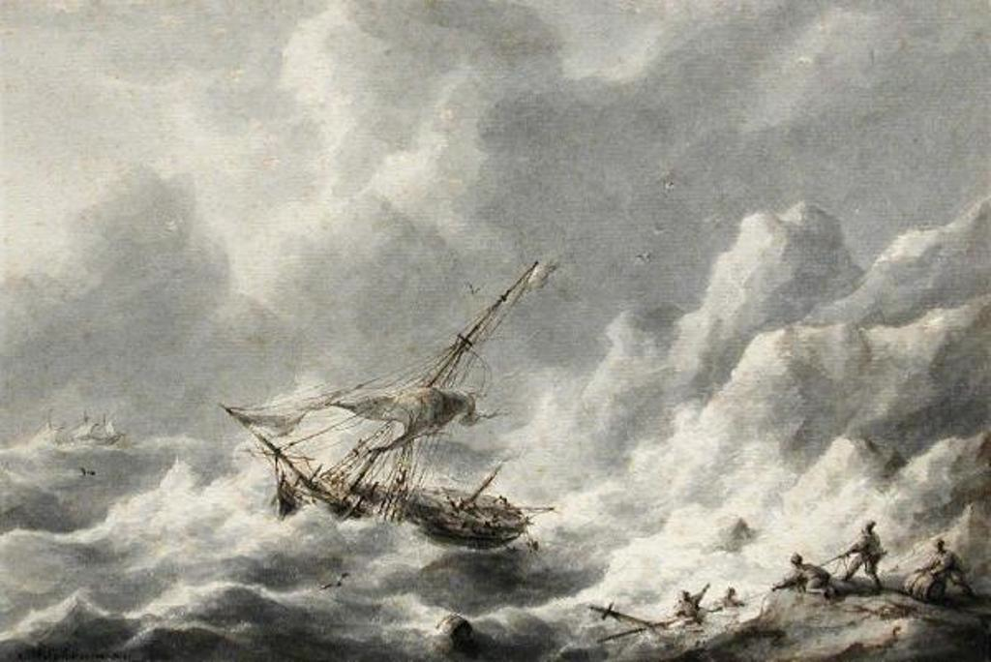
What is the secondary headteacher’s perspective?

Slide 3
1: Then

Slide 4
2: Now

Slide 5
A History of English in 5 Texts

Slide 6
1: 1921
Sampson

Slide 7
2: 1967
Holbrook

Slide 8
3: 1974
Bullock

Slide 9
4: 1984
HMI

Slide 10
4: 1984

Slide 11
5: May 2013
SPaG

Slide 13
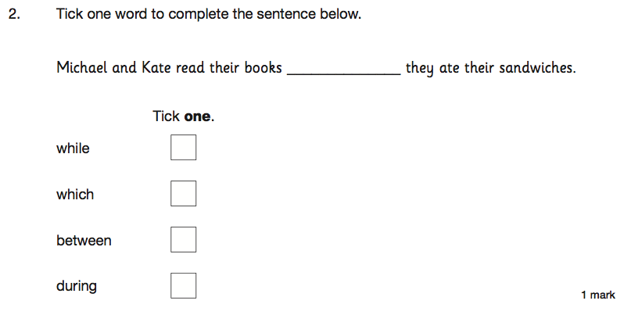

Slide 14
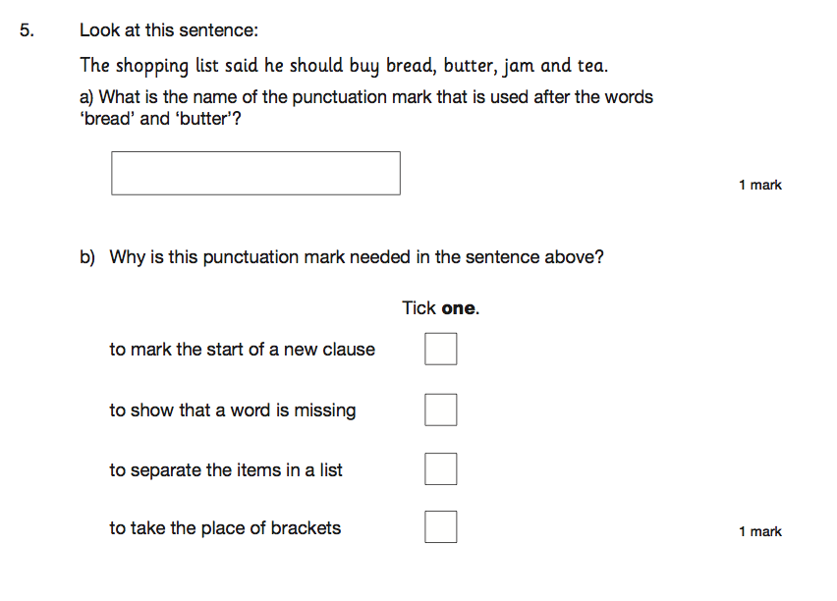

Slide 15
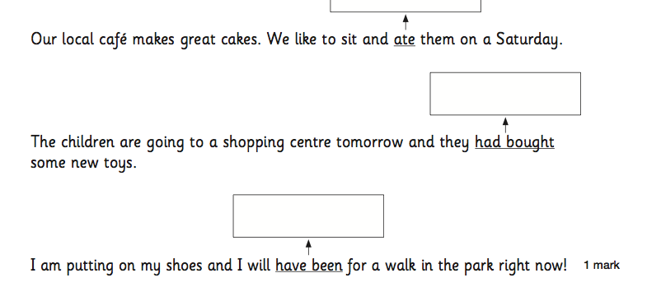

Slide 16
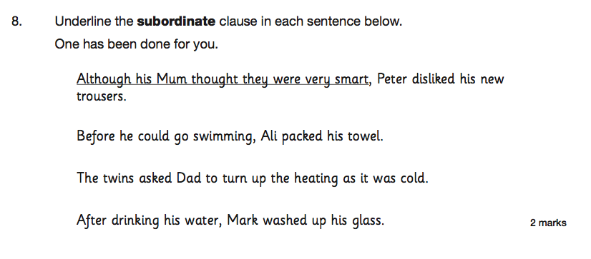

Slide 17
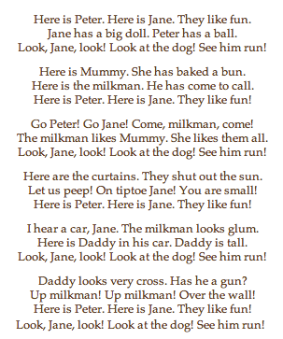
Wendy Cope
Reading Scheme

Slide 18
Unintended consequences for students

Slide 19
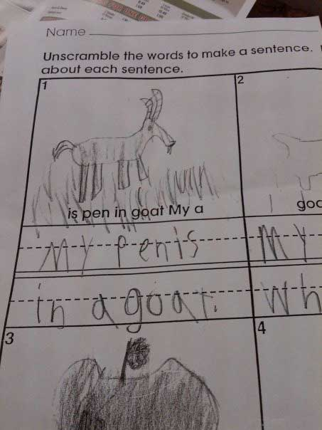

Slide 20
Unintended consequences for schools

Slide 21
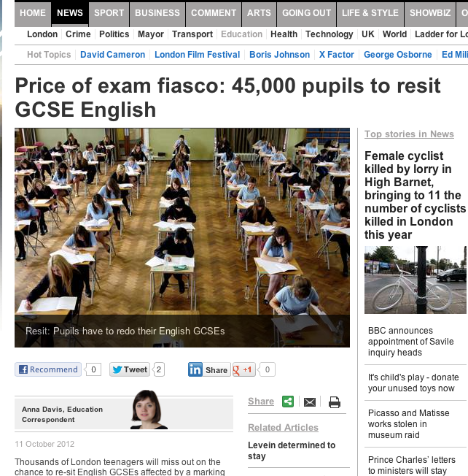
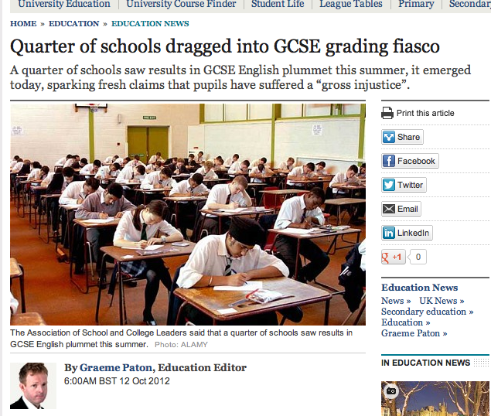
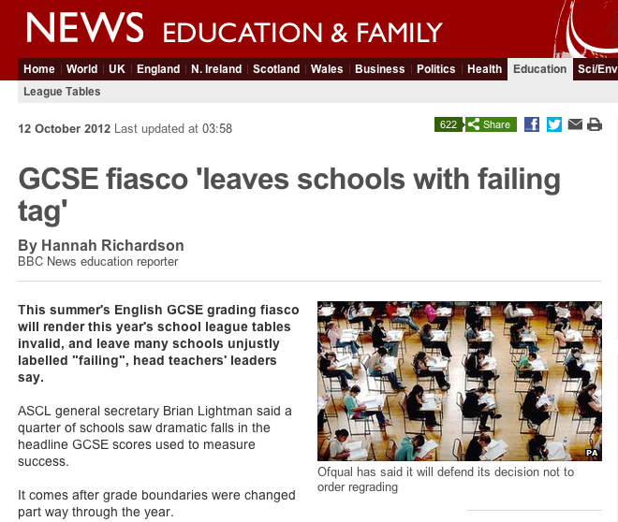

Slide 22
I am a head of a fantastic school. It was designated satisfactory by Ofsted following 16 months in special measures.
My job is currently secure in spite of flatlining this year due to the English issue at 54% 5 A*-C inc E and M. All other indicators soared. I have invited Ofsted in to redesignate and am awaiting the call.
We are resitting with our students - all who have come back from college on a Friday night to undertake intensive revision sessions with the Head of English. She is a teacher with real integrity and professionalism, who on results day spent the morning throwing up and apologising for the mess she had made when in reality it was none of her doing.
My frustration at this is immense. The young men who it has mostly affected deserve better. The teachers deserve better.
Head 1:

Slide 23
Friday morning. Sick in the stomach. Just picked up your blog via Twitter.
Yesterday I invited my Head of English to a meeting to further discuss English performance and his leadership.
HoD opens letter and after reading the contents (pretty ominous but genuinely praising his professionalism, and suggestions of how to improve things) promptly resigns.
Tears (sadness & relief) follow. Relief? That there wasn’t going to be a sacking. Relief from me that I took a step to deal with a matter which in truth I wanted to ignore - for my colleague is a very decent person.
I used to love my job as a Headteacher. Yesterday wasn’t an easy call. Since our 5+A*-C E/M dropped a long way I haven’t loved my job.
I feel impotent, a failure and, like now, I cry over work issues.
Head 2:

Slide 24
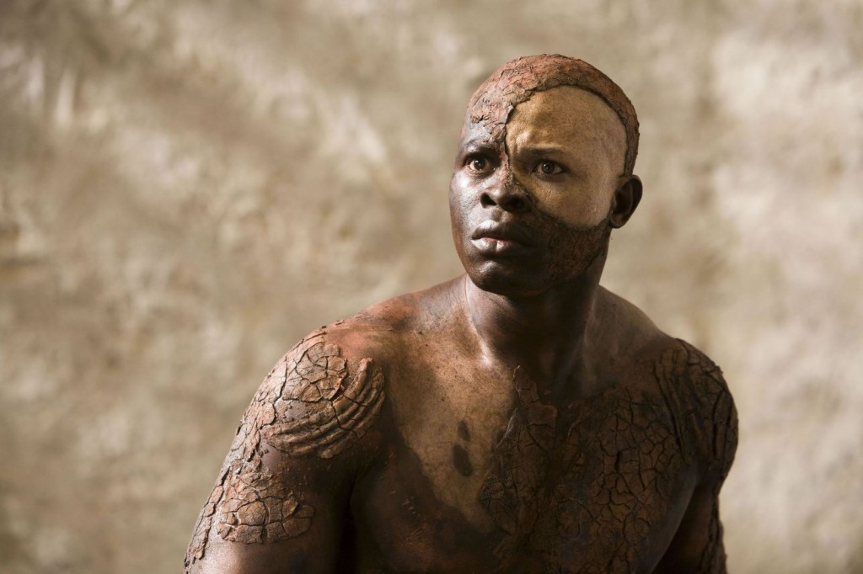
It’s time to reclaim English

Slide 25
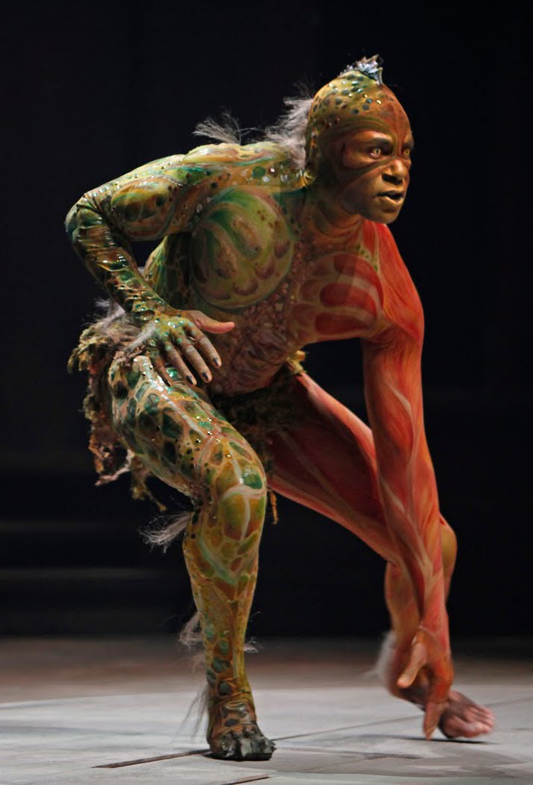
1: Decouple English & performance tables … but not lose the ‘rigour’ argument

Slide 26
2: Have stronger subject associations

Slide 27
3: Regain our confidence about what English is and what it is for

Slide 28
English Teacher
Petite, white-haired Miss Cartwright
Knew Shakespeare off by heart,
Or so we pupils thought.
Once in the stalls at the Old Vic
She prompted Lear when he forgot his part.
Ignorant of Scrutiny and Leavis,
She taught Romantic poetry,
Dreamt of gossip with dead poets.
To an amazed sixth form once said: ‘How good to spend a night with Shelley.’
In long war years she fed us plays,
Sophocles to Shaw’s St Joan.
Her reading nights we named our Courting Club,
Yet always through the blacked-out streets
One boy left the girls and saw her home.
When she closed her eyes and chanted
‘Ode to a Nightingale’
We laughed yet honoured her devotion.
We knew the man she should have married
Was killed at Passchendaele.
Brian Cox
From Collected Poems, Carcanet Press 1993.

Slide 29
‘O Brave New World’:
Reclaiming English
Geoff Barton: 18 May 2013
Twitter: @RealGeoffBarton
Presentation at geoffbarton.co.uk (115)

