Slide 1
‘Don’t
call
it
Literacy!’
Geoff Barton ⎜ www.geoffbarton.co.uk (presentation 117) ⎜ Twitter: @RealGeoffBarton

Slide 2
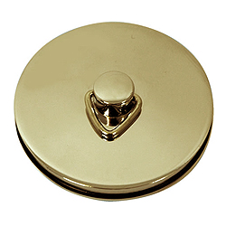
This is an expensive plug ➔

Slide 3
This is a
cheap plug ➔
By G Ratnob

Slide 4
‘Don’t
call
it
Literacy!’
Geoff Barton ⎜ www.geoffbarton.co.uk (presentation 117) ⎜ Twitter: @RealGeoffBarton

Slide 5
Real
Literacy!

Slide 7
Reading, Writing and Communication

Slide 8
The story so far

Slide 9
The story so far

Slide 10
Last year …

Slide 13
This year …

Slide 14
I will make you a better writer

Slide 15
‘Don’t Call it Literacy’ 2012
aka
‘The Way We Were’

Slide 16
1: Matthew Matters

Slide 17
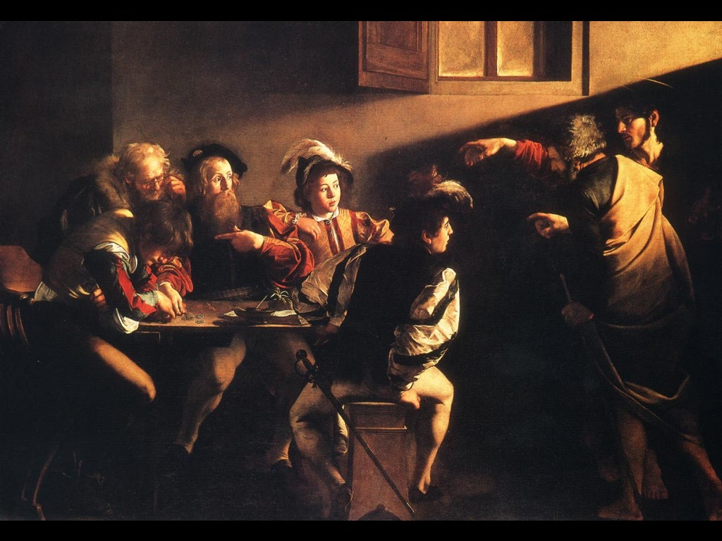
‘As the word rich grow richer, the word poor grow poorer.’
Canadian Association of School Librarians

Slide 18
2: Literacy is a club

Slide 19
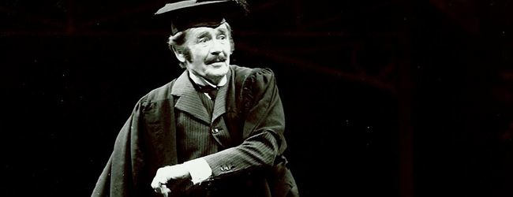
3: Literacy is teacher talk too

Slide 20
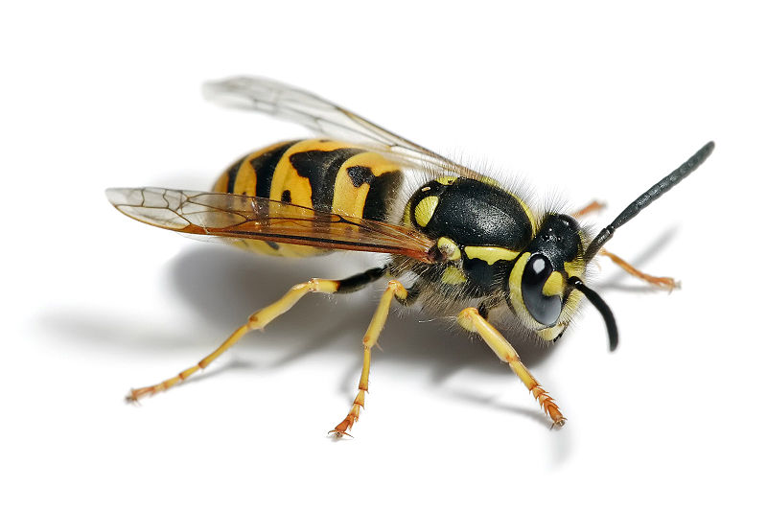
4: The word ‘literacy’ may be a nuisance

Slide 21
5: The secret of literacy is simple …

Slide 22
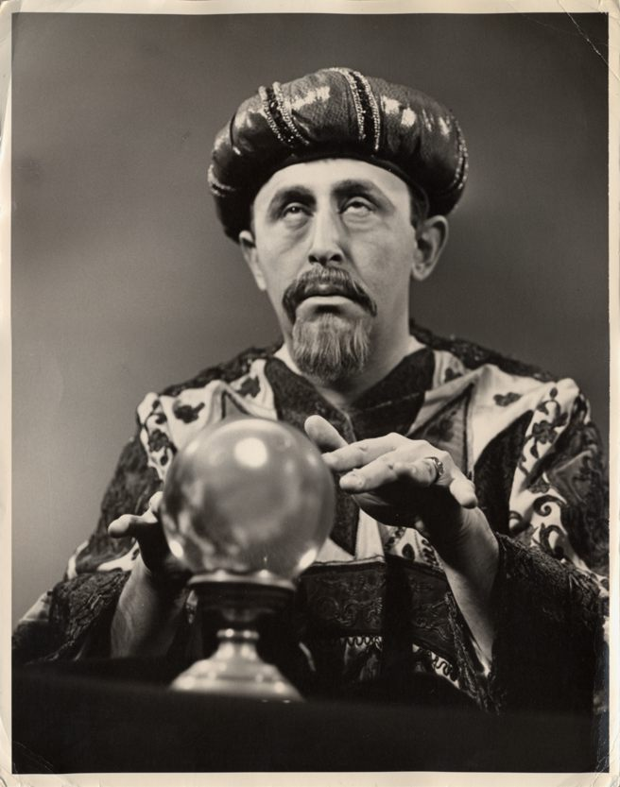

Slide 23
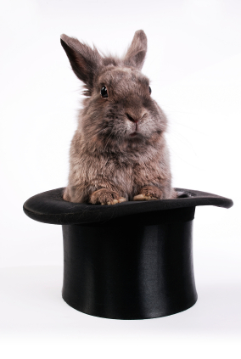
Make the implicit explicit

Slide 24
SKIMMING

Slide 25
What is this text about? Where might you find it?

Slide 26
The climate of the Earth is always changing. In the past it has altered as a result of natural causes. Nowadays, however, the term climate change is generally used when referring to changes in our climate which have been identified since the early part of the 1900's . The changes we've seen over recent years and those which are predicted over the next 80 years are thought to be mainly as a result of human behaviour rather than due to natural changes in the atmosphere.

Slide 27
The best treatment for mouth ulcers. Gargle with salt water. You should find that it works a treat. Salt is cheap and easy to get hold of and we all have it at home, so no need to splash out and spend lots of money on expensive mouth ulcer creams.

Slide 28
Urquhart castle is probably one of the most picturesquely situated castles in the Scottish Highlands. Located 16 miles south-west of Inverness, the castle, one of the largest in Scotland, overlooks much of Loch Ness. Visitors come to stroll through the ruins of the 13th-century castle because Urquhart has earned the reputation of being one of the best spots for sighting Loch Ness’s most famous inhabitant.

Slide 29
Urquhart castle is probably one of the most picturesquely situated castles in the Scottish Highlands. Located 16 miles south-west of Inverness, the castle, one of the largest in Scotland, overlooks much of Loch Ness. Visitors come to stroll through the ruins of the 13th-century castle because Urquhart has earned the reputation of being one of the best spots for sighting Loch Ness’s most famous inhabitant.

Slide 30
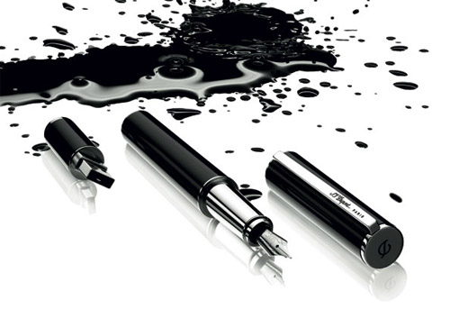
Urquhart castle is probably one of the most picturesquely situated castles in the Scottish Highlands. Located 16 miles south-west of Inverness, the castle, one of the largest in Scotland, overlooks much of Loch Ness. Visitors come to stroll through the ruins of the 13th-century castle because Urquhart has earned the reputation of being one of the best spots for sighting Loch Ness’s most famous inhabitant.

Slide 31
Urquhart castle is probably one of the most picturesquely situated castles in the Scottish Highlands. Located 16 miles south-west of Inverness, the castle, one of the largest in Scotland, overlooks much of Loch Ness. Visitors come to stroll through the ruins of the 13th-century castle because Urquhart has earned the reputation of being one of the best spots for sighting Loch Ness’s most famous inhabitant.

Slide 32
Urquhart castle is probably one of the most picturesquely situated castles in the Scottish Highlands. Located 16 miles south-west of Inverness, the castle, one of the largest in Scotland, overlooks much of Loch Ness. Visitors come to stroll through the ruins of the 13th-century castle because Urquhart has earned the reputation of being one of the best spots for sighting Loch Ness’s most famous inhabitant.

Slide 33
Urquhart castle is probably one of the most picturesquely situated castles in the Scottish Highlands. Located 16 miles south-west of Inverness, the castle, one of the largest in Scotland, overlooks much of Loch Ness. Visitors come to stroll through the ruins of the 13th-century castle because Urquhart has earned the reputation of being one of the best spots for sighting Loch Ness’s most famous inhabitant.

Slide 34
SCANNING

Slide 35
Where did the first cell phones begin?
Name 2 other features that started to be included in phones
Why are cell phones especially useful in some countries?

Slide 36
Where begin?
Two features?
Some countries?
Cellular telephones
The first cellular telephone system began operation in Tokyo in 1979, and the first U.S. system began operation in 1983 in Chicago. A camera phone is a cellular phone that also has picture taking capabilities. Some camera phones have the capability to send these photos to another cellular phone or computer. Advances in digital technology and microelectronics has led to the inclusion of unrelated applications in cellular telephones, such as alarm clocks, calculators, Internet browsers, and voice memos for recording short verbal reminders, while at the same time making such telephones vulnerable to certain software viruses. In many countries with inadequate wire-based telephone networks, cellular telephone systems have provided a means of more quickly establishing a national telecommunications network.

Slide 37
Independent Research
(FOFO)

Slide 38
Research the life of
Martin Luther King

Slide 39
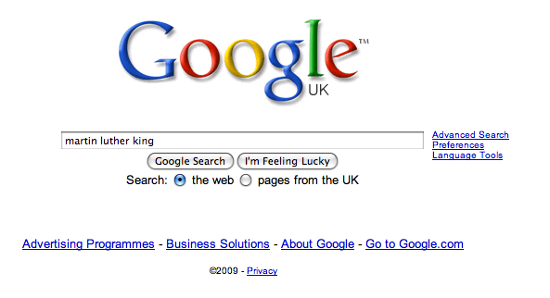

Slide 46
From implicit to explicit:
How we* use lexical words when skimming
How we* use textual conventions in scanning
How we* assess the authenticity of a text when researching
* the ‘word rich’
* or students who have been well taught

Slide 47
‘Don’t Call it Literacy’ 2012
aka
‘The Way We Were’

Slide 48
2013:
London 2012
GCSE English fiasco
Matt Smith quits Doctor Who

Slide 49
I will make you a better writer

Slide 50
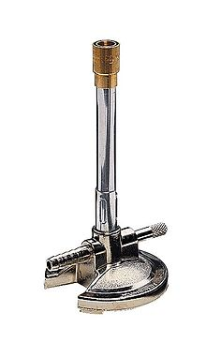

Slide 51
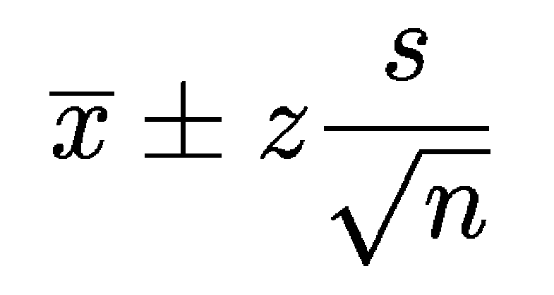

Slide 53
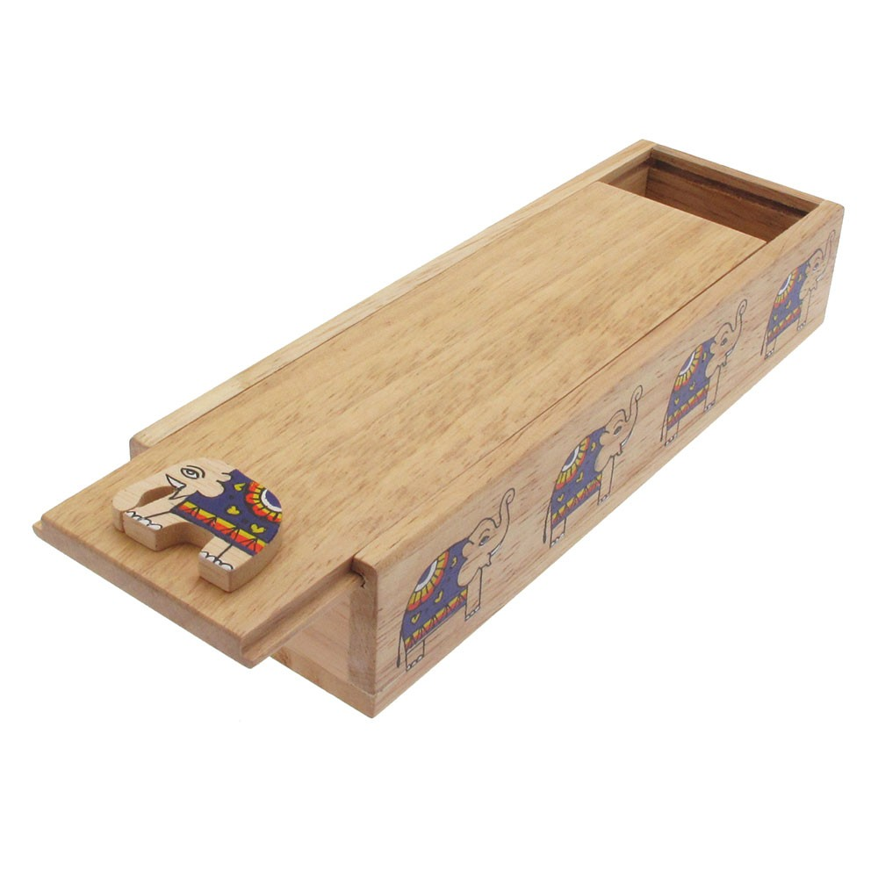

Slide 54
Shifting from ‘WHAT’ to ‘HOW’

Slide 55
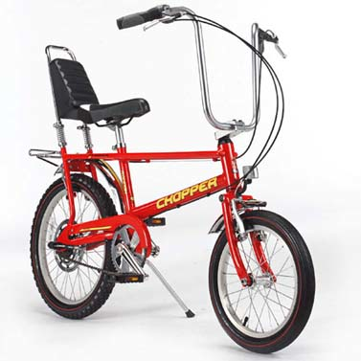
‘WHAT’
‘HOW’

Slide 56
‘WHAT’
‘HOW’

Slide 57
WRITERS’ DECISIONS …
FORMAL ⬅➔ INFORMAL?
PERSONAL ⬅➔ IMPERSONAL?
CHRONOLOGICAL ⬅➔ NON-CHRONOLOGICAL?
How do we teach our students the ‘how’ of writing?

Slide 58
Test 1:
Write this sentence down
Notes:
It’s really beautiful out there today, I believe.

Slide 59
Test 2:
Describe your journey here today

Slide 60
‘WHAT’
‘HOW’

Slide 61
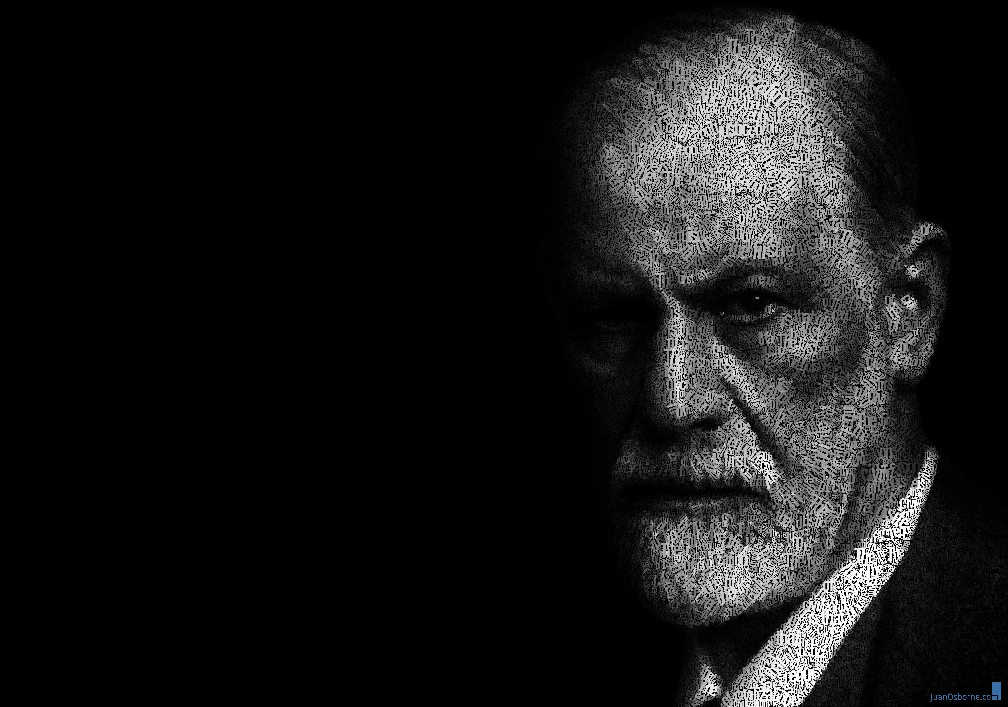
"One might compare the relation of the ego the id with that between a rider and his horse”

Slide 62
Self-regulation

Slide 63
What does an evaluation LOOK like?
How do I ORGANISE my writing?
How do I make it IMPERSONAL?
Which WORDS do designers use?
How FORMAL should it be?
How should I use LAYOUT?

Slide 64
Demo

Slide 65
Write an article for your local newspaper arguing against school uniform

Slide 66
Familiarity with genre
Not writing an essay
Being interesting
Deploying metaphor
Barriers
Writing vividly
Making an impact
Using short & long sentences
Being accurate
Surprising the reader
Avoiding ‘and’ and ‘but’

Slide 67
Read like a writer

Slide 68
Lots of people these days have tattoos? Is this a good thing or something that should be discouraged?
How would you start? How would you grab the reader’s interest?
How does this writer write? What do you notice about how he expresses his opinion?
Tony Parsons, The Mirror, 23 June, 2012

Slide 69
AS soon as the sun starts shining, I realise with a sinking heart that Britain is now a tattooed nation. Tattoos are everywhere. You see them on firm young flesh and on wobbly, middle-aged flab, as common now on the school run and in the supermarket queue as they are on some footballer or his wife. I feel like the last man left alive whose skin crawls at the sight of these crass daubings. I wish it were just a celebrity fad. But when the Military Wives had the Christmas No 1 with their haunting ­Wherever You Are, their soloist, Samantha Stevenson, had so many hearts and flowers tattooed across her chest that she resembled a box of Cadbury’s Roses.
✓ ✗

Slide 70
Some people believe far-flung holiday destinations are a waste of money and damage the planet. Write an article saying what you think.
Jeremy Clarkson, Sunday Times

Slide 71
For your next holiday, why don’t you take all your money and put it on the fire? Then stand in a fridge for a week, beating your children with a baseball bat until their arms and legs break. And then, after you’ve eaten some melted cheese, dislocate your shoulder. If all of this appeals then you are probably one of the 1.3 million British people …
… who go on a skiing holiday at this time of year.

Slide 72
Write an article for your local newspaper arguing against school uniform

Slide 73
1 Read
2 Thin-slice techniques
3 Demonstrate with commentary
4 Practise & feedback
5 Write
Dependence
Independence

Slide 74
Familiarity with genre
Not writing an essay
Being interesting
Deploying metaphor
Barriers
Writing vividly
Making an impact
Using short & long sentences
Being accurate
Surprising the reader
Avoiding ‘and’ and ‘but’

Slide 75
Being interesting
Barriers

Slide 76
Write an article for your local newspaper arguing against school uniform

Slide 77
‘Don’t
call
it
Literacy!’
Geoff Barton ⎜ www.geoffbarton.co.uk (presentation 117) ⎜ Twitter: @RealGeoffBarton

