Slide 1
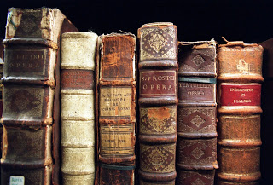
‘O Brave New World’:
Liberating through Literacy
Geoff Barton, Head, King Edward VI School
geoffbarton.co.uk/teacher-resources (113)
Twitter: @RealGeoffBarton
‘The limits of my language are the limits of my world’
Ludwig Wittgenstein

Slide 2
‘O Brave New World’:
Liberating through Literacy
1: What
2: Why
3: How

Slide 3
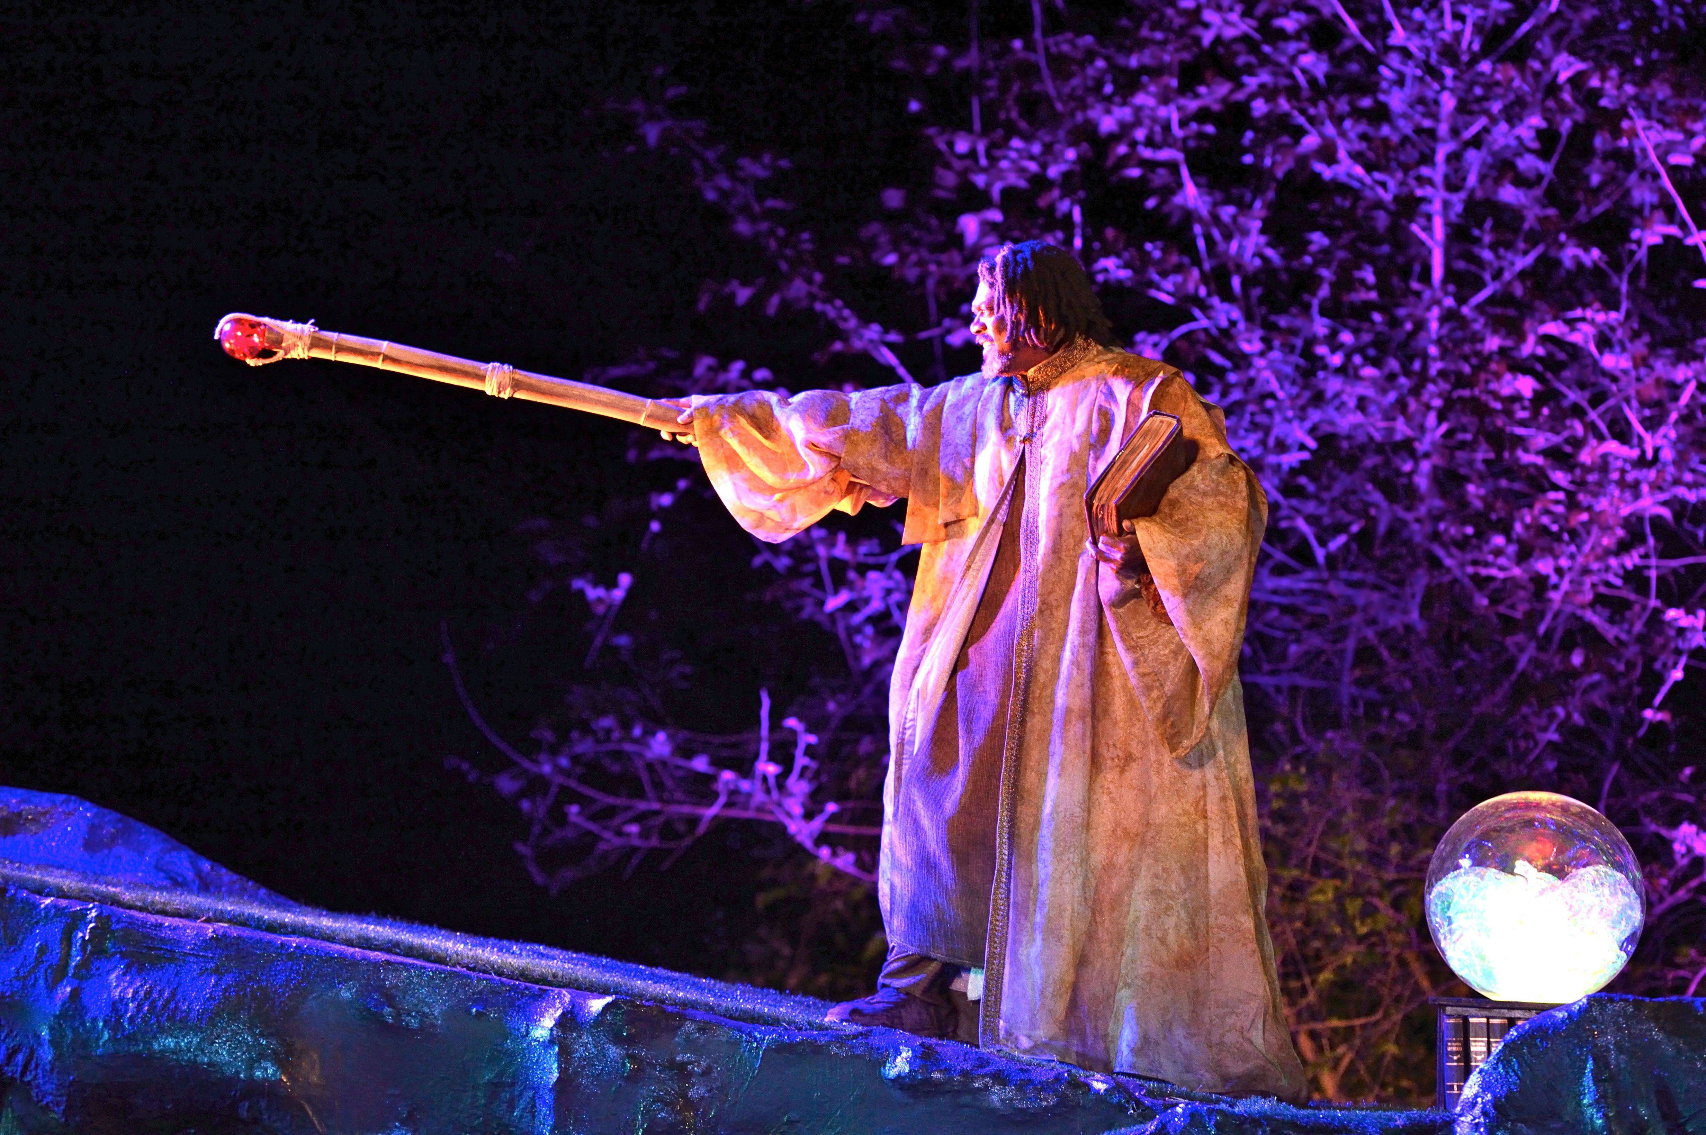
Through formative assessment I will make you better at
READING & WRITING & SPELLING

Slide 4
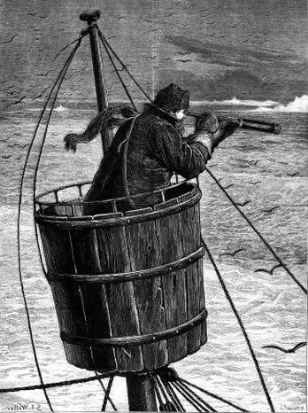
Surveying the landscape
Master:
“We run ourselves aground”

Slide 6
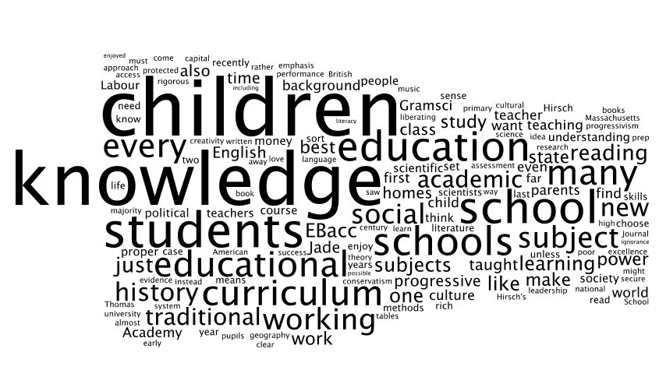

Slide 7
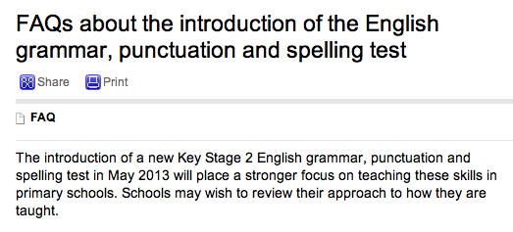

Slide 8
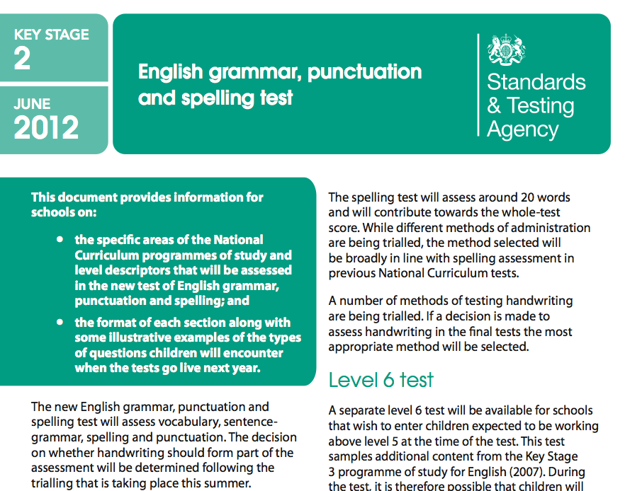

Slide 9
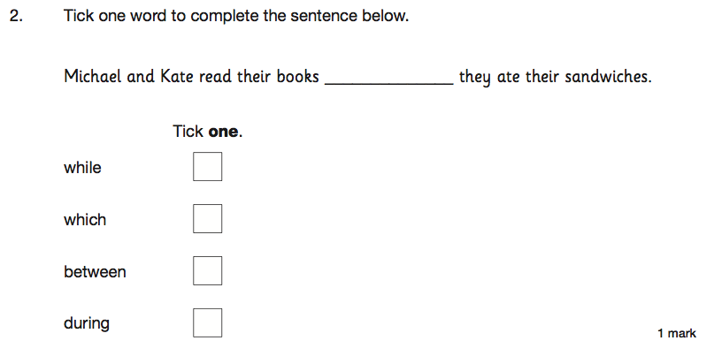

Slide 10
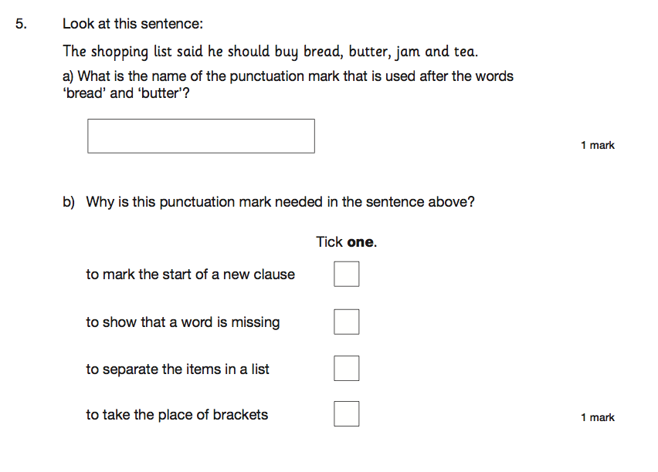

Slide 11
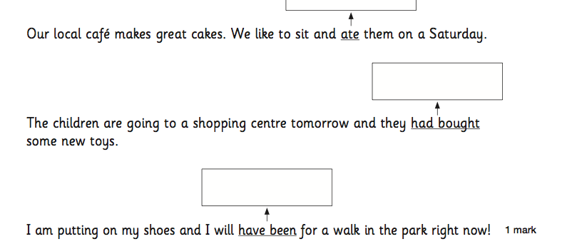

Slide 12
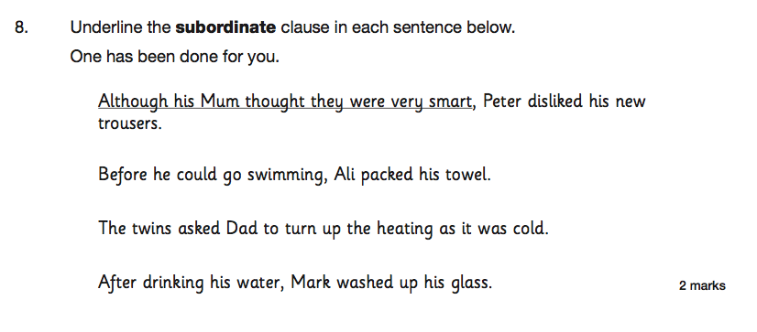

Slide 13
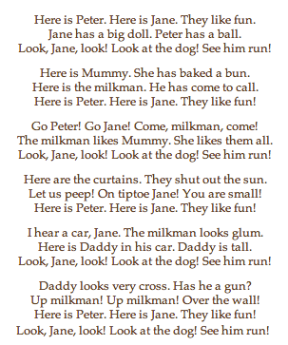
Wendy Cope
Reading Scheme

Slide 14
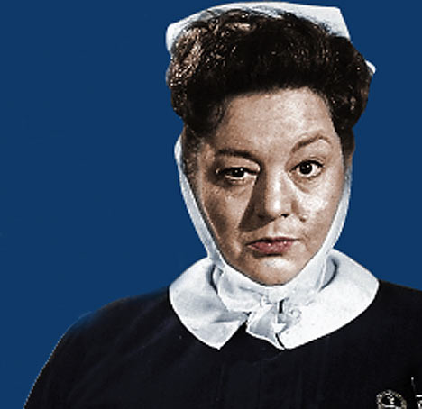
Diagnosis:

Slide 15
Question:
?
Unconfident
Confident
Irrespective of background

Slide 16
Answer:
Teach them

Slide 17
Provocations:
We haven’t done literacy
It’s all about the classroom
Knowledge and instruction may be more important than we realised
Remember the “Matthew Effect”

Slide 18
The Matthew Effect
(Robert K Merton)

Slide 19
The rich shall get richer and the poor shall get poorer
Matthew 13:12

Slide 20
“The word-rich get richer while the word-poor get poorer” in their reading skills
(CASL)

Slide 21
“While good readers gain new skills very rapidly, and quickly move from learning to read to reading to learn, poor readers become increasingly frustrated with the act of reading, and try to avoid reading where possible”
The Matthew Effect
Daniel Rigney

Slide 22
“Students who begin with high verbal aptitudes find themselves in verbally enriched social environments and have a double advantage.”
The Matthew Effect
Daniel Rigney

Slide 23
“Good readers may choose friends who also read avidly while poor readers seek friends with whom they share other enjoyments”
The Matthew Effect
Daniel Rigney

Slide 24
Stricht’s Law: “reading ability in children cannot exceed their listening ability …”
E.D. Hirsch
The Schools We Need

Slide 25
“Spoken language forms a constraint, a ceiling not only on the ability to comprehend but also on the ability to write, beyond which literacy cannot progress”
Myhill and Fisher

Slide 26
“The children who possess intellectual capital when they first arrive at school have the mental scaffolding and Velcro to catch hold of what is going on, and they can turn the new knowledge into still more Velcro to gain still more knowledge”.
E.D. Hirsch
The Schools We Need

Slide 27
Aged 7:
Children in the top quartile have 7100 words; children in the lowest have around 3000.
The main influence is parents.
DfE Research Unit

Slide 28
The Matthew Effect:
The rich will get richer &
the poor will get poorer

Slide 29
Talking Point
Why literacy matters – ‘The Matthew Effect’ – the Literacy Club
What’s new? What’s familiar?
Implications for you and your subject?

Slide 30
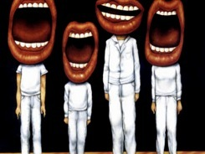
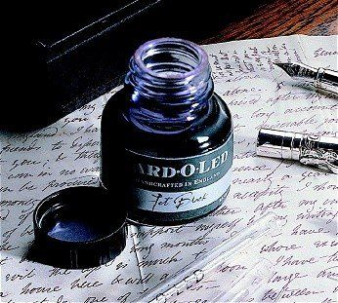
5 key ingredients
Then teach you something
Then reflection

Slide 31
Understand the significance of exploratory talk
Model good talk – eg connectives
Re-think questioning – ‘why & how’, thinking time, and no-hands-up
Consciously vary groupings
Get conversation into the school culture

Slide 32
DEMO

Slide 33
Focus: speaking in public

Slide 34
Barriers:
Lack of confidence
Lack of structure
Lack of depersonalised tone

Slide 35
Task: why school uniform crushes our individuality

Slide 36
Stance, notes, pen
Number points
Be repetitive
Sentence functions
Confidence
Structure
Depersonalised tone
Avoid I / me
Use so / because / however / therefore

Slide 37
Talking Point
Understand the significance of exploratory talk
Model good talk – eg connectives
Re-think questioning – ‘why & how’, thinking time, and no-hands-up
Consciously vary groupings
Get conversation into the school culture
What are the main types of talk needed in your subject?
Barriers?
So what could you do?

Slide 38
Teach reading – scanning, skimming, analysis
Read aloud and display
Teach key vocabulary
Demystify spelling
Teach research, not FOFO

Slide 39
DEMO

Slide 40
SKIMMING

Slide 41
The climate of the Earth is always changing. In the past it has altered as a result of natural causes. Nowadays, however, the term climate change is generally used when referring to changes in our climate which have been identified since the early part of the 1900's . The changes we've seen over recent years and those which are predicted over the next 80 years are thought to be mainly as a result of human behaviour rather than due to natural changes in the atmosphere.

Slide 42
The best treatment for mouth ulcers. Gargle with salt water. You should find that it works a treat. Salt is cheap and easy to get hold of and we all have it at home, so no need to splash out and spend lots of money on expensive mouth ulcer creams.

Slide 43
Lexical v Grammatical Words

Slide 44
Urquhart castle is probably one of the most picturesquely situated castles in the Scottish Highlands. Located 16 miles south-west of Inverness, the castle, one of the largest in Scotland, overlooks much of Loch Ness. Visitors come to stroll through the ruins of the 13th-century castle because Urquhart has earned the reputation of being one of the best spots for sighting Loch Ness’s most famous inhabitant.

Slide 45
Urquhart castle is probably one of the most picturesquely situated castles in the Scottish Highlands. Located 16 miles south-west of Inverness, the castle, one of the largest in Scotland, overlooks much of Loch Ness. Visitors come to stroll through the ruins of the 13th-century castle because Urquhart has earned the reputation of being one of the best spots for sighting Loch Ness’s most famous inhabitant.

Slide 46
Urquhart castle is probably one of the most picturesquely situated castles in the Scottish Highlands. Located 16 miles south-west of Inverness, the castle, one of the largest in Scotland, overlooks much of Loch Ness. Visitors come to stroll through the ruins of the 13th-century castle because Urquhart has earned the reputation of being one of the best spots for sighting Loch Ness’s most famous inhabitant.

Slide 47
Urquhart castle is probably one of the most picturesquely situated castles in the Scottish Highlands. Located 16 miles south-west of Inverness, the castle, one of the largest in Scotland, overlooks much of Loch Ness. Visitors come to stroll through the ruins of the 13th-century castle because Urquhart has earned the reputation of being one of the best spots for sighting Loch Ness’s most famous inhabitant.

Slide 48
Urquhart castle is probably one of the most picturesquely situated castles in the Scottish Highlands. Located 16 miles south-west of Inverness, the castle, one of the largest in Scotland, overlooks much of Loch Ness. Visitors come to stroll through the ruins of the 13th-century castle because Urquhart has earned the reputation of being one of the best spots for sighting Loch Ness’s most famous inhabitant.

Slide 49
SCANNING

Slide 50
Where did the first cell phones begin?
Name 2 other features that started to be included in phones
Why are cell phones especially useful in some countries?

Slide 51
Where begin?
Two features?
Some countries?
Cellular telephones
The first cellular telephone system began operation in Tokyo in 1979, and the first U.S. system began operation in 1983 in Chicago. A camera phone is a cellular phone that also has picture taking capabilities. Some camera phones have the capability to send these photos to another cellular phone or computer. Advances in digital technology and microelectronics has led to the inclusion of unrelated applications in cellular telephones, such as alarm clocks, calculators, Internet browsers, and voice memos for recording short verbal reminders, while at the same time making such telephones vulnerable to certain software viruses. In many countries with inadequate wire-based telephone networks, cellular telephone systems have provided a means of more quickly establishing a national telecommunications network.

Slide 52
RESEARCH SKILLS

Slide 53
Research the life of
Martin Luther King

Slide 54
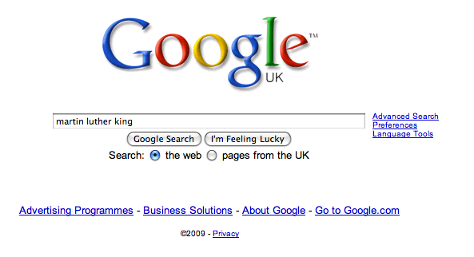

Slide 61
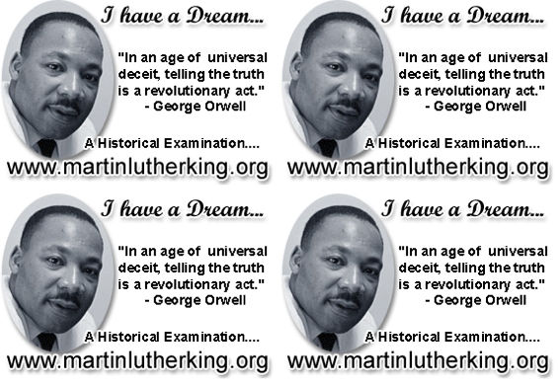

Slide 62
DEMYSTIFYING
SPELLING
3
Notes:
7 spellings: Government – February – parliament – separate – believe – necessary - accommodation

Slide 63
1 - SOUNDS

Slide 64
Government

Slide 65
February

Slide 66
Parliament

Slide 67
2 -VISUALS

Slide 68
Se-para-te
Be-lie-ve

Slide 69
3 - MNEMONICS

Slide 70
necessary

Slide 71
accommodation

Slide 72
Talking Point
Teach reading – scanning, skimming, analysis
Read aloud and display
Teach key vocabulary
Demystify spelling
Teach research, not FOFO
What are the main types of reading needed in your subject?
Barriers?
So what could you do?

Slide 73
Demonstrate writing
Teach composition & planning
Allow oral rehearsal
Short & long sentences
Connectives

Slide 74
Know your connectives
Adding: and, also, as well as, moreover, too
Cause & effect: because, so, therefore, thus, consequently
Sequencing: next, then, first, finally, meanwhile, before, after
Qualifying: however, although, unless, except, if, as long as, apart from, yet
Emphasising: above all, in particular, especially, significantly, indeed, notably
Illustrating: for example, such as, for instance, as revealed by, in the case of
Comparing: equally, in the same way, similarly, likewise, as with, like
Contrasting: whereas, instead of, alternatively, otherwise, unlike, on the other hand

Slide 75
Demonstrate writing
Teach composition & planning
Allow oral rehearsal
Short & long sentences
Connectives

Slide 76
DEMO

Slide 77
Task: write a persuasive article on a controversial subject

Slide 78
Barriers:
Essay-like
Lack of familiarity with genre
Lack of interestingness

Slide 80
Review and compare in a pair:
WHAT? HOW?
How did you approach the task? How did you get started? What were the main barriers?
What did you write? Where did you get your ideas? Are you pleased with it?

Slide 81
MAIN HURDLES
A Thinking of the right word
B Knowing how to get started
C Making it interesting
D Knowing how to link my ideas together
E Trying to make it funny or entertaining
Put these ‘barriers’ in rank order

Slide 82
Are social media sites like Twitter a good thing? Write an article …
Grace Dent, Independent, WEDNESDAY 16 MAY 2012

Slide 83
I've made a decision. From now on, if I need help, I'm heading straight to Twitter. I've tweeted pleas before. I once posted that I needed a job and the same afternoon got commissioned to write an article. But a few weeks ago, I discovered the true benefits of the virtual world. It was election day and on my way back from a lunchtime trip to the launderette I discovered a huge BNP banner had been tied to the lamp post outside my flat. My immediate reaction was to pull it down. The trouble was, I'm short and it was higher than my tallest chair could reach. So I sent out a tweet. Could anyone help me tear down this monstrosity?
Momtaz Begum-Hossain, Guardian, WEDNESDAY 16 MAY 2012

Slide 84
Are TV reality shows a good thing?
Polly Hudson, The Mirror, 18 May 2012

Slide 85
THERE was only one real winner of Britain’s Got Talent and he didn’t slobber over any of the female judges. No, it wasn’t Pudsey the dog or Simon Cowell for me – it was incredible teenage opera singer Jonathan Antoine. A year ago he was a virtual recluse, having given up his A-levels after being bullied at school about his weight. Even on the show he remained painfully shy, glancing at his singing companion Charlotte Jaconelli for encouragement. His mum has told how for years he simply wanted to melt into the background and would hide behind a baggy jumper. Now he goes out wearing a Superman T-shirt. Jonathan has played the ace card in dealing with bullies. He has beaten them with brilliance.

Slide 86
Some people believe far-flung holiday destinations are a waste of money and damage the planet. Write an article …
Jeremy Clarkson, Sunday Times

Slide 87
For your next holiday, why don’t you take all your money and put it on the fire? Then stand in a fridge for a week, beating your children with a baseball bat until their arms and legs break. And then, after you’ve eaten some melted cheese, dislocate your shoulder. If all of this appeals then you are probably one of the 1.3 million British people …
… who go on a skiing holiday at this time of year.

Slide 88
Some people say school uniform is an outdated concept, a waste of time and money. Write a newspaper article saying why school uniform is a good idea.

Slide 89
Talking Point
Demonstrate writing
Teach composition & planning
Allow oral rehearsal
Short & long sentences
Connectives
What are the main types of writing needed in your subject?
Barriers?
So what could you do?

Slide 91
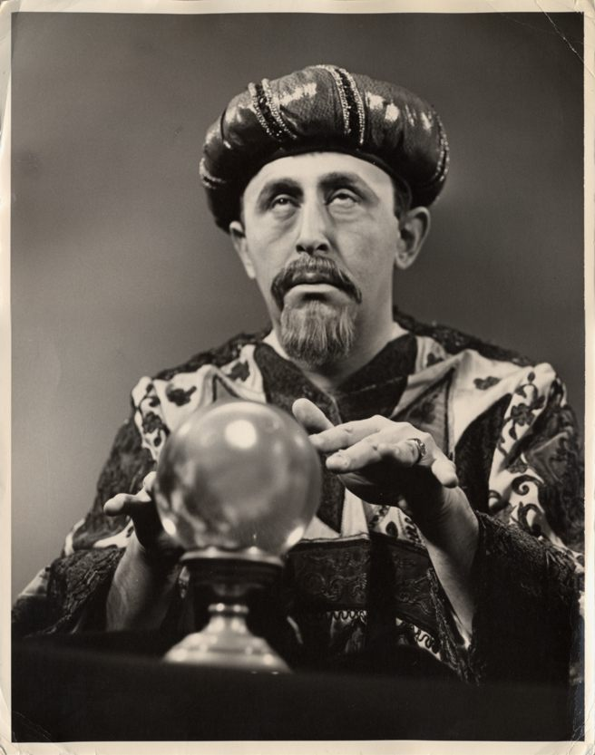
SUMMARY:
The Secret of Literacy

Slide 92
Stand by …

Slide 93
Ready …?

Slide 94
Tension now intolerable … ?

Slide 95
Well, it’s not literacy …

Slide 96
… it’s making the implicit explicit – and modelling it …

Slide 97
… without which, the rich will get richer & the poor will get poorer

Slide 98
… so we could just call it ‘what great teachers do’

Slide 99
Ideal for family & friends:

Slide 100
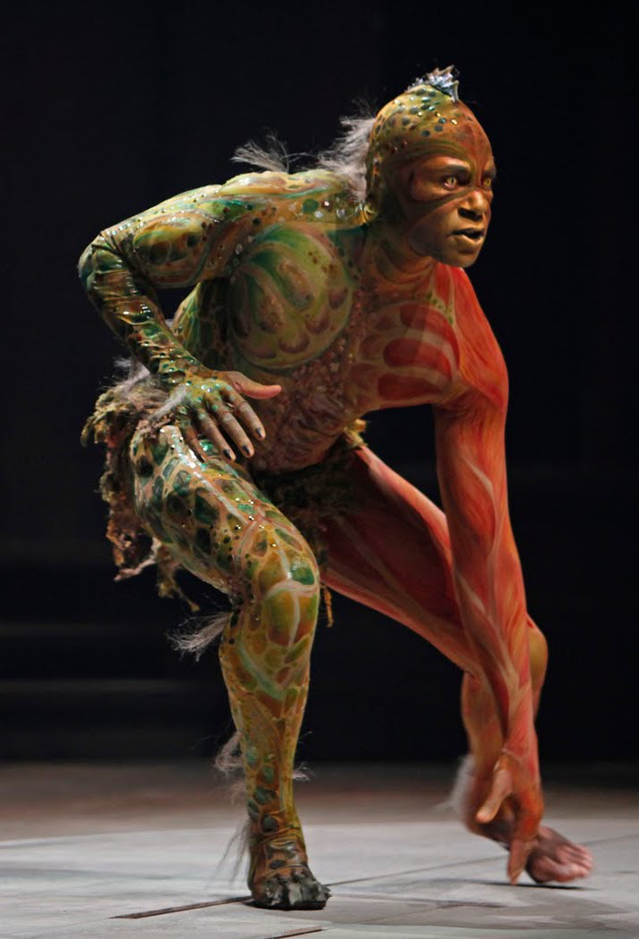
“We are such stuff as dreams are made on, and our little life is rounded with a sleep.”

Slide 101
‘O Brave New World’:
Liberating through Literacy
Geoff Barton, Head, King Edward VI School
geoffbarton.co.uk/teacher-resources (113)
Twitter: @RealGeoffBarton
‘The limits of my language are the limits of my world’
Ludwig Wittgenstein

