Slide 1
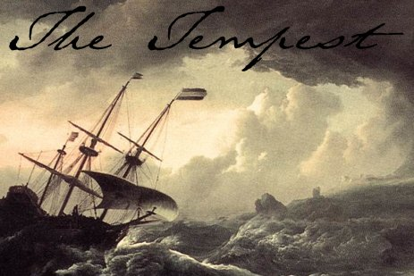
‘O Brave New World’:
What kind of leaders does our education system need?
Geoff Barton
Headteacher, King Edward VI School
Download at www.geoffbarton.co.uk (111)
Twitter: @RealGeoffBarton

Slide 2
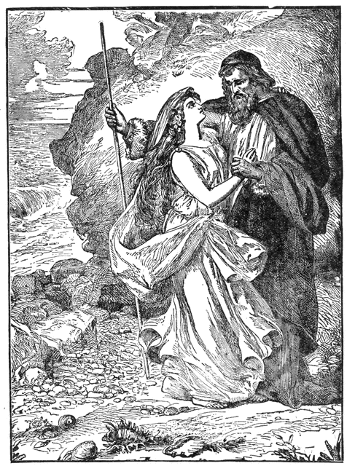
Miranda:
“O brave new world, That has such people in't!”
Prospero:
“Tis new to thee”

Slide 3
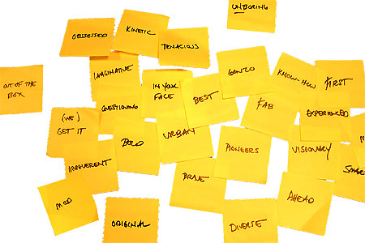
Literacy
www.geoffbarton.co.uk/teacher-resources (111)

Slide 4
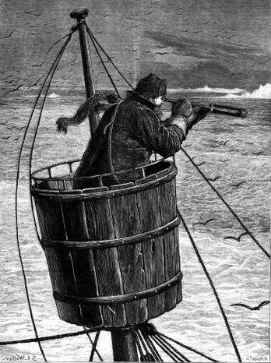
1: Surveying the landscape
Master:
“We run ourselves aground”

Slide 5
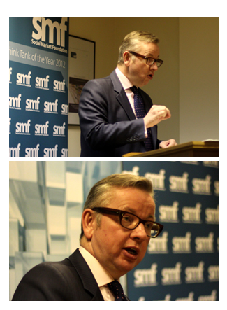
Speech to Social Market Foundation
5 February 2013

Slide 7
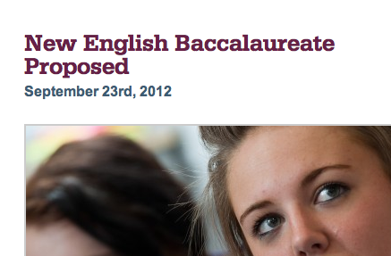
Prospero:
“What see'st thou else In the dark backward and abysm of time?”

Slide 8
Examples …

Slide 9
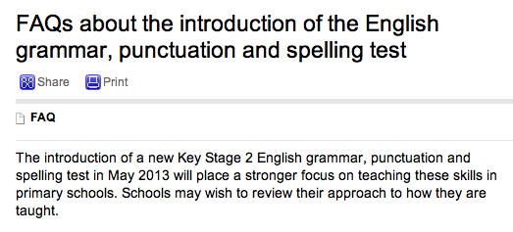
Prospero:
For this, be sure, to-night thou shalt have cramps, Side-stitches that shall pen thy breath up; urchins Shall, for that vast of night that they may work, All exercise on thee.

Slide 10
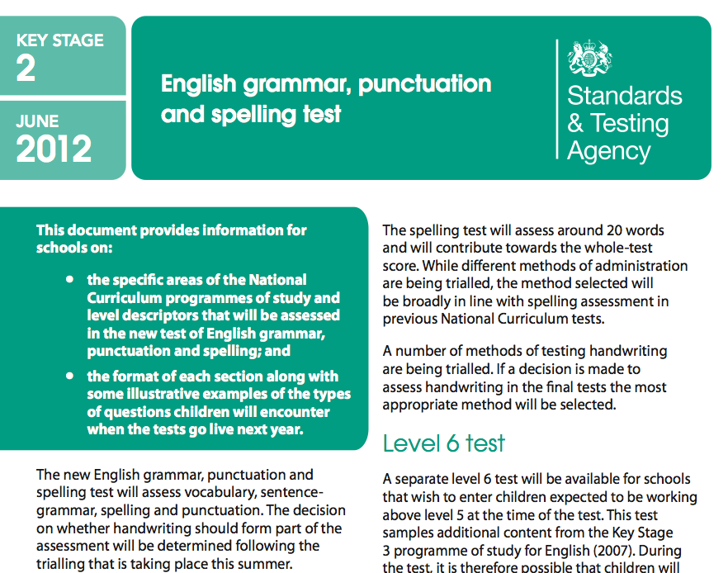

Slide 11
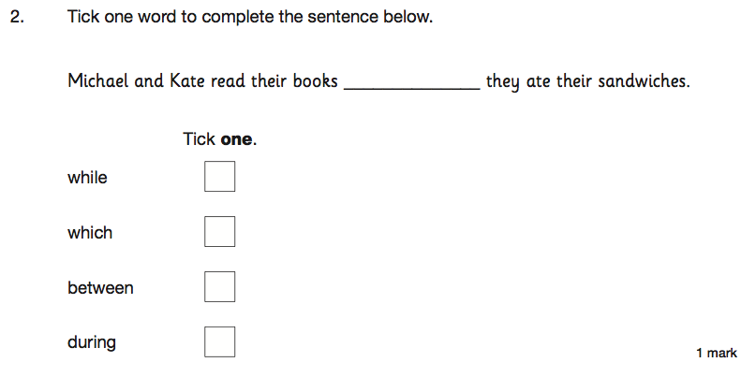

Slide 12
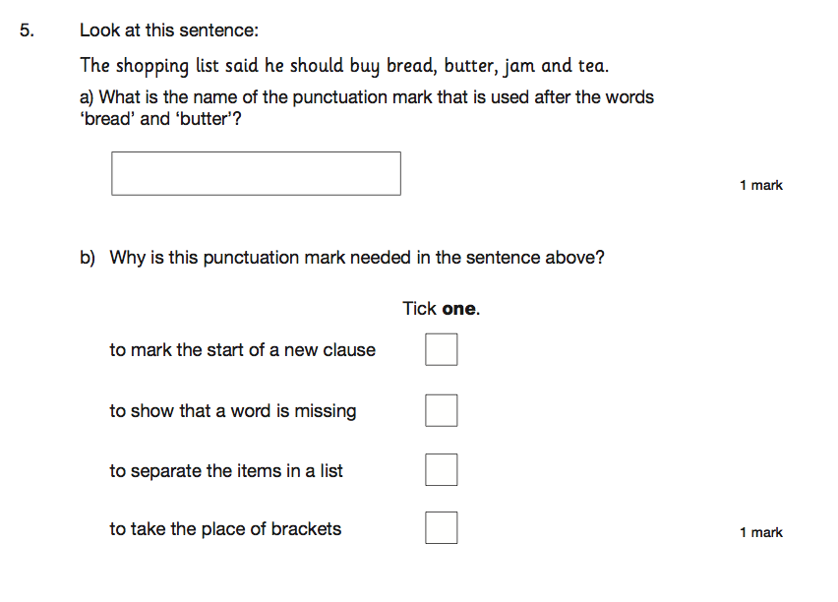

Slide 13
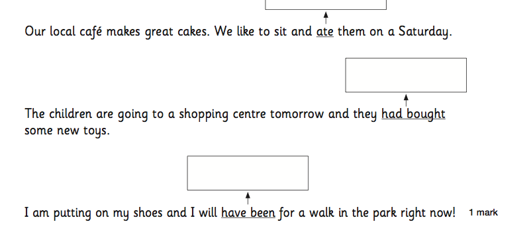

Slide 14
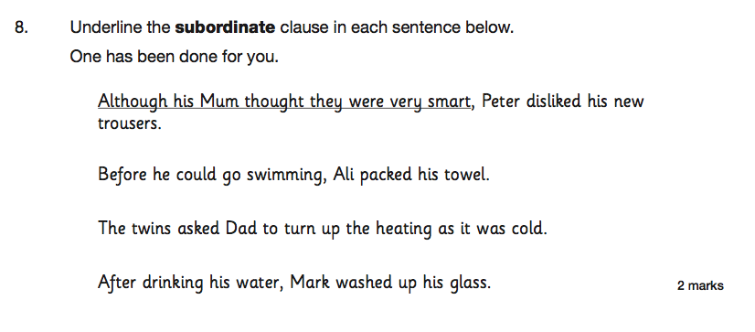

Slide 15
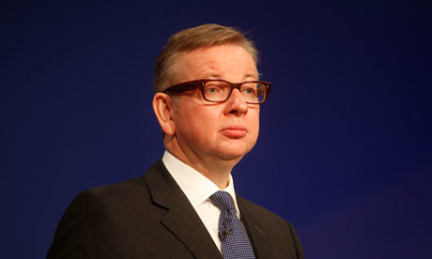
Gonzalo:
“I have great comfort from this fellow. Methinks he hath no drowning mark upon him; his complexion is perfect gallows”

Slide 16
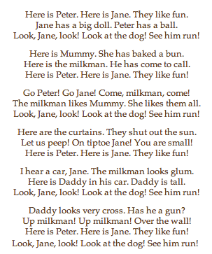
Wendy Cope
Reading Scheme

Slide 17
Unintended consequences

Slide 18
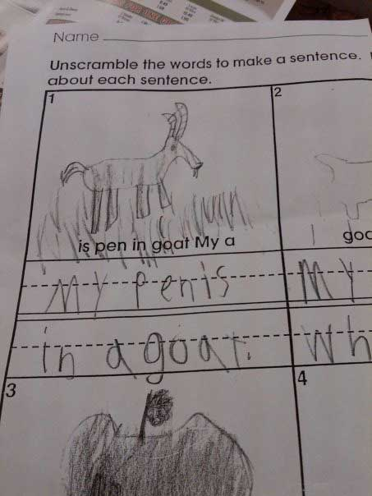

Slide 19
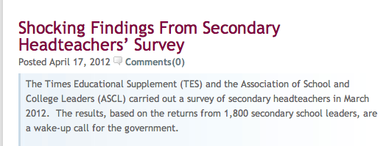

Slide 20
37% are actively planning to leave the profession.
92% don’t think the government is supportive of the teaching profession.
23% would recommend headship to their colleagues the corollary of which is that 77% wouldn’t recommend it.
61% said the government’s education reforms will have a detrimental impact on state education.
73% of deputies and assistant headteachers said they were less likely to want to take up a headship than they would have been 12 months ago.

Slide 21
37% are actively planning to leave the profession.
92% don’t think the government is supportive of the teaching profession.
23% would recommend headship to their colleagues the corollary of which is that 77% wouldn’t recommend it.
61% said the government’s education reforms will have a detrimental impact on state education.
73% of deputies and assistant headteachers said they were less likely to want to take up a headship than they would have been 12 months ago.

Slide 22
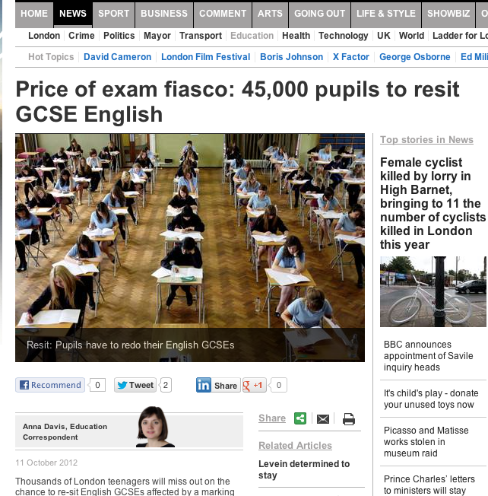
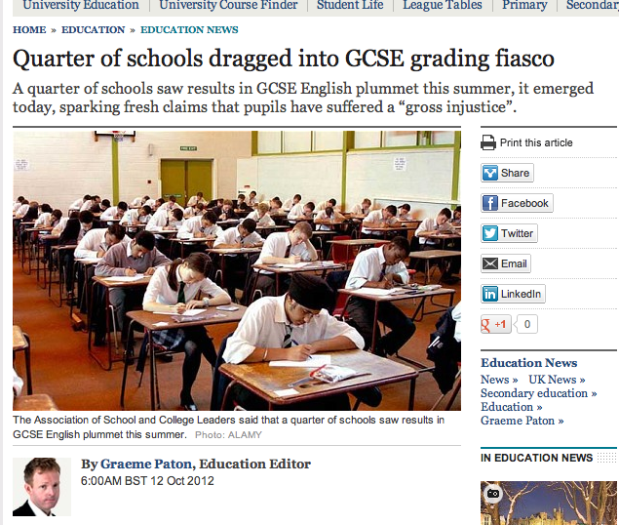
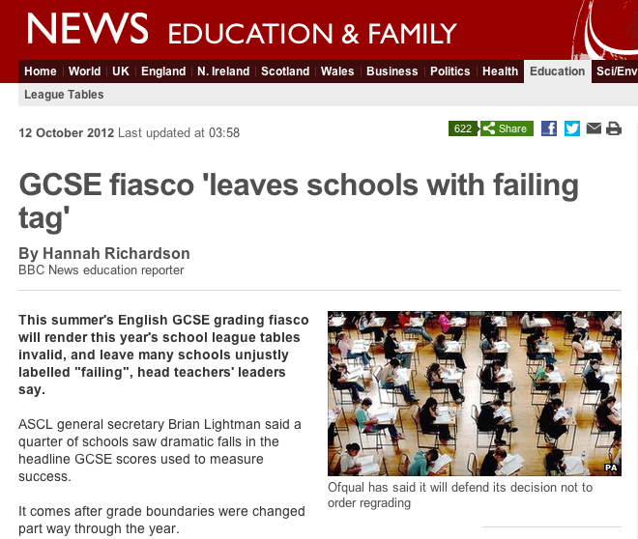

Slide 23
I am a head of a fantastic school. It was designated satisfactory by Ofsted following 16 months in special measures.
My job is currently secure in spite of flatlining this year due to the English issue at 54% 5 A*-C inc E and M. All other indicators soared. I have invited Ofsted in to redesignate and am awaiting the call.
We are resitting with our students - all who have come back from college on a Friday night to undertake intensive revision sessions with the Head of English. She is a teacher with real integrity and professionalism, who on results day spent the morning throwing up and apologising for the mess she had made when in reality it was none of her doing.
My frustration at this is immense. The young men who it has mostly affected deserve better. The teachers deserve better.
Head 1:

Slide 24
Friday morning. Sick in the stomach. Just picked up your blog via Twitter.
Yesterday I invited my Head of English to a meeting to further discuss English performance and his leadership.
HoD opens letter and after reading the contents (pretty ominous but genuinely praising his professionalism, and suggestions of how to improve things) promptly resigns.
Tears (sadness & relief) follow. Relief? That there wasn’t going to be a sacking. Relief from me that I took a step to deal with a matter which in truth I wanted to ignore - for my colleague is a very decent person.
I used to love my job as a Headteacher. Yesterday wasn’t an easy call. Since our 5+A*-C E/M dropped a long way I haven’t loved my job.
I feel impotent, a failure and, like now, I cry over work issues.
Head 2:

Slide 25
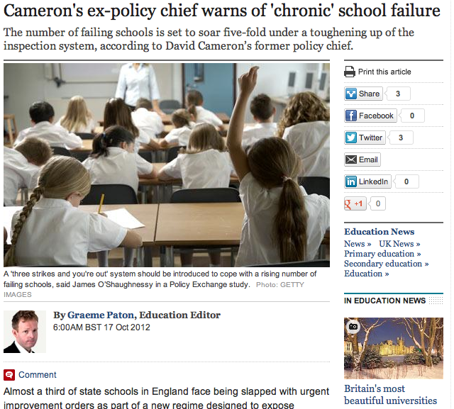

Slide 26
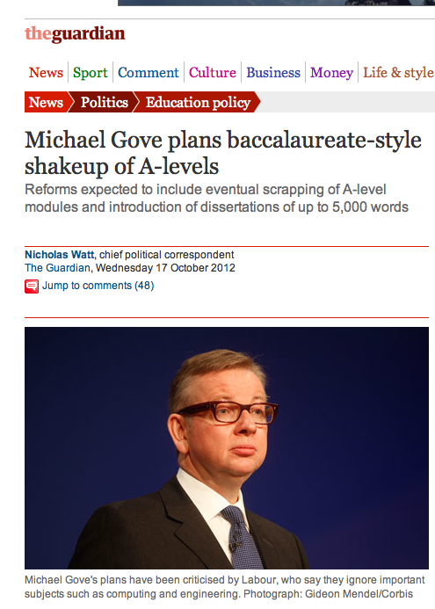

Slide 27
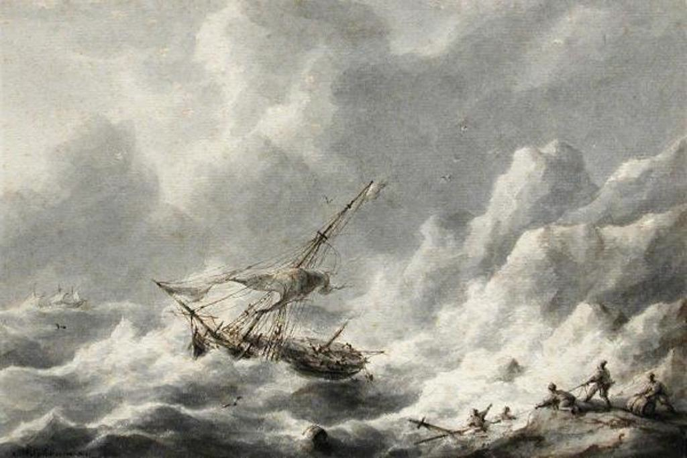
Pace of reform
Nature of reform
Tone of reform
Disconnect
Feeling of being run by people who haven’t run things
Ironically mechanistic view of education
Swagger.
Issues:

Slide 28
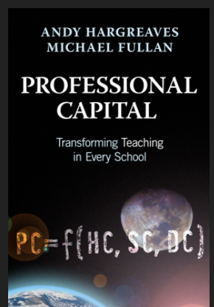

Slide 29
‘When the classroom door is closed, the teacher will always remain in charge. Where students are concerned, the teacher will always be more powerful than the principal, the president or the prime minister.
Successful and sustainable improvement can therefore never be done to
or even for teachers.
It can only ever be achieved
by and with them.’

Slide 30
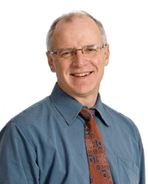

Slide 31
Much of the research on change in schools is pessimistic: Milbrey McLaughlin once wrote that ‘policy cannot mandate what matters’

Slide 32
‘We need to distinguish change from improvement’

Slide 33
‘I put teaching and learning practices far ahead of curriculum as a means of improving student outcomes and believe that the emphasis on curriculum in many places has not been the best priority for limited time, energy and resources.’

Slide 34
It is a myth that you have to address students’ personal problems before you get to their learning: ‘as more kids learned to read and were successful, behaviour problems declined precipitously: good teaching was the best strategy to improve student behaviour’

Slide 35
‘Curriculum matters less than quality of teaching, as shown by the very significant differences in achievement from one teacher to another in the same course or curriculum.’

Slide 36
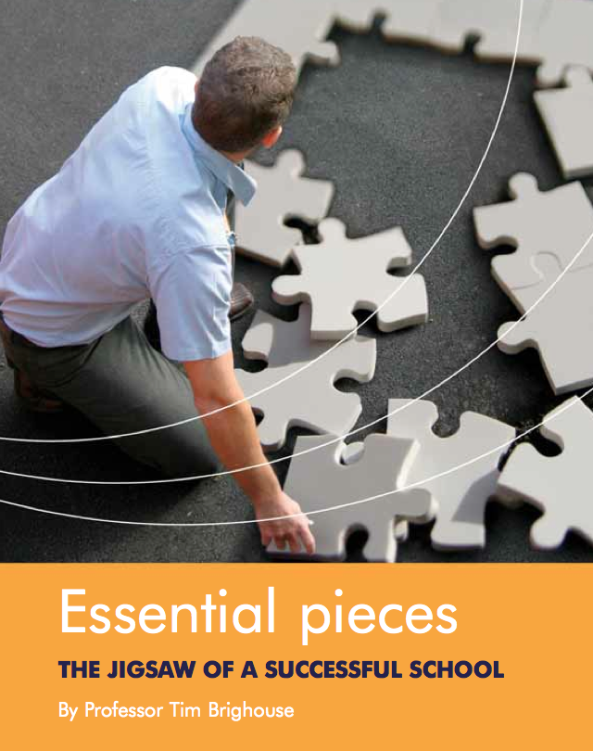

Slide 37
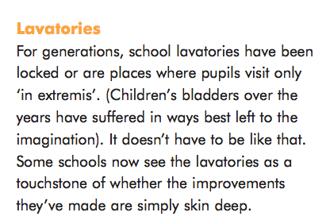

Slide 38
What are the ideas and people who have shaped your values, and why?

Slide 39
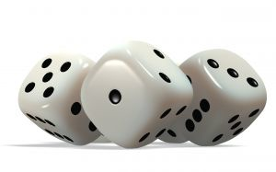
This much I know

Slide 40
15

Slide 41
Old Joke

Slide 42
Collective Nouns

Slide 43
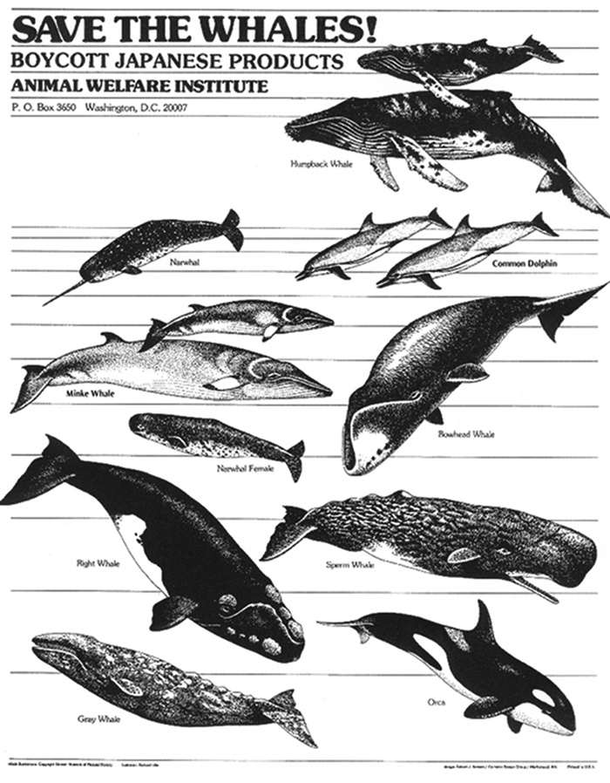
1
Notes:
pod

Slide 44
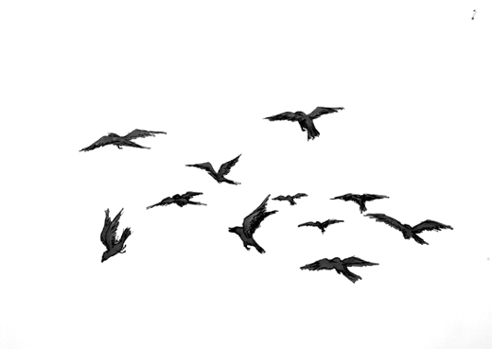
2
Notes:
murder

Slide 45
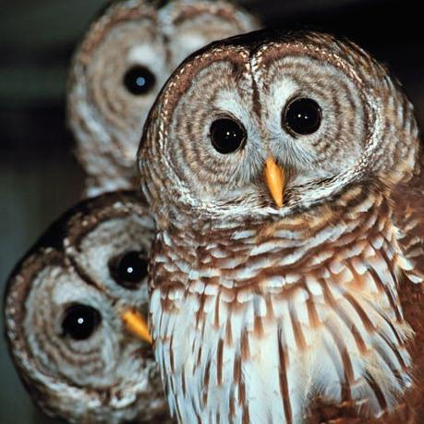
3
Notes:
Parliament

Slide 46
4
Notes:
Pitying of turtledoves

Slide 47
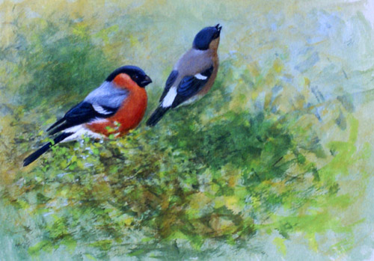
5
Notes:
Bellowing of bullfinches

Slide 48
Q: What’s the collective noun for a group of headteachers?
A: A ‘lack’ of principals

Slide 49
Q: What’s the collective noun for a group of headteachers?
A: A ‘lack’ of principals

Slide 50
Q: What’s the collective noun for a group of headteachers?
A: A ‘lack’ of principles

Slide 51
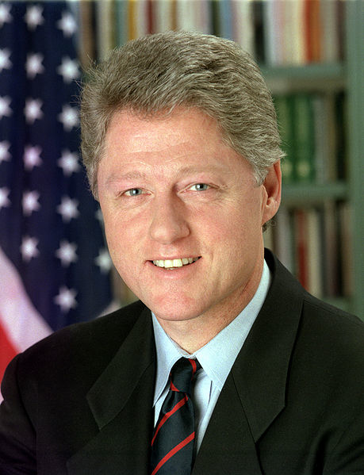
"If you do what you've always done, you'll get what you've always got"
Bill Clinton
US President, 1993-2001

Slide 52
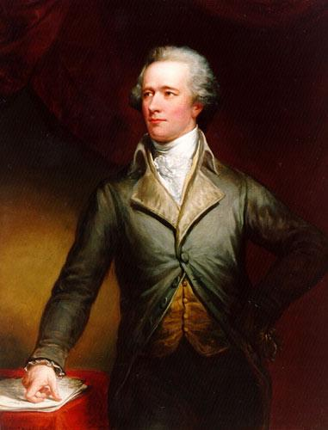
“Those who stand for nothing fall for anything”
Alexander Hamilton
Founding Father, 1755-1803

Slide 53
CHANGE
VALUES

Slide 54
15

Slide 55
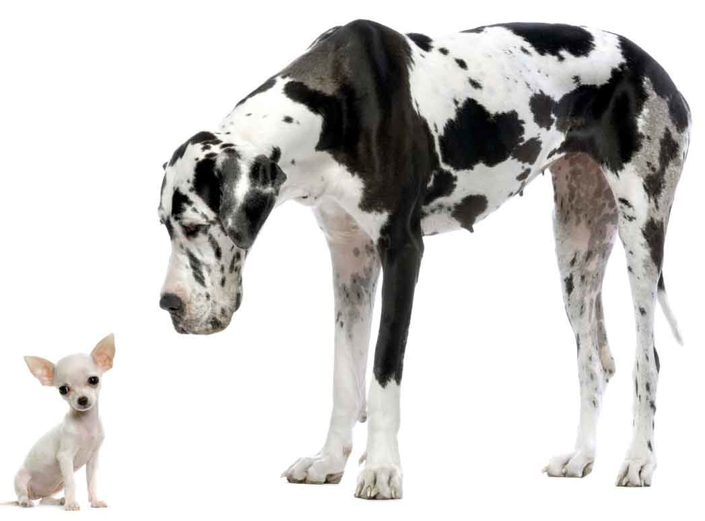
1
Small things are linked to big things

Slide 56
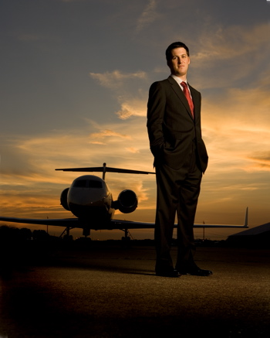
2
Chief executives belong to business

Slide 57
3
Saying no is harder than saying yes

Slide 58
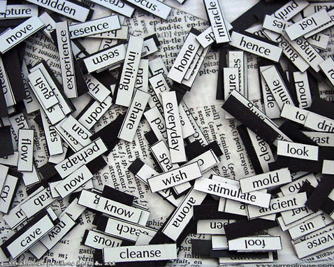
4
Pronouns matter:
I – we
Me - us

Slide 59
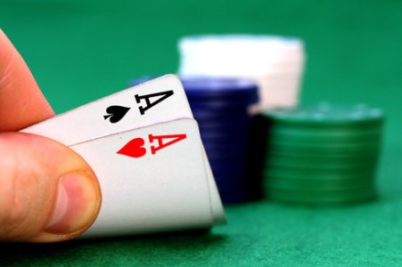
5
Bluffing is an essential skill

Slide 60
6
We need to be crosser

Slide 61
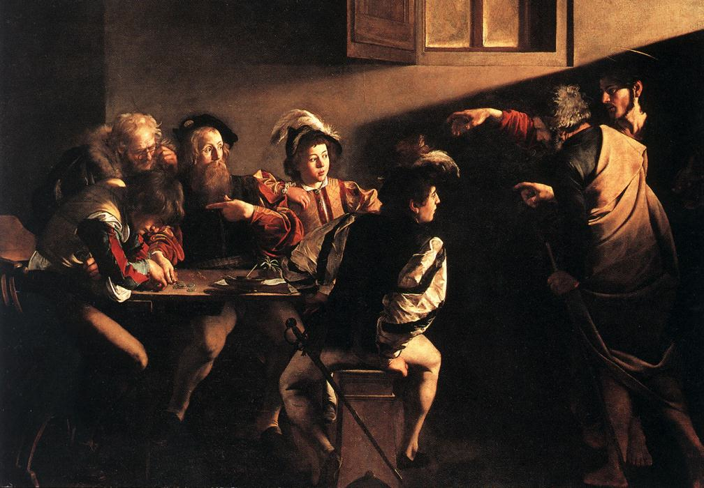
7
Matthew was right

Slide 62
The Matthew Effect
(Robert K Merton)

Slide 63
The rich shall get richer and the poor shall get poorer
Matthew 13:12

Slide 64
“The word-rich get richer while the word-poor get poorer” in their reading skills
(CASL)

Slide 65
“While good readers gain new skills very rapidly, and quickly move from learning to read to reading to learn, poor readers become increasingly frustrated with the act of reading, and try to avoid reading where possible”
The Matthew Effect
Daniel Rigney

Slide 66
“Students who begin with high verbal aptitudes find themselves in verbally enriched social environments and have a double advantage.”
The Matthew Effect
Daniel Rigney

Slide 67
“Good readers may choose friends who also read avidly while poor readers seek friends with whom they share other enjoyments”
The Matthew Effect
Daniel Rigney

Slide 68
Stricht’s Law: “reading ability in children cannot exceed their listening ability …”
E.D. Hirsch
The Schools We Need

Slide 69
“Spoken language forms a constraint, a ceiling not only on the ability to comprehend but also on the ability to write, beyond which literacy cannot progress”
Myhill and Fisher

Slide 70
“The children who possess intellectual capital when they first arrive at school have the mental scaffolding and Velcro to catch hold of what is going on, and they can turn the new knowledge into still more Velcro to gain still more knowledge”.
E.D. Hirsch
The Schools We Need

Slide 71
Aged 7:
Children in the top quartile have 7100 words; children in the lowest have around 3000.
The main influence is parents.
DfE Research Unit

Slide 72
Every teacher in English is a teacher of English
George Sampson, 1922

Slide 73
The Matthew Effect:
The rich will get richer &
the poor will get poorer

Slide 74
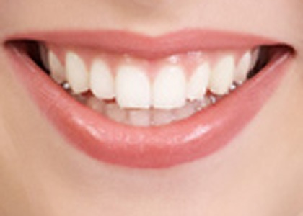
8
Appearances matter

Slide 75
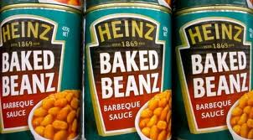
9
We are not making baked beans

Slide 76
10
This isn’t a club for teachers

Slide 77
11
Underpinning question:
‘Would I be happy for my child to be taught in this classroom?’

Slide 78
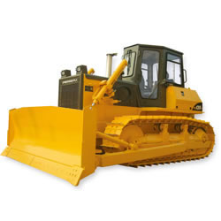
12
Getting work done counts for a lot

Slide 79
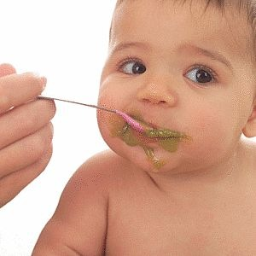
13
We must teach what real learning is

Slide 80
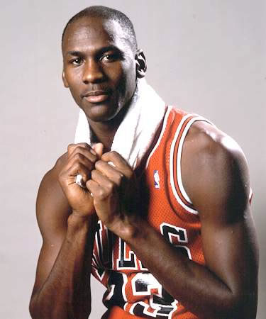
“I've missed more than 9000 shots in my career. I've lost almost 300 games. 26 times, I've been trusted to take the game winning shot and missed. I've failed over and over and over again in my life. And that is why I succeed.”
Michael Jordan
US basketball player

Slide 81
14
We have to be able to look ourselves in the mirror

Slide 82
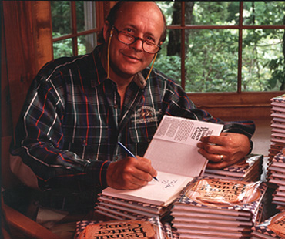
“Our character is what we do when we think no one is looking.”
H. Jackson Browne
Author of Life’s Little Instruction Book

Slide 83
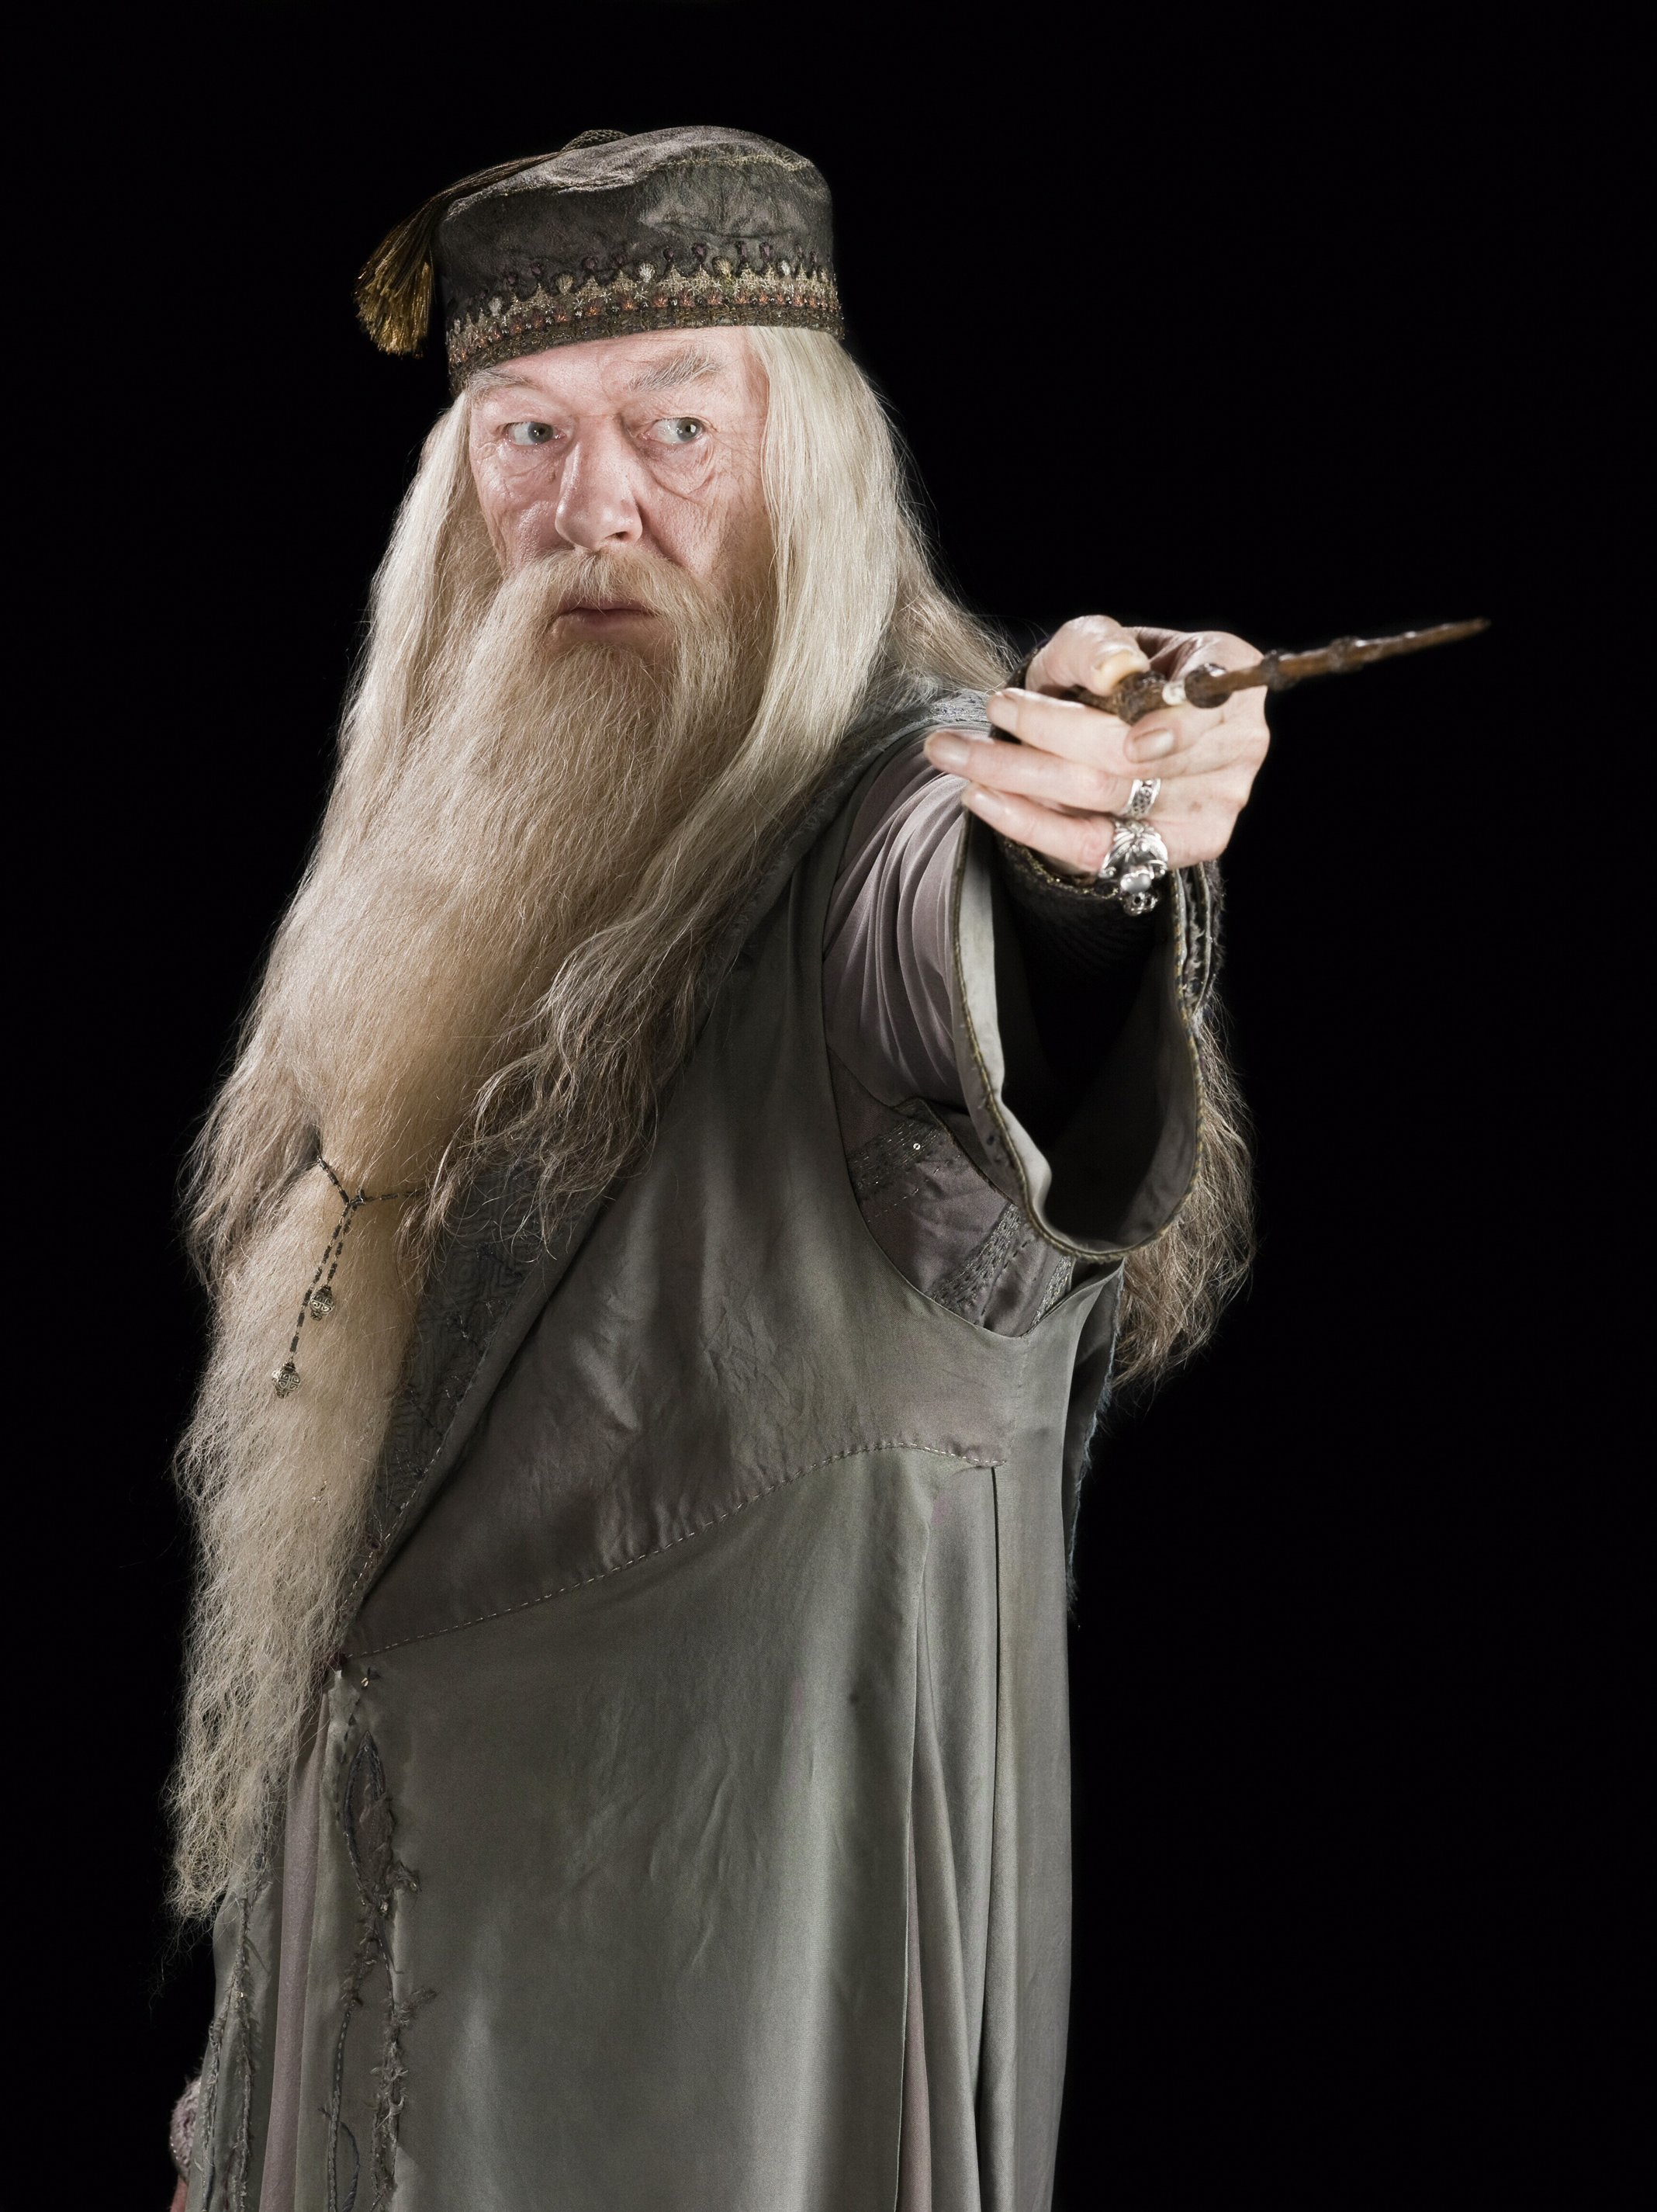
“It takes a great deal of courage to stand up to your enemies … but even more to stand up to your friends”
Albus Dumbledore
Harry Potter & the Chamber of Secrets

Slide 84
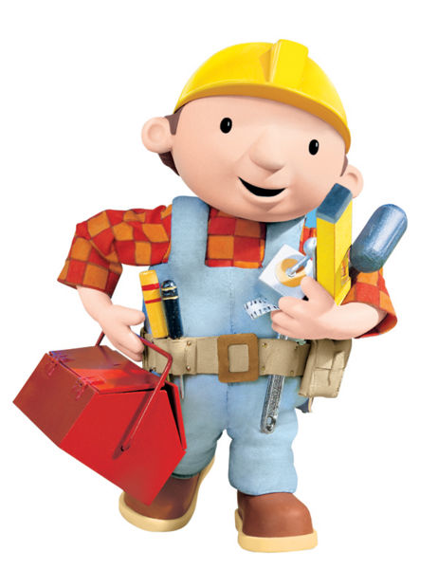
15
It’s a job …
though an extraordinary one

Slide 85
What are your non-negotiable principles?

Slide 86
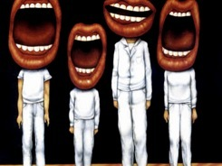
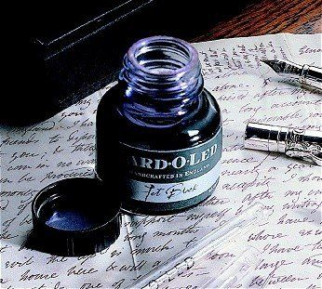
Translating ‘what’ into ‘how’

Slide 87
Understand the significance of exploratory talk
Model good talk – eg connectives
Re-think questioning – ‘why & how’, thinking time, and no-hands-up
Consciously vary groupings
Get conversation into the school culture

Slide 88
Talking Point
Understand the significance of exploratory talk
Model good talk – eg connectives
Re-think questioning – ‘why & how’, thinking time, and no-hands-up
Consciously vary groupings
Get conversation into the school culture
How would you make this happen across every classroom in your school?

Slide 89
Teach reading – scanning, skimming, analysis
Read aloud and display
Teach key vocabulary
Demystify spelling
Teach research, not FOFO

Slide 90
DEMO

Slide 91
SKIMMING

Slide 92
The climate of the Earth is always changing. In the past it has altered as a result of natural causes. Nowadays, however, the term climate change is generally used when referring to changes in our climate which have been identified since the early part of the 1900's . The changes we've seen over recent years and those which are predicted over the next 80 years are thought to be mainly as a result of human behaviour rather than due to natural changes in the atmosphere.

Slide 93
The best treatment for mouth ulcers. Gargle with salt water. You should find that it works a treat. Salt is cheap and easy to get hold of and we all have it at home, so no need to splash out and spend lots of money on expensive mouth ulcer creams.

Slide 94
Lexical v Grammatical Words

Slide 95
Urquhart castle is probably one of the most picturesquely situated castles in the Scottish Highlands. Located 16 miles south-west of Inverness, the castle, one of the largest in Scotland, overlooks much of Loch Ness. Visitors come to stroll through the ruins of the 13th-century castle because Urquhart has earned the reputation of being one of the best spots for sighting Loch Ness’s most famous inhabitant.

Slide 96
Urquhart castle is probably one of the most picturesquely situated castles in the Scottish Highlands. Located 16 miles south-west of Inverness, the castle, one of the largest in Scotland, overlooks much of Loch Ness. Visitors come to stroll through the ruins of the 13th-century castle because Urquhart has earned the reputation of being one of the best spots for sighting Loch Ness’s most famous inhabitant.

Slide 97
Urquhart castle is probably one of the most picturesquely situated castles in the Scottish Highlands. Located 16 miles south-west of Inverness, the castle, one of the largest in Scotland, overlooks much of Loch Ness. Visitors come to stroll through the ruins of the 13th-century castle because Urquhart has earned the reputation of being one of the best spots for sighting Loch Ness’s most famous inhabitant.

Slide 98
Urquhart castle is probably one of the most picturesquely situated castles in the Scottish Highlands. Located 16 miles south-west of Inverness, the castle, one of the largest in Scotland, overlooks much of Loch Ness. Visitors come to stroll through the ruins of the 13th-century castle because Urquhart has earned the reputation of being one of the best spots for sighting Loch Ness’s most famous inhabitant.

Slide 99
Urquhart castle is probably one of the most picturesquely situated castles in the Scottish Highlands. Located 16 miles south-west of Inverness, the castle, one of the largest in Scotland, overlooks much of Loch Ness. Visitors come to stroll through the ruins of the 13th-century castle because Urquhart has earned the reputation of being one of the best spots for sighting Loch Ness’s most famous inhabitant.

Slide 100
SCANNING

Slide 101
Where did the first cell phones begin?
Name 2 other features that started to be included in phones
Why are cell phones especially useful in some countries?

Slide 102
Where begin?
Two features?
Some countries?
Cellular telephones
The first cellular telephone system began operation in Tokyo in 1979, and the first U.S. system began operation in 1983 in Chicago. A camera phone is a cellular phone that also has picture taking capabilities. Some camera phones have the capability to send these photos to another cellular phone or computer. Advances in digital technology and microelectronics has led to the inclusion of unrelated applications in cellular telephones, such as alarm clocks, calculators, Internet browsers, and voice memos for recording short verbal reminders, while at the same time making such telephones vulnerable to certain software viruses. In many countries with inadequate wire-based telephone networks, cellular telephone systems have provided a means of more quickly establishing a national telecommunications network.

Slide 103
RESEARCH SKILLS

Slide 104
Research the life of
Martin Luther King

Slide 105
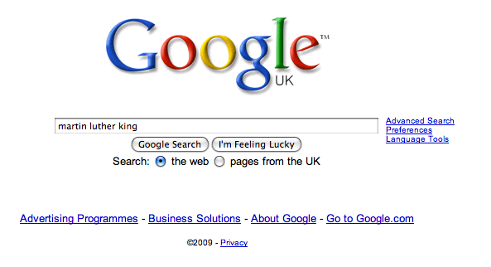

Slide 112
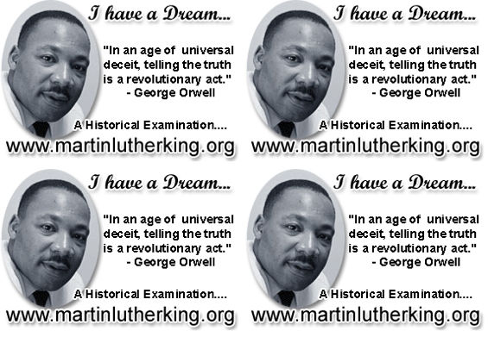

Slide 113
Talking Point
Teach reading – scanning, skimming, analysis
Read aloud and display
Teach key vocabulary
Demystify spelling
Teach research, not FOFO
How would you make this happen across every classroom in your school?

Slide 114
Demonstrate writing
Teach composition & planning
Allow oral rehearsal
Short & long sentences
Connectives

Slide 115
Know your connectives
Adding: and, also, as well as, moreover, too
Cause & effect: because, so, therefore, thus, consequently
Sequencing: next, then, first, finally, meanwhile, before, after
Qualifying: however, although, unless, except, if, as long as, apart from, yet
Emphasising: above all, in particular, especially, significantly, indeed, notably
Illustrating: for example, such as, for instance, as revealed by, in the case of
Comparing: equally, in the same way, similarly, likewise, as with, like
Contrasting: whereas, instead of, alternatively, otherwise, unlike, on the other hand

Slide 116
Talking Point
Demonstrate writing
Teach composition & planning
Allow oral rehearsal
Short & long sentences
Connectives
How would you make this happen across every classroom in your school?

Slide 117
For family & friends:

Slide 118
Epilogue

Slide 119
‘O Brave New World’:
What kind of leaders does our education system need?
Geoff Barton
Headteacher, King Edward VI School
Download at www.geoffbarton.co.uk (111)
Twitter: @RealGeoffBarton

