Slide 1
‘O Brave New World’:
What kind of leaders does our education system need?
Geoff Barton
Head, King Edward VI School
Download at www.geoffbarton.co.uk (118)
Twitter: @RealGeoffBarton

Slide 2
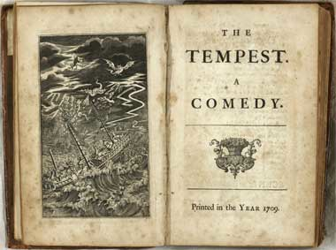

Slide 3
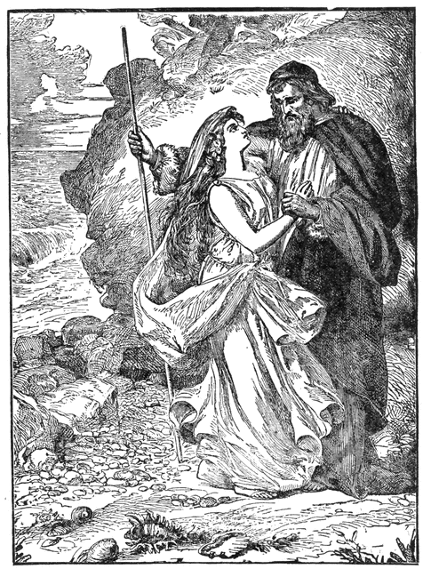
Miranda:
“O brave new world, That has such people in't!”
Prospero:
“Tis new to thee”

Slide 4
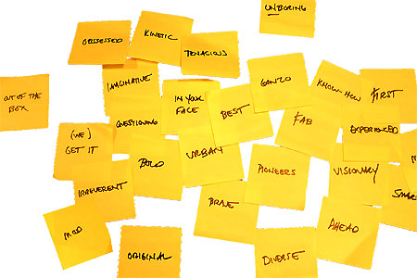

Slide 5
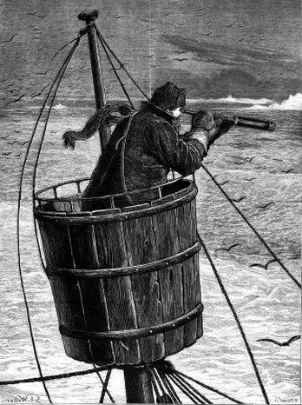
Part 1: Surveying the landscape
Master:
“We run ourselves aground”

Slide 6
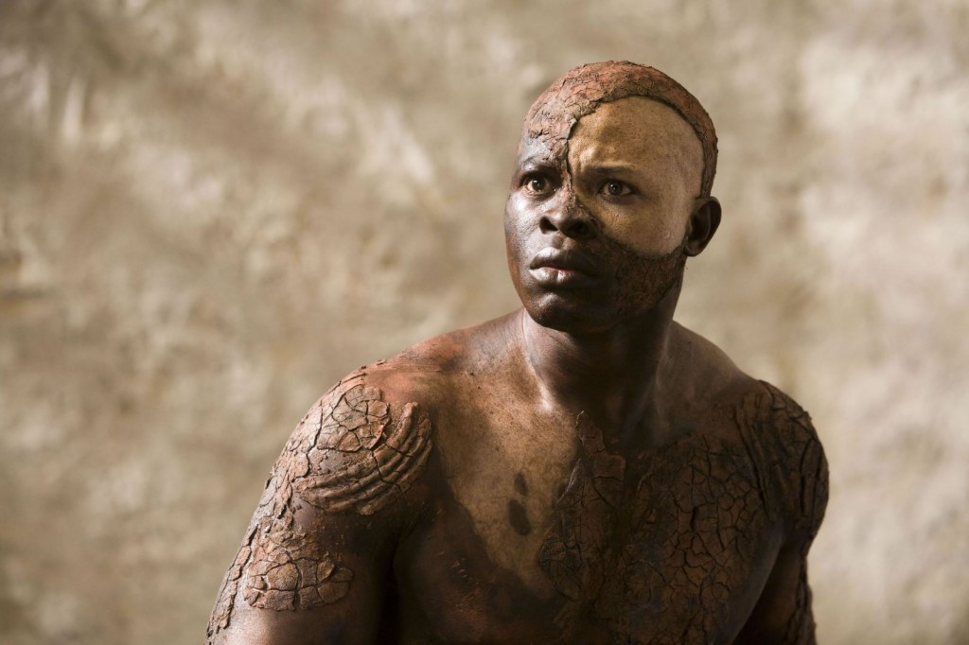
Part 2:
What do we owe as leaders to our students?

Slide 7
Part 1: Surveying the landscape
Master:
“We run ourselves aground”

Slide 8
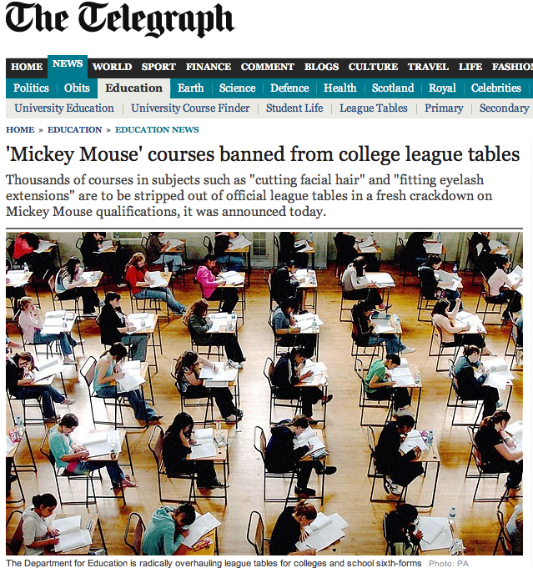

Slide 9
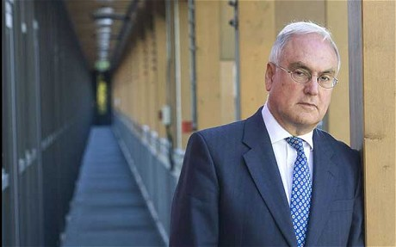
Sir Michael Wilshaw, 7 March 2013:
Changes to Ofsted's inspection regime - and the scrapping of the "satisfactory" rating - had driven standards up …
Ofsted's new framework is having a "galvanising effect" on the schools system.

Slide 10
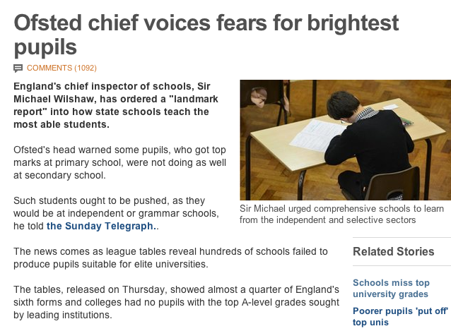

Slide 11
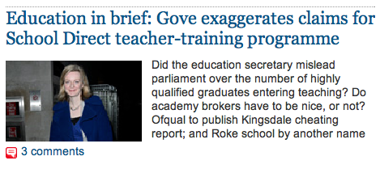

Slide 12
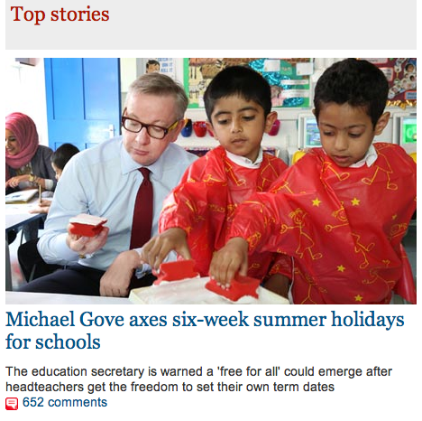

Slide 14
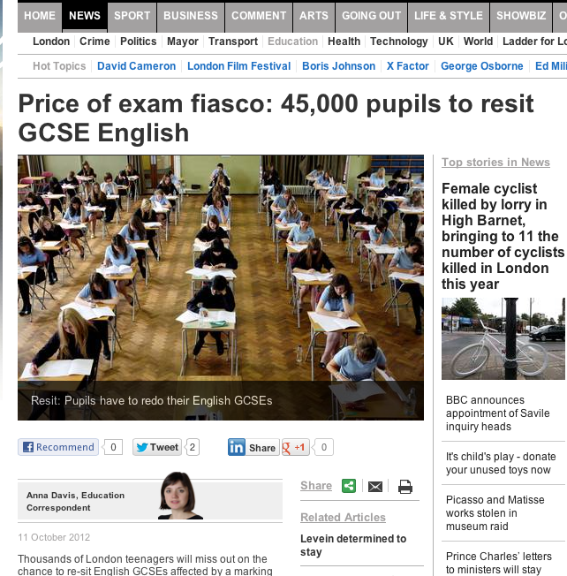
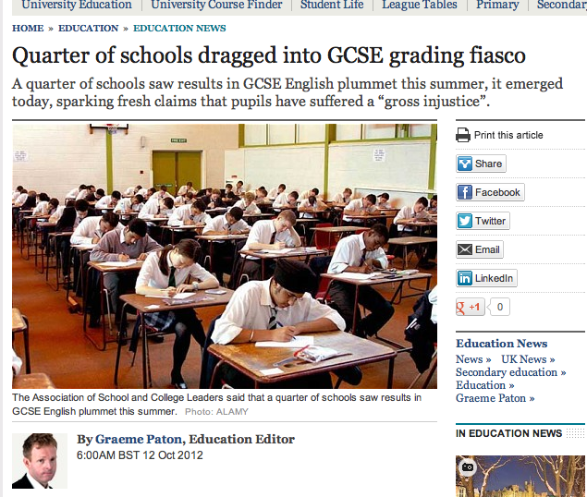
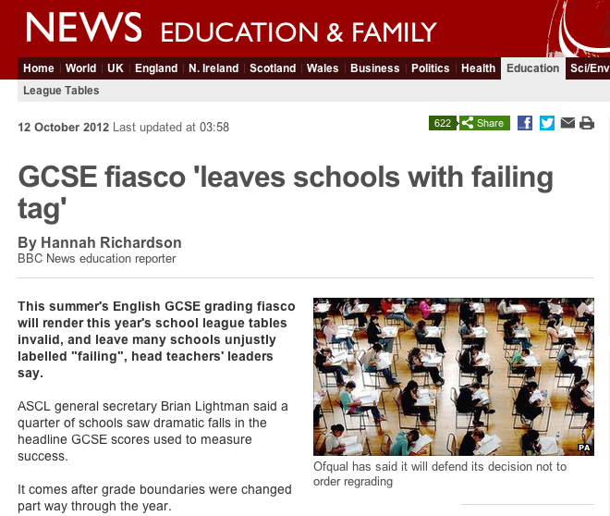

Slide 15
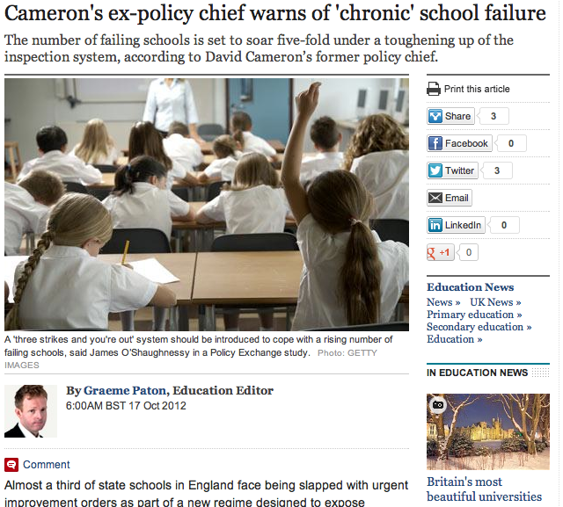

Slide 16
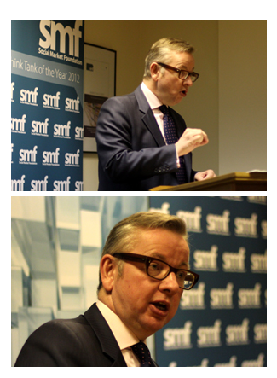
Speech to Social Market Foundation
5 February 2013

Slide 18
“Two particular individuals have influenced me more than any others …”

Slide 19
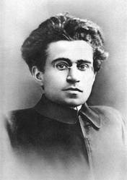

Slide 20
At a tragically early age Jade was diagnosed with cervical cancer. Terminally ill, she had to make plans for her two beloved boys …
She used her money to send them to the most traditional, academically demanding prep school she could find. So they could enjoy the best education reality TV could buy.

Slide 21
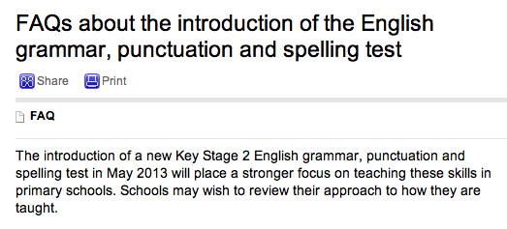

Slide 23
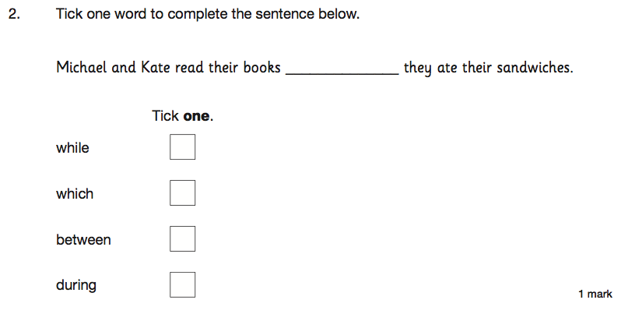

Slide 24
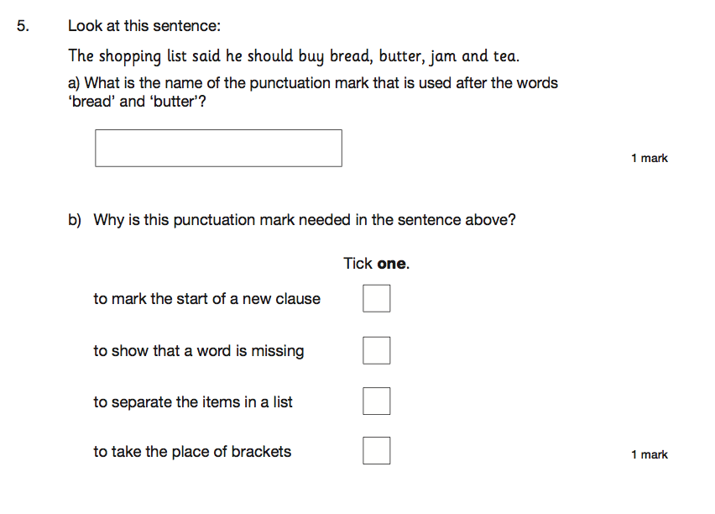

Slide 25
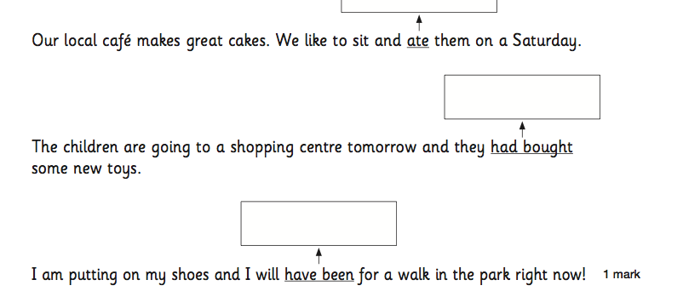

Slide 26
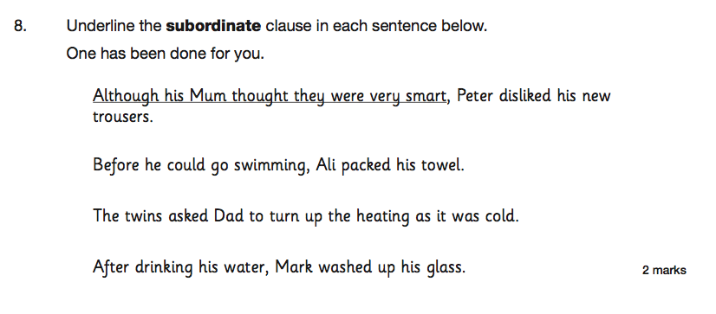

Slide 27
Unintended consequences

Slide 28
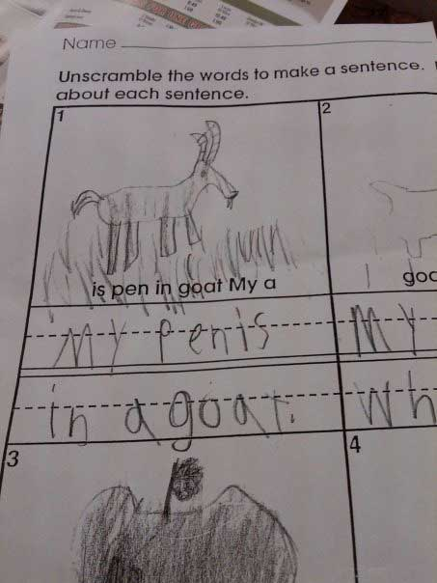

Slide 29
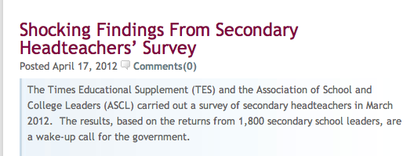

Slide 30
37% are actively planning to leave the profession.
92% don’t think the government is supportive of the teaching profession.
23% would recommend headship to their colleagues the corollary of which is that 77% wouldn’t recommend it.
61% said the government’s education reforms will have a detrimental impact on state education.
73% of deputies and assistant headteachers said they were less likely to want to take up a headship than they would have been 12 months ago.

Slide 31
37% are actively planning to leave the profession.
92% don’t think the government is supportive of the teaching profession.
23% would recommend headship to their colleagues the corollary of which is that 77% wouldn’t recommend it.
61% said the government’s education reforms will have a detrimental impact on state education.
73% of deputies and assistant headteachers said they were less likely to want to take up a headship than they would have been 12 months ago.

Slide 32
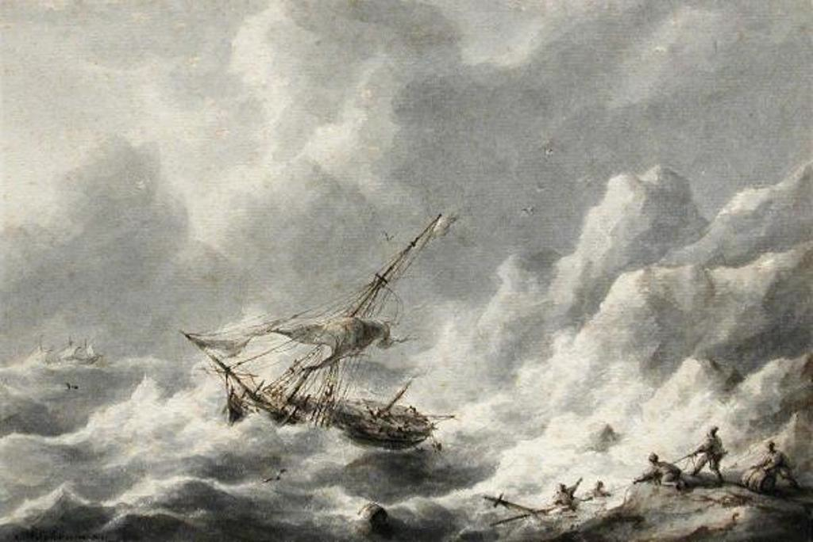
Issues:

Slide 33
Pace of reform
Nature of reform
Tone of reform
Disconnect
Feeling of being run by people who haven’t run things
Ironically mechanistic view of education
Swagger.
Issues:

Slide 34
I am a head of a fantastic school. It was designated satisfactory by Ofsted following 16 months in special measures.
My job is currently secure in spite of flatlining this year due to the English issue at 54% 5 A*-C inc E and M. All other indicators soared. I have invited Ofsted in to redesignate and am awaiting the call.
We are resitting with our students - all who have come back from college on a Friday night to undertake intensive revision sessions with the Head of English. She is a teacher with real integrity and professionalism, who on results day spent the morning throwing up and apologising for the mess she had made when in reality it was none of her doing.
My frustration at this is immense. The young men who it has mostly affected deserve better. The teachers deserve better.
Head 1:

Slide 35
Friday morning. Sick in the stomach. Just picked up your blog via Twitter.
Yesterday I invited my Head of English to a meeting to further discuss English performance and his leadership.
HoD opens letter and after reading the contents (pretty ominous but genuinely praising his professionalism, and suggestions of how to improve things) promptly resigns.
Tears (sadness & relief) follow. Relief? That there wasn’t going to be a sacking. Relief from me that I took a step to deal with a matter which in truth I wanted to ignore - for my colleague is a very decent person.
I used to love my job as a Headteacher. Yesterday wasn’t an easy call. Since our 5+A*-C E/M dropped a long way I haven’t loved my job.
I feel impotent, a failure and, like now, I cry over work issues.
Head 2:

Slide 36
Part 2:
What do we owe as leaders to our students?

Slide 38
‘When the classroom door is closed, the teacher will always remain in charge. Where students are concerned, the teacher will always be more powerful than the principal, the president or the prime minister.
Successful and sustainable improvement can therefore never be done to
or even for teachers.
It can only ever be achieved
by and with them.’

Slide 39
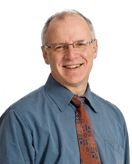

Slide 40
‘Curriculum matters less than quality of teaching, as shown by the very significant differences in achievement from one teacher to another in the same course or curriculum.’

Slide 42
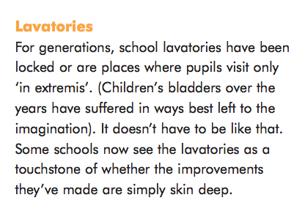

Slide 44
Grit
Curiosity
Self-control
Social intelligence
Zest
Optimism
Gratitude
Plus …
Bouncing back from failure

Slide 45
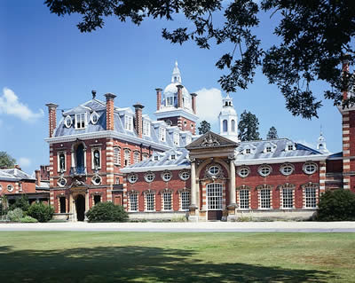
Wellington College

Slide 47
Five years with us is not long. Every experience needs to make a difference, and be part of a wider whole which serves as a framework to shape the lives of these young men and women. It needs to reinforce values and beliefs that will make them good people as well as preparing them for the competitive, dynamic and global workplace of the 21st century.
Yes, we are hugely ambitious academically for our pupils, ensuring that they secure the results to go on to the world’s best universities and on to careers of significance, influence and service.
But we also want them to live lives which are personally and socially fulfilling. In those five years, we can develop within them a love for art, music, dance, theatre and culture which will enrich the whole of their lives.

Slide 48
This much I know

Slide 49
10

Slide 50
Old Joke

Slide 51
Collective Nouns

Slide 52
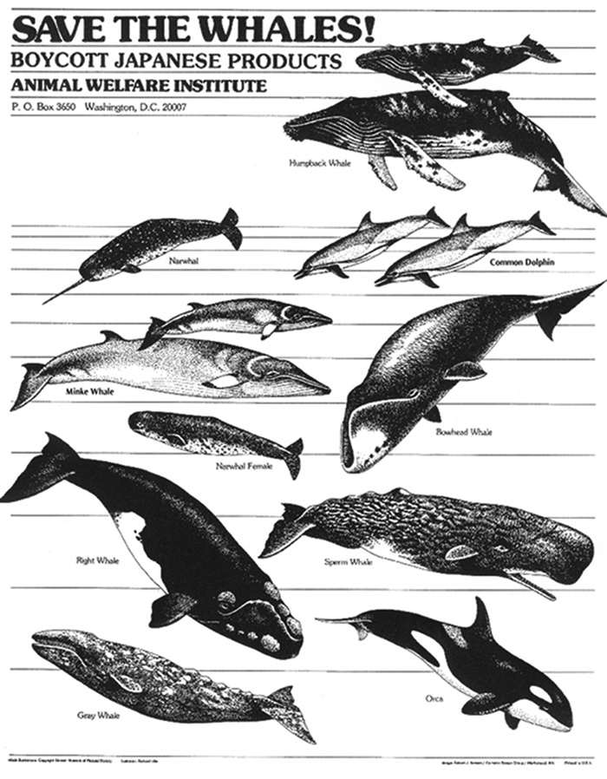
1
Notes:
pod

Slide 53
2
Notes:
murder

Slide 54
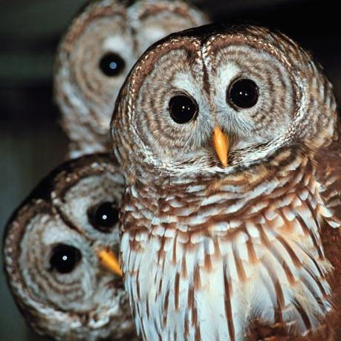
3
Notes:
Parliament

Slide 55
4
Notes:
Pitying of turtledoves

Slide 56
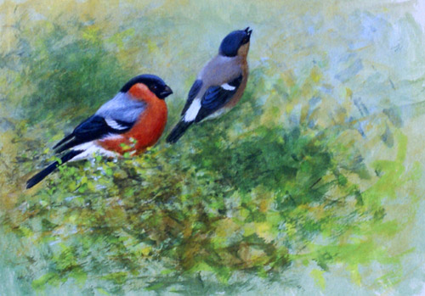
5
Notes:
Bellowing of bullfinches

Slide 57
Q: What’s the collective noun for a group of headteachers?
A: A ‘lack’ of principals

Slide 58
Q: What’s the collective noun for a group of headteachers?
A: A ‘lack’ of principals

Slide 59
Q: What’s the collective noun for a group of headteachers?
A: A ‘lack’ of principles

Slide 60
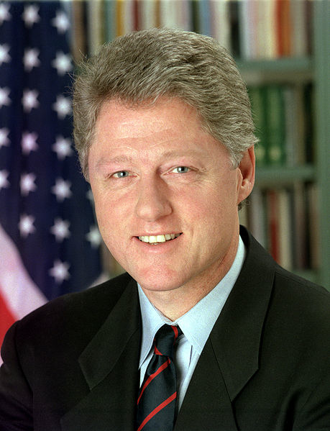
"If you do what you've always done, you'll get what you've always got"
Bill Clinton
US President, 1993-2001

Slide 61
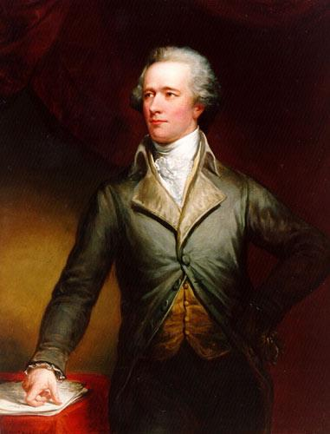
“Those who stand for nothing fall for anything”
Alexander Hamilton
Founding Father, 1755-1803

Slide 62
CHANGE
VALUES

Slide 63
10

Slide 64
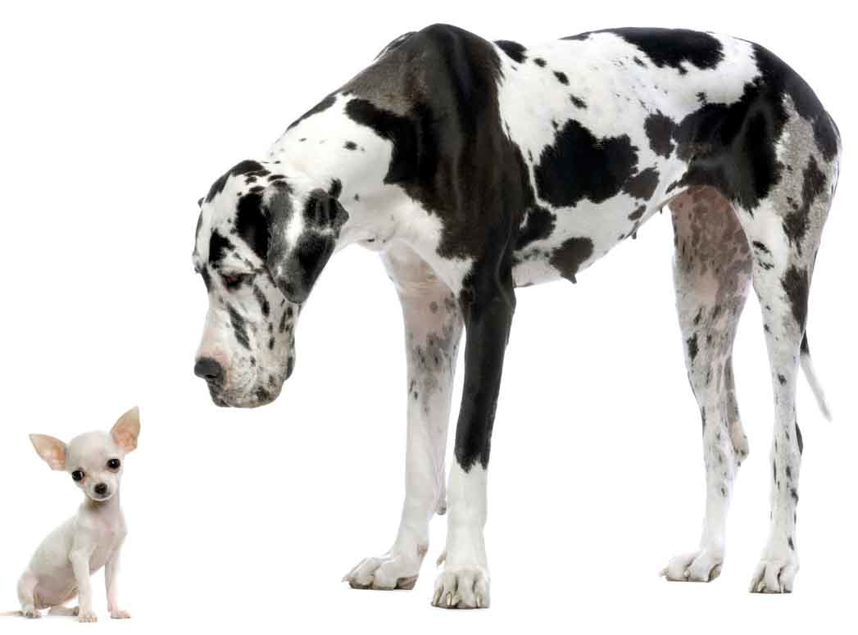
1
Small things are linked to big things

Slide 65
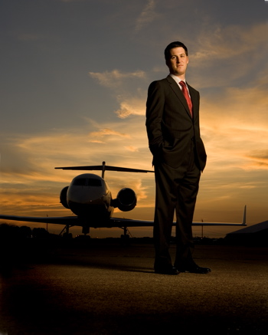
2
Chief executives belong to business

Slide 66
3
Saying no is harder than saying yes

Slide 67
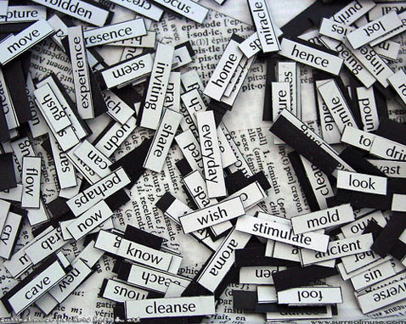
4
Pronouns matter:
I – we
Me - us

Slide 68
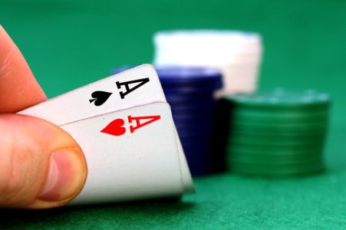
5
Bluffing is an essential skill

Slide 69
6
We need to be crosser

Slide 70
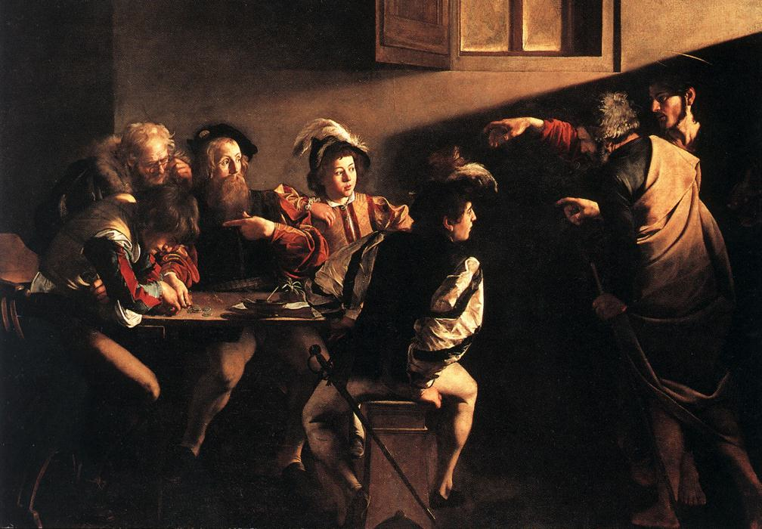
7
Matthew was right

Slide 71
The Matthew Effect
(Robert K Merton)

Slide 73
The rich shall get richer and the poor shall get poorer
Matthew 13:12

Slide 74
“The word-rich get richer while the word-poor get poorer” in their reading skills
(CASL)

Slide 75
“While good readers gain new skills very rapidly, and quickly move from learning to read to reading to learn, poor readers become increasingly frustrated with the act of reading, and try to avoid reading where possible”
The Matthew Effect
Daniel Rigney

Slide 76
Every teacher in English is a teacher of English
George Sampson, 1922

Slide 77
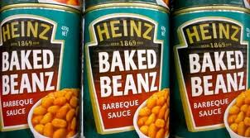
8
We are not making baked beans

Slide 78
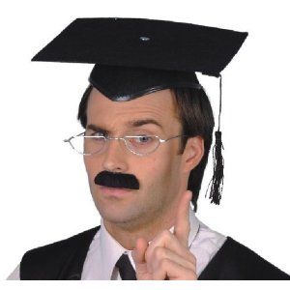
9
This isn’t a club for teachers

Slide 79
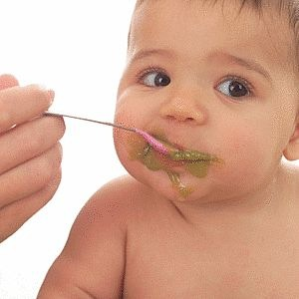
10
We must teach what real learning is

Slide 80
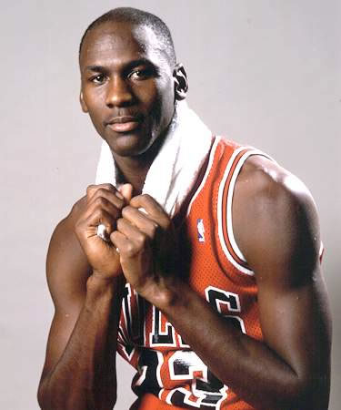
“I've missed more than 9000 shots in my career. I've lost almost 300 games. 26 times, I've been trusted to take the game winning shot and missed. I've failed over and over and over again in my life. And that is why I succeed.”
Michael Jordan
US basketball player

Slide 81
Epilogue

Slide 82
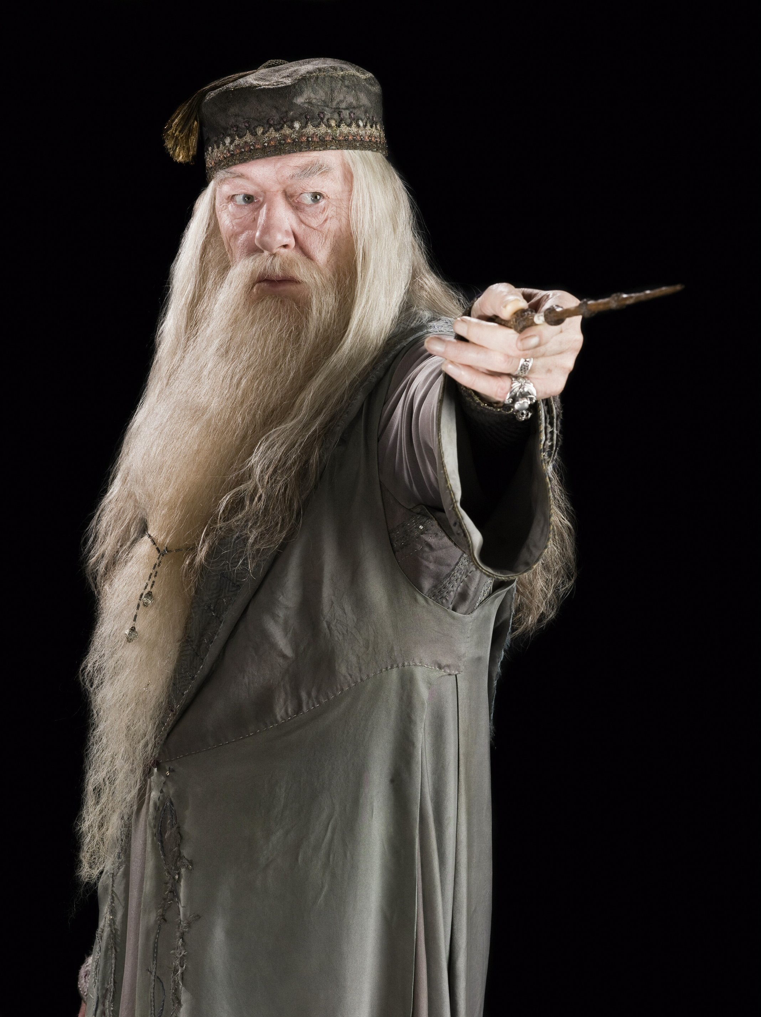
“It takes a great deal of courage to stand up to your enemies … but even more to stand up to your friends”
Albus Dumbledore
Harry Potter & the Chamber of Secrets

Slide 83
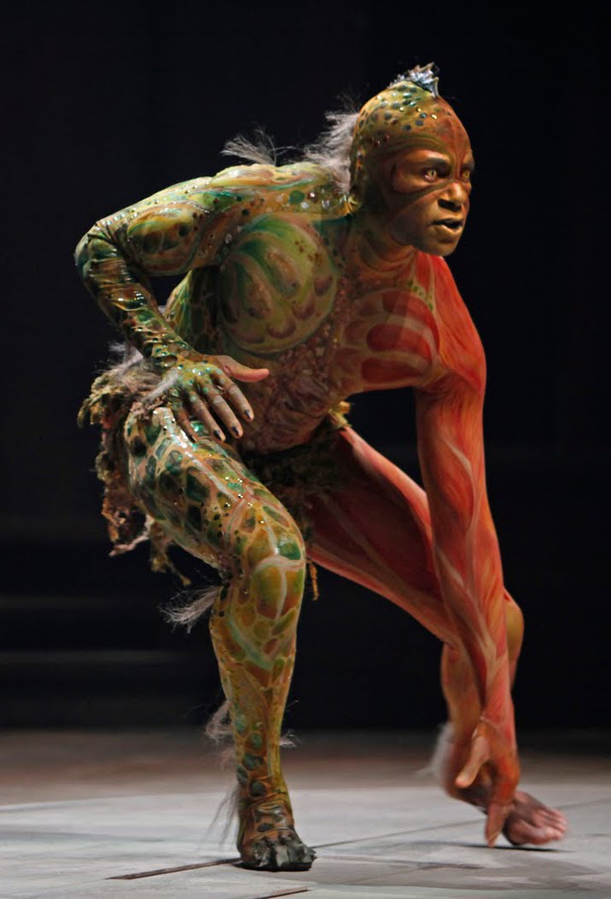
“We are such stuff as dreams are made on, and our little life is rounded with a sleep.”

Slide 84
‘O Brave New World’:
What kind of leaders does our education system need?
Geoff Barton
Headteacher, King Edward VI School
Download at www.geoffbarton.co.uk (118)
Twitter: @RealGeoffBarton

