Slide 1
Don’t Call it iteracy:
Essential Literacy Knowledge for all Teachers
Geoff Barton
Wednesday, March 14, 2012
Download this presentation at www.geoffbarton.co.uk
(Presentation number 99)

Slide 2
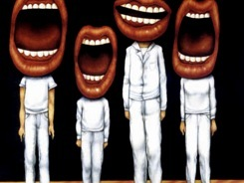
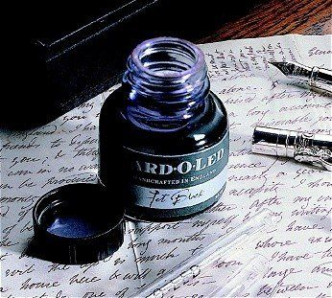

Slide 3
The Matthew Effect
(Robert K Merton)

Slide 4
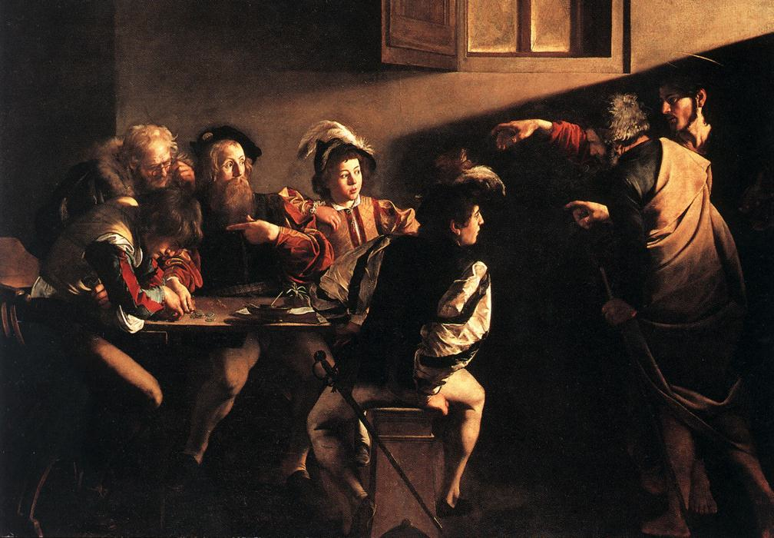

Slide 5
Understand the significance of exploratory talk
Model good talk – eg connectives
Re-think questioning – ‘why & how’ – and hands-up
Vary groupings
Get conversations into the school culture

Slide 6
READING

Slide 7
Teach reading – scanning, skimming, analysis
Read aloud and display
Teach key vocabulary
Demystify spelling
Teach research, not FOFO

Slide 8
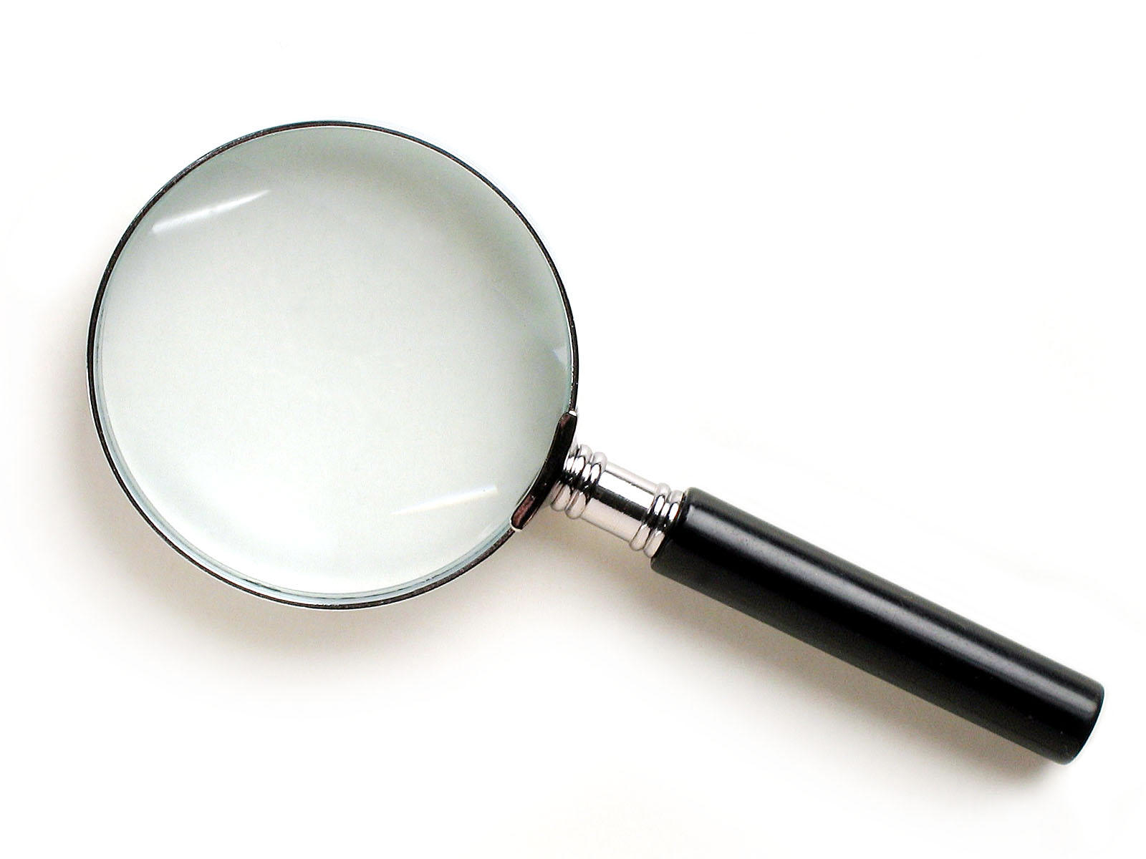
SKIMMING

Slide 9
The climate of the Earth is always changing. In the past it has altered as a result of natural causes. Nowadays, however, the term climate change is generally used when referring to changes in our climate which have been identified since the early part of the 1900's . The changes we've seen over recent years and those which are predicted over the next 80 years are thought to be mainly as a result of human behaviour rather than due to natural changes in the atmosphere.

Slide 10
The best treatment for mouth ulcers. Gargle with salt water. You should find that it works a treat. Salt is cheap and easy to get hold of and we all have it at home, so no need to splash out and spend lots of money on expensive mouth ulcer creams.

Slide 11
Urquhart castle is probably one of the most picturesquely situated castles in the Scottish Highlands. Located 16 miles south-west of Inverness, the castle, one of the largest in Scotland, overlooks much of Loch Ness. Visitors come to stroll through the ruins of the 13th-century castle because Urquhart has earned the reputation of being one of the best spots for sighting Loch Ness’s most famous inhabitant.

Slide 12
SCANNING

Slide 13
Where did the first cell phones begin?
Name 2 other features that started to be included in phones
Why are cell phones especially useful in some countries?

Slide 14
Where begin?
Two features?
Some countries?
Cellular telephones
The first cellular telephone system began operation in Tokyo in 1979, and the first U.S. system began operation in 1983 in Chicago. A camera phone is a cellular phone that also has picture taking capabilities. Some camera phones have the capability to send these photos to another cellular phone or computer. Advances in digital technology and microelectronics has led to the inclusion of unrelated applications in cellular telephones, such as alarm clocks, calculators, Internet browsers, and voice memos for recording short verbal reminders, while at the same time making such telephones vulnerable to certain software viruses. In many countries with inadequate wire-based telephone networks, cellular telephone systems have provided a means of more quickly establishing a national telecommunications network.

Slide 15
Close Reading

Slide 16
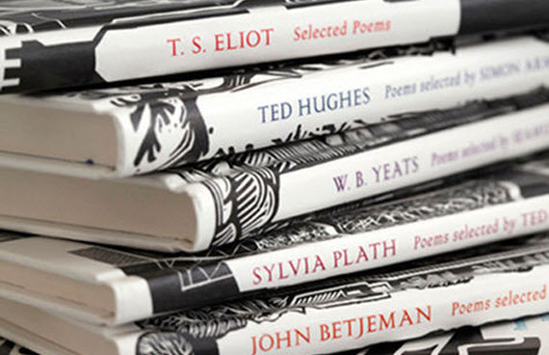

Slide 17
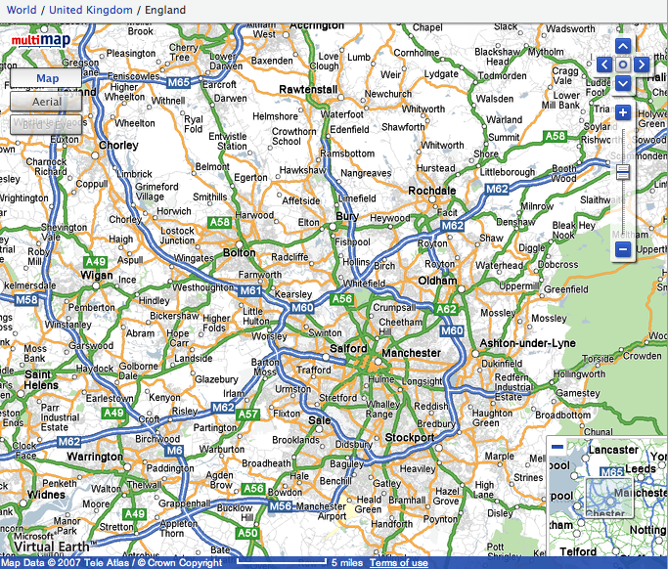

Slide 18
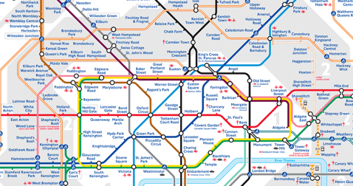
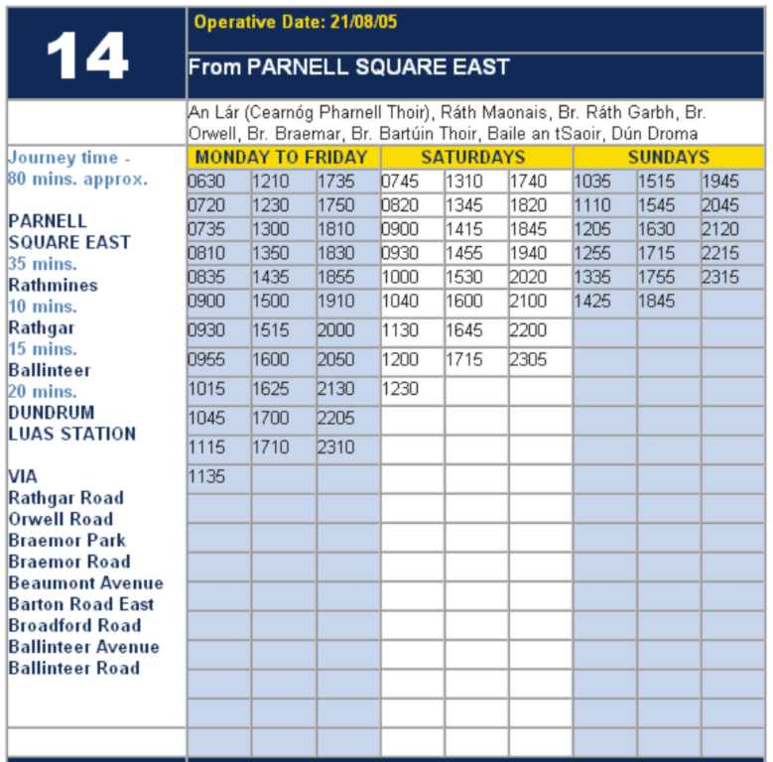
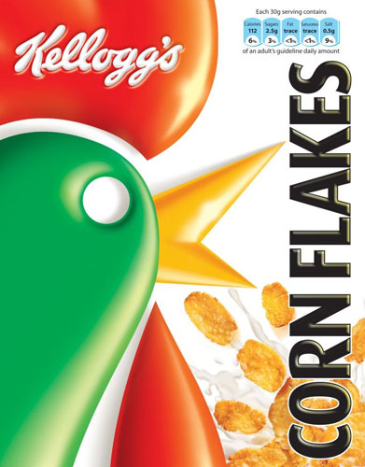
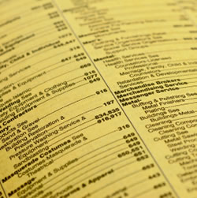

Slide 19
RESEARCH SKILLS

Slide 20
Research the life of
Martin Luther King

Slide 21
So how would you, a fully paid-up member of the literacy club, approach the task?

Slide 22
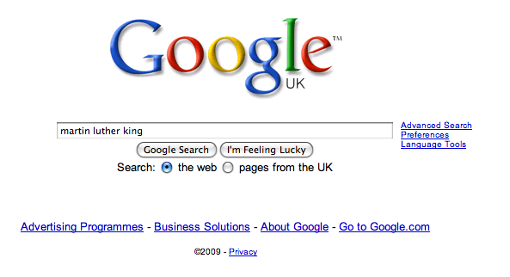

Slide 28
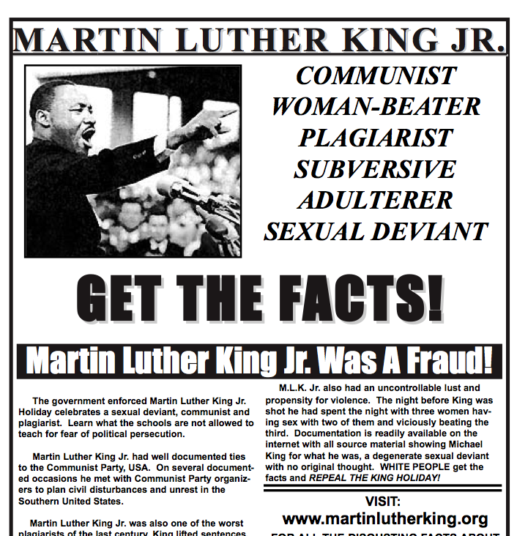

Slide 29
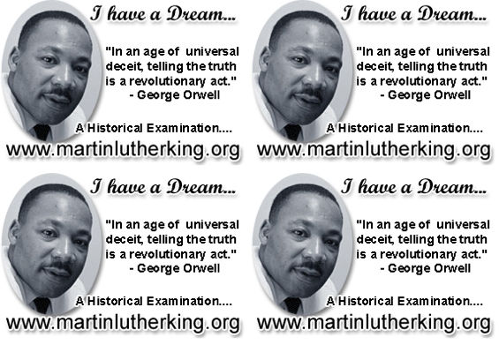

Slide 30
Teach reading – scanning, skimming, analysis
Read aloud and display
Teach key vocabulary
Demystify spelling
Teach research, not FOFO

Slide 31
DEMYSTIFYING
SPELLING
3

Slide 32
1 - SOUNDS

Slide 33
Government

Slide 34
February

Slide 35
2 -VISUALS

Slide 36
Se-para-te
Be-lie-ve

Slide 37
3 - MNEMONICS

Slide 38
necessary

Slide 39
accommodation

Slide 40
Teach reading – scanning, skimming, analysis
Read aloud and display
Teach key vocabulary
Demystify spelling
Teach research, not FOFO

Slide 41
Demonstrate writing
Teach composition & planning
Allow oral rehearsal
Short & long sentences
Connectives

Slide 42
Know your connectives
Adding: and, also, as well as, moreover, too
Cause & effect: because, so, therefore, thus, consequently
Sequencing: next, then, first, finally, meanwhile, before, after
Qualifying: however, although, unless, except, if, as long as, apart from, yet
Emphasising: above all, in particular, especially, significantly, indeed, notably
Illustrating: for example, such as, for instance, as revealed by, in the case of
Comparing: equally, in the same way, similarly, likewise, as with, like
Contrasting: whereas, instead of, alternatively, otherwise, unlike, on the other hand

Slide 43
DEMO

Slide 44
Demonstrate writing
Teach composition & planning
Allow oral rehearsal
Short & long sentences
Connectives

Slide 46
SUMMARY

Slide 47
1: It’s not literacy

Slide 48
2: It’s making the implicit explicit – and modelling it

Slide 49
3: Without us, the rich will get richer & the poor will get poorer

Slide 51
Don’t Call it iteracy:
Essential Literacy Knowledge for all Teachers
Geoff Barton
Wednesday, March 14, 2012
Download this presentation at www.geoffbarton.co.uk
(Presentation number 99)

