Slide 1
‘Boys & Literacy’: Teaching Leaders Conference
Geoff Barton
Head, King Edward VI School, Suffolk
Saturday, April 28, 2012
Download this presentation free at www.geoffbarton.co.uk/teacher-resources (number 100)

Slide 2
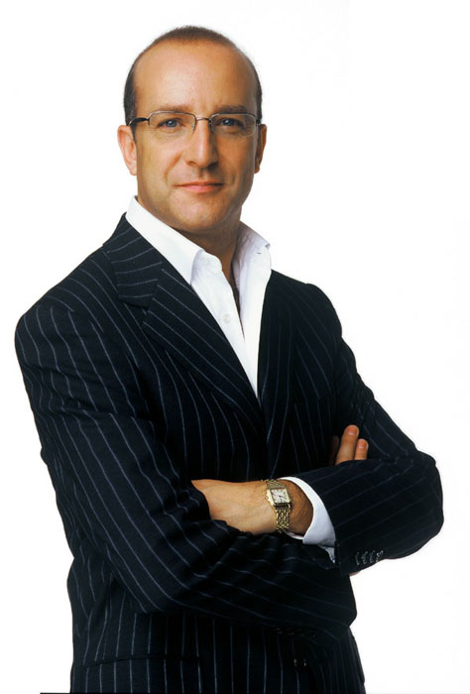
I can make you read and write better

Slide 3
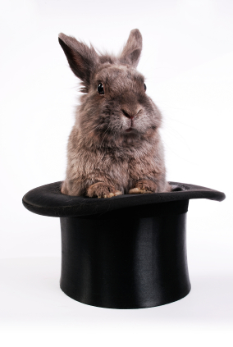
The Secret of Literacy

Slide 5
What
How

Slide 6
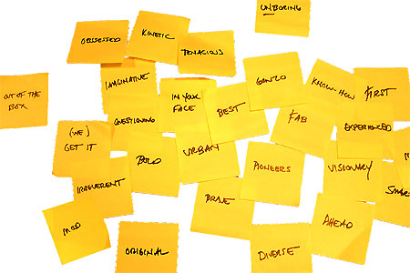

Slide 7
The ‘What’ of Literacy

Slide 8
5 Provocations

Slide 9
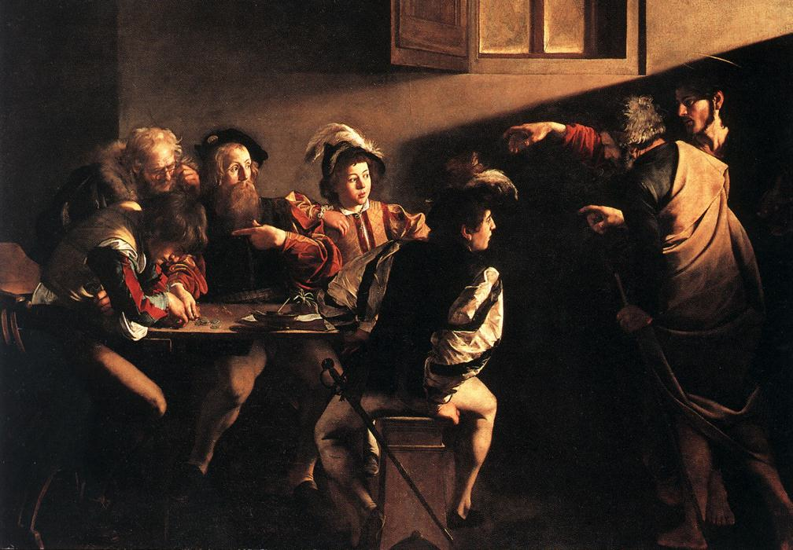

Slide 10
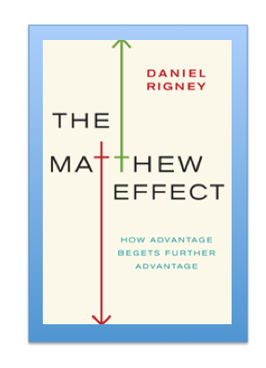
1
Monopoly idea by
Leonard Beeghly

Slide 11
2
If you scout out the best professors their courses will be interesting even if you start out not caring about the subject … curriculum matters less than quality of teaching
Ben Levin

Slide 12
3
“Knowledge is no more outdated today than it was 100 or 200 years ago”
Frank Furedi

Slide 13
4
“Spoken language forms a constraint, a ceiling not only on the ability to comprehend but also on the ability to write, beyond which literacy cannot progress”
Myhill and Fisher

Slide 14
5
Stricht’s Law:
“reading ability in children cannot exceed their listening ability …”

Slide 15
Implications for ‘boys & literacy’:
Careful not to pander to stereotypes
It may not be the curriculum that should be our main focus
Maybe teaching should be about: relevance, overview, modelling skills, questioning, feedback, toughness, humour, rigour
Good talk matters
There won’t be many boys who want to do badly

Slide 16
The Secret of Literacy

Slide 17
Stand by

Slide 18
Here goes

Slide 19
Brace yourself

Slide 20
Ready?

Slide 21
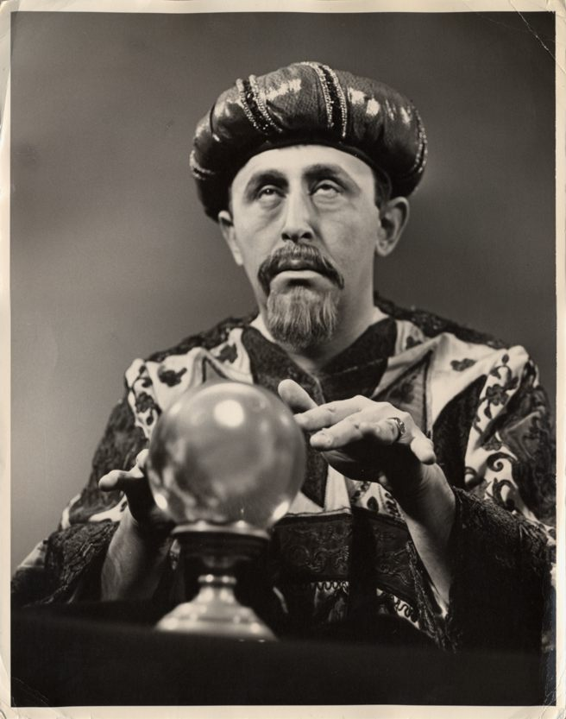
Making the implicit explicit

Slide 22
Demo

Slide 23
I can make you read and write better

Slide 25
SKIMMING

Slide 26
The climate of the Earth is always changing. In the past it has altered as a result of natural causes. Nowadays, however, the term climate change is generally used when referring to changes in our climate which have been identified since the early part of the 1900's . The changes we've seen over recent years and those which are predicted over the next 80 years are thought to be mainly as a result of human behaviour rather than due to natural changes in the atmosphere.

Slide 27
The best treatment for mouth ulcers. Gargle with salt water. You should find that it works a treat. Salt is cheap and easy to get hold of and we all have it at home, so no need to splash out and spend lots of money on expensive mouth ulcer creams.

Slide 28
The best treatment for mouth ulcers. Gargle with salt water. You should find that it works a treat. Salt is cheap and easy to get hold of and we all have it at home, so no need to splash out and spend lots of money on expensive mouth ulcer creams.

Slide 29
Urquhart castle is probably one of the most picturesquely situated castles in the Scottish Highlands. Located 16 miles south-west of Inverness, the castle, one of the largest in Scotland, overlooks much of Loch Ness. Visitors come to stroll through the ruins of the 13th-century castle because Urquhart has earned the reputation of being one of the best spots for sighting Loch Ness’s most famous inhabitant.

Slide 30
Urquhart castle is probably one of the most picturesquely situated castles in the Scottish Highlands. Located 16 miles south-west of Inverness, the castle, one of the largest in Scotland, overlooks much of Loch Ness. Visitors come to stroll through the ruins of the 13th-century castle because Urquhart has earned the reputation of being one of the best spots for sighting Loch Ness’s most famous inhabitant.

Slide 31
Urquhart castle is probably one of the most picturesquely situated castles in the Scottish Highlands. Located 16 miles south-west of Inverness, the castle, one of the largest in Scotland, overlooks much of Loch Ness. Visitors come to stroll through the ruins of the 13th-century castle because Urquhart has earned the reputation of being one of the best spots for sighting Loch Ness’s most famous inhabitant.

Slide 32
Urquhart castle is probably one of the most picturesquely situated castles in the Scottish Highlands. Located 16 miles south-west of Inverness, the castle, one of the largest in Scotland, overlooks much of Loch Ness. Visitors come to stroll through the ruins of the 13th-century castle because Urquhart has earned the reputation of being one of the best spots for sighting Loch Ness’s most famous inhabitant.

Slide 33
Urquhart castle is probably one of the most picturesquely situated castles in the Scottish Highlands. Located 16 miles south-west of Inverness, the castle, one of the largest in Scotland, overlooks much of Loch Ness. Visitors come to stroll through the ruins of the 13th-century castle because Urquhart has earned the reputation of being one of the best spots for sighting Loch Ness’s most famous inhabitant.

Slide 34
SCANNING

Slide 35
Where did the first cell phones begin?
Name 2 other features that started to be included in phones
Why are cell phones especially useful in some countries?

Slide 36
Where begin?
Two features?
Some countries?
Cellular telephones
The first cellular telephone system began operation in Tokyo in 1979, and the first U.S. system began operation in 1983 in Chicago. A camera phone is a cellular phone that also has picture taking capabilities. Some camera phones have the capability to send these photos to another cellular phone or computer. Advances in digital technology and microelectronics has led to the inclusion of unrelated applications in cellular telephones, such as alarm clocks, calculators, Internet browsers, and voice memos for recording short verbal reminders, while at the same time making such telephones vulnerable to certain software viruses. In many countries with inadequate wire-based telephone networks, cellular telephone systems have provided a means of more quickly establishing a national telecommunications network.

Slide 37
Research the life of
Martin Luther King

Slide 38
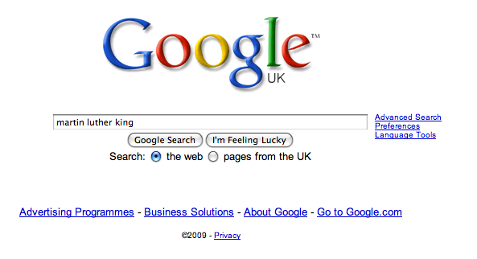

Slide 44
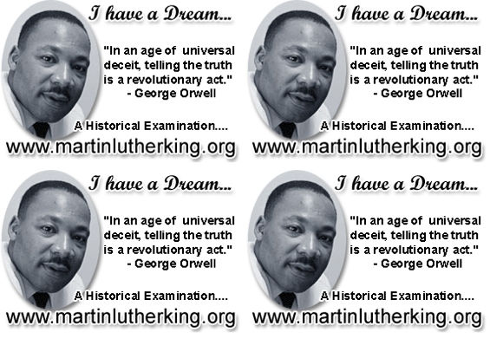

Slide 46
Writing Task
+ 3 skills
= better writer

Slide 47
Describe this room

Slide 48
3 writing essentials:
Think of your reader: clarify or mystify
Use short & long sentences
Reject the first word you think of

Slide 49
Demo

Slide 50
Describe your journey here

Slide 51
I can make you read and write better

Slide 52
Summary
Literacy matters and trumps intelligence
Great teachers model and demonstrate, making the implicit explicit
The ‘how’ therefore matters more than the ‘what’

Slide 53
‘Boys & Literacy’: Teaching Leaders Conference
Geoff Barton
Head, King Edward VI School, Suffolk
Saturday, April 28, 2012
Download this presentation free at www.geoffbarton.co.uk/teacher-resources (number 100)
@RealGeoffBarton

