Slide 1
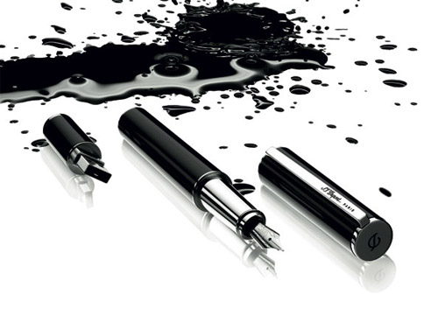
Which bits of grammar matter?
Geoff Barton
June 26, 2012
Download this presentation free at www.geoffbarton.co.uk/teacher-resources (number 103)

Slide 2
Hello.

Slide 3
The Literacy Club

Slide 4
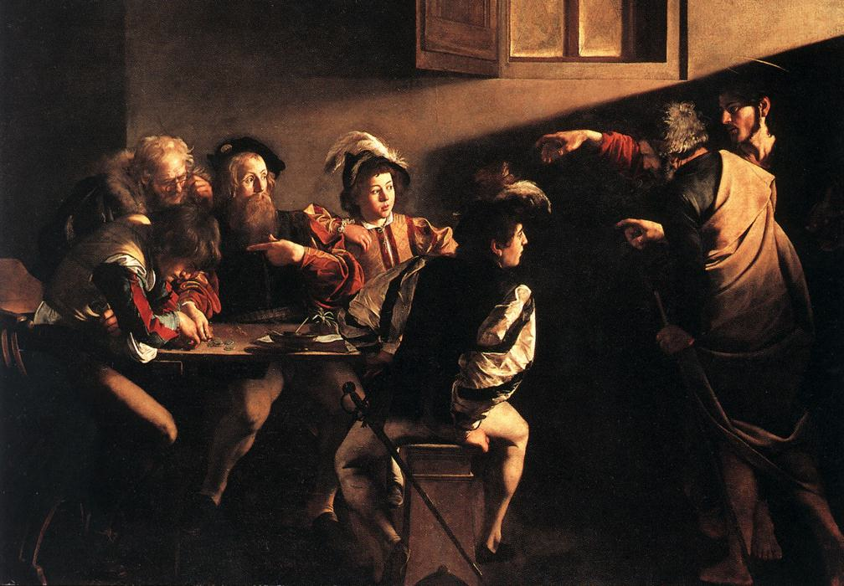

Slide 5
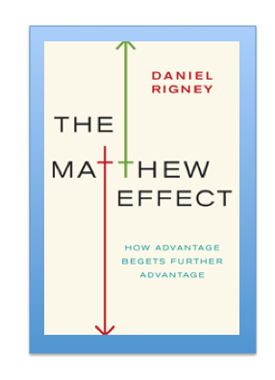
‘The Matthew Effect’: Robert K. Merton
Monopoly by Leonard Beeghly

Slide 6
“The word-rich get richer while the word-poor get poorer”
(CASL)
Canadian Association of School Librarians

Slide 7
“While good readers gain new skills very rapidly, and quickly move from learning to read to reading to learn, poor readers become increasingly frustrated with the act of reading, and try to avoid reading where possible”
The Matthew Effect
Daniel Rigney

Slide 8
“Students who begin with high verbal aptitudes find themselves in verbally enriched social environments and have a double advantage.”
The Matthew Effect
Daniel Rigney

Slide 9
“Good readers may choose friends who also read avidly while poor readers seek friends with whom they share other enjoyments”
The Matthew Effect
Daniel Rigney

Slide 10
“Spoken language forms a constraint, a ceiling not only on the ability to comprehend but also on the ability to write, beyond which literacy cannot progress”
Myhill and Fisher

Slide 11
One in six people in the UK struggle with literacy. This means their literacy is below the level expected of an eleven year old.
National Literacy Trust
Literacy: State of the Nation – A Picture of Literacy in the UK Today
2010

Slide 12
The Literacy Club

Slide 13
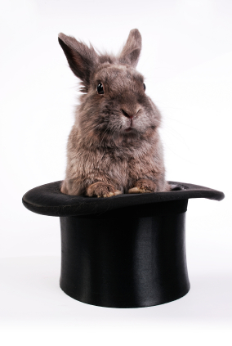
The Secret of Literacy

Slide 14
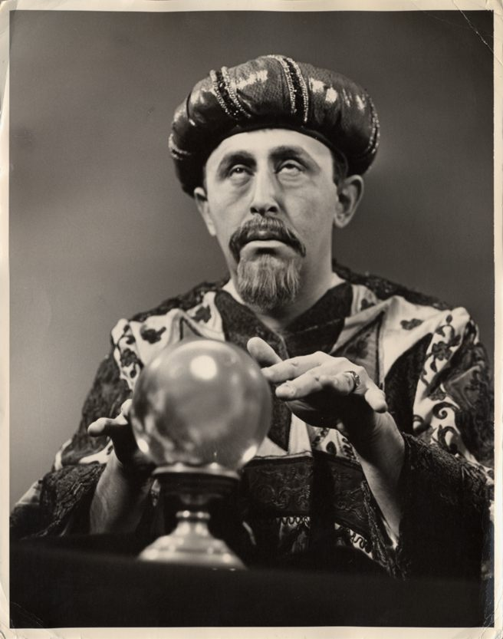
Making the implicit explicit

Slide 15
WHOLE-SCHOOL LITERACY

Slide 16
Literacy culture
Understand – and be angry about – the significance of the Matthew Effect
Speaking and listening
Talk matters
Exploratory talk
Social talk
Reading
Teach reading (skimming, scanning, analysis, independent research not FOFO)
Reading for Pleasure
Vocabulary
Spelling strategies (visual, aural, mnemonics)
Writing
Sentence variety & connectives
Planning & structure

Slide 17
ENGLISH

Slide 18
1 Writing more interesting sentences
Coordination
Conjunctions: and, but, or
Subordination
Conjunctions: when, if, because, although, as
Relative clauses: that, who, which …
-ing verbs: Walking down the street, I felt sick
2 Adding detail through modification
Adjectives & adverbs
The old dog woke up abruptly
Expanding noun phrases
The dog on the carpet woke up
The dog, which was lying on the carpet, woke up

Slide 19
3 Active / passive
I am afraid I broke the greenhouse window
I am afraid the greenhouse window has been broken
4 Cohesion across sentences and paragraphs
Pronouns (he)
Discourse markers (on the other hand

Slide 20
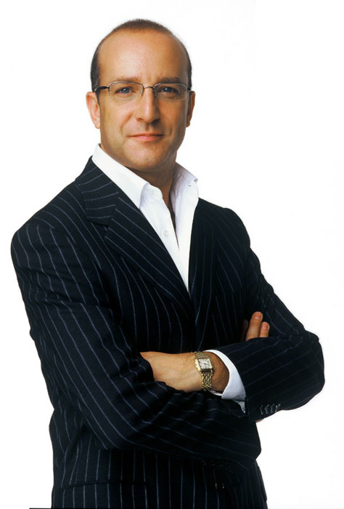
1
I will make you read and write and spell better

Slide 21
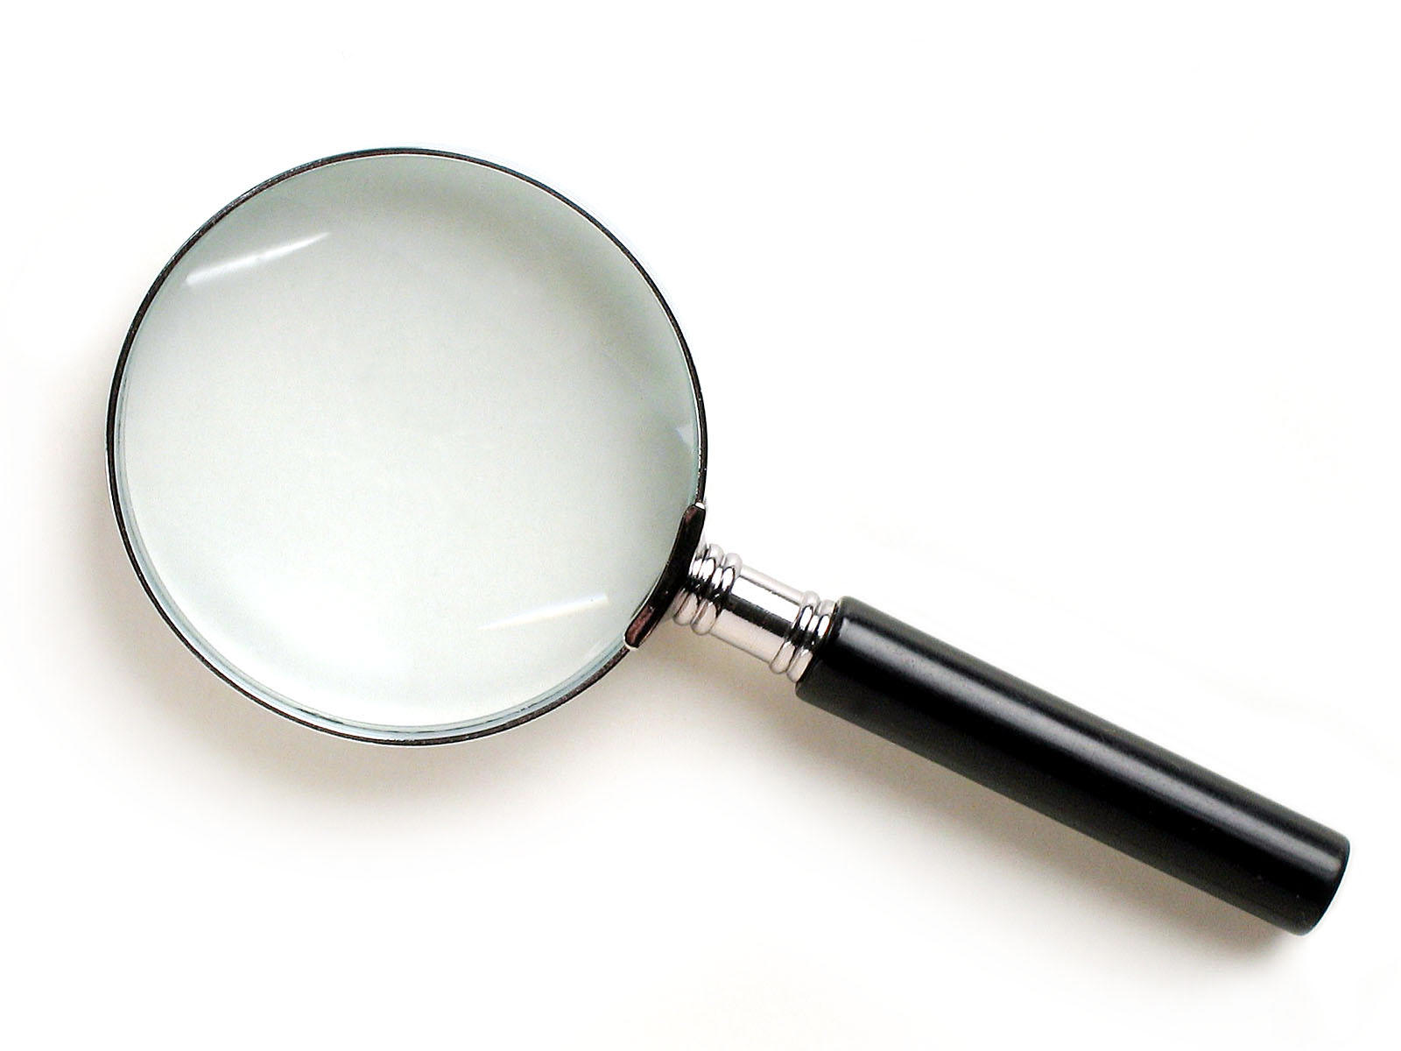
SKIMMING

Slide 22
The climate of the Earth is always changing. In the past it has altered as a result of natural causes. Nowadays, however, the term climate change is generally used when referring to changes in our climate which have been identified since the early part of the 1900's . The changes we've seen over recent years and those which are predicted over the next 80 years are thought to be mainly as a result of human behaviour rather than due to natural changes in the atmosphere.

Slide 24
The best treatment for mouth ulcers. Gargle with salt water. You should find that it works a treat. Salt is cheap and easy to get hold of and we all have it at home, so no need to splash out and spend lots of money on expensive mouth ulcer creams.

Slide 26
The best treatment for mouth ulcers. Gargle with salt water. You should find that it works a treat. Salt is cheap and easy to get hold of and we all have it at home, so no need to splash out and spend lots of money on expensive mouth ulcer creams.

Slide 28
Urquhart castle is probably one of the most picturesquely situated castles in the Scottish Highlands. Located 16 miles south-west of Inverness, the castle, one of the largest in Scotland, overlooks much of Loch Ness. Visitors come to stroll through the ruins of the 13th-century castle because Urquhart has earned the reputation of being one of the best spots for sighting Loch Ness’s most famous inhabitant.

Slide 29
Urquhart castle is probably one of the most picturesquely situated castles in the Scottish Highlands. Located 16 miles south-west of Inverness, the castle, one of the largest in Scotland, overlooks much of Loch Ness. Visitors come to stroll through the ruins of the 13th-century castle because Urquhart has earned the reputation of being one of the best spots for sighting Loch Ness’s most famous inhabitant.

Slide 30
Urquhart castle is probably one of the most picturesquely situated castles in the Scottish Highlands. Located 16 miles south-west of Inverness, the castle, one of the largest in Scotland, overlooks much of Loch Ness. Visitors come to stroll through the ruins of the 13th-century castle because Urquhart has earned the reputation of being one of the best spots for sighting Loch Ness’s most famous inhabitant.

Slide 31
Urquhart castle is probably one of the most picturesquely situated castles in the Scottish Highlands. Located 16 miles south-west of Inverness, the castle, one of the largest in Scotland, overlooks much of Loch Ness. Visitors come to stroll through the ruins of the 13th-century castle because Urquhart has earned the reputation of being one of the best spots for sighting Loch Ness’s most famous inhabitant.

Slide 32
Urquhart castle is probably one of the most picturesquely situated castles in the Scottish Highlands. Located 16 miles south-west of Inverness, the castle, one of the largest in Scotland, overlooks much of Loch Ness. Visitors come to stroll through the ruins of the 13th-century castle because Urquhart has earned the reputation of being one of the best spots for sighting Loch Ness’s most famous inhabitant.

Slide 33
SCANNING

Slide 34
Where did the first cell phones begin?
Name 2 other features that started to be included in phones
Why are cell phones especially useful in some countries?

Slide 35
Where begin?
Two features?
Some countries?
Cellular telephones
The first cellular telephone system began operation in Tokyo in 1979, and the first U.S. system began operation in 1983 in Chicago. A camera phone is a cellular phone that also has picture taking capabilities. Some camera phones have the capability to send these photos to another cellular phone or computer. Advances in digital technology and microelectronics has led to the inclusion of unrelated applications in cellular telephones, such as alarm clocks, calculators, Internet browsers, and voice memos for recording short verbal reminders, while at the same time making such telephones vulnerable to certain software viruses. In many countries with inadequate wire-based telephone networks, cellular telephone systems have provided a means of more quickly establishing a national telecommunications network.

Slide 36
Where begin?
Two features?
Some countries?

Slide 37
Independent Research
(FOFO)

Slide 38
Research the life of
Martin Luther King

Slide 39
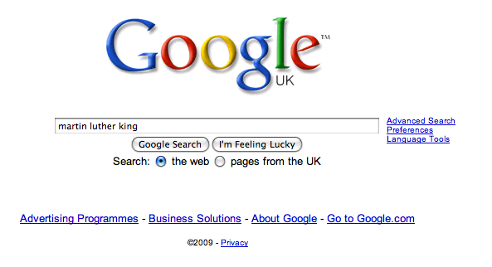

Slide 45
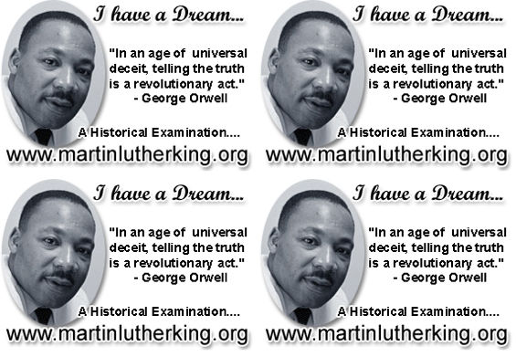

Slide 46
1
I will make you read and write and spell better

Slide 47
3 writing essentials:
Use short & long sentences
Kick-start sentences: -ed, -ing, -ly
Vary your connectives: as, although, while, despite

Slide 48
Demo

Slide 49
1
I will make you read and write and spell better

Slide 50
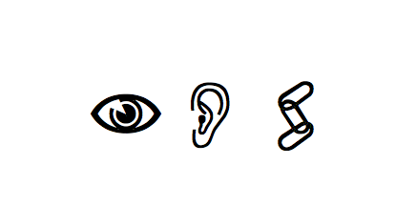

Slide 51
Be-lie-ve
Sep-a-rat-e

Slide 52
Govern+ment
February

Slide 53
Accommodation
Practice/Practise
Necessary

Slide 54
1
I will make you read and write and spell better

Slide 55
2
The secret of literacy …
is making the implicit explicit

Slide 56
Which bits of grammar matter?
Geoff Barton
June 26, 2012
Download this presentation free at www.geoffbarton.co.uk/teacher-resources (number 103)

