Slide 1
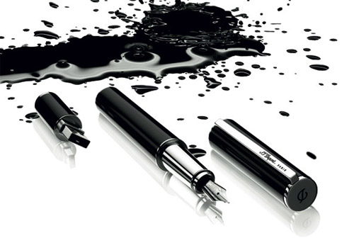
Don’t Call it Literacy
Geoff Barton
Head, King Edward VI School, Suffolk
Friday, 22 June 12
Download this presentation free at www.geoffbarton.co.uk/teacher-resources (number 102)

Slide 2
Hello.

Slide 3
2

Slide 4
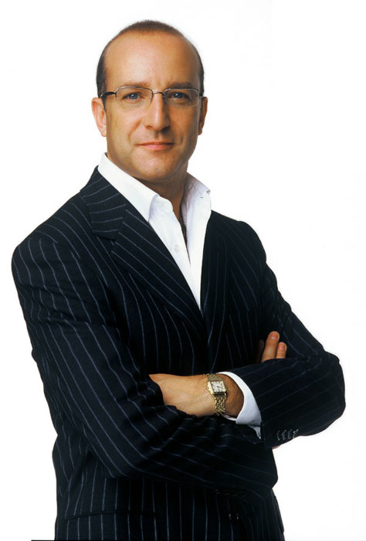
1
I will make you read and write and spell better

Slide 5
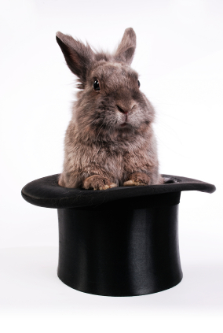
2
The Secret of Literacy

Slide 6
The Literacy Club

Slide 7
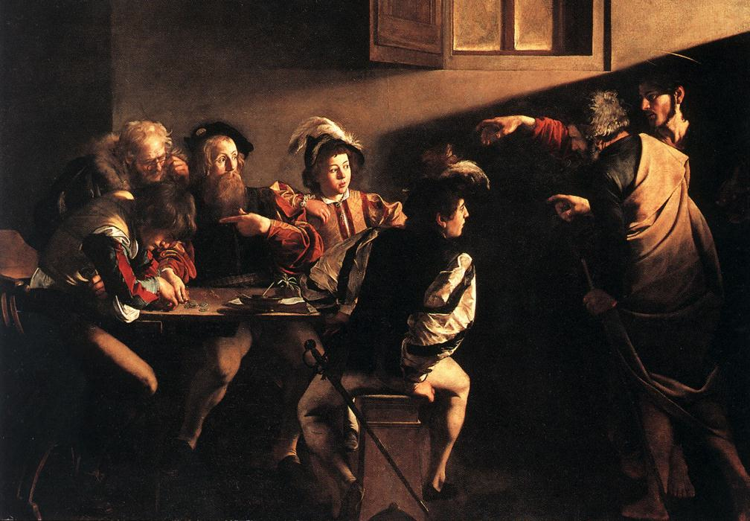

Slide 8
Implications

Slide 9
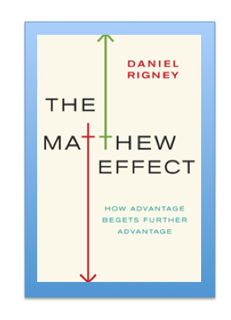
‘The Matthew Effect’: Robert K. Merton
Monopoly by Leonard Beeghly

Slide 10
“The word-rich get richer while the word-poor get poorer”
(CASL)
Canadian Association of School Librarians

Slide 11
“While good readers gain new skills very rapidly, and quickly move from learning to read to reading to learn, poor readers become increasingly frustrated with the act of reading, and try to avoid reading where possible”
The Matthew Effect
Daniel Rigney

Slide 12
“Students who begin with high verbal aptitudes find themselves in verbally enriched social environments and have a double advantage.”
The Matthew Effect
Daniel Rigney

Slide 13
“Good readers may choose friends who also read avidly while poor readers seek friends with whom they share other enjoyments”
The Matthew Effect
Daniel Rigney

Slide 14
“Spoken language forms a constraint, a ceiling not only on the ability to comprehend but also on the ability to write, beyond which literacy cannot progress”
Myhill and Fisher

Slide 15
One in six people in the UK struggle with literacy. This means their literacy is below the level expected of an eleven year old.
National Literacy Trust
Literacy: State of the Nation – A Picture of Literacy in the UK Today
2010

Slide 16
One in five parents easily find the opportunity to read to their children, with the rest struggling to read to their children due to fatigue and busy lifestyles.
National Literacy Trust
Literacy: State of the Nation – A Picture of Literacy in the UK Today
2010

Slide 17
1-in-16 adults cannot identify a concert venue on a poster that contains name of band, price, date, time and venue
National Literacy Trust

Slide 18
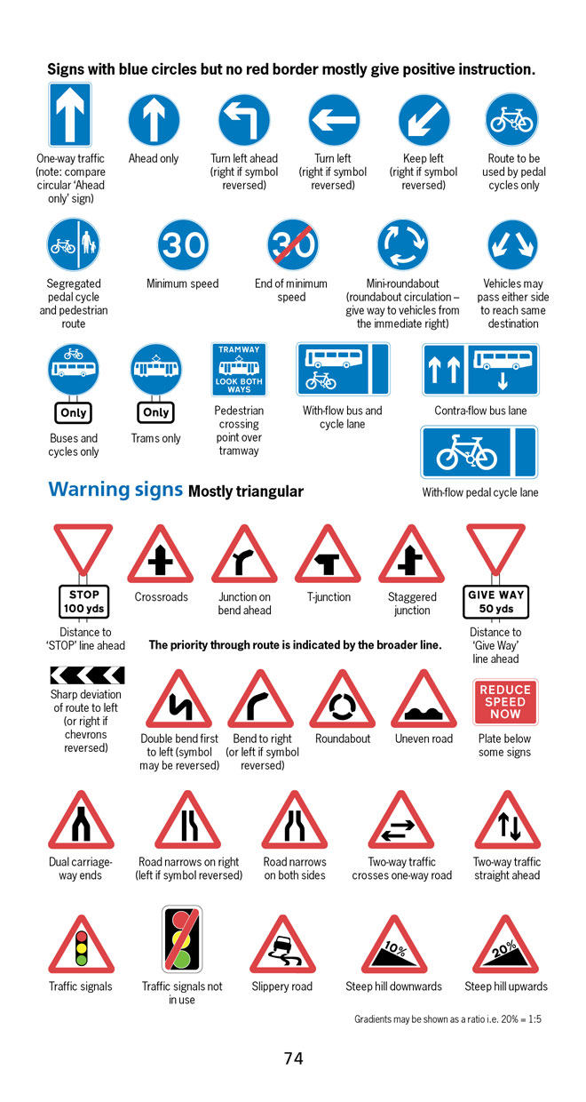
BBC NEWS ONLINE:
More than half of British motorists cannot interpret road signs properly, according to a survey by the Royal Automobile Club.
The survey of 500 motorists highlighted just how many people are still grappling with it.

Slide 19
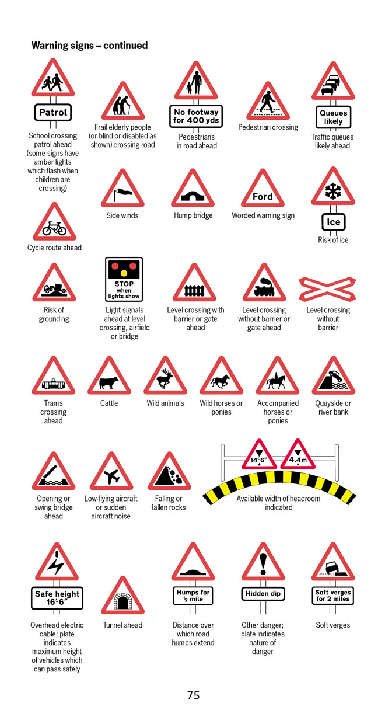
According to the survey, three in five motorists thought a "be aware of cattle" warning sign indicated …
an area infected with foot-and-mouth disease.

Slide 20
The Secret of Literacy

Slide 21
Stand by

Slide 22
Here goes

Slide 23
Brace yourself

Slide 24
Ready?

Slide 25
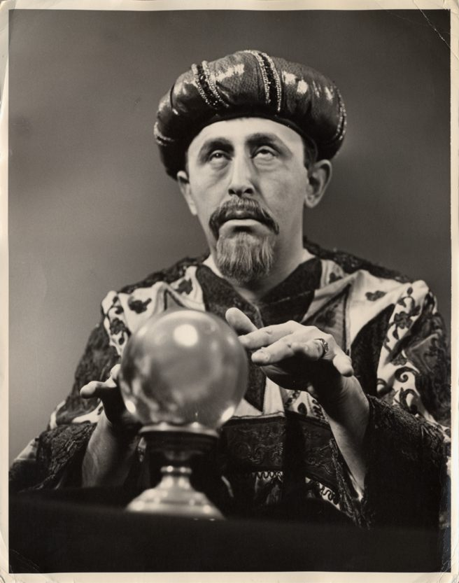
Making the implicit explicit

Slide 26
1
I will make you read and write and spell better

Slide 27
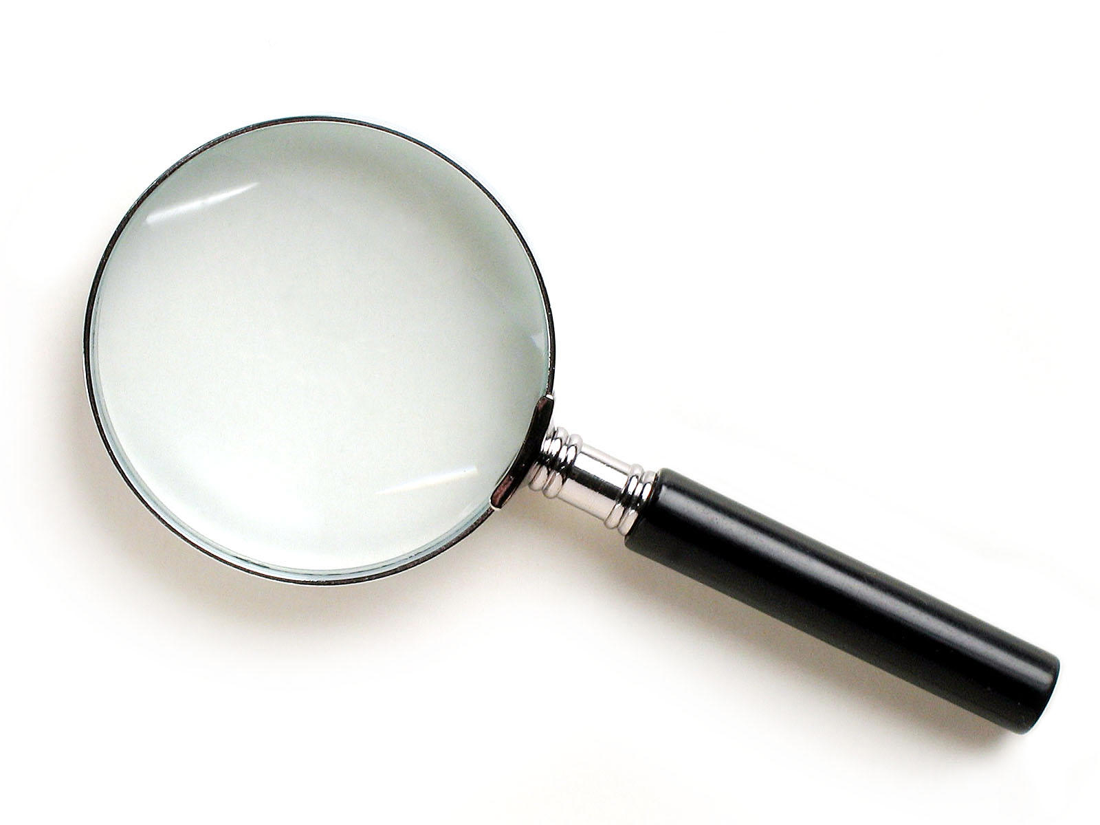
SKIMMING

Slide 28
The climate of the Earth is always changing. In the past it has altered as a result of natural causes. Nowadays, however, the term climate change is generally used when referring to changes in our climate which have been identified since the early part of the 1900's . The changes we've seen over recent years and those which are predicted over the next 80 years are thought to be mainly as a result of human behaviour rather than due to natural changes in the atmosphere.

Slide 30
The best treatment for mouth ulcers. Gargle with salt water. You should find that it works a treat. Salt is cheap and easy to get hold of and we all have it at home, so no need to splash out and spend lots of money on expensive mouth ulcer creams.

Slide 32
The best treatment for mouth ulcers. Gargle with salt water. You should find that it works a treat. Salt is cheap and easy to get hold of and we all have it at home, so no need to splash out and spend lots of money on expensive mouth ulcer creams.

Slide 34
Urquhart castle is probably one of the most picturesquely situated castles in the Scottish Highlands. Located 16 miles south-west of Inverness, the castle, one of the largest in Scotland, overlooks much of Loch Ness. Visitors come to stroll through the ruins of the 13th-century castle because Urquhart has earned the reputation of being one of the best spots for sighting Loch Ness’s most famous inhabitant.

Slide 35
Urquhart castle is probably one of the most picturesquely situated castles in the Scottish Highlands. Located 16 miles south-west of Inverness, the castle, one of the largest in Scotland, overlooks much of Loch Ness. Visitors come to stroll through the ruins of the 13th-century castle because Urquhart has earned the reputation of being one of the best spots for sighting Loch Ness’s most famous inhabitant.

Slide 36
Urquhart castle is probably one of the most picturesquely situated castles in the Scottish Highlands. Located 16 miles south-west of Inverness, the castle, one of the largest in Scotland, overlooks much of Loch Ness. Visitors come to stroll through the ruins of the 13th-century castle because Urquhart has earned the reputation of being one of the best spots for sighting Loch Ness’s most famous inhabitant.

Slide 37
Urquhart castle is probably one of the most picturesquely situated castles in the Scottish Highlands. Located 16 miles south-west of Inverness, the castle, one of the largest in Scotland, overlooks much of Loch Ness. Visitors come to stroll through the ruins of the 13th-century castle because Urquhart has earned the reputation of being one of the best spots for sighting Loch Ness’s most famous inhabitant.

Slide 38
Urquhart castle is probably one of the most picturesquely situated castles in the Scottish Highlands. Located 16 miles south-west of Inverness, the castle, one of the largest in Scotland, overlooks much of Loch Ness. Visitors come to stroll through the ruins of the 13th-century castle because Urquhart has earned the reputation of being one of the best spots for sighting Loch Ness’s most famous inhabitant.

Slide 39
SCANNING

Slide 40
Where did the first cell phones begin?
Name 2 other features that started to be included in phones
Why are cell phones especially useful in some countries?

Slide 41
Where begin?
Two features?
Some countries?
Cellular telephones
The first cellular telephone system began operation in Tokyo in 1979, and the first U.S. system began operation in 1983 in Chicago. A camera phone is a cellular phone that also has picture taking capabilities. Some camera phones have the capability to send these photos to another cellular phone or computer. Advances in digital technology and microelectronics has led to the inclusion of unrelated applications in cellular telephones, such as alarm clocks, calculators, Internet browsers, and voice memos for recording short verbal reminders, while at the same time making such telephones vulnerable to certain software viruses. In many countries with inadequate wire-based telephone networks, cellular telephone systems have provided a means of more quickly establishing a national telecommunications network.

Slide 42
Where begin?
Two features?
Some countries?

Slide 43
Independent Research
(FOFO)

Slide 44
Research the life of
Martin Luther King

Slide 45
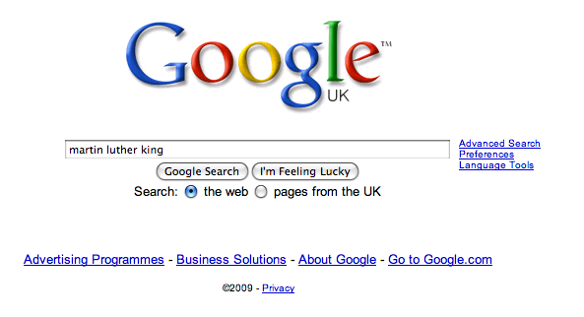

Slide 52
1
I will make you read and write and spell better

Slide 53
3 Steps to writing better

Slide 54
Describe this room

Slide 55
3 writing essentials:
Use short & long sentences
Kick-start sentences: -ed, -ing, -ly
Vary your connectives: as, although, while, despite

Slide 56
Demo

Slide 57
Describe your journey here

Slide 58
1
I will make you read and write and spell better

Slide 59
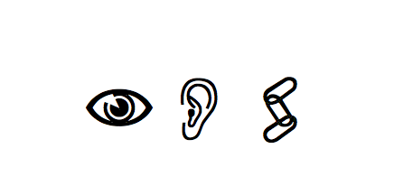

Slide 60
Be-lie-ve
Sep-a-rat-e

Slide 61
Govern+ment
February

Slide 62
Accommodation
Practice/Practise
Necessary

Slide 63
1
I will make you read and write and spell better

Slide 64
2
The secret of literacy …
is that it’s not really literacy

Slide 65
Don’t Call it Literacy
Geoff Barton
Head, King Edward VI School, Suffolk
Friday, 22 June 12
Download this presentation free at www.geoffbarton.co.uk/teacher-resources (number 102)
@RealGeoffBarton

