Slide 1
How do you persuade people to agree with you about a subject you’re not necessarily interested in – in writing, in an unfamiliar format, in exam conditions, and in just 30 minutes?

Slide 2
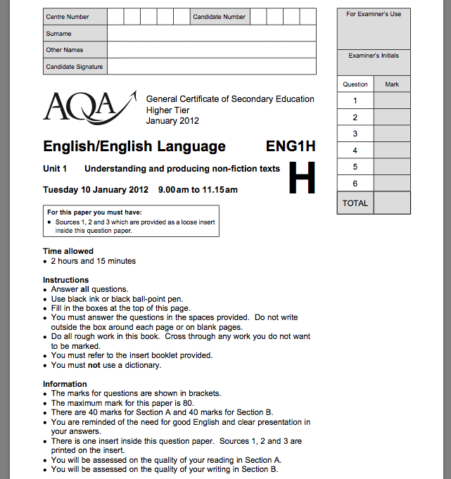

Slide 4
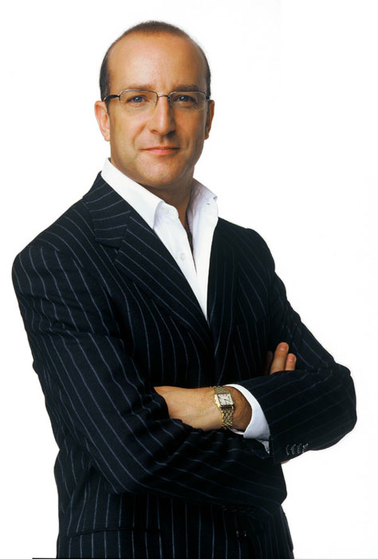
I will make you a better writer in 30 minutes

Slide 5
What you can and can’t do
Practise
Do it better

Slide 6
4 minutes

Slide 8
Review and compare in a pair:
WHAT? HOW?
How did you approach the task? How did you get started? What were the main barriers?
What did you write? Where did you get your ideas? Are you pleased with it?

Slide 9
MAIN HURDLES
A Thinking of the right word
B Knowing how to get started
C Making it interesting
D Knowing how to link my ideas together
E Trying to make it funny or entertaining
Put these ‘barriers’ in rank order

Slide 10
MAIN HURDLES
A Thinking of the right word
B Knowing how to get started
C Making it interesting
D Knowing how to link my ideas together
E Trying to make it funny or entertaining

Slide 11
MAIN HURDLES
In a three, 30 seconds to brainstorm
Then 60 seconds to note:
3 specific techniques the writer uses to grab interest
Which of these works best

Slide 12
Are social media sites like Twitter a good thing? Write an article …
Grace Dent, Independent, WEDNESDAY 16 MAY 2012

Slide 13
I've made a decision. From now on, if I need help, I'm heading straight to Twitter. I've tweeted pleas before. I once posted that I needed a job and the same afternoon got commissioned to write an article. But a few weeks ago, I discovered the true benefits of the virtual world. It was election day and on my way back from a lunchtime trip to the launderette I discovered a huge BNP banner had been tied to the lamp post outside my flat. My immediate reaction was to pull it down. The trouble was, I'm short and it was higher than my tallest chair could reach. So I sent out a tweet. Could anyone help me tear down this monstrosity?
Momtaz Begum-Hossain, Guardian, WEDNESDAY 16 MAY 2012

Slide 14
Are TV reality shows a good thing?
Polly Hudson, The Mirror, 18 May 2012

Slide 15
THERE was only one real winner of Britain’s Got Talent and he didn’t slobber over any of the female judges. No, it wasn’t Pudsey the dog or Simon Cowell for me – it was incredible teenage opera singer Jonathan Antoine. A year ago he was a virtual recluse, having given up his A-levels after being bullied at school about his weight. Even on the show he remained painfully shy, glancing at his singing companion Charlotte Jaconelli for encouragement. His mum has told how for years he simply wanted to melt into the background and would hide behind a baggy jumper. Now he goes out wearing a Superman T-shirt. Jonathan has played the ace card in dealing with bullies. He has beaten them with brilliance.

Slide 16
Some people believe far-flung holiday destinations are a waste of money and damage the planet. Write an article …
Jeremy Clarkson, Sunday Times

Slide 17
For your next holiday, why don’t you take all your money and put it on the fire? Then stand in a fridge for a week, beating your children with a baseball bat until their arms and legs break. And then, after you’ve eaten some melted cheese, dislocate your shoulder. If all of this appeals then you are probably one of the 1.3 million British people …
… who go on a skiing holiday at this time of year.

Slide 18
Summary:
How to make writing more interesting

Slide 19
3 minutes

Slide 20
Some people say school uniform is an outdated concept, a waste of time and money. Write a newspaper article saying why school uniform is a good idea.

Slide 21
I will make you a better writer in 30 minutes:
‘Interestingness’

Slide 22
Homework:
Read something
Write something

