Slide 1
Don’t Call it iteracy
Ofsted’s Communication Focus
4 November 2015
Twitter: @RealGeoffBarton
Download this presentation at www.geoffbarton.co.uk
(Presentation number 110)
Notes:
Afternoon implementations stuff isn’t crisp enough – it needs some dilemmas

Slide 2
Expectations …
2
1

Slide 3
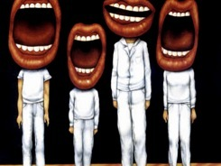
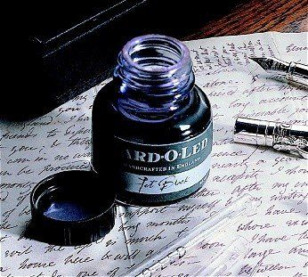

Slide 4
Aims:
I will make you better at READING & WRITING
& SPELLING

Slide 5
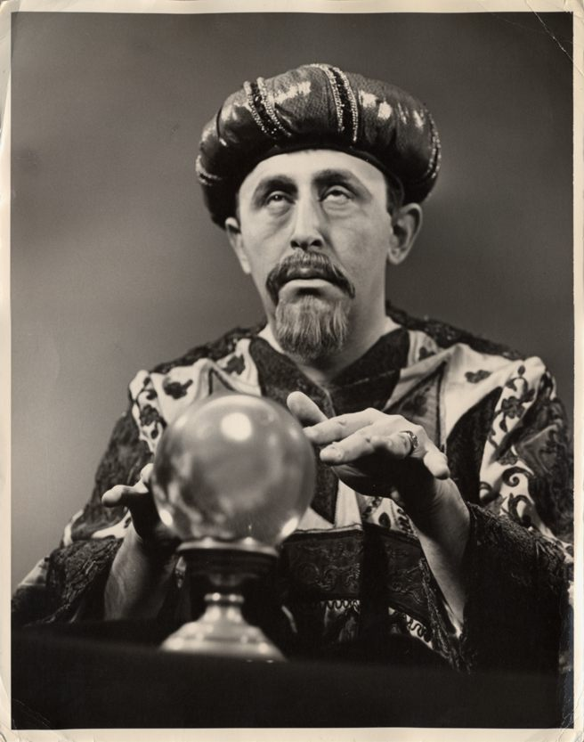
Today’s bonus:
Today I will reveal the secret of literacy

Slide 6
Structure:
Session 1: Why literacy matters / the Ofsted view
Session 2: Essentials for impact:
- Speaking & Listening
- Reading
- Writing / Marking
Session 3: Literacy in action:
Lesson observation & implications

Slide 7
Approach:

Slide 8
THE HABITS OF LITERACY

Slide 9
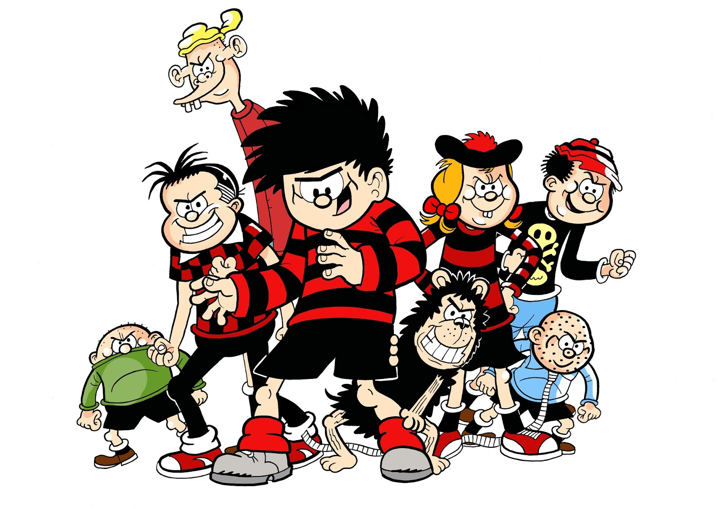

Slide 10
Ice-Breaker A:
Think of the most successful student you teach.
What is distinctive about what she can do?
skills – attitude - qualities

Slide 11
Ice-Breaker B:
What would we need to do to give every student* the chance to develop the same skills, attitude and qualities?
*Irrespective of background

Slide 12
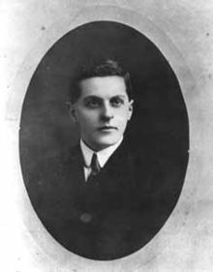
“The limits of my language mean the limits of my world”
Ludwig Wittgenstein

Slide 13
THE HABITS OF LITERACY

Slide 14
‘More than 40% of the actions people perform each day aren’t decisions but habits …’

Slide 15
‘Habits, scientists say, emerge because the brain is constantly looking for ways to save effort’

Slide 16
‘That’s why signing kids up for piano lessons or sports is so important. It has nothing to do with creating a good musician or a five year-old soccer star’

Slide 17
Hypothesis:
Become a Year 11 writer again
… for five minutes

Slide 18
Hypothesis:
Task:
Describe the room we are in

Slide 19
Q1 (of 2):
How did you approach the task?

Slide 20
Q2:
As teacher, what language knowledge could I have taught you to help you write better?

Slide 21
Q:
?
Unconfident
Confident
Irrespective of background

Slide 22
A:
Teach them

Slide 23
Provocations:
We haven’t done literacy
It’s all about the classroom
Knowledge and instruction may be more important than we realised
Remember the “Matthew Effect”

Slide 24
The Matthew Effect
(Robert K Merton)

Slide 25
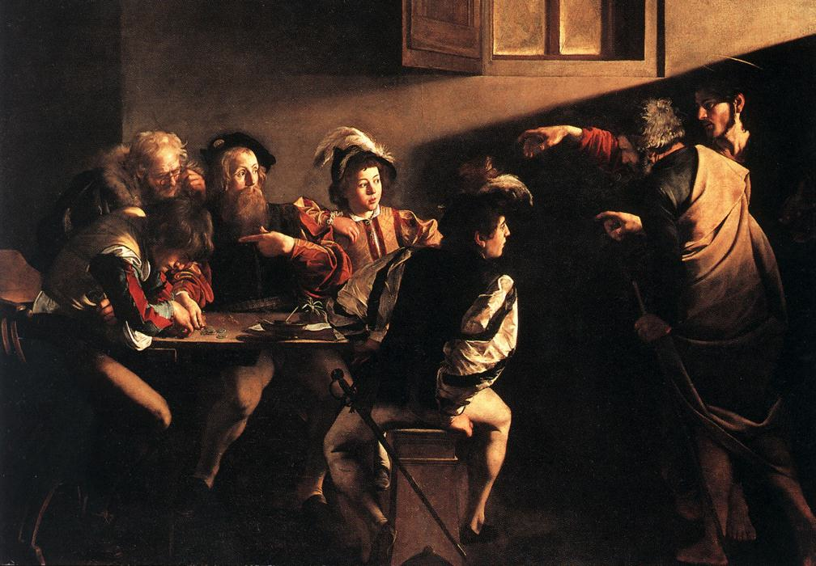

Slide 26
The rich shall get richer and the poor shall get poorer
Matthew 13:12

Slide 27
“The word-rich get richer while the word-poor get poorer” in their reading skills
(CASL)

Slide 28
“While good readers gain new skills very rapidly, and quickly move from learning to read to reading to learn, poor readers become increasingly frustrated with the act of reading, and try to avoid reading where possible”
The Matthew Effect
Daniel Rigney

Slide 29
“Students who begin with high verbal aptitudes find themselves in verbally enriched social environments and have a double advantage.”
The Matthew Effect
Daniel Rigney

Slide 30
“Good readers may choose friends who also read avidly while poor readers seek friends with whom they share other enjoyments”
The Matthew Effect
Daniel Rigney

Slide 31
‘Too often the argument for reading is made by those who have spent their lives as insiders; the pleasures of solitary reading are so obvious, the value of reading so self-evident, that we fail to appreciate how utterly strange reading is to the outsider’
Thomas Newkirk
‘Masculinity in Boys’

Slide 32
Stricht’s Law: “reading ability in children cannot exceed their listening ability …”
E.D. Hirsch
The Schools We Need

Slide 33
“Spoken language forms a constraint, a ceiling not only on the ability to comprehend but also on the ability to write, beyond which literacy cannot progress”
Myhill and Fisher

Slide 34
“The children who possess intellectual capital when they first arrive at school have the mental scaffolding and Velcro to catch hold of what is going on, and they can turn the new knowledge into still more Velcro to gain still more knowledge”.
E.D. Hirsch
The Schools We Need

Slide 35
Aged 7:
Children in the top quartile have 7100 words; children in the lowest have around 3000.
The main influence is parents.
DfE Research Unit

Slide 36
The Matthew Effect:
The rich will get richer &
the poor will get poorer

Slide 37
The Literacy Club

Slide 38
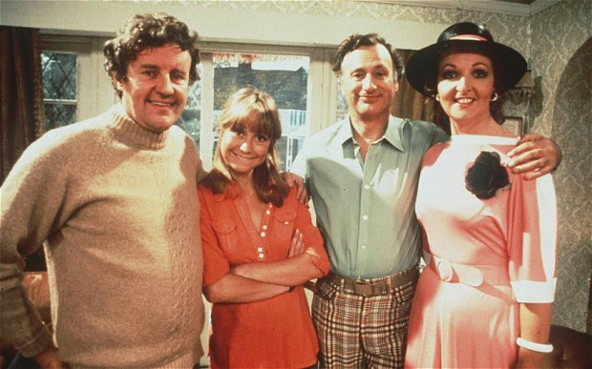

Slide 39
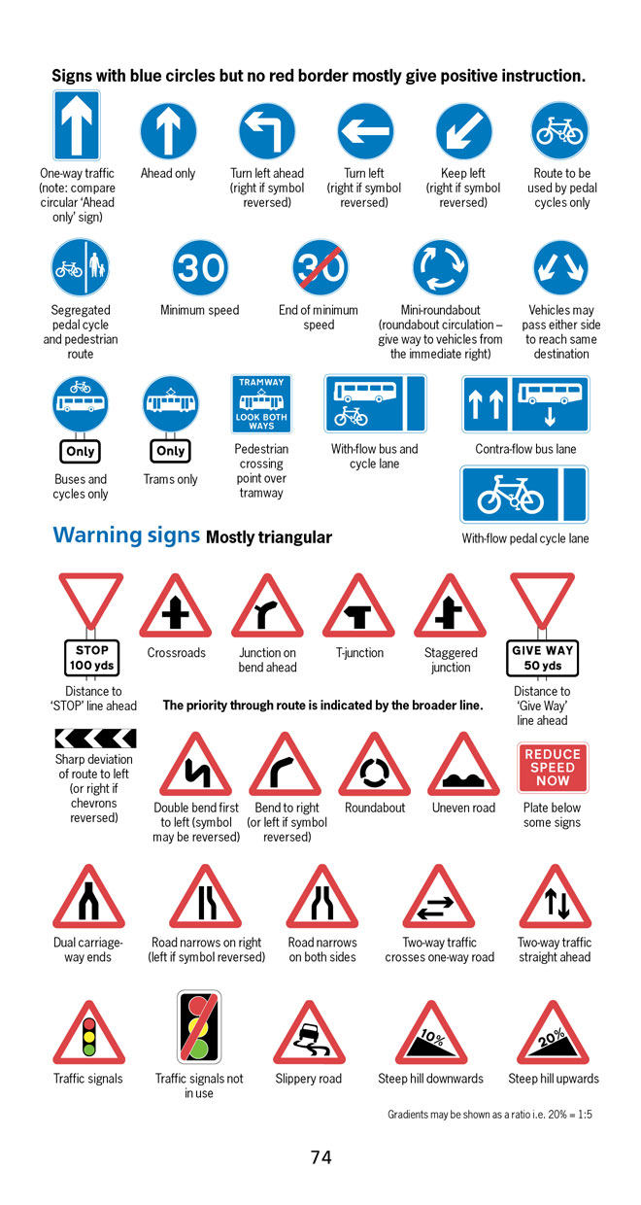
BBC NEWS ONLINE:
More than half of British motorists cannot interpret road signs properly, according to a survey by the Royal Automobile Club.
The survey of 500 motorists highlighted just how many people are still grappling with it.

Slide 40
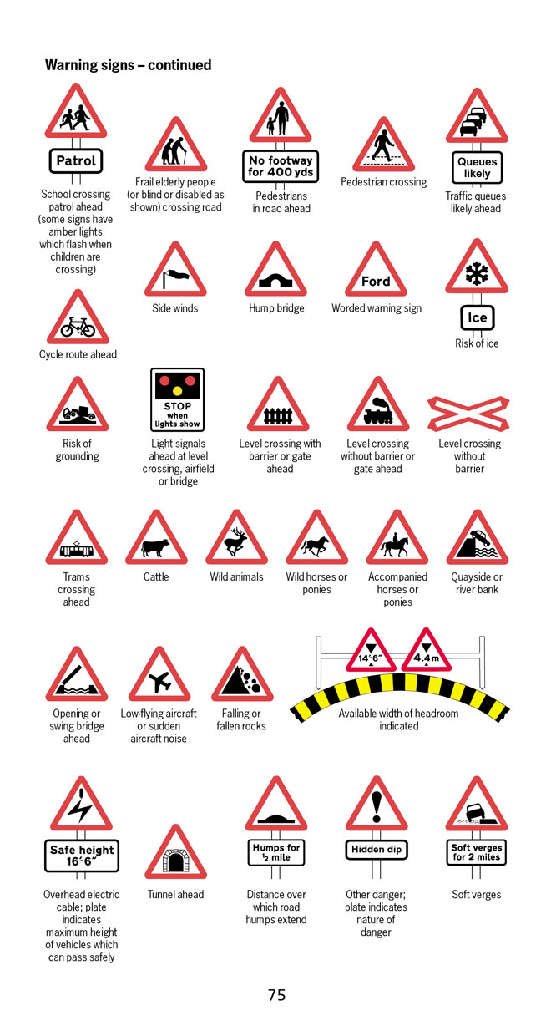
According to the survey, three in five motorists thought a "be aware of cattle" warning sign indicated …
an area infected with foot-and-mouth disease.

Slide 41
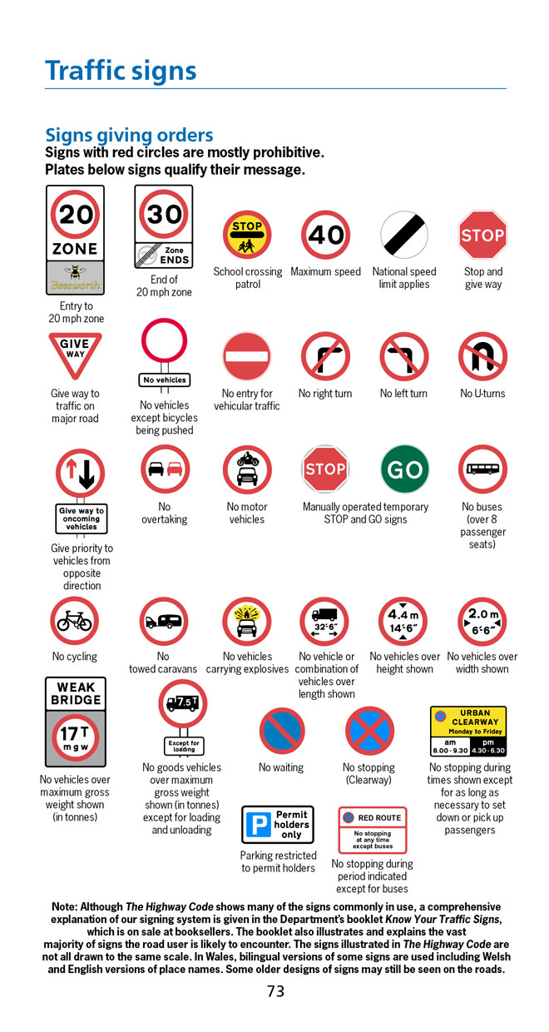
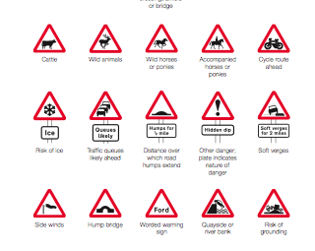
Common mistakes:
No motor vehicles: Beware of fast motorbikes
Wild horses:
‘Marlborough country’ advert

Slide 42
Dogs must be carried on the escalator

Slide 43
The
view
of literacy

Slide 45
✗ May be mechanistic and superficial
✔ Yet may be very helpful

Slide 46
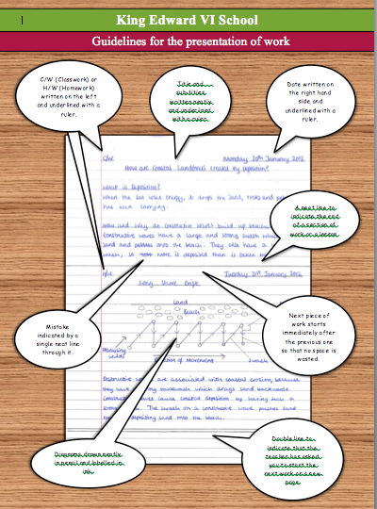

Slide 48
Are key terms and vocabulary clear and explored with pupils to ensure that they recognise and understand them? Are they related to similar words or the root from which they are derived?
Do teachers identify any particular features of key terms and help pupils with strategies for remembering how to spell them or why they might be capitalised (e.g. ‘Parliament’ in history or citizenship)?
Do teachers remind pupils of important core skills – for example how to skim a text to extract the main elements of its content quickly or to scan a text for information about a key word or topic?

Slide 49
Do teachers make expectations clear before pupils begin a task – for example on the conventions of layout in a formal letter or on the main features of writing persuasively?
Do teachers reinforce the importance of accuracy in spoken or written language – for example, emphasising the need for correct sentence punctuation in one-sentence answers or correcting ‘we was...’ in pupils’ speech?
Do teachers identify when it is important to use standard English and when other registers or dialects may be used – for example, in a formal examination answer and when recreating dialogue as part of narrative writing?

Slide 50
Do teachers help pupils with key elements of literacy as they support them in lessons? Do they point out spelling, grammar or punctuation issues as they look at work around the class?
Does teachers’ marking support key literacy points? For example, are key subject terms always checked for correct spelling? Is sentence punctuation always corrected?

Slide 51
Talking Point
Why literacy matters – ‘The Matthew Effect’ – the Literacy Club – the Ofsted view
What’s new? What’s familiar?
Implications for you and your subject?

Slide 52
5 key ingredients
Then teach you something
Then reflection

Slide 53
Understand the significance of exploratory talk
Model good talk – eg connectives
Re-think questioning – ‘why & how’, thinking time, and no-hands-up
Consciously vary groupings
Get conversation into the school culture

Slide 54
DEMO

Slide 55
Focus: speaking in public

Slide 56
Barriers:
Lack of confidence
Lack of structure
Lack of depersonalised tone

Slide 57
Task: why school uniform crushes our individuality

Slide 58
Stance, notes, pen
Number points
Be repetitive
Sentence functions
Confidence
Structure
Depersonalised tone
Avoid I / me
Use so / because / however / therefore

Slide 59
Talking Point
Understand the significance of exploratory talk
Model good talk – eg connectives
Re-think questioning – ‘why & how’, thinking time, and no-hands-up
Consciously vary groupings
Get conversation into the school culture
What are the main types of talk needed in your subject?
Barriers?
So what could you do?

Slide 60
Teach reading – scanning, skimming, analysis
Read aloud and display
Teach key vocabulary
Demystify spelling
Teach research, not FOFO

Slide 61
DEMO

Slide 62
SKIMMING

Slide 63
The climate of the Earth is always changing. In the past it has altered as a result of natural causes. Nowadays, however, the term climate change is generally used when referring to changes in our climate which have been identified since the early part of the 1900's . The changes we've seen over recent years and those which are predicted over the next 80 years are thought to be mainly as a result of human behaviour rather than due to natural changes in the atmosphere.

Slide 64
The best treatment for mouth ulcers. Gargle with salt water. You should find that it works a treat. Salt is cheap and easy to get hold of and we all have it at home, so no need to splash out and spend lots of money on expensive mouth ulcer creams.

Slide 65
Lexical v Grammatical Words

Slide 66
Urquhart castle is probably one of the most picturesquely situated castles in the Scottish Highlands. Located 16 miles south-west of Inverness, the castle, one of the largest in Scotland, overlooks much of Loch Ness. Visitors come to stroll through the ruins of the 13th-century castle because Urquhart has earned the reputation of being one of the best spots for sighting Loch Ness’s most famous inhabitant.

Slide 67
Urquhart castle is probably one of the most picturesquely situated castles in the Scottish Highlands. Located 16 miles south-west of Inverness, the castle, one of the largest in Scotland, overlooks much of Loch Ness. Visitors come to stroll through the ruins of the 13th-century castle because Urquhart has earned the reputation of being one of the best spots for sighting Loch Ness’s most famous inhabitant.

Slide 68
Urquhart castle is probably one of the most picturesquely situated castles in the Scottish Highlands. Located 16 miles south-west of Inverness, the castle, one of the largest in Scotland, overlooks much of Loch Ness. Visitors come to stroll through the ruins of the 13th-century castle because Urquhart has earned the reputation of being one of the best spots for sighting Loch Ness’s most famous inhabitant.

Slide 69
Urquhart castle is probably one of the most picturesquely situated castles in the Scottish Highlands. Located 16 miles south-west of Inverness, the castle, one of the largest in Scotland, overlooks much of Loch Ness. Visitors come to stroll through the ruins of the 13th-century castle because Urquhart has earned the reputation of being one of the best spots for sighting Loch Ness’s most famous inhabitant.

Slide 70
Urquhart castle is probably one of the most picturesquely situated castles in the Scottish Highlands. Located 16 miles south-west of Inverness, the castle, one of the largest in Scotland, overlooks much of Loch Ness. Visitors come to stroll through the ruins of the 13th-century castle because Urquhart has earned the reputation of being one of the best spots for sighting Loch Ness’s most famous inhabitant.

Slide 71
SCANNING

Slide 72
Where did the first cell phones begin?
Name 2 other features that started to be included in phones
Why are cell phones especially useful in some countries?

Slide 73
Where begin?
Two features?
Some countries?
Cellular telephones
The first cellular telephone system began operation in Tokyo in 1979, and the first U.S. system began operation in 1983 in Chicago. A camera phone is a cellular phone that also has picture taking capabilities. Some camera phones have the capability to send these photos to another cellular phone or computer. Advances in digital technology and microelectronics has led to the inclusion of unrelated applications in cellular telephones, such as alarm clocks, calculators, Internet browsers, and voice memos for recording short verbal reminders, while at the same time making such telephones vulnerable to certain software viruses. In many countries with inadequate wire-based telephone networks, cellular telephone systems have provided a means of more quickly establishing a national telecommunications network.

Slide 74
CLOSE READING

Slide 75
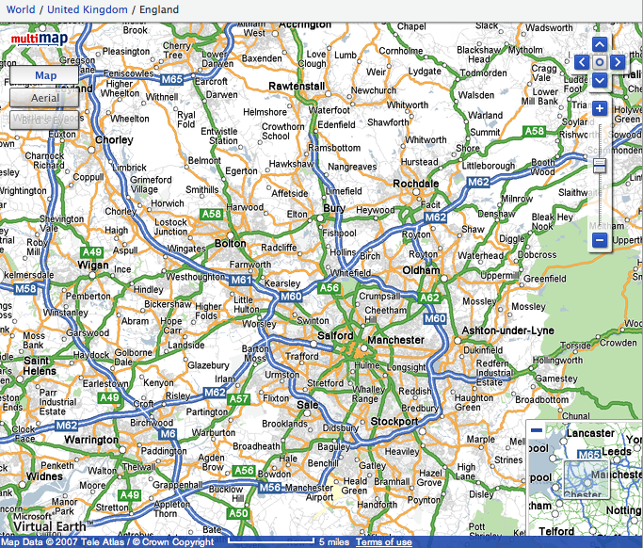

Slide 76
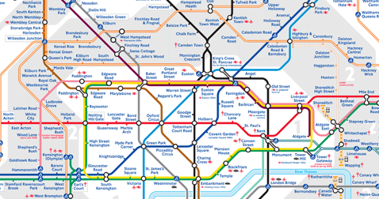
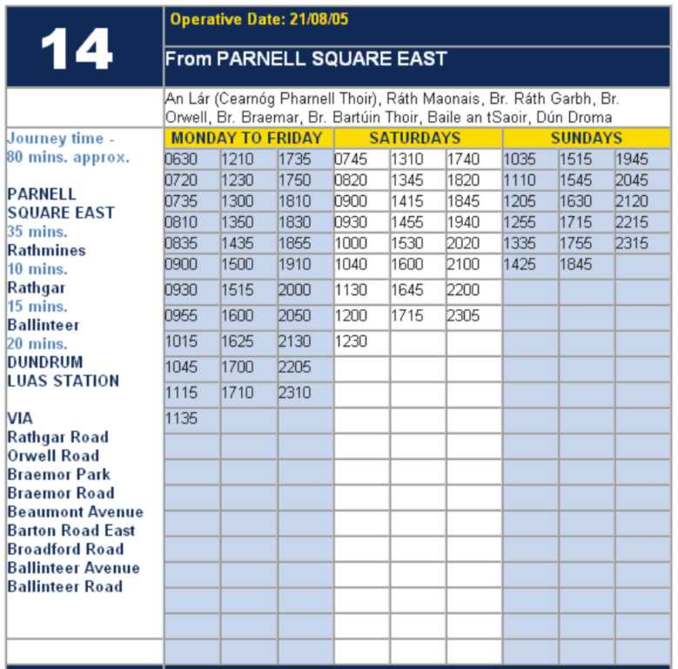

Slide 77
RESEARCH SKILLS

Slide 78
Research the life of
Martin Luther King

Slide 79
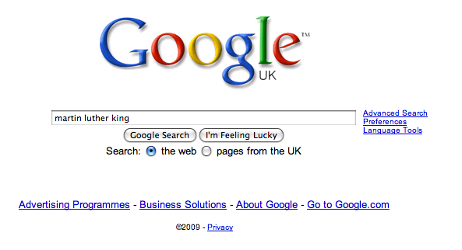

Slide 87
DEMYSTIFYING
SPELLING
3
Notes:
7 spellings: Government – February – parliament – separate – believe – necessary - accommodation

Slide 88
1 - SOUNDS

Slide 89
Government

Slide 90
February

Slide 91
Parliament

Slide 92
2 -VISUALS

Slide 93
Se-para-te
Be-lie-ve

Slide 94
3 - MNEMONICS

Slide 95
necessary

Slide 96
accommodation

Slide 97
A READING CULTURE
Notes:
7 spellings: Government – February – parliament – separate – believe – necessary - accommodation

Slide 99
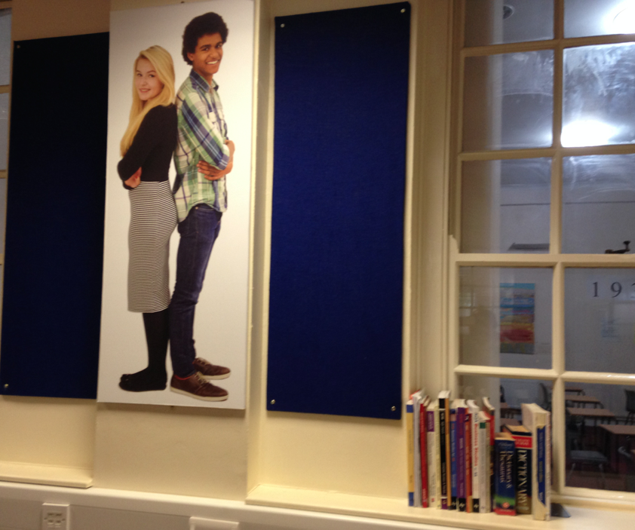

Slide 100
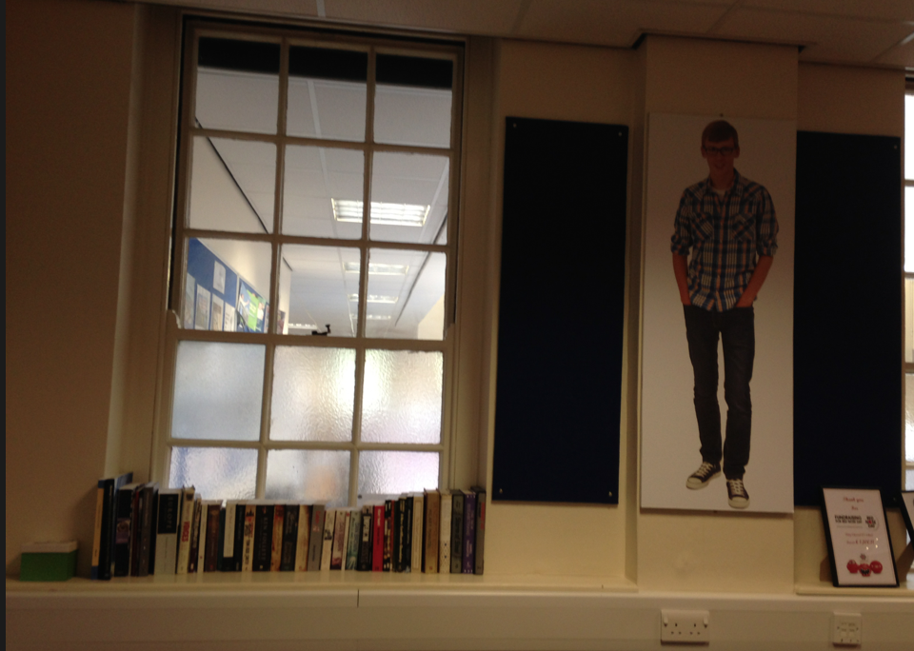

Slide 101
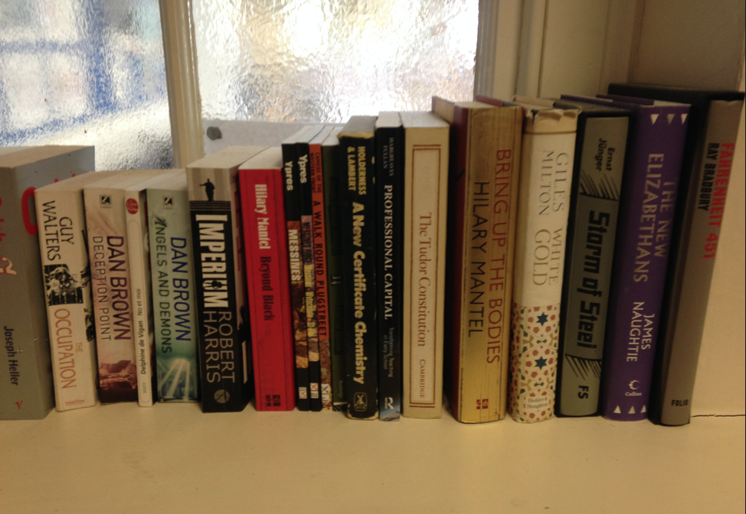

Slide 102
Talking Point
Teach reading – scanning, skimming, analysis
Read aloud and display
Teach key vocabulary
Demystify spelling
Teach research, not FOFO
What are the main types of reading needed in your subject?
Barriers?
So what could you do?

Slide 103
Demonstrate writing
Teach composition & planning
Allow oral rehearsal
Short & long sentences
Connectives

Slide 104
Know your connectives
Adding: and, also, as well as, moreover, too
Cause & effect: because, so, therefore, thus, consequently
Sequencing: next, then, first, finally, meanwhile, before, after
Qualifying: however, although, unless, except, if, as long as, apart from, yet
Emphasising: above all, in particular, especially, significantly, indeed, notably
Illustrating: for example, such as, for instance, as revealed by, in the case of
Comparing: equally, in the same way, similarly, likewise, as with, like
Contrasting: whereas, instead of, alternatively, otherwise, unlike, on the other hand

Slide 105
Demonstrate writing
Teach composition & planning
Allow oral rehearsal
Short & long sentences
Connectives

Slide 106
DEMO

Slide 107
Task: write a persuasive article on a controversial subject

Slide 108
Barriers:
Essay-like
Lack of familiarity with genre
Lack of interestingness

Slide 109
Some people believe far-flung holiday destinations are a waste of money and damage the planet. Write an article …
Jeremy Clarkson, Sunday Times

Slide 110
For your next holiday, why don’t you take all your money and put it on the fire? Then stand in a fridge for a week, beating your children with a baseball bat until their arms and legs break. And then, after you’ve eaten some melted cheese, dislocate your shoulder. If all of this appeals then you are probably one of the 1.3 million British people …
… who go on a skiing holiday at this time of year.

Slide 111
Talking Point
Demonstrate writing
Teach composition & planning
Allow oral rehearsal
Short & long sentences
Connectives
What are the main types of writing needed in your subject?
Barriers?
So what could you do?

Slide 113
Literacy in Action
Watch the lesson, making notes about:
How the teacher and environment are helping students to learn
What further steps could be taken
What feedback you would give – and how

Slide 114
Year 10 Science lesson: Tom Carey

Slide 115
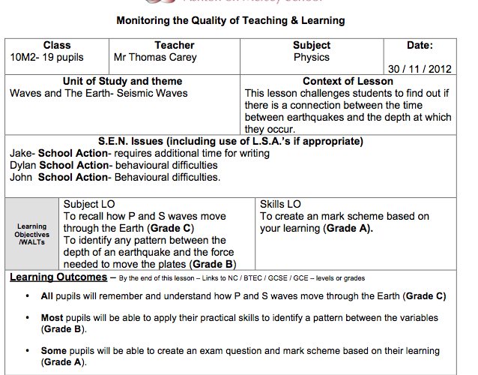
Whole-School Leadership of Teaching & Learning

Slide 116
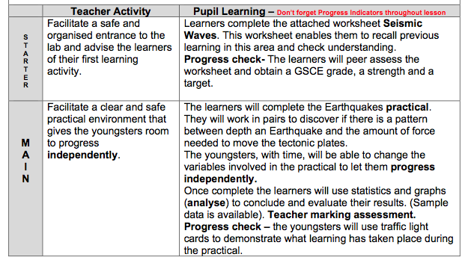
Whole-School Leadership of Teaching & Learning

Slide 117
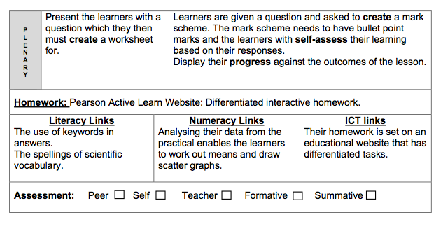
Whole-School Leadership of Teaching & Learning

Slide 118
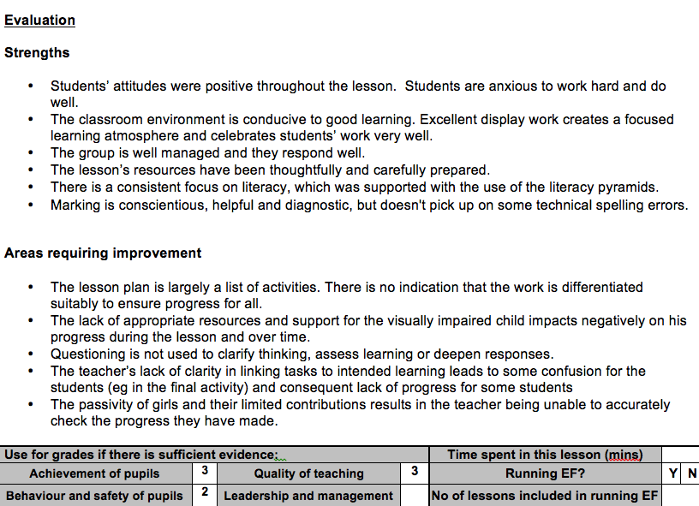

Slide 119
So what do we do now to make his teaching more effective?

Slide 120
Management issues:
If we know what we want teachers to do, how do we make sure they do it?

Slide 121
Reading: Who teaches skills? What’s encouraging reading for pleasure? Who
teaches teachers how to create effective handouts?
Writing: What good practice is in your school? How is it shared? Who teachers depersonalisation and connectives? Where is marking best?
Management: How are you making sure the right things happen more and the wrong things happen less?

Slide 122
SUMMARY:
The Secret of Literacy

Slide 123
Stand by …

Slide 124
Ready …?

Slide 125
Tension now intolerable … ?

Slide 126
Well, it’s not literacy …

Slide 127
… it’s making the implicit explicit – and modelling it …

Slide 128
… without which, the rich will get richer & the poor will get poorer

Slide 130
… so we could just call it ‘what great teachers do’

Slide 131
For family & friends:

Slide 132
Key Messages:
1
The new Ofsted framework changes everything – possibly for the better

Slide 133
Key Messages:
2
‘Every teacher in English is a teacher of English’ is now placed centre-stage – with carrot and stick to help make it happen

Slide 134
Key Messages:
3
Things need rethinking:
Performance management
Training
Use of TAs
Role of the Librarian

Slide 135
Key Messages:
Teachers need to see how good and outstanding teachers make implicit skills explicit, so …
4
develop a team of classroom coaches

Slide 136
Key Messages:
5
Every school needs an astringent culture of evaluation that leads to action

Slide 137
Key Messages:
6
Involve students more in feedback: what helps them to learn?

Slide 138
Key Messages:
7
Turn fewer blind eyes

Slide 139
Key Messages:
8
Look at more books and planners – at random – regularly and keep records

Slide 140
Key Messages:
9
Remember the Matthew Effect:
The ‘word poor’ need us more than ever

Slide 141
Key Messages:
10
Get it right, and this could be a transformation in the progress our students make

Slide 142
Don’t Call it iteracy
Ofsted’s Communication Focus
4 November 2015
Twitter: @RealGeoffBarton
Download this presentation at www.geoffbarton.co.uk
(Presentation number 110)

Slide 143
This is an expensive plug ➔

Slide 144
This is a
cheap plug ➔

Slide 145
Don’t Call it iteracy
Ofsted’s Communication Focus
4 November 2015
Twitter: @RealGeoffBarton
Download this presentation at www.geoffbarton.co.uk
(Presentation number 110)

