Slide 2
What are the main barriers to learning in Maths and how can we help pupils to overcome them?
Sarah Whyand wy@king-ed.suffolk.sch.uk

Slide 3
The fear factor
Sarah Whyand wy@king-ed.suffolk.sch.uk
Notes:
Change the perception – acceptable to say can’t do maths
10 numeracy questions for them to do.

Slide 4
Q. 16 x 25

Slide 6
Solve:
2x - 5 = 14

Slide 7
3 4 5 8
Q. What is the mean?

Slide 8
Q. a² x a³ = a?

Slide 9
Q. Increase 60 by 20%

Slide 10
Q. 0.3 x 0.2

Slide 12
Q. -2 - - 5

Slide 13
Now calculate angle b
61°
b

Slide 14
Q. 16 x 25
Ans. 400
Notes:
Did you use a written method?
Did you divide by 4 and multiply by 100?
Multiply by 5 and 5 again?.... Helping students to find the most effective method.

Slide 15
Ans. 18
Notes:
Why is it students can find 1/5 but not 2/5?

Slide 16
Solve:
2x - 5 = 14
Ans. X = 9.5
Notes:
Whole concept of even accessing the ‘algebra’ in the first instance – a massive barrier to some.

Slide 17
3 4 5 8
Q. What is the mean?
Ans. 5
(Total =20 then divide by the number of values)
Notes:
A literacy issue here… the mathematics is impossible if the students don’t understand the jargon.

Slide 18
Q. a² x a³ = a?
Ans. a⁵
Notes:
Moving into abstract thinking. The majority of students won’t ever need to use the laws of indices in the real world – only those students who take their maths further will have any real appreciation of this.

Slide 19
Q. Increase 60 by 20%
Ans. 72
Notes:
So many methods… calculator and non-calculator. Again, what is it asking in the first instance?

Slide 20
Q. 0.3 x 0.2
Ans. 0.06
Notes:
We can all answer 2x3 but why then is 0.3 x 0.2 so difficult?

Slide 21
(If you got you could still divide top and bottom by 3)
Notes:
Simple proportionality, knowing to check the work.

Slide 22
Q. -2 - - 5
Ans. 3
Notes:
When do two minuses make a plus? Getting students to appreciate the rules and break the problem down.

Slide 23
Now calculate angle b
61°
b
Ans. 151°
Notes:
So many skills and things to remember here….

Slide 24
Expectations
Notes:
Setted subject, expectations too low, they are in set 5 so they won’t get a C grade
Foundation “banded” groups
Confidence the key issue

Slide 25
Changing the structure
Notes:
Not to mess with staff having consistent groups and continuity and ownership for results
After Easter - revision carousel, each staff teaches a topic, let’s say 4 time to four different foundation groups – grew out of need (poor teacher, equality of examination preparation), time effective for teacher, resources good as preparation high, shared with other in team so collaborative, agreed key topics

Slide 26
Intervention
Notes:
1. Easter revision sessions for targeted students – maths staff paid or day off in lieu
2. Sixth form mentors, HLTA, extra staff member – support outside the classroom, been in a class of 30 for 5 years and still doesn’t get it, needs smaller group, opportunity to ask more detail and time
3. Sixth form students – those doing AS maths and those who got C grades
4. Don’t look to always get lower class sizes, 6 sets and 1 member of staff for withdrawal allow you to target students, the argument that the smaller the group the better the attainment doesn’t wash from 30 to 26. But from 30 to group of 5 it does.

Slide 27
Recommended resources
Notes:
Maths Watch CD
Mymaths.co.uk
Develop your VLE – Subject specific pages on the website.

Slide 28
Recommended Resources
www.mymaths.co.uk
MathsWatch CD
www.kangaroomaths.com
MEP – resources Exeter University
10-4-10
Notes:
Kangaroo / Kenny’s Pouch – assessment, make the grade

Slide 29
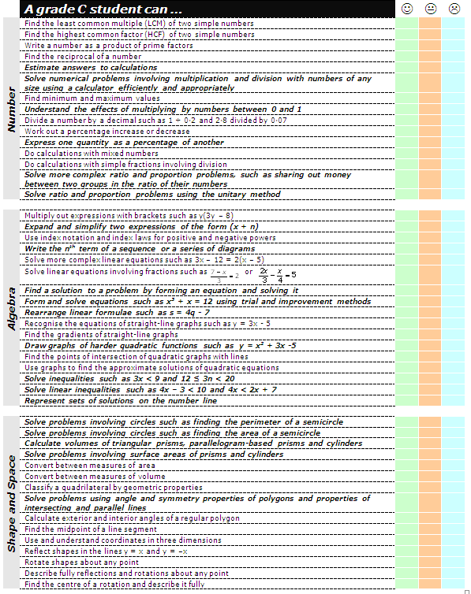
Notes:
Kangaroo maths – make the grade

Slide 30
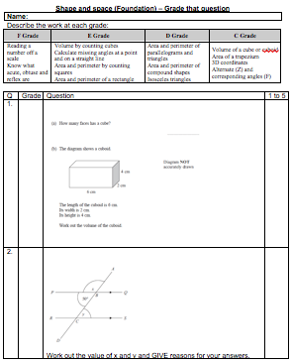
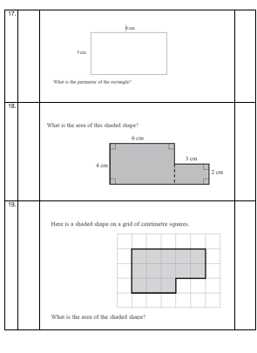
Notes:
Kangaroo maths – make the grade
False in many ways but gives the students the stepping stones they need.

Slide 31
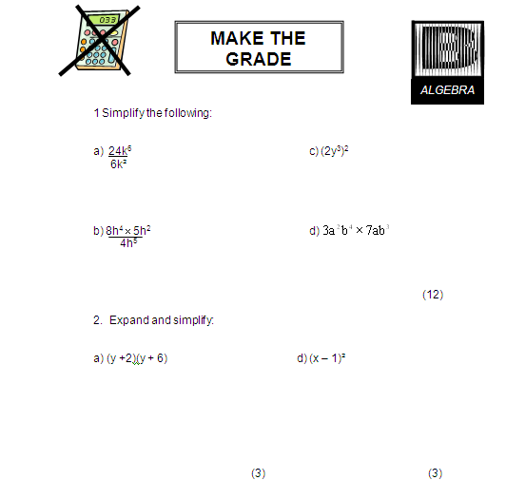
Notes:
Kangaroo maths – make the grade

Slide 32
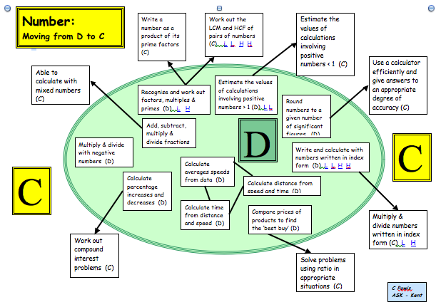
Notes:
Moving from one grade to another at GCSE – helps the students to structure their development – reality of 80% G-D questions but allows them to see the building blocks

Slide 33
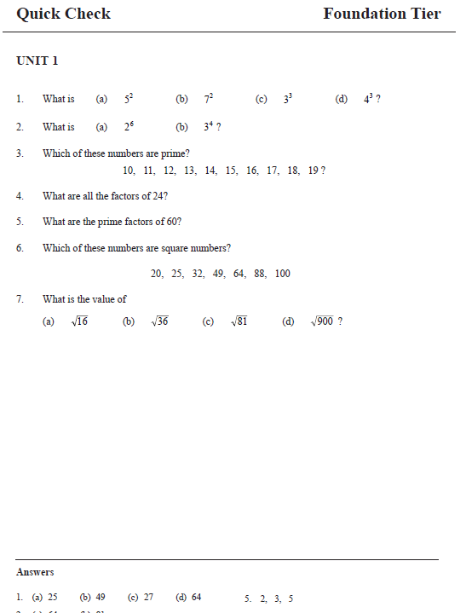
Notes:
Mep topic check

Slide 34
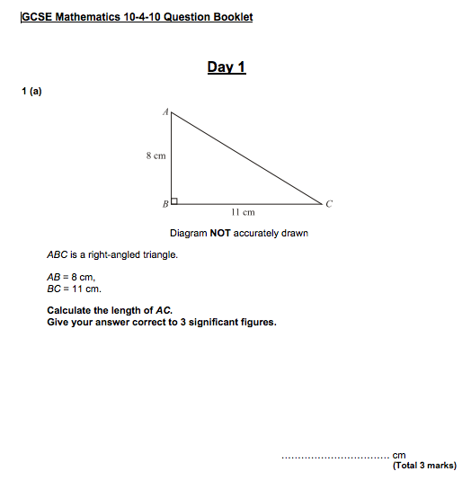
Notes:
10 for 10 questions

Slide 35
Diagnostic questions
Notes:
A means of assessing what they know or rather, what the misconceptions are. Superb form of AfL!

Slide 36
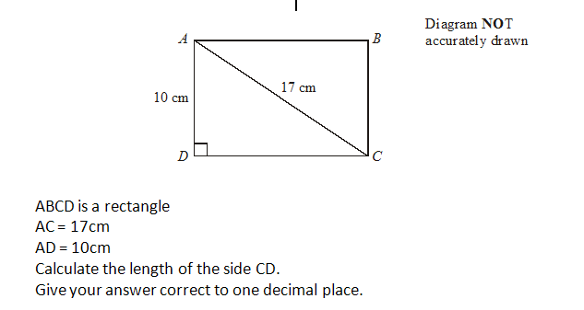

Slide 38
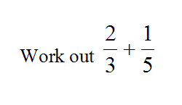
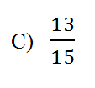
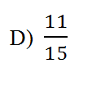

Slide 39
Skills reminders
Notes:
Students in Maths have SO much to learn/retain not only in terms of content but also SKILLS.

Slide 40
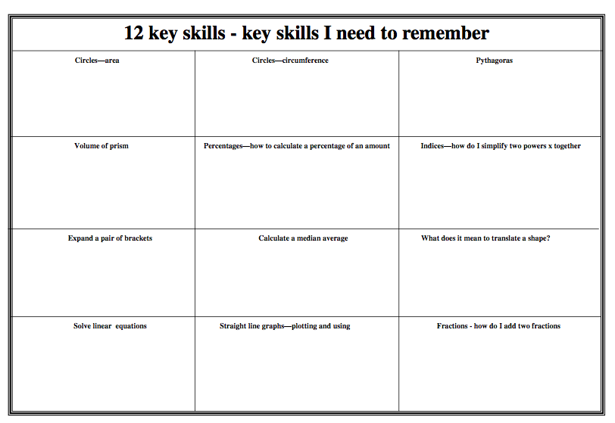
Notes:
Not just the bare facts but HOW to use them

Slide 41
Proportionality
Notes:
240 students in a survey – what do they drink, 60 drunk coffee, what angle is this on a pie chart? What percentage is this?
100mph, how far do I go in 3 hours? What time will it take me to go 70 miles?

Slide 42
Proportionality
240 students in a survey
Asked what do they drink most often at break
30 said coffee
What angle is this on a pie chart?
What percentage is this?
Notes:
30/240 x 360 = 45 degrees
30/240 x 100 = 12.5%

Slide 43
Proportionality
A car is travelling at 100mph
How far do I go in 3 hours?
What time will it take me to go 70 miles?
If I halved my speed to 50mph how long would it take me?
Notes:
300 miles
0.7 x 60 minutes = 42 minutes

Slide 44
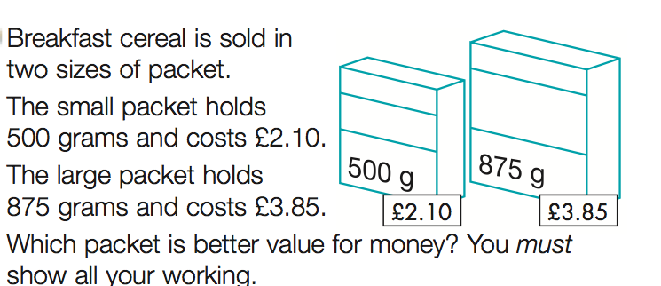
Proportionality
Notes:
2.1/500 = 0.0042 pence per gram
3.85/875 = 0.0044

Slide 45
Proportionality
5 miles : 8 kilometers
Notes:
5 miles = 8 km
120/8 = 25 x 5 = 75 miles per hour

Slide 46
D to C skills v A to A* skills

Slide 47
C Grade in Mathematics
Skills and formulae to learn
Confidence
Commit pen to paper
Proportionality
Notes:
The boys issue!

Slide 48
A* Grade in Mathematics
Skills and formulae to learn
Confidence
Adaptablity
Transferability
Algebraic manipulation

Slide 49
What are the main barriers to learning in Maths and how can we help pupils to overcome them?

Slide 50
Key Messages
Work with individuals and genuinely unpick their misconceptions
Don’t just focus on the “C” grade skills – their misunderstandings are often at a more fundamental level – 80% of the questions on the exam are below C grade
Get students confident to “have a go” – the number-phobic but hardworking students often don’t put pen to paper for fear of it being wrong

Slide 51
What are the main barriers to learning in Maths and how can we help pupils to overcome them?

