Slide 1
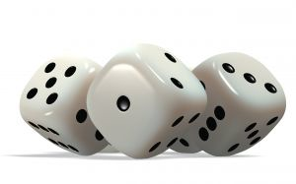
Retaining our values in a fragmenting system
Geoff Barton
King Edward VI School, Bury St Edmunds
Wednesday, May 16, 2012
Download this presentation at www.geoffbarton.co.uk/teacher-resources (Number 101)

Slide 2
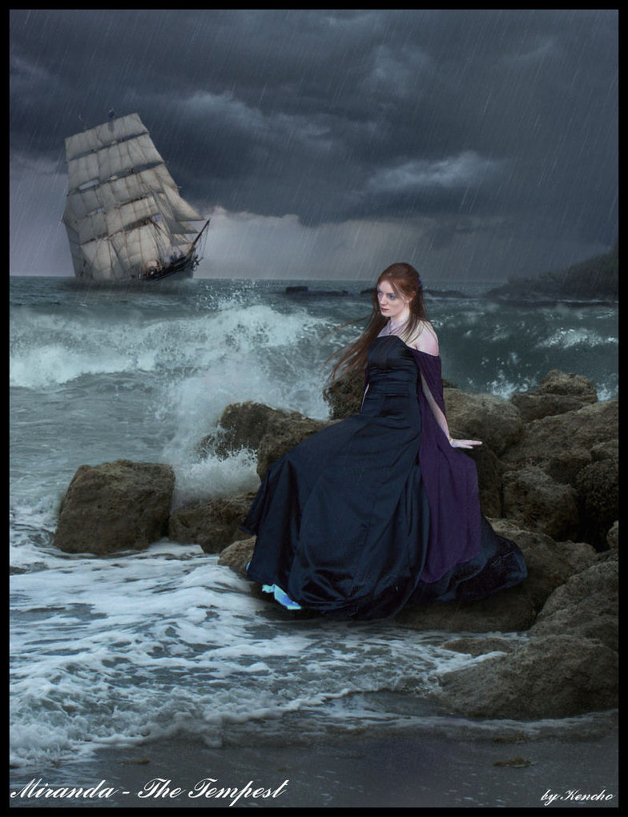
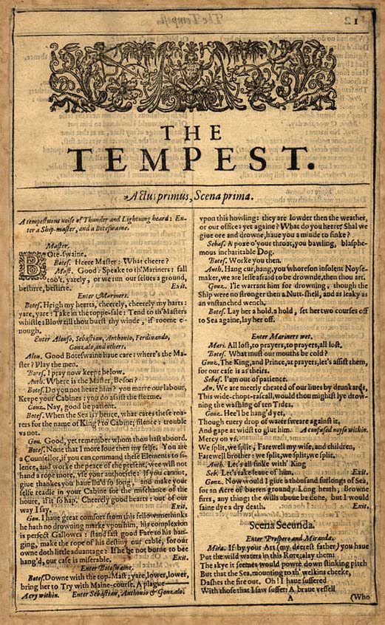
Notes:
Miranda

Slide 3
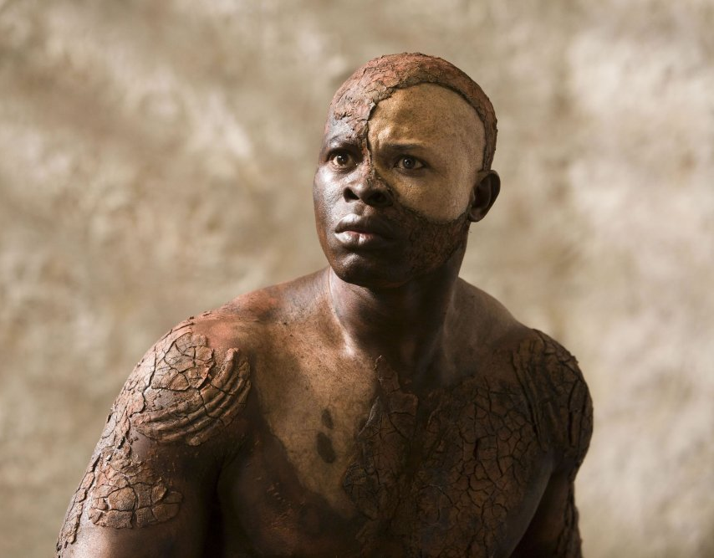
Notes:
Caliban
Ferdinand

Slide 4
Miranda:
“O brave new world that has such people in't!”
Prospero:
“'Tis new to thee”.

Slide 5
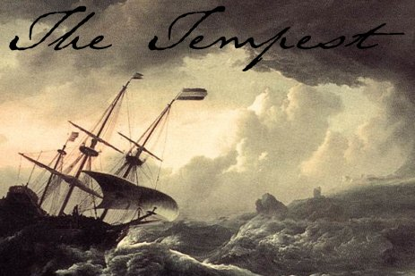

Slide 6
10

Slide 7
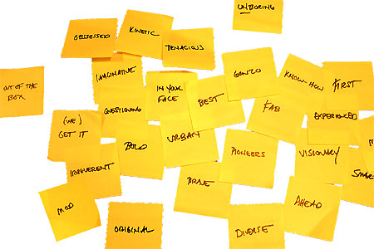
www.geoffbarton.co.uk/teacher-resources (101)

Slide 8
New York Times

Slide 9
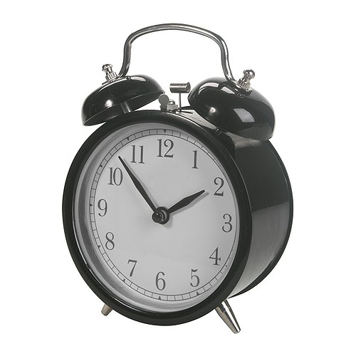

Slide 10
Old Joke

Slide 11
Collective Nouns

Slide 12
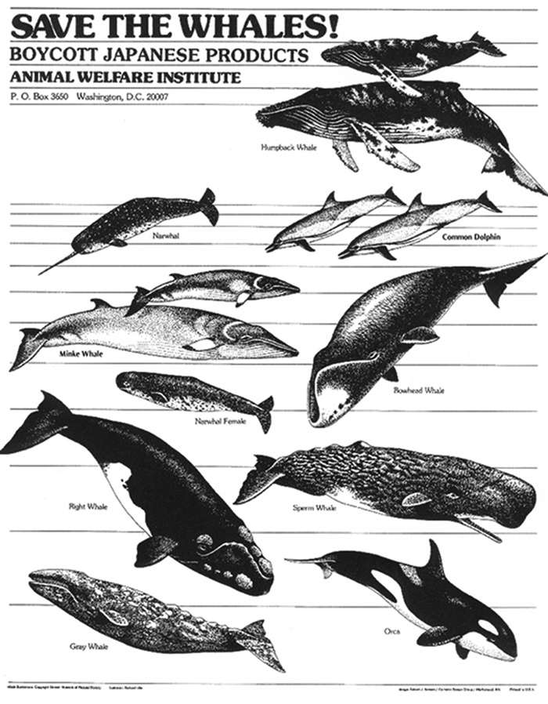
1
Notes:
pod

Slide 13
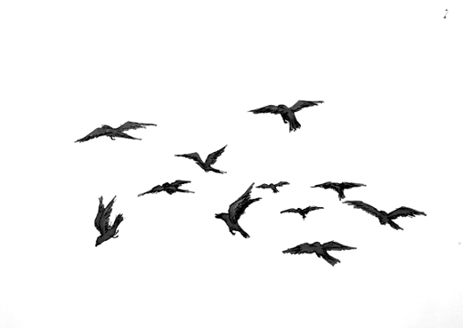
2
Notes:
murder

Slide 14
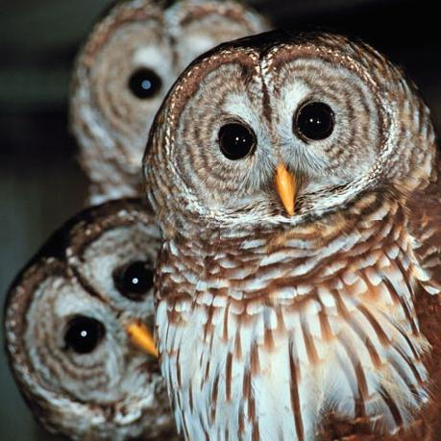
3
Notes:
Parliament

Slide 15
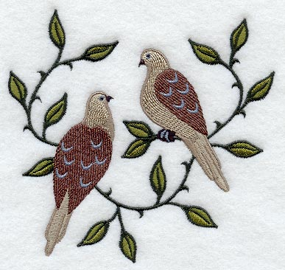
4
Notes:
Pitying of turtledoves

Slide 16
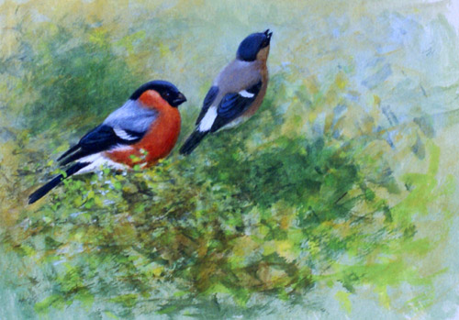
5
Notes:
Bellowing of bullfinches

Slide 17
Q: What’s the collective noun for a group of headteachers?
A: A ‘lack’ of principals

Slide 18
Q: What’s the collective noun for a group of headteachers?
A: A ‘lack’ of principals

Slide 19
Q: What’s the collective noun for a group of headteachers?
A: A ‘lack’ of principles

Slide 20
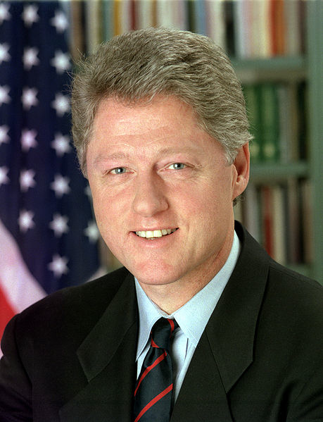
"If you do what you've always done, you'll get what you've always got"
Bill Clinton
US President, 1993-2001

Slide 21
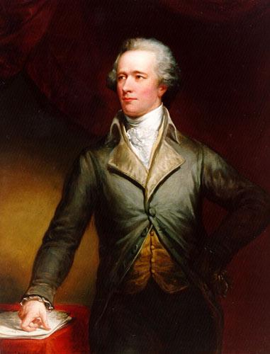
“Those who stand for nothing fall for anything”
Alexander Hamilton
Founding Father, 1755-1803

Slide 22
CHANGE
VALUES

Slide 23
10

Slide 24
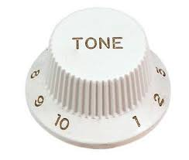
1
In leadership, tone matters

Slide 25
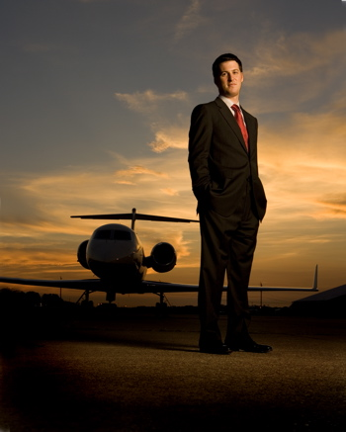
2
Chief executives belong to business

Slide 26
3
Saying no is harder than saying yes

Slide 27
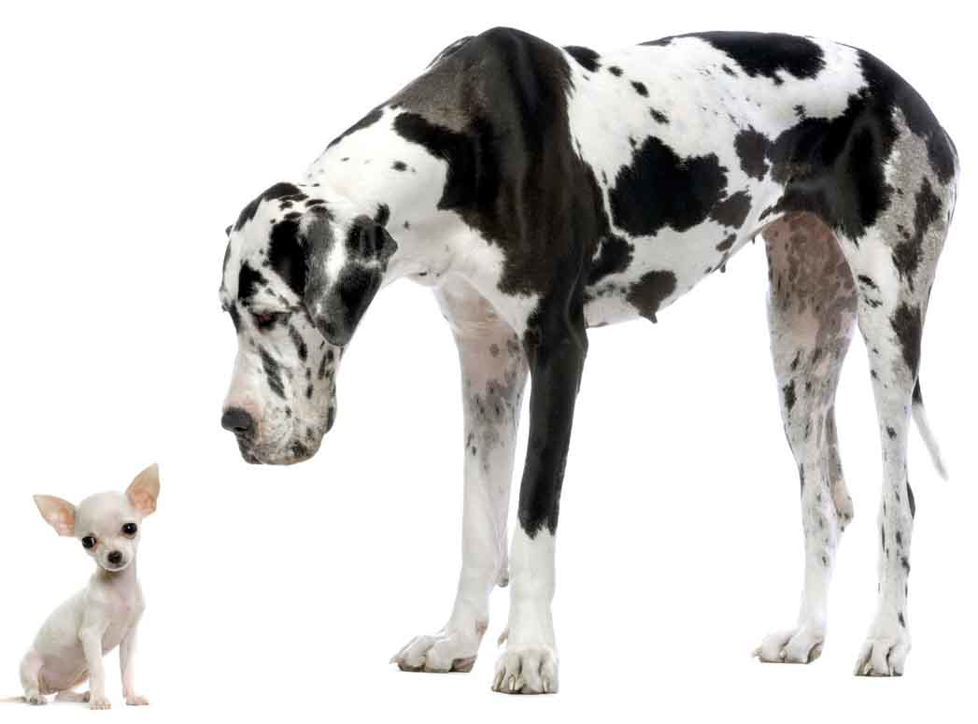
4
Small things are linked to big things

Slide 28
5
We need to be crosser

Slide 29
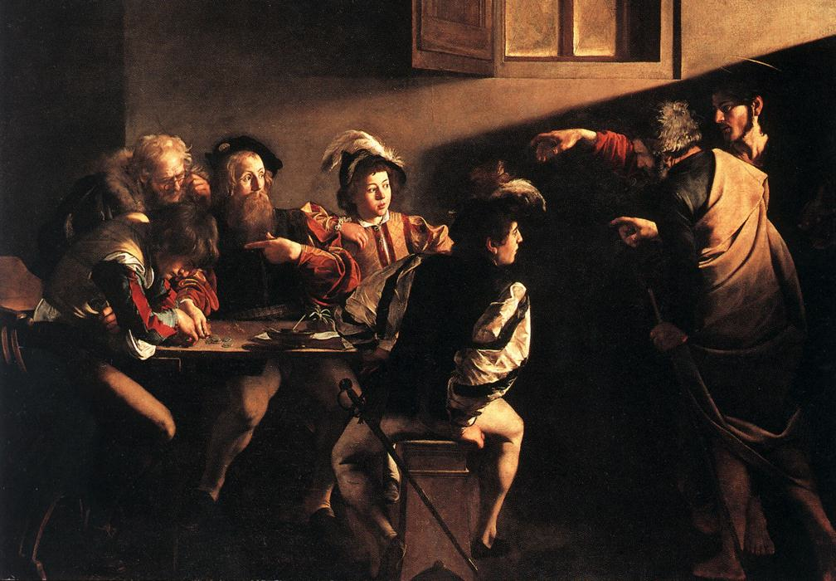
6
Matthew was probably right

Slide 30
The Matthew Effect
(Robert K Merton)

Slide 32
For whosoever hath, to him shall be give: but whosoever hath not, from him shall be taken away
Matthew 13:12

Slide 33
The word-rich get richer while the word-poor get poorer
(CASL)

Slide 34
Demo 1

Slide 35
Demo 2

Slide 36
Research the life of
Martin Luther King

Slide 37
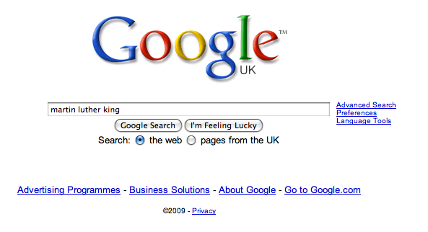

Slide 43
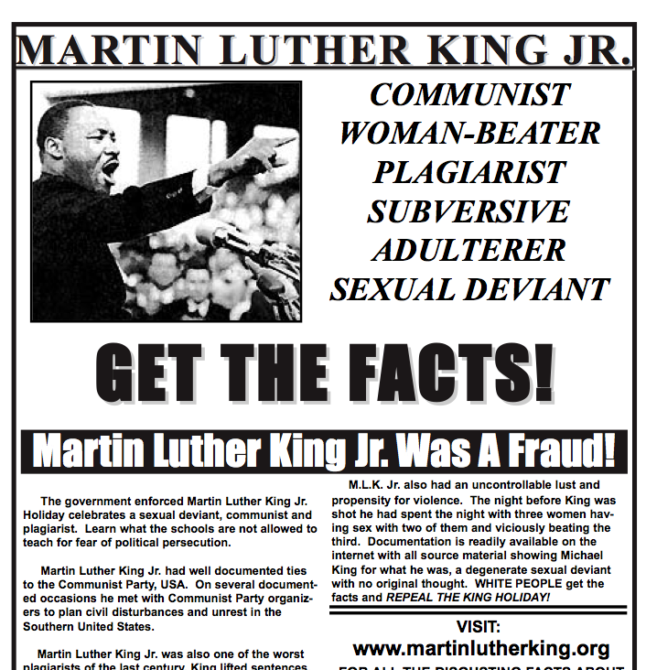

Slide 44
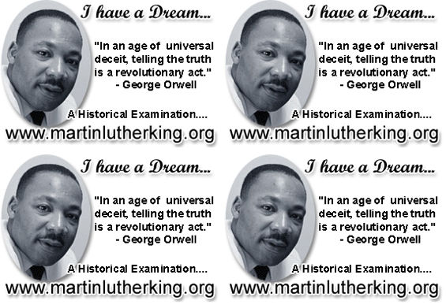

Slide 45
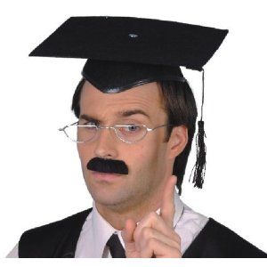
7
This isn’t a club for teachers

Slide 46
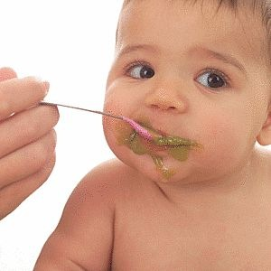
8
We must teach what real learning is

Slide 47
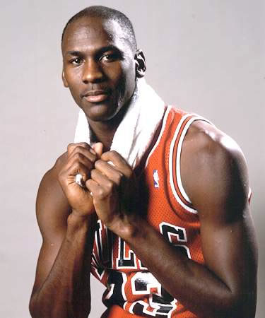
“I've missed more than 9000 shots in my career. I've lost almost 300 games. 26 times, I've been trusted to take the game winning shot and missed. I've failed over and over and over again in my life. And that is why I succeed.”
Michael Jordan
US basketball player

Slide 48
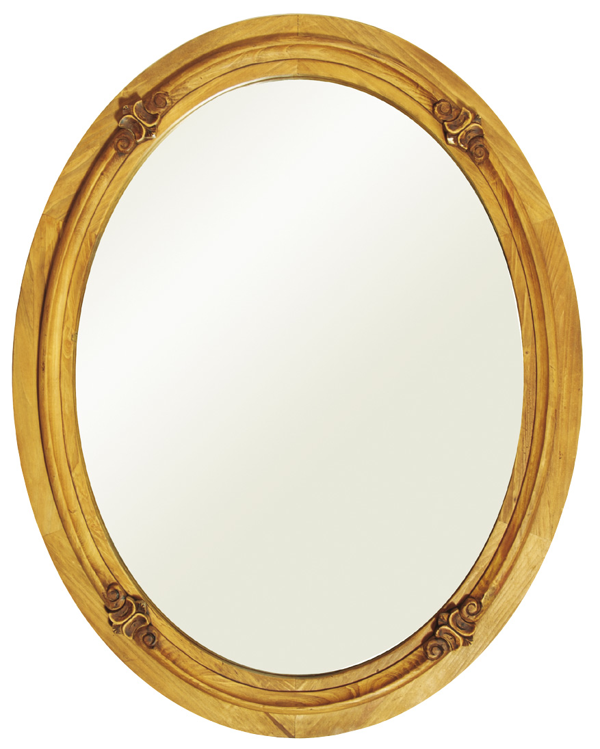
9
We have to be able to look ourselves in the mirror

Slide 49
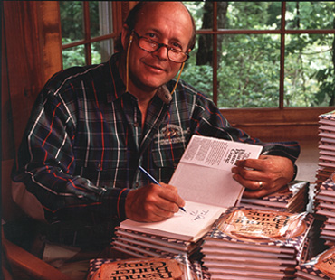
“Our character is what we do when we think no one is looking.”
H. Jackson Browne
Author of Life’s Little Instruction Book

Slide 50
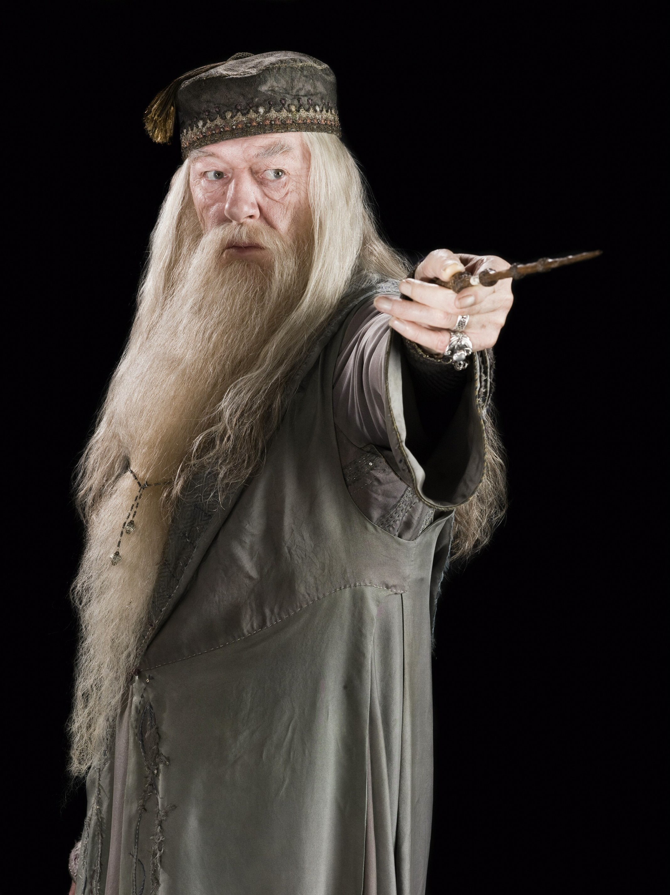
“It takes a great deal of courage to stand up to your enemies … but even more to stand up to your friends”
Albus Dumbledore
Harry Potter & the Chamber of Secrets

Slide 51
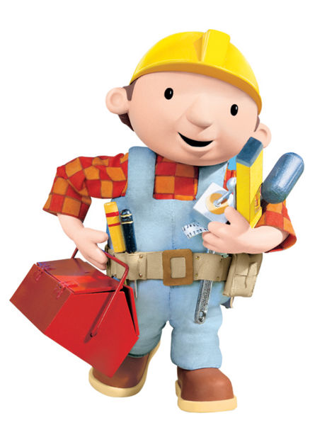
10
It’s a job …
though an extraordinary one

Slide 52
Retaining our values in a fragmenting system
Geoff Barton
King Edward VI School, Bury St Edmunds
Thursday, May 17, 2012
Download this presentation at www.geoffbarton.co.uk/teacher-resources (Number 101)

