Slide 1
Don’t Call it iteracy
Geoff Barton
Head, King Edward VI School, Suffolk
Download this presentation at www.geoffbarton.co.uk
(Presentation number 90)

Slide 2
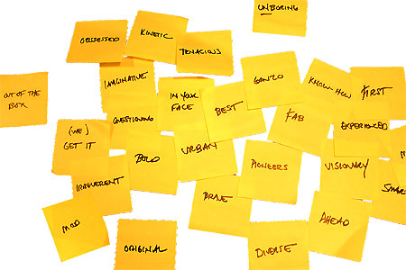
Approach:

Slide 3
Provocations:
We haven’t done literacy
It’s all about the classroom
Knowledge and instruction may be more important than we realised
Remember the “Matthew Effect”

Slide 4
The Matthew Effect
(Robert K Merton)

Slide 5
The rich shall get richer and the poor shall get poorer
Matthew 13:12

Slide 6
“The word-rich get richer while the word-poor get poorer” in their reading skills
(CASL)

Slide 7
“While good readers gain new skills very rapidly, and quickly move from learning to read to reading to learn, poor readers become increasingly frustrated with the act of reading, and try to avoid reading where possible”
The Matthew Effect
Daniel Rigney

Slide 8
“Students who begin with high verbal aptitudes and find themselves in verbally enriched social environments are at a double advantage.”
The Matthew Effect
Daniel Rigney

Slide 9
“Good readers may choose friends who also read avidly while poor readers seek friends with whom they share other enjoyments”
The Matthew Effect
Daniel Rigney

Slide 10
Stricht’s Law: “reading ability in children cannot exceed their listening ability …”
E.D. Hirsch
The Schools We Need

Slide 11
“Spoken language forms a constraint, a ceiling not only on the ability to comprehend but also on the ability to write, beyond which literacy cannot progress”
Myhill and Fisher

Slide 12
“The children who possess intellectual capital when they first arrive at school have the mental scaffolding and Velcro to catch hold of what is going on, and they can turn the new knowledge into still more Velcro to gain still more knowledge”.
E.D. Hirsch
The Schools We Need

Slide 13
Aged 7:
Children in the top quartile have 7100 words; children in the lowest have around 3000.
The main influence is parents.
DfE Research Unit

Slide 14
The Matthew Effect:
The rich will get richer &
the poor will get poorer

Slide 15
The Literacy Club

Slide 16
Literacy standards in England
1945
1997

Slide 18
Every teacher in English is a teacher of English
George Sampson, 1922

Slide 19
Guess the Text Type

Slide 20
1 - Where would you find this text?
2 - How do you know?

Slide 21
1
Proud mum in a million Natalie Brown hugged her beautiful baby daughter Casey yesterday and said: “She’s my double miracle.”

Slide 22
2
The blood vessels of the circulatory system, branching into multitudes of very fine tubes (capillaries), supply all parts of the muscles and organs with blood, which carries oxygen and food necessary for life.

Slide 23
3
Ensure that the electrical supply is turned off. Ensure the existing circuit to which the fitting is to be connected has been installed and fused in accordance with current L.L.L wiring regulations

Slide 24
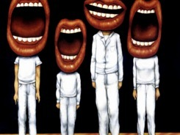
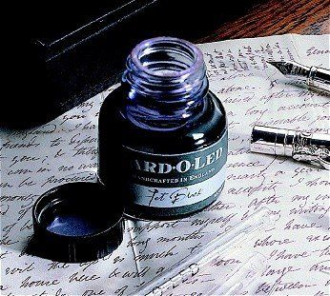

Slide 25
Understand the significance of exploratory talk
Model good talk – eg connectives
Re-think questioning – ‘why & how’ – and hands-up
Vary groupings
Get conversations into the school culture

Slide 26
1: What type of talk characterises your classroom? How do you help students to talk like a scientist / historian / geographer ..?
2: How do you ask questions? How do you receive answers? Do ‘why’ and ‘how’ questions happen other than by accident? Do the same students always answer?
3: How do groupings work in your classroom? Are they planned? Do the word-rich get richer? Is spoken vocabulary modelled?
Team Implications …

Slide 27
Teach reading – scanning, skimming, analysis
Read aloud and display
Teach key vocabulary
Demystify spelling
Teach research, not FOFO

Slide 28
SKIMMING

Slide 29
The climate of the Earth is always changing. In the past it has altered as a result of natural causes. Nowadays, however, the term climate change is generally used when referring to changes in our climate which have been identified since the early part of the 1900's . The changes we've seen over recent years and those which are predicted over the next 80 years are thought to be mainly as a result of human behaviour rather than due to natural changes in the atmosphere.

Slide 30
The best treatment for mouth ulcers. Gargle with salt water. You should find that it works a treat. Salt is cheap and easy to get hold of and we all have it at home, so no need to splash out and spend lots of money on expensive mouth ulcer creams.

Slide 31
Urquhart castle is probably one of the most picturesquely situated castles in the Scottish Highlands. Located 16 miles south-west of Inverness, the castle, one of the largest in Scotland, overlooks much of Loch Ness. Visitors come to stroll through the ruins of the 13th-century castle because Urquhart has earned the reputation of being one of the best spots for sighting Loch Ness’s most famous inhabitant.

Slide 32
SCANNING

Slide 33
Where did the first cell phones begin?
Name 2 other features that started to be included in phones
Why are cell phones especially useful in some countries?

Slide 34
Where begin?
Two features?
Some countries?
Cellular telephones
The first cellular telephone system began operation in Tokyo in 1979, and the first U.S. system began operation in 1983 in Chicago. A camera phone is a cellular phone that also has picture taking capabilities. Some camera phones have the capability to send these photos to another cellular phone or computer. Advances in digital technology and microelectronics has led to the inclusion of unrelated applications in cellular telephones, such as alarm clocks, calculators, Internet browsers, and voice memos for recording short verbal reminders, while at the same time making such telephones vulnerable to certain software viruses. In many countries with inadequate wire-based telephone networks, cellular telephone systems have provided a means of more quickly establishing a national telecommunications network.

Slide 35
CLOSE READING

Slide 36
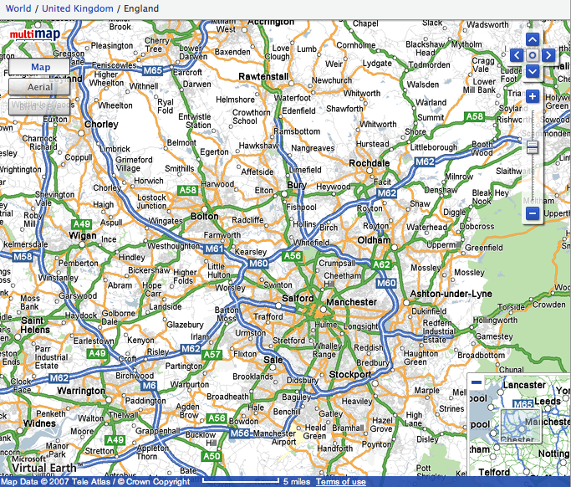

Slide 37
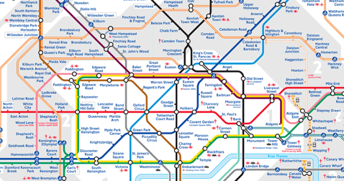
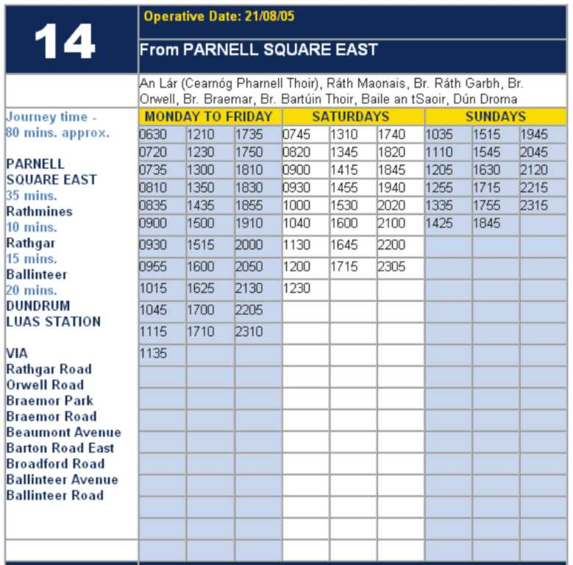
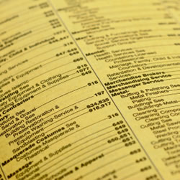

Slide 38
RESEARCH SKILLS

Slide 39
Research the life of
Martin Luther King

Slide 40
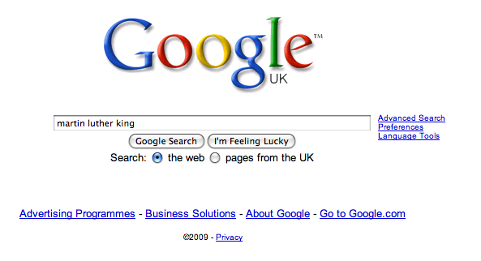

Slide 47
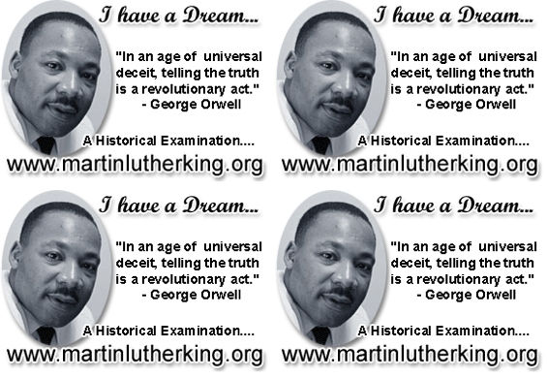

Slide 48
Demo

Slide 49
DEMYSTIFYING
SPELLING
3

Slide 50
1 - SOUNDS

Slide 51
Government

Slide 52
Happened

Slide 53
February

Slide 54
2 -VISUALS

Slide 55
Se-para-te
Be-lie-ve

Slide 56
3 - MNEMONICS

Slide 57
necessary

Slide 58
accommodation

Slide 59
Teach reading – scanning, skimming, analysis
Read aloud and display
Teach key vocabulary
Demystify spelling
Teach research, not FOFO

Slide 60
1: What kinds of texts do students in your subject need to read? What are the barriers to understanding? How do you help them – eg with vocabulary?
2: What are the ‘power words’ in your subject? Where do students encounter them? Which are the troublesome spellings? How do you demystify them?
3: What’s your contribution to reading for pleasure? Do students see you reading and hear you talk about reading? Do you teach them research skills?
Team Implications …

Slide 61
Demonstrate writing
Teach composition & planning
Allow oral rehearsal
Short & long sentences
Connectives

Slide 62
Know your connectives
Adding: and, also, as well as, moreover, too
Cause & effect: because, so, therefore, thus, consequently
Sequencing: next, then, first, finally, meanwhile, before, after
Qualifying: however, although, unless, except, if, as long as, apart from, yet
Emphasising: above all, in particular, especially, significantly, indeed, notably
Illustrating: for example, such as, for instance, as revealed by, in the case of
Comparing: equally, in the same way, similarly, likewise, as with, like
Contrasting: whereas, instead of, alternatively, otherwise, unlike, on the other hand

Slide 63
DEMO

Slide 64
Evaluate the product you have made

Slide 65
1: What kinds of writing do students need to do in your subject? Where do they see the process as well as the product? When do they see you writing and reflecting aloud on your writing?
2: What are the 5 essential ingredients in a text required in your subject:
personal/impersonal?
formal/informal?
layout features?
key vocabulary?
sentence types?
Team Implications …

Slide 66
Demonstrate writing
Teach composition & planning
Allow oral rehearsal
Short & long sentences
Connectives

Slide 68
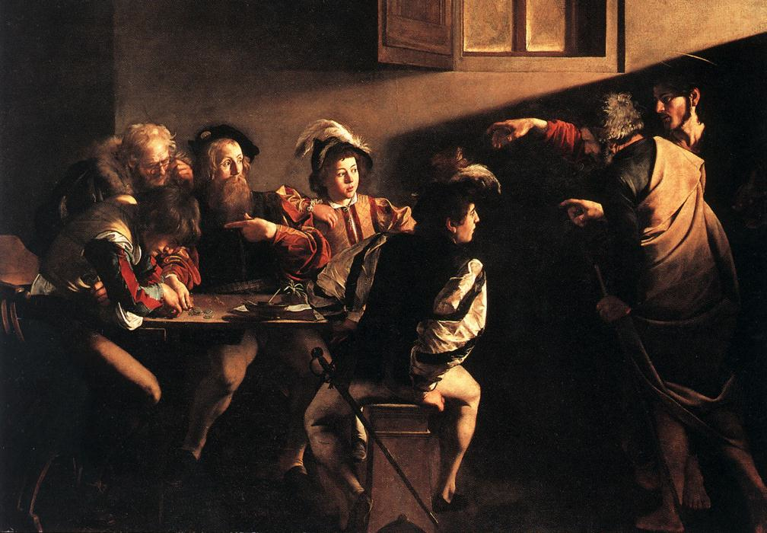

Slide 69
SUMMARY

Slide 70
1: It’s not literacy

Slide 71
2: It’s making the implicit explicit – and modelling it

Slide 72
3: Without us, the rich will get richer & the poor will get poorer

Slide 73
Don’t Call it iteracy
Geoff Barton
Head, King Edward VI School, Suffolk
Download this presentation at www.geoffbarton.co.uk
(Presentation number 90)

