Slide 1
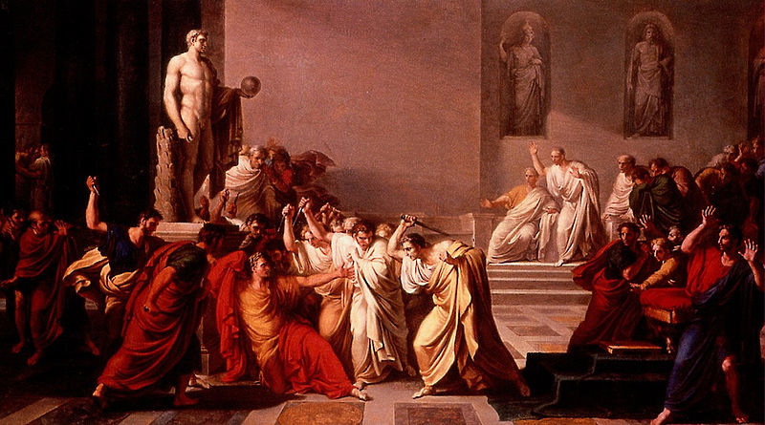
Vincenzo Camuccini, Mort de Cesar, 1798

Slide 2
Teaching Schools
on the Ides of March
Geoff Barton, Headteacher
King Edward VI School
March 15, 2011
Download at www.geoffbarton.co.uk (Presentation 88)

Slide 3
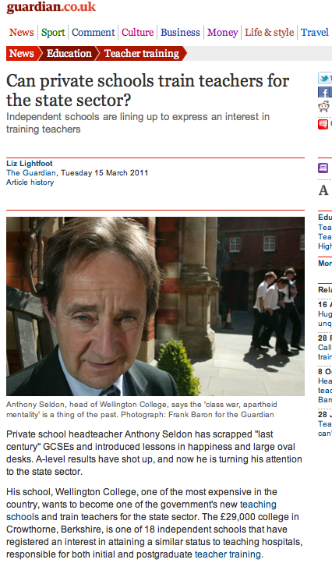

Slide 4
3 Soothsayers
3 Provocations
8 Warnings

Slide 5
US

Slide 6
1400
350 Sixth Form
Sports College
Training School
No tricks

Slide 7
3 Soothsayers

Slide 8
“The quality of an education system cannot exceed the quality of its teachers”
Michael Barber

Slide 9
“For too many teachers, 20 years is one year repeated 20 times”
Michael Fullan

Slide 10
‘Blink’
‘Withitness’
Malcolm Gladwell

Slide 11
3
PROVOCATIONS

Slide 12
1 Teaching is a craft: it is about instruction

Slide 13
2 Underpinning assumptions will need to change – eg PPA time, workforce remodelling, teaching standards

Slide 14
3 If teaching schools are to be deemed a success, they must create more good teachers in the schools that need them most

Slide 15
WARNINGS
8

Slide 16
1
Resist the myth of shiny newness …

Slide 17
We intend to bring together the Training School and Teaching School models, to create a national network of Teaching Schools. These will be outstanding schools, which will take a leading responsibility for providing and quality assuring initial teacher training in their area.

Slide 18
2
Beware the bounty hunters

Slide 20
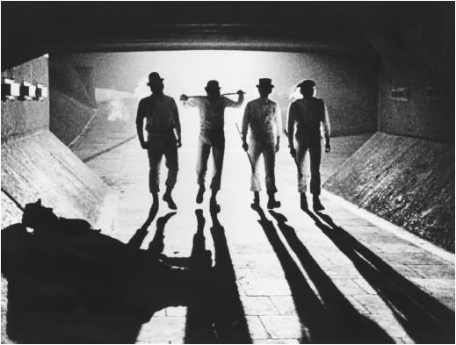

Slide 21
3
Partnership is best done with, not to

Slide 22
4
Don’t swallow the Ofsted myth

Slide 23
5
Resist anything pre-packaged

Slide 24
6
Train teachers for the real world

Slide 25
Learn the lessons of Gladwell: it’s about the classroom
7

Slide 26
8
Remember that names matter

Slide 27
And finally …

Slide 28
Vincenzo Camuccini, Mort de Cesar, 1798

Slide 29
Teaching Schools
on the Ides of March
Geoff Barton, Headteacher
King Edward VI School
March 15, 2011
Download at www.geoffbarton.co.uk (Presentation 88)

