Slide 1
DEVELOPING CONFIDENT READERS
Geoff Barton
September 30, 2011

Slide 2
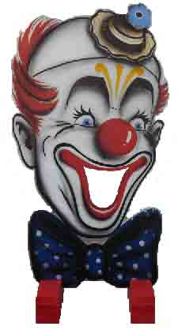
Reading Fun Pack

Slide 3
SKIMMING SCANNING

Slide 4
Cloze PREDICTION

Slide 5
There was a young man from Dealing
Who caught the bus for Ealing.
It said on the door
Don't spit on the floor
So
he
jumped
up
and
spat
on
the
ceiling.

Slide 6
There once was a man from Peru, Who dreamed of eating his shoe, He awoke with a fright, In the middle of the night,
And
found
that
his
dream
had
come
true.

Slide 7
How we Read: Exploring Lexical v Grammatical Clues

Slide 8
What type of text is this?
What is its topic?

Slide 9
The name of the planet is derives from the mythical Roman god Saturn, god of fertility, and agriculture. The god Saturn also gives its name to the word "Saturday". Saturn is clearly visible in the night sky with the naked eye, and in consequence has been known to humans since pre-historic times, but it was not until the year 1659 that the Astronomer Christian Huygens correctly identified Saturn's now famous rings using his telescope. Saturn is the sixth furthest planet in our solar system from the sun, the average distance being 1427 million km; Earth by comparison is nine and a half times this distance away from the sun. The planet Saturn has a diameter of about 120536km, eleven times that of the Earth, making it the second biggest planet in our solar system. Its mass is second only to Jupiter, and is 95 times greater than that of Earth.
1Type of Text? 2Topic?
Facts and info about the Planet Saturn

Slide 10
The name of the planet is derives from the mythical Roman god Saturn, god of fertility, and agriculture. The god Saturn also gives its name to the word "Saturday". Saturn is clearly visible in the night sky with the naked eye, and in consequence has been known to humans since pre-historic times, but it was not until the year 1659 that the Astronomer Christian Huygens correctly identified Saturn's now famous rings using his telescope. Saturn is the sixth furthest planet in our solar system from the sun, the average distance being 1427 million km; Earth by comparison is nine and a half times this distance away from the sun. The planet Saturn has a diameter of about 120536km, eleven times that of the Earth, making it the second biggest planet in our solar system. Its mass is second only to Jupiter, and is 95 times greater than that of Earth.
1Type of Text? 2Topic?
Facts and info about the Planet Saturn

Slide 11
The name of the planet is derives from the mythical Roman god Saturn, god of fertility, and agriculture. The god Saturn also gives its name to the word "Saturday". Saturn is clearly visible in the night sky with the naked eye, and in consequence has been known to humans since pre-historic times, but it was not until the year 1659 that the Astronomer Christian Huygens correctly identified Saturn's now famous rings using his telescope. Saturn is the sixth furthest planet in our solar system from the sun, the average distance being 1427 million km; Earth by comparison is nine and a half times this distance away from the sun. The planet Saturn has a diameter of about 120536km, eleven times that of the Earth, making it the second biggest planet in our solar system. Its mass is second only to Jupiter, and is 95 times greater than that of Earth.
1Type of Text? 2Topic?
Facts and info about the Planet Saturn

Slide 12
The name of the planet is derives from the mythical Roman god Saturn, god of fertility, and agriculture. The god Saturn also gives its name to the word "Saturday". Saturn is clearly visible in the night sky with the naked eye, and in consequence has been known to humans since pre-historic times, but it was not until the year 1659 that the Astronomer Christian Huygens correctly identified Saturn's now famous rings using his telescope. Saturn is the sixth furthest planet in our solar system from the sun, the average distance being 1427 million km; Earth by comparison is nine and a half times this distance away from the sun. The planet Saturn has a diameter of about 120536km, eleven times that of the Earth, making it the second biggest planet in our solar system. Its mass is second only to Jupiter, and is 95 times greater than that of Earth.
1Type of Text? 2Topic?
Facts and info about the Planet Saturn

Slide 13
The name of the planet is derives from the mythical Roman god Saturn, god of fertility, and agriculture. The god Saturn also gives its name to the word "Saturday". Saturn is clearly visible in the night sky with the naked eye, and in consequence has been known to humans since pre-historic times, but it was not until the year 1659 that the Astronomer Christian Huygens correctly identified Saturn's now famous rings using his telescope. Saturn is the sixth furthest planet in our solar system from the sun, the average distance being 1427 million km; Earth by comparison is nine and a half times this distance away from the sun. The planet Saturn has a diameter of about 120536km, eleven times that of the Earth, making it the second biggest planet in our solar system. Its mass is second only to Jupiter, and is 95 times greater than that of Earth.
1Type of Text? 2Topic?
Facts and info about the Planet Saturn

Slide 14
The name of the planet is derives from the mythical Roman god Saturn, god of fertility, and agriculture. The god Saturn also gives its name to the word "Saturday". Saturn is clearly visible in the night sky with the naked eye, and in consequence has been known to humans since pre-historic times, but it was not until the year 1659 that the Astronomer Christian Huygens correctly identified Saturn's now famous rings using his telescope. Saturn is the sixth furthest planet in our solar system from the sun, the average distance being 1427 million km; Earth by comparison is nine and a half times this distance away from the sun. The planet Saturn has a diameter of about 120536km, eleven times that of the Earth, making it the second biggest planet in our solar system. Its mass is second only to Jupiter, and is 95 times greater than that of Earth.
1Type of Text? 2Topic?
Facts and info about the Planet Saturn

Slide 15
The name of the planet is derives from the mythical Roman god Saturn, god of fertility, and agriculture. The god Saturn also gives its name to the word "Saturday". Saturn is clearly visible in the night sky with the naked eye, and in consequence has been known to humans since pre-historic times, but it was not until the year 1659 that the Astronomer Christian Huygens correctly identified Saturn's now famous rings using his telescope. Saturn is the sixth furthest planet in our solar system from the sun, the average distance being 1427 million km; Earth by comparison is nine and a half times this distance away from the sun. The planet Saturn has a diameter of about 120536km, eleven times that of the Earth, making it the second biggest planet in our solar system. Its mass is second only to Jupiter, and is 95 times greater than that of Earth.
1Type of Text? 2Topic?
Facts and info about the Planet Saturn

Slide 16
The name of the planet is derives from the mythical Roman god Saturn, god of fertility, and agriculture. The god Saturn also gives its name to the word "Saturday". Saturn is clearly visible in the night sky with the naked eye, and in consequence has been known to humans since pre-historic times, but it was not until the year 1659 that the Astronomer Christian Huygens correctly identified Saturn's now famous rings using his telescope. Saturn is the sixth furthest planet in our solar system from the sun, the average distance being 1427 million km; Earth by comparison is nine and a half times this distance away from the sun. The planet Saturn has a diameter of about 120536km, eleven times that of the Earth, making it the second biggest planet in our solar system. Its mass is second only to Jupiter, and is 95 times greater than that of Earth.
1Type of Text? 2Topic?
Facts and info about the Planet Saturn

Slide 17
The name of the planet is derives from the mythical Roman god Saturn, god of fertility, and agriculture. The god Saturn also gives its name to the word "Saturday". Saturn is clearly visible in the night sky with the naked eye, and in consequence has been known to humans since pre-historic times, but it was not until the year 1659 that the Astronomer Christian Huygens correctly identified Saturn's now famous rings using his telescope. Saturn is the sixth furthest planet in our solar system from the sun, the average distance being 1427 million km; Earth by comparison is nine and a half times this distance away from the sun. The planet Saturn has a diameter of about 120536km, eleven times that of the Earth, making it the second biggest planet in our solar system. Its mass is second only to Jupiter, and is 95 times greater than that of Earth.
1Type of Text? 2Topic?
Facts and info about the Planet Saturn

Slide 18
The name of the planet is derives from the mythical Roman god Saturn, god of fertility, and agriculture. The god Saturn also gives its name to the word "Saturday”. Saturn is clearly visible in the night sky with the naked eye, and in consequence has been known to humans since pre-historic times, but it was not until the year 1659 that the Astronomer Christian Huygens correctly identified Saturn's now famous rings using his telescope. Saturn is the sixth furthest planet in our solar system from the sun, the average distance being 1427 million km; Earth by comparison is nine and a half times this distance away from the sun. The planet Saturn has a diameter of about 120536km, eleven times that of the Earth, making it the second biggest planet in our solar system. Its mass is second only to Jupiter, and is 95 times greater than that of Earth.
1Type of Text? 2Topic?
Facts and info about the Planet Saturn

Slide 19
Using prediction and discussion to increase understanding
Brian Moore, Cold Heaven

Slide 20
Using prediction and discussion to increase understanding
What happens?
What will happen next? Why?
Tension rating 1-10

Slide 21
1/8
The wooden seats of the little pedal boat were angled so that Marie looked up at the sky. There were no clouds. In the vastness above her a gull calligraphed its flight. Marie and Alex pedalled in unison, the revolving paddles making a slapping sound against the waves as the pedal boat treadmilled away from the beach, passing through ranks of bathers to move into the deeper, more solitary waters of the Baie des Anges. Marie slackened her efforts but Alex continued determinedly, steering the pedalo straight out into the Mediterranean.

Slide 22
2/8
‘Let’s not go too far,’ she said.
‘I want to get away from the crowd. I’m going to swim.’
It was like him to have some plan of his own, to translate idleness into activity even in these few days of vacation. She now noted his every fault. It was as though, having decided to leave him, she had withdrawn his credit. She looked back at the sweep of hotels along the Promenade des Anglais. Today was the day she had hoped to tell him. She had planned to announce it at breakfast and leave, first for New York, then on to Los Angeles to join Daniel. But at breakfast she lacked all courage. Now, with half the day gone, she decided to postpone it until tomorrow.

Slide 23
3/8
Far out from shore, the paddles stopped. The pedalo rocked on its twin pontoons as Alex eased himself up from his seat. He handed her his sunglasses. ‘This should do,’ he said and, rocking the boat even more, dived into the ultramarine waters. She watched him surface. He called out: ‘Just follow along, okay?’ He was not a good swimmer, but thrashed about in an energetic, erratic freestyle. Marie began to pedal again, her hand on the tiller, steering the little boat so that she followed close. Watching him, she knew he could not keep up this pace for long. She saw his flailing arms and for a moment thought of those arms hitting her. He had never hit her. He was not the sort of man who would hit you. He could be hurt, and cold, and possibly vindictive. But he was not violent.

Slide 24
4/8
She heard a motorboat, the sound becoming louder. She looked back but did not see a boat behind her. Then she looked to the right where Alex was swimming and saw a big boat with an outboard motor coming right at them, coming very fast.

Slide 25
5/8
Of course they see us, she thought, alarmed, and then as though she were watching a film, as though this were happening to someone else, she saw there was a man in the motorboat, a young man wearing a green shirt; he was not at the tiller, he was standing in the middle of the boat with his back to her and as she watched he bent down and picked up a child who had fallen on the floorboards. ‘Hey?’ she called. ‘Hey?’ for he must turn around, the motorboat was coming right at Alex, right at her. But the man in the boat did not hear. He carried the child across to the far side of the boat; the boat was only yards away now.

Slide 26
6/8
‘Alex,’ she called. ‘Alex, look out.’ But Alex flailed on and then the prow of the motorboat, slicing up water like a knife, hit Alex with a sickening thump, went over him and smashed into the pontoons of the little pedal boat, upending it, and she found herself in the water, going under, coming up. She looked and saw the motorboat churning off, the pedal boat hanging from its prow like a tangle of branches. She heard the motorboat engine cut to silence, then start up again as the boat veered around in a semicircle and came back to her. Alex?

Slide 27
7/8
She looked: saw his body near her just under the water. She swam toward him, breastroke, it was all she knew. He was floating face down, spread-eagle. She caught hold of his wrist and pulled him towards her. The motorboat came alongside, the man in the green shirt reaching down for her, but, ‘No, no,’ she called and tried to push Alex toward him. The man caught Alex by the hair of his head and pulled him up, she pushing, Alex falling back twice into the water, before the man, with a great effort, lifted him like a sack across the side of the boat, tugging and heaving until Alex disappeared into the boat. The man shouted, ‘Un instant, madame, un instant’ and reappeared, putting a little steel ladder over the side. She climbed up onto the motorboat as the man went out onto the prow to disentangle the wreckage of the pedalo.

Slide 28
8/8
A small child was sitting at the back of the boat, staring at Alex’s body, which lay face-down on the floorboards. She went to Alex and saw blood from a wound, a gash in the side of his head, blood matting his hair. He was breathing but unconscious. She lifted him and cradled him in her arms, his blood trickling onto her breasts. She saw the boat owner’s bare legs go past her as he went to the rear of the boat to restart the engine. The child began to bawl but the man leaned over, silenced it with an angry slap, the man turned to her, his face sick with fear. ‘Nous y serons dans un instant,’ he shouted, opening the motor to full throttle. She hugged Alex to her, a rivulet of blood dripping off her forearm onto the floorboards as the boat raced to the beach.

Slide 29
BUILDING TENSION
Brian Moore, Cold Heaven

Slide 30
Building Accessibility

Slide 31
Read this text: What are the barriers to learning? What could we do to help?

Slide 32
Bernstein, Leonard (1918-90) US conductor and versatile composer, whose works range from symphonies to popular musicals. Born at Lawrence, Massachusetts, he studied at Harvard University, the Curtis Institute, and also, during the summers of 1940 and 1941, at Tanglewood under KOUSSEVITSKY, who – impressed by his talent – made him his assistant there in 1942. He quickly attracted notice as a conductor (and pianist) and made his name overnight when he deputized at short notice for Bruno WALTER in 1944.

Slide 33
1: ASSESSING ACCESSIBILITY
Bernstein, Leonard (1918-90) US conductor and versatile composer, whose works range from symphonies to popular musicals. Born at Lawrence, Massachusetts, he studied at Harvard University, the Curtis Institute, and also, during the summers of 1940 and 1941, at Tanglewood under KOUSSEVITSKY, who – impressed by his talent – made him his assistant there in 1942. He quickly attracted notice as a conductor (and pianist) and made his name overnight when he deputized at short notice for Bruno WALTER in 1944.

Slide 34
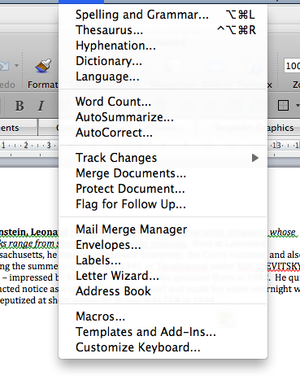
ACCESSIBILITY

Slide 35
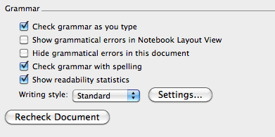
ACCESSIBILITY

Slide 36
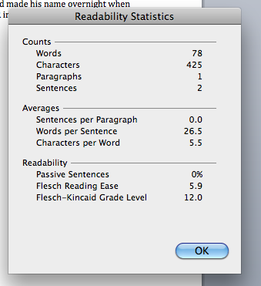
ACCESSIBILITY

Slide 37
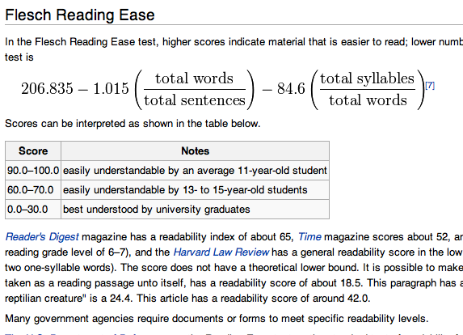
ACCESSIBILITY

Slide 38
2: FRAMING THE TEXT
Key words:
Harvard = one of America’s top universities in north-Eastern USA
Tanglewood = music academy near Harvard
JUST WHO WAS LEONARD BERNSTEIN?
Leonard Bernstein was a famous conductor. He studied at Harvard University and the Curtis Institute., During the summers of 1940 and 1941, he studied at Tanglewood under the famous Russian teacher KOUSSEVITSKY. Koussevitsky was impressed by his talent and made him his assistant there in 1942.
He quickly attracted notice as a conductor (and pianist) and made his name overnight when he stood in for (deputised) at short notice for Bruno WALTER in 1944.

Slide 39
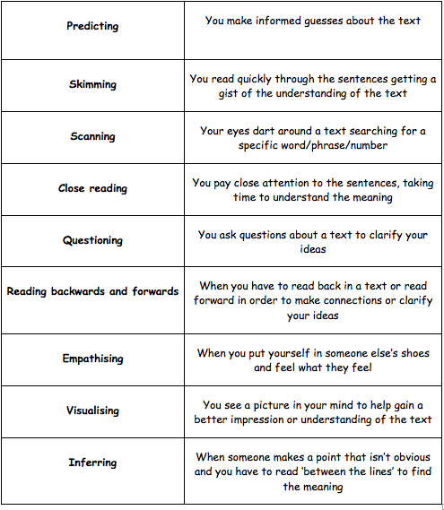
3: Alternatives to
comprehension
questions
Using:
Games
Starters
Timers
Presentations
Groupings (eg word-rich with word-poor)

Slide 40
Outcome:
To create a lesson plan, which integrates a new reading strategy

Slide 41
Key messages:
Reading matters
Accessibility can easily be altered
Reading isn’t just comprehension
Reading should be modelled as what adults do
The library has a central role in this

