Slide 1
MARKING FOR PROGRESS
Geoff Barton
September 30, 2011

Slide 2
The most important changes in classrooms were the way the teachers gave feedback to students, and the ways in which they involved the students in their own learning.
The most common form of feedback in schools in this country is for students to be given a mark, often with some sort of comment. Carefully controlled studies have shown that giving students marks is no better than giving no feedback at all. Giving comments, on the other hand, produces substantial improvements in learning.

Slide 3
However, what is surprising is that giving both marks and comments together produces no improvement. When students get both a mark and a comment, the first thing they do is look at their mark.
The second thing they do is look at their neighbour’s mark. They hardly ever look at the comments. Teachers who spend time crafting helpful comments are therefore wasting their time if they also give a mark - the students who get high marks feel they don’t need to read the comments, and those who get low marks don’t want to.
The teachers would be better off just giving marks. The students won’t learn anything, but it saves time

Slide 4
Our feedback must tell students not just what needs to be improved, but also how to go about it. We need to involve them more in their learning.

Slide 5
Some Gentle Provocations …

Slide 6
1 If I am a student in your classroom, how do I know how well I am doing? How do I know how well I could be doing? How do I know what I need to do next to improve?
2 If you are away, are there resources that will help me to continue to make progress? Is there a clear, annotated exemplar of what outstanding work looks like – something that I can aspire to?
3 Do you mark my work? How? How often? Are you marking it for me, for my parents, or for ‘the management’?
4 Will the feedback you give me resemble the feedback my teacher last year or in the classroom next door gave me? If not, why not? Am I being quietly expected to play ‘guess what’s in the teacher’s mind’?

Slide 7
5 Do you talk to me about my work and progress? Do older students or better students give me feedback? Do I mix with the word-rich and the experts in this subject, or am I consigned to the word-poor?
6 Where can I keep track of the progress I am making: is there a grid or graph I can refer to? When and how often do I know my targets and target grades? Where can my parents see these? Does progress in my mind only mean grades?
7 When you mark my work what do you correct? Do you change my grammar and spelling? All of it or some of it? How do you know whether the corrections you make have any impact?
8 How will you inform me about marking criteria and symbols in the future?

Slide 8
Two guiding principles
60% of secondary children never have a conversation with an adult in school
Prof John West-Burnham
UK spends £2.4 billion in teacher marking, chiefly to keep parents happy. Most marking has no effect.
Dylan Wiliam

Slide 9
Improving learning through
assessment depends on:
the provision of effective feedback to pupils;
the active involvement of pupils in their own learning;
adjusting teaching to take account of the results of assessment;
a recognition of the profound influence assessment has on the motivation and self-esteem of pupils, both of which are crucial influences on learning;
the need for pupils to be able to assess themselves and understand how to improve.

Slide 10
10 practical steps to improve marking
1
Have an assessment policy that clearly separates FORMATIVE and SUMMATIVE assessment
Assessment for learning
Assessment for monitoring

Slide 11
2
Re-think what formative assessment includes …
Peer evaluation
Group feedback
Rapid 1:1s

Slide 12
3
Therefore re-think assessment tasks and homework
eg every lesson has a homework of 15 minutes
Reinforcing skills … leading to the next stage in learning

Slide 13
4
Thus give higher status to homework
Every lesson starts swith a rapid recap of skills

Slide 14
5
Thus use step-by-step homeworks to lead to key assessments every 4 weeks

Slide 15
6
Communicate this policy to parents, emphasising the frequency and rigour of homework

Slide 16
7
Make marking criteria explicit - ie “this is what I am looking for in this piece of work”

Slide 17
8
Mark selectively: eg features which are related to:
(i) the specific task
(ii) subject-specific uses of language and/or
(iii) the school’s cross-curricular priorities for literacy development.

Slide 18
9
Develop a consistent approach, easily interpretable by pupils and parents: this means consistency across subjects and teachers

Slide 19
10
Make it interactive - expect a response: we have to involve students more in their own progress

Slide 20
OUR APPROACH
Get feedback from students on their attitudes to marking - what helps them & what doesn’t
Display marking criteria in all classrooms
Get one team testing new homework-setting patterns
Get clear in our own minds formative -v- summative assessment
Use sampling to evaluate marking

Slide 21
Some examples …

Slide 31
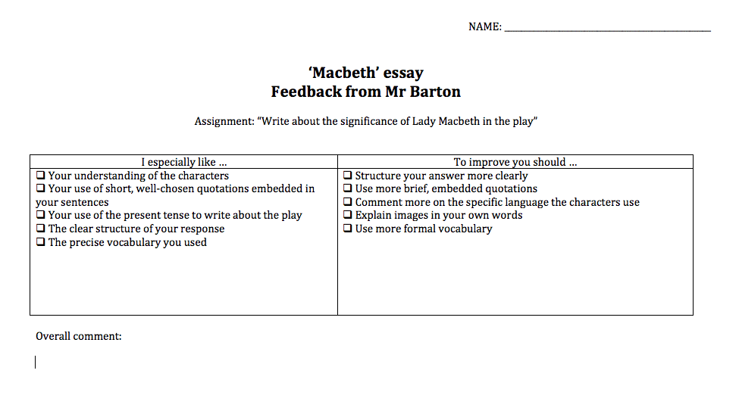

Slide 32
ACTIVITY:
Think about marking in your classroom and re-mark a piece of work using the standard symbols

Slide 33
MARKING FOR PROGRESS
Geoff Barton
September 30, 2011

