Slide 1
Don’t Call it Literacy
Geoff Barton
Head, King Edward VI School, Bury St Edmunds
Wednesday, July 7, 2010
Download this presentation at www.geoffbarton.uk
Teacher Resources page: download number 79

Slide 2
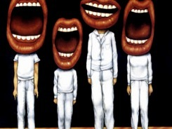
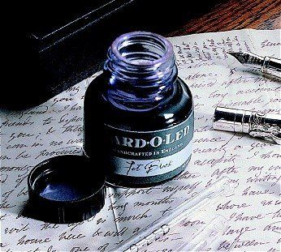

Slide 3
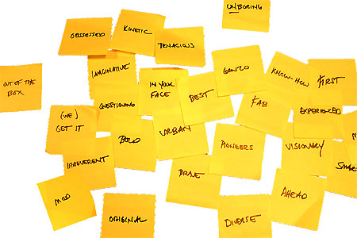
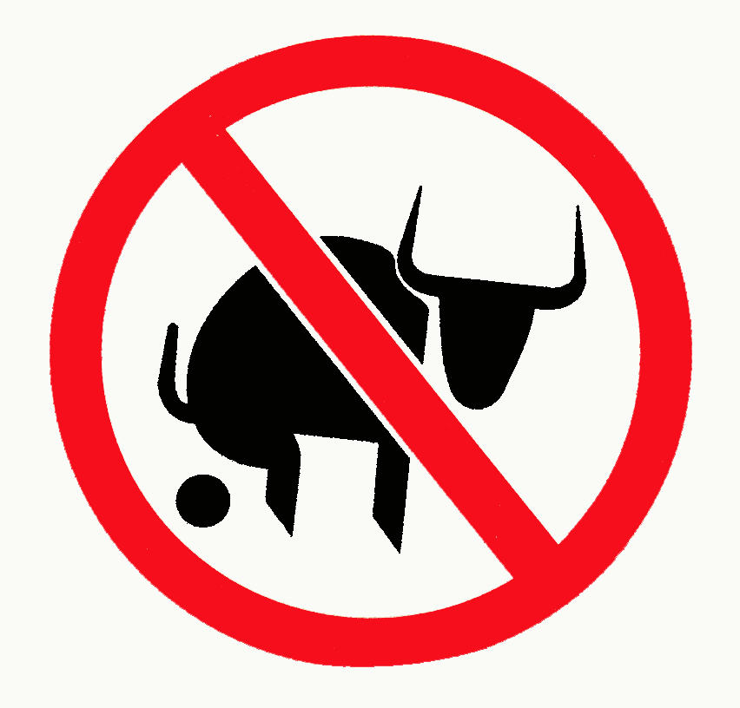
Approach:

Slide 4
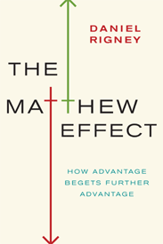

Slide 5
3
Opening provocations:
1:
We haven’t ‘done’ literacy

Slide 6
3
Opening provocations:
2:
Every teacher in English is a teacher of English
George Sampson, “English for the English”, 1922

Slide 7
3
Opening provocations:
3:
Literacy matters

Slide 8
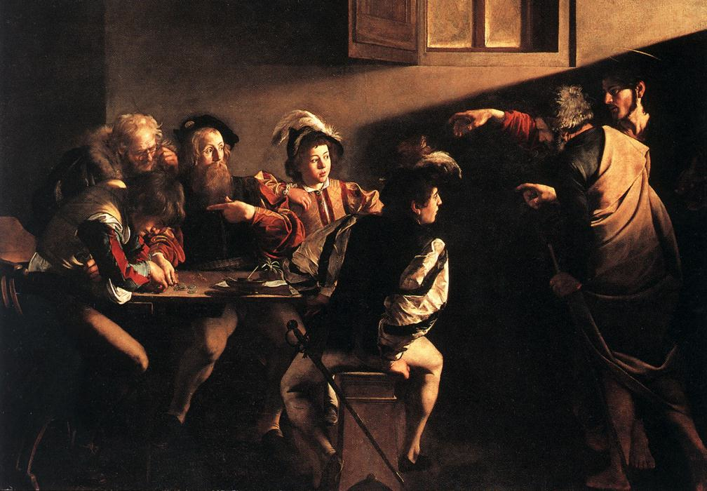

Slide 9
“For whosoever hath, to him shall be given and he shall have more abundance: but whosoever hath not, from him shall be taken away even that he hath”.

Slide 10
The rich shall get richer and the poor shall get poorer

Slide 11
“the word-rich get richer while the word-poor get poorer”

Slide 12
“Students who begin with high verbal aptitudes and find themselves in verbally enriched social environments are at a double advantage.”

Slide 13
Poor readers become increasingly frustrated with the act of reading, and try to avoid reading where possible … more likely to drop out of school …
Good readers may choose friends who also read avidly while poor readers seek friends with whom they share other enjoyments

Slide 14
“While good readers gain new skills very rapidly, and quickly move from learning to read to reading to learn, poor readers become increasingly frustrated with the act of reading, and try to avoid reading where possible”

Slide 15
“While good readers gain new skills very rapidly, and quickly move from learning to read to reading to learn, poor readers become increasingly frustrated with the act of reading, and try to avoid reading where possible”

Slide 16
“The children who possess intellectual capital when they first arrive at school have the mental scaffolding and Velcro to catch hold of what is going on, and they can turn the new knowledge into still more Velcro to gain still more knowledge”.

Slide 17
Stricht’s Law: “reading ability in children cannot exceed their listening ability …”

Slide 18
What we know about … the importance of talk
“Spoken language forms a constraint, a ceiling not only on the ability to comprehend but also on the ability to write, beyond which literacy cannot progress”
Myhill & Fisher
Cited in Ofsted English Report 2005

Slide 19
The Literacy Club

Slide 20
Dogs must be carried on the escalator

Slide 21
LITERACY for LEARNING

Slide 23
Understand the significance of exploratory talk
Model good talk – eg connectives
Re-think questioning: why & how?
Re-think hands-up
Get conversations into the school culture

Slide 24
Teach reading – scanning, skimming, analysis
Read aloud and display
Build word power
Demystify spelling
Teach research, not FOFO

Slide 25
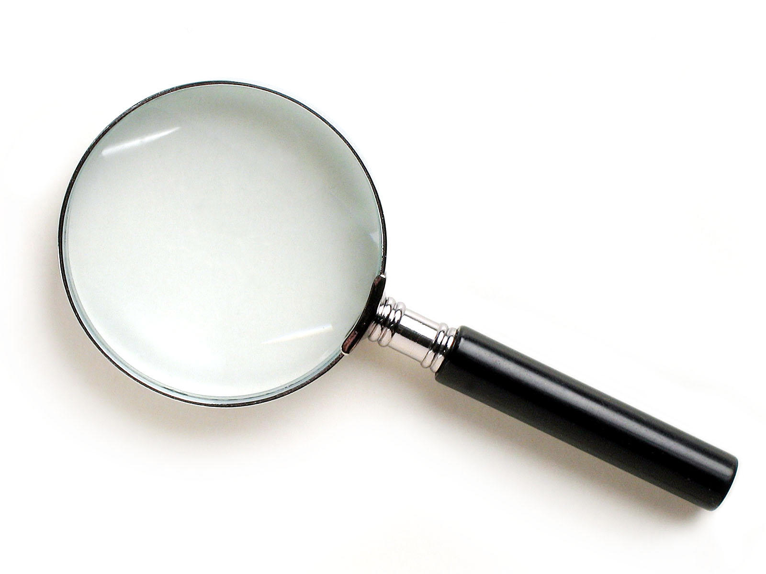
SKIMMING

Slide 26
The climate of the Earth is always changing. In the past it has altered as a result of natural causes. Nowadays, however, the term climate change is generally used when referring to changes in our climate which have been identified since the early part of the 1900's . The changes we've seen over recent years and those which are predicted over the next 80 years are thought to be mainly as a result of human behaviour rather than due to natural changes in the atmosphere.

Slide 27
The best treatment for mouth ulcers. Gargle with salt water. You should find that it works a treat. Salt is cheap and easy to get hold of and we all have it at home, so no need to splash out and spend lots of money on expensive mouth ulcer creams.

Slide 28
SCANNING

Slide 29
Where did the first cell phones begin?
Name 2 other features that started to be included in phones
Why are cell phones especially useful in some countries?

Slide 30
Where begin?
Two features?
Some countries?
Cellular telephones
The first cellular telephone system began operation in Tokyo in 1979, and the first U.S. system began operation in 1983 in Chicago. A camera phone is a cellular phone that also has picture taking capabilities. Some camera phones have the capability to send these photos to another cellular phone or computer. Advances in digital technology and microelectronics has led to the inclusion of unrelated applications in cellular telephones, such as alarm clocks, calculators, Internet browsers, and voice memos for recording short verbal reminders, while at the same time making such telephones vulnerable to certain software viruses. In many countries with inadequate wire-based telephone networks, cellular telephone systems have provided a means of more quickly establishing a national telecommunications network.

Slide 31
How we read:
Exploring lexical v grammatical clues

Slide 32
What type of text is this?
What is its topic?

Slide 33
The name of the planet is derives from the mythical Roman god Saturn, god of fertility, and agriculture. The god Saturn also gives its name to the word "Saturday". Saturn is clearly visible in the night sky with the naked eye, and in consequence has been known to humans since pre-historic times, but it was not until the year 1659 that the Astronomer Christian Huygens correctly identified Saturn's now famous rings using his telescope. Saturn is the sixth furthest planet in our solar system from the sun, the average distance being 1427 million km; Earth by comparison is nine and a half times this distance away from the sun. The planet Saturn has a diameter of about 120536km, eleven times that of the Earth, making it the second biggest planet in our solar system. Its mass is second only to Jupiter, and is 95 times greater than that of Earth.
1Type of Text? 2Topic?
Facts and info about the Planet Saturn

Slide 34
The name of the planet is derives from the mythical Roman god Saturn, god of fertility, and agriculture. The god Saturn also gives its name to the word "Saturday". Saturn is clearly visible in the night sky with the naked eye, and in consequence has been known to humans since pre-historic times, but it was not until the year 1659 that the Astronomer Christian Huygens correctly identified Saturn's now famous rings using his telescope. Saturn is the sixth furthest planet in our solar system from the sun, the average distance being 1427 million km; Earth by comparison is nine and a half times this distance away from the sun. The planet Saturn has a diameter of about 120536km, eleven times that of the Earth, making it the second biggest planet in our solar system. Its mass is second only to Jupiter, and is 95 times greater than that of Earth.
1Type of Text? 2Topic?
Facts and info about the Planet Saturn

Slide 35
The name of the planet is derives from the mythical Roman god Saturn, god of fertility, and agriculture. The god Saturn also gives its name to the word "Saturday". Saturn is clearly visible in the night sky with the naked eye, and in consequence has been known to humans since pre-historic times, but it was not until the year 1659 that the Astronomer Christian Huygens correctly identified Saturn's now famous rings using his telescope. Saturn is the sixth furthest planet in our solar system from the sun, the average distance being 1427 million km; Earth by comparison is nine and a half times this distance away from the sun. The planet Saturn has a diameter of about 120536km, eleven times that of the Earth, making it the second biggest planet in our solar system. Its mass is second only to Jupiter, and is 95 times greater than that of Earth.
1Type of Text? 2Topic?
Facts and info about the Planet Saturn

Slide 36
The name of the planet is derives from the mythical Roman god Saturn, god of fertility, and agriculture. The god Saturn also gives its name to the word "Saturday". Saturn is clearly visible in the night sky with the naked eye, and in consequence has been known to humans since pre-historic times, but it was not until the year 1659 that the Astronomer Christian Huygens correctly identified Saturn's now famous rings using his telescope. Saturn is the sixth furthest planet in our solar system from the sun, the average distance being 1427 million km; Earth by comparison is nine and a half times this distance away from the sun. The planet Saturn has a diameter of about 120536km, eleven times that of the Earth, making it the second biggest planet in our solar system. Its mass is second only to Jupiter, and is 95 times greater than that of Earth.
1Type of Text? 2Topic?
Facts and info about the Planet Saturn

Slide 37
The name of the planet is derives from the mythical Roman god Saturn, god of fertility, and agriculture. The god Saturn also gives its name to the word "Saturday". Saturn is clearly visible in the night sky with the naked eye, and in consequence has been known to humans since pre-historic times, but it was not until the year 1659 that the Astronomer Christian Huygens correctly identified Saturn's now famous rings using his telescope. Saturn is the sixth furthest planet in our solar system from the sun, the average distance being 1427 million km; Earth by comparison is nine and a half times this distance away from the sun. The planet Saturn has a diameter of about 120536km, eleven times that of the Earth, making it the second biggest planet in our solar system. Its mass is second only to Jupiter, and is 95 times greater than that of Earth.
1Type of Text? 2Topic?
Facts and info about the Planet Saturn

Slide 38
The name of the planet is derives from the mythical Roman god Saturn, god of fertility, and agriculture. The god Saturn also gives its name to the word "Saturday". Saturn is clearly visible in the night sky with the naked eye, and in consequence has been known to humans since pre-historic times, but it was not until the year 1659 that the Astronomer Christian Huygens correctly identified Saturn's now famous rings using his telescope. Saturn is the sixth furthest planet in our solar system from the sun, the average distance being 1427 million km; Earth by comparison is nine and a half times this distance away from the sun. The planet Saturn has a diameter of about 120536km, eleven times that of the Earth, making it the second biggest planet in our solar system. Its mass is second only to Jupiter, and is 95 times greater than that of Earth.
1Type of Text? 2Topic?
Facts and info about the Planet Saturn

Slide 39
The name of the planet is derives from the mythical Roman god Saturn, god of fertility, and agriculture. The god Saturn also gives its name to the word "Saturday". Saturn is clearly visible in the night sky with the naked eye, and in consequence has been known to humans since pre-historic times, but it was not until the year 1659 that the Astronomer Christian Huygens correctly identified Saturn's now famous rings using his telescope. Saturn is the sixth furthest planet in our solar system from the sun, the average distance being 1427 million km; Earth by comparison is nine and a half times this distance away from the sun. The planet Saturn has a diameter of about 120536km, eleven times that of the Earth, making it the second biggest planet in our solar system. Its mass is second only to Jupiter, and is 95 times greater than that of Earth.
1Type of Text? 2Topic?
Facts and info about the Planet Saturn

Slide 40
The name of the planet is derives from the mythical Roman god Saturn, god of fertility, and agriculture. The god Saturn also gives its name to the word "Saturday". Saturn is clearly visible in the night sky with the naked eye, and in consequence has been known to humans since pre-historic times, but it was not until the year 1659 that the Astronomer Christian Huygens correctly identified Saturn's now famous rings using his telescope. Saturn is the sixth furthest planet in our solar system from the sun, the average distance being 1427 million km; Earth by comparison is nine and a half times this distance away from the sun. The planet Saturn has a diameter of about 120536km, eleven times that of the Earth, making it the second biggest planet in our solar system. Its mass is second only to Jupiter, and is 95 times greater than that of Earth.
1Type of Text? 2Topic?
Facts and info about the Planet Saturn

Slide 41
The name of the planet is derives from the mythical Roman god Saturn, god of fertility, and agriculture. The god Saturn also gives its name to the word "Saturday". Saturn is clearly visible in the night sky with the naked eye, and in consequence has been known to humans since pre-historic times, but it was not until the year 1659 that the Astronomer Christian Huygens correctly identified Saturn's now famous rings using his telescope. Saturn is the sixth furthest planet in our solar system from the sun, the average distance being 1427 million km; Earth by comparison is nine and a half times this distance away from the sun. The planet Saturn has a diameter of about 120536km, eleven times that of the Earth, making it the second biggest planet in our solar system. Its mass is second only to Jupiter, and is 95 times greater than that of Earth.
1Type of Text? 2Topic?
Facts and info about the Planet Saturn

Slide 42
The name of the planet is derives from the mythical Roman god Saturn, god of fertility, and agriculture. The god Saturn also gives its name to the word "Saturday". Saturn is clearly visible in the night sky with the naked eye, and in consequence has been known to humans since pre-historic times, but it was not until the year 1659 that the Astronomer Christian Huygens correctly identified Saturn's now famous rings using his telescope. Saturn is the sixth furthest planet in our solar system from the sun, the average distance being 1427 million km; Earth by comparison is nine and a half times this distance away from the sun. The planet Saturn has a diameter of about 120536km, eleven times that of the Earth, making it the second biggest planet in our solar system. Its mass is second only to Jupiter, and is 95 times greater than that of Earth.
1Type of Text? 2Topic?
Facts and info about the Planet Saturn

Slide 43
The name of the planet is derives from the mythical Roman god Saturn, god of fertility, and agriculture. The god Saturn also gives its name to the word "Saturday". Saturn is clearly visible in the night sky with the naked eye, and in consequence has been known to humans since pre-historic times, but it was not until the year 1659 that the Astronomer Christian Huygens correctly identified Saturn's now famous rings using his telescope. Saturn is the sixth furthest planet in our solar system from the sun, the average distance being 1427 million km; Earth by comparison is nine and a half times this distance away from the sun. The planet Saturn has a diameter of about 120536km, eleven times that of the Earth, making it the second biggest planet in our solar system. Its mass is second only to Jupiter, and is 95 times greater than that of Earth.
1Type of Text? 2Topic?
Facts and info about the Planet Saturn

Slide 44
The name of the planet is derives from the mythical Roman god Saturn, god of fertility, and agriculture. The god Saturn also gives its name to the word "Saturday". Saturn is clearly visible in the night sky with the naked eye, and in consequence has been known to humans since pre-historic times, but it was not until the year 1659 that the Astronomer Christian Huygens correctly identified Saturn's now famous rings using his telescope. Saturn is the sixth furthest planet in our solar system from the sun, the average distance being 1427 million km; Earth by comparison is nine and a half times this distance away from the sun. The planet Saturn has a diameter of about 120536km, eleven times that of the Earth, making it the second biggest planet in our solar system. Its mass is second only to Jupiter, and is 95 times greater than that of Earth.
1Type of Text? 2Topic?
Facts and info about the Planet Saturn

Slide 45
The name of the planet is derives from the mythical Roman god Saturn, god of fertility, and agriculture. The god Saturn also gives its name to the word "Saturday". Saturn is clearly visible in the night sky with the naked eye, and in consequence has been known to humans since pre-historic times, but it was not until the year 1659 that the Astronomer Christian Huygens correctly identified Saturn's now famous rings using his telescope. Saturn is the sixth furthest planet in our solar system from the sun, the average distance being 1427 million km; Earth by comparison is nine and a half times this distance away from the sun. The planet Saturn has a diameter of about 120536km, eleven times that of the Earth, making it the second biggest planet in our solar system. Its mass is second only to Jupiter, and is 95 times greater than that of Earth.
1Type of Text? 2Topic?
Facts and info about the Planet Saturn

Slide 46
The name of the planet is derives from the mythical Roman god Saturn, god of fertility, and agriculture. The god Saturn also gives its name to the word "Saturday". Saturn is clearly visible in the night sky with the naked eye, and in consequence has been known to humans since pre-historic times, but it was not until the year 1659 that the Astronomer Christian Huygens correctly identified Saturn's now famous rings using his telescope. Saturn is the sixth furthest planet in our solar system from the sun, the average distance being 1427 million km; Earth by comparison is nine and a half times this distance away from the sun. The planet Saturn has a diameter of about 120536km, eleven times that of the Earth, making it the second biggest planet in our solar system. Its mass is second only to Jupiter, and is 95 times greater than that of Earth.
1Type of Text? 2Topic?
Facts and info about the Planet Saturn

Slide 47
The name of the planet is derives from the mythical Roman god Saturn, god of fertility, and agriculture. The god Saturn also gives its name to the word "Saturday". Saturn is clearly visible in the night sky with the naked eye, and in consequence has been known to humans since pre-historic times, but it was not until the year 1659 that the Astronomer Christian Huygens correctly identified Saturn's now famous rings using his telescope. Saturn is the sixth furthest planet in our solar system from the sun, the average distance being 1427 million Km; Earth by comparison is nine and a half times this distance away from the sun. The planet Saturn has a diameter of about 120536km, eleven times that of the Earth, making it the second biggest planet in our solar system. Its mass is second only to Jupiter, and is 95 times greater than that of Earth.
1Type of Text? 2Topic?
Facts and info about the Planet Saturn
Saturn
http://www.facts-about.org.uk/science-planet-saturn-planet-info.htm

Slide 48
How we Read: Exploring Lexical v Grammatical Clues

Slide 49
What type of text is this?
What is its topic?

Slide 50
1Type of Text? 2Topic?
The beginning of the bassoon is similar to the oboe. The bassoon itself first appeared about 1650, and by the end of the 1700’s, it had from 4 to 8 keys. During the 1800’s, many people experimented with improving the fingering of the bassoon. Most of the changes helped the fingering, but made the tone of the instrument suffer. The Heckel family of Germany managed to improve the fingering of the bassoon without damaging its tone. Many professionals today play bassoons made by the Heckel Company.The bassoon is the lowest and largest of the woodwinds. Its sound has a lot of variety, depending on if low, medium or high notes are used. In the very highest range, the bassoon can sound throaty and not of this world. In its mid-range, the bassoon has a large, full, mellow noise. In the lowest range, it can be extremely powerful and heavy.

Slide 51
1Type of Text? 2Topic?
The beginning of the bassoon is similar to the oboe. The bassoon itself first appeared about 1650, and by the end of the 1700’s, it had from 4 to 8 keys. During the 1800’s, many people experimented with improving the fingering of the bassoon. Most of the changes helped the fingering, but made the tone of the instrument suffer. The Heckel family of Germany managed to improve the fingering of the bassoon without damaging its tone. Many professionals today play bassoons made by the Heckel Company.The bassoon is the lowest and largest of the woodwinds. Its sound has a lot of variety, depending on if low, medium or high notes are used. In the very highest range, the bassoon can sound throaty and not of this world. In its mid-range, the bassoon has a large, full, mellow noise. In the lowest range, it can be extremely powerful and heavy.

Slide 52
1Type of Text? 2Topic?
The beginning of the bassoon is similar to the oboe. The bassoon itself first appeared about 1650, and by the end of the 1700’s, it had from 4 to 8 keys. During the 1800’s, many people experimented with improving the fingering of the bassoon. Most of the changes helped the fingering, but made the tone of the instrument suffer. The Heckel family of Germany managed to improve the fingering of the bassoon without damaging its tone. Many professionals today play bassoons made by the Heckel Company.The bassoon is the lowest and largest of the woodwinds. Its sound has a lot of variety, depending on if low, medium or high notes are used. In the very highest range, the bassoon can sound throaty and not of this world. In its mid-range, the bassoon has a large, full, mellow noise. In the lowest range, it can be extremely powerful and heavy.

Slide 53
1Type of Text? 2Topic?
The beginning of the bassoon is similar to the oboe. The bassoon itself first appeared about 1650, and by the end of the 1700’s, it had from 4 to 8 keys. During the 1800’s, many people experimented with improving the fingering of the bassoon. Most of the changes helped the fingering, but made the tone of the instrument suffer. The Heckel family of Germany managed to improve the fingering of the bassoon without damaging its tone. Many professionals today play bassoons made by the Heckel Company.The bassoon is the lowest and largest of the woodwinds. Its sound has a lot of variety, depending on if low, medium or high notes are used. In the very highest range, the bassoon can sound throaty and not of this world. In its mid-range, the bassoon has a large, full, mellow noise. In the lowest range, it can be extremely powerful and heavy.

Slide 54
1Type of Text? 2Topic?
The beginning of the bassoon is similar to the oboe. The bassoon itself first appeared about 1650, and by the end of the 1700’s, it had from 4 to 8 keys. During the 1800’s, many people experimented with improving the fingering of the bassoon. Most of the changes helped the fingering, but made the tone of the instrument suffer. The Heckel family of Germany managed to improve the fingering of the bassoon without damaging its tone. Many professionals today play bassoons made by the Heckel Company.The bassoon is the lowest and largest of the woodwinds. Its sound has a lot of variety, depending on if low, medium or high notes are used. In the very highest range, the bassoon can sound throaty and not of this world. In its mid-range, the bassoon has a large, full, mellow noise. In the lowest range, it can be extremely powerful and heavy.

Slide 55
1Type of Text? 2Topic?
The beginning of the bassoon is similar to the oboe. The bassoon itself first appeared about 1650, and by the end of the 1700’s, it had from 4 to 8 keys. During the 1800’s, many people experimented with improving the fingering of the bassoon. Most of the changes helped the fingering, but made the tone of the instrument suffer. The Heckel family of Germany managed to improve the fingering of the bassoon without damaging its tone. Many professionals today play bassoons made by the Heckel Company.The bassoon is the lowest and largest of the woodwinds. Its sound has a lot of variety, depending on if low, medium or high notes are used. In the very highest range, the bassoon can sound throaty and not of this world. In its mid-range, the bassoon has a large, full, mellow noise. In the lowest range, it can be extremely powerful and heavy.

Slide 56
1Type of Text? 2Topic?
The beginning of the bassoon is similar to the oboe. The bassoon itself first appeared about 1650, and by the end of the 1700’s, it had from 4 to 8 keys. During the 1800’s, many people experimented with improving the fingering of the bassoon. Most of the changes helped the fingering, but made the tone of the instrument suffer. The Heckel family of Germany managed to improve the fingering of the bassoon without damaging its tone. Many professionals today play bassoons made by the Heckel Company.The bassoon is the lowest and largest of the woodwinds. Its sound has a lot of variety, depending on if low, medium or high notes are used. In the very highest range, the bassoon can sound throaty and not of this world. In its mid-range, the bassoon has a large, full, mellow noise. In the lowest range, it can be extremely powerful and heavy.

Slide 57
What’s this text?
How do you know?
Urquhart castle is probably one of the most picturesquely situated castles in the Scottish Highlands. Located 16 miles south-west of Inverness, the castle, one of the largest in Scotland, overlooks much of Loch Ness. Visitors come to stroll through the ruins of the 13th-century castle because Urquhart has earned the reputation of being one of the best spots for sighting Loch Ness’s most famous inhabitant.

Slide 58
TEACH READING

Slide 59
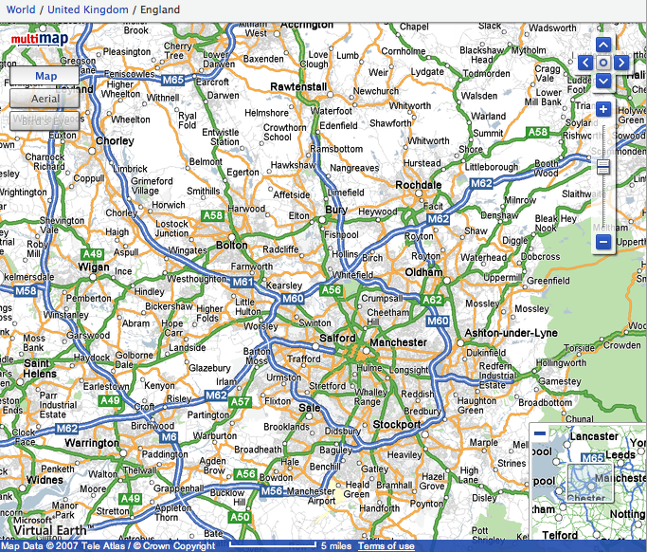

Slide 60
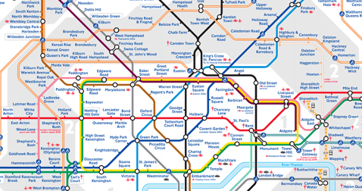
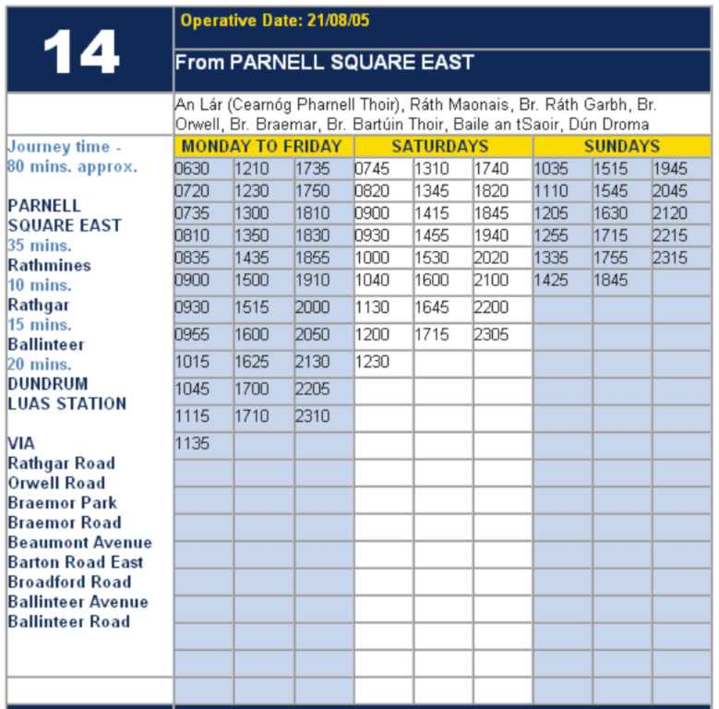
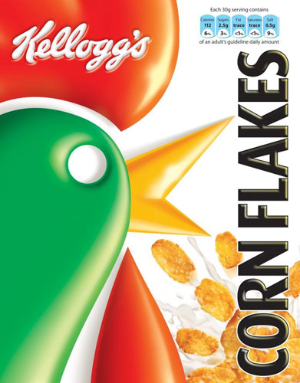
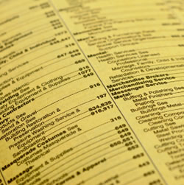

Slide 61
Research skills, not FOFO

Slide 62
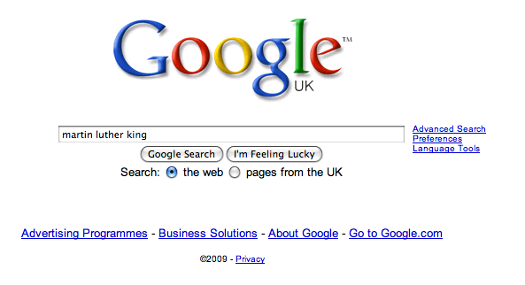

Slide 68
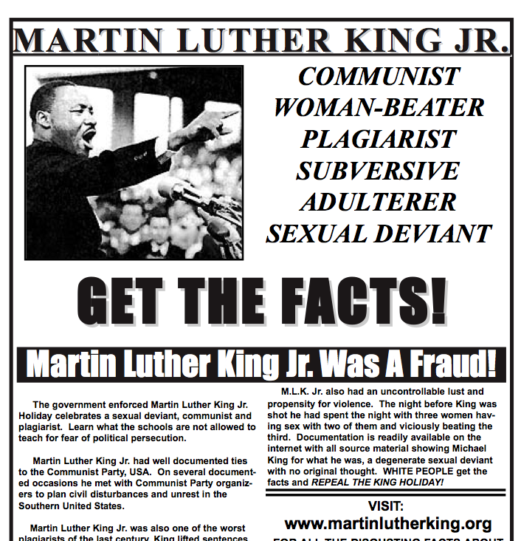

Slide 69
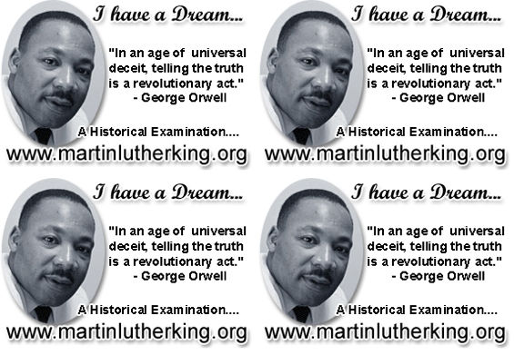

Slide 70
Demystify Spelling

Slide 71
1 - SOUNDS

Slide 72
Govern+ment
Feb-ru-ary

Slide 73
2 -VISUALS

Slide 74
Se-para-te
Be-lie-ve

Slide 75
3 - MNEMONICS

Slide 76
Necessary

Slide 77
practice / practise
replace with
advice / advise

Slide 78
BUILD WORD POWER

Slide 79
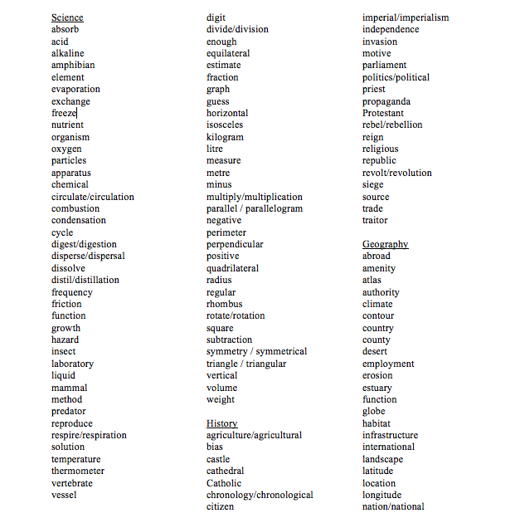

Slide 80
Demonstrate writing
Teach composition & conventions
Allow oral rehearsal
Short & long sentences
Connectives

Slide 81
Know your connectives
Adding: and, also, as well as, moreover, too
Cause & effect: because, so, therefore, thus, consequently
Sequencing: next, then, first, finally, meanwhile, before, after
Qualifying: however, although, unless, except, if, as long as, apart from, yet
Emphasising: above all, in particular, especially, significantly, indeed, notably
Illustrating: for example, such as, for instance, as revealed by, in the case of
Comparing: equally, in the same way, similarly, likewise, as with, like
Contrasting: whereas, instead of, alternatively, otherwise, unlike, on the other hand

Slide 83
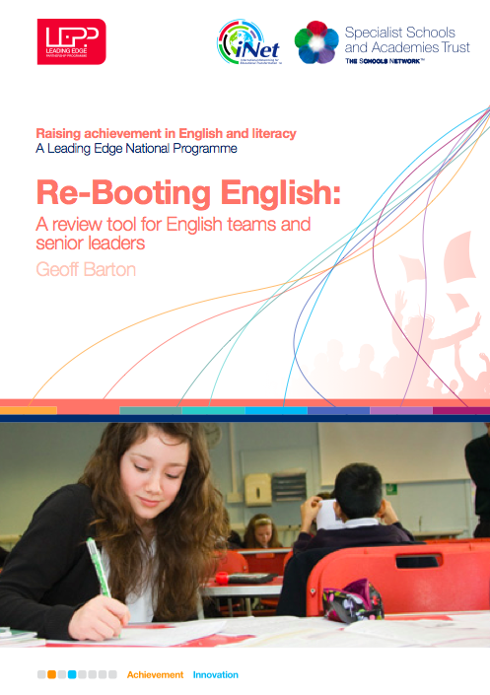
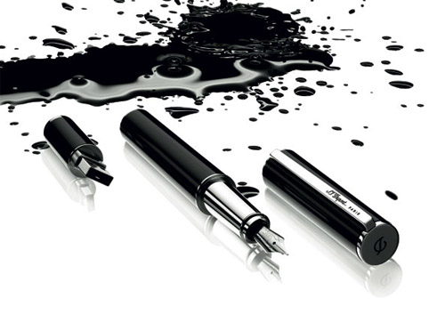

Slide 84
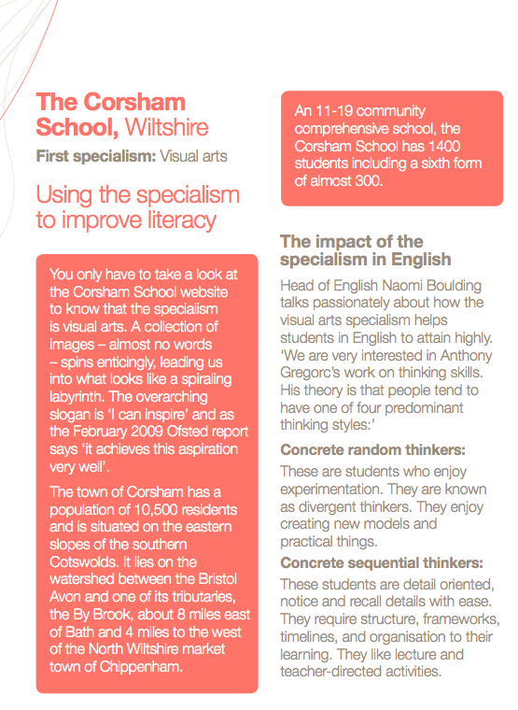
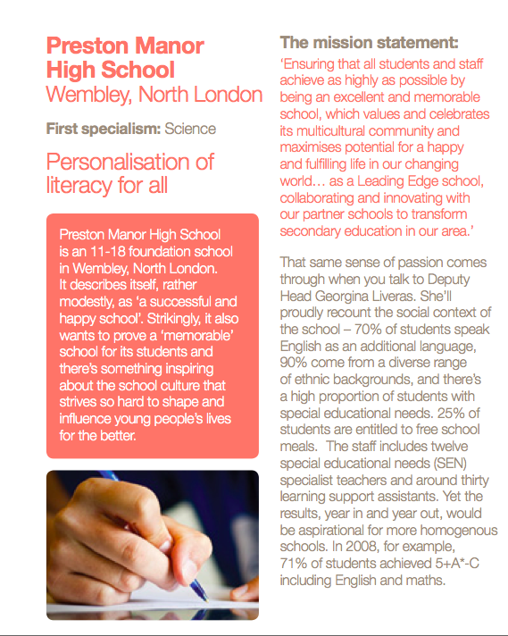
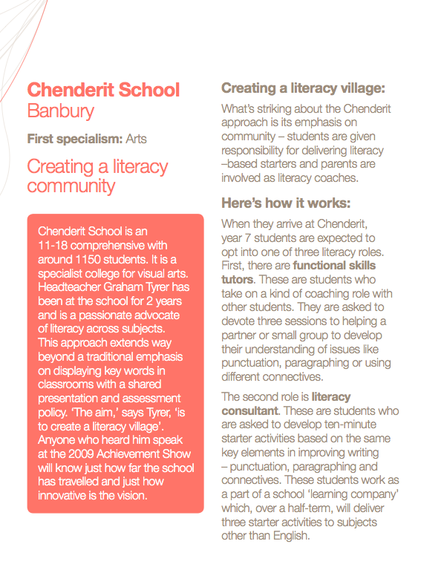
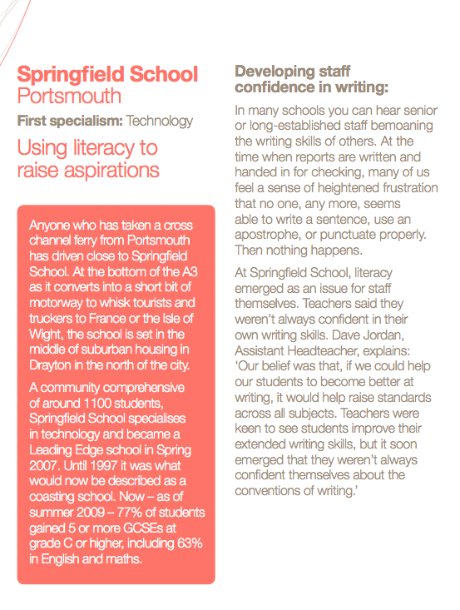
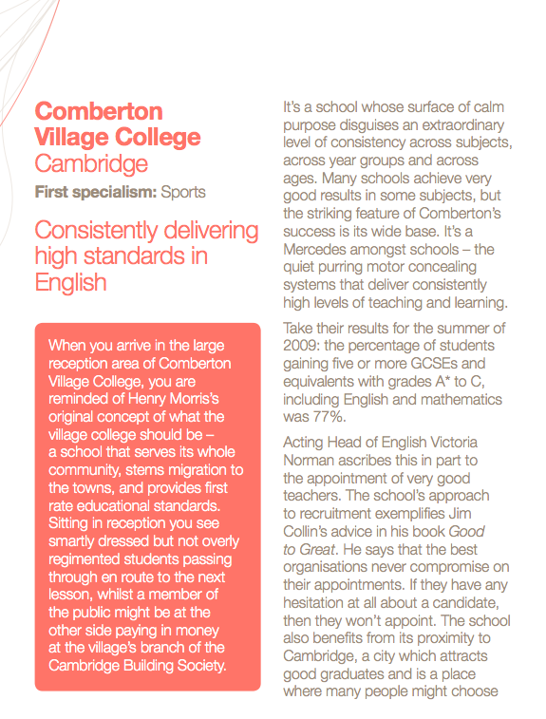

Slide 85
Don’t Call it Literacy
Geoff Barton
Head, King Edward VI School, Bury St Edmunds
Thursday, July 8, 2010
Download this presentation at www.geoffbarton.uk
Teacher Resources page: download number 79

