Slide 1
Some Strategies for School Improvement
Geoff Barton
Head, King Edward VI School, Bury St Edmunds
Friday, July 9, 2010
Download this presentation at www.geoffbarton.uk
Teacher Resources page: download number 80

Slide 2
There ain’t no Cavalry out there, Captain
Geoff Barton
Head, King Edward VI School, Bury St Edmunds
Friday, July 9, 2010
Download this presentation at www.geoffbarton.uk
Teacher Resources page: download number 80

Slide 3
Don’t Call it Literacy!
Geoff Barton
Head, King Edward VI School, Bury St Edmunds
Friday, July 9, 2010
Download this presentation at www.geoffbarton.uk
Teacher Resources page: download number 80

Slide 4
It’s all about the Classroom, Stupid!
Geoff Barton
Head, King Edward VI School, Bury St Edmunds
Friday, July 9, 2010
Download this presentation at www.geoffbarton.uk
Teacher Resources page: download number 80

Slide 5
How we help our students to learn lots and how we help our teachers to achieve that with all students

Slide 6
WHAT
HOW

Slide 7
KNOWLEDGE
LITERACY SKILLS
BEHAVIOUR FOR LEARNING

Slide 8
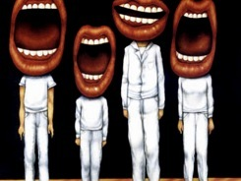
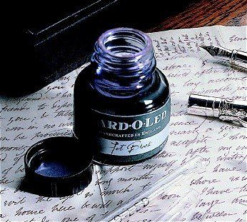

Slide 9
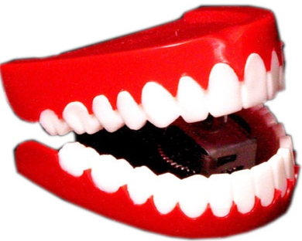
Conversation

Slide 11
Opinion, not advice

Slide 12
School improvement doesn’t come pre-packaged

Slide 13
It’s not a quick hit

Slide 14
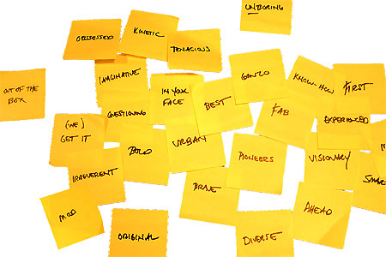
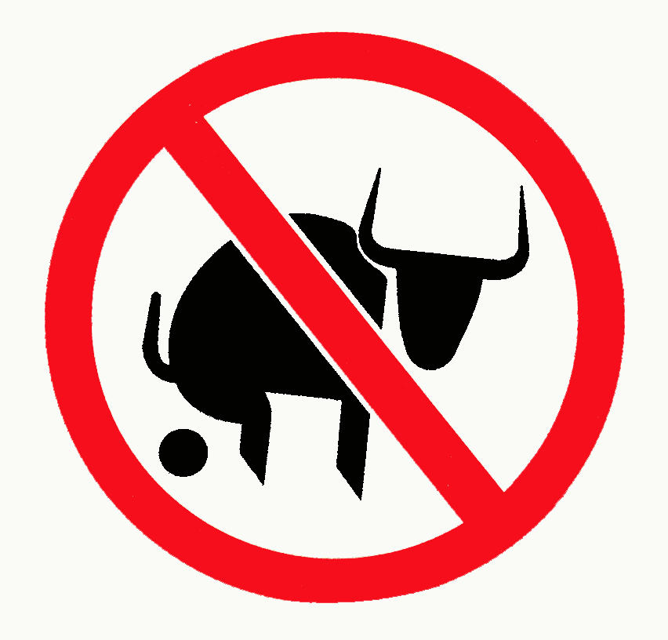
Approach:

Slide 15
Don’t Call it Literacy

Slide 16
Beacon Schools
Training Schools
Coasting Schools
Super Heads
Consultant Heads
Executive Heads
Schools are becoming immune to school improvement
London Challenge
National Challenge
National strategies
Leading Edge
Consultants
School improvement partners
Gaining Ground
Leading Light Schools
Trust Schools

Slide 17
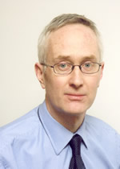
Michael Barber

Slide 18
Literacy standards in England
1945
1997

Slide 19
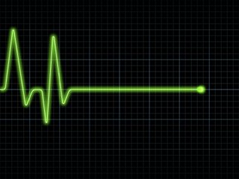

Slide 20
3
Opening provocations:
1:
We haven’t ‘done’ literacy

Slide 21
3
Opening provocations:
2:
Every teacher in English is a teacher of English
George Sampson, “English for the English”, 1922

Slide 22
3
Opening provocations:
3:
Literacy matters

Slide 23
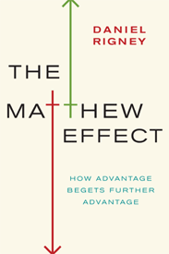
“For whosoever hath, to him shall be given and he shall have more abundance: but whosoever hath not, from him shall be taken away even that he hath”.

Slide 24
The rich shall get richer and the poor shall get poorer

Slide 25
“the word-rich get richer while the word-poor get poorer”

Slide 26
“Students who begin with high verbal aptitudes and find themselves in verbally enriched social environments are at a double advantage.”

Slide 27
Poor readers become increasingly frustrated with the act of reading, and try to avoid reading where possible … more likely to drop out of school …
Good readers may choose friends who also read avidly while poor readers seek friends with whom they share other enjoyments

Slide 28
“While good readers gain new skills very rapidly, and quickly move from learning to read to reading to learn, poor readers become increasingly frustrated with the act of reading, and try to avoid reading where possible”

Slide 29
“While good readers gain new skills very rapidly, and quickly move from learning to read to reading to learn, poor readers become increasingly frustrated with the act of reading, and try to avoid reading where possible”

Slide 30
“The children who possess intellectual capital when they first arrive at school have the mental scaffolding and Velcro to catch hold of what is going on, and they can turn the new knowledge into still more Velcro to gain still more knowledge”.

Slide 31
Stricht’s Law: “reading ability in children cannot exceed their listening ability …”

Slide 32
What we know about … the importance of talk
“Spoken language forms a constraint, a ceiling not only on the ability to comprehend but also on the ability to write, beyond which literacy cannot progress”
Myhill & Fisher
Cited in Ofsted English Report 2005

Slide 33
Churchdown parish magazine:
‘Would the congregation please note that the bowl at the back of the church labelled “for the sick” is for monetary donations only’

Slide 34
LITERACY for LEARNING

Slide 36
Understand the significance of exploratory talk
Model good talk – eg connectives
Re-think questioning: why & how?
Re-think hands-up
Get conversations into the school culture

Slide 37
Teach reading – scanning, skimming, analysis
Read aloud and display
Build word power
Demystify spelling
Teach research, not FOFO

Slide 38
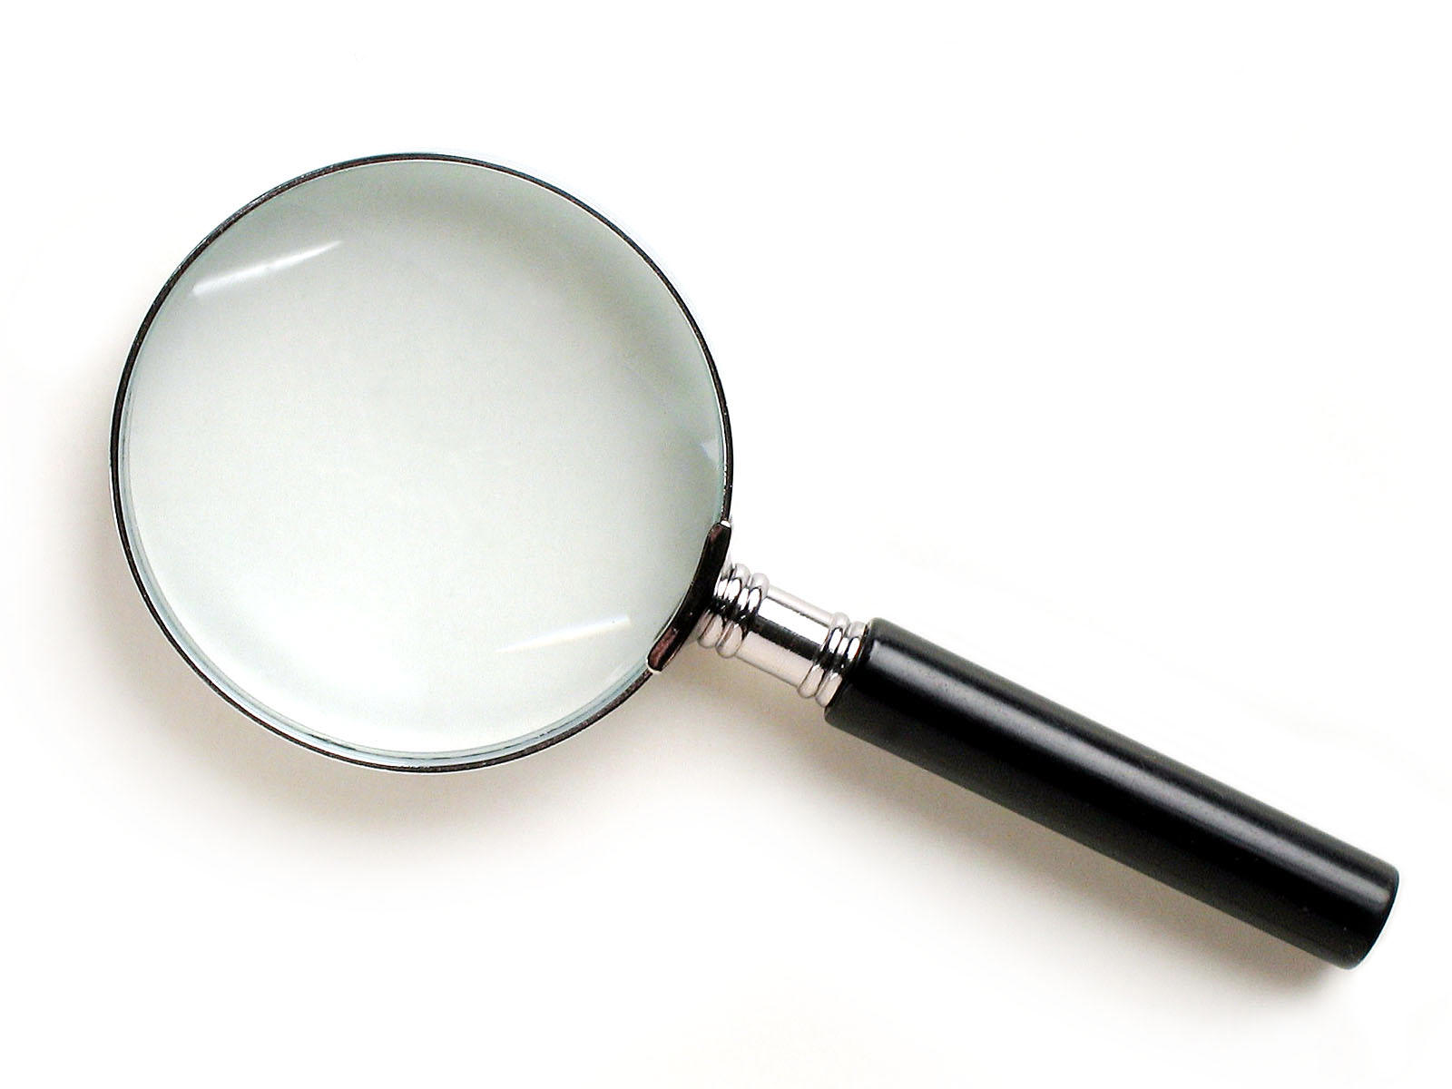
SKIMMING

Slide 39
The climate of the Earth is always changing. In the past it has altered as a result of natural causes. Nowadays, however, the term climate change is generally used when referring to changes in our climate which have been identified since the early part of the 1900's . The changes we've seen over recent years and those which are predicted over the next 80 years are thought to be mainly as a result of human behaviour rather than due to natural changes in the atmosphere.

Slide 40
The best treatment for mouth ulcers. Gargle with salt water. You should find that it works a treat. Salt is cheap and easy to get hold of and we all have it at home, so no need to splash out and spend lots of money on expensive mouth ulcer creams.

Slide 41
SCANNING

Slide 42
Where did the first cell phones begin?
Name 2 other features that started to be included in phones
Why are cell phones especially useful in some countries?

Slide 43
Where begin?
Two features?
Some countries?
Cellular telephones
The first cellular telephone system began operation in Tokyo in 1979, and the first U.S. system began operation in 1983 in Chicago. A camera phone is a cellular phone that also has picture taking capabilities. Some camera phones have the capability to send these photos to another cellular phone or computer. Advances in digital technology and microelectronics has led to the inclusion of unrelated applications in cellular telephones, such as alarm clocks, calculators, Internet browsers, and voice memos for recording short verbal reminders, while at the same time making such telephones vulnerable to certain software viruses. In many countries with inadequate wire-based telephone networks, cellular telephone systems have provided a means of more quickly establishing a national telecommunications network.

Slide 44
How we read:
Exploring lexical v grammatical clues

Slide 45
What type of text is this?
What is its topic?

Slide 46
The name of the planet is derives from the mythical Roman god Saturn, god of fertility, and agriculture. The god Saturn also gives its name to the word "Saturday". Saturn is clearly visible in the night sky with the naked eye, and in consequence has been known to humans since pre-historic times, but it was not until the year 1659 that the Astronomer Christian Huygens correctly identified Saturn's now famous rings using his telescope. Saturn is the sixth furthest planet in our solar system from the sun, the average distance being 1427 million km; Earth by comparison is nine and a half times this distance away from the sun. The planet Saturn has a diameter of about 120536km, eleven times that of the Earth, making it the second biggest planet in our solar system. Its mass is second only to Jupiter, and is 95 times greater than that of Earth.
1Type of Text? 2Topic?
Facts and info about the Planet Saturn

Slide 47
The name of the planet is derives from the mythical Roman god Saturn, god of fertility, and agriculture. The god Saturn also gives its name to the word "Saturday". Saturn is clearly visible in the night sky with the naked eye, and in consequence has been known to humans since pre-historic times, but it was not until the year 1659 that the Astronomer Christian Huygens correctly identified Saturn's now famous rings using his telescope. Saturn is the sixth furthest planet in our solar system from the sun, the average distance being 1427 million km; Earth by comparison is nine and a half times this distance away from the sun. The planet Saturn has a diameter of about 120536km, eleven times that of the Earth, making it the second biggest planet in our solar system. Its mass is second only to Jupiter, and is 95 times greater than that of Earth.
1Type of Text? 2Topic?
Facts and info about the Planet Saturn

Slide 48
The name of the planet is derives from the mythical Roman god Saturn, god of fertility, and agriculture. The god Saturn also gives its name to the word "Saturday". Saturn is clearly visible in the night sky with the naked eye, and in consequence has been known to humans since pre-historic times, but it was not until the year 1659 that the Astronomer Christian Huygens correctly identified Saturn's now famous rings using his telescope. Saturn is the sixth furthest planet in our solar system from the sun, the average distance being 1427 million km; Earth by comparison is nine and a half times this distance away from the sun. The planet Saturn has a diameter of about 120536km, eleven times that of the Earth, making it the second biggest planet in our solar system. Its mass is second only to Jupiter, and is 95 times greater than that of Earth.
1Type of Text? 2Topic?
Facts and info about the Planet Saturn

Slide 49
The name of the planet is derives from the mythical Roman god Saturn, god of fertility, and agriculture. The god Saturn also gives its name to the word "Saturday". Saturn is clearly visible in the night sky with the naked eye, and in consequence has been known to humans since pre-historic times, but it was not until the year 1659 that the Astronomer Christian Huygens correctly identified Saturn's now famous rings using his telescope. Saturn is the sixth furthest planet in our solar system from the sun, the average distance being 1427 million km; Earth by comparison is nine and a half times this distance away from the sun. The planet Saturn has a diameter of about 120536km, eleven times that of the Earth, making it the second biggest planet in our solar system. Its mass is second only to Jupiter, and is 95 times greater than that of Earth.
1Type of Text? 2Topic?
Facts and info about the Planet Saturn

Slide 50
The name of the planet is derives from the mythical Roman god Saturn, god of fertility, and agriculture. The god Saturn also gives its name to the word "Saturday". Saturn is clearly visible in the night sky with the naked eye, and in consequence has been known to humans since pre-historic times, but it was not until the year 1659 that the Astronomer Christian Huygens correctly identified Saturn's now famous rings using his telescope. Saturn is the sixth furthest planet in our solar system from the sun, the average distance being 1427 million km; Earth by comparison is nine and a half times this distance away from the sun. The planet Saturn has a diameter of about 120536km, eleven times that of the Earth, making it the second biggest planet in our solar system. Its mass is second only to Jupiter, and is 95 times greater than that of Earth.
1Type of Text? 2Topic?
Facts and info about the Planet Saturn

Slide 51
The name of the planet is derives from the mythical Roman god Saturn, god of fertility, and agriculture. The god Saturn also gives its name to the word "Saturday". Saturn is clearly visible in the night sky with the naked eye, and in consequence has been known to humans since pre-historic times, but it was not until the year 1659 that the Astronomer Christian Huygens correctly identified Saturn's now famous rings using his telescope. Saturn is the sixth furthest planet in our solar system from the sun, the average distance being 1427 million km; Earth by comparison is nine and a half times this distance away from the sun. The planet Saturn has a diameter of about 120536km, eleven times that of the Earth, making it the second biggest planet in our solar system. Its mass is second only to Jupiter, and is 95 times greater than that of Earth.
1Type of Text? 2Topic?
Facts and info about the Planet Saturn

Slide 52
The name of the planet is derives from the mythical Roman god Saturn, god of fertility, and agriculture. The god Saturn also gives its name to the word "Saturday". Saturn is clearly visible in the night sky with the naked eye, and in consequence has been known to humans since pre-historic times, but it was not until the year 1659 that the Astronomer Christian Huygens correctly identified Saturn's now famous rings using his telescope. Saturn is the sixth furthest planet in our solar system from the sun, the average distance being 1427 million km; Earth by comparison is nine and a half times this distance away from the sun. The planet Saturn has a diameter of about 120536km, eleven times that of the Earth, making it the second biggest planet in our solar system. Its mass is second only to Jupiter, and is 95 times greater than that of Earth.
1Type of Text? 2Topic?
Facts and info about the Planet Saturn

Slide 53
The name of the planet is derives from the mythical Roman god Saturn, god of fertility, and agriculture. The god Saturn also gives its name to the word "Saturday". Saturn is clearly visible in the night sky with the naked eye, and in consequence has been known to humans since pre-historic times, but it was not until the year 1659 that the Astronomer Christian Huygens correctly identified Saturn's now famous rings using his telescope. Saturn is the sixth furthest planet in our solar system from the sun, the average distance being 1427 million km; Earth by comparison is nine and a half times this distance away from the sun. The planet Saturn has a diameter of about 120536km, eleven times that of the Earth, making it the second biggest planet in our solar system. Its mass is second only to Jupiter, and is 95 times greater than that of Earth.
1Type of Text? 2Topic?
Facts and info about the Planet Saturn

Slide 54
The name of the planet is derives from the mythical Roman god Saturn, god of fertility, and agriculture. The god Saturn also gives its name to the word "Saturday". Saturn is clearly visible in the night sky with the naked eye, and in consequence has been known to humans since pre-historic times, but it was not until the year 1659 that the Astronomer Christian Huygens correctly identified Saturn's now famous rings using his telescope. Saturn is the sixth furthest planet in our solar system from the sun, the average distance being 1427 million km; Earth by comparison is nine and a half times this distance away from the sun. The planet Saturn has a diameter of about 120536km, eleven times that of the Earth, making it the second biggest planet in our solar system. Its mass is second only to Jupiter, and is 95 times greater than that of Earth.
1Type of Text? 2Topic?
Facts and info about the Planet Saturn

Slide 55
The name of the planet is derives from the mythical Roman god Saturn, god of fertility, and agriculture. The god Saturn also gives its name to the word "Saturday". Saturn is clearly visible in the night sky with the naked eye, and in consequence has been known to humans since pre-historic times, but it was not until the year 1659 that the Astronomer Christian Huygens correctly identified Saturn's now famous rings using his telescope. Saturn is the sixth furthest planet in our solar system from the sun, the average distance being 1427 million km; Earth by comparison is nine and a half times this distance away from the sun. The planet Saturn has a diameter of about 120536km, eleven times that of the Earth, making it the second biggest planet in our solar system. Its mass is second only to Jupiter, and is 95 times greater than that of Earth.
1Type of Text? 2Topic?
Facts and info about the Planet Saturn

Slide 56
The name of the planet is derives from the mythical Roman god Saturn, god of fertility, and agriculture. The god Saturn also gives its name to the word "Saturday". Saturn is clearly visible in the night sky with the naked eye, and in consequence has been known to humans since pre-historic times, but it was not until the year 1659 that the Astronomer Christian Huygens correctly identified Saturn's now famous rings using his telescope. Saturn is the sixth furthest planet in our solar system from the sun, the average distance being 1427 million km; Earth by comparison is nine and a half times this distance away from the sun. The planet Saturn has a diameter of about 120536km, eleven times that of the Earth, making it the second biggest planet in our solar system. Its mass is second only to Jupiter, and is 95 times greater than that of Earth.
1Type of Text? 2Topic?
Facts and info about the Planet Saturn

Slide 57
The name of the planet is derives from the mythical Roman god Saturn, god of fertility, and agriculture. The god Saturn also gives its name to the word "Saturday". Saturn is clearly visible in the night sky with the naked eye, and in consequence has been known to humans since pre-historic times, but it was not until the year 1659 that the Astronomer Christian Huygens correctly identified Saturn's now famous rings using his telescope. Saturn is the sixth furthest planet in our solar system from the sun, the average distance being 1427 million km; Earth by comparison is nine and a half times this distance away from the sun. The planet Saturn has a diameter of about 120536km, eleven times that of the Earth, making it the second biggest planet in our solar system. Its mass is second only to Jupiter, and is 95 times greater than that of Earth.
1Type of Text? 2Topic?
Facts and info about the Planet Saturn

Slide 58
The name of the planet is derives from the mythical Roman god Saturn, god of fertility, and agriculture. The god Saturn also gives its name to the word "Saturday". Saturn is clearly visible in the night sky with the naked eye, and in consequence has been known to humans since pre-historic times, but it was not until the year 1659 that the Astronomer Christian Huygens correctly identified Saturn's now famous rings using his telescope. Saturn is the sixth furthest planet in our solar system from the sun, the average distance being 1427 million km; Earth by comparison is nine and a half times this distance away from the sun. The planet Saturn has a diameter of about 120536km, eleven times that of the Earth, making it the second biggest planet in our solar system. Its mass is second only to Jupiter, and is 95 times greater than that of Earth.
1Type of Text? 2Topic?
Facts and info about the Planet Saturn

Slide 59
The name of the planet is derives from the mythical Roman god Saturn, god of fertility, and agriculture. The god Saturn also gives its name to the word "Saturday". Saturn is clearly visible in the night sky with the naked eye, and in consequence has been known to humans since pre-historic times, but it was not until the year 1659 that the Astronomer Christian Huygens correctly identified Saturn's now famous rings using his telescope. Saturn is the sixth furthest planet in our solar system from the sun, the average distance being 1427 million km; Earth by comparison is nine and a half times this distance away from the sun. The planet Saturn has a diameter of about 120536km, eleven times that of the Earth, making it the second biggest planet in our solar system. Its mass is second only to Jupiter, and is 95 times greater than that of Earth.
1Type of Text? 2Topic?
Facts and info about the Planet Saturn

Slide 60
The name of the planet is derives from the mythical Roman god Saturn, god of fertility, and agriculture. The god Saturn also gives its name to the word "Saturday". Saturn is clearly visible in the night sky with the naked eye, and in consequence has been known to humans since pre-historic times, but it was not until the year 1659 that the Astronomer Christian Huygens correctly identified Saturn's now famous rings using his telescope. Saturn is the sixth furthest planet in our solar system from the sun, the average distance being 1427 million Km; Earth by comparison is nine and a half times this distance away from the sun. The planet Saturn has a diameter of about 120536km, eleven times that of the Earth, making it the second biggest planet in our solar system. Its mass is second only to Jupiter, and is 95 times greater than that of Earth.
1Type of Text? 2Topic?
Facts and info about the Planet Saturn
Saturn
http://www.facts-about.org.uk/science-planet-saturn-planet-info.htm

Slide 61
How we Read: Exploring Lexical v Grammatical Clues

Slide 62
1Type of Text? 2Topic?
The beginning of the bassoon is similar to the oboe. The bassoon itself first appeared about 1650, and by the end of the 1700’s, it had from 4 to 8 keys. During the 1800’s, many people experimented with improving the fingering of the bassoon. Most of the changes helped the fingering, but made the tone of the instrument suffer. The Heckel family of Germany managed to improve the fingering of the bassoon without damaging its tone. Many professionals today play bassoons made by the Heckel Company.The bassoon is the lowest and largest of the woodwinds. Its sound has a lot of variety, depending on if low, medium or high notes are used. In the very highest range, the bassoon can sound throaty and not of this world. In its mid-range, the bassoon has a large, full, mellow noise. In the lowest range, it can be extremely powerful and heavy.

Slide 63
1Type of Text? 2Topic?
The beginning of the bassoon is similar to the oboe. The bassoon itself first appeared about 1650, and by the end of the 1700’s, it had from 4 to 8 keys. During the 1800’s, many people experimented with improving the fingering of the bassoon. Most of the changes helped the fingering, but made the tone of the instrument suffer. The Heckel family of Germany managed to improve the fingering of the bassoon without damaging its tone. Many professionals today play bassoons made by the Heckel Company.The bassoon is the lowest and largest of the woodwinds. Its sound has a lot of variety, depending on if low, medium or high notes are used. In the very highest range, the bassoon can sound throaty and not of this world. In its mid-range, the bassoon has a large, full, mellow noise. In the lowest range, it can be extremely powerful and heavy.

Slide 64
1Type of Text? 2Topic?
The beginning of the bassoon is similar to the oboe. The bassoon itself first appeared about 1650, and by the end of the 1700’s, it had from 4 to 8 keys. During the 1800’s, many people experimented with improving the fingering of the bassoon. Most of the changes helped the fingering, but made the tone of the instrument suffer. The Heckel family of Germany managed to improve the fingering of the bassoon without damaging its tone. Many professionals today play bassoons made by the Heckel Company.The bassoon is the lowest and largest of the woodwinds. Its sound has a lot of variety, depending on if low, medium or high notes are used. In the very highest range, the bassoon can sound throaty and not of this world. In its mid-range, the bassoon has a large, full, mellow noise. In the lowest range, it can be extremely powerful and heavy.

Slide 65
1Type of Text? 2Topic?
The beginning of the bassoon is similar to the oboe. The bassoon itself first appeared about 1650, and by the end of the 1700’s, it had from 4 to 8 keys. During the 1800’s, many people experimented with improving the fingering of the bassoon. Most of the changes helped the fingering, but made the tone of the instrument suffer. The Heckel family of Germany managed to improve the fingering of the bassoon without damaging its tone. Many professionals today play bassoons made by the Heckel Company.The bassoon is the lowest and largest of the woodwinds. Its sound has a lot of variety, depending on if low, medium or high notes are used. In the very highest range, the bassoon can sound throaty and not of this world. In its mid-range, the bassoon has a large, full, mellow noise. In the lowest range, it can be extremely powerful and heavy.

Slide 66
1Type of Text? 2Topic?
The beginning of the bassoon is similar to the oboe. The bassoon itself first appeared about 1650, and by the end of the 1700’s, it had from 4 to 8 keys. During the 1800’s, many people experimented with improving the fingering of the bassoon. Most of the changes helped the fingering, but made the tone of the instrument suffer. The Heckel family of Germany managed to improve the fingering of the bassoon without damaging its tone. Many professionals today play bassoons made by the Heckel Company.The bassoon is the lowest and largest of the woodwinds. Its sound has a lot of variety, depending on if low, medium or high notes are used. In the very highest range, the bassoon can sound throaty and not of this world. In its mid-range, the bassoon has a large, full, mellow noise. In the lowest range, it can be extremely powerful and heavy.

Slide 67
1Type of Text? 2Topic?
The beginning of the bassoon is similar to the oboe. The bassoon itself first appeared about 1650, and by the end of the 1700’s, it had from 4 to 8 keys. During the 1800’s, many people experimented with improving the fingering of the bassoon. Most of the changes helped the fingering, but made the tone of the instrument suffer. The Heckel family of Germany managed to improve the fingering of the bassoon without damaging its tone. Many professionals today play bassoons made by the Heckel Company.The bassoon is the lowest and largest of the woodwinds. Its sound has a lot of variety, depending on if low, medium or high notes are used. In the very highest range, the bassoon can sound throaty and not of this world. In its mid-range, the bassoon has a large, full, mellow noise. In the lowest range, it can be extremely powerful and heavy.

Slide 68
1Type of Text? 2Topic?
The beginning of the bassoon is similar to the oboe. The bassoon itself first appeared about 1650, and by the end of the 1700’s, it had from 4 to 8 keys. During the 1800’s, many people experimented with improving the fingering of the bassoon. Most of the changes helped the fingering, but made the tone of the instrument suffer. The Heckel family of Germany managed to improve the fingering of the bassoon without damaging its tone. Many professionals today play bassoons made by the Heckel Company.The bassoon is the lowest and largest of the woodwinds. Its sound has a lot of variety, depending on if low, medium or high notes are used. In the very highest range, the bassoon can sound throaty and not of this world. In its mid-range, the bassoon has a large, full, mellow noise. In the lowest range, it can be extremely powerful and heavy.

Slide 69
1Type of Text? 2Topic?
The beginning of the bassoon is similar to the oboe. The bassoon itself first appeared about 1650, and by the end of the 1700’s, it had from 4 to 8 keys. During the 1800’s, many people experimented with improving the fingering of the bassoon. Most of the changes helped the fingering, but made the tone of the instrument suffer. The Heckel family of Germany managed to improve the fingering of the bassoon without damaging its tone. Many professionals today play bassoons made by the Heckel Company.The bassoon is the lowest and largest of the woodwinds. Its sound has a lot of variety, depending on if low, medium or high notes are used. In the very highest range, the bassoon can sound throaty and not of this world. In its mid-range, the bassoon has a large, full, mellow noise. In the lowest range, it can be extremely powerful and heavy.

Slide 70
What’s this text?
How do you know?
Urquhart castle is probably one of the most picturesquely situated castles in the Scottish Highlands. Located 16 miles south-west of Inverness, the castle, one of the largest in Scotland, overlooks much of Loch Ness. Visitors come to stroll through the ruins of the 13th-century castle because Urquhart has earned the reputation of being one of the best spots for sighting Loch Ness’s most famous inhabitant.

Slide 71
TEACH READING

Slide 72
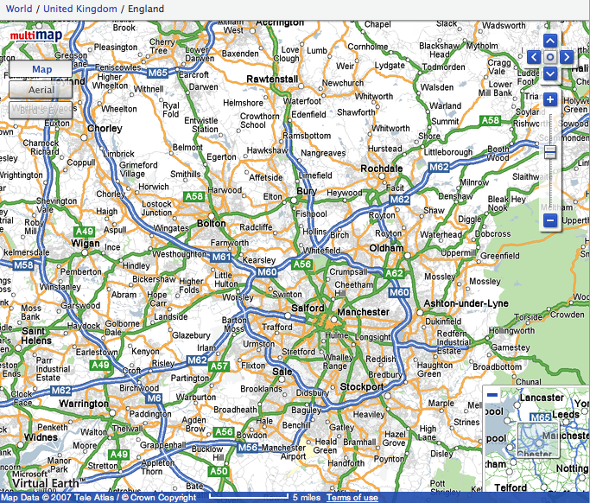

Slide 73
Research skills, not FOFO

Slide 74
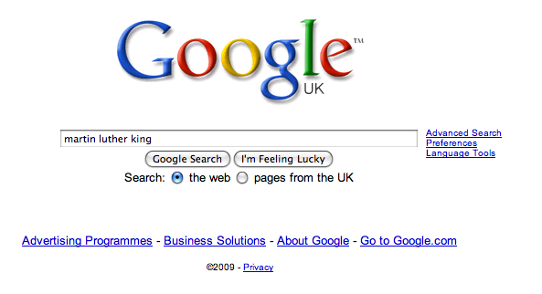

Slide 80
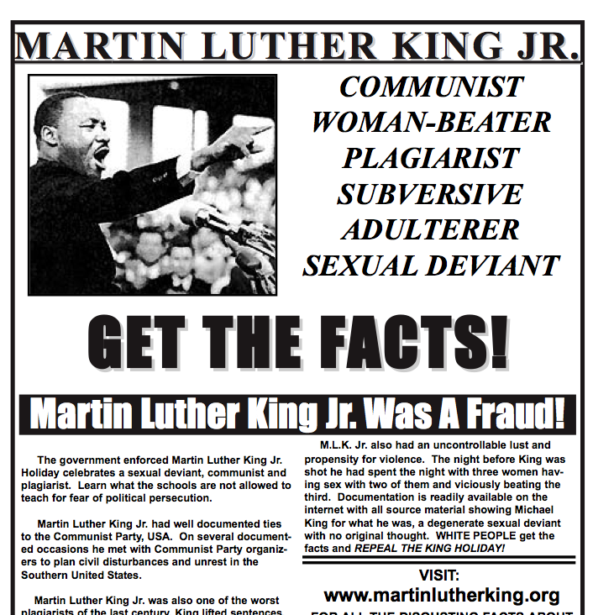

Slide 81
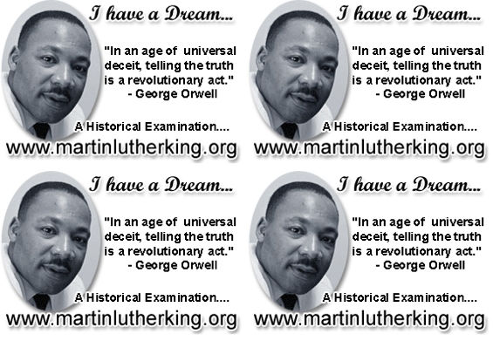

Slide 82
Demystify Spelling

Slide 83
1 - SOUNDS

Slide 84
Govern+ment
Feb-ru-ary

Slide 85
2 -VISUALS

Slide 86
Se-para-te
Be-lie-ve

Slide 87
3 - MNEMONICS

Slide 88
Necessary

Slide 89
practice / practise
replace with
advice / advise

Slide 90
BUILD WORD POWER

Slide 91
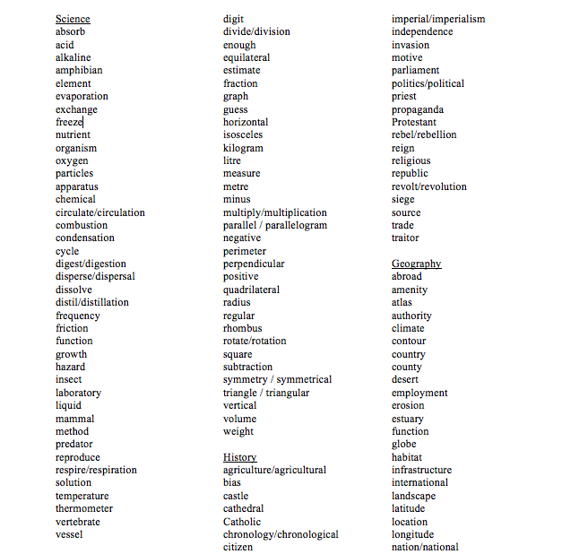

Slide 92
Demonstrate writing
Teach composition & conventions
Allow oral rehearsal
Short & long sentences
Connectives

Slide 93
Know your connectives
Adding: and, also, as well as, moreover, too
Cause & effect: because, so, therefore, thus, consequently
Sequencing: next, then, first, finally, meanwhile, before, after
Qualifying: however, although, unless, except, if, as long as, apart from, yet
Emphasising: above all, in particular, especially, significantly, indeed, notably
Illustrating: for example, such as, for instance, as revealed by, in the case of
Comparing: equally, in the same way, similarly, likewise, as with, like
Contrasting: whereas, instead of, alternatively, otherwise, unlike, on the other hand

Slide 95
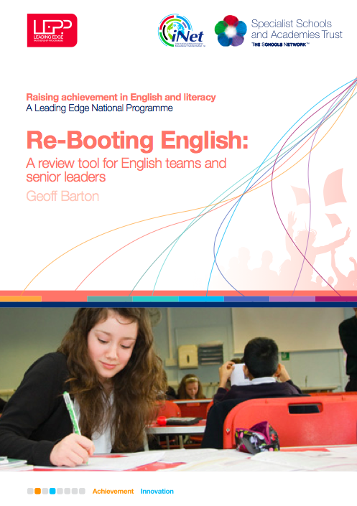
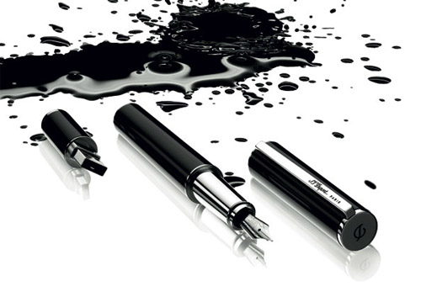

Slide 96
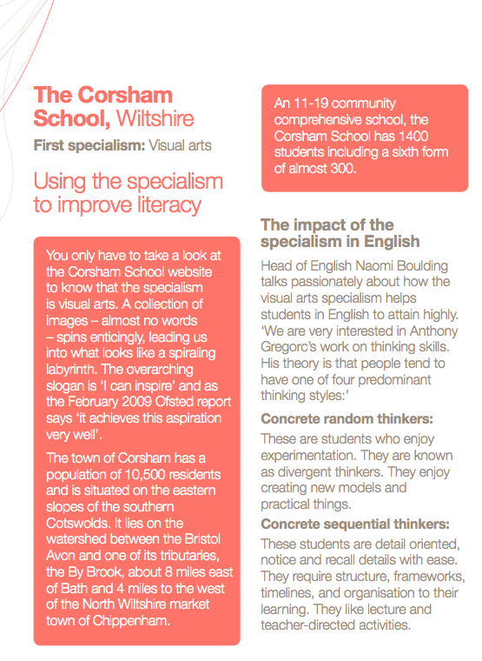
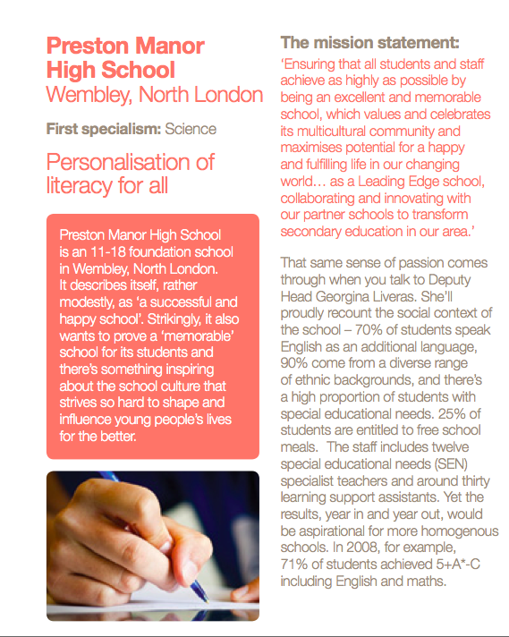
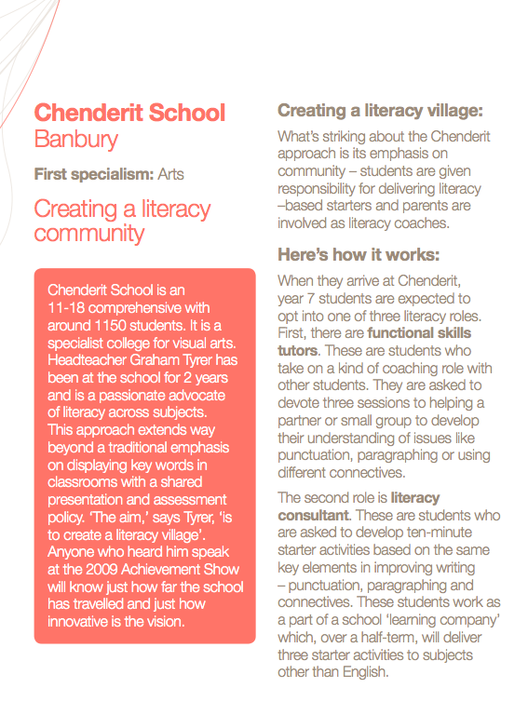
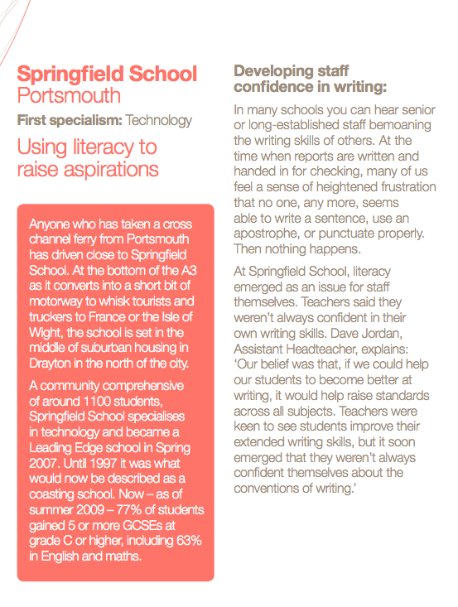
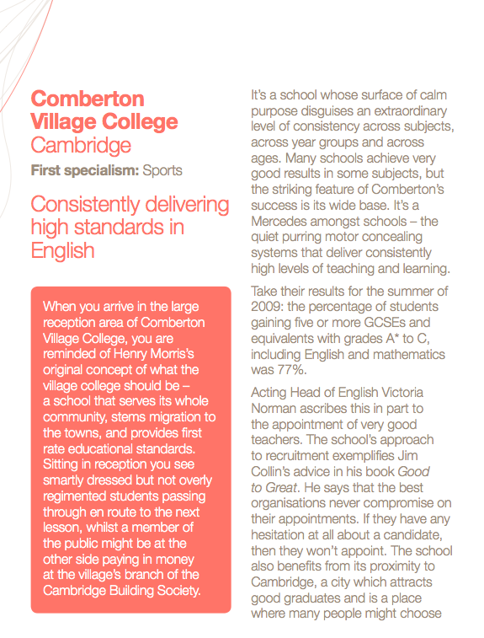

Slide 97
Don’t Call it Literacy
Geoff Barton
Head, King Edward VI School, Bury St Edmunds
Friday, July 9, 2010
Download this presentation at www.geoffbarton.uk
Teacher Resources page: download number 79

Slide 98
The Micro-Skills of Teaching

Slide 99
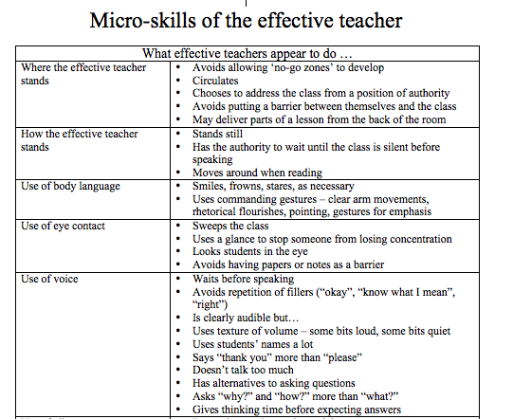

Slide 100
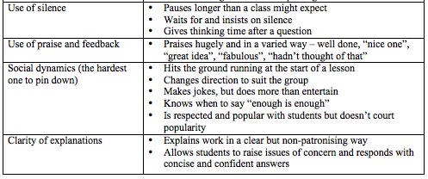

Slide 101
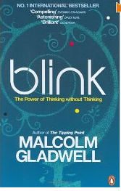
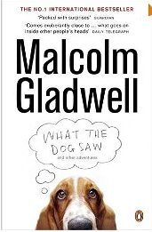

Slide 102
“Demography is destiny”

Slide 103
Some Strategies for School Improvement
Geoff Barton
Head, King Edward VI School, Bury St Edmunds
Friday, July 9, 2010
Download this presentation at www.geoffbarton.uk
Teacher Resources page: download number 80

