Slide 1
W(h)ither Ofsted?
Geoff Barton
Head, King Edward VI School, Suffolk
Download this presentation at www.geoffbarton.co.uk (Presentation 73)
Notes:
Hope that doesn’t seem unfair and that I should
pick on someone my own size

Slide 2
Stand by …

Slide 3
Provocative opening premise:

Slide 4
We would like better schools in Britain

Slide 5
?
Notes:
What role is Ofsted in that?

Slide 6
February 2009 & April 2010

Slide 7
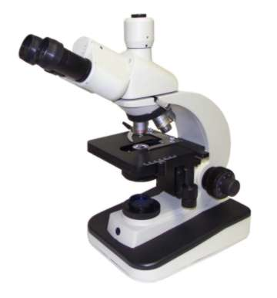
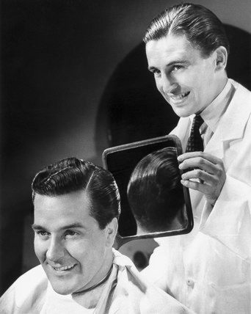
Notes:
What role is Ofsted in that?

Slide 8
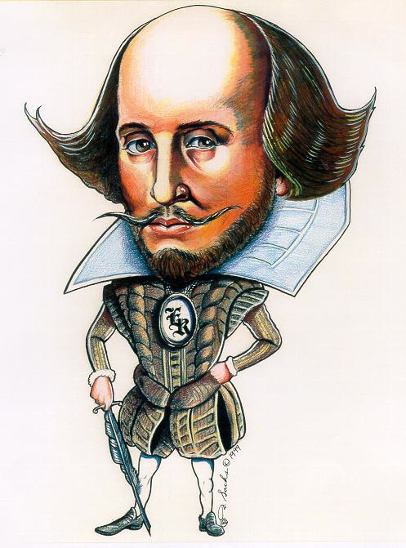

Slide 10
We know what we are, but know not what we may be.
Hamlet 4.V

Slide 12
Oh, that way madness lies; let me shun that.
King Lear, 3.iv

Slide 13
Beacon Schools
Training Schools
Coasting Schools
Super Heads
Consultant Heads
Executive Heads
Schools are becoming immune to school improvement
London Challenge
National challenge
National strategies
Leading Edge
Consultants
School improvement partners
Gaining Ground
Leading Light Schools
Trust Schools

Slide 15
The system needs to improve the system

Slide 16
Us

Slide 17
What is Ofsted for?

Slide 18
What is Ofsted for?
WHO

Slide 19
Parents & carers
Schools themselves

Slide 20
Parents & carers

Slide 24
Parents & carers
Schools themselves

Slide 26
Trevor Averre-Beason,
Director of Education,
Lilac Sky Schools
TES

Slide 27
I look back in horror. Neither I nor my colleagues knew in the early 1980s if we were a good school. We didn't objectively know how it compared to any local or national schools. Parents couldn't have been sure what we were teaching or if it was cost-effective or efficient. They couldn't know if their sons or daughters were achieving as well they should.

Slide 28
2
Our expectations have changed
Society’s expectations have changed

Slide 29
John Seddon
Michael Barber
v

Slide 30
“Barber set up and ran the Prime Minister’s Delivery Unit – a misnomer since it didn’t deliver”.
John Seddon
Of Michael Barber

Slide 31
Deliverology “leads to activities to tick the box”
John Seddon, Systems Thinking in the Public Services

Slide 32
“What measures are you using to help you understand and improve your work?” …
John Seddon, Systems Thinking in the Public Services

Slide 33
… leads organizations then to ask: “Are we measuring the right things?”
John Seddon, Systems Thinking in the Public Services

Slide 34
Barber’s questions:
What are you trying to do?
How are you trying to do it?
How do you know you are succeeding?
If you’re not succeeding, how will you change things?
How can we help you?

Slide 35
Where next?

Slide 36
1: External validation is important … for all schools
… and parents

Slide 37
2: Schools are complex, but a few simple questions may help to illuminate them

Slide 38
3: Lesson observation is important to avoid “phone it in” syndrome

Slide 39
4: Ofsted should describe, with rigorous detachment but sensitivity, our position on a journey

Slide 40
5: Ofsted should help schools to become more ‘intelligent’

Slide 41
So that …

Slide 43
“We know what we are, but know not what we may be.”
Hamlet 4.V

Slide 44
W(h)ither Ofsted?
Geoff Barton
Head, King Edward VI School, Suffolk
Download this presentation at www.geoffbarton.co.uk (Presentation 73)

