Slide 1
English GCSE: C or higher – guaranteed!

Slide 2
Hello.

Slide 3
Getting a C in English is easier than you think

Slide 4
Today

Slide 5
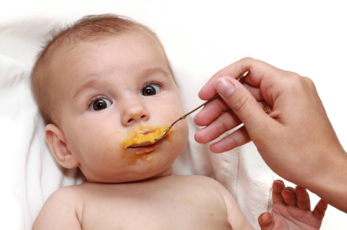
x

Slide 6
What

Slide 7
How

Slide 8
2

Slide 9
1 – Listen
2 - Practise

Slide 10
Visualise what success will feel like

Slide 12
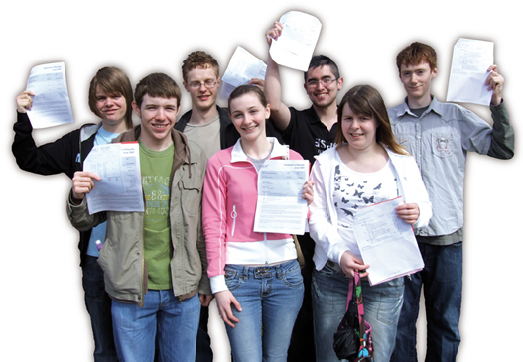

Slide 14
What

Slide 15
English -v-
English Literature

Slide 16
PAPER 1

Slide 17
1:
Reading non-fiction:
understand / presentation / language
Writing to argue / persuade / advise

Slide 19
Read

Slide 24
Write

Slide 25
Foundation

Slide 26
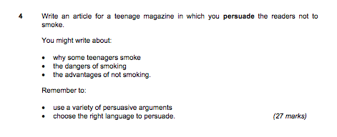

Slide 27
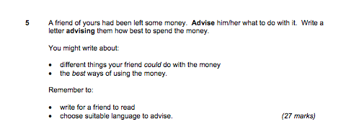

Slide 28
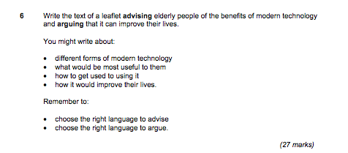

Slide 29
Higher

Slide 33
PAPER 2

Slide 34
2:
Reading poetry
Writing to inform / explain / describe

Slide 35
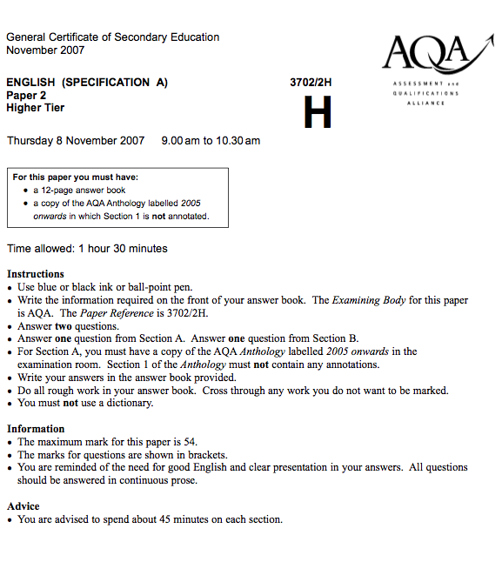

Slide 36
Foundation

Slide 37
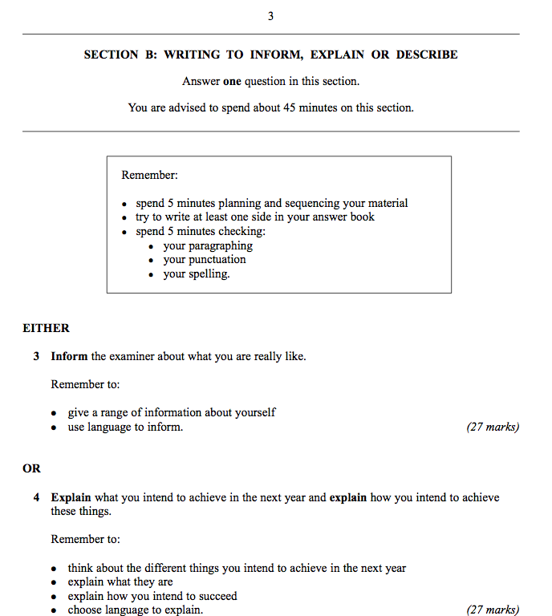

Slide 38
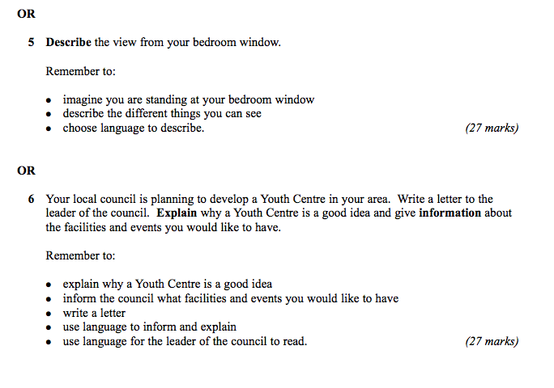

Slide 39
Higher

Slide 40
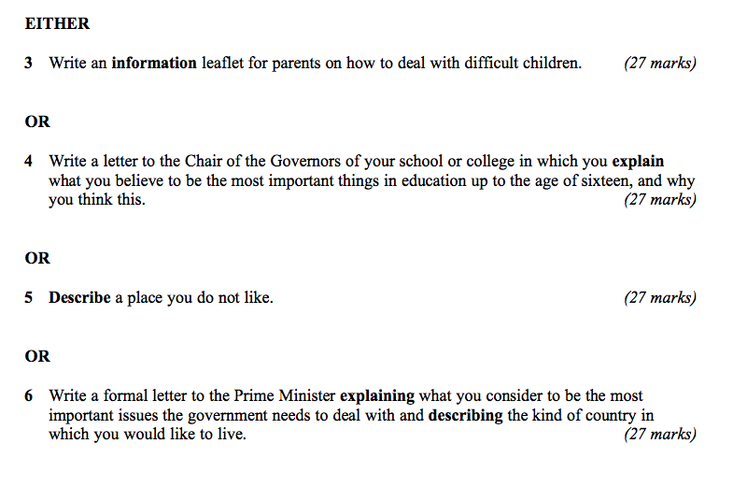

Slide 41
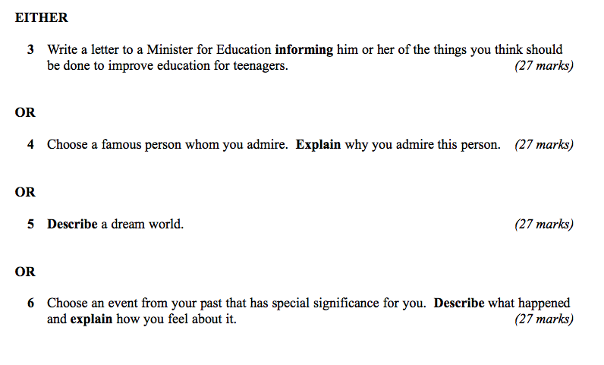

Slide 42
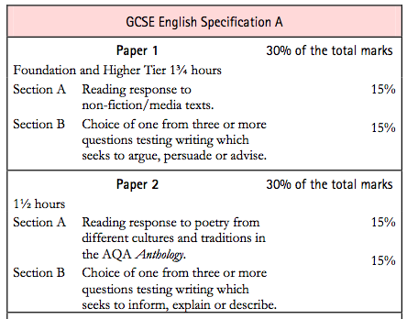

Slide 43
Today:
Write better
Read better
Spell better

Slide 44
What

Slide 45
PAPER 1

Slide 47
PAPER 2

Slide 49
How

Slide 50
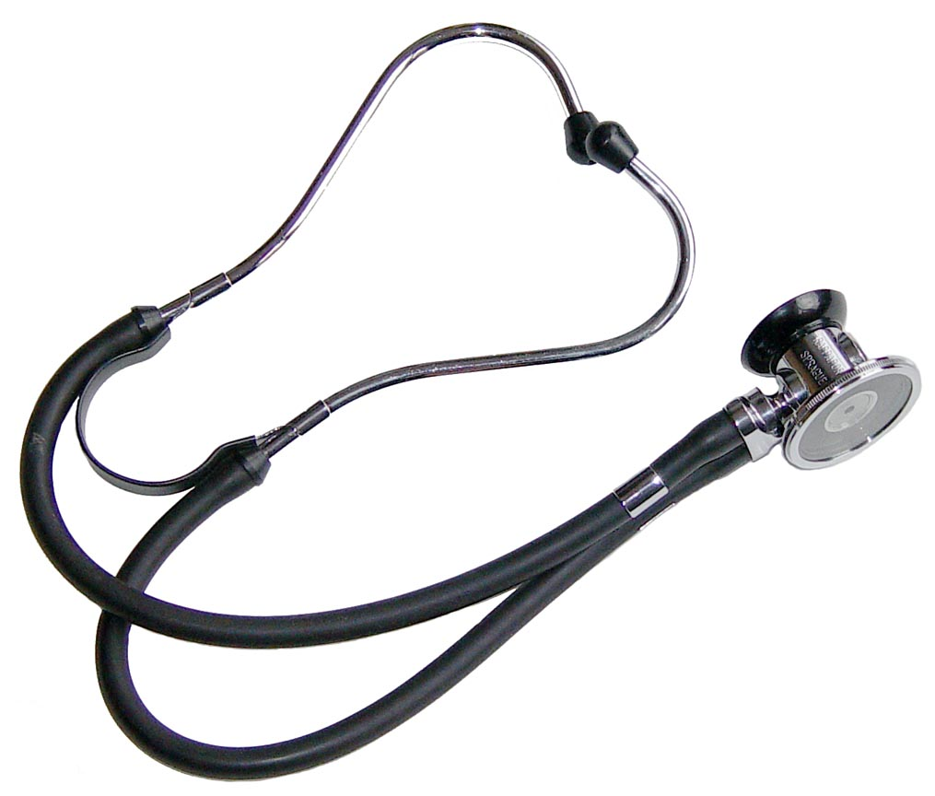

Slide 51
Describe the room you are in

Slide 53
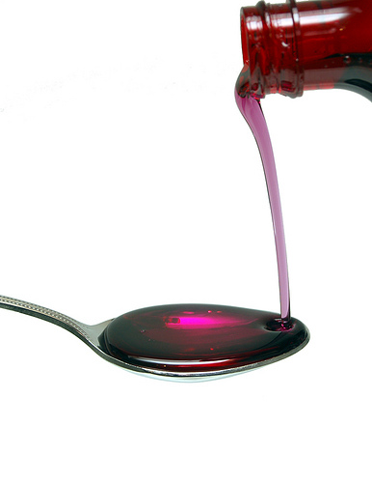

Slide 54
3

Slide 55
1: You find it hard to come up with ideas / get started
2: You’re not sure how to make your writing interesting / develop your ideas
3: You’re not sure how to revise for English /you lack concentration

Slide 56
1: How to come up with ideas

Slide 57
Choose the right question: description and letters are most straightforward
Start differently (Not “the room is”)
Start with a quotation / statistic / question / detail / story
Think of a film or story
Write a plan

Slide 58
2: How to make your writing interesting

Slide 59
Use short and long sentences
Avoid “and” and “but”
Instead try:
2-part sentences using connectives (“As .., …”)
2-part sentences starting with “–ing”
2-part sentences starting with “-ed”
Sentences joined by “which, that, who”

Slide 60
3: How to guarantee your C

Slide 61
Read and write stuff
Hide your spelling weaknesses
Learn vocabulary (eg “suggest”)
Trick your brain
Trick the examiner

Slide 62
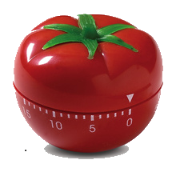
25 mins
+5 mins
Pomodoro Technique

Slide 63
English GCSE: C or higher – guaranteed!

Slide 64
Spelling Matters (but it’s a con-trick)

Slide 65
1: You’re better at spelling than you think

Slide 66
2: People judge us by appearances

Slide 67
3: A small number of words make a big difference

Slide 68
4: There are 3 easy ways to improve your spelling

Slide 69
5: Stop thinking that spelling is linked to intelligence

Slide 70
How to spell better:
See: be-lie-ve
Hear: Feb-Ru-ary
Memorise: necessary

Slide 71
TEST

Slide 72
25 of the most commonly misspelt words in English:
accommodation
analysis
argument
beautiful
Beginning
believe
Busi+ness
definitely
Development
disappearance
disappoint
embarrassment
environment
fulfil
happened
interesting
necessary
possession
preparation
receive
separate
sincerely
skilful
surprise
tomorrow

Slide 73
Build your confidence in reading

Slide 74
Where would you find this text?
What’s its purpose?
What can you say about the language?

Slide 75
Jake began to dial the number slowly as he had done every evening at six o’clock ever since his father had passed away. For the next fifteen minutes he settled back to listen to what his mother had done that day.

Slide 76
Where would you find this text?
What’s its purpose?
What can you say about the language?

Slide 77
Seville is voluptuous and evocative. It has to be seen, tasted and touched. The old quarter is Seville as it was and is. Walk in its narrow cobbled streets, with cascades of geraniums tumbling from balconies and the past shouts so loudly that one can almost glimpse dark-cloaked figures disappearing silently through carved portals.

Slide 78
Where would you find this text?
What’s its purpose?
What can you say about the language?

Slide 79
Proud mum in a million Natalie Brown hugged her beautiful baby daughter Casey yesterday and said: “She’s my double miracle.”

Slide 80
Where would you find this text?
What’s its purpose?
What can you say about the language?

Slide 81
The climate of the Earth is always changing. In the past it has altered as a result of natural causes. Nowadays, however, the term climate change is generally used when referring to changes in our climate which have been identified since the early part of the 1900's . The changes we've seen over recent years and those which are predicted over the next 80 years are thought to be mainly as a result of human behaviour rather than due to natural changes in the atmosphere.

Slide 82
Where would you find this text?
What’s its purpose?
What can you say about the language?

Slide 83
The best treatment for mouth ulcers. Gargle with salt water. You should find that it works a treat. Salt is cheap and easy to get hold of and we all have it at home, so no need to splash out and spend lots of money on expensive mouth ulcer creams.

Slide 84
Where would you find this text?
What’s its purpose?
What can you say about the language?

Slide 85
Urquhart castle is probably one of the most picturesquely situated castles in the Scottish Highlands. Located 16 miles south-west of Inverness, the castle, one of the largest in Scotland, overlooks much of Loch Ness. Visitors come to stroll through the ruins of the 13th-century castle because Urquhart has earned the reputation of being one of the best spots for sighting Loch Ness’s most famous inhabitant.

Slide 86
Where did the first cell phones begin?
Name 2 other features that started to be included in phones
Why are cell phones especially useful in some countries?

Slide 87
Where did the first cell phones begin?
Name 2 other features that started to be included in phones
Why are cell phones especially useful in some countries?
Cellular telephones
The first cellular telephone system began operation in Tokyo in 1979, and the first U.S. system began operation in 1983 in Chicago. A camera phone is a cellular phone that also has picture taking capabilities. Some camera phones have the capability to send these photos to another cellular phone or computer. Advances in digital technology and microelectronics has led to the inclusion of unrelated applications in cellular telephones, such as alarm clocks, calculators, Internet browsers, and voice memos for recording short verbal reminders, while at the same time making such telephones vulnerable to certain software viruses. In many countries with inadequate wire-based telephone networks, cellular telephone systems have provided a means of more quickly establishing a national telecommunications network.

Slide 88
TEST

Slide 89
25 of the most commonly misspelt words in English:
accommodation
analysis
argument
beautiful
Beginning
believe
Busi+ness
definitely
Development
disappearance
disappoint
embarrassment
environment
fulfil
happened
interesting
necessary
possession
preparation
receive
separate
sincerely
skilful
surprise
tomorrow

Slide 90
English GCSE: C or higher – guaranteed!

Slide 91
So what have we learned …?

Slide 92
English GCSE: C or higher – guaranteed!

Slide 93
D or lower: inaccurate
C: accurate, plus paragraphs
B: accurate plus a bit interesting
A: accurate, interesting, enjoyable
A*: quirky

Slide 94
www.geoffbarton.co.uk

Slide 95
English GCSE: C or higher – guaranteed!

