Slide 1
English GCSE: Make it an A or A*

Slide 2
Hello.

Slide 3
Getting a top grade in English is easier than you think

Slide 4
Today

Slide 5
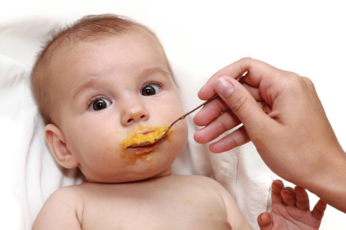
x

Slide 6
What

Slide 7
How

Slide 8
2

Slide 9
1 – Listen
2 - Practise

Slide 10
confidence
self-belief
risk
Plus … read

Slide 11
Visualise what success will feel like

Slide 15
What

Slide 16
English -v-
English Literature

Slide 17
PAPER 1

Slide 19
1:
Reading non-fiction:
understand / presentation / language
Writing to argue / persuade / advise

Slide 20
PAPER 2

Slide 21
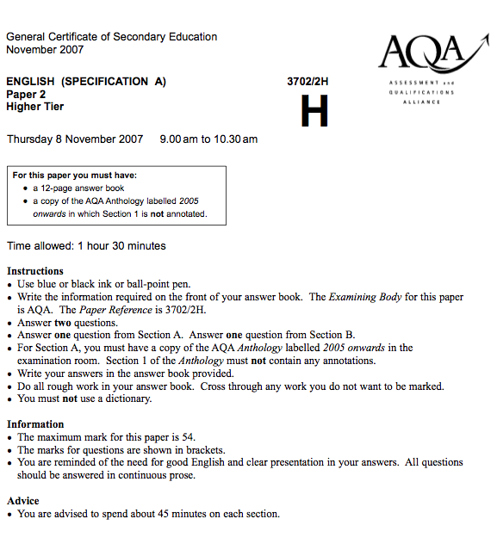

Slide 22
2:
Reading poetry
Writing to inform / explain / describe

Slide 23
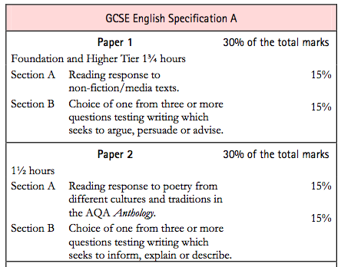

Slide 24
PAPER 1

Slide 26
PAPER 2

Slide 27
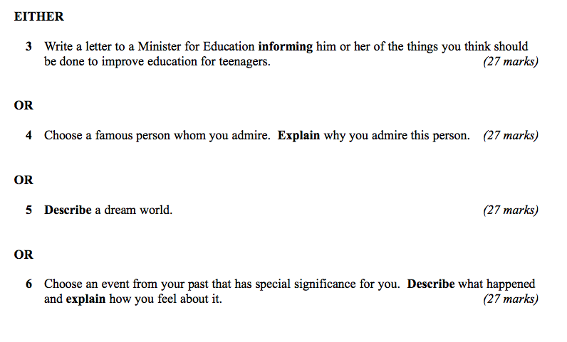

Slide 28
What

Slide 29
How

Slide 31
Describe the room you are in

Slide 33
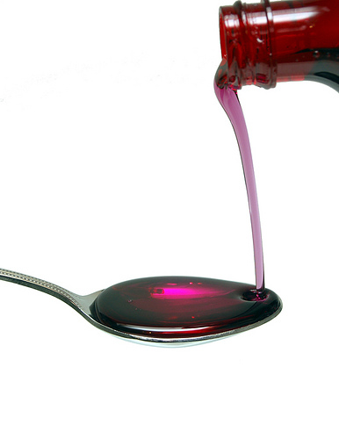

Slide 34
3

Slide 35
1: You find it hard to come up with ideas / get started
2: You’re not sure how to make your writing interesting / develop your ideas
3: You’re not sure how to revise for English /you lack concentration

Slide 36
1: How to come up with ideas

Slide 37
Lie
Start with dialogue
Start with a quotation / statistic
Start with a question
Start with a detail
Start with an anecdote (personal story)
Think of a film or story
Keep the reader guessing

Slide 38
2: How to make your writing interesting

Slide 39
Use short and long sentences
Avoid “and” and “but”
Instead try:
2-part sentences using connectives (“As .., …”)
2-part sentences starting with “–ing”
2-part sentences starting with “-ed”
Sentences joined by “which, that, who”
Use vivid detail
Be varied: description – questions – dialogue – statistics - anecdote

Slide 40
3: How to prepare for your A/A*

Slide 41
Read stuff
Write stuff
Learn vocabulary (writing it down)
Trick your brain
Use psychology in the exam hall

Slide 42
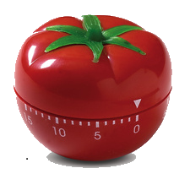
25 mins
+5 mins
Pomodoro Technique

Slide 43
English GCSE: Make it an A or A*

Slide 44
Good Luck!

Slide 45
www.geoffbarton.co.uk

Slide 46
English GCSE: Make it an A or A*

Slide 47
D or lower: inaccurate
C: accurate, plus paragraphs
B: accurate plus a bit interesting
A: accurate, interesting, enjoyable
A*: quirky

Slide 48
English GCSE: Make it an A or A*

