Slide 1
Things I wish I’d known in Year 11
5

Slide 2
Geoff Barton Headteacher, King Edward VI School, Suffolk & English Teacher

Slide 3
Things I wish I’d known in Year 11
5

Slide 4
Me

Slide 5
You

Slide 6
Things I wish I’d known in Year 11
5

Slide 7
Exams open doors … then disappear
1

Slide 8
It’s no one else’s fault
2

Slide 9
Intelligence is over-rated
3

Slide 10











2009
5xGCSE

Slide 11
Notes:
Study day, Easter, booster,

Slide 12
Intelligence is over-rated
3

Slide 13
People shape who we become
4

Slide 14
You get one chance: so what’s your legacy?
5
Notes:
Facebook

Slide 15
Things I wish I’d known in Year 11
5

Slide 16
English

Slide 17
English
Be accurate. Be interesting.
Small words make a difference.
Planning counts.
Seeming a good speller is easy.

Slide 18
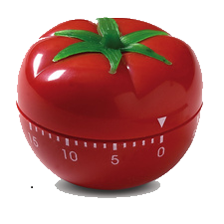
25 mins
+5 mins
Pomodoro Technique

Slide 19
Things I wish I’d known in Year 11
5

